Slide 1

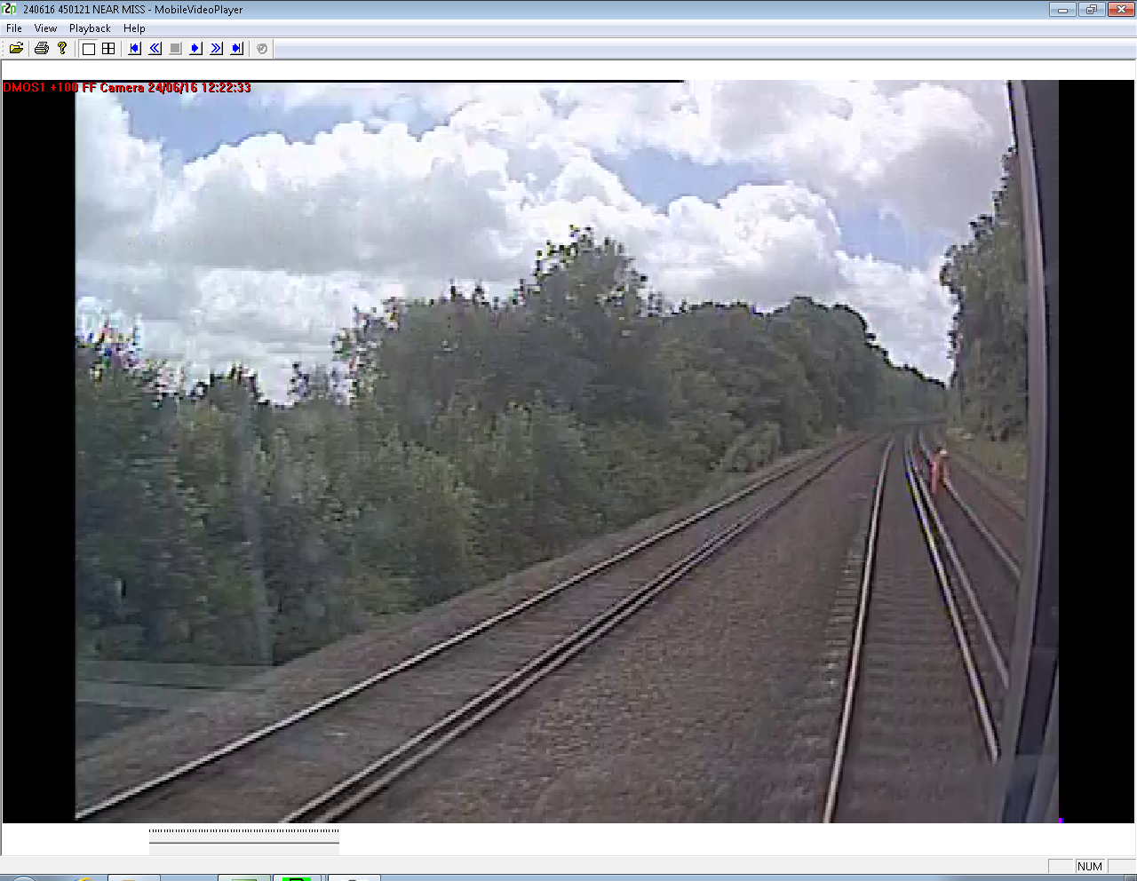
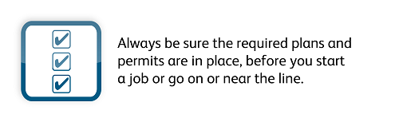

Wessex Route Near Miss Stand Down Brief. July 2016

Slide 2
Purpose and process
The purpose of this briefing is to inform all of our staff of 3 Serious Near Miss incidents that have happened on Wessex Route in the last three weeks. To raise awareness of the risks associated with these incidents, promote discussion and ultimately keep our people safe.
Anyone who works on the Wessex Route Infrastructure or who manage or affect NR or Contractor staff who work on our infrastructure will have this Stand-down briefing in July.
Records of all attendees will be kept on the record of briefing form. Feedback will be collated and returned to the WHS&EA via your Line management.

Slide 3
Background
Between the 14th June and 28th of June, 5 Track-workers were involved in 3 Serious Near Miss with a Train.
Further details of each of these incidents will be shown later in this presentation.
Each incident is the subject of a separate investigation to consider the circumstances, conclude the root causes and make recommendations and/or take local actions to avoid repetition of a similar incident in the future.
Each of these incidents appear to involve a Breach of the Life Saving Rule for Safe System of work and therefore subject to review against the Fair Culture Flow Chart and the Fair Culture Panel.

Slide 4
What are the known similarities.
No safe system of work was in place.
No Rule Book based ‘safe system of protection’ was in place.
At least 1 individual in each incident had to move very quickly out of the 4ft on which the oncoming train was travelling.
The individuals involved did not reach a place of safety in 10 seconds or more.
Each incident was recorded on forward facing CCTV.
None of these incidents were reported by the team involved
5 individuals are lucky to be alive today.

Slide 5
Trains: Stopping times and distances
Assuming the driver reacts quickly & without gradient.
Train speed MPH | Distance to stop Metres | Time to stop Seconds | Equates to No of sleepers
30 | 241 | 30 | 370
40 | 391 | 38 | 600
50 | 575 | 45 | 885
60 | 793 | 53 | 1220
70 | 1045 | 61 | 1607
80 | 1331 | 68 | 2047
90 | 1639 | 76 | 2521

Slide 6
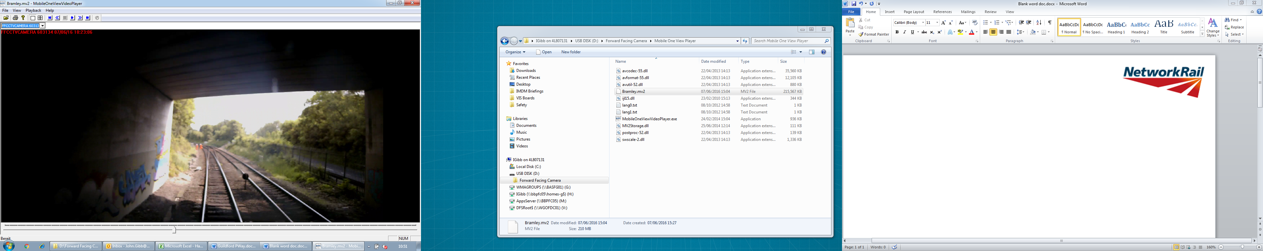
1. Tuesday 14th June: Outside of Basingstoke at 50m 20ch on the Up Reading line.
Line speed of 50 mph
This is a Red Zone Prohibited Working Area.
Both individuals were in the 4ft in the path of the oncoming train when it came around the curve
Train Driver issued an emergency horn warning and emergency brake.
Individuals reached the Up Cess with less than 8 seconds before the train passed.
One of them stumbled as he rushed out of the path of the train.
No SSOW was in place.

Slide 7
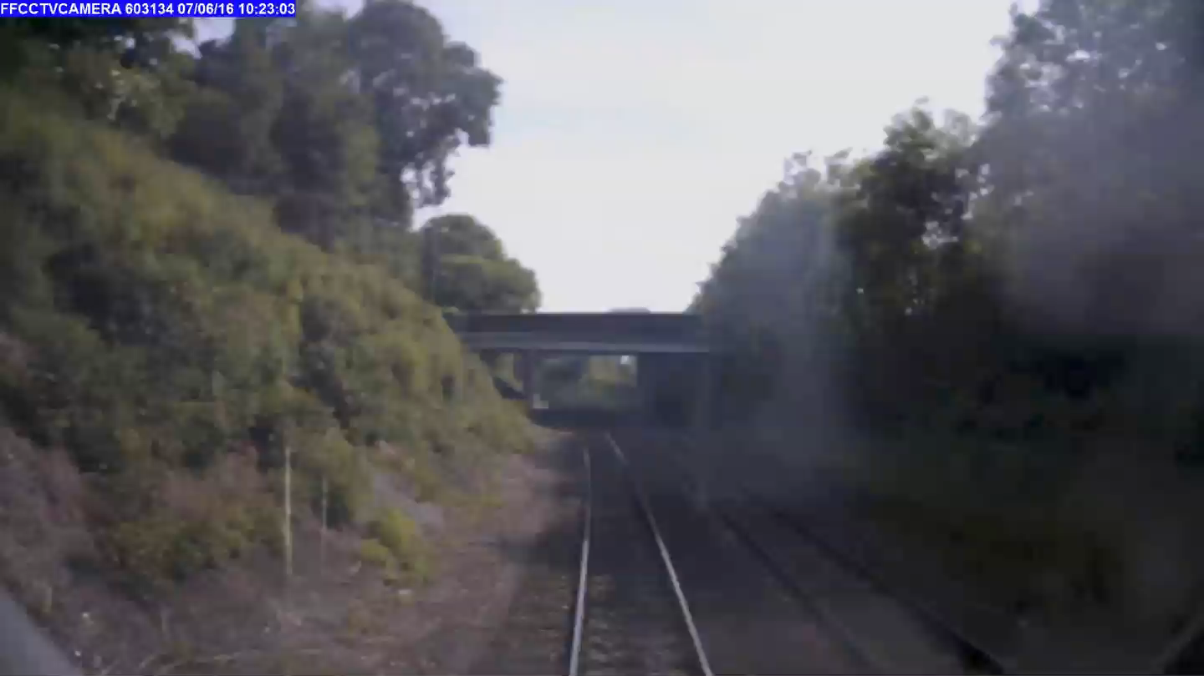

Slide 8
2. Friday 24th June at Shawford on the Down Line of the BML1 at 69m 23ch
Curved track, line speed of 90mph
One individual in the 4ft of the oncoming train moved to 6ft with less than 4 seconds
Shortly afterwards a freight train approached on the Up Line
No SSOW was in place
No COSS briefing had taken place
The Lookout was not on site

Slide 9
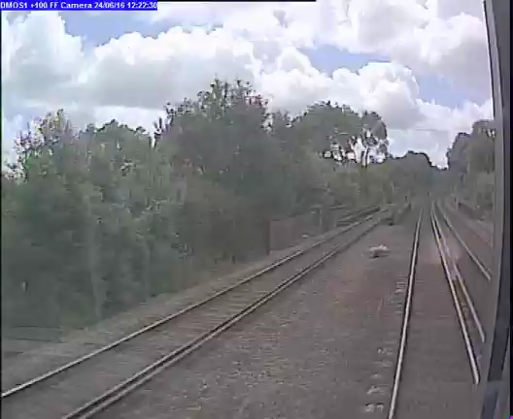

Slide 10
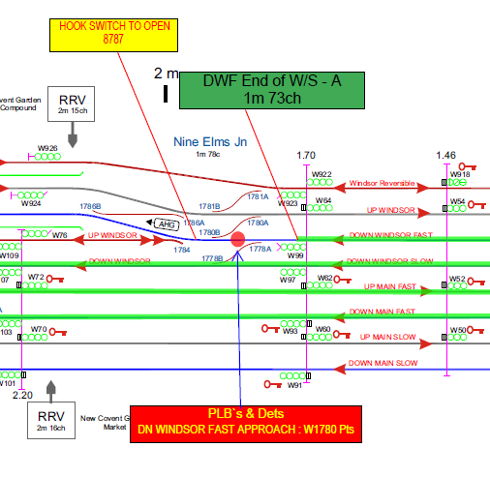
3. Tuesday 28th June at 0110 hrs. Nine Elms on the Up Windsor at 1m 78 ch
Line Diagram
Line Speed 45 mph.
PSS placed the PLB & opened a Hook-switch as shown on map.
A line blockage was taken to access across the Windsor Reversible and UP Windsor at Nine Elms into the T3 and then given up.
After pulling the Hookswitch the COSS did not retake the Line Blockage to return to the access point.
They walked into the Up Windsor into the path of the train.
No SSOW was in place
Route to & from access point

Slide 11
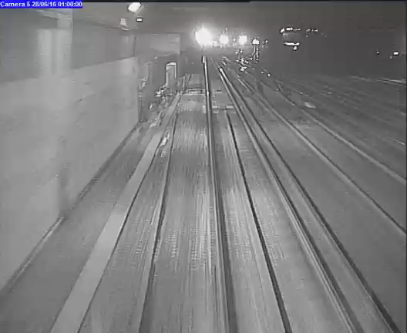

Slide 12
Discussion points
The Life Saving Rules are aptly named;
When you go on or about the line
Always have a safe system of work pack that covers the site of work,
Always have a COSS briefing before you start work.
Always follow the instructions given by the COSS and ask questions if you do not understand
If you are the COSS, always set up the ‘method of protection’ to protect the lives of your men.
Never cut these corners.

Slide 13
Feedback
This is the question…..
Why is it people take these chances?
If you think you know, you can help prevent further incidents like these, so please let us know.
tracey.capstick@networkrail.co.uk
Wessex Route Workforce Health Safety & Environment Advisor

