Slide 1

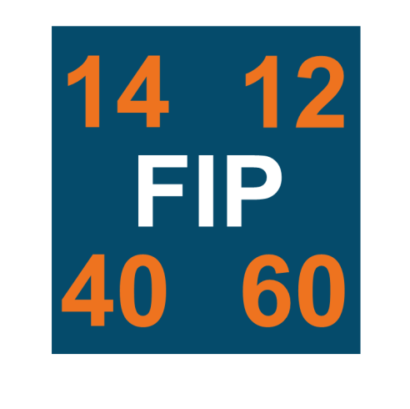

Fatigue Improvement Programme
Awareness Briefing (v11)
Name of Function, Date
Notes:
Key Message: Welcome
First of all welcome and thank you for giving us the opportunity to present the Fatigue Improvement Programme to you.
The purpose of this brief is to:
Provide an awareness of why we are revising our Fatigue standard,
Provide an awareness of the intended outcomes of the programme,
Provide an awareness of the approach and timescales of the programme, and;
Provide details on the governance and scope.
Please do ask questions as they may arise.

Slide 2

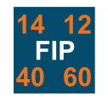
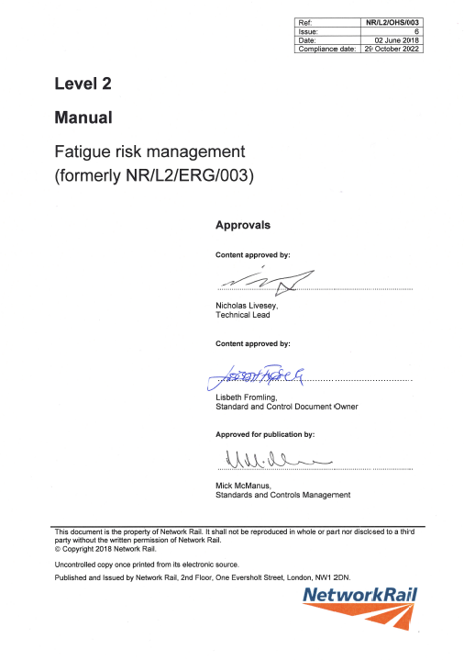
What are we doing?
The previous standard (v5) only covered safety critical workers, the new standard (v6) applies to everyone within Network Rail and those working on Network Rail infrastructure.
The new standard does not impose limits on what people can work but instead introduces four ‘trigger points’ where mitigating actions are required.
Notes:
Key Message: The standards main function is to improve Fatigue Risk Management and NOT limit hours.
This is not a new standard. It is revising the existing 003 standard from version 5 to version 6. Whereas v5 only covered Safety Critical workers, this new revision will cover all staff and those working on NR infrastructure. It therefore has the potential to affect £150k plus people.
You may have heard that the revisions will be limiting the hours worked of individuals but this is not the case. It will introduce points at which a Group or Individual Fatigue Management Plan is written and agreed.
The business recognises that there may be circumstances when longer hours are needed. It is acceptable to work these longer hours provided that the risk of fatigue has been considered and will be managed and mitigated as far as practicable.
However, the best way to minimise fatigue is to ensure that an individual is not put into the position of working to the point of fatigue. Hence risk is reduced if the trigger points are not exceeded.

Slide 3

Fatigue Improvement Programme – Four Perspectives
Legal Perspective
Moral Perspective
We need to become legally compliant and satisfy our Regulator
We need Policy & Process that encompasses our
Safety Vision
HSAW Act
ROGS
Working Time Regulations
Mgt of HSAW Regs
Recommendations
Everyone Home Safe
Safety & Performance
Duty of Care
It’s the “Right thing”
All have responsibilities
Statistical Perspective
Factual Perspective
We need to provide Fatigue education to raise awareness
We need corporate memory to avoid the recurrence of the past
Similar physical impairment to alcohol
Performance impairment
Higher injury rate
Ability to make sound judgements
74 Industry Accidents Clapham
East Somerset Junction
Reading RTA
Scotland RTA
6000+ exceedances per period
Notes:
Key Message: There are 4 perspectives as to “Why” we are running the Fatigue Improvement Programme.
We have a moral duty
We need to have learned from the past
We have a legal duty.
The Moral Perspective:
I do not think anyone in the room would argue that managing the fatigue of our workforce is not the right thing to do. It absolutely fits in with the business vision of “Everyone Home Safe everyday” The word home here is very important. The FIP looks at, not only the time we spend working, but the “Door to Door” timings. It should be remembered that EVERYONE has a moral duty to manage not only their own Fatigue but to look out for the signs of fatigue in others.
The Factual Perspective:
Since 1988, the Clapham Disaster, there have been numerous fatalities and serious injuries within the industry where fatigue has been deemed a causal or contributory factor. However, it begs the question as to how many more have had fatigue as a contributory or causal factor but the investigation has not picked up on this? The 6000+ exceedances relate to exceedance of the Hidden recommendations. This would indicate that v5 of the standard is not necessarily widely enforced.
Later in the presentation is a timeline for the main fatigue related incidents.
The Statistical Perspective
There have been well over 17,000 pieces of research published into Sleep and Fatigue. We have all suffered from fatigue due to one reason or another. We know how it can affect us. It has a very similar affect to Alcohol. The business has very strict D&A policies which are generally adhered to. We need to have the same for Fatigue.
The Legal Perspective
Currently v5 of the standard only applies to Safety Critical workers. This stems from Lord Chief Justice Hidden’s recommendations following the Clapham disaster. Current HSAW act states that we have a duty of care for all our employees. There are other statutory legislation that needs to be complied with but also there are a number of Recommendations where NR has been asked to strengthen its Fatigue Management.

Slide 4

Fatigue Improvement Programme – The Factual Perspective
Accidents and Incidents
Manchester Pic RTA
Near Miss
2012
Newark Northgate
1Fatality
2014
Hockham
Rd UWC
6 Injured
2016
52
612
Leighton Buzzard
Slip/ Lapse
2013
Imberhorne Bridge
1 Injured
2014
Stafford
1 Fatalities
36 Injured
1990
Cardiff_ Near miss
2016
East Somerset
Derailment two
locomotives
2008
Clapham
35 Fatalities
484 Injured
1988
Great Heck
10 Fatalities
82 Injured
2001
Scotland RTA
1 Injured 2014
Camden Jnc_ Near miss
2017
Newark RTA
2 Fatalities
2013
Reading RTA
3 Fatalities
2 Injured
2014
1980
1985
1990
2000
2005
2010
2015
2020
Manchester Piccadilly 13/04/2012 - Rec A5.2
Newark RTA 19/06/2013 - Rec A6.1, A6.2, A6.3
Newark Northgate Lookout fatality - 22/01/2014 - Rec A6.4
Network Rail’s management of fatigue risk for signallers does not reflect current good practice.
RAIB 11/17
Plus we are
Seeing more than
6000 breaches of
the max 60
hour week per
period!
Imberhorne Bridge 07/09/14 Rec A7.1
Leighton Buzzard RTA 23/07/13 A6.1
Recommendations from Incidents
Notes:
Key Messages: 52 fatalities and 612 injuries as a result of fatigue since 1988. No one would disagree that a One in either of those circles is too many.
This slide is fairly self explanatory and provides a timeline for those main incidents that have had fatigue identified as a causal or contributory factor. It also provides details of the Recommendations referenced in the previous slide. Further to the right you will see that incidents increase and risk from driving increases. (although the severity reduces) It is right therefore that we introduce ways of managing fatigue better.

Slide 5
Fatigue Improvement Programme – Outcomes
Accidents
Regulatory Compliance
Work Life Balance
Fatigue
Legislative
Compliance
Improved
Investigation
Protocols
Increased Awareness of risk and increased Interventions & close Calls
Actions
Improved Mental Health for Employees
Improved Work Force Morale
Improved Work Force
Fatigue Resilience
Ability to
Identify & Address Triggers and Implementation of Risk Mitigation Measures
Health &
Wellbeing
Safe
Environment to
Declare Fatigue
Change
Behaviours and
Strengthened Fatigue
Laedership
Consistent
Approach across
NR & Supply
Chain
Behaviours
Notes:
Key Message: It is not just about KPIs around accidents. The cultural and behavioural change and Health and Well Being are key elements of the programme and this is reflected in the expected outcomes.
Discuss each circle.
Outcomes that result in actions:
Legislative Compliance
The current standard only covers safety critical staff. The revised standard covers ALL staff. This brings us in line with H&S legislation.
Improved Investigation Protocols.
- At source do not plan work that requires a risk of fatigue: Ensure that fatigue is in investigation remits and properly investigated even if it is not immiediately thought of as a causal factor.
Increased awareness of risk and increased intervention and close calls.
- The programme is about managing fatigue risk before it becomes an issue. There are lots of actions that can be taken to mitigate potential fatigue risk. (Travel time to work site, scope of work, welfare, shared driving etc) The educational piece of the Programme will raise awareness of Fatigue Risk but it is imperative that this education is put to good use when planning work. As awareness increases it will be normal for interventions and close calls to rise however these will then subsequently decrease over time.
Outcomes that support health and wellbeing:
Improved mental health of our employees.
A good nights sleep enables the body to carry out a multitude of repairs. It is well documented scientifically that 8 hours of good sleep has a large beneficial effect on Mental Wellbeing.
Improved work force morale
By demonstrating a caring attitude, reducing the numbers of accidents and improving our employees work life balance will increase morale. Fatigue does not start and stop at the “Factory gates”. It effects home life and hence your families and friends. When we reduce fatigue we improve that ever so cheesy “Work life balance” scenario.
Workforce resilience to fatigue increases.
In having strong fatigue management discussions and actions the occurrences of fatigue decrease. However in those times when it does occur the ability of the business to limit and “bounce back” is increased. The educational element will discuss sleep debt. The resilience is centred very much around recognising sleep debt and minimising it.
Ability to identify and address triggers and implementation of mitigation measures
In identifying the triggers of fatigue and putting mitigation plans in place early, it is natural that the safety of our staff will improve. The Therefore in doing so the health and well being of our staff will be improved. This outcome significantly supports the safety of our employees and customers. Fatigue can kill and maim. By managing our risk of fatigue we will reduce our accidents to both our workforce and our customers.
Outcomes that result in behaviour change:
Safe environment to declare feeling fatigued and request a FMP.
- An environment where raising your hand and declaring you are or may become fatigue is acceptable. Sleep has an image problem, we stigmatize sleep and think its lazy and slothful - people wear lack of sleep as a badge of honour to be celebrated. This has to change.
Behaviours change and fatigue leadership strengthens.
- Fatigue risk management is both top down and bottom up. We need everyone in the organisation to recognise Fatigue as a risk and implement mitigating actions every day. There needs to be a recognition that both the business and individuals have responsibilities. There are 3 levels: Corporate policy/process, Functional implementation and individual duty. We call this the responsibility egg.

Slide 6
Fatigue Improvement Programme – Delivery and Change Approach
Requirement
Enablers
Fatigue Risk Management Principles
Fatigue Risk Index Module
Fatigue Risk Assessment Module
Exceedance Management Module
Roster Design Module
Working Time Limits & On Call Module
Recruitment to required levels
Business Support Framework
Support Documentation
Process Change (Capturing time)
Change Impact Assessment
Stakeholder Engagement
Management Information Suite
KPIs (Lead and Lag Indicators)
Strengthened Self - Assurance
Compliance Monitoring
Investigation Protocols
Policy and Frameworks (Standard)
Line Management fatigue
Considerations.
Personal fatigue management
(Health and Wellbeing)
Monitoring
Education
Notes:
Key Message: The full picture of the Fatigue Improvement Programme becomes apparent when all the pieces of the jigsaw come together.
In the case of the Fatigue Improvement Programme there are 2 Jigsaws. Each with an individual picture but when brought together create a “Change Vista” These two jigsaws are the Delivery and Change approach (Central Team) and the Implement and Embed approach. (Overall Business)
Delivery and Change approach.
The approach of any project or programme starts with a requirement. In the case of the FIP that will be the standard. This sets out the “rules” by which we will all comply. The standard will be in a modularised form and will consist of a Principles document and 5 modules. (Briefly run through the modules and what they cover)
Simply having a document will not be enough however, if the business is unable to implement or comply with it. Therefore a number of enablers will be required to aid embedment and compliance. In the case of the FIP this will be staffing levels at a suitable level, Business support and support documentation, potential process changes, an understanding of the impact of the changes on roles and the stakeholder management and communication. In addition to the standard itself there will be a number of guidance documents produced.
Having the requirement and ensuring the business is in a position to implement are 2 very important elements but the jigsaw picture is not yet complete. In order for the cultural and behavioural changes to embed and be efficient the programme recognises the need for suitable education. This can take many forms but we accept that it is much more than putting a power point slide together and badging it as an e-learning experience. This is an emerging element of the programme and we are engaging with our stakeholders to glean their views and on boarding Behavioural and Cultural change specialists to assist. Current thoughts on this element take the form of two streams. A work element and line management education and secondly a personal educational element. The first is very much tied in with the standard and the FIP policy. The second is around the personal responsibility that individuals have regarding their management of fatigue.
Finally with the requirement developed, the enablers in place and the educational piece landed, the change can finally move into BAU. However all the good work can be lost very quickly if monitoring is not put in place. This will take the form of strengthened compliance and assurance and revised investigation protocols.
We will discuss the Implement and Embed approach in a later slide.

Slide 7
Fatigue Improvement Programme – Core Principles and Trigger Points
14
12
Door to Door
<12 hrs – End of CP6 Vision
12-14hrs – Group Mgt Plan
>14hr – Individual Mgt Plan
between shifts
Fatigue Risk Index
Working week
>60hrs – Individual mgt plan
40
60
Notes:
Key Message: The programmes driver is better management of our Fatigue Risk.
As well as widening the standard to all people working on Network Rail’s infrastructure, the programme introduces the use of group and individual fatigue management plans dependant on what TRIGGER points are passed. The business recognises that under certain circumstances longer shifts may be necessary, however these should be the exception rather than the norm. If “an exception” occurs then Fatigue of an individual or group should be considered and managed. The recording of this will be in the form of a Fatigue Management Plan (FMP).
14 hours door to door.
“Door” is your primary “place of rest”. Everyone should be working to achieve 12 hours or less door to door. This is the aspiration for the business at the end of CP6. Through suitable resource levels, effective rostering, improved planning and more efficient infrastructure and processes this aspiration will be met.
Now how has this been determined?
There have been 17,000 separate scientific research papers published and the vast majority have determined that the human body requires 8 hours of quality sleep a night. This allows it to carry out all of the activities it does when in the state of sleep suspension (Recovery, memory assimilation, brain repairs, detoxification etc). HSE guidance additionally states that an individual should allow an hour before and after sleep to spend quality time with family and relax and prepare for sleep. These minimum scientific guidance times therefore leave 14 hours, the operative word being guidance and not “Target”.
The business has therefore determined that by the end of CP6 individuals would be able to achieve 2 hours either side of sleep for personal time and pre and post bedtime routines. If, however, a work pattern is 12 to 14 hours door to door (i.e. impinging into the 2 hours either side of sleep) then a Group FMP will be written. In this context a group can be a team, a function, a route, determined by the number of people expected to be working 12 to 14 hours door to door. If greater than 14 hours is required (in exceptional circumstances) then individual FMPs should be written for all of those expected to work this.
12 hours between shifts.
This is already in the current v5 of the standard but is now being widened to all people working on Network Rail’s infrastructure. This means if a person leaves their place of work at say 8pm they should not be starting back at their place of work until at least 8am. This was a “Hidden” recommendation following the 1988 Clapham Rail disaster so should not be a surprise.
60 hour Working Week.
Fatigue risk is a cumulative risk and build up over relatively short periods of time. Therefore this trigger point has been introduced to cover where people are working longer shifts. Currently in the business we should not exceed a 72 hour working week, therefore the introduction of this trigger point is therefore decreasing the working week to a recommended 60 hours. As a business, we are not encouraging individuals to work 60 hours in a week, however we recognise that in some circumstances there will be occasions when these hours will need to be worked.
Fatigue Risk Index.
This is the HSEs recognised tool for guiding individuals in the risk of fatigue being encountered.

Slide 8
Fatigue Improvement Programme Work Streams
Work Stream | Description | Work Stream Lead
Fatigue Risk Management (FRM) Standard | Publish a Fatigue Risk Management standard, the core module will contain the principles with 5 subsequent modules detailing the requirements of the standard. The modules will be published through a phased approach from Jun 2018 to Dec 2019. Following publication the work stream will provide business support and strengthening of the assurance and investigation protocols. | STE – David Burgess Nick Livesey (SME)
Engagement & Consultation with Trades Unions | IR to engage and consult with TU colleagues on the principles and requirements of the revised FRM Standard. This adopts a novel framework for the publication of the modular standard approach. | IR – Joanne Gill
Business Change (Aiding embedment) | Define the business change strategy and plan to support embedment of the FRM standard. Lead and assist in MSP4NR business change deliverables, such as change impact assessment, benefits matrix and mapping, and activities such as facilitating brief the briefer. Support the business with implementation and action plans. Support the programme with monitoring of progress against plans. Support interface with dependant programmes. | STE – Andy Labrum Richard Whitfield
People (National Recruitment & Training) | Lead the ‘vacancy gap’ analysis for the business and define a recruitment and training strategy and plan to enable the principles and requirements of the FRM standard to be embedded and complied with. Support and monitor recruitment and training KPIs to provide confidence that the establishment can accept the change to ways of working. | HR – Dee Balderson
Education | Manage and develop educational material to facilitate the behavioural change and support the health and wellbeing outcomes of the programme. | STE – Amanda Webster
Notes:
Key Message: STE is leading a central Team which covers the “Delivery and Change element” of the Programme
There are 5 key work streams covering the Standard development, TU negotiations, Business Change, People frameworks and Education.
Standard Development
This work stream will utilise the businesses standards process for the development of the core principles and associated 5 modules. The Core Principles Document and Module One, Fatigue Risk Index Module have been published (02 June 2018) and reside on the Standards website. (Please feel free to go and have a look) Remaining modules will be published between now and December 2019. As each module is published a review of previous modules will be carried out taking into account feedback. It is possible that previous modules may be updated and re-published at these times. In addition to the development and publication of the standard, the work stream will produce associated guidance material, provide business support and strengthen the investigation and assurance activities when.
Trade Union Engagement
Utilising a model which is novel in approach, TU safety representation sit on the working groups developing the standard and modules. At time of publication IR reps are briefed and feedback obtained. TU consultation will then take place in Dec 2019 as per normal practice. Consultation on individual elements throughout now to Dec 19 is possible should our TU colleagues deem it necessary.
Business Change
This work stream manages the change element of the programme. Its main foundation will be the facilitation of the Change Impact Assessments (CIA). As the programme effects all elements of the business the CIA work is a large but important undertaking. Although CIAs are the main foundation the Business change element will also facilitate benefit matrices and mapping, MSP4NR documentation and stage gate reviews. As the main change will be throughout the business the team will also support the rest of the business in implementing and embedding and subsequent readiness reporting.
People
This work stream is led by the HR function and will result in Frameworks for both Recruitment and Training. The work stream starts with a competency gap analysis. This differs slightly from a vacancy analysis as it looks at the competencies required by the business. (i.e. A welder may result in 2 additional heads as a welders mate may be required also). The work stream will also offer support and guidance to the business during implementation and embedment.
Education
Key to the change taking place across the business and the behavioural outcomes is the education element. Traditionally education has been limited to standards briefing which concentrate on the key changes in the new standard. The Fatigue Improvement Programme, however, are breaking new ground by focusing on the educational elements of fatigue itself, the behaviours relating to Fatigue Management and the health and wellbeing activities associated with the change.

Slide 9
Fatigue Risk Management Standard Approach
The Core Fatigue Risk Management (FRM) Principles, and Fatigue Risk Index (FRI) module will be published in June 18. Subsequent modules to be published by Dec 2019. Compliance will be a phased approach taking into consideration the challenges the business face.
Jun 18
Dec 19
Oct 22
Dec 18
Mar 19
Fatigue Risk Management Principles Core Std.
*
Compliance Date
Fatigue Risk Assessment Module
*
*
*
Fatigue Risk Index Module
Roster Design Module
Exceedance Mgt. Module
Working time limits & On-call Module
Publish modules in a staggered approach to allow for trial & IR outcomes to be incorporated
Transition Period
* These four modules require TU negotiation and should include outcomes from any Fatigue Risk Management trials. The order of publication of the modules maybe subject to change dependant upon TU outcomes. However, the final Dec 2019 date is the baseline forecast for publication.
Notes:
Key Message: The Key Dates are December 19 for the publication of the standard and its modules and October 2022 for the Compliance Date.
As stated the standard is being developed in a modularised way. The first “Fatigue Risk Management Principles Core standard” and “Fatigue Risk Index Module” were published on the 2 June 18 and reside on the Standards website. (Please feel free to go and have a look). The slide shows the order of publication and the dates expected for publication. These dates are however, subject to potential change, dependant on the TU negotiation progress and feedback. The December 2019 publication of the standard and ALL its modules is a fixed and therefore key date. As the standard and its modules are developed it may be prudent to run a trial. This may be of potential wearable tech, or a new process, or the key principles of the Fatigue Programme. What form or outcomes any potential trial takes has yet to be determined and will be come apparent as development continues.
In recognition of the behavioural change and the need to ensure that the enablers are in place to facilitate compliance, the business has agreed to a relatively long transition period. Again this is where the Fatigue improvement programme breaks new ground. During this time the business will be expected to be introducing the standard in a phased way, providing updates on transition readiness and recruiting and training. Compliance therefore, after October 2022, will be achievable.

Slide 10
Fatigue Improvement Programme – Governance
Strategic Oversight
ExCom Reporting
ExCom
Programme Accountability (STE)
(Horizontal Programme Governance)
Fatigue Improvement Programme Board
Chair – Lisbeth Fromling
Digital
Railway
Finance
IP
Corporate
Comms
STE
System
Operator
Legal
HR
Route
Businesses
Route
Services
Delivery Accountability (STE)
(Vertical Functional Governance)
Fatigue Improvement Programme Steering Group
STE
Group HR (Recruitment)
Route Services (NRT & HRSS)
IP
Route Businesses
Digital
Railway
J Hendon
Alison Rumsey
Susan Cooklin
F Paonessa
RMDS
David Waboso
D Burgess
TBC
Guy Wilmshurt-Smith
TBC
Route Change Leads
DR Change Leads
Group HR (IR)
NRT/HRSS
Vertical Governance
IP Vertical Governance
IP PBR
DR
Vertical Governance
STE Vertical Governance
Home Safe
Plan
Routes
Vertical Governance
PBR
M Faruqi
HR Vertical Governance
J Gill
Programme Co-ordination – Led by STE
Julian Hendon - Programme Manager
Notes:
Key Message: The governance of the Programme is split across 3 levels, Strategic Oversight, Horizontal Programme Governance and Vertical functional Delivery Governance.
ExCom provide the strategic oversight for the programme. The programme is represented on ExCom by Graham Hopkins, Group Safety Technical and Engineering Director. The programme provides regular updates to ExCom.
Overall Programme Accountability rests with the Fatigue Improvement Programme Board. Sitting on this board, chaired by Lisbeth Fromling, Chief Quality Health Safety and Environmental Officer are all areas of the business. Lisbeth Fromling also fulfils the role of Sponsor. The programme Board provides executive and strategic leadership to both support and challenge the direction and performance of the programme
STE, on behalf of the business and Programme Board, manage the delivery across the business with individual functional areas being accountable for their delivery via their own governance arrangements. STE chairs the Fatigue Improvement Steering Group. The Steering Group provides leadership and consistency across work streams and both supports and challenges the performance of the programme.
Individual Functional Work streams provide the delivery mechanism for their respective workstreams. They ensure functional vertical governance and delivery to Time, Cost and Quality is adhered to.
STE, via the Programme Manager, ensures Programme co-ordination across work streams and escalation to Steering Group and Programme Board.

Slide 11
Fatigue Improvement Programme – Implement and Embed Approach
Contribute
Implement
Participate in workshops / meetings etc.
Review and feedback cycles.
Management and delivery of functional
briefings and CIA activities.
Participate in potential trials.
Support and participate in stakeholder
management.
Management of the Standard
implementation in the function.
Management of vacancy gaps.
Management of recruitment.
Provision of periodic progress
reporting.
Local stakeholder management.
Determine local enablers to facilitate
embedment.
Work to the standard.
Participation in and provision of
compliance and assurance activities.
Participate in PIR and Lessons Learned.
Lead by example.
Management of the change
within the function.
Participation in and provision of
readiness reporting.
Long term cultural and
behavioural change
Lead by example.
Follow
Embed
Notes:
Key Message: The full picture of the Fatigue Improvement Programme becomes apparent when all the pieces of the jigsaw come together.
As we have already stated, in the case of the Fatigue Improvement Programme there are 2 Jigsaws. Each with an individual picture but when brought together create a “Change Vista” You will remember that these two jigsaws are the Central Team approach and the Overall Business approach.
We have previously discussed the Delivery and Change approach in an earlier slide.
Implement and Embed approach.
All parts of the business will be carrying out their own implementation and embedment activities. The earlier Delivery and Change activities provide the necessary tools, guidance and support necessary to assist this phase.
All areas of the business will Contribute to the Delivery and change activities to ensure fitness for purpose. This will take the form of workshop participation, review and feedback, management of functional CIAs, briefings and local stakeholder management activities. This will ensure the foundations are right for the specific functional needs.
As each work stream progresses, it will be the responsibility of the functional businesses to Implement the enablers and carry out the education to ensure the best possible underpinning for the embedment is in place. This means that it is imperative that the functional business monitor the briefing of the standard and its modules, manage the analysis of its competency gap and subsequent recruitment and training, carry out local stakeholder engagement and finally determine and develop any particular local enablers that are required.
The Embedment activities are particularly important as they provide the Cultural and Behavioural change necessary to ensure their functions are able to follow and comply with the standard. It is particularly important that the “Lead by Example” philosophy is adopted. With this cascading from the “top” of the function downwards, embedment and compliance become so much easier.
Finally once the standard and its modules have been published, implemented and embedded it is important that the function does not “rest on its laurels”. It takes hard work to maintain a level of compliance and to manage its staffs fatigue. The delivery and change activities will produced strengthened compliance and assurance protocols but it is important that these are used in an honest and open manner and not used as a “Stick”. Once again the “Lead by Example” activity is crucial.

Slide 12
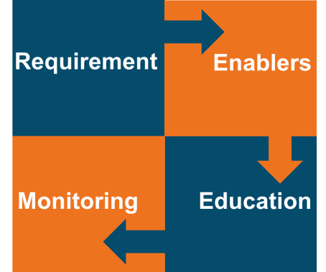
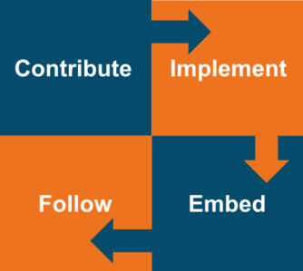
Fatigue Improvement Programme – Delivery Streams and Scope
Delivery and Change (Central Team)
Implement and Embed (Business)
Standard and Supporting documents
Briefing and Training Materials
Business change strategy and
Facilitation
Compliance and Assurance strategy
And tools.
Functional Business Areas
OUTCOMES
14 Hours D2D
12 Hours Breaks
Max 60 Hour Week
FRI = 40.
STE
Standard
Management of the standard
implementation.
Management of the change.
Management of the recruitment.
Management of compliance and
assurance
Provision of reporting
IR
Trade Union engagement strategy
and representation at council meetings.
Group / Route HR
Amend and publish PTR&R
Amend and publish phase 2b
Amend and publish NRP
Introduction of ECO roster principles
Introduction of Management
rostering and on call arrangements
People
Route Services NRT & HRSS
Training materials for new Recruits.
Recruitment on boarding
Amend employee T&Cs
Realise
Benefit
Notes:
Key Message: This slide encompasses all elements of the Change Vista that we have discussed in this presentation.
This slide provides an overview of the approach and scope.

Slide 13
Fatigue Improvement Programme
Thank you for your time.
Any Questions?

