Slide 1

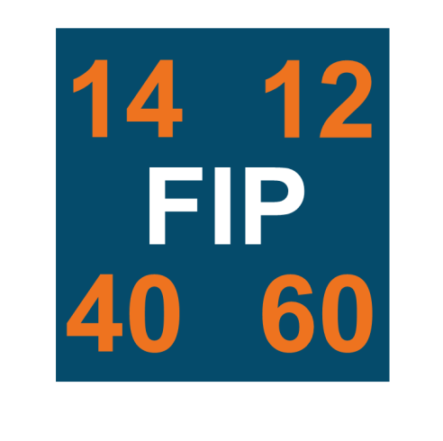

NR/L2/OHS/003 - Management of Fatigue Risk
Standard Update Briefing
V1 – June 2018

Slide 2

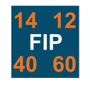

Our driving ambition at Network Rail is to ensure we get Everyone Home Safe Everyday through proactive and effective risk management.
Fatigue presents one of the most complex risks to manage and it can affect everyone within our industry, regardless of role. Up to now our management of fatigue risk has been directed by the requirements introduced after the Clapham Rail disaster in 1988, with the focus being on those safety critical workers within the industry.
However, with the launch of the Fatigue Improvement Programme we are now looking to expand our commitment to managing fatigue risk to all of those who work for or on behalf of Network Rail.
This represents a significant step change in risk management and will be supported through the introduction of the revised Network Rail standard ‘NR/L2/OHS/003 – Fatigue Risk Management’.
Graham Hopkins
Group Safety, Technical & Engineering Director
Safety, Technical & Engineering (STE)

Slide 3
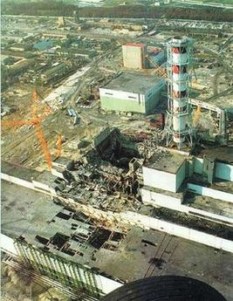

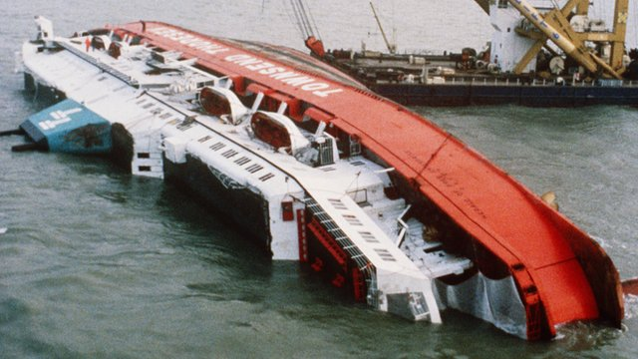
What is Fatigue Risk?
Fatigue is generally considered to be a state of perceived weariness resulting from physical or mental exhaustion that can result from prolonged working, heavy workload, insufficient rest and/or inadequate sleep
Fatigue has been at the heart of many well known disasters, including the Chernobyl reactor meltdown; the Challenger shuttle explosion; and the capsizing of the Herald of Free Enterprise in Zeebrugge Harbour
However, whilst those were major events it’s important for us to understand that fatigue can affect us all, causing us to make decisions and mistakes that can result in injury to ourselves and/or others
The standard referred to in this briefing represents the beginning of an improved approach to fatigue risk management, detailing what is expected of managers and those who are managed alike

Slide 4
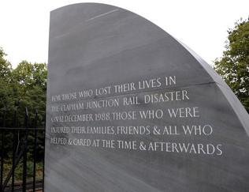
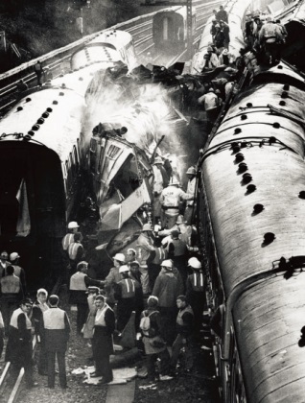
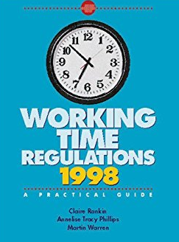
Background
In railway terms fatigue has been an important issue since 1988, where it was identified as a potential factor in the Clapham rail disaster
The subsequent investigation report (commonly known as the ‘Hidden’ report) recommended that British Rail needed to control the fatigue from excessive working hours
‘Hidden’ working time limits were a response to that recommendation, introducing limits for track workers:
  maximum rostered 12hr shift;
  minimum 12hr rest between shifts;
  no more than 13 shifts in 14 consecutive days;
  maximum 72hr working week.
Then in 1998 the Working Time Regulations introduced additional legal requirements for limiting working hours
Introduction of The Railways and Other Guided Transport Systems (Safety) Regulations 2006 (ROGS) mandated fatigue management for Safety Critical Workers

Slide 5
Current Limitations
Whilst the rail industry has worked to these ‘Hidden’ limits and the working time regulations, there have been limitations to their effectiveness. These Include;
  Current working time limits and fatigue risk management requirements only focus on safety critical workers
  Hidden working time limits and working time regulations are not considered adequate fatigue risk controls on their own
  There are no requirements to consider fatigue risk from commuting or other potential personal issues that may adversely affect that risk
  Grey areas exist in relation to definitions of ‘work’ within current standards (e.g. definition of on call)
  Existing risk management measures generally reactive, rather than proactive
  Fatigue risk and controls not well understood and well supported, especially in parts of the organisation that do not have safety critical workers.

Slide 6
NR/L2/OHS/003 – Fatigue Risk Management – What’s new?
NR/L2/OHS/003 – Fatigue Risk Management (combined standard and modules) will provide clearer requirements for managing fatigue risk for Network Rail staff and those working on behalf of Network Rail
The standard adopts a modular approach, focussing on the key areas for effective fatigue risk management in a concise, user friendly format
The standard will be developed over 2 years, with the final module being published in December 2019
However, final compliance date is October 2022. This reflects the understanding that these standard changes may also require system changes and will need a change in business behaviours
Jun 18
Dec 19
Oct 22
Dec 18
Mar 19
Fatigue Risk Management Principles Core Std.
Fatigue Risk Assessment Module
Compliance Date
Fatigue Risk Index Module
Roster Design Module
Exceedance Mgt. Module
Working time & On-call Module

Slide 7
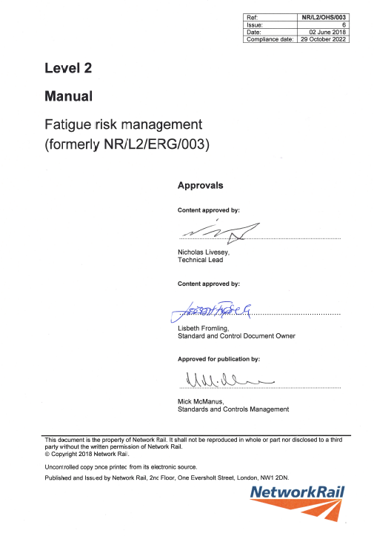
What’s new? - NR/L2/OHS/003: Fatigue Risk Management
  NR/L2/OHS/003 - Fatigue Risk Management: Core standard, provides definitions and principles that are consistent across all of the subsequent modules
  Standard to be developed and published in modular format, final module to be released December 2019
  Revised standard applies to everyone working for or on behalf of Network Rail, no longer limited to only safety critical workers
  Maintains the existing ‘hidden’ working hours limits (work no longer than 12hrs; 12hrs rest between shifts; no more than 13 shifts in 14 consecutive days; no more than 72hrs in a single working week)
  Lays foundation for proactive fatigue risk management and defines responsibilities for managers and individuals
  Details assurance requirements for managers with responsibilities for managing staff fatigue.

Slide 8
What’s new? - Module 1: Fatigue Risk Index Principles
  The first module to accompany the standard (same publication date) is NR/L2/OHS/003/Mod1 - Fatigue Risk Index Principles. This identifies new requirements, such as;
    Identifies Health & Safety Executive’s Fatigue Risk Index (FRI) as the consistent method for measuring fatigue risk within an organisation
    Defines when an FRI assessment is required to be completed
    Establishes what data is needed to achieve accurate measurement, taking into account information such as commuting times, workload, attention requirements and periods & duration of rest within shifts
    Provides the framework for how to interpret the FRI output; when a score identifies a potential fatigue risk to be present; and what action should be undertaken when this risk is identified
    Determines what follow up is required when a roster is identified to have fatigue risk issues and identify potential means to mitigate the risk if the FRI score cannot be reduced by redesigning the roster

Slide 9
Fatigue Risk Management – Manager’s Responsibilities
  The revised standard highlights the need for Managers to understand potential fatigue risks associated with their staff
  Intent is that a better understanding of the people that work within the organisation will enable more effective fatigue risk management
  Standard requires that Managers will confirm rosters will have had a FRI assessment completed and the output maintained with the roster
  Line Managers are required to monitor working hours of their staff against identified working time limits/triggers identified within the standard
  Any exceedences need to be reported by the Line Manager in line with the Functional Head’s reporting mechanism (e.g. Through control room/visualisation meetings)
  Where exceedences occur then the Line Manager is required to maintain a record for auditable purposes
  As additional Modules are released further details of Manager’s responsibilities will be detailed and support systems and materials will be developed to reduce business impact

Slide 10

Fatigue Improvement Programme
This brief will be updated as future modules are published and the standard itself updated
The standard will also be supported by good practice guidance that will offer practical means to achieve compliance
Any Questions?
If you have any questions or need
further assistance please contact your Workforce HSE Advisor or email:
FatigueImprovementProgramme@networkrail.co.uk

