Slide 1
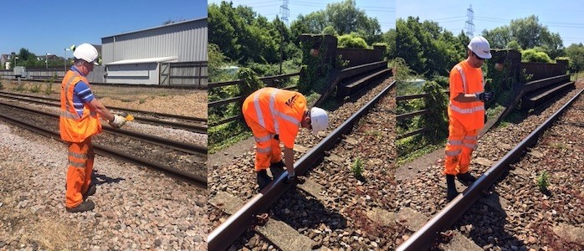

Wessex
Route
Network Rail
Health, Safety and Environment Period Cascade for P3. 2018/19

Slide 2
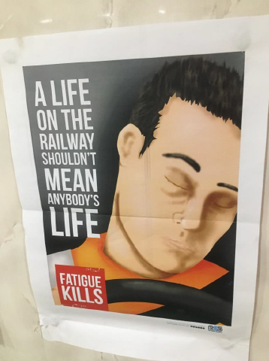
Welcome
Welcome to your Health, Safety and Environment Cascade for Period 3 2018/19.
In this cascade;
Workforce Accidents
Safety Stand-down
Asbestos
Risk of RRV runaway
  Safety alert
  MC & POS briefing
Sentinel App Improvements
Health and Wellbeing
  New Management of Fatigue Standard
Safety Alerts
Operational Notices
Close Calls
Environmental
Appreciation

Slide 3

Workforce Safety
Lost time injuries
Location | Department | Injury | Circumstances | Lessons Learnt/Discussion
Level Crossing | OM Outer | Pain to lower back and hip | Whilst removing a cow from the lineside, IP was required move quickly to avoid the animals movements and in doing so twisted his back and hips, suffering discomfort.
Trackside | TSM Wimbledon Inner DU | Muscle tear | Whilst using an impact wrench, IP suffered pain to back and numbness in legs. | Manual handling and rotation of labour. See Wessex Route LLC Impact Wrench 10-06-18.pdf
Trackside | TSM Woking Inner DU | Cuts, bruises and damage to a bone in his shoulder. | Whilst walking on the infrastructure IP sustained face, arm and shoulder injuries when he fell after tripping on a wooden edging panel. | The number of slip, trip and fall accidents are on the increase. See Wessex Route LLC STF June 18.pdf
Platform | TSM Wimbledon Inner DU | 1 ½ cut on head. | Whist handling an iron man from platform to the track, IP was pulled forward ; fell from the platform striking his head on a rail sustaining a 1 ½ inch cut to his head. Potentially a serious injury , an MRI scan for the injury was clear. | Manual Handling of equipment to site and communication between team members. See Wessex Route LLC Wimbledon slip trip and fall June 18.pdf

Slide 4
Workforce Safety
No lost time injuries
Location | Department | Injury | Circumstances | Lessons Learnt/discussion
Trackside | TSM Bournemouth Outer DU | Torn finger nail | Whilst putting a magnet out for an ESR the IP caught his finger nail on a mechanism. | Would use of different gloves prevent this?
Access point | TSM Woking Inner DU | Sprained ankle | Whilst accessing the track during inclement weather, the IP slipped on steel plating screwed onto the walkway and slipped over. | As preceding LLC. Slips, trips and falls.
Trackside | Telecoms | Cut to and twisted wrist and sprained ankle. | Whilst walking up access steps at Northam Sub Station holding the hand rail, the fixings gave way causing the IP to fall backwards down the steps. He also hit the back of his head luckily this was protected by his hard hat. | Please…Close call all loose access step handrails before they deteriorate to this state.
Trackside | TSM Havant Outer DU | Sore thumb | Whilst using a rail cutter, the blade pinched in the rail pulling the disc cutter forward, this yanked on the IP's hand pulling on his right . | General top tips for using a rail saw; supported rail, clamp tightly, check the disc before use.

Slide 5

Workforce Safety
No lost time injuries
Location | Department | Injury | Circumstances | Lessons Learnt/discussion
Access point | TSM Woking Inner DU | Wrist Left hand | Whilst removing a speed board magnet from the rear of a van, the IP was struck on the wrist by a pandrol clip that had become attached to the magnet and had fallen from his grip once he had prised it away from the magnet. | Magnetic units should be transported in the boxes provided to avoid collecting other metal objects.
Trackside | TSM Eastleigh Outer DU | Wrist Left hand | Whilst walking in the cess, the IP was stung by an insect. Initially there was a burning sensation this escalated to swelling to the hand. He was treated at A&E with a ‘anti-histamine’ injection. | Insect season is upon us..if possible; cover up your body parts, avoid perfumed lotions & body sprays and avoid nests.
Access gate and third party land, Campbell Road. | TSM Eastleigh Outer DU | Potential Asbestos dust exposure | Two members of staff returned to a NR vehicle to find the area and the vehicle covered with dust. A barrier had been placed in the vicinity and they were subsequently told work on third party land included demolition of structure with asbestos; therefore some dust may contain asbestos. | Use of the access gate has been temporarily suspended whilst we investigate the incident. See later slide for reporting exposure Wessex Route LLC Access Closed due to Asbestos Contamination..pdf

Slide 6

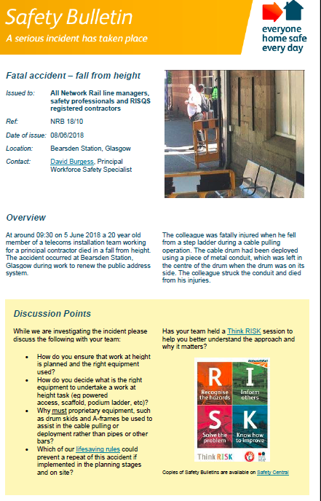
Safety Stand-down
During the month of July there will be an industry Safety Stand-down following the death of the young man in Scotland on the 5th June.
All materials will be supplied from STE, promoted by the CEO and cascaded throughout the organisation.

Slide 7
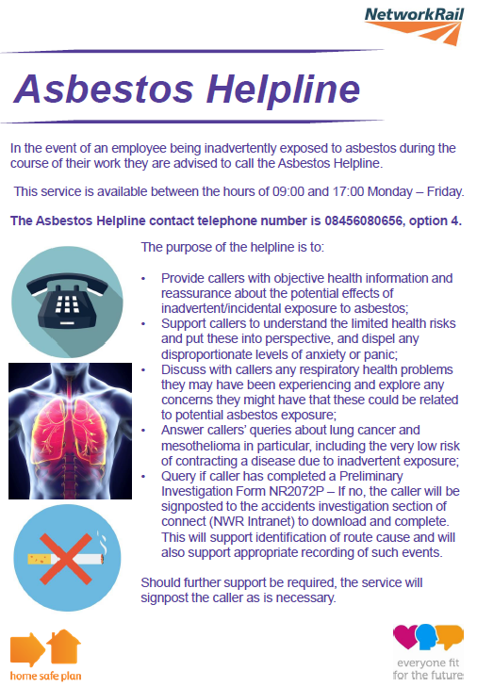
Asbestos
What you need to know
There are a number of Asbestos Guidance Notes available on the intranet at this link….
Asbestos Guidance Notes | Safety Central
Check ARMs when scheduling work to minimise potential exposure
Network Rails asbestos management system is called ARMS - Asbestos Risk Management System
It is a web-based application and is accessed using the internet in a secure manner.: https://arms.networkrail.co.uk
How it Works
Data collected from site using Survey Template.
Survey data inputted into ARMS
NR management of data (prioritisation, allocation & management of resources & monitoring of remaining ACMs)
Who needs to know about it?
Anyone who could come into contact with asbestos or is in charge of people who could come into contact with asbestos when working on our properties, which basically means anyone who carries out maintenance or renewals.
The most appropriate users are people who schedule work.
How do we get access to it?
Access can be given to anyone who requires it by completing the Read Only Request Form and returning to Asset Systems Business Support .

Slide 8
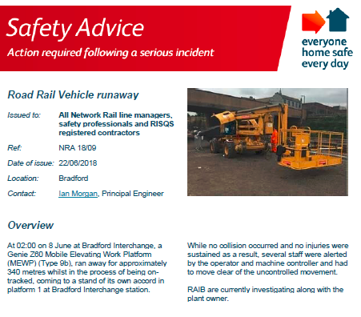
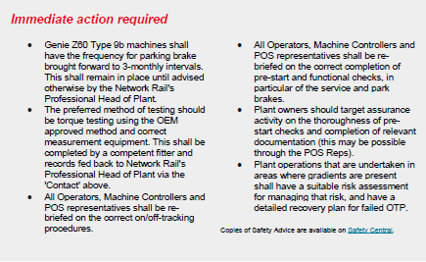
Risk of RRV Runaway
Briefing requirement following this incident..
Please see next slide for the briefing required by the immediate actions section of this Safety Advice.

Slide 9
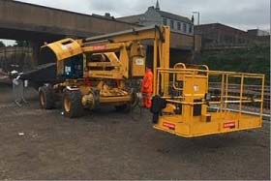
Risk of RRV Runaway
Briefing to all Machine Controllers and POSs
All OTP shall be checked prior to use by the Machine Operator and Machine/Crane Controller as appropriate and complete the machine controller checklist.
Only place OTP on or off the track:
a) at approved road rail access points or using temporary access ramps that are identified in the safe system of work; and
b) in accordance with the operating instructions and Certificate of Engineering Acceptance (ECC) for the OTP.
Machine operators shall check OTP for suitability and correct functionality immediately after placing on track ensuring that the rolling brake test has been completed for all OTP , including trailers and braked attachments.
Results of these checks are to be recorded using NR/L2/RMVP/0200_F027 by the machine/crane controller and retained.
POS reps must also complete the POS rep checklist OTP/POS/REP/02
For any further information then contact: Keith Penn: Rail Plant support Engineer: keith.penn@networktrail.co.uk

Slide 10

Workforce Safety
Sentinel App improvements
Swipe Out reminders on Mobile apps
To provide card checkers with the ability to set swipe out reminders for themselves and/or their team members. This will initially be defaulted to 15 minutes prior to swipe out however extra fields will be added to enable you to set your own reminders.
Surfacing Medical Expiry when checking a card
The most recent medical date will be displayed underneath the medical restrictions section on the swipe in/check a card and show own card pages of the app and the PC Card reader.
Show reasons for 'No Core Competence' and update existing ATW denial reasons
In order to make it clearer why people are being denied access to site we will be changing some of the alerts to, Check Core Competence, Check Primary Sponsor, Check Medical and Check D & A.
Alerts that will stay the same are, Cardholder Suspended, Card Cancelled, No Sponsor (in relation to a sub sponsor) and Pending Sponsor Risk Assessment.
Display 'Valid Until' Date in MySentinel
This will provide visibility of the 'Valid Until date' for competences held by an individual in addition to the Expiry Date for each competence. This will help the individual identify when their competences will become invalid as this may be sooner than the Expiry Date, for example, post-mentorship or interim assessments are required to maintain the competence validity.

Slide 11
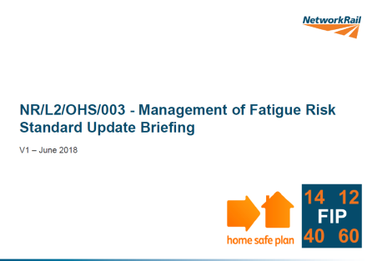
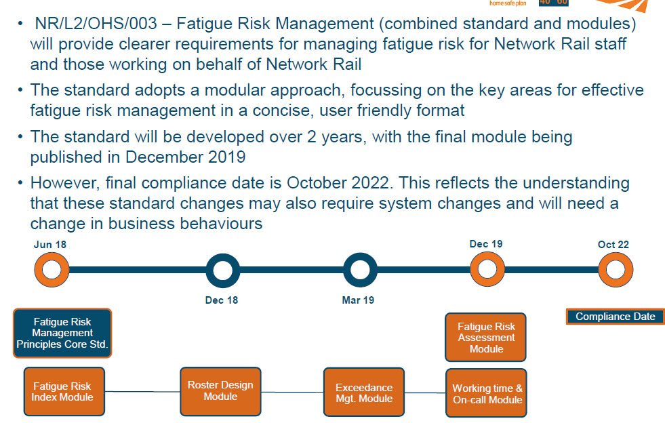

Health and Wellbeing
NR/L2/OHS/033 Management of Fatigue Risk
The full introductory ppt is attached to this cascade for those who want more information early.
This will affect all staff not just those who are safety critical.
We will being conducting a series of Impact workshops over the next few weeks.

Slide 12

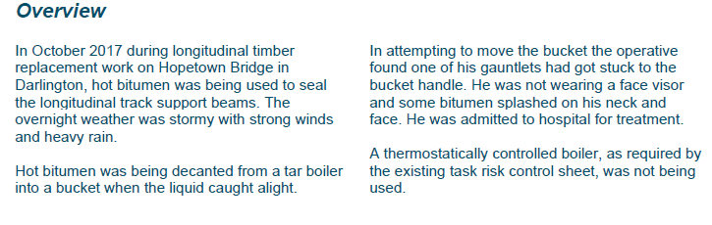

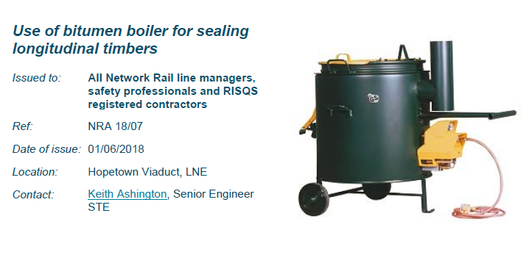
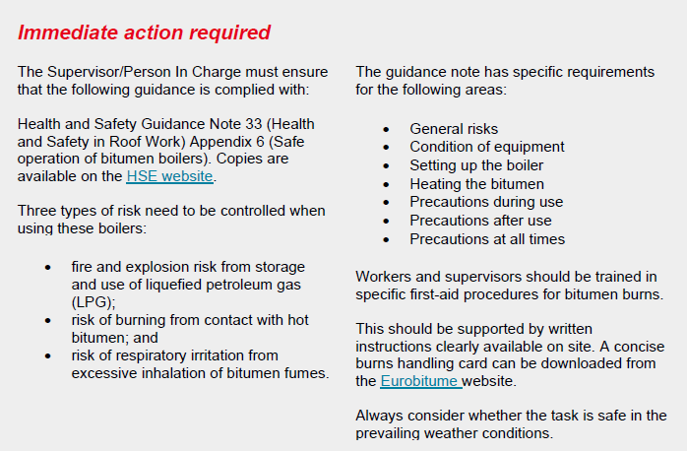
Safety Alerts
Bitumen Boilers sealing Longitudinal timbers
hsg33.pdf

Slide 13
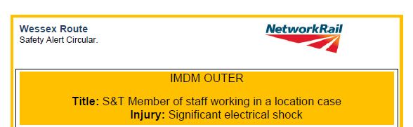
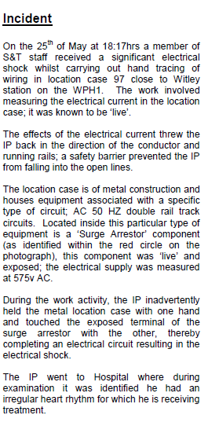
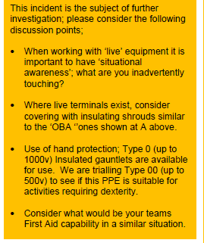
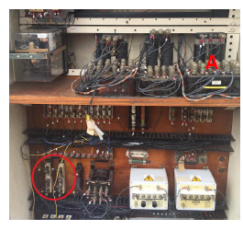
Safety Alerts
Wessex Staff accident update
Wessex Route LLC Electrical Shock Location Cabinet June 18.pdf

Slide 14
Operational Notices
Connect the links before brief, important information for all are contained in these Notices.
NR-OPS-024 Bridge Strike Management.pdf
NR-OPS-025 Cropredy HABD Failure.doc
NR-OPS-026 Points Run Through Evesham.pdf
NR-OPS-028 Line Blockage Irregularity Eastfield.pdf
TLP-090-Shared-Learning-Farrigndon-Possession-Irregularity.pdf
TLP-091-Shared-Learning-Work-at-Height.pdf

Slide 15

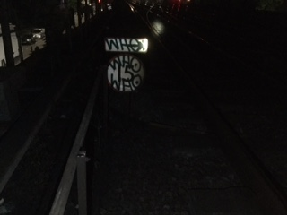
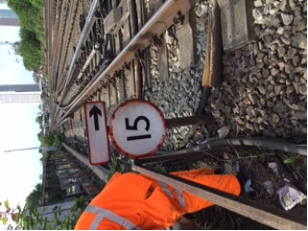
Close Calls
Call it in to prevent future accidents
    Seen something that doesn’t look or feel right? Call it in
    By calling in an incident that has the potential to cause damage or injury, you can help prevent it occurring in the future
    Apparently if everyone can find two a week we will reach our Corporate Scorecard target... Please make them meaningful.
    Interesting Close call of the period… reported by the lovely Dave Preece
    Incident Location:
    Vauxhall-ELR-BML1- DMS 17 chain-on the approach to 1600A points.
    Incident Description:
    Drivers 15MPH Speed indicator heavily covered in graffiti.
    What event could have resulted from this unsafe act/condition:
    Excessive train speed & potential derailment.
    Has the risk been removed?
    Cleaned by P-way staff.

Slide 16


Environment
It’s a way of life……

Slide 17
Appreciation to……
Two members of Woking P-way (Perry Fielder and Jason Gilliland) were on their way to site when an RTA occurred between the car in front of them and an oncoming car, causing significant damage to both vehicles involved. Both vehicles had families with children inside. Perry and Jason assisted to get both families out of the cars as quickly as possible and ensured that they were not hurt. They then directed traffic around the collision until the police arrived at which point they assisted the police until the situation could be resolved.
Then days later they assisted in the Surbiton train evacuation.

