Slide 1
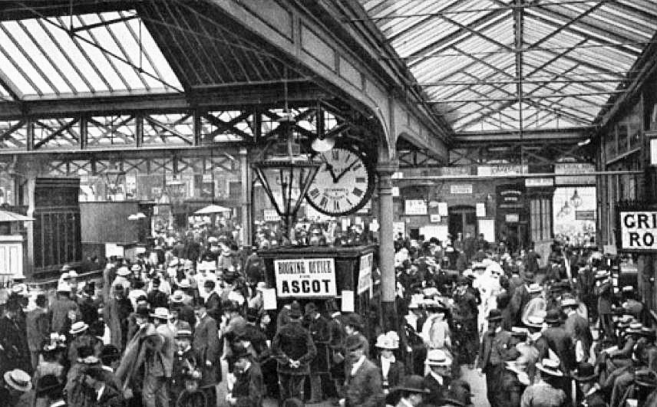
Period 4 Safety Cascade
Picture of Waterloo Station in 1902 – Waterloo Station celebrated its 170th Birthday this Period

Slide 2


Welcome to the Wessex Route Health Safety and Environment (HSE) Communications for Period 4, Included in this issue:
SAFETY
Welcome
Workforce safety – Safety calendar
Workforce accidents – 1 lost time injury
Workforce accidents – 7 non- lost time injuries
Workforce Safety
Working with the Live Conductor rail
Dynamic risk Assessment
Driving News
Ad Blue
Enhanced Driving risk ‘Dry to Wet’
Safety Bulletins
Safety Notices: Weed Train.
Community Safety Update
Health and wellbeing
Mental Health
Respiratory update
Close call of the period
Appreciation.

Slide 3

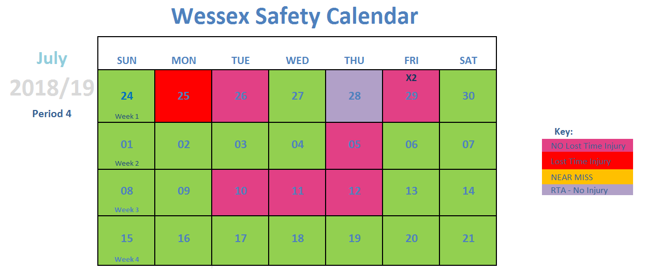
SAFETY
Workforce safety – safety calendar
For more information, please contact your local WHSEA

Slide 4
SAFETY
Workforce accidents
Accident – Lost Time Injury (1)
OUTER DU – Basingstoke S&T 25th June | Whilst standing in the Up Cess in a position of safety, a member of an S&T team felt a sharp pain in his ankle as a SWR train passed on the Up Slow. This is subject to further investigation but it would appear an object fell off the train and struck the IP on the ankle. Accident classification: Struck by Falling/Flying Objects
For more information, please contact your local WHSEA

Slide 5
SAFETY
Workforce accidents
Minor accident – Non Lost Time Injury (7)
OUTER DU – Salisbury P-way 26th June | The IP was walking in the cess over uneven ground when an ankle gave way , causing the IP to stumble forward, falling onto ballast. Slip Trip and fall: ballast.
OUTER DU- Havant P-way Station 29th June | Whilst using an iron man, the IP released the ratchet, this caused it to spin around and catching the lower part of his right arm.. Use of tools and equipment: this should be completed in a controlled manner.
INNER DU – Guildford P-way 29th June | A contractor from Ganymede was undertaking lookout duties for the maintenance team when ballast gave way underfoot causing the IP to fall, grazing the IP’s left lower shin and the side of his leg. Slip, Trip or fall: ballast.
Outer DU – 5th July | Whilst cycling to Winchester station a car pulled out in front of the IP on the approach to the station. IP had insufficient to time to stop or avoid car, he came into contact with the car and was knocked from the pedal cycle.
INNER DU – Feltham S&T 10th July | The IP was unloading small tools and meters from the back of the van to place in the storage unit. Whilst doing so he caught his finger on an object and grazed his middle finger causing it to bleed. Consider the use of gloves at all times.
INNER DU – CRE 11th July | The IP was working in the depot; Wimbledon store. He was stung by a wasp on the lip.
INNER DU- Woking S&T 12th July | The IP was attending a first aid course and was participating in rolling the ‘casualty’ over, he felt a slight tweak in his back, which became more uncomfortable later that night. This was reported the following Monday. Please report accidents at the time, however small they seem.
For more information, please contact your local WHSEA

Slide 6

SAFETY
Safety bulletin
Significant Accident on South East Route
Overview
On 12th July a Maintenance contractor team were tasked with clearing ballast from the foot of the rail to allow for a PLPR inspection.
The Safe System of Work was open line with lookout protection.
At approximately 1030hrs, upon the approach of a train, the gang were called out to a position of safety.
As the train passed the IP was struck by a piece of ballast which broke his safety glasses and resulted in a large laceration above his right eye needing in 8 stitches.
It is clear that the injury could have been significantly more serious had the IP not been wearing his safety glasses.
An internal investigation is currently underway, but it is likely that the incident was caused by the train’s shoe gear hitting a high ballast profile.
Immediate Actions
Please ensure that you have been issued with the correct eye protection for the task and that they are in good condition, and that they are worn at all times (if you are unsure ASK your Manager)
Do not hesitate to challenge any individual who is not wearing their safety glasses (or full and correct PPE)
Your Safe Work Pack must contain the task, location and operational risks and control measures. Ensure you are briefed on these prior to starting work
When carrying out similar tasks please be reminded of the importance of maintaining a ballast profile which is clear of the conductor rail and of the collector shoes.
Remember Take 5 for safety! Think about the risk before, during and at the end of the task

Slide 7
SAFETY
Safety Advice
Use of speed board equipment.

Slide 8
SAFETY
Workforce Safety
Third rail…Risk Level 1, 2 or 3?
A couple of incidents and accidents across the 3rd rail areas recently suggest it’s about time we re-visited what the minimum Risk Levels are and what controls should be in place. See attached TRCS for full details.
What are the increased risk factors for all levels?
Hot weather
Damp/wet conditions
Darkness
Continued crossing of the live rail

Slide 9
SAFETY
Workforce Safety
Third rail…Risk Level 1.
Working on the Conductor rail is an ISOLATION
Reminder
Permits
Testing
Conformation for a Temporary Isolation

Slide 10
SAFETY
Workforce Safety
Third rail…Risk Level 2
Controls for working at Risk Level 2 (<300mm from a Live conductor Rail)
Reminder
Tools
Shields
Clothing

Slide 11
SAFETY
Workforce Safety
Third rail…Risk Level 3.
Risk Level 3 working more than 300mm from a live conductor rail.
Reminder
Tools
Shields
Clothing

Slide 12

SAFETY
Workforce Safety
Dynamic Risk Assessment
What is Dynamic Risk Assessment?
Is the practice of mentally observing, assessing and analysing an environment while we work, to identify and remove risk.
The process allows individuals to identify a hazard on the spot and make quick decisions in regards to their own safety.
While steps can be taken to reduce and eliminate workplace hazards, there are some risks that are unpredictable and difficult to control. For example, leaving a tool in a daft position in a work site for someone to trip over.
The ability to carry out a dynamic risk assessment allows someone to identify a potentially dangerous environment or situation and take the appropriate steps to leave the environment or remove the risk before it causes an accident or incident.
The best tool for identifying risk is ‘honing your basic survival instinct’.

Slide 13
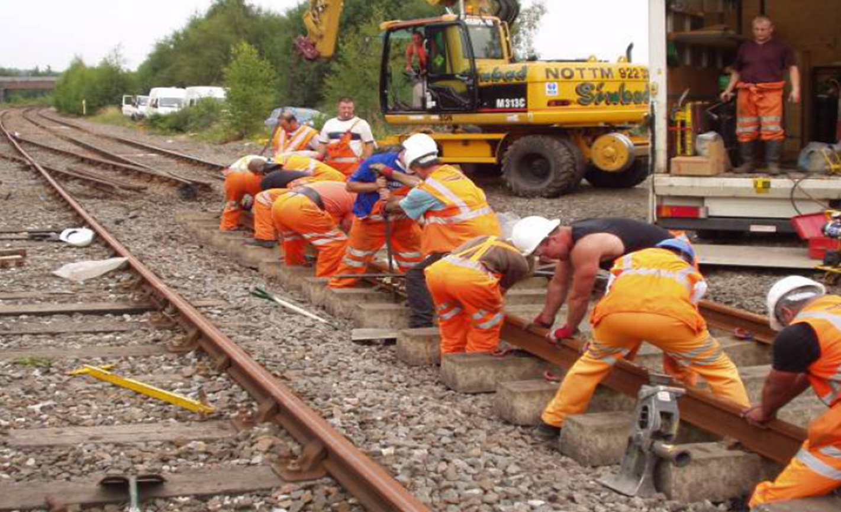
SAFETY
Workforce Safety
Dynamic Risk Assessment
What risks can you spot?

Slide 14

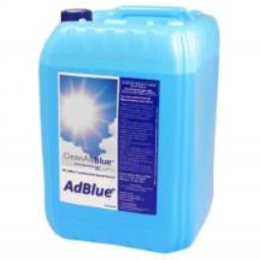
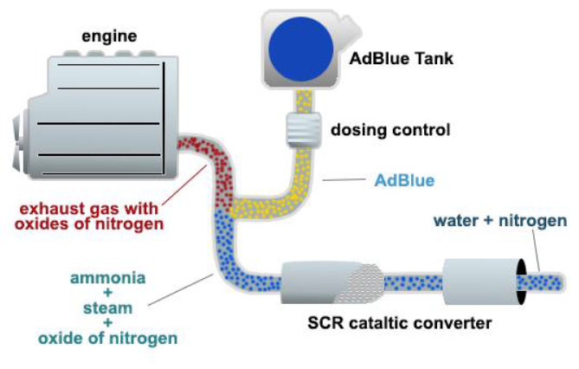
When the fuel is burned by the engine, Ad Blue is injected into the SCR catalyst in order to convert the NOx into a less harmful mixture of nitrogen and water vapour. The solution is stored in its own tank separate from the diesel, and is injected into the outgoing exhaust gas before the SCR catalytic converter, the urea present becomes ammonia when heated, reacting with the NOx in the emissions to convert the pollutants into nitrogen, water, and a small amount of carbon dioxide, elements that are already natural to the air that we breathe.
SAFETY
Driving news
Does Your New Diesel Vehicle Use Ad Blue? What is Ad Blue?
Ad Blue
is NOT a fuel or even a fuel additive therefore has its own tank
A warning light will illuminate on the dash when less than 300 miles supply is left.
If it runs out the engine will not restart.
A Ford Transit tank for it will hold around 20 litres.
A tank of it will last about 5000 miles.
It can be purchased on the normal fuel card as a fuel related product
It can also be purchased in bulk from I-proc.
Care should be taken when refilling the tank in order to prevent dirt and contamination entering the vehicle’s system.
Running diesel engines without it or allowing contamination to enter the system will cause expensive damage.

Slide 15
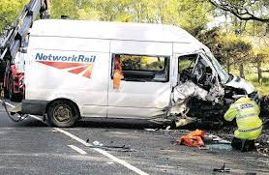
SAFETY
Driving news
Driving Conditions following a dry spell
What are the risks associated with the change in driving conditions when we have rain following a dry spell?
There is scientific data available that concludes that driving in wet conditions immediately following a dry spell has increased risk of an Road Traffic Collison (RTC). The Police acknowledge that there is an increase in RTCs due to the change in stopping distances which catch people out.
As well as peoples behaviour and driving styles that can cause an increase in RTCs, the vehicle itself will need attention such as:
Windscreen wipers (can become deteriorated in hot weather)
Tyres
Grease and fluid top ups
Note: All drivers are reminded that there a requirement to still complete the log book as well as logging into VSWS.
Discussion Points:
Are your vehicles ready for heavy rain?
How do you change your driving style in different conditions?

Slide 16
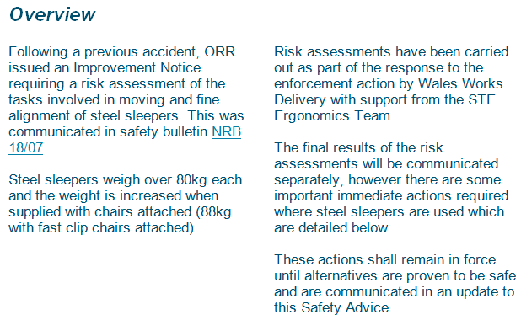
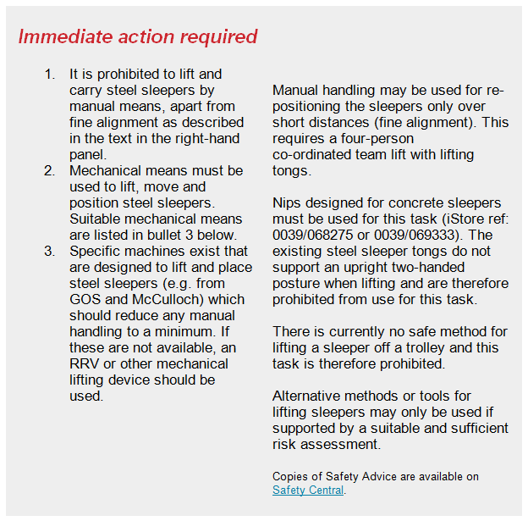
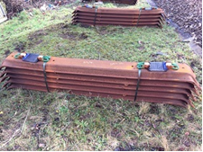
SAFETY
Safety bulletin
Manual handling of steel sleepers

Slide 17
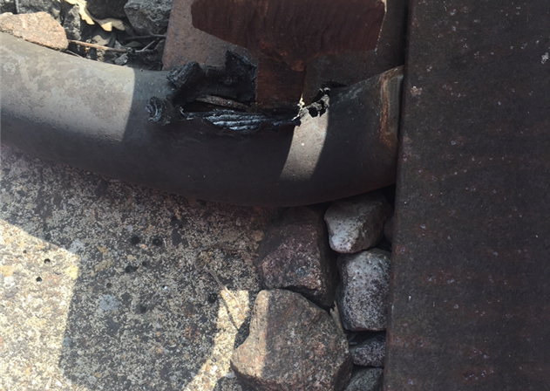
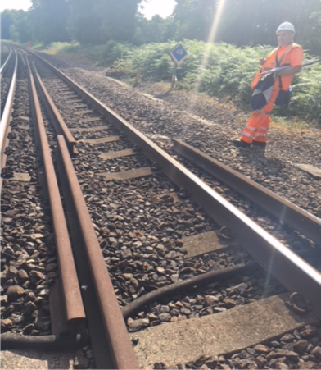
SAFETY
Safety notice
WESSEX OUTER DU – Live scrap rail
Overview
At 10:13 on 19th July, the team leader of Inspection staff at Havant P-way escalated a safety issue that had been identified following a track patrol where a scrap piece of rail had crept in the warm weather and had eroded away the insulation of a 750v cable causing the rail to become live. Temporary work to make the rail safe was carried at the same day and full repair completed for the damaged cable the same night.
Immediate Actions- Subject to investigation
Re-brief track inspection staff that where we have long sections of CWR in the 4ft or on the ballast shoulder we must spray the rail ends to be able to monitor how much the rails are creeping during the summer months.

Slide 18
SAFETY
Safety notice
WEED SPRAYING TRAINS
ARE IN OPERATION
Staff on or near the line when a Weed Control Train approaches should take the following action:
Acknowledge and move to a position of safety
Remain in the PoS; make yourself visible to the Driver who will suspend spraying as the train passes..
Do not ‘hide’ behind bushes in an attempt to avoid being sprayed, the spray jets are specifically designed to penetrate bushes.
The herbicides deployed by the Weed Control Train are biodegradable, non irritant and non harmful at the low concentrations used. In the unlikely event that staff are sprayed accidentally it is recommended that they take the following actions:
• If the eyes have been sprayed, rinse immediately with clean, water for 15 minutes and obtain medical aid if any discomfort is felt thereafter.
• Rinse any exposed skin with clean water and wash with soap and water afterwards.
• Avoid eating, drinking, or smoking until this procedure has been carried out.
• Change any sprayed clothing at the earliest convenient time and retain in a plastic bag for collection.
• Report the incident to the Route Operations Control.
• Should any member of staff be sprayed they may obtain advice from SCO 24:7 Seasonal Controller
01908 723500 (Option 8)
Should any member of staff require any further information or advice please contact:
SCO 24:7 Seasonal Controller 01908 723500 (Option 8)

Slide 19

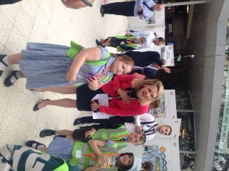
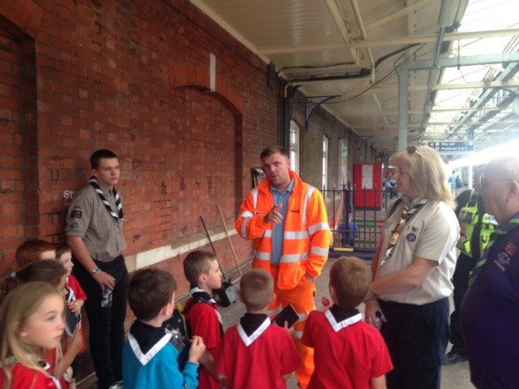
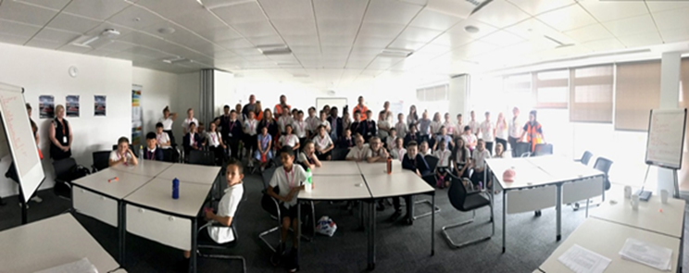
SAFETY
Community safety
Rail Safety sessions have now been delivered to over 20,000 children and adults on Wessex
Basingstoke Campus was opened to 70,11-12 year olds for our first rail safety community event we have ran in our own facilities. The event included a theatre show, level crossing awareness, BTP introduction and the children designed their own safety campaign.
A group of Beavers followed their rail safety session with a train trip from Basingstoke Station and a visit to the Signallers – thank you to all those who supported!
Children from Thomson House School designed their interpretation of ‘Waterloo station for the future’ for the 170th anniversary of Waterloo. The children also met Mark Carne and Becky Lumlock.
For more information or if you would like to become a volunteer please contact our Community Safety Manager‐ Marcia.Burnett@networkrail.co.uk

Slide 20
SAFETY
Community safety
A thank you to:
Southampton P-Way team who noticed a children’s camp near tracks and reported the risk, identifying name of the school. We contacted the school and delivered safety sessions to over 700 students. The school have asked us to return each year to deliver the safety message to the incoming year 7 students.
A primary school teacher contacted us to ask for a rail safety assembly, as she previously taught in a school where a child died, she commented;.
“breaking the news to a class of 8 and 9 year olds that one of their school friends would never be coming back. The sadness was overwhelming, she was just a child, with what should have been her whole life ahead of her. She was 10 years old and had been playing conkers down by the track in Staines with her twin brother and another friend the night before, she had accidentally stepped on a live rail track and been electrocuted. Breaking the news was horrendous”
Following the sessions she wrote:
“Thank you so much for coming and delivering such engaging and valuable workshops to year 5. The response has been overwhelming, speaking to parents the children went straight home and engaged in discussions with them about how to stay safe and making the right choices. We would really appreciate it if we could make you coming in a regular event in the academic year. The impact you’ve had on promoting discussions inside and outside the classroom has been invaluable.”
For more information or if you would like to become a volunteer please contact our Community Safety Manager‐ Marcia.Burnett@networkrail.co.uk

Slide 21



SAFETY
Health News - Mental Health
For more information, please contact our Occupational Health and Wellbeing Manager‐ Grazia.Elsehimy@networkrail.co.uk

Slide 22

SAFETY
Health News - Mental Health
For more information, please contact our Occupational Health and Wellbeing Manager‐ Grazia.Elsehimy@networkrail.co.uk

Slide 23
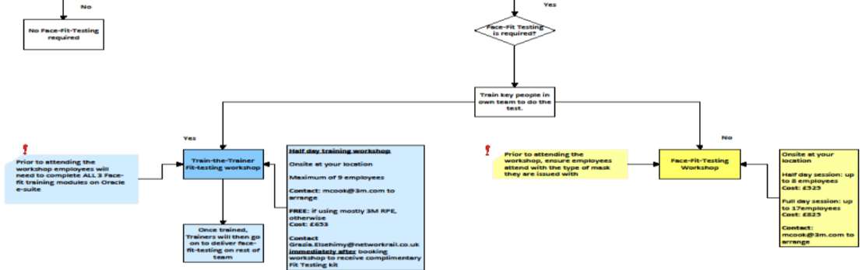
Health and Wellbeing
Health News - Respiratory
On Oracle there are 3 core respiratory modules which depending on your work activity must be completed.
Module 1: Awareness of Respiratory Hazards: All Wessex PTS holders need to complete this brief, to increase their awareness of the respiratory hazards (i.e. diesel fumes; ballast dust; chemical fumes etc.) in the working environment
Module 2: Face fit requirements and Fit Check: Everyone issued with tight fitting Respiratory Protective Equipment (RPE) like the below ALSO need to complete this brief in addition to the one above
Module 3: Face testing: Employees that want to train to become face-fit-testers need to complete this module as well.

Slide 24
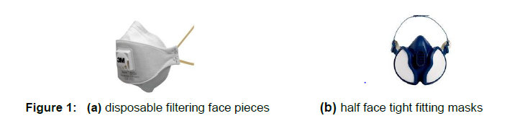
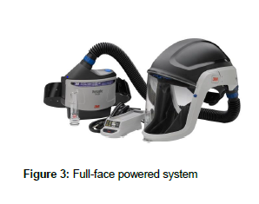
Health and Wellbeing
Health News - Respiratory
Respiratory Protective Equipment (RPE)
Tight Fitting Face Pieces
Loose Fitting Face Pieces
Relies on a tight seal around the face
This means no facial hair as this would compromise the effectiveness of the seal and subsequently the protection.
Anyone issued with tight fitting RPE, must be face-fit-tested.
Relies on enough clean being provided to the wearer to prevent contaminant leaking in.
Facial hair has no impact on the effectiveness of this respirator..
No requirement for face-fit-testing.

Slide 25


SAFETY
Close Call of the period
While it's a fact close calls remain a centrally set target, Wessex will not treat them as a numbers game
On 2nd July the a Reporter raised:
Description:
MPV discharging liquid indiscriminately in close proximity to Salisbury S&T office / mess room
What could have happened:
Contaminated water discharge and spray onto persons walking past on walking route to and from depot.
Actions Required: Review of the maintenance activities and location of these activities for the MPV Responsible Manager.
On 13th July, the Responsible manager provided the following feedback:
JSD have interviewed there operator and investigated what has happened. Below is a summary of the report:
The operator stated that when testing the system prior to departure only fresh water from the water tank was used, also it is unlikely that any particles from the tank would have been emitted from the spray head due to the filtering system, which would not allow any foreign particles to be emitted from the spray head.
The “Fresh” water would have only been present in the tank for up to 24hrs prior to the testing of the spay heads and therefore it is highly unlikely that anything other than fresh water would have been emitted.
It is possible that as the jets of water were emitted from the spray head, they hit the ground throwing up particles from the ground.
All operators have been instructed to ensure that testing of the jetting system take place away from any offices, and they have been advised that they should test the system at the furthest point from the road way “Just after entry into the depot” and not alongside the portacabins/offices. This will ensure that testing in an area where persons could be present is do not occur.
JSD have apologised to me for the concerns and issues this incident have caused to people working in the depot and they have committed to ensure that they are more aware of the surroundings when carrying out testing.

Slide 26

Lewis Smith Team Leader Pete Avison Patroller Wesley Hubbard Paul McGrath Robert Chivers from Havant P-way for staying on site when a piece of scrap rail became live after making contact with a 750v cable. They stayed on site to make sure no one was exposed to the ‘live rail’ until it could be made safe.
SAFETY
Thank you

