Slide 1
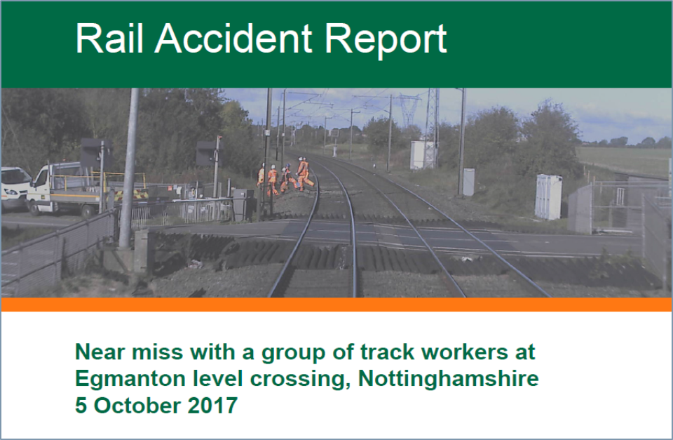
Wessex
Route
Network Rail
This years must read report…
Health, Safety and Environment Period Cascade for P5. 2018/19

Slide 2
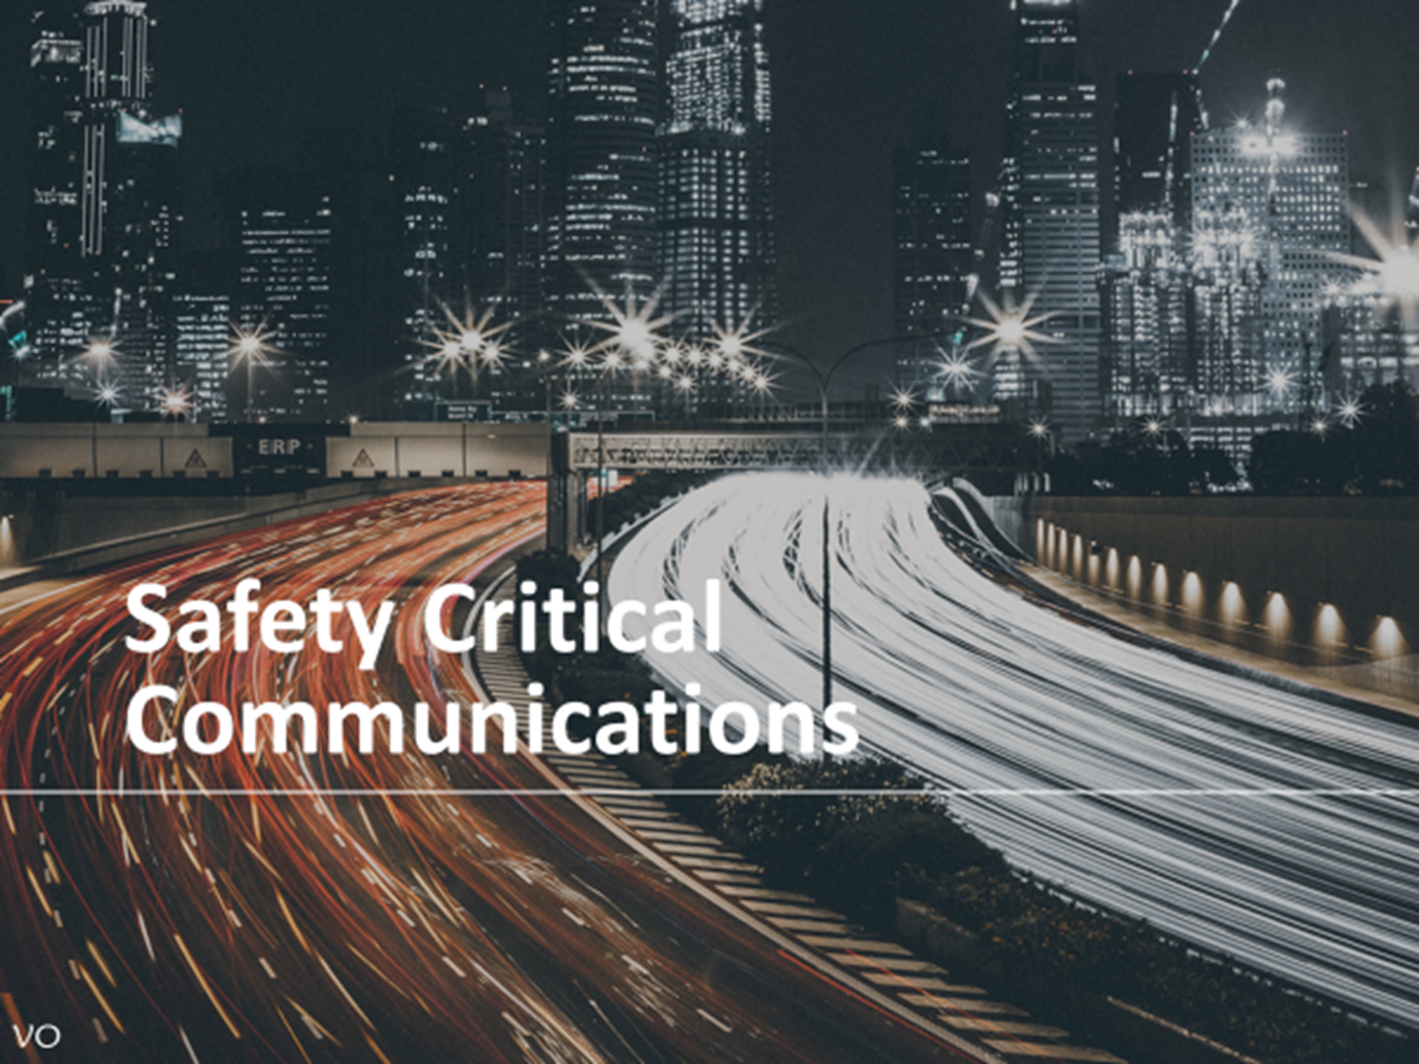
Welcome
Welcome to your Health, Safety and Environment Cascade for Period 5 2018/19.
In this cascade;
Egmanton Near Miss
Workforce accidents
Line Blockage Irregularity
Safety Critical Communications
Electrical Safety
Live TCR
Hot works
Close Calls
Health and Wellbeing
Sleep dept
Safety Bulletins
Appreciation

Slide 3

Track Worker Safety Egmanton Near Miss
At 1122 hrs on 5th October 2017, a group of trackworkers narrowly missed being struck by a train moving at 124mph. (<1 second)
The NR PiC had 23 yrs service, the others were supplied by a contractor - 50% of them had between 4 & 12 months experience.
This is the story…please discuss during the briefing section.
Egmanton-risk-awareness-team-briefing.pptx

Slide 4
Track Worker Safety Egmanton Near Miss
The RAIB report into this event is a ‘must read’ document for everyone who works in the railway.
Here is shown the reports comments on Safety Leadership on site, the report also sights concerns on:
Others in the group not challenging safety concerns,
The vulnerability contractors feel working for NR if they raise concerns,
Looking after inexperienced people,
NRs training and management of competence regime.
The PiC/COSS set up a system of work that was neither safe or compliant.
He use
None of the members of the group effectively challenged the safe system of work
Full RAIB Report Egmanton.pdf

Slide 5

Workforce Safety Significant no lost time injuries
Dept | Date Location | Detail
Outer E&P | 25/07/2018 Worting Junction sub-station | Whilst crimping up earthing cables IP caught his finger in the handles of the crimper and crushed it breaking a finger nail. Classification: Use of tools and equipment.
Inner RT&L | 25/07/2018 Wimbledon Depot | IP caught his face & neck on over hanging branches, whilst walking down a poorly lit alley at the rear of a building causing small cuts to the ear & neck. Use of authorised walking route with lighting after dark.
Inner Operations | 26/07/2018 Bentley | While stepping over a running rail to the Cess, the IP sustained bruising and discomfort to her left arm and right hip as a result falling down a drainage channel because the lid had not been replaced. If you see a lid missing report and replace to avoid this happening to another.
Works Delivery Track Outer | 23/07/2018 Luggershaw | IP sustained contact slight dermatitis on his arms and neck when his skin came into contact with wood preservative imbued in wooden sleepers. Use of gloves and tools to protect the skin.
Woking P-Way | 30/07/2018 Woking Depot | Whilst using a 'clamp shell' style hole punch the IP sustained damage to her forefinger when she was ably assisted by another who inadvertently pushed the punch down whilst her finger was in the equipment.
Havant P-Way | 29/07/2018 Portsmouth Harbour | IP advised he rolled his ankle walking on ballast whilst carrying out a track patrol in the 4 foot at Vernon Bridge (Portsmouth Harbour). IP advises his ankle is sore, but can be walked on. Classification; Slip, trip, fall.
Outer D&P | 15/08/2018 Brockenhurst | IP received an electric shock whilst maintaining a TCR. See slide 8.

Slide 6
Workforce Safety Petersfield Line Blockage Irregularity

Slide 7

Monitoring of Safety Critical Communications NR/L3/MTC/MG0173 Comp Date 01/09/18
Why;
The industry minimum standard for acceptable Safety Critical Conversations is raising the bar. We know that poor communication is a factor in almost all safety incidents. Its not just about knowing the phonetic alphabet.
Effects;
All staff carrying out SCC including PICOP/ES/COSS/IWA/PC.
By Line Manager.
Annually (3 conversations & Emergency call)
Recorded on SMF/MG/467
Results viewed by WHSEAs & IMDM or equivalent in PDRs
Methods;
Voice recordings
CRG attendance
Post accident/incident tapes
PGSI/observation
Simulated conversations
There are 6 training modules everyone must go through, each is about 30-40 minutes long. This will be done as a safety hour each period – records to be kept.
Read the accompanying instruction sheet prior to running a session with your teams;.
This is the link to Module 1 Foundation.
RSSB-SCC-Module-1-Foundation.pptx

Slide 8
Electrical Safety Staff electric shock from Live TCR case
Route Policy.
If any staff member receives an electric shock they will either;
attend hospital or call an ambulance to the scene for a medical assessment.

Slide 9
Electrical Safety Cable theft = potential ‘Hot Sites’
Do not touch or come into contact with buildings or fencing of a suspected or known Hot Site: there is a risk of danger from high voltage currents. See full instruction attached.

Slide 10
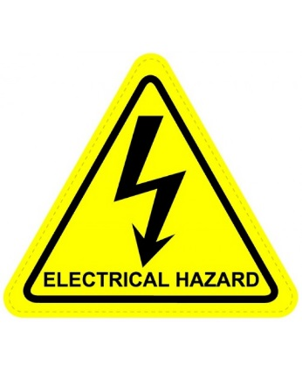
Electrical Safety Focused Close Call reporting
In recent months there has been a number of incidents where injury has occurred or the potential of serious injury from unexpected sources of electricity has been found, for example:
S & T staff working in Loc case (P3)
Scrap rail found live at 750v dc (P4)
D&P staff with TCR (P5)
I want everyone to report in the Close Call system any situations where they think there may be uncontrolled exposure to electrical risk using the words ELECTRICAL HAZARD to the responsible manager Route WHSEA so I can evaluate any so far unforeseen risks.
Thank you….T.M. Capstick. RWHSEA.

Slide 11
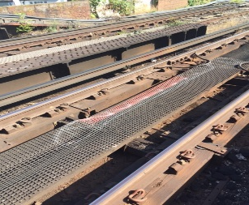
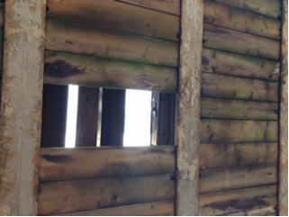
Workforce Safety These incidents were reported as accidents but are also good Close Call Reports
Consider what a good Close Call really is - there is no safety benefit in reporting nonsense, but there are opportunities to be identified and reported every day, it is just realising it. Consider the following examples…
Dept | Date/location | Description | Solution
D&P Inner | 07/08/2018 Epsom | Whilst walking over a wheel timber bridge (West Street bridge), a contractors foot went partially through rotten decking, he tripped landing on his leg and arm, no injury was sustained. | The rotten decking has been removed and replaced.
Wimbledon P-Way | 12/08/2018 Raynes Park | Whilst carrying out preparation works for wheel timber renewals at Raynes Park (Bridge 13/A, 8m51, Up RPE), a member of contract staff, working on NR's behalf fell through the 'Crash decking' as they were stripping out a wheel timber, no injury was sustained. There was a potential to fall approximately 15ft. | Consider how to manage the risk of a fall from height when scoping work. Are parapets or crash decking associated with bridges designed to prevention of falls from height? Check with the Buildings and Civils RAM when planning.

Slide 12

Health and Wellbeing Sleep debt… who knew?
Join the Yammer group ‘Fatigue Improvement Programme’ for daily fatigue related facts..

Slide 13
Safety Bulletin Unauthorised staff giving advice to level crossing users .

Slide 14
Safety Bulletin Engineering moves and level crossings

Slide 15
Front Line Safety Challenge 2018 Slip, trip and falls

Slide 16
Appreciation to……
To Nick Carter TSM Eastleigh for supporting those affected by the recent sad and unexpected loss of a member of staff.
All those ‘stars’ involved in the recent BBC and ITV Media series

