Slide 1
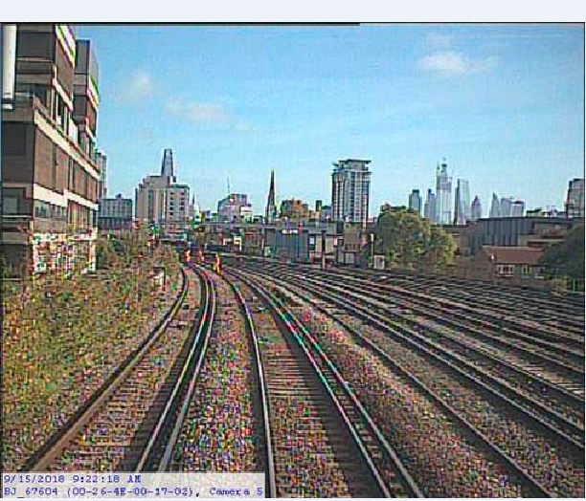
Wessex
Route
Network Rail
Health, Safety and Environment Period Cascade for P6. 2018/19

Slide 2
Welcome
Welcome to your Health, Safety and Environment Cascade for Period 6 2018/19.
In this cascade;
Workforce Accidents
Slip trip and fall Hazards
Operational incidents
Winter preparedness
Authority Number for SWPs
Site Wardens – what is the purpose?
Electrical Risk; Close Calls please
Health and Wellbeing
Mental First Aid Awareness courses.
Respiratory Awareness & Face Fit Briefings
Health & Safety Workshop reminder
Safety Bulletins
Appreciation

Slide 3

Workforce Safety Significant injuries
Inner DU NLT | 23/08/18 | Datchet: An Operative was walking along the track working as a lookout. The ballast shifted beneath him and he fell over sustaining a grazed right arm. Discussion point: STF… Ballast.
Inner DU NLT | 25/08/18 | An S&T Team Leader, was attending a TPWS failure at Kingston, whilst crossing over two running lines to the cess, crossed over one running rail and as he placed his foot on the ballast, the ballast moved and caused him to twist his ankle. He sustained pain and swelling in the ankle exacerbated by all of his weight being centred on the front foot. Discussion point: STF.. Ballast.
Inner DU LT | 28/08/18 | Guildford Depot: A Nash Contractor working for the Inner Off Track section, was exiting a vehicle on arrival at Guildford Off Track depot to report for work, he was wearing 'training shoes'. While getting out of the van, he put his left foot onto an uneven surface and twisted his ankle, suffering a torn a ligament. Discussion point: STF …Uneven surface
Works Delivery LT | 12/09/18 | Windsor Station: While testing track circuits as part of wire degradation tests on a LOC, the IP a Works Delivery Signals Operative, stepped over the running rail & conductor rail in one movement, believing this to be from ballast to ballast. He inadvertently stepped on to a timber sleeper, which resulted in him slipping and falling on to his side. Sustaining pain in his arm, shoulder and neck as well as limited movement on his left side. Discussion point: STF … Uneven surface.

Slide 4
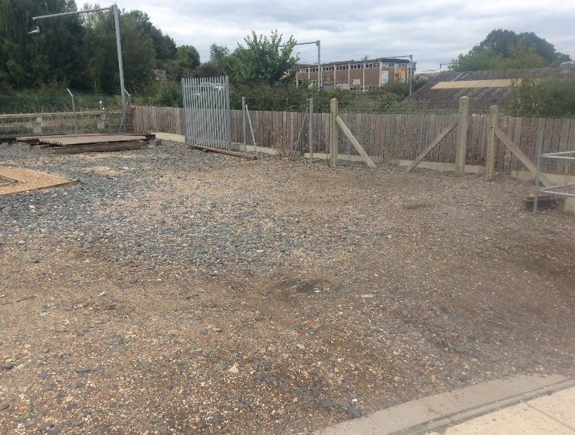
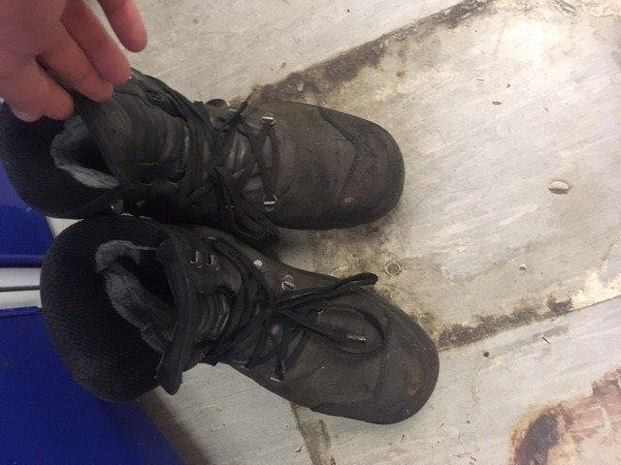
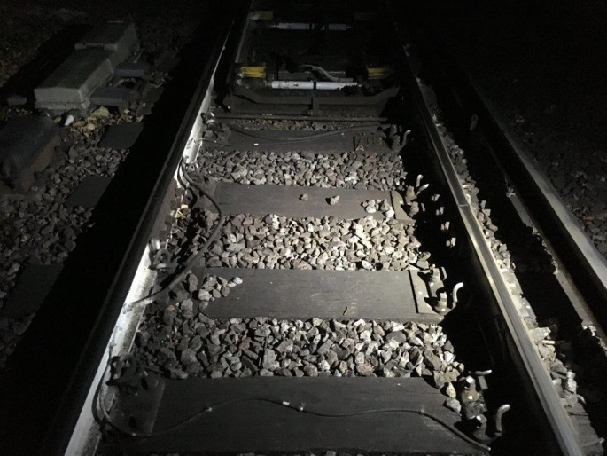
Workforce Safety Hazards that can cause accidents - something to think about.
Off the track uneven surface can catch you out too.
Is there sufficient lighting on your
worksite to see where you are walking?
Are your boots in good condition
and have you done them up properly?
Discuss these?

Slide 5
Workforce Safety Three operational risk incidents still under investigation.
Until these events are fully investigated and a formal Safety Alert can be issued please adhere to the below instructions;
27th August at 1102 hrs an S&T COSS contacted the Signaller at Dorchester Box to take a Line Blockage on the Down Line clear of 558pt to DR193 near Upwey. Immediately after the Line Blockage was granted, a train approached the S&T team:1W57 was already within the Line Blockage before it was given. See Operational Notice later.
Safety Critical Communication between the COSS and Signaller must be formal, clear and precise.
28th August at 1157 hrs, a P-way COSS attempted to take a planned Line Blockage on the Up Fast between E87 and E91. During the conversation it became apparent the COSS was at Southampton Airport but the Line Blockage was for a section of track at Eastleigh.
COSS’s to check they are in the right location for the Line Blockage they are taking.
On 15th September at 0930 hrs a Near Miss occurred on the Up Windsor line at 0m 56 ch. The P-way staff were working using the unassisted Lookout warning system.
COSS’s must check the Lookout arrangements are formalised, sufficient sighting distance can be achieved and test the system before putting the staff to work..

Slide 6

Workforce Safety Staff Winter Preparedness
Are you prepared – personal kit check.
Sufficient good condition PPE -Enough layers? Thermal underlayers, Waterproof/Clean Hi-Viz external layer
Safety Boots – Correct for activity? **Good condition/no leaks/plenty of grip/ good laces.
Personal Headlamp and Site Lighting – new bulbs & batteries
Gloves – warm & waterproof, fit for purpose.
Task Related PPE – do you know what it is? see the TRCS and order to replace worn equipment.
The PPE catalogue is ‘on line’ and should be available in the depot.

Slide 7
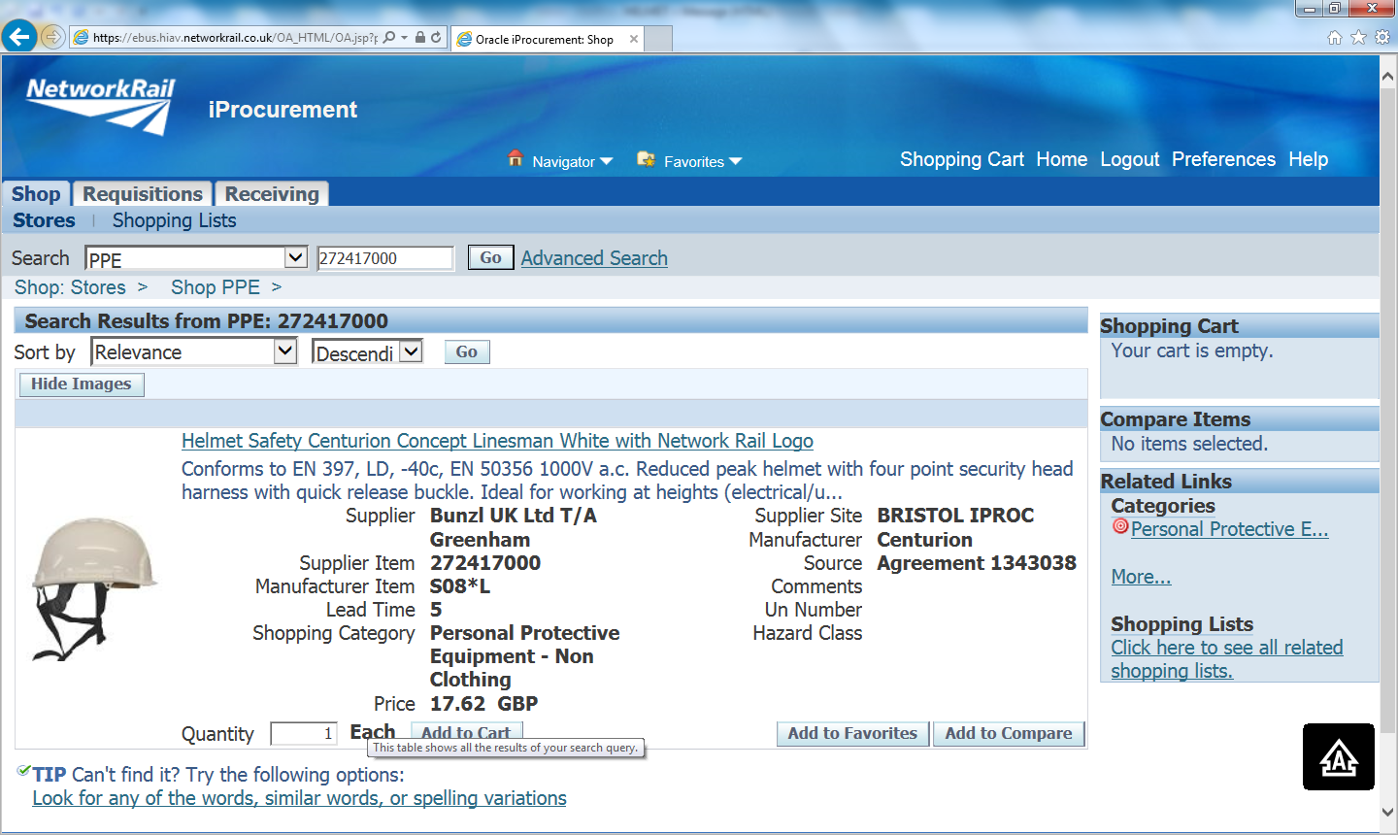
Safety Helmet Comfortable with a better chin strap
New hard hat available on the system, designed for staff working at height or activities where the standard chin strap isn’t suitable, helmet also fits with the Winter head cover.

Slide 8
Safe Work Packs Authority numbers for SWPs
What is the purpose of an Authority Number?
To confirm a Responsible Manager understands and agrees change to the SWP,
A conversation between PIC and RM is necessary before an Authority Number can be given.
These are the only circumstances when a Responsible Manager can issue an Authority Number for a SWP, this is only after it has been verified by the PIC and authorised by an RM ;
There is requirement to move down the Hierarchy of Operational Control,
A significant change to work content and/or risk controls is required,
Changes to planned details are not supported by information in the SWP,
Site of work limits need extending to cover additional work,
Unforeseen absence of the named PIC has meant that another PIC has to be nominated for the work by the RM in the previous 24 hrs.
There is an Authority Number Record form to generate and record Authority Numbers on ‘Wessex App Forms’.
Use of this is mandated from 1st November 2018 for ALL Authority Numbers.

Slide 9
Operational Protection Systems Use of site wardens: separated system.
Safe System of Work using Site Warden Warning
When using a Site Warden Warning there must be at least 2 metres (6ft 6 inches) between the site and the nearest open line, a site warden is appointed if there are more than two people in the group.
Safe System of Work
COSS
Site Warden
Two Metres

Slide 10
Operational Protection Systems Site Wardens: What is the purpose?
Where there is a distance of at least 2 metres (6 feet 6 inches) between the nearest running rail of an open line and the site of work, a site warden will be appointed.
The Site Warden must watch the group and make sure that no one moves beyond the safe limits laid down by the COSS.
The Site Warden must warn anyone who attempts to move beyond the safe limits by shouting ‘GET BACK’. If they do not immediately move back into the safe area, the Site Warden must give a series of short sharp blasts on the whistle or horn until they do move back into the safe area.
There must be an identifiable limit to the site of work.
If it is only you and one other person in the group, you do not need to appoint a site warden. However, you must make sure neither of you go any closer than 2 metres (6 feet 6 inches) to the nearest running rail of the open line.

Slide 11

Electrical Safety Focused Close Call reporting
REPEATED SLIDE
In recent months there has been a number of incidents where injury has occurred or the potential of serious injury from unexpected sources of electricity has been found, for example:
S & T staff working in Loc case (P3)
Scrap rail found live at 750v dc (P4)
D&P staff with Traction Current Relay (P5)**
I want everyone to report in the Close Call system any situations where they think there may be uncontrolled exposure to electrical risk using the words ELECTRICAL HAZARD to the responsible manager Route WHSEA so I can evaluate any so far unforeseen risks.
Thank you….T.M. Capstick. RWHSEA.

Slide 12


Health and Wellbeing
Mental Health First Aid Awareness Half day Training
What is it?
Half day course to enlighten you on;
What ‘mental health’ is and how to challenge the social stigma associated with it.
Some basic knowledge of some common mental health issues.
A bit about looking after your own mental health
Having some confidence to support someone in distress or who may be experiencing a mental health issue
Who can enrol?
ALL Wessex employees irrespective of job role.
How can I book on?
See links below
PLEASE NOTE.
On completion;
You will not be a Mental Health First Aider. This course is for general awareness only.
You will receive a certificate of attendance to say you are ‘Mental Health First Aid Aware’
Course: | Date: | Time: | Room: | Location: | Booking Link:
Mental Health First Aid (Half Day Awareness) | 07/11/2018 | 09:00 – 13:00 | Training Room 4 & 5 | Basingstoke ROC | https://www.eventbrite.co.uk/e/mental-health-first-aid-awareness-tickets-49854023727
Mental Health First Aid (Half Day Awareness) | 05/12/2018 | 09:30 – 13:30 | Eastleigh AMM 1 | Eastleigh Depot | https://www.eventbrite.co.uk/e/mental-health-first-aid-awareness-tickets-49855820100
Mental Health First Aid (Half Day Awareness) | 24/01/2019 | 22:00 – 02:00 | Room 1A | Clapham Depot | https://www.eventbrite.co.uk/e/mental-health-first-aid-awareness-tickets-49852000676

Slide 13
Health and Wellbeing
Respiratory Awareness Brief
GET THE BRIEFING….
Face Fit Downloadable briefing: Module 1 – Awareness of Respiratory Hazards
WHO?.....This briefing is for ALL Wessex PTS holders
Face Fit Downloadable briefing: Module 2 – Face Fit Requirements and Fit Check
WHO? This briefing is for ALL Wessex staff issued with ‘tight fitting RPE’.
Face Fit Downloadable briefing: Module 3 – Face Fit Testing
WHO? This briefing is for ALL Wessex employees training to be face-fit-tester
Please note:
In Oracle use the term “Face Fit” in the search bar to find the Briefings
Responsible Managers then need to download the briefs to cascade out to their respective employees and keep records of those briefed.

Slide 14
Our Safety Workshop reminder Have you booked on?
Woking 18th October
Southampton 31st October
Woking 6th November
Southampton 29th November

Slide 15
Safety Bulletin Securing materials for the passage of trains .

Slide 16
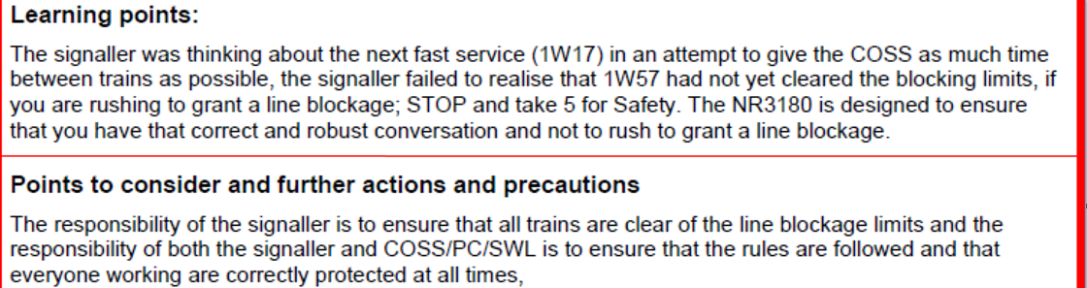
Safety Bulletin Line Blockage Irregularity at Dorchester .

Slide 17
Appreciation from Charlie Usher – Head of Maintenance
Thank you to all those involved in the recent good progress on our track speed recovery plan.
8 speeds have been removed
2 x 20MPH speeds raised (one to 40 MPH and one to 50MPH).
We achieved a net improvement of 3, and this included the early removal of our longest and most performance impacting speed at Wanborough (stone blowing work held up better than anticipated).
Another speed removed was on the Up at Reading Spur Junction, which will improve right time arrivals at Reading.
The Maintenance Team continues to focus on recovering our position, and I’m proud of the determination that continues to be shown by our people at all levels within the organisation

