Slide 1
Safety Critical Communications
MODULE: PROTOCOLS

Slide 2
Briefer’s Introduction:
Welcome to the Protocols module for rail industry communications.
This module looks at the following:
Intro – a reminder of what SCC is and why it is important
How communication occurs and why we need protocols
The ABC-P concept
The Phonetic Alphabet
Numbers

Slide 3
How the Course Works:
The programme consists of six modules. We recommend that they are delivered in order, but you may select a particular module if required:
Foundation
Protocols 1
Structure and Lead Responsibility
Protocols 2
Confirming Understanding
Communication Skills
*Please read the Briefing Notes prior to delivering a module. They provide background information to enable you to manage the exercises and discussions.
*You will also be required to perform a short assessment at the end of the course to make sure attendees understand the content. See the Briefing Notes.

Slide 4


Welcome

Slide 5

Safety Critical Communications
VO

Slide 6


All operational communication by front-line staff is safety critical.
VO

Slide 7

By ‘operational’ &‘front line’ we mean:
Maintenance
TOC & Network Rail Control
Signalling
Station Operations
Driving
Shunting
…VO

Slide 8

VO

Slide 9

National
MINIMUM
Standard
VO

Slide 10


Let’s start by reminding ourselves why safety critical communications are important. The following led to a near-miss incident.
Blockade
There are three telephone conversations between a driver and a signaller. The driver’s train has a technical fault and he wishes to leave his cab to conduct a test (“do a rotational”). He therefore requires that the line be blocked (“a blockade”) to prevent trains from hurtling past while he is outside. The fourth call is from a different driver, reporting the near-miss incident.

Slide 11

The Nature of Communications

Slide 12
Video
Photographs
Words
Speech Schematics
Emoticons
Sounds
Colours
Painting
Graphics
Hieroglyphics
Printed-word
Animation
Sounds
diagrams
VO

Slide 13

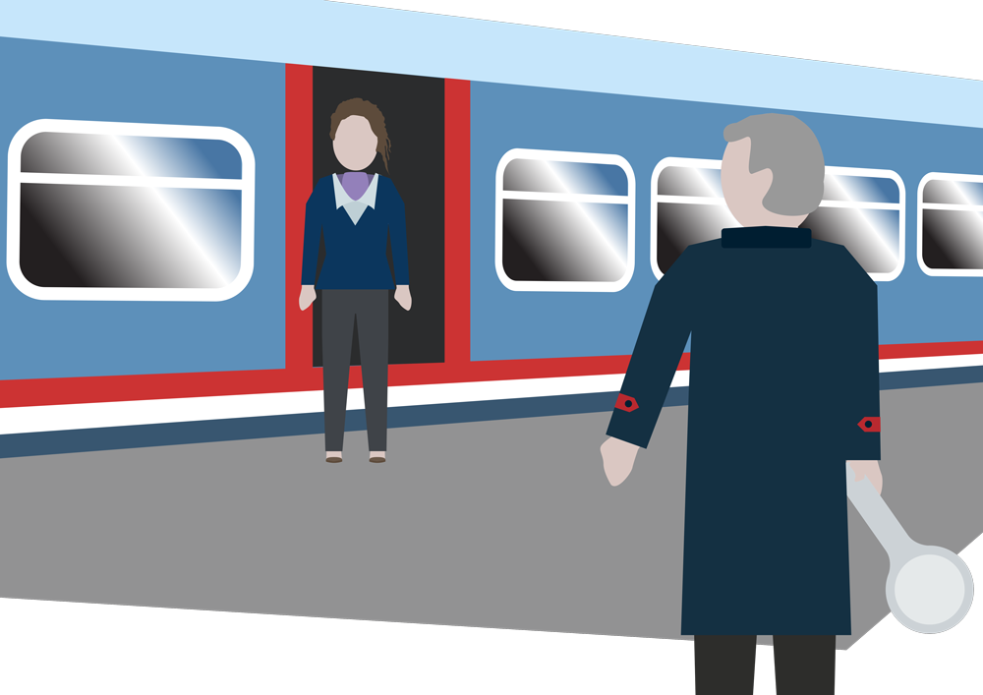
See who we’re talking to;
Gestures, Facial expression
VO

Slide 14
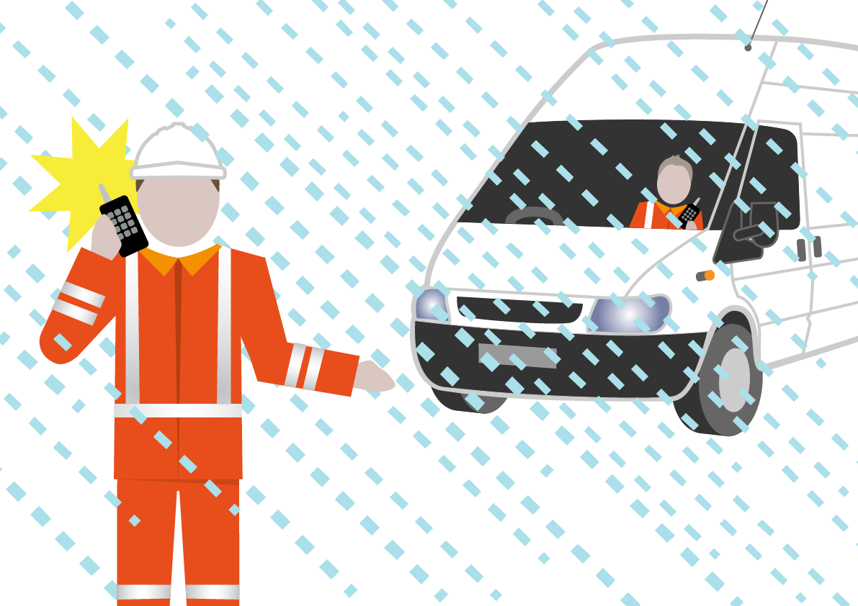
VO

Slide 15
Communication Protocols:
Aid understanding
Help avoid errors
VO

Slide 16

Thinking about UK society:
What do you do when you meet someone?
How and when does this change? eg. job interview vs. mate down the pub vs. family member.
Why do we need this ‘greeting’ protocol?

Slide 17

Protocols

Slide 18
Protocol: an agreed way of doing something
VO

Slide 19

VO

Slide 20



Rail Communication Protocols:
ABC-P
The Phonetic Alphabet
Railway Numbers
VO

Slide 21
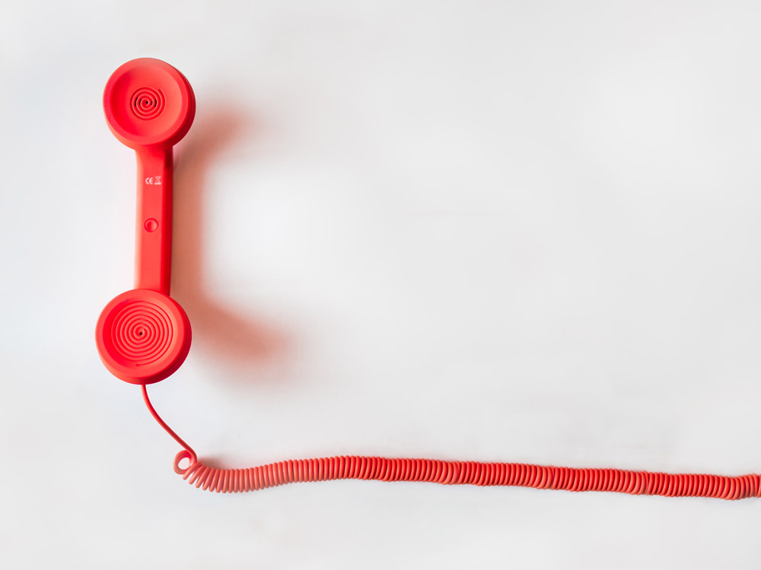
ABC- P

Slide 22
A
ccurate
B
rief
C
lear
P
ABC- P
rofessional
VO

Slide 23
Play the recording and answer the questions (on next page).
The Coasting Train

Slide 24

Q. Take each of the THREE elements:
Accurate
Brief
Clear
Rate the conversation against each of them on a scale of 1 to 5, where 1 is excellent.
You can replay the clip:

Slide 25
Q. Overall, how ‘tight’ was the verbal contract agreed between the signaller and driver?

Slide 26

Q. What could they have done?
Click to Reveal Answers
VO

Slide 27
The Signaller must slow down his speech.
The Signaller must stop over-talking the driver and allow him to finish his sentences.
The Signaller must use more precise descriptions of locations, so “clear of the crossing at Chettisham” not ‘clear of Chettisham’
The Signaller must avoid slang “You’ve struck in”.
The Driver and Signaller must stop talking and thinking at the same time. They could say “Let me think” and then speak.
There must be a ‘repeat back’ of the instructions

Slide 28
Model Answer
The Coasting Train
Model Answer

Slide 29

rofessional
ABC- P
VO

Slide 30
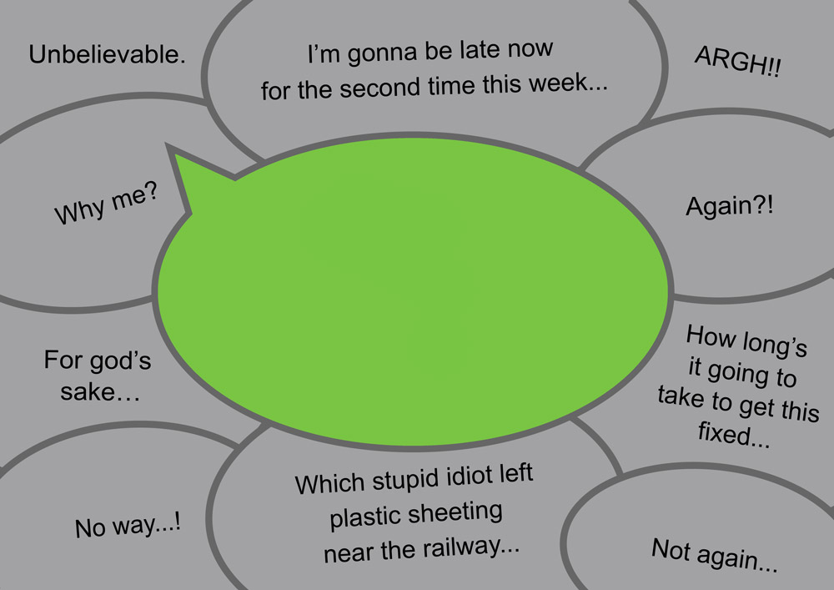
‘Hello, Tyneside, this is driver of Bravo one one three standing at platform Metro University. I've got some plastic sheeting wrapped around the pantograph…’
…VO

Slide 31
A
ccurate
B
rief
C
lear
and Professional
VO

Slide 32

The Phonetic Alphabet

Slide 33
WHY USE
The Phonetic Alphabet?
VO

Slide 34
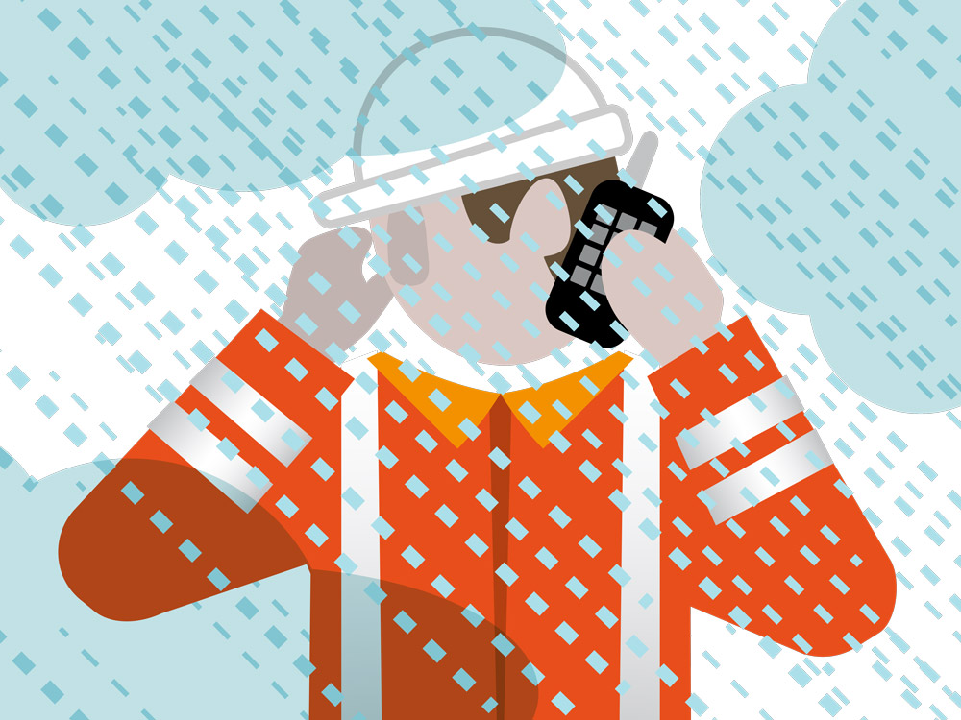
VO

Slide 35
The Phonetic Alphabet:
A
B
C
Alpha
Bravo
Charlie
D
E
F
G
H
Delta
Echo
Foxtrot
Golf
Hotel
I
J
K
L
M
India
Juliett
Kilo
Lima
Mike
N
O
P
Q
R
November
Oscar
Papa
Quebec
Romeo
S
T
U
V
W
Sierra
Tango
Uniform
Victor
Whiskey
X
Y
Z
Class practice: using phonetics, spell:
your surname; your company; the day
Xray
Yankee
Zulu
VO…

Slide 36
Use the Phonetic Alphabet for all key information.
VO

Slide 37
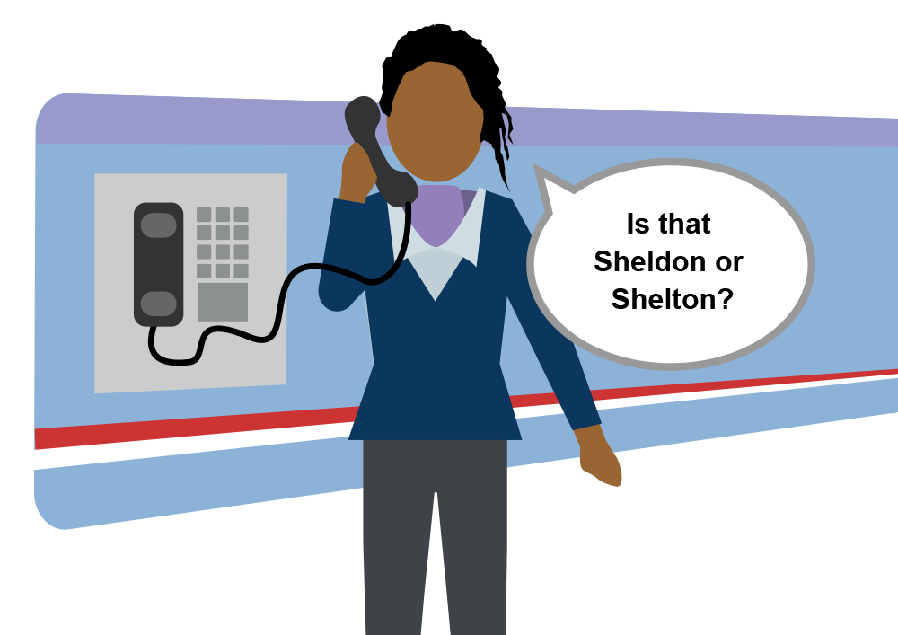
VO

Slide 38
The Phonetic Alphabet – Example
Play the recording and answer the questions (next page).

Slide 39
Was the conversation:
Accurate?
Brief?
Clear?
Was the conversation professional? If not, why not?
Was the phonetic alphabet used correctly?

Slide 40

Saying Numbers
VO

Slide 41
W23:
Signal
whisky two three signal
1B98
Train Code:
one bravo nine eight
Line Blockage:
three six five three eight nine two
3656892
…VO…VO

Slide 42
Saying Numbers Clearly

Slide 43
Line Blockage:
3656892
three six five…six eight …nine two
National Rail
Enquiries:
0345 748 4950
zero three four five…seven four eight… four nine five zero
The batch size for numbers is not important though 5 should be the maximum.
VO

Slide 44
We must use single numbers, zero, one, two etc., for all key information
VO

Slide 45

Weights & Measures

Slide 46
Weights & Measures:
25kg is “twenty-five kilograms”
200L is “two-hundred litres”
VO…

Slide 47

Time
VO

Slide 48
We must use the twenty-four-hour clock.
VO

Slide 49

24-hour clock:
1005 or 10:05
“ten zero five hours”
1720 or 17:20
“seventeen twenty hours”
2230 or 22:30
“twenty-two thirty hours”
VO…VO

Slide 50
0900
“zero nine hundred hours”
10:00
“ten hundred hours”
1100
“eleven hundred hours”
23:00
“twenty three hundred hours”
VO

Slide 51
Time – 24:00/00:00
VO

Slide 52
2400 or 24:00 or 0000 or 00:00
VO

Slide 53
2400 on Monday
0000 on Tuesday
MON
TUES
VO

Slide 54
2355
0005
2400
“twenty-four hundred hours”
VO

Slide 55
Let’s take a look at some more examples:
VO

Slide 56

250 tonnes
“two-hundred and fifty tonnes”
W39 signal
“whisky three nine signal”
Train code 1K26
“train code one kilo two six”
HM95 signal
“hotel mike nine five signal”
Spell ‘Arbroath’ phonetically
“alpha romeo bravo romeo oscar alpha tango hotel”
Time: 1000
“ten hundred hours”
Time: 19:30
“nineteen thirty hours”

Slide 57

Module Two Review

Slide 58
1
Operational communications must be ABC-P: Accurate, Brief, Clear, and Professional
2
Use the Phonetic Alphabet for all key information.
3
Use single numbers, zero, one, two etc., for all key information
use natural speech for weights and measures
always state the units: metres, miles, kilometres
4
Use the 24-hour clock to say time,
state “hours” to emphasise that you are giving a time
use “hundred hours” to state ‘on the hour’ times such as 1100
use “twenty-four hundred hours” in preference to “zero hundred” hours
VO

Slide 59

Module Conclusion
VO

Slide 60
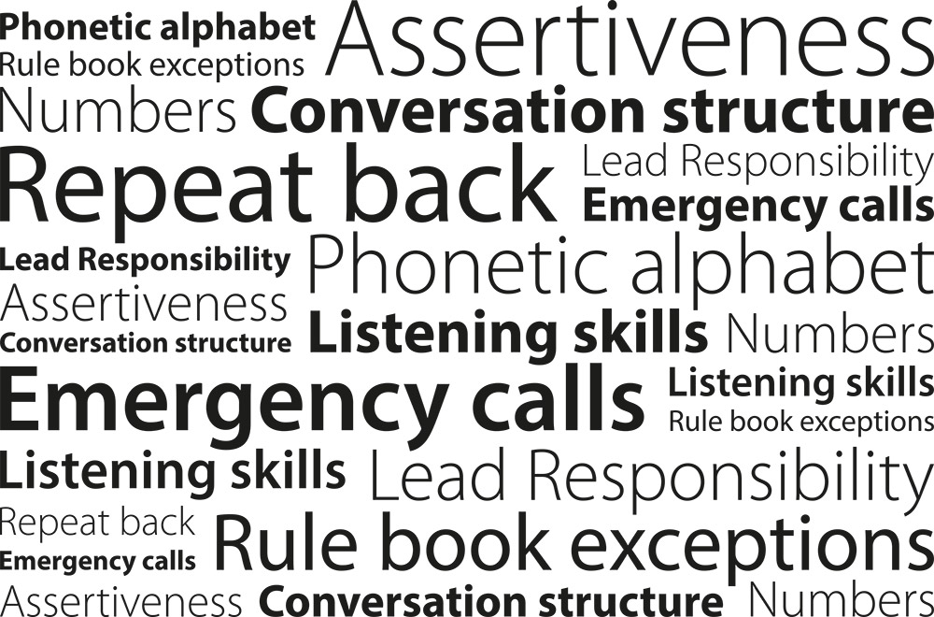
VO

Slide 61

Every time we hold an operational conversation, we are agreeing a contract
- keep the contract tight
Your briefer will now conduct a short test to confirm understanding.
VO

