Slide 1
Wessex
Route
Network Rail
These RISK posters are attached to this presentation…please print and add to safety notice boards.
Health, Safety and Environment Period Cascade for P7. 2018/19

Slide 2
Welcome
Welcome to the Health, Safety and Environment Cascade for Period 7 2018/19.
In this cascade;
Workforce Accidents
Line Blockage Irregularity
Near Miss at Waterloo - update
Think RISK 2 – two new videos
Driver Handbook
Reverse Parking Policy
Drivers Code
Winter Safety .. Look out for each other.
Rule Book Change
Safety Critical Communications: Module 2. ABC-P
Health and Wellbeing
The Menopause.
The Flu Vaccine
Environmental Close Calls
Electrical Risk; Close Calls please
Safety Bulletins
Appreciation

Slide 3

Workforce Safety Significant injuries
Works Delivery | 18/09/2018 | At Whimple, the IP sustained a twisted ankle when he was carrying out manual handling activities, removing equipment from site at a location where the underfoot conditions were freshly laid, unconsolidated ballast, that caused him to loose secure footing and slip. Classification Slip, Trip, Fall/Manual Handling.
Inner DU | 19/09/2018 | At Point Pleasant, the IP sustained a cut to his elbow and swelling to his ankle when while undertaking wheel timber renewals, the individual temporarily forgot about a gap between the timbers, resulting in him misplacing his foot, slipping and falling over. Classification Slip, Trip, Fall.
Works Delivery | 03/10/2018 | At Ludgershall, the IP sustained bruising to his right hand when, whilst placing base plates between sleepers and rails during sleeper changing he slid the base plate under the rail and trapped his fingers momentarily. Classification: Contact.
Outer DU | 18/09/2018 | At Cosham Junction, the IP was alighting from a NR van on private land at an access gate, the ground was uneven, he twisted his ankle as he stepped into an unnoticed pothole causing soft tissue damage to his ankle. Classification Slip, Trip, Fall.
Outer DU | 02/10/2018 | A30 near Popham, the IP was the driver of a NR Van when it was struck on the drivers side by another vehicle that had failed to stop at a red ATS. She sustained shock and concussion with related stiffness to the body. Classification RTA.
Works Delivery | 07/10/2018 | At Wilton Junction, during the installation of new timbers at a site where they had previously been removed, the IP was instructed to lay out materials ready for the installation, as he was walking ballast to ballast holding two bags of AS (Railway Chair) Screws, weighing approximately 15kg holding each by either side of his body, he stepped into a track bed without ballast and fell sustaining a dislocated thumb as he landed. Classification Slip, Trip, Fall./Manual handling.

Slide 4
Workforce Safety Line Blockage Irregularity .
On Tuesday 02/10/2018 at 0847 on the PAA1 at Aldershot tunnel. A Patrolling Team of three were involved in a near miss with an MPV inside a Line Blockage whilst taking the protection to patrol through the tunnel. Points to note:
The SCC was formal between the COSS and Signaller, including the location of the team, the limits of the LB and all details were repeated back.
During the call it was stated that once a train had passed through the line blockage would be granted.
The call was terminated due a train going passed the Patrol Team and agreement was reached for COSS to contact Signaller once train had passed.
During this second call the line block was given, the authorising number was provided by signaller, whilst a second train within the protection limits.
The Signaller gave LB with MPV in section.
Whilst this incident is under investigation, COSS’s to take the following actions;
Always confirm with the Signaller there is no train within the limits of a Line Blockage prior to accepting the Authority Number.
This is of paramount importance if there is anything in the conversation with the Signaller that suggests this might be the case. This is to make sure you are clear about which train the signaller is referring to.
Always stay in a place of safety and immediately report to the signaller any unexpected movement of trains in a Line Blockage

Slide 5
Operational Incident Near Miss at London Waterloo
Discussion point:
Is your Safe Work Pack suitable for the task and location you are working in?
If you are going down the hierarchy of operational control or significantly change the task activity do you always seek authority with a number from a Responsible Manager?
Do your teams understand the term ‘separated protection’ and use site wardens correctly
When using Lookout warning, is the sighting distance required available?
Do you always test the safe system of work before you use it

Slide 6
Everyone Safety Think RISK campaign… new videos.
Two great videos should be available on these links;
New materials for onward briefing are attached to this cascade.
Full Think RISK ppt
Facilitators Guidance Notes
Two videos starring real railway folk.
Worthy of everyone's time
https://safety.networkrail.co.uk/wp-content/uploads/2018/09/Think_RISK_Process_Glasgow_Subtitled.wmv
https://safety.networkrail.co.uk/wp-content/uploads/2018/09/Think_RISK_Process_Glasgow_Subtitled.mp4
https://safety.networkrail.co.uk/wp-content/uploads/2018/10/Think_RISK_People_Brighton_Subtitled.wmv

Slide 7
Drivers Beware Drivers Handbook: Drivers Code of Conduct.
All authorised drivers must familiarise themselves with the contents of the Drivers Handbook.
Check out
Drivers Code of Conduct on Page 3.
See Page 38……
Parking Vehicles
Drivers should adhere to the company policy of reverse parking at all NR locations unless exemption has been given for the location.
Are there any exempt locations on Wessex?
Have all parking locations displaying ‘Reverse Parking’ signs?
A copy of the Drivers Handbook is attached to this Safety Cascade;

Slide 8

Full winter brief attached here safety cascade…Winter-Safety-Brief.pdf

Slide 9
Rule Book Change From 1st December
This is the change in wording in Handbook 8 of the Rule Book.
The term ‘Authorised’ should be taken to mean ‘Authorised by the Responsible Manager in the SWP as under 019’.
The term ‘always be used when it is possible to do so’ is the same as before.
Note: SSOWPS 2.5 should be upgraded to provide the NR3180 by the end of December.

Slide 10
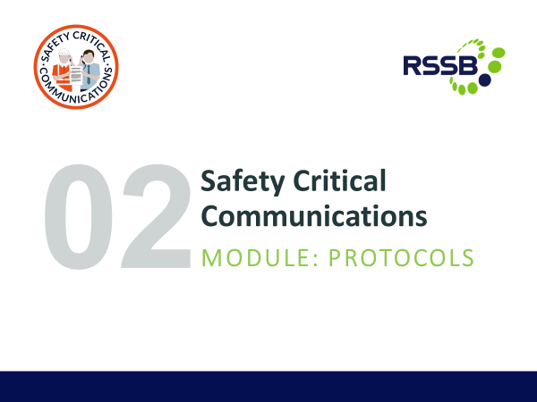

Safety Critical Communications Module 2 PROTOCOLS
The compliance date of the new Monitoring of SCC standard has been pushed back, that is a temporary delay.
Those with COSS/PC/ES/IWA/PICOP competencies need to meet the minimum SCC standard.
Are your SCC ABC-P?
Accurate
Brief
Clear &
Professional
Follow this line to the second training session on SCC
RSSB-SCC-Module-2-Protocols-1.pptx

Slide 11

Health and Wellbeing
THE MENOPAUSE
Menopause… Health and wellbeing.
See attached ppt for more information.
Menopause-Slide-Deck-October-2018.pdf

Slide 12
Health and Wellbeing
THE FLU JAB

Slide 13
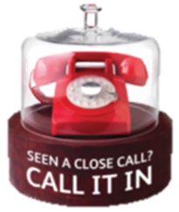
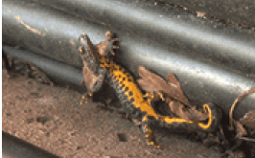
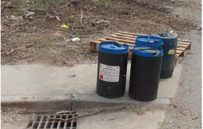
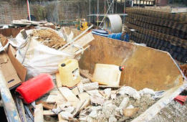

Environmental Close Calls
The Close Call system allows for the reporting of anything that has the potential to cause harm or damage, which includes impacts to the environment or protected species.
An environmental Close call is a situation that could cause environmental damage, impact or nuisance
An environmental incident is an event that has caused environmental damage, impact or nuisance
Close Call Examples
Confirmed identification of protected species or invasive plants without causing disturbance
Spills contained in a bund or lack of bund or drip tray
Poor waste storage and
segregation
To report a close call use the App or call 01908 723 500

Slide 14

Electrical Safety Focused Close Call reporting
REPEATED SLIDE
In recent months there has been a number of incidents where injury has occurred or the potential of serious injury from unexpected sources of electricity has been found, for example:
S & T staff working in Loc case (P3)
Scrap rail found live at 750v dc (P4)
D&P staff with Traction Current Relay (P5)**
I want everyone to report in the Close Call system any situations where they think there may be uncontrolled exposure to electrical risk using the words ELECTRICAL HAZARD to the responsible manager Route WHSEA so I can evaluate any so far unforeseen risks.
Thank you….T.M. Capstick. RWHSEA.

Slide 15
Safety Bulletin Overturned Excavator .
Not on the Railway but lessons would apply..
On 26th September at a construction site in Feltham an excavator partially overturned during a lifting (slewing) operation because it had exceeded its safe working load.
Initial investigations have found the lifting operation was undertaken as an additional unplanned action and was not subjected to the normal safety controls and planning that must be undertaken.

Slide 16
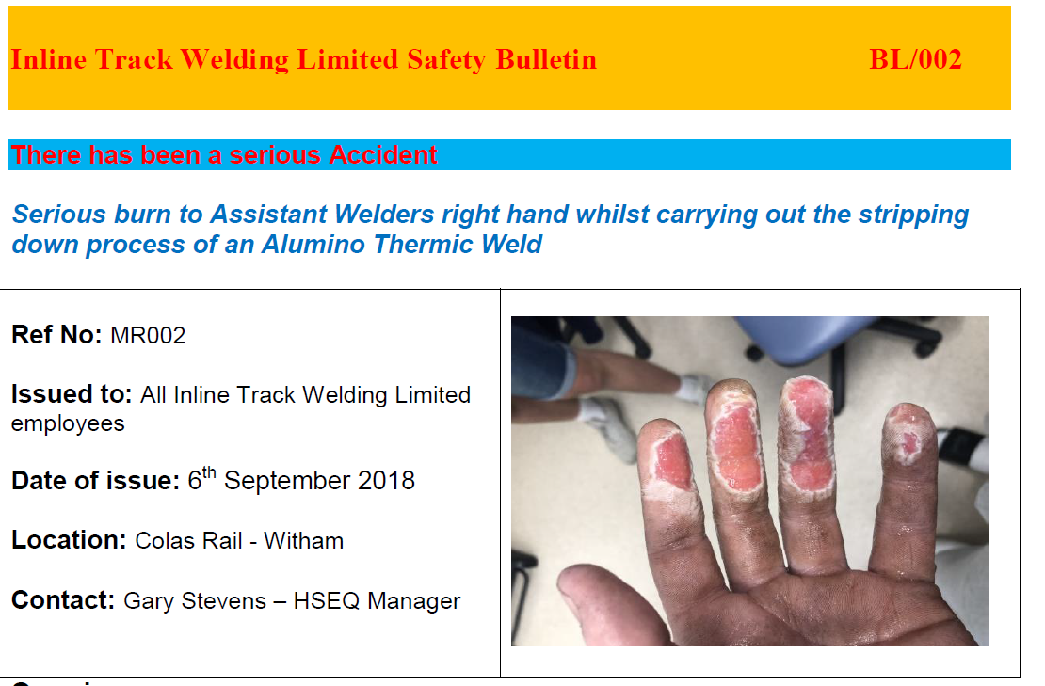
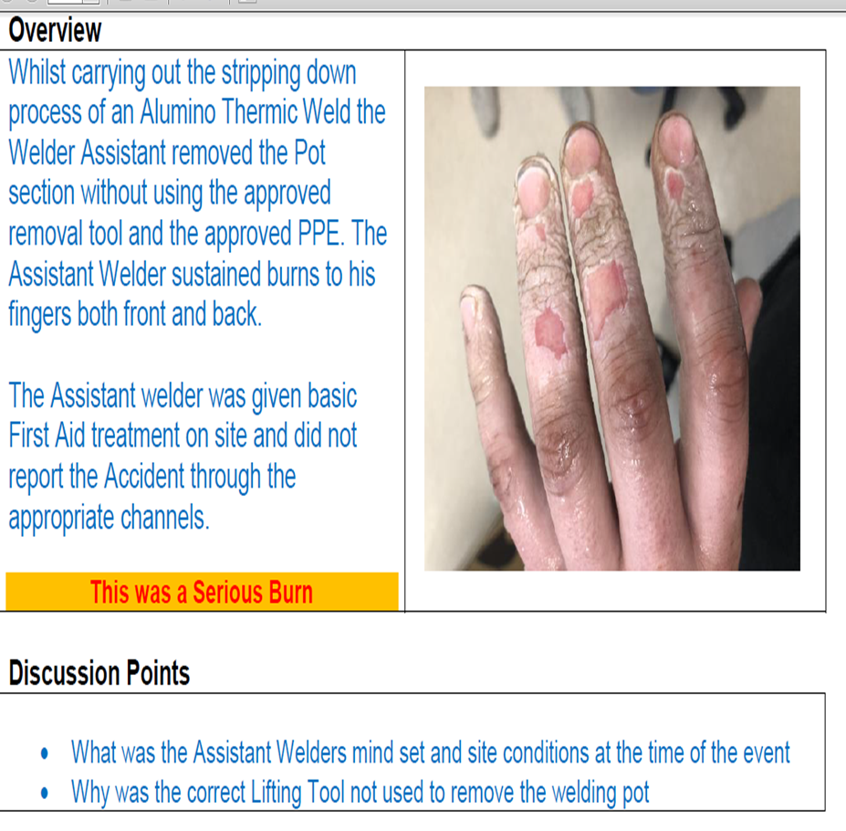
Safety Bulletin Burns injury to Assistant welder
Reminder to our Welders to :
Use the right tool for the job
Wear correct PPE
If we have new or inexperienced assistant welders they will need additional supervision and/or reminding.

Slide 17
Appreciation
Add some pertinent to your teams…

