Slide 1

Network Rail
Wessex
Route
Health, Safety and Environment Period Cascade for P9. 2018/19

Slide 2
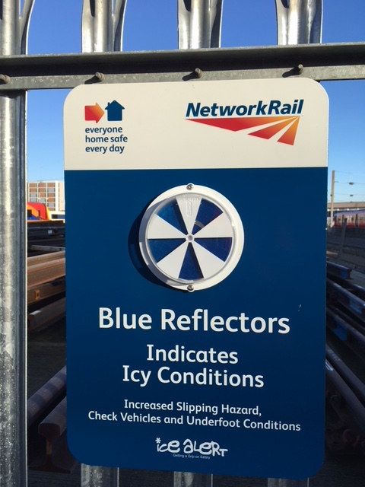
Welcome
Welcome to the Health, Safety and Environment Cascade for Period 9 2018/19.
In this cascade;
Workforce Accidents
NLT Accidents
Scrap causes live running rail and injury
Lymington Viaduct (STF)
Manual Handling injury
Trolley incident: Handbook 10
Operation Risk: best practise
Cold weather preparedness
NR3180 Briefing
TRCS- reminders
Health and Wellbeing
Random acts of kindness are good for you
Safety Bulletins
11kv depot cable strike
RRV over level crossing
Make the right call
Meet the new WHSEA
Worksafe procedure
Wessex App forms reminders.

Slide 3

Workforce Safety Notable NLT injuries
Inner DU | 14/11/18 | At Leatherhead a CRE Team were threatened by a member of the public following a complaint about noise. The Team Leader contacted the WICC and after a conversation between ICC and the complainant, he walked away. Discussion: Always report threats or assaults to ICC for action, escalate to the BTP if necessary..
Inner DU | 19/11/18 | The IP based at Wimbledon P-Way depot, lifted a wheelie bin lid in order to place the rubbish in it, as he was placing the rubbish into the bin, there was a large gust of wind that caught the lid pushing it onto his head: he sustained minor bruising. Discussion: Hazards are not just confined to the track.
Outer DU | 22/11/18 | S&T at Millbrook were conducting routine points maintenance. The IP slipped and fell, knocking a bucket of degreaser over causing a small amount to splash on to his face. Believing his eye to be contaminated he immediately washed it with eyewash and had a colleague check for any detritus. Upon returning to the depot later he rinsed his eye with eyewash again. The IP was wearing Stealth 9000 safety glasses at the time of the incident. Discussion: This is a reminder to check the eye wash is in the First Aid kit and is in date.
Inner DU | Various | On 3 separate occasions uneven underfoot conditions of the ballast on the infrastructure caused IPs to slips trips and fall causing injuries to both knees and ankles. Discussion: Additional concentration is needed during wet and icy conditions because of the increase in the likelihood of these types of accidents. Make sure you have sufficient lighting, and good condition footwear particularly the depth of tread and length and strength of laces, NOTE: Immediate first aid to minimise damage…REST – ICE – COMPRESS - ELEVATE
Inner DU | 02/12/18 | A contract welder suffered minor muscle pain in his back whilst manually unloading a trolley from the back of his van at the beginning of his shift at Woking Junction Access point. Discussion point: Warm up and always assess the load, seek assistance with a difficult load.

Slide 4
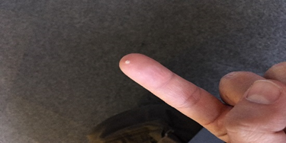
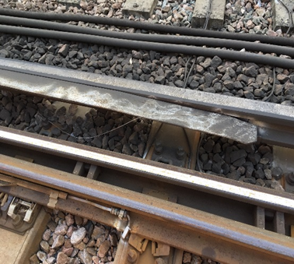
Workforce Safety Electrified running rail causes electric shock/burn injury.
The incident.
19/11/18 on the DMS BML1 at approximately 7m 54ch, an S&T Technician was investigating a 'BC’ track circuit failure connected to 755B points.
He was carrying out tests using a voltage meter reader to establish the voltage going through the track circuit when an electrical arc occurred, he received an electric shock and a 2mm (approximate) burn to the tip of his left index finger.
It was established a piece of scrap wire was in contact with both the live conductor rail and the adjacent S&T running rail. This caused the running rail to become electrified to 750 volts resulting in the incident.
The scrap wire had not been noticed by the team prior to carrying out the tests and there is no way of knowing how it got into this position. When a current reading was taken from within the location case, the fuses of the meter were blown which suggested a very high voltage and current in the track. The IP then applied the meter to test the rails, which is when the arc and injury occurred.
The IP was immediately taken to the local Hospital A&E department for tests as per the route instruction. An ECG (Electrocardiogram) determined his wellbeing and fortunately he was able to return to work.
The offending piece of scrap rail
Lessons learnt.
Beware the unexpected hazard - Take 5.
Use type 00 electrical insulating rubber gauntlets (which are available on I-Proc: PPE), when carrying out any work where ‘there is unexplained circumstances surrounding equipment not operating as expected’ and there is potential to come into contact with live electrical equipment.
Type 00 gauntlets
are guaranteed up to 500V but are tested up to 750V.
provide better dexterity than type 0 gauntlets.
If you are working on the infrastructure, make sure you remove any item of equipment or materials that could cause this situation.

Slide 5
Workforce Safety Second injury on Lymington Viaduct.
Accident.
On Thursday 20th Nov, whilst undertaking a track inspection to see completed work on Lymington Viaduct, a Section Supervisor attended site with a patrolman. Whilst walking across the bridge a walk board gave way unexpectedly under him, this resulted in the IP falling through up to his hip causing bruising and injury to his left knee when it struck a metal cross brace.
History.
The structure had recently been re-opened following remedial work. However, it is clear the wooden walking route is not in a safe condition to be walked upon. This type of damage is not clearly visible
Action.
The inspection regime for this and similar structures are being examined. In the interim, please report similar wooden structures with any suspected damage to ICC immediately and Close Call for the attention of the WHSEA.
This walking route only across
Lymington Viaduct.

Slide 6
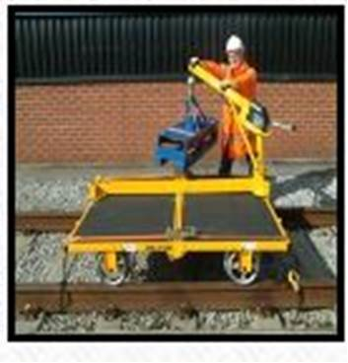
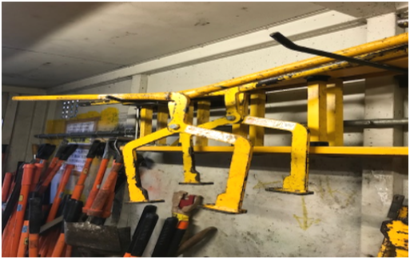
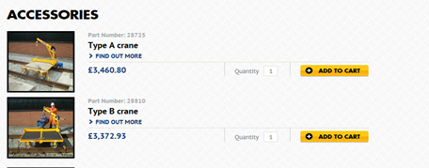
Track Worker Safety Manual Handling Options
Incident.
Works Delivery S&T Outer were renewing Points machines at Pirbright Junction. 2 new point machines were taken to site on the back of a flat bed fitted with a Hiab, they were lifted onto the trolley at the RRV access and pushed out to the point ends for renewal.
Whilst on site all point machines (circa 225kgs) were disconnected or reconnected and moved using scissor tools, carried out with a 4-person lift using 2 scissor lifters.
The IP was one of 4 people lifting a point machine with scissors. When the lift leader called the lift and the team started to lift the unit the IP’s opposite number on the other end of the sissors slipped and stumbled, this meant the load became unbalanced.
The IPs shoulder was injured as a result of the sudden jolt and increase in weight distribution.
For all heavy lifting these permaquip trolleys are available with lifting gear tested for up to 420kgs loads.

Slide 7
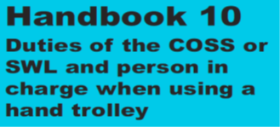
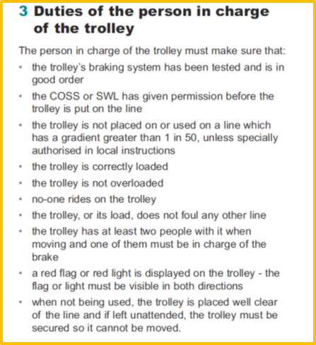
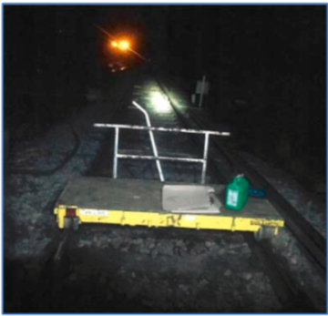
Workforce Safety .
Incident
On 26th November a PICOP attempted to handback Possession WON Item 38 with a track circuit failure. It transpired a hand trolley had been left on site by a Works Delivery team at 11m 11ch on the Up Main Slow, the BML1.
Points to note:
During the ES briefing it was not made clear to the ES a hand trolley was in use.
During handover of the work activity shift to the subsequent PiC/COSS, the presence of the hand trolley was not passed on.
The hand trolley was not displaying a red flag or a red light visible in both directions, consequently it was not visible to any other parties who were in the vicinity and may have noted the existence of the hand trolley before the worksite had been given up.
Action to be taken
Below is a complete reminder of the full ‘duties of the person in charge of the trolley’.
Please discuss and understand that failure to comply with any of these duties would constitute an unsafe act.
Hand trolley without red flag
or light; is not acceptable.
Wessex Route LLC Use of Hand Trolleys Dec 18.pdf

Slide 8
Operational safe system of work Best practise
Incident
Following the report of a near miss involving S&T staff at Clapham that, once investigated was found to be an optical illusion by a train driver, some important lessons learnt associated with the operational safe system of work in use can be highlighted.
The S&T team were responding to a track failure on the points and were working, with a line blockage in place on the DWF (Down Windsor Fast) and under a separated (Site Warden) protection arrangement.
The Person in Charge (PiC) was also acting as the COSS and as the appointed Site Warden for the separated protection limits.
However, the incident has raised the importance of identifying sites where adjacent lines are open and identifying both the limits of the protection and the instructions to Site Wardens.
Lessons Learnt.
KNOW THE LIMITS: Separated protection limits are paramount for team safety, know what those limits are and stay within the limits of the protection at all times.
TAKE THE LINE BLOCKAGES YOU NEED. Where work is taking place within complex S&C, such as the location above, line blockages should be taken on adjacent lines where the work activity may take you.
DELEGATE SOME ROLES. Team Leaders; delegate the duties wherever possible. Do not let one person take responsibility for all the roles and tasks for an activity.
Alleged near miss- lessons learnt final.pdf

Slide 9
Workforce safety Cold weather preparedness
Winter is upon us, and we all have seen the temperatures drop, particularly overnight.
There are some key things you can do to minimise the risk to you and your teams’ health and wellbeing.
Vehicles:
Do you have the right tyres on your vehicle? Do they have adequate tread? Are snow chains at the ready?
Use the FLOWER technique to check the vehicle prior to use. (Fuel, Lights, Oil, Water, Electrics, Rubber) When parking a vehicle; is the area safe and the under foot conditions solid,
Avoid parking on bends where other road users will not see the vehicle.
Lighting:
Do you have sufficient lighting both on your head and for the site ? Are you able to see the hazards where you are walking/working.
Keep a body warm:
Layer up to keep warm.
You are most at risk of injury when your body is cold and muscles have been set in one position for a prolonged period; you are a track athlete ..keep moving and/or limber up to warm your muscles prior to a physical activity.
Take regular food and drink breaks to keep fuel in your tank.
Depots & access points:
Make sure that every depot and access gate has adequate salt/grit supplies,
Use it on potentially slippery surfaces before walking over them, particularly steps and stairs.
Flower vehicle check.pdf

Slide 10
Line Blockage Safety The new NR3180
We should all now be using the same form NR3180 when taking and granting a line blockage. This means both COSS/PC and Signaller will be working through the same form to assist clarity of understanding.
The SSOWPS and the GZAC system were upgraded recently both using the same templated form (Slightly different to the one on the RSSB website as v4), so please use the one sent out with the briefing if you need to use a second form, or you are using an IRP.
We are awaiting confirmation that the new IRP Books have been updated.
Please make sure you fully understand the Briefing sent out on the topic, linked below
Wessex Route Safety Alert. NR3180 in SSOWPS.Nov 18.pdf

Slide 11
Trackworker Safety TRCS REMINDERS.
Top Tips
Biological Hazards
Use PPE
Identify risks when scoping work
Report to ICC for Contractor attendance and removal
Chemical Hazards
Eliminate or reduce exposure
Use PPE
See COSHH risk assessments and Safety Data Sheets for information.
Top Tips
Check the insulation on all tools prior to use,
Inspect the conductor rail shield with great regularity,
Increased risk to staff if;
Icy underfoot conditions
Darkness
Flood water
Torrential rain – Risk Level 1 required.
NR_L3_MTC_RCS0216_GA20.pdf
NR_L3_MTC_RCS0216_GH03.pdf

Slide 12


Health and Wellbeing
Live longer – be kind.
Kindness Decreases
PAIN
Engaging in acts of kindness produces endorphins—the brain’s natural painkiller!
STRESS
Perpetually kind people have 23% less cortisol (the stress hormone) and age slower than the average population!
ANXIETY
A group of highly anxious individuals performed at least six acts of kindness a week. After one month, there was a significant increase in positive moods, relationship satisfaction and a decrease in social avoidance in socially anxious individuals. University of British Columbia Study
DEPRESSION
A study at a University School of Medicine found that when we give of ourselves, everything from life satisfaction to self- realization and physical health is significantly improved. Mortality is delayed, depression is reduced, well-being and good fortune are increased.
BLOOD PRESSURE
Committing acts of kindness lowers blood pressure. Research has shown acts of kindness create emotional warmth, which releases a hormone known as oxytocin. Oxytocin causes the release of a chemical called nitric oxide, which dilates the blood vessels. This reduces blood pressure and protects the heart.
Kindness Increases
THE LOVE HORMONE
Witnessing acts of kindness produces oxytocin, (the ‘love hormone)’ which aids in lowering blood pressure, improves overall heart-health, increases self-esteem and optimism.
ENERGY
50%of participants in one study reported that they felt stronger and more energetic after helping others; many also reported feeling calmer and less depressed, with increased feelings of self-worth.
LIFESPAN
“People who volunteer tend to experience fewer aches and pains, . Giving help to others protects overall health twice as much as aspirin protects against heart disease. People 55 and older who volunteer for two or more organizations have an impressive 44% lower likelihood of dying early, and that’s after sifting out every other contributing factor.
PLEASURE
According to research when you are kind to another person, your brain’s pleasure and reward centres light up, as if you were the recipient of the good deed—not the giver.
SEROTONIN
Like most medical antidepressants, kindness stimulates the production of serotonin.

Slide 13
Safety Bulletin 11kV Depot Cable strike.
Safety-Bulletin-NRB-18_18-11kV-Depot-Cable-Strike.pdf

Slide 14
Safety Bulletin 11kVDepot Cable Strike.
Cable spiking device
Addendum from Nigel Wheeler RAM E&P
Unless a cable has been positively identified (eg from an end) then any cable should be spiked (using a cable spiking device) before cutting. This spiking process provides a safely applied short circuit to the cable should it be live and therefore de-energises the cable
Even where an isolation of cables is in place and a permit to work issued, if the positive identification has not been carried out then spiking is always required.

Slide 15
Safety Bulletin RRV passing onto Level Crossing
Safety-Bulletin-NRB-18_17-RRV-passing-onto-Level-Crossing.pdf
WESSEX Discussion Points
Work planning activities must include;
the identification of an ES with valid competencies,
the anticipated OTP movements within a worksite,
identification of the need for a Level Crossing Barrier Attendant.
Handbook 15 (Section 7.10) states;
The MC must authorised the OTP to pass over a level crossing only when permission has been given by the ES
The ES must give the MC specific instructions about what must be done at each level crossing. (It is necessary to reach a clear understanding regarding the location of the OTP.)
The MC must give these instructions to the OTP operator.

Slide 16
MAKE THE RIGHT CALL.

Slide 17
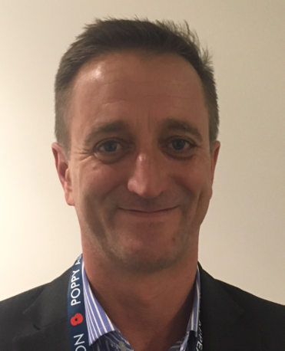
New WHSEA for Works Delivery
Stuarts introductory statement;
I have spent the last 8 years as an HSE advisor/manager within the rail, highways and tunnelling industry sectors.
My rail experience is primarily with the station build and fit-out of Farringdon Station on the Thameslink upgrade but also with Crossrail West IP Paddington to Reading. I have also worked on National Grid Power Tunnels Stage 1 (Wandsworth the Hackney), A38 Birmingham Tunnel Refurbishments & Heathrow Tunnel Refurbishment.
Prior to becoming an HSE, I was a communications delivery/project manager with various companies contracted to Network Rail, London Underground & Highways and a Project Engineer installing various fibre networks throughout the UK and Riyad, Saudi Arabia
I am a keen fair weather motorcyclist, Rescue Diver, and supporter of dreadful rugby teams.
Stuart Paul is the new
WHSEA for Works Delivery.

Slide 18
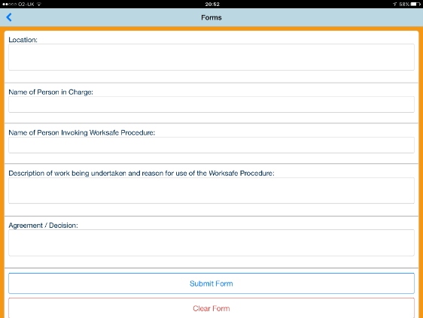
Worksafe Procedure
The Worksafe Procedure Form can be found on Wessex Apps.

Slide 19
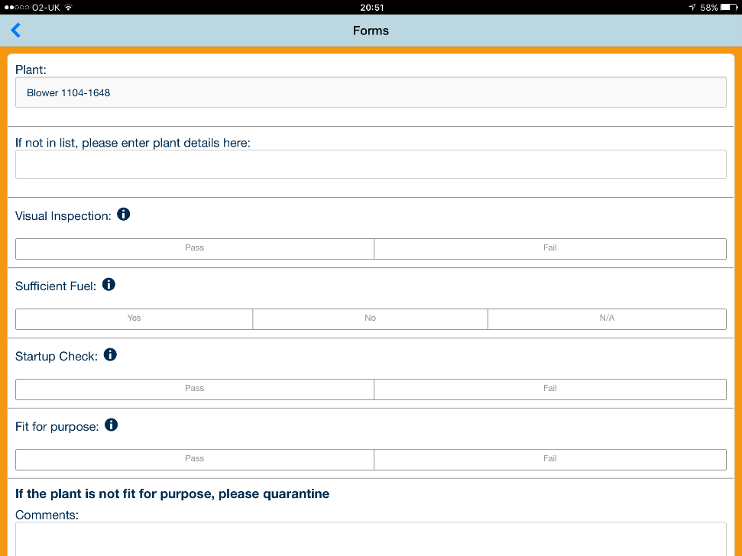
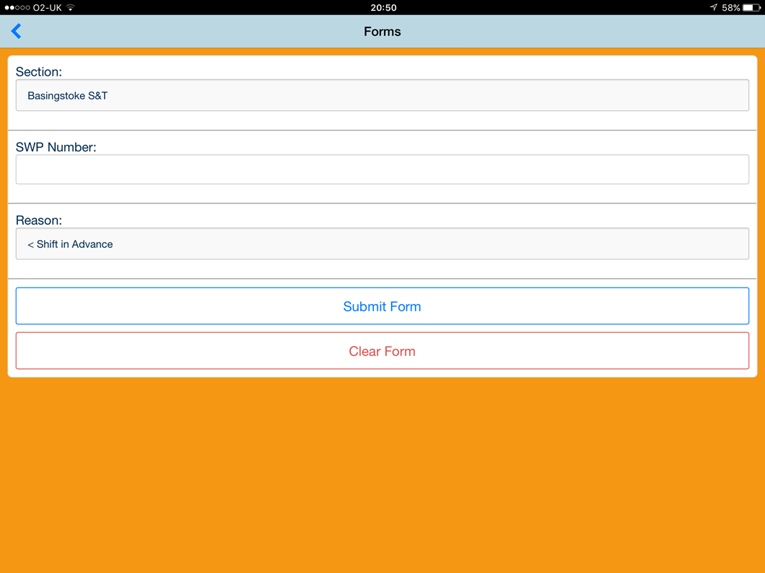
Wessex Apps Forms
Note: since 1st November, all SWP ‘Authority Numbers must be registered on the 019 Authority Number form to generate an Authority.
The Plant Pre-use check form covers many items of plant from Brush Cutters to Drills

