Slide 1


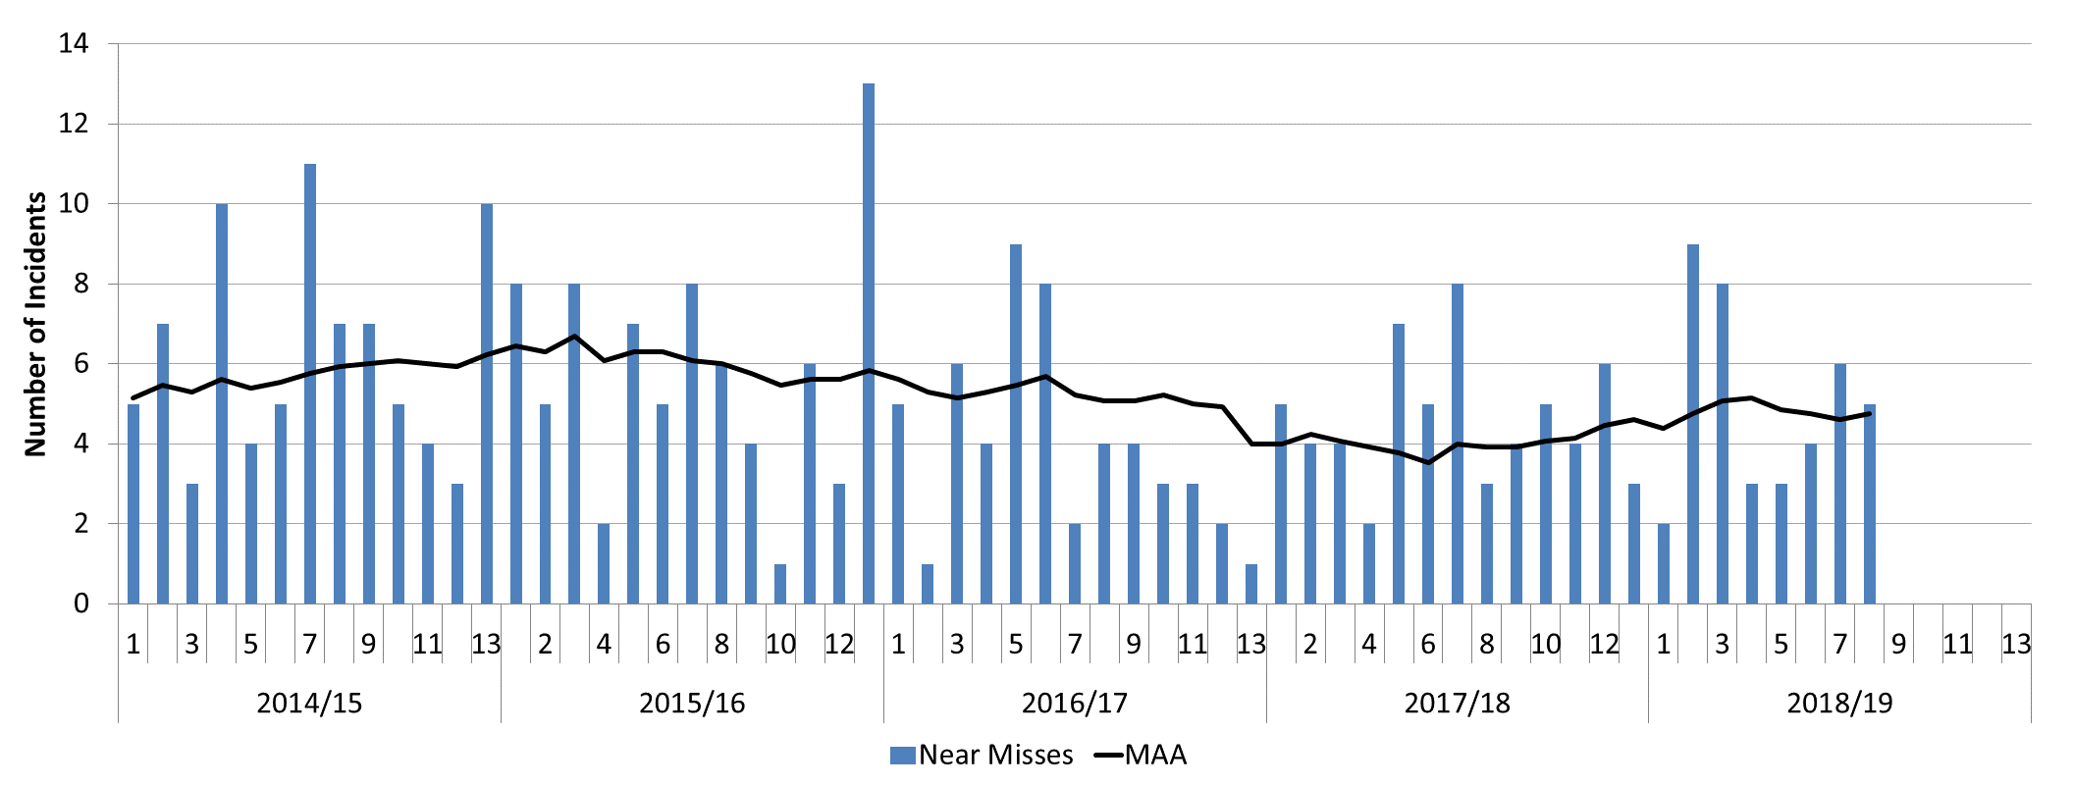
Briefing note: Near misses safety hour
Date:
01/02/2019
Subject:
Near misses: It won’t happen here
To:
To Heads of Safety and Internal Communications
06 November 2018, Network Rail heard the shocking news that whilst carrying out possession support duties, a member of Southeast’s route possession delivery team was struck by a train at Stoats Nest Junction and was killed.
This incident is still under formal investigation, and the findings will be released in due course.
However, it is now time to take a stance, to take action and to focus on the alarming rise in the number of ‘near misses’ across the infrastructure. A near miss is specifically defined in railway terminology as an incident involving a train or rail mounted plant that has occurred due to an unsafe condition or act which in other circumstances could have resulted in personal injury.
Over the last year we have seen a significant increase in near misses involving trackworkers who move out of the way of passing trains with just seconds remaining.
Near misses: It wont happen here pack
STE’s QHSE department has created a safety hour, which includes a message from Lisbeth Fromling, chief QHSE officer, a montage of recent near miss CCTV footage, and prompts to aid discussions.
The pack is delivered as a PowerPoint, with two films that can be either embedded or played at source. This open access does allow the flexibility for local leaders to add a local message.
Although the materials feature frontline staff, they should be made available to all levels in order to discuss their role in stopping near misses happening, as the end result of the clips is a person leaping out the way of a train, in most cases a much larger failure that can be traced back has occurred.

Slide 2
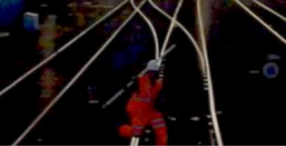
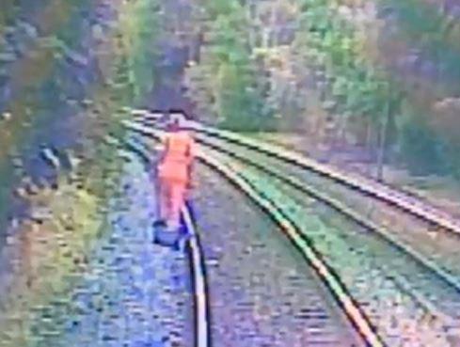
Next steps
Please work closely with colleagues in Internal Communications, the Safety profession, known facilitators and local union safety reps, to spread the packs.
Pass on any outcomes, actions or good practice to the heads of safety in your business so they can report back to STE at their professional head meeting.
Create local MyConnect stories or Yammer discussions to drive engagement.
Encourage leadership whilst on safety tours to hold conversations on this alarming subject matter.
Materials available
The information is available on Safety Central
https://safety.networkrail.co.uk/tools-resources/safety-stand-down-materials/it-wont-happen-here/
Containing:
Safety Hour Pack
Near miss compilation
Facilitators guide
Think RISK - People
Stoats Nest Junction Safety Bulletin
2013 Incidents film
We are encouraging feedback or comments to
Local safety professions
ThinkRISK@networkrail.co.uk or feed back via the Think RISK Yammer page

