Slide 1

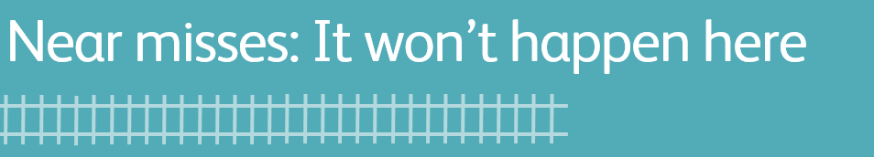
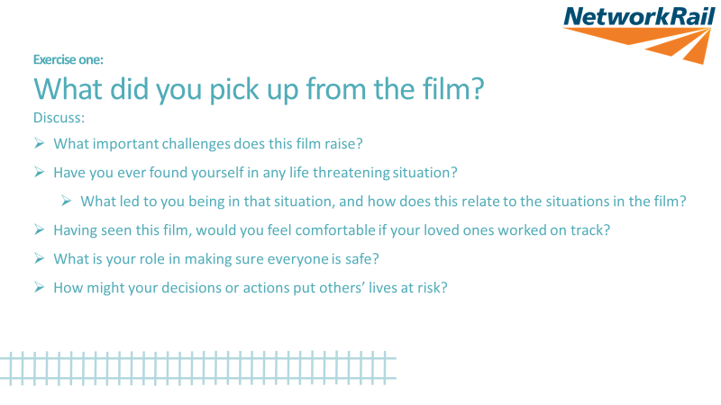
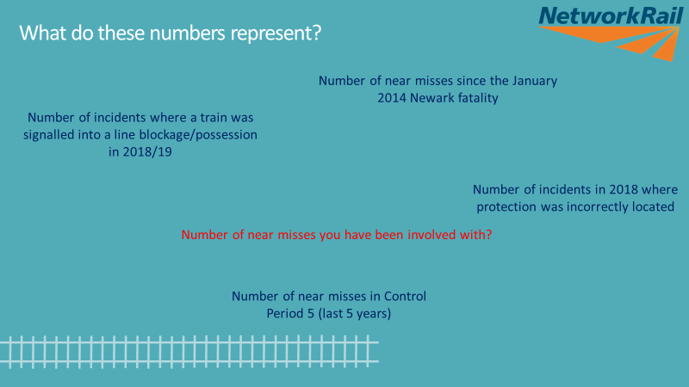

Safety Hour Discussion Pack
Purpose of the discussion:
It won’t happen here? We need to challenge the belief that it’s only others that are unsafe and these near misses would never happen to us.
It won’t happen here. We need to discuss with each other what actions we will take to make sure near misses stop.
Definition of a near miss: When a train or On Track Machine ( OTM ) driver has had to apply the emergency brakes or that trackworkers have not reached a position of safety and remained there for 10 seconds prior to the train or OTM passing
Discussion points: Use the below to plan your facilitated discussion. Remember, you don’t have to have all the answers – the role of the facilitator is to create an engaging discussion where everyone identifies and commits to solutions.
Before your session, please download the two films and a PowerPoint from:
\\Corp\dfsroot$\SZ\WMAGroups\01 - Route IM Director - Wessex\02 - Route Safety Hour Reporting\02 - Route Safety Hour Reporting\Safety Cascades 18-19\P11 1819/
https://www.wikihow.com/Embed-Video-in-PowerPoint
Content | Time | Questions
Slide 1 |  | Opening slide
Slide 2 contains: Lisbeth Fromling opening Near miss films compilation Stoats Nest slide Near miss stills - Lisbeth | 5 mins | Insert film 1 These near misses could be anywhere - every route sent shocking films
Slide 3 | 7 mins | Exercise one: What did you pick up on from the film? Use the questions on the slide displayed Encourage people to think about not only why the person had to jump out of the way, but also what led them to be in an unsafe situation in the first place
Slide 4 | 2 mins | What do these number represent? In January 2014, John Wright was hit by a train at Newark Northgate station. Until November 2018 we had not lost any other colleagues on track But it has been close – many times, as the films show. Have an open discussion re any incidents they’ve been involved in.

Slide 2
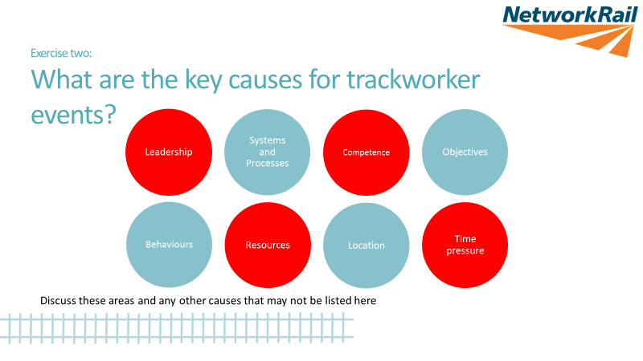
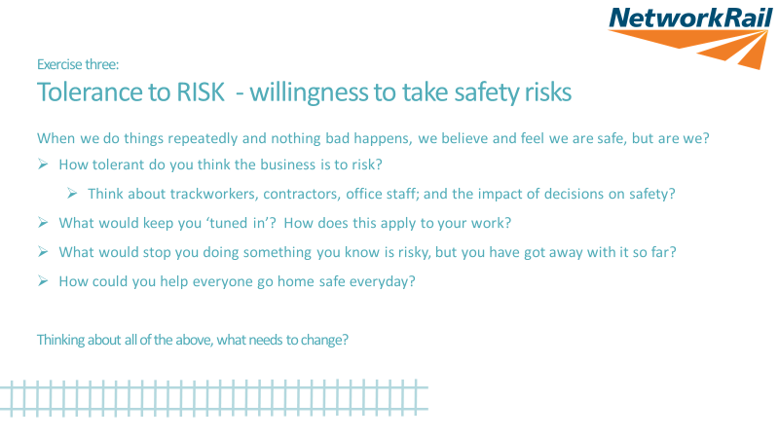
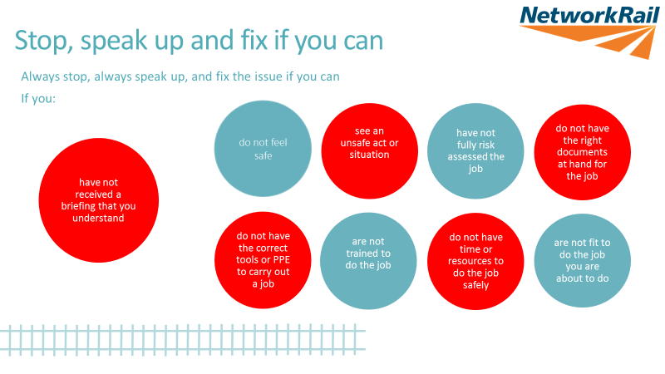
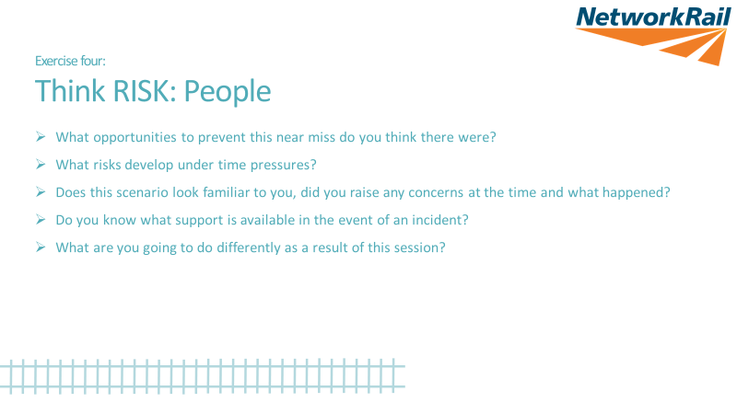
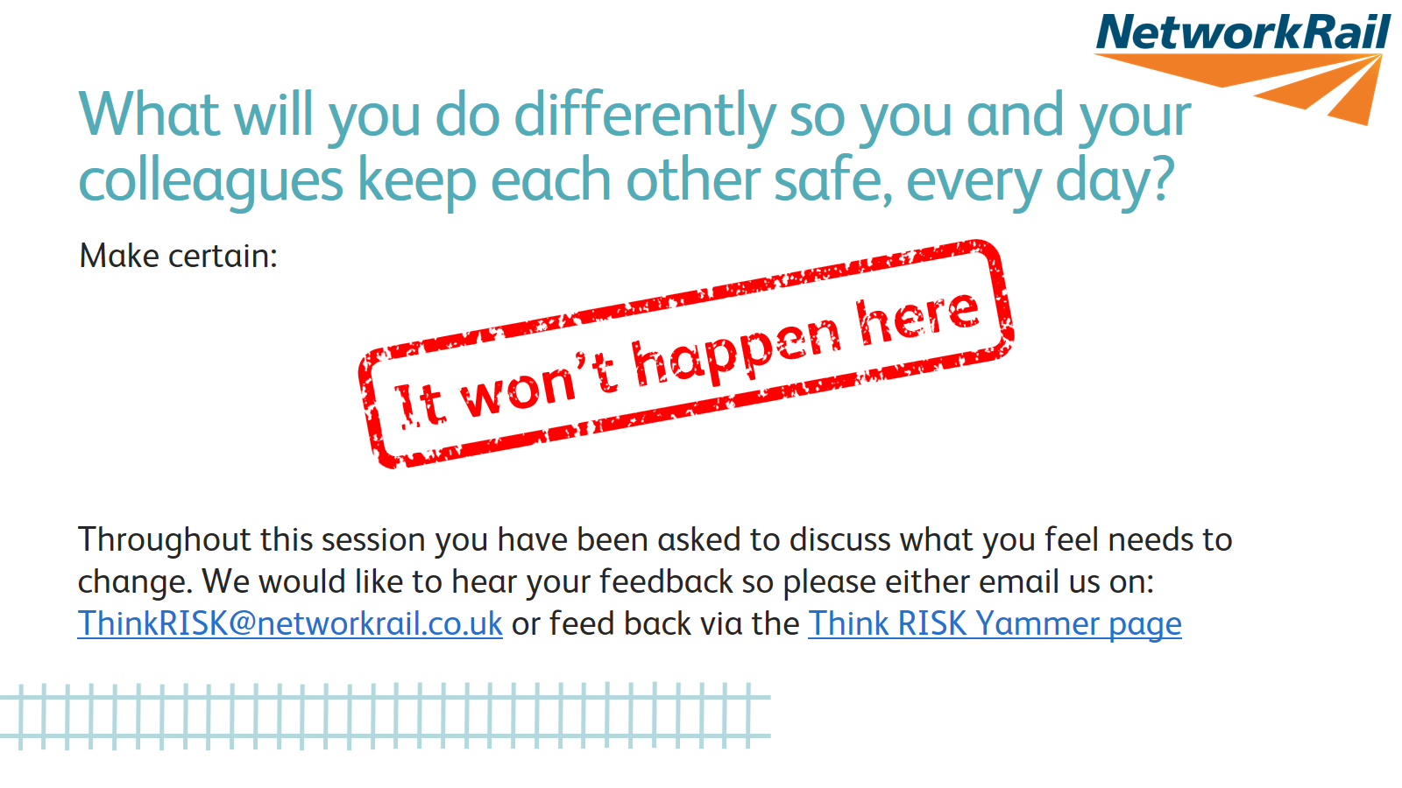
Content | Time | Questions
Slide 5 | 10 mins | Exercise two: what are the key causes for trackworker events? You may want to use smaller groups Discuss each of the topics - what is it about each of these areas that helps manage risk and what can make it worse? For example: What is the impact of staff being regularly trained in using new kit compared to them trying to work out ‘what to do on the job?’
Slide 6 | 10 mins | Exercise three: risk tolerance Encourage the group to think what people would be doing that shows they are too tolerant to risk - do people question each other, do they intervene if they see something risky, do people check and assure that jobs are completed safely as well as to time? It is easy to become accustomed to the risks around you- tuning out- becoming complacent. Help the group explore what they will do to improve these situations in the future.
Slide 7 | 5 mins | Stop, speak up and fix it if you can Read out these statements If people start talking about why it is hard to do any of them, make a note of what they say and use it as part of the discussion after the next film.
Slide 8 | 8 mins | Insert film 2
Slide 9 | 8 mins | Exercise 4: Think RISK: People Make sure when people are working they stop to think – ‘are we doing this safely?’ Are we safe from the trains, moving equipment, in the tasks we are doing, with the tools and people we have…? Encourage people to raise issues with their line managers Make sure people know how to use close call, speak up, work safe. Reinforce ideas and examples where people are doing the right things for safety.
Slide 10 | 5 mins | It won’t happen here Encourage participants to go away with practical solutions - how can they feedback issues? How can they speak up when things are wrong? Challenge each other to be safer every day. And contact via the details below if they have any further ideas.

Slide 3
Safety Hour Discussion Pack
Discussion points | Supporting notes
Call to action | Take notes of: The ideas of what people are going to do to change What they think needs to change Any ideas they would like to share with the safety team
Each route and function will be determining how they roll this out. Please find out what the local arrangements are for collating feedback and attendance. STE communications will request feedback regularly from routes/functions
For further information: https://safety.networkrail.co.uk/
Feedback, ideas and suggestions can be submitted by either the Think RISK Yammer page or via email to ThinkRISK@networkrail.co.uk

