Slide 1
Wessex
Route
To be distributed to all the business units and displayed on your notice boards please
Safety Vision Update 2019
Health, Safety and Environment Period Cascade for P11. 2018/19

Slide 2
Welcome
Welcome to the Health, Safety and Environment Cascade for Period 11 2018/19.
In this cascade;
Significant workforce events
Line Blockage Improvement Plan Update
Driving Risk – Get some training
NR National Near Miss Presentation & Safety Hour Discussion Pack
Health and Wellbeing
Mental Health First Aider
Safety Bulletins, Alerts and Advice
NRB-19-01-Godinton-Substation-Staff-Injury
NRX-19_01-Cable-Drum-Trailer-Failure
NRA19-01-Mini-DiggersMake the right call
Technical safety bulletin 1 - Godinton substation
Technical safety bulletin 2 - Godinton - Issue 2.2
Infrastructure Plant Manual NR/L2/RMVP/0200 Issue 10
Meet the new WHSEA’s

Slide 3
Significant workforce events

Slide 4
Line Blockage Update
The Route has an Irregular Working Steering Group. This is chaired by the Chief Operating Officer, the attendees include Head of Maintenance, Head of Operations and the Health and Safety Manager.
The Route Union Safety Representative is Ian Watson (Telecoms).
These are some of the activities in the Route Near Miss and Line Blockage Recovery Plan owned by this Group;
Occupational Psychology Centre to work with Signallers and help identify pre-cursor indicators in the workforce.
Increase the use of Track Safety Technology to minimise Track staff exposure to risks associated with unassisted lookout systems and line blockage without additional protection systems
Increased use of 'additional protection arrangements' in Line Blockages
New technology to improve the standard of Safety Critical Communications to reduce error rate.

Slide 5
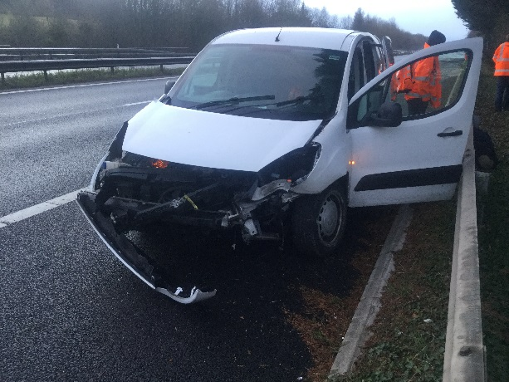
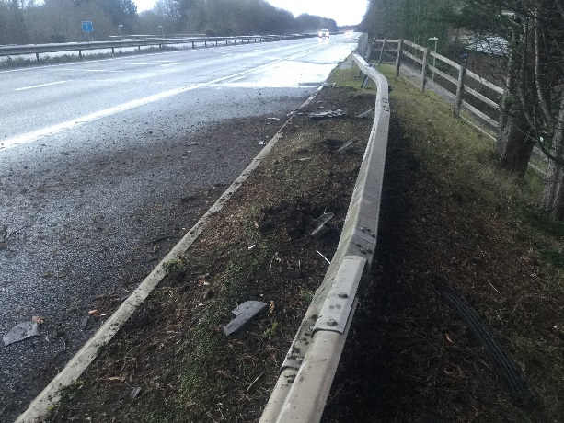
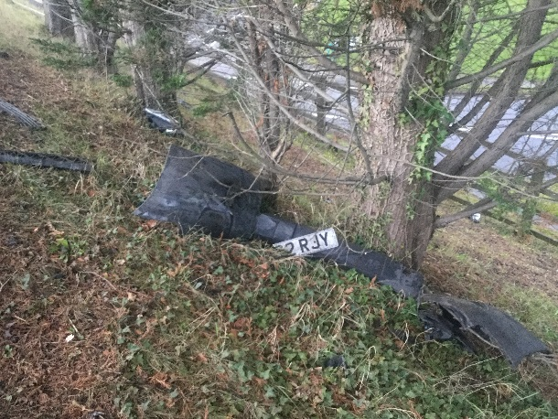
Workforce Safety
Driving Risk – Get some driver training
On Sunday 27th January at 0715, four members of P-way staff were in an NR vehicles driving northbound on the A3 near Rowlands Castle driving to work, one was due to act as ES, one was the MC for the last shift in a golden possession worksite.
The driver noticed a slow moving vehicle in the inside lane, on approach it became obvious at the last moment the vehicle was travelling at approximately 5mph.
Our driver swerved to the fast lane to avoid this vehicle, this resulted in the van with NR staff spinning out of control and hitting the barriers, coming to rest in the hard shoulder.
This was a scary and potentially fatal accident, luckily no other vehicles were around at the time.
PLEASE: Book your staff onto the driver awareness courses; either through Oracle or direct through Stuart.Cowley@networkrail.co.uk
For more information regarding the accident follow the link - Wessex Route RTC on the A3 27-01-2019

Slide 6

Near misses: It won’t happen here
Link to the Wessex Safety Hour Discussion Pack
Safety-Hour-Discussion-Pack-Wessex-Final-Version

Slide 7
Insert / play film one: Near miss montage

Slide 8
Exercise one: What did you pick up from the film?
Discuss:
What important challenges does this film raise?
Have you ever found yourself in any life threatening situation?
What led to you being in that situation, and how does this relate to the situations in the film?
Having seen this film, would you feel comfortable if your loved ones worked on track?
What is your role in making sure everyone is safe?
How might your decisions or actions put others’ lives at risk?

Slide 9
What do these numbers represent?
305
Number of near misses since the January 2014 Newark fatality
Number of incidents where a train was signalled into a line blockage/possession in 2018/19
320
29
Number of incidents in 2018 where protection was incorrectly located
Number of near misses you have been involved with?
?
Number of near misses in Control Period 5 (last 5 years)
41

Slide 10
Exercise two: What are the key causes for trackworker events?
Leadership
Systems and Processes
Competence
Objectives
Behaviours
Resources
Location
Time pressure
Discuss these areas and any other causes that may not be listed here

Slide 11
Exercise three: Tolerance to RISK - willingness to take safety risks
When we do things repeatedly and nothing bad happens, we believe and feel we are safe, but are we?
How tolerant do you think the business is to risk?
Think about trackworkers, contractors, office staff; and the impact of decisions on safety?
What would keep you ‘tuned in’? How does this apply to your work?
What would stop you doing something you know is risky, but you have got away with it so far?
How could you help everyone go home safe everyday?
Thinking about all of the above, what needs to change?

Slide 12
Stop, speak up and fix if you can
Always stop, always speak up, and fix the issue if you can
If you:
have not received a briefing that you understand
do not feel safe
see an unsafe act or situation
have not fully risk assessed the job
do not have the right documents at hand for the job
do not have the correct tools or PPE to carry out a job
are not trained to do the job
do not have time or resources to do the job safely
are not fit to do the job you are about to do

Slide 13

Insert / play film two: Think RISK - People

Slide 14
Exercise four: Think RISK: People
What opportunities to prevent this near miss do you think there were?
What risks develop under time pressures?
Does this scenario look familiar to you, did you raise any concerns at the time and what happened?
Do you know what support is available in the event of an incident?
What are you going to do differently as a result of this session?

Slide 15

What will you do differently so you and your colleagues keep each other safe, every day?
Make certain:
It won’t happen here
Throughout this session you have been asked to discuss what you feel needs to change. We would like to hear your feedback so please either email us on: ThinkRISK@networkrail.co.uk or feed back via the Think RISK Yammer page

Slide 16


Health and Wellbeing
MENTAL HEALTH FIRST AIDER
If you want to find out more about how to become a MHFA, then contact:
Grazia.Elsehimy@networkrail.co.uk

Slide 17
Safety Bulletins, Alerts, Advice
Safety-Bulletin-NRB-19-01-Godinton-Substation-Staff-Injury
Safety-Alert-NRX-19_01-Cable-Drum-Trailer-Failure
Safety-Advice-NRA19-01-Mini-Diggers
Technical safety bulletin 1 - Godinton substation
Technical safety bulletin 2 - Godinton - Issue 2.2
Wessex Route Lessons Learned Rail Saddle Accident 040219

Slide 18
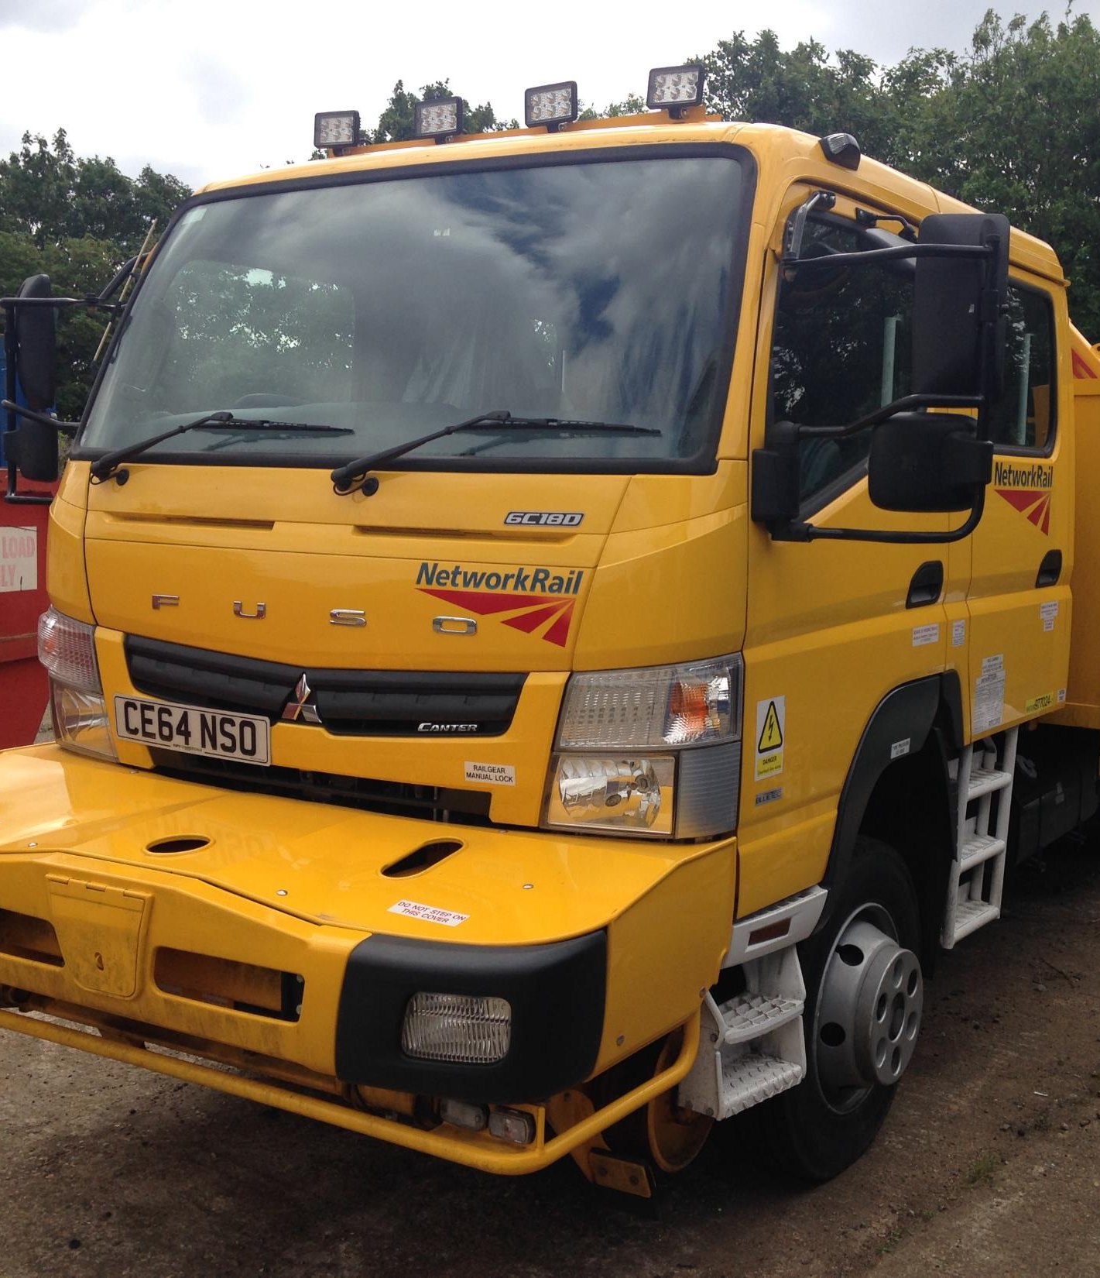
Infrastructure Plant Manual NR/L2/RMVP/0200 Issue 10
Is now available on
Network Rail Standards and Controls
The Compliance date is 2nd March 2019.
Key Changes are:
The number of modules has reduced from 32 to 18.
A new Guidance notes module as a separate document.
P521 POS module, section 4.1: The POS provider is responsible for assigning competent OTP personnel including Machine Operator’s, Machine/Crane Controllers and POS representatives.
If you or your team Plan, Operate or Control OTP,
you need a briefing. A Briefing Pack is available.
Please contact:
Keith Penn
Rail Plant Support Engineer.
mailto:keith.penn@networkrail.co.uk

Slide 19
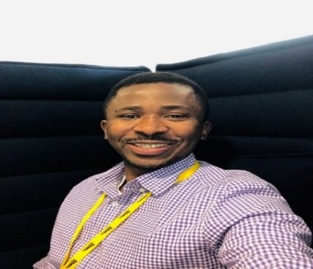
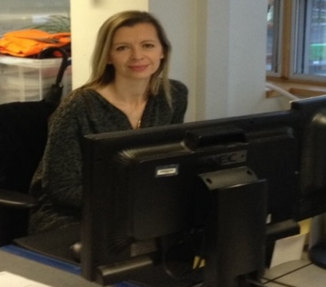
New WHSEAS for the Route
Achilleus Iheozor-Ejiofor (RAM team, B&C and ASPRO team)
I’ve joined Network Rail from outside the rail industry, having practiced my trade in oil and gas, manufacturing and construction industries, from geologist geotechnical engineer to QHSE Advisor..
I hope to bring some transferable experience gained outside to an already successful team, to help improve and preserve Network Rail’s safety vision of Everyone Home Safe Everyday.
Tele: 07732639425
Andrea de la Mothe –(Maintenance & Ops) – 6 month secondment
I have worked for Network Rail since 2002; starting as a Section Admin & Planner for various functions, I became the WHSEA for the busy Croydon DU 4 years ago which I thoroughly enjoyed.
I bring some experience, a desire to know more and take on new challenges.
I look forward to meeting as many of you as possible in the next few months.
Tele: 07711602186

