Slide 1
Level 1 Investigation Workshop
Getting the best out of a Level 1 investigation and why

Slide 2
Level 1 Investigation Workshop - Agenda
Levels of investigation
When a Level 1 is required and why
What types of evidence is required
Completing a level 1 and who to involve
Required content
Risk ranking
What is an immediate cause
What is an underlying cause (using the 10 Incident Factors)
Applying Fair Culture
Actions
What then happens

Slide 3
What is a Level 1and why is it required
In January 2015 Network Rail saw the replacement of the numerous accident and incident report forms with a single ‘intelligent' form which guides staff completing it.
The form also includes identifying whether the event involves a lifesaving rule breach and an indication of the behavioural cause. The process is known as a preliminary report and investigation or level 1 investigation.
Preliminary investigations will provide us with better information about accidents and incidents that are not subject to a local or formal investigation and allow us to put corrective actions and mitigations in place.
Local investigations known as level 2 and formal investigations as level 3.
These are based on the Level 1 depending on the severity of the incident and level of risk that was exposed.

Slide 4
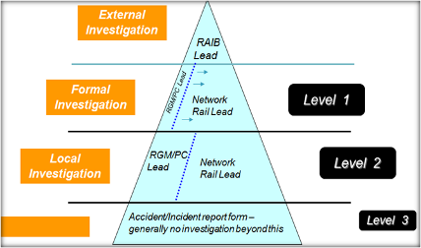
Levels of Investigation
Within Network Rail we structure our investigations according to the potential risk of the type of event.
Level 3
Level 1
A Level 1 or preliminary investigation is the simplest investigation
A Level 2 (or ‘Local’) investigation is slightly more in-depth
A Level 3 (or ‘Formal’) investigation is usually held into complex and high risk events

Slide 5
What types of evidence is required
How accident/incident happened: Brief description of facts of the event. Details of injured party of those involved/department & line manager On-site lead and Responsible manager for Golden Hour. Name of First Aider in attendance Note- severity of injury and hospital attended accompanied by If serious: Next of kin arrangements (details & whom to inform if required)
Site Photographs of; Site, plant, equipment and materials in situ - without moving. Close up of damage to plant, equipment, materials, Injuries, both relative to body and close up.
Factual initial statements from; Involved individuals: Details of any and all witnesses on site; even negative statements. Can include any notes or diagrams made at the time.

Slide 6
What types of evidence is required
Descriptions of Site, lighting, weather, site relative to other locations or ELR & Mileage Whether location or incident involves or impacts third parties work, land and contact details of third party.
Request Forward facing CCTV from SWR Voice recordings; including COSS ES PICOP, Signaller, ECRO and ICC if relevant.
Instruct: Those involved to suitable location. Evidence collation contact (normally line manager or person nominated by DCP or Initial Investigator if known ) of photographs, statements, initial evidence, including CCTV and voice recordings. Physical Evidence (plant/equipment)to be removed and stored in suitable agreed location. Initial Investigator to consider Drugs & Alcolhol testing.
Paperwork collated and delivered to Line Manager or DCP: SWPs/IRPs Permits to work Possession/PICOP pack RT3181 or NR3180 Signal Box Log Work Orders or similar

Slide 7
Completing a level 1 and who to involve
A Lead Investigator (If a Life Saving Rule (LSR) has been breached, the Lead Investigator needs to be independent).
The person/s involved and any witnesses.
Health and Safety Rep participation (Appointed by the Lead Investigator)
H&S TU reps must be appointed for all LSR breaches
H&S TU reps are also encouraged to be part of the process where an incident may or has had significant consequences.
Note:
An Industrial TU rep is not required to be present as this part of the process is fact finding only and not a disciplinary.
Should an individual request one to support them, they are to arrange this themselves but they should not influence proceedings.

Slide 8
Where to find the most recent Level 1 template
It is important to download and use the most recent Level 1 template every time you carry out a new investigation.
If you have access to Connect within Network Rail, you will find it within this link
https://networkrail.sharepoint.com/sites/myconnect/ste/Pages/Accident-and-incident-reporting.aspx
You should then consider titling your report similar to this example below for easy referencing and searching;
P06 1819 2018-09-01 Guildford – Inner Mnt Coss LB irreg GZAC 77853 – L1.v1 Draft
Period | Period Year | Date (in reverse) | Location Of incident | Department | Role | Incident / Accident detail | Version

Slide 9
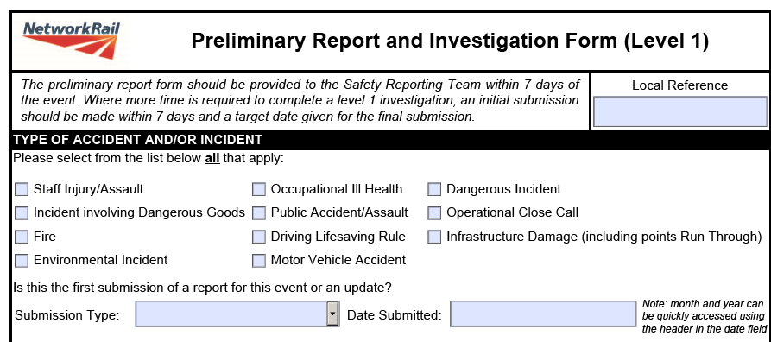
Required content
Local reference – This number is local to you or your department
Type of incident – Tick what is relevant to the event. This will then generate other required data to be completed.
Submission type - Drop down and select ‘New’
Date submitted – Use the drop down to select the date. Do not type it in.

Slide 10
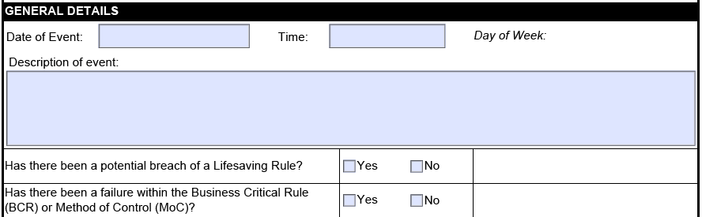
Event detail
Date of the Event – (The date it took place).
Time – The time the event took place. (Do not type in approximately)
Tick the next two boxes unless they are not relevant.
Description of the event – (Expand on the detail in this section so that anyone can understand it).
When did the incident occur and where?
Who were involved? (Job / Role titles. Not names).
What was the planned activity?
What were the conditions and were there environmental factors involved?
Build a time line picture of the steps that occurred prior to incident, then detail the incident / accident , how it occurred, what / who else was involved / what was the outcome, how the area was made safe / contained, what follow up actions and chain of care took place, how the incident was concluded, summarise the event. (Best practise: List the evidence used / Factors discussed).

Slide 11
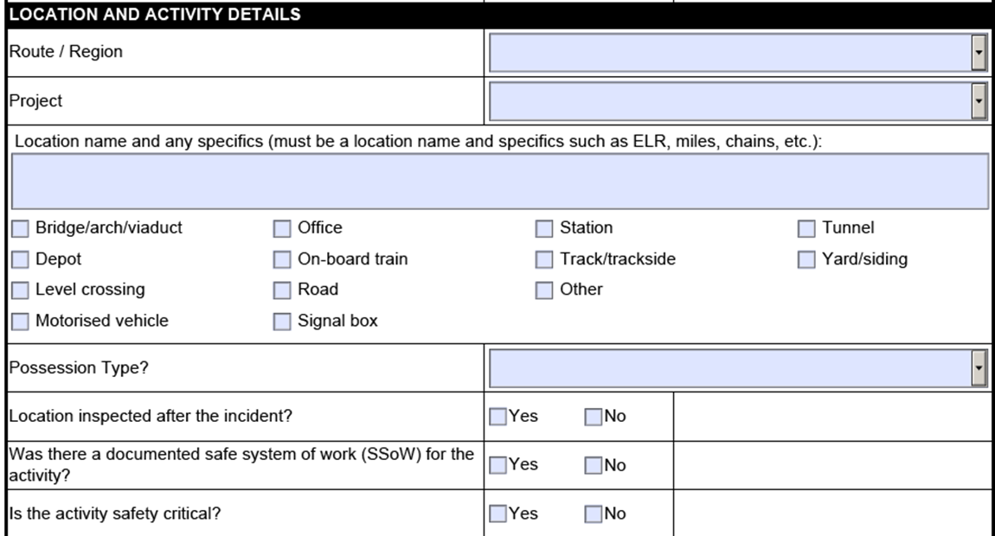
Location and activity details
Use both drop downs and select.
Ref. Project, this is the department of the person/s implicated or injured.
Nearest location, mileage and ELR.
Tick the boxes that are relevant. (If in doubt, find out).
Use drop down and select if a possession was involved.
Tick the boxes relevant and complete additional detail as required

Slide 12
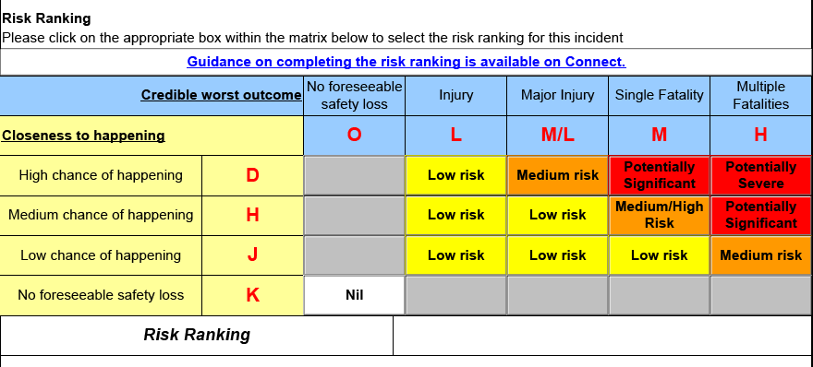
Risk Ranking
To record your ‘Credible worst outcome’ and ‘Closeness to happening’; use this example below;
H = More than one member of staff were at risk from xxx
J = Staff had yet to be authorised to carry out the activity which significantly reduced the incident from escalating.
For guidance on this section, you can click on the guidance link in blue on the Level 1 form.
(The next 2 slides shows what you will see).
Notes:
Exercise 3: Risk Ranking

Slide 13
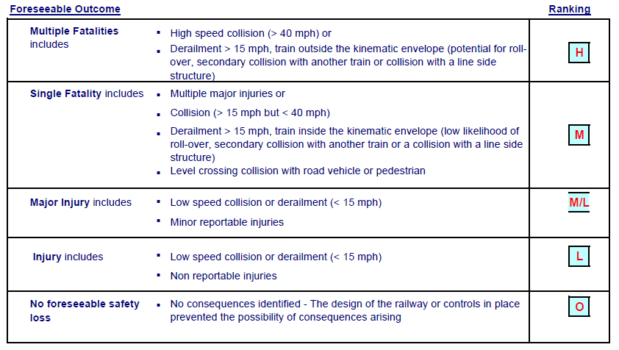
Risk Ranking
Notes:
Exercise 3: Risk Ranking

Slide 14
Risk Ranking
Notes:
Exercise 3: Risk Ranking

Slide 15
Person Details
Only add in those members of staff who were involved or injured in the event.
If there is more than one person, click the ‘Add Person’ box and complete the detail as required.
If it is a Network Rail staff member, leave the address blank.
For Contractors, record the full address.
(Note: The Contractor may just offer their employers address, but make this clear within the address section).

Slide 16
Person Details
This section can only be collated by questioning the person/s involved or requesting it from their line manager.
Date entered current duties = the activity they are performing.
Date entered current grade = the role and grade they are in.
Date entered service = when they began on the railway.

Slide 17
Injury Details
If the incident was NOT an accident or an assault DO NOT complete the top section.
Tick what’s relevant if ‘For Cause’ screening was carried out and complete the relevant detail required in the boxes that then appear.

Slide 18
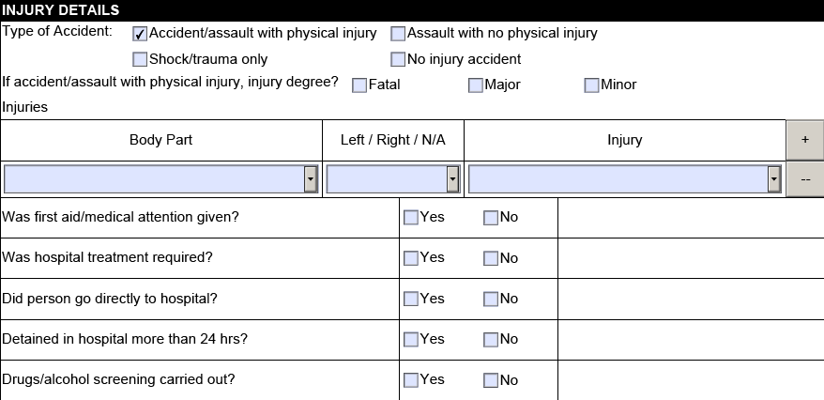
Injury Details
For injuries, click the box relevant
Use the drop downs to record the injury details.
If more than one part of the body is injured, click on +.
Tick the boxes relevant and add in the required detail if other boxes appear.

Slide 19
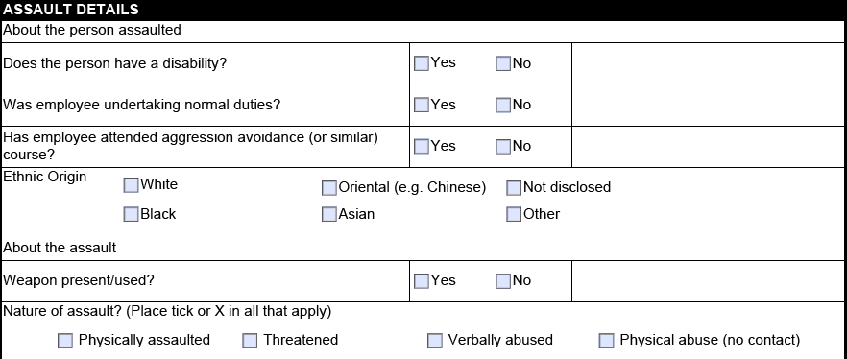
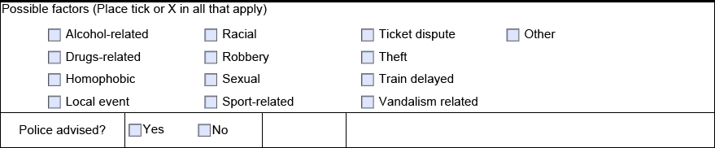
Assault Details
Leave blank and only complete these sections if an assault has taken place.
Tick the boxes relevant and add in the required detail if other boxes appear.

Slide 20
Immediate and Underlying Causes
What happened immediately before the incident resulting in the event.
(Keep this brief).
What allowed the immediate cause to happen.
(Consider using Why / Because until you have exhausted all possibilities and make use of the Underlying cause drop downs to assist you).
For more than one cause, click on ‘Add Cause’.
http://connectdocs/NetworkRail/Documents/Assurance/SafetyAndCompliance/AccidentInvestigation/InvestigatorsHandbook/AGuideToThe10IncidentFactorsv2.1.pdf

Slide 21
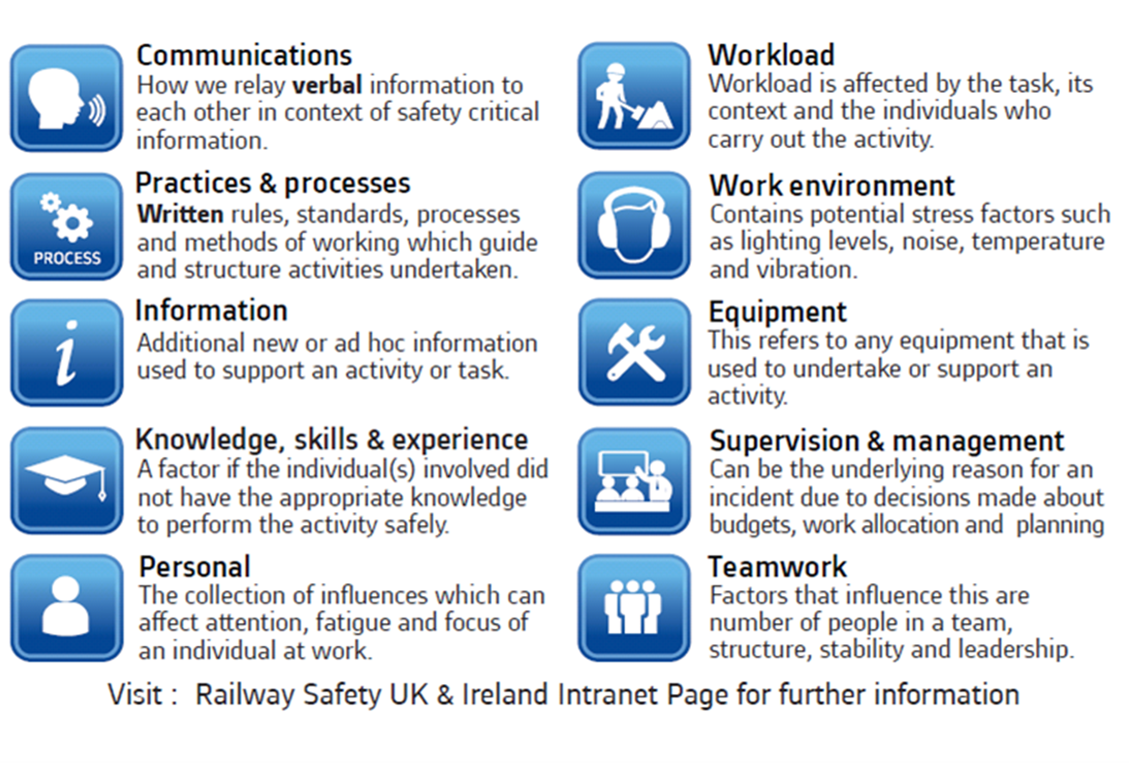
Underlying causes

Slide 22
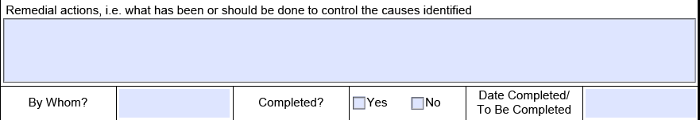
Remedial actions
Each underlying cause will require a remedial action.
Chain of care was carried out and an immediate de-brief of the event took place.
The area was made safe and the following mitigation measures / actions were carried out.
Xx
Xx
By Whom – This is the person that is responsible for the action and not person involved or injured.
Consider how you can immediately close out the action prior to the Level 1 being signed off as complete.

Slide 23
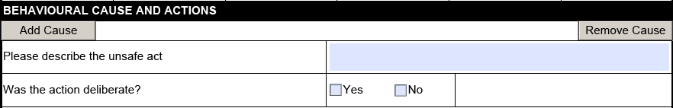
Behavioural Cause and Actions
Unsafe Acts are the performance of a task or other activity that is conducted in a manner that may threaten health and/or safety by;
Not following a set down rule, instruction or process.

Slide 24
Behavioural Cause and Actions
Answer the Yes / No boxes with a tick and explain your rationale behind that selection.
This section should be carried out with the H&S TU rep (should one have been appointed).
Remember – Where a LSR has been breached, this is mandatory.
The behavioural causes may conclude that a Contravention or Reckless Contravention has occurred. This shall then be subject to an Independent Review Panel review.
(Note: Other reports may be reviewed as part of a 20% check. (See IRP slide)).
Use this link to assist you;
https://safety.networkrail.co.uk/tools-resources/fair-culture-investigations/
For more than one unsafe act, click on ‘Add Cause’.
-

Slide 25
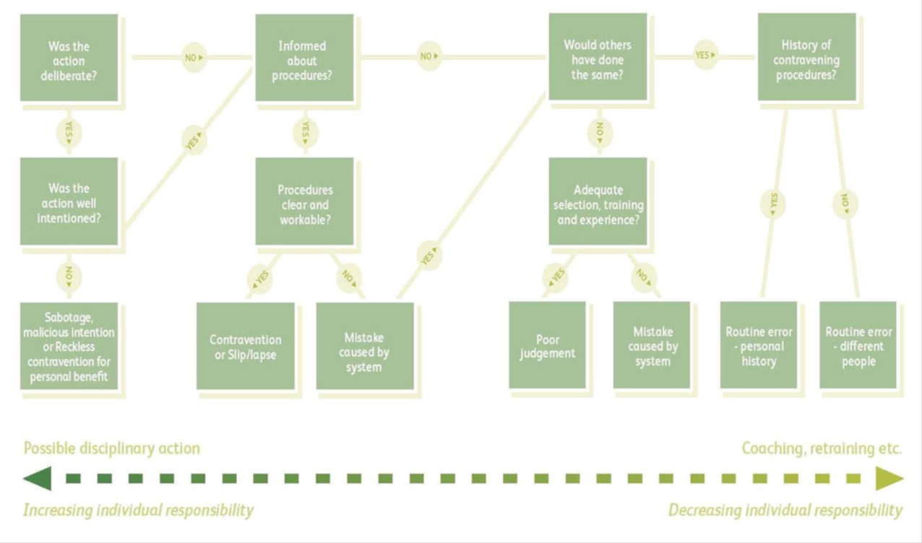
Applying Fair Culture (Discussion slide)

Slide 26
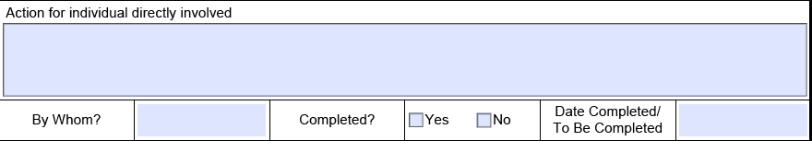
Behavioural Cause and Actions
Action for individual directly involved;
The person involved in this event has been re-briefed and has been placed on an action plan which includes the following (eg);
The assessment module associated with xxx will be retaken.
The activity they carried out shall be simulated and assessed.
They will be mentored for a total of xxx months.
Voice coms will be reviewed for a period of xxx.
By Whom
This is the person that is responsible for the action.
Date Completed / To Be Completed
Consider how you can immediately close out the action prior to the Level 1 being signed off as complete.
Note: ALL open actions should be tracked locally until closed.

Slide 27
Action for the manager of individual
Action for manager of individual eg;
The team shall be briefed on this event to mitigate against future accidents / incidents.
The brief shall consist of;
Xx
Xx
This shall also be shared with the Workforce Health Safety and Environment Advisor with the view of potentially being placed within Pulse, on the Safety Cascade or via a Bulletin.
By Whom
This is the person responsible for this action.
Date Completed / To Be Completed
Consider how you can immediately close out the action prior to the Level 1 being signed off as complete.
Note: ALL open actions should be tracked locally until closed.

Slide 28
What happens next once complete
Once the Draft is complete, ensure you have saved your report to file with a title eg.
P06 1819 2018-09-01 Guildford – Inner Mnt Coss LB irreg GZAC 77853 – L1.v1 Draft
Send this to;
For Maintenance and Works Delivery – Your Designated Competent Person (DCP) and WHSEA
For Operations – Your Operations Manager
For Ops Planning – Your DCP, Akinkunle Akindele and Bernard Toska
Copy in;
Steve.cory@networkrail.co.uk
WessexSafetyReporting@networkrail.co.uk
Once signed off by DCP, they are responsible to re-title the report as FINAL and forward the Level 1 to
WessexSafetyReporting@networkrail.co.uk or via Steve.cory@networkrail.co.uk
The event will then be closed down within the incident trackers and SMIS unless the report requires revisiting or escalating to the next level of investigation.
Reports that have Contravention or Reckless Contraventions outcomes are then submitted to IRP as mandatory.
LSR breaches also form part of a 20% selection.
Notes:
Handout – Professional Heads

Slide 29
Independent Review Panel (IRP)
Independent Review Panels (IRPs) have been established to check that the fair culture principles have been followed during the safety investigation, that the fair culture flowchart has been applied correctly and that the report provides sufficient description to substantiate the identified behavioural cause.
Mandated to attend are;
Independent Manager – Derek Crisp
Head of Safety (eg HoRSHE, Head of S&SD) – David Smith
Lead HR Business Partner – Sandra Lloyd
Lead Trade Union Health and Safety Rep – Adrian Yates (RMT) and Ron Gayler (TSSA)
(Note: If any of the above cannot attend, there are deputy arrangements available).
The Panel review the content and conclude whether the outcome is correct or incorrect, but the DCP has the final say.
All outcomes are fed back to the DCP and Lead Investigator, should be shared with the person involved and the appropriate corrective actions put in place.
Where the Panel and DCP are not in agreement, the Central National Safety Team carry out a review and make the decision on behalf of the route.
Reckless Contravention outcomes may lead to disciplinary action and a further disciplinary investigation will then be instigated outside this process.
Notes:
Handout – Professional Heads

Slide 30
Any Questions?
Notes:
Handout – Professional Heads

