Slide 1
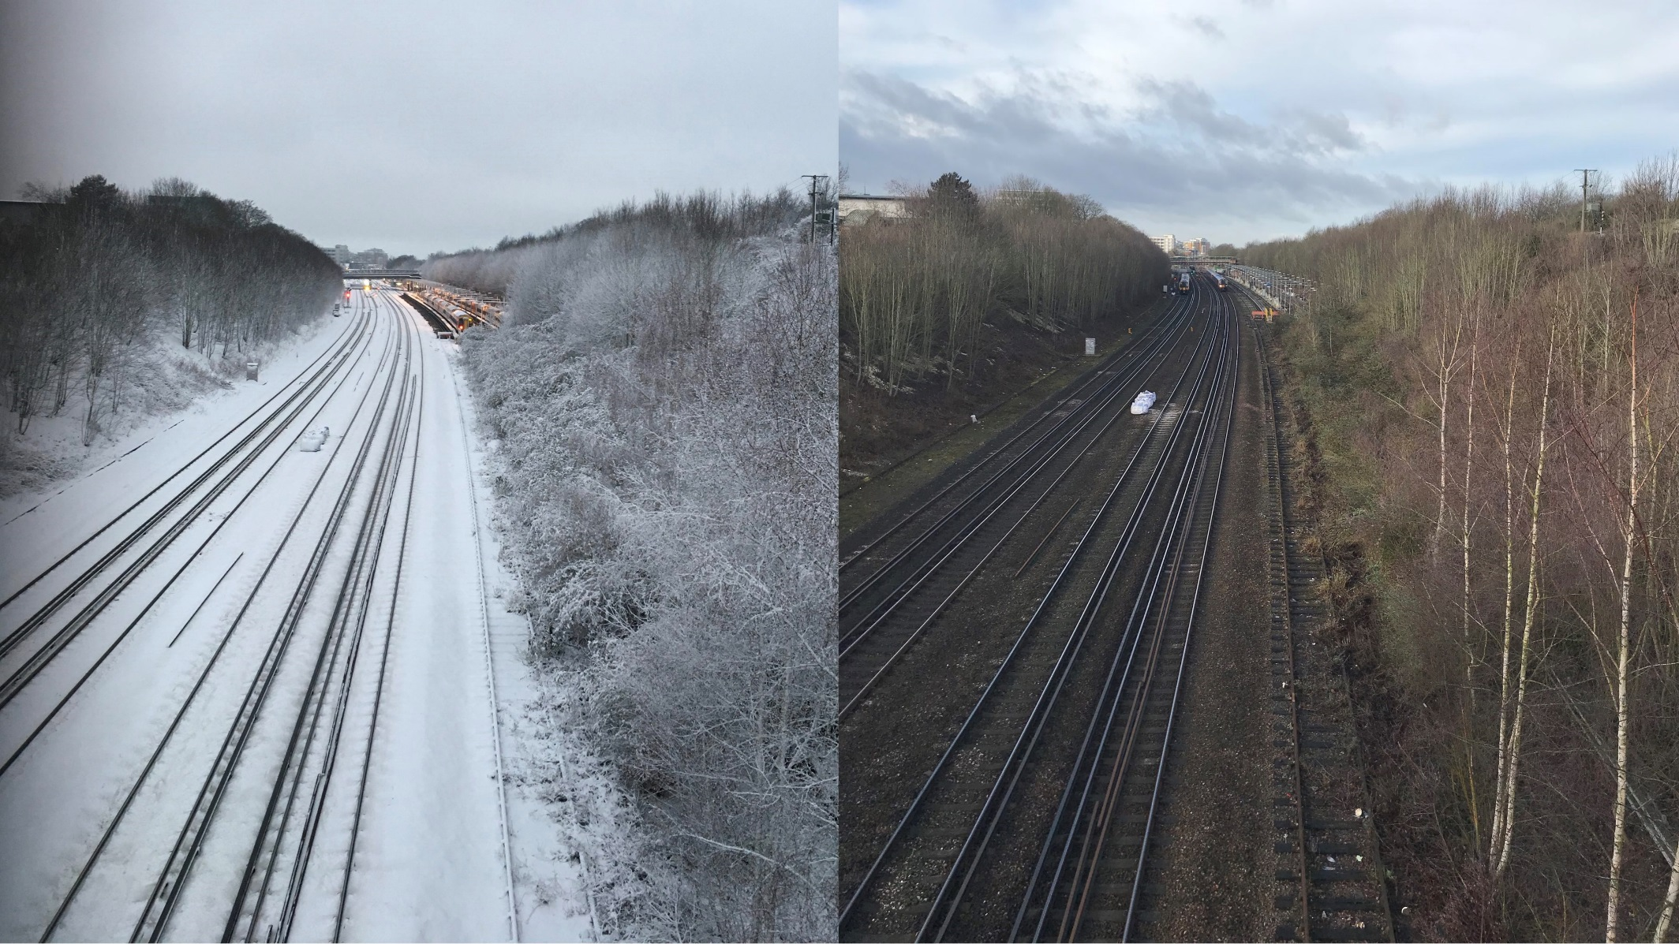
Wessex Route
What a Period, from this
to this…
Health, Safety and Environment Period Cascade for P12. 2018/19

Slide 2
Welcome
Welcome to the Health, Safety and Environment Cascade for Period 12 2018/19.
In this cascade;
Significant workforce events
Near Miss at Richmond
Train striking an object at Overton
GE/RT/8000 HB8 – IWA, COSS or PC Blocking the Line
Front Line Focus Episode 83 and Working at Height
Golden Hour and Evidence Gathering
Level 1 Investigations – Best Practice
Safety Bulletins, Alerts and Advice
Lessons Learnt - Near Miss Feltham 10-02-2019
Train Striking Welding Kit at Overton
Safety-Advice-NRA19-02-Long-Portable-Earths
Safety-Bulletin-NRB19-03-Person-struck-by-falling-over-head-wire
Shared-Learning-NRL19-01-RIDDOR-Burn-Injury-Use-of-hedge-trimmer
Shared-Learning-NRL19-02-OTP-exclusion-zone-lighting-systems.pdf
Shared-Learning-NRL19-04-RIDDOR-Dangerous-Occurrence-Signalling-wrong-side-failure
NR_L3_OPS_047_F3.27A Maxey CCTV LC 22.12.2018
Infrastructure Plant Manual NR/L2/RMVP/0200 Issue 10 - Key Changes to OTP CORE Competence
Environmental Update
Fatigue – World Sleep Day
Health and Wellbeing
Mindful March
Wessex Apps

Slide 3
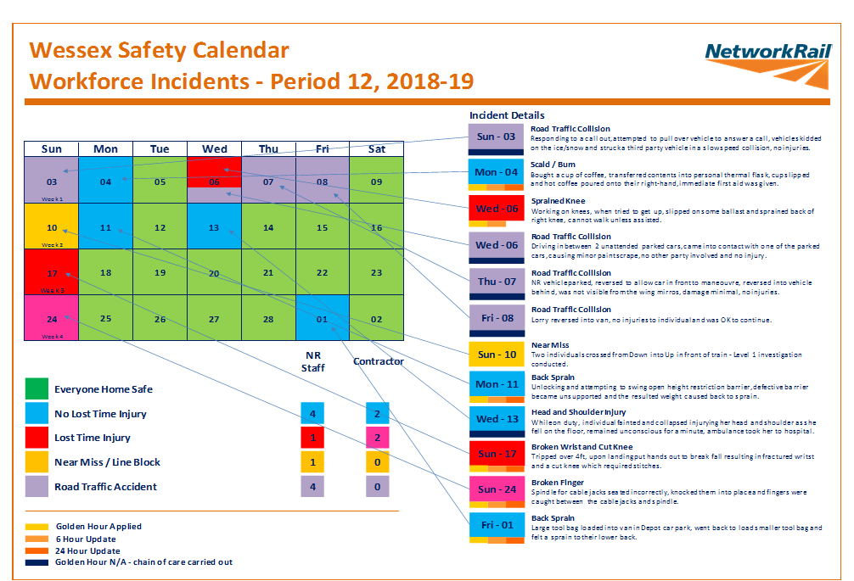
Significant workforce events

Slide 4

Near Miss
2 staff from Feltham P-way were carrying out a basic visual track inspection (track patrol) between Whitton and North Sheen on the Up and Down Richmond Line (RDG). One member of staff was acting as the PIC/COSS and carrying out the Patrol, whilst his colleague was carrying out the duties of a Site Lookout. After completing the patrol, the PIC/COSS crossed from the Down line to the Up line to walk back toward Richmond Station to maintain 598 points.
The team proceeded 20yds toward Richmond Station, where their sighting distance had been reduced to approximately 175yds. The minimum sighting distance to set up a Safe System of Work in this location is 450yds. The team were about to cross from the Up cess to the Down cess when the Lookout noticed the lights of 5Z07 (an empty coaching stock) approaching through Richmond Station on the Up line and both stepped back out into the Up cess.
As the sighting distance was not sufficient, the team were not in a Position of Safety (POS) for 10 seconds before the train passed them, therefore this was a Near Miss.
Take 5 for Safety
Don’t cross the lines if you don’t have to!
Do you set up, test and continually maintain your safe system of work?
Do the Track Patrols, the associated diagrams and the Safe System of Work used all align?

Slide 5

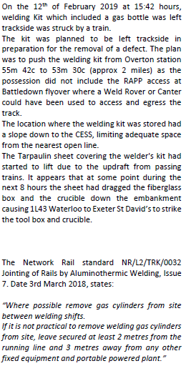
OCC – Train striking an object

Slide 6
GE/RT/8000 HB8
Change to Extract HB 8 - IWA, COSS or PC Blocking the Line – additional protection should be used where possible. (1st December 2018)
This includes detonator protection and track circuit operating devices.
Line Blockage (LB) arrangements should be reviewed to ascertain if an additional protection can be used. (Near Miss and LB Irregularity Reduction Plan)
The signaller will not grant the LB to you until the portion of line concerned is clear of all trains unless one of the following applies:
Where authorised, you and the signaller can be sure that all trains have passed beyond your site of work.
A train has become disabled, or is at a stand, and will make no further movements until the LB is given up.
When you are both sure that the details on your LB form are correct and all your arrangements have been carried out, the signaller will give you an authority number that you must record on your NR3180 form. You may now treat the LB as granted.

Slide 7
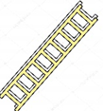
Front Line Focus / Working at Height
Please view the latest edition of the Front Line Focus on the below link:
Front Line Focus Episode 83 - January 2019.mp4
The Working at Height hierarchy
Avoid…if it is not necessary to work at height don’t. Design it out.
Prevent…use an existing place of work at height that does not involve the risk of falling. (a fixed structure like a gantry with fixed guard rails and a safe means of access)
Mitigate…minimise the distance and consequences of a fall
Give priority to collective protective measures…use of guard rails (910 - 950mm high and a toe board take priority)
Prevent the risk of falls by using personal protective measures….in this case harnesses, lanyards, work positioning belts and fall arrest equipment is last measure of protection.
A decision was made across the Wessex Route in 2017 (by the Area Director, RWHSEA and the IMDMs) that our staff will not work at height using the ‘fall arrest protection’ method. If the work cannot be accomplished under work positioning or fall restraint the staff should not take the risks associated with fall arrest.
As most of our signalling structures are of relatively similar build and construction, it was agreed that the standard assessment for ‘rescue’ within the L3, Appendix C NR_L3_MTC_SE0220_04.pdf will be used. If there are additional risks associated with a specific site then this can be amended for that site if necessary.

Slide 8
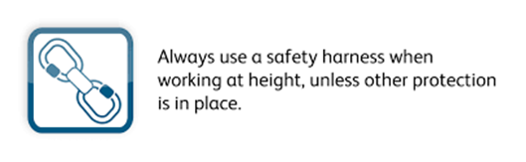
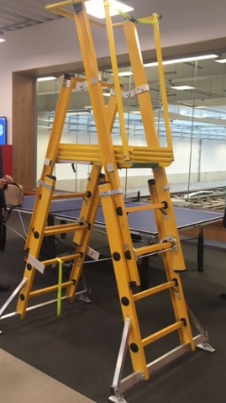
Working at Height cont.
Life Saving Rule:
There have been emergency changes to the Work at Height Standard (compliance date 11/01/2019) NR/L2/OHS/022
The changes affect section 14 of the standard and introduce controls on the category of ladder that can be used.
A portable ladder or a step ladder should be suitable and can only be used if the activity is deemed a low risk and the duration is max of 30 min.
Any surface upon which a ladder or step ladder are positioned shall be fixed, stable, firm and in good condition to support the ladder.
Fixed ladders – whenever a fixed ladder is climbed the person climbing the ladder shall always carry out a visual check of the structure and ladder, particularly securing points, both prior to climbing and during the climb.
There are many podium style GRP ladders available that are ideal for working at fixed heights and would provide a safer option for our staff.
Other protection’ is also known as collective protection and includes :-
guard rails minimum 910 mm high on existing structures and minimum 950 mm for all new / replacement structures.
Scaffolding around structure

Slide 9


Golden Hour / Evidence Gathering
DCP to consolidate findings from the investigation and to ensure Lessons Learned is completed. To be send to the Safety Team for inclusion in the Periodic Safety Cascade. Responsible manager to discuss with team at safety hour and implement any safety improvements recommended.
All accidents/near miss events are immediately (or as soon as it is practicable and safe to do so) reported to the WICC and an initial accident form is completed by the ICC and the reporter.
5
28 days
1
1hr
5
1
Discuss in the Periodic Safety Cascade and implement improvements
Report accidents/near miss events to the WICC
4
Accident Reporting & Investigation
It is vital to gather any available evidence as soon as it is practicable to do so. Take photos of the injury, of the location where the accident occurred, and of any tools/equipment that were used at the time and quarantine these so they can be used during the investigation. Remember we are trying to understand what happened so we can prevent reoccurrence!
2
1hr
Fully investigate the accident / incident / near miss
2
Level 1 report to be completed and submitted to the DCP within 7 days. The DCP (Head of Department) will appoint a Lead Investigator if a further investigation is necessary.
Gather all available evidence incl photos from the site
4
7 days
Lev1
3
Provide an update on the IP – duty of care (Golden Hour)
Responsible Manager to call control and provide both the 6hr and 24hr update on the accident.
3
6hr & 24hr

Slide 10
Level 1 Investigations – Best Practice
Level 1
The new Level 1 Investigation Report was introduced in January 2015 and replaced the previous numerous reports. This simplified the process and the report itself is an intelligent form that guides the investigating manager through the completion.
A good Preliminary investigation should provide us with better information about accidents and incidents, identifying any route causes and allowing us to put corrective actions and mitigations in place in order to avoid any re-occurrence.
The Level 1 will also identify whether the event involves a lifesaving rule breach and an indication of the behavioural cause.
At the end of last year a few workshops were run offering an advice and guidance to the managers who complete the Level 1 investigations.
A “Best Practice” Guide that was used during these workshops can be found on the following link:
Level 1 Investigation Best Practise Guide.pptx
We also have a “Best Practice Guide for evidence gathering for IO’s and Investigators, please see the link below:
Best practise evidence gathering for IO and Investigators.v2.xlsx
If there is a further need for more workshops to be delivered please let Steve Cory know – steve.cory@networkrail.co.uk

Slide 11
Safety Bulletins, Alerts, Advice
Lessons Learnt - Near Miss Feltham 10-02-2019.pdf
Train Striking Welding Kit at Overton.pdf
Safety-Advice-NRA19-02-Long-Portable-Earths.pdf
Safety-Bulletin-NRB19-03-Person-struck-by-falling-over-head-wire.pdf
Shared-Learning-NRL19-01-RIDDOR-Burn-Injury-Use-of-hedge-trimmer.pdf
Shared-Learning-NRL19-02-OTP-exclusion-zone-lighting-systems.pdf
Shared-Learning-NRL19-04-RIDDOR-Dangerous-Occurrence-Signalling-wrong-side-failure.pdf
NR_L3_OPS_047_F3.27A Maxey CCTV LC 22.12.2018.pdf

Slide 12
Infrastructure Plant Manual NR/L2/RMVP/0200 Issue 10
The Compliance date is 2nd March 2019.
If you or your team Plan, Operate or Control OTP, you need a briefing on the Infrastructure Plant Manual updates.
Contact Keith Penn, RPSE
for more information.
mailto:keith.penn@networkrail.co.uk
Wessex On Track Plant HUB Site is now available, follow this link:
Wessex On Track Plant Home
All Plant information including Standards Updates, Training, POS and Competencies.
Key Changes to OTP CORE Competence:
This competence Now has a 5 year validity period, previously a 50 year competence, so check your expiry date!
This is the primary OTP Competence.

Slide 13


Breeding Bird Season
Bird breeding season runs from March until September. During this period Network Rail restricts its vegetation management operations and conducts thorough bird nesting checks prior to works. You can view relevant inspection forms and the full 2019 Breeding Bird Check briefing on Safety Central .
Conducting a nesting bird check (survey)
Firstly, does your work need doing?
Central guidance providing more detail on restrictions will be released in due course.
If yes, then you will need to conduct a site check up to a week prior to works starting.
The best time to do a survey is between dawn and 08:00, up to one week before works, and during clear weather, if possible. The new process is to stop regularly and observe bird activity.
Use the survey form to log your checks and retain for future reference. Take photos so that you can share the information effectively
Mark out your exclusion zones around bird nest when applicable.
SSSI’s might have specific restrictions, so check Site Management Statements for more detail
It is an offence to;
Kill, injure or take any wild bird
Intentionally take, damage or destroy the nest of any
wild bird whilst it is in use or being built
Intentionally take or destroy the egg of any wild bird
It is an offence to;
Intentionally or recklessly disturb any wild bird listed on Schedule 1 while it’s nest building, or at a nest containing eggs or young, or disturb the dependent young of such a bird
Further information
Contact your Environment Specialist (Becky Jones), Senior Asset Engineer - Lineside (Sue Warner), STE Environment lead (Dr Neil Strong) or Framework Ecologists for further information. You can view relevant inspection forms and full briefing on Safety Central .

Slide 14
Route Energy Management
Energy consumption (non traction electricity and gas) within Wessex Route has increased by 5.3% from the CP4 exit baseline to P11 18/19.
Financial year to date Wessex Route has spent 4.4 million on energy, which is 1.9 million over budget.
Significant environmental benefits and financial savings can be made through identification and implementation of energy saving opportunities (both technical & behavioural); therefore an action plan is under development.
Behavioural change alone can yield savings of up to 5%. What changes could you and your team make to save energy?
Help Inform the recovery plan….
If you have any suggestions to help Wessex Route reduce its energy consumption please email: WessexCI@networkrail.co.uk
League Table P11 2018/2019 0
 |  |  | YTD Energy Reduction against baseline | Energy Performance movement from last period
1 |  | Scotland | -15.4% | -1.3%
2 |  | LNE & EM | -11.1% | -0.1%
3 |  | South East | -10.6% | -1.5%
4 |  | Anglia | -5.1% | 0.6%
5 |  | Wales | -0.2% | -0.4%
6 |  | Western | 0.2% | 0.2%
7 |  | LNW | 4.6% | 0.6%
8 |  | Wessex | 5.3% | -1.0%
(Routes are ranked based on their Control Period to Date energy reductions against the CP4 exit baseline combined with their energy management maturity score)

Slide 15
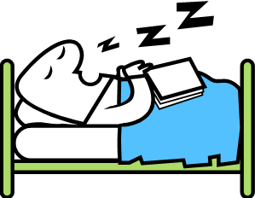

Fatigue – World Sleep Day
World Sleep Day is March 15, 2019
World Sleep Day is designed to raise awareness of sleep as a human privilege that is often compromised by the habits of modern life.
Why do we need sleep:
Discussion Points:
Are you struggling to sleep?
Can you create a better sleeping environment?
Can you develop a sleep routine?
Locks in Information -
Restores information that wasn’t ingrained during the day
Preserves important memories and ditches those of less importance
Provides time for memory building and brain cleaning (Toxic waste removal)
Sleep makes remote associations between pieces of information that our conscious daytime brains see as separate. In fact, people were 33% more likely to make creative connections after quality sleep.
Cerebral spinal fluid whisks away waste products, such as toxic proteins that can lead to Alzheimers and dementia.
Did you know: In the deepest stage of sleep, the part of your brain that’s responsible for relaying nerve impulses throughout the spinal cord sends a message to turn off motor neurons, causing temporary paralysis.
If you want to find out more about Fatigue and Sleep, please contact:
FatigueImprovementProgramme@networkrail.co.uk

Slide 16
Time to be mindful

Slide 17

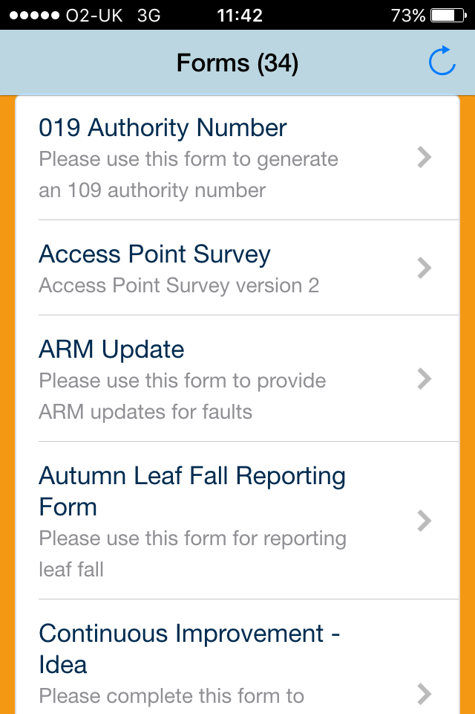
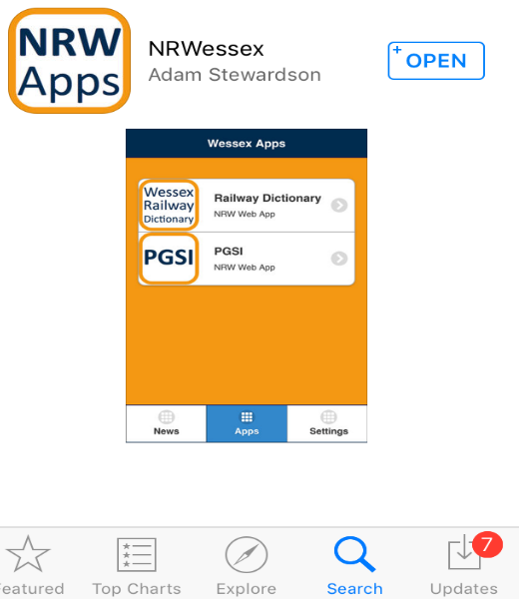
NR Wessex Apps
The NR Wessex App is found on the Apple App store, not on a NR specific App.
Once downloaded, it will appear on your home screen and you can add apps contained within directly on to your I-device.
Apps available include;
Pocket Guides - providing a reference to some common tasks.
Great British Public Toilets - providing information on the nearest public toilet.
Forms – please see of the available forms on the right and there are many more.
Safety Hour capture – does what it says on the tin.
Petrol Prices – the nearest petrol stations and the best prices available.
Railway Dictionary – containing frequently used words and acronyms.

Slide 18
Thank you and keep safe

