Slide 1

Standard 019 PDSW
“One+ Year On”
Wessex Route version of National Briefing

Slide 2
PDSW Vision
There will be a person in charge accountable for managing site, task and operational safety risk.
That person will have been involved in the planning of the work.
The PIC will be involved in the planning and delivery of the work being undertaken.
It is understood this may not be face to face; telephone and or email communication is acceptable.

Slide 3
Introduction
Embedment Issues:
National feedback has shown that the key themes for non-compliance towards to the standard include;
Lack of understanding of the new process
Lack of understanding of the PIC role and responsibility
Operational challenges making it difficult to always involve the PIC in planning
Planner capability and capacity

Slide 4

Key Roles
Person In Charge (PIC)
Collaborates with the Planner to produce a SWP
(NOTE: for cyclical SWPs this need only be the original PIC, for some locations a Super-PIC can do this for Blocking duties on behalf of others, depending on TSMs following the agreed Wessex process.)
Co-ordinates and delivers the briefings on site
Accountable for the site, task and operational risks
Manages and co-ordinate activities on site
Responsible for escalating issues (over runs, accidents, incidents)
The COSS still ensures the operational risks controlled, and the line is clear and safe for the passage of trains
Person In Charge
(PIC)

Slide 5

Key Roles
Planner
Creates & facilitates the production of the Safe Work Pack, in collaboration with all PICs, as directed by the Responsible Manager
Planner

Slide 6

Key Roles
Responsible Manager
Delegates the work activity to the appropriate Planner(s) and PIC(s)
Authorises the Safe Work Pack is fit for purpose
Accountable for the safe planning and delivery of the works
Responsible Manager

Slide 7
Variations from planned work
If the PIC determines that the SWP is inadequate or cannot be implemented as planned (due to weather conditions, failure of equipment, resourcing issues etc) the PIC may vary the task.
To do this, they must consider:
The planned protection or warning arrangements
New task and site risk controls
Be competent in the task or seek advice / guidance from competent persons e.g. COSS or task specific competence.
Have staff with the correct task competencies, equipment and PPE
The PIC can do this without an authority number if they use the existing or a higher planned level of operational hierarchy and mileages identified in the SWP and the task risk has not increased.
The PIC must be able to brief the work team on the new task and controls.
.

Slide 8

Long Worksites
The direction:
For any work that takes place at two or more locations (either common goal working or where there are discrete pockets of work e.g. installation of an earth strap, placing of protection)) there needs to be a PIC at each location
Each physically separated site of work within a long worksite must have a PIC
One site of work, one SWP, one PIC.
All PICs must be involved in the production of the SWP and the consideration of all task, site and operational risk
A COSS cannot carry out work without acting as a PIC
PIC
PIC
SITE OF WORK
SITE OF WORK

Slide 9
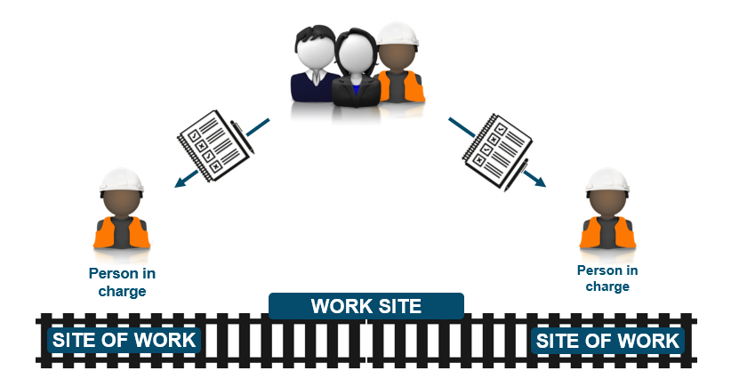
Practicalities of the process
Option 1 – multiple packs created through SSoWP
To comply to the standard completely, each individual site of work within the Engineering Supervisors Worksite, requires a pack to be created involving the PIC in the planning.
For Long worksites this would require all PICs involved in the work having individual packs and to have been involved in the planning of it.

Slide 10
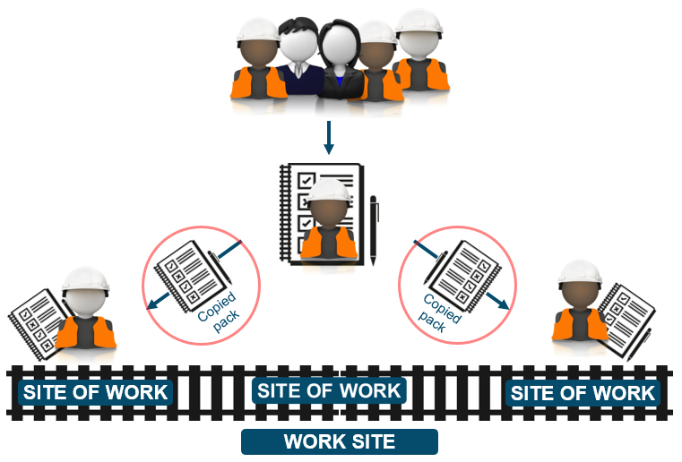
Practicalities of the process
Option 2 – single pack created through SSoWP
Alternatively;
Planners may create a single SWP for a common goal, covering all tasks at the sites of work and including all site and task risks associated with the activities to be undertaken.

Slide 11
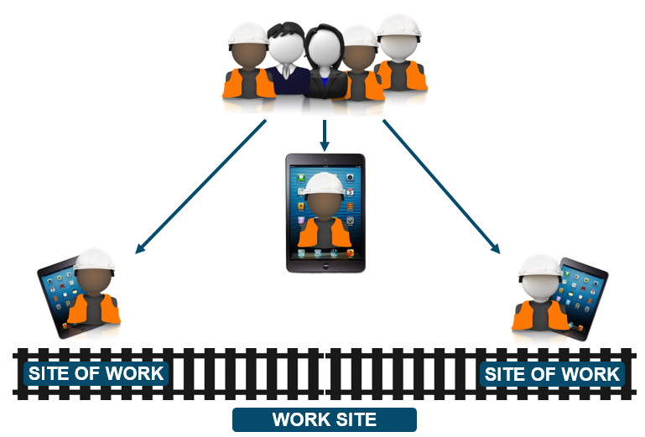
Practicalities of the process
Option 3 – multiple copies distributed through eSWPs
The eSWP solution simplifies this process. Provided all PICs have been involved with the planning of the activities it’s a simple matter of including them when sending out the emailed packs
Verification and authorisation processes still apply.

Slide 12
A year+ on…
…what have the 019 changes meant for you?
A year on, what do we still need to do?
Remind our people of the key changes and the purpose of the core roles: RM, Planner and PIC
Continue to drive 019 compliance
Help our people to understand “what’s in it for them” and the overall safety benefit from the Programme
Review of end to end planning process which was put in place for 019 implementation
Challenge the method of working during planning to drive Protection rather than Warning as the preferred method

