Slide 1
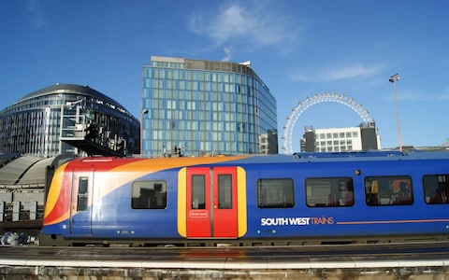
Wessex Route
Health, Safety and Environment Period Cascade for P13. 2018/19

Slide 2
Content
Welcome to your Health, Safety and Environmental Cascade for Period 13 2018/19. Please discuss and share the items that are relevant to your teams and display any relevant Safety Bulletins or Lessons Learned on your notice boards.
Included in this cascade is also the Front Line Focus Episode 84
Front Line Focus Episode 84 - March 2019.mp4
Significant Workforce Events
Asbestos
Range Finders
Guidance for ALO Planning and Infrastructure Plant Manual Guidance NR/GN/RMVP/0200 Issue 1 (Speed of Movements)
019 “One+ Year On”
Environmental Update
Health and Wellbeing
Wessex Access Points App

Slide 3
Significant Workforce Events

Slide 4
ECRO recharged incorrect isolation
On 22 March an Appointed Person (AP) for an electrical isolation connected with a TFL Line Blockage at Gunnersbury (Item 167) contacted the Raynes Park ECRO and asked for a B1 isolation to be re-energised.
During the call the ECRO quoted all information on a B2 isolation document for a different and incorrect isolation (Item 157).
The AP agreed the details but clearly did not listen to the information quoted by the ECRO, which was totally wrong.
As the result a different worksite was re-energised, whilst staff were working within. Fortunately no one was injured.
Additionally, one of the short circuit straps placed to protect the worksite arc’d and blew off because it was not securely attached .
This incident is under investigation but in the meantime note;
Safety Critical Communications require people to listen as well as speak; actively listen to what the other party is saying.
Apply all short circuit straps (SCS) properly as per training and instruction otherwise, in the event of an inadvertent re-energisation of a worksite, the SCSs will not remain in place and the conductor rail will become live.
Lack of attention can Kill
You can challenge the ‘lead’ in SCC if the SCC is not clear.
Confirm individuals involved in the SCC are the correct people.
Ensure key details are repeated back.
Question anything that was unclear.
Use the phonetic alphabet.
Keep SCC’s professional, clear and concise, even if you know the person you are talking to.

Slide 5
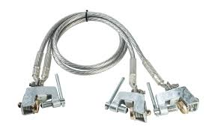
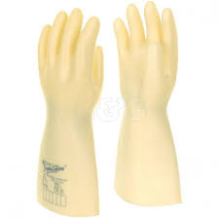
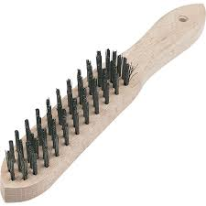
Application of short circuiting straps only
Only staff who are certificated as competent as Level A (Authorised/Nominated) or Level B (Competent/Authorised) Persons may carry out this activity.
Rubber gloves or gauntlets shall be worn throughout the application process.
Before use of the short-circuiting straps check for any damage or wear and that all bolted connections are secure.
The underside of the rails where the short-circuiting straps are to be applied shall be cleaned by the wire brush.
Each of the clamps can than be fitted, ensuring they are all properly tightened.
Notes:
Please refer to NR/WI/ELP/27140 – The Application of short circuiting straps for conductor rail isolations for more information

Slide 6
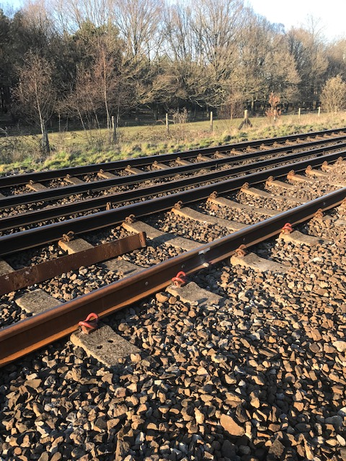
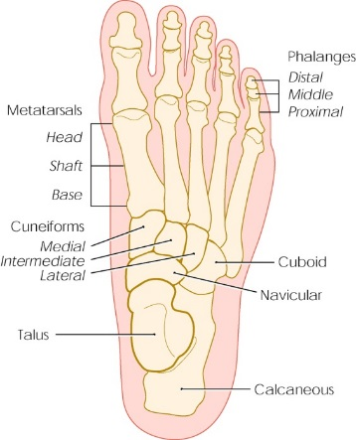
Broken Metatarsal Bones
A serious accident occurred at Woodfidley LC on 27th March 2019 at 01:15 when a piece of rail trapped the IP’s foot. The rail was moved by a member of the welding team from GPX without informing anybody of his intentions to move the rail.
The IP was immediately taken to the nearest A&E where it was confirmed his 2nd and 3rd metatarsals were broken. The estimated recovery time is 2 months.
This accident is still under investigation. Whilst the details are being confirmed, please discuss with your teams:
The importance of remaining vigilant at all times and the importance of warning others in your work site when moving rails
Any team manual handling should be properly co-ordinated and the person in charge should control all the movements

Slide 7
Asbestos Awareness
There is a mandatory Asbestos Training module on Oracle for all employees… have you done yours?
Some roles have been identified for additional training, ask your WHSEA if you are not sure.
A suite of Asbestos Guidance notes have also been created to assist anyone who may disturb asbestos containing materials (ACM’s) when working on our infrastructure. The guides must not be used in place of an asbestos survey. The link to the guidance notes is below, please note that these are grouped for ease of reference: Asbestos Guidance Notes
To ensure the compliance with the Control of Asbestos Regulations 2012 (CAR 2012) Network Rail has got the Asbestos Risk Management System (ARMS).
It is important to remember that as long as asbestos is in good condition and is not disturbed or damaged there is a negligible risk. However, if it is disturbed or damaged, it can become a danger to health.
Notes:
The guidance notes will show where ACM’s are likely to be and identify whether the risk is high, medium or low.
The asbestos guidance notes are currently being reviewed and will be circulated once the review process has been completed.
The ARMS is used for monitoring and management of asbestos containing materials (ACM’s).
If asbestos is disturbed the fibres are released into the air and people may breathe them in.

Slide 8
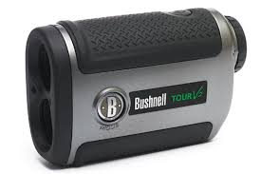
Range Finders
Rangefinders are by no means a ‘new’ tool, they have been available to our teams for a considerable time.
A rangefinder gives you the opportunity to ‘check’ the sighting distance available when setting up the SSOW rather than just accepting a best guess or placing a Lookout where he/she has always been.
Use of one can give additional confirmation that sufficient sighting distance is available for the group to reach the position of safety with the minimum of 10 seconds to spare before a train reaches the groups location.
Any additional measure to check the validity / suitability of sighting distance must be considered to be a good option and the use of a rangefinder to ‘check’ sighting distance does this.
The rangefinder can be used in conjunction with the methods of establishing sighting distance currently in use.

Slide 9
Any Line Open COP0032 Guidance for ALO Planning
There must always be a documented risk assessment in place if there is an open line when plant is operated on Network Rail managed infrastructure
Where plant can foreseeably foul an open line, then the Guidance in COP0032 must be followed and controls put in place.
Link to RSSB:COP0032.pdf
If you or your team Plan, Operate or Control OTP, you need to consider ALO.
If you require a briefing or more information, contact:
Keith Penn, RPSE
mailto:keith.penn@networkrail.co.uk
Notes:
This applies not only to RRV’s or RMMS’s but also includes lineside deliveries using knuckle boom cranes, mobile cranes, forklift trucks, etc.
There is a template for the ALO plan which is the risk assessment when plant could potentially foul an open line.

Slide 10
Infrastructure Plant Manual Guidance NR/GN/RMVP/0200 Issue 1
OTP Movements authority and associated speeds within an engineering possession.
Handbook 15 States:
7.4 Speed of movements
The following movements are restricted to a maximum of 5 mph (10 km/h):
• over points
• anywhere within sidings
• controlled from the ground
• where speed has not been given by the ES or PICOP.
Other movements may be authorised by the ES or PICOP at a speed up to 25 mph (40 km/h).

Slide 11
PDSW 019 “One+ Year On”
It has been more than a Year since the introduction of the Revised Standard 019.
So what have these changes meant for you and what do we still need to do?
Remind our people of the key changes and the purpose of the core roles of RM, Planner and PIC
Continue to drive compliance to the 019
Help our people to understand the benefits
Review off the end to end planning process which was put in place for the 019 implementation
Challenge the method of working during the planning stages to drive the use of Protection rather than Warning as the preferred method
A full presentation to be shared with your staff can be found on the link below:
Standard-019-PDSW-One-year-on Wessex Route.pptx
We will also be creating “ The best practice” Guide that will be shared in due course.

Slide 12
Safety Bulletins, Alerts, Advice
Safety-Advice-NRA19-04-Rotameg-Rail-Lifter.pdf
Shared-Learning-NRL19-03-Lifesaving-Rule-Test-before-Touch-rev-2.pdf
Shared-Learning-NRL19-04-RIDDOR-Dangerous-Occurrence-Signalling-wrong-side-failure.pdf
Shared-Learning-NRL19-05-Managing-the-risk-from-welding-fumes.pdf
Wessex Route Cable Theft Bulletin - Update 20/03/19.pdf
ESW Irregularity - Ops Alert NR_L3_OPS_050_F3.27A.pdf
NR-L3-OPS 050 Carlton CCTV Operations Alert March 2019.pdf
RIDDOR accident Broken metatarsals at Woodfidley LC (Beaulieu Road) 27 03 2019.pdf

Slide 13

Waste Classification
Mis-description of waste soils has become a growing problem for the Environment Agency. The letter below provides guidance and also acts as a reminder that ALL waste streams must be correctly segregated and correctly classified by the producer.

Slide 14

Health
OH Provider
OH Assist – Name Change to Optima Health
On Tuesday 5th March 2019, OH Assist changed its name and began trading as Optima Health.
The Occupational Health contract with Network Rail is unchanged and the services provided will remain the same.

Slide 15
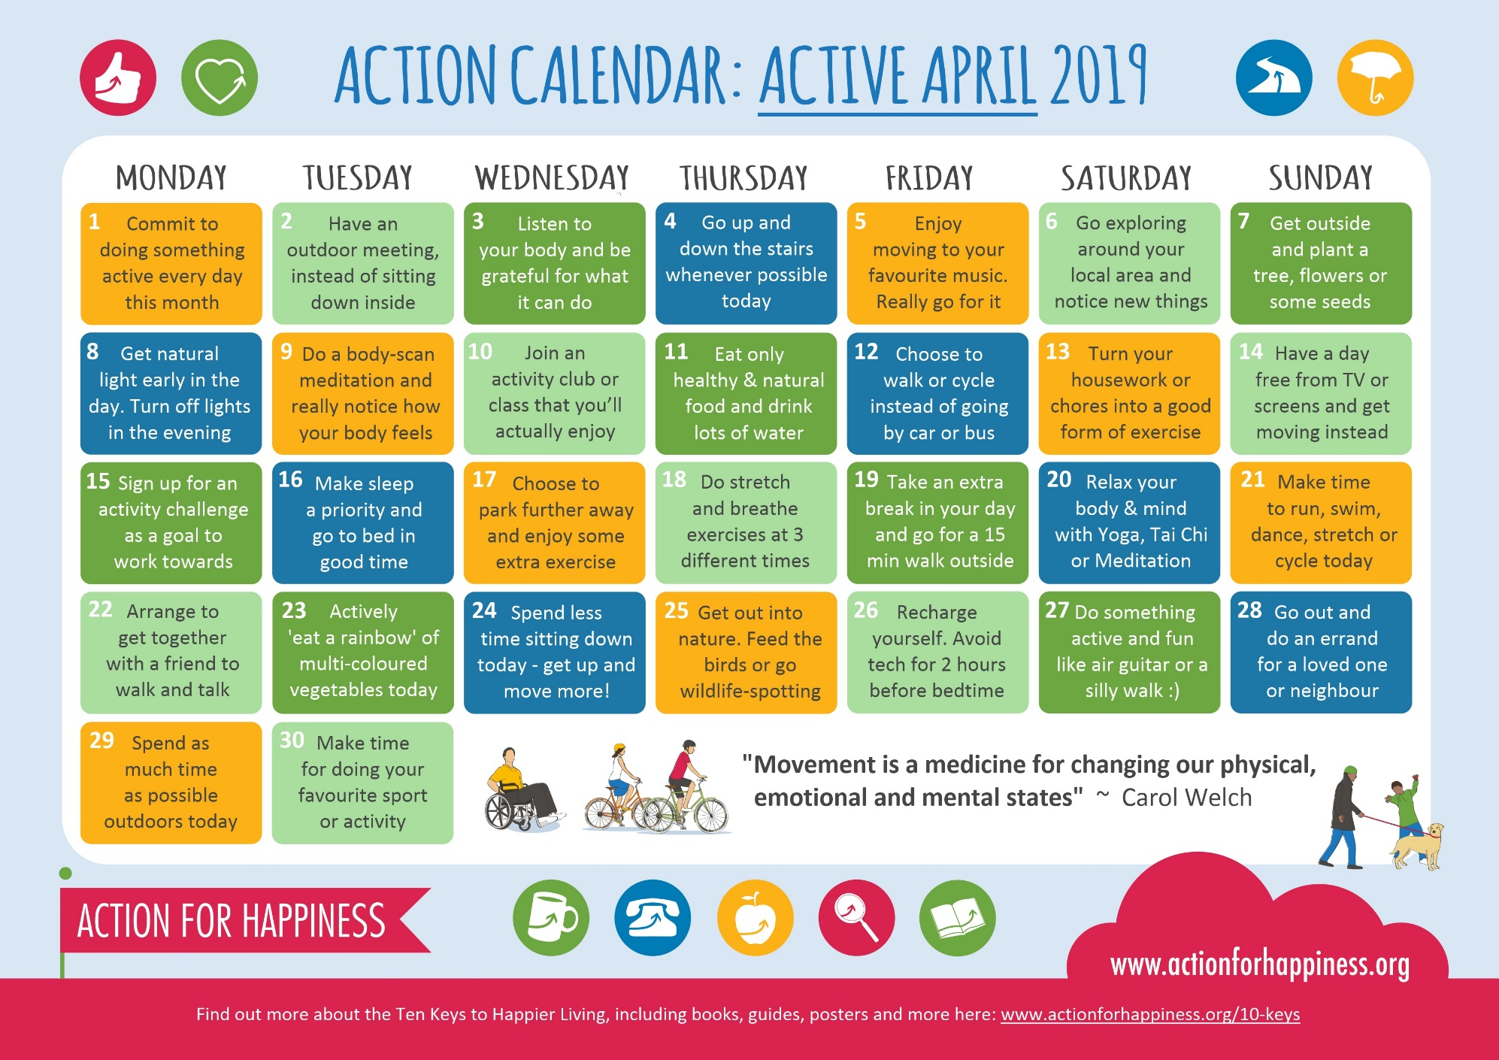
Time to be active

Slide 16
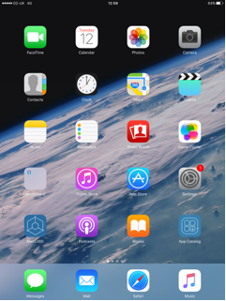
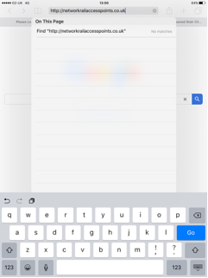
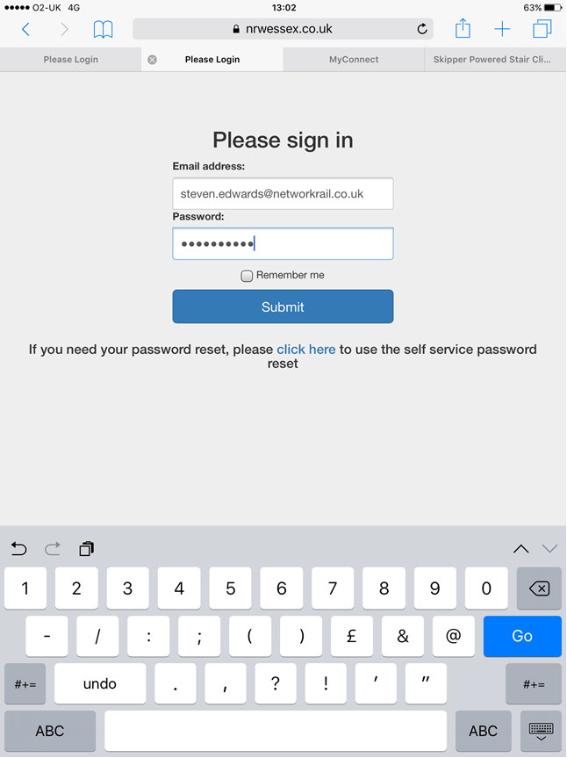
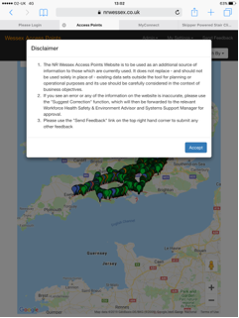
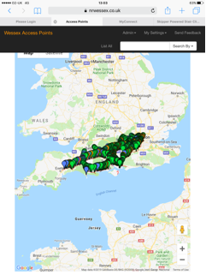
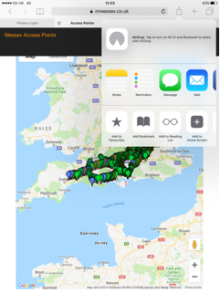
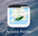
Wessex Access Point App
Sign in using your Network Rail email address and your Wessex apps password. If you don’t have a password, reset it by clicking on the ‘click here’ icon and creating and submitting your own password. This is for Wessex apps and the access point app only and does not replace your normal log-in details.
To install the Wessex Access Point app, click on the Safari icon on your I-pad
Enter http://networkrailaccesspoints.co.uk/ into your browser.
If you are happy with the disclaimer, click accept.
The access point app, in all its glory, will be open. Click on the circled icon and it will open the next image.
Here you can add it to your home screen.
The access point app is now available to you at the touch of an icon!

Slide 17
Thank you and keep safe

