Slide 1
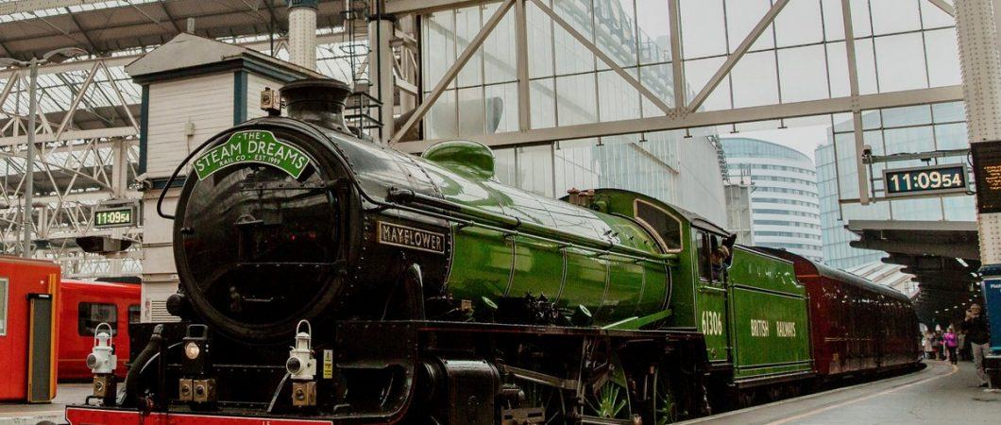
Health, Safety and Environment Period Cascade for P01 2019/20
Wessex Route

Slide 2
Content
Welcome to your Health, Safety and Environmental Cascade for Period 01 2019/20. Please discuss and share the items that are relevant to your teams and display any relevant Safety Bulletins or Lessons Learnt on your notice boards.
Significant Workforce Events
Near Miss at Woking Jn
Near Miss at New Covent Garden Market
The Importance of Supervision
Near Miss at Sundon (LNE)
Near Miss - Line Blockage (Western Works Delivery)
Significant Lost Time Injury – Dislocated Knee
Lost Time Injury – Ankle Tissue Damage
Manual Handling
Golden Hour Process
Safety Bulletin – Needle Stick injury
Plant Manual Update - Gradient Restrictions of Rail Trolleys and Rail Handlers
Environmental Update
Health and Wellbeing
Diversity and Inclusion – Ramadan

Slide 3



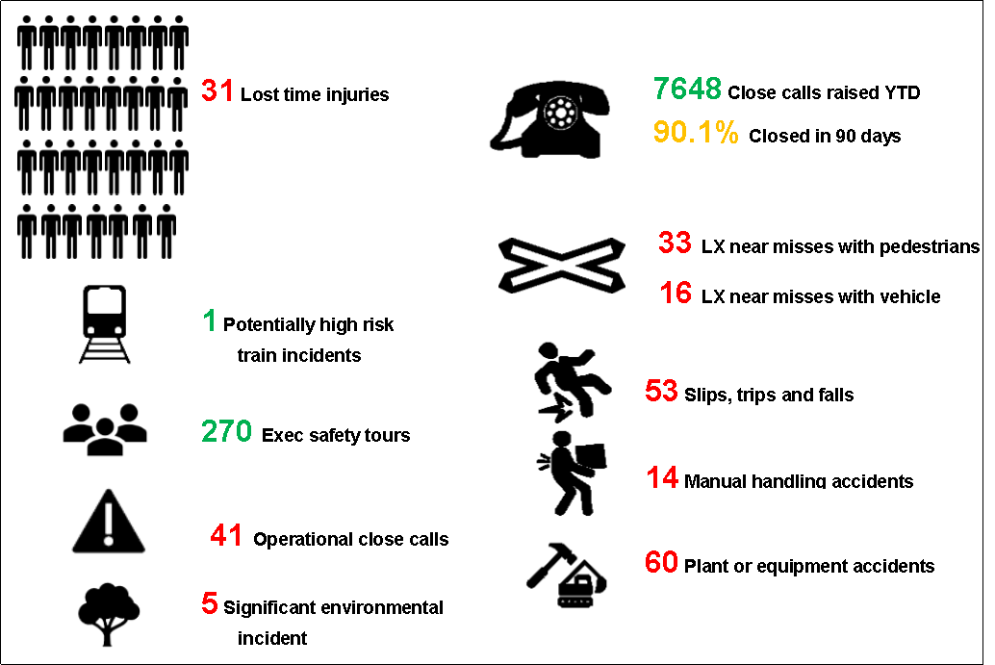

Workforce Safety
Slips, Trips and Falls x 4
04/04/2019 – Lookout stood on a catch pit lid which gave way. The IP fell over dislocating his knee. Unable to return to work to date LT
Discussion: How do you remain situationally aware of the hazards around you and your team?
Manual Handling x 2
11/04/2019 - The IP (LOSC Ganymede) was carrying a stressing ram down access steps at Vaggs Lane (New Milton). Reaching the last step the IP turned their ankle resulting in sprain and tissue damage LT
Discussion: Do you use the correct manual handling technique? Remember avoid, assess, review
Person interacting with tool/equipment
02/04/2019 – a strail lifter was dropped on IP’s foot during a re-fitment of strail panels. This was not reported at the time as the IP was not aware of the severity of the injury LT
Near Miss
15/04/2019 – Near Miss occurred at C/E of Woking Jn. The COSS/PIC got out of the 4ft only 4 seconds before the train passed the location
Discussion: How do you remain situationally aware of the hazards around you and your team?
Significant Events in the Period
Sun | Mon | Tue | Wed | Thu | Fri | Sat
 | 01 | 02 | 03 | 04 | 05 | 06
Week 1
07 | 08 | 09 | 10 | 11 | 12 | 13
Week 2
14 | 15 | 16 | 17 | 18 | 19 | 20
Week 3
21 | 22 | 23 | 24 | 25 | 26 | 27
Week 4

Slide 4
Operational Incident
Near Miss at Woking Jn
On 15th April 2019 at 11:27, during a Track Patrol of Woking Junction on the Down Fast of BLM1 at Country End of Woking Station, the Patroller /COSS was involved in a Near Miss with a SWR train 1P32.
This was a regular patrol and involved an experienced patroller. He had situated his lookout in a regularly used position of safety in the down cess, whilst he inspected 2231 pts. The site lookout was instructed to look out for trains moving toward the group on the Down Main and Slow. The 1P32 approached the group on the bi-directional Down Guilford line having crossed from the Up Guilford line (London bound).
The lookout noticed movement of the 1P32 toward the Patroller/COSS who made his way across the Down Main, Up Main and Up Slow to a position of safety. The 1P32 passed this location approx. 4 seconds later.

Slide 5
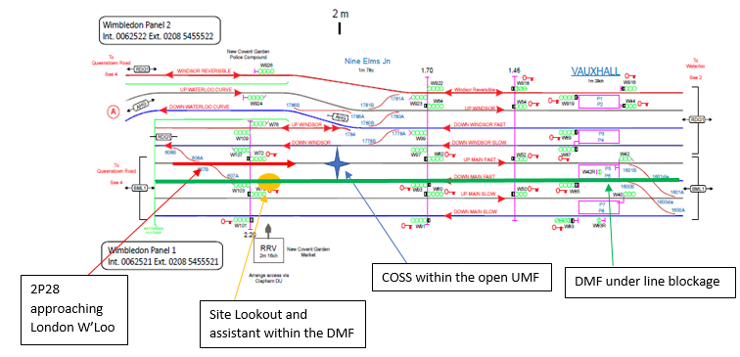
Operational Incident
Near Miss New Covent Garden Market – Period 02
On the 28th April 2019, a 3-man maintenance team based at Clapham Junction were undertaking a track inspection of the Down and Up Main Fast lines of the BML1’s between 1m78ch and 2m50ch.
The work was to be carried out within a Protection Controller's line blockage of the DMF.
The UMF was to be inspected under Lookout protection, using the blocked DMF as the position of safety.
The COSS/PIC instructed the Lookout and the assistant to remain at 2m14ch while he walked toward London to carry out the track inspection as far as 1m78ch.
After the COSS/PIC had completed this inspection he began to walk back toward his group on the DMF when he identified a number of dislodged Pandrol clips on the UMF.
The COSS/PIC crossed into the UMF to replace the clips and whilst undertaking this task 2P28 (Portsmouth to Waterloo) approached.
The COSS did not hear the first warning from the driver. After the second warning the COSS acknowledged the driver and stepped into the POS in the blocked DMF.
Both the Near Misses are currently under investigation but the initial findings highlight the following:
Importance of the decisions we make every day
Importance of raising concerns if something does not feel safe
Importance of challenging each other to ensure we all go home safe to our loved ones every day

Slide 6
Trackworker Safety
The Importance of Supervision Because when something goes wrong it is scrutinised
The HaSAW Act requires the employer to provide ‘supervision’ for its staff including contractors ‘as far as is reasonably practicable’.
The way we discharge this legal obligation is by Line Managers conducting either PGSIs or Senior Manager Safety Conversations.
It is important Managers conduct PGSIs/Safety Conversations on their staff particularly when they are exposed to significant risks.
These are the issues:
How do you know what your staff are doing unless you go out with them?
How do you prove you have done this if you do not document it? We have the PGSI App to enable us to record the visits.
What should you focus on, probably your departments high risk areas.
Some suggestions are
Implementation of operational risk controls
Manual Handling practises
Work where there is exposure to electrical risks
Exposure in a worksite to OTP and OTM
Would your ‘supervision’ regime stand up to scrutiny?

Slide 7
Operational Incident
Near Miss at Sundon, Bedfordshire (LNE)

Slide 8
Operational Incident
Near Miss - Line Blockage (Western Works Delivery)
On the 16th April 2019 a train passed a work group after the COSS took an approved line block with the Signaller.
The Driver did not sound the horn or report this as a Near Miss, as the 8 tonne excavator, which was being used to lift concrete blocks, was 8 meters away from the line and the 4 men team was in the cess side of the vortok fencing (separated). However this was an ALO work and the line was believed to be blocked, so the consequences could have been catastrophic.
The COSS is currently receiving counselling as he keeps replaying the incident and he has also been taken off of safety critical duties.
The voice communications were reviewed and the COSS made no Safety Critical Communication errors.
Please discuss with your teams:
The importance of ensuring good Safety Critical Communications are followed at all times. Repeat back any signaller instructions and make sure a clear understanding is reached
GERT800-HB8 Issue 7, IWA, COSS or PC blocking the line – Additional Protection should be used where possible
Actual location – the train above followed the train involved in the Near Miss

Slide 9
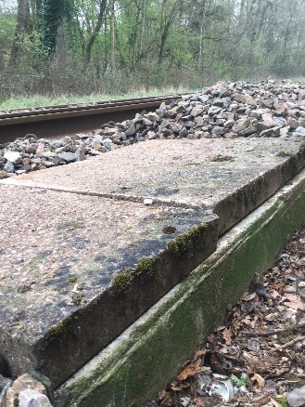
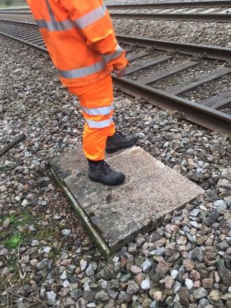
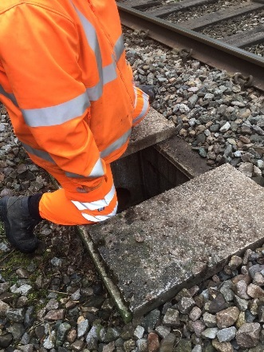
Trackworker Safety – Slips, Trips and Falls
Significant Lost Time Injury – dislocated knee
Please refer to the Lessons Learnt on the following link: Lessons Learnt Dislocated knee at Dunbridge 040419.pdf

Slide 10
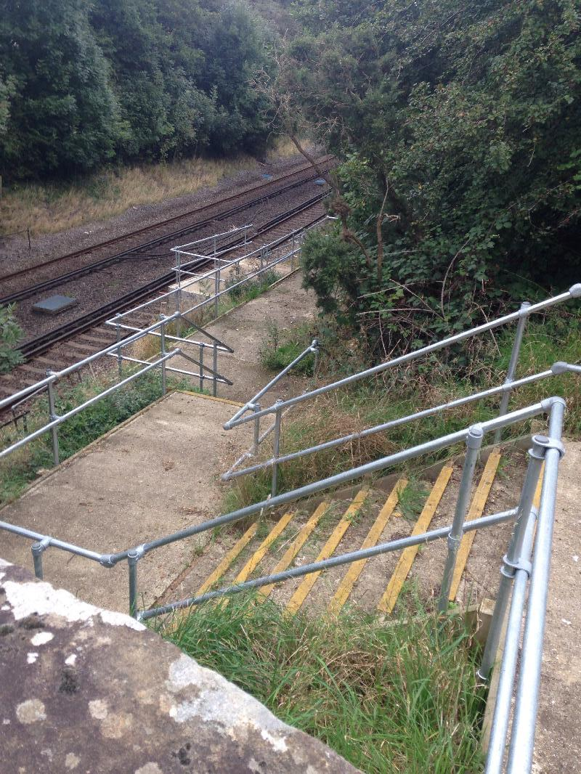
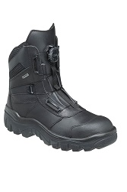
Trackworker Safety – Manual Handling
Lost Time Injury - Tissue Damage
Boa style boots are now available on I-proc and can be ordered for your staff. These boots come with fitted metatarsal protection and some of the other benefits are:
No laces to trip over
Time saved putting on and taking off the boot
Even tightening
Quick release if the boot gets stuck
Supplier Item NR10/5
Please refer to the Lessons Learnt on the following link: Lessons Learnt Ankle injury at Vaggs Lane 110419.pdf

Slide 11

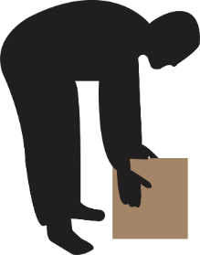




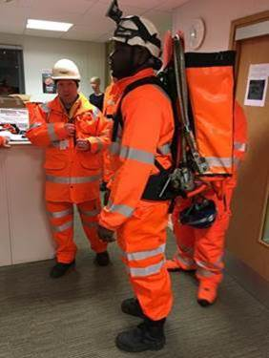
Workforce Safety – Manual Handling
xxx
Why do we have so many manual handling accidents?
Did you know that a specialised backpack has been developed (with the assistance from our route) to assist the strapping teams to carry all the necessary equipment to site safely. It is designed to carry 2 shorting cables, 2 worksite marker boards (lightweight version) and all the PPE, testing kit and paperwork for the task.
The backpack has a yoke to carry the shorting cables (preventing the need to carry them over the shoulder or roll them up in the bag). The bag is attached to the frame by magnets, so can be pre-loaded and stored away from the frame. Also, if the bag is snagged, it pulls off the frame to protect the user. The harness includes waist and chest straps to spread the load on the spine.
The backpack is available through iStore reference 0111/120776
Trackside Hazards
eg. vegetation
Incorrect manual handling techniques
Contents of the load
Attitudes and behaviours
Untidy worksites
Please watch the Manual Handling video that is part of the Think RISK campaign and discuss the content with your teams:
ThinkRISK_Plant_Sandiacre.mp4

Slide 12

WESSEX ROUTE - GOLDEN HOUR 2019
DCP to consolidate findings and ensure Lessons Learned document is completed; this will be submitted to the Safety Team for inclusion in the period safety cascade. Responsible manager to discuss with team at safety hour and implement any safety improvements recommended.
5
All accidents/near miss events are reported immediately (or as soon as it is practicable and safe to do so) to the WICC and an initial accident form is completed by the ICC and the reporter.
1
5
Report accidents/near miss events to the WICC
Discuss in the Periodic Safety Cascade and implement improvements
4
1
Accident Reporting & Investigation
Investigate the event
It is vital to gather all available evidence as soon as it is practicable to do so. Take photos of the injury, the location where the accident occurred and of any tools/equipment that were used at the time and quarantine these so they can be examined during the investigation. Remember we are trying to understand what happened so we can prevent reoccurrence!
Gather all available evidence, photos
of injury & site
2
Level 1 report to be completed and submitted to the DCP within 7 days. The DCP will appoint a Lead Investigator if a further investigation is necessary.
4
Lev1
3
6hr ICC update & 24 hr H&S Manager telecon
2
Responsible Manager to;
Call ICC and provide a 6hr update
Call into 24 hrs teleconference with the Health and Safety Manager..
3

Slide 13

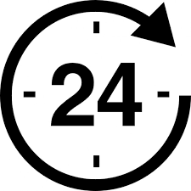
Key Point Card
WESSEX ROUTE - GOLDEN HOUR 2019
1Hour
Workforce accident or near miss reported to Wessex ICC
6 Hours
24 Hours
Responsible Manager hands over duty of care & care plan to Line Manager who:
Wessex ICC issues control report form (NR2072R) at 6hrs
refines the care provided if necessary – consider both physical and mental wellbeing
provides updated event and injury details to Wessex ICC
On site Person in Charge (PiC) identified and any immediate action undertaken
Responsible Manager will gather initial facts and secure all evidence from witnesses.
Wessex ICC issues alert to existing ‘Accident Forms’ distribution list
Responsible Manager;
undertakes medical referral / occupational support if necessary
completes Investigation Form (Level 1)
Line Manager & WHSEA to attend Route Health and Safety Managers teleconference call to give full details and discuss progress in the 24hr update.
Responsible Manager appointed by Wessex ICC; liaises with PiC
Photographs of all injuries and site/plant involved will be taken.
re-assesses of the injury severity
owns duty of care and confirms injury severity
Notes:
A guide to aid the process will be issues also.

Slide 14
Safety Bulletin
Needlestick Injury (Western Route)

Slide 15
Infrastructure Plant Manual
Gradient Restrictions of Rail Trolleys and Rail Handlers
Runaway Incidents in CP5
Gradient restrictions have been imposed on ironmen and link trolleys due to these incidents of a maximum gradient of 1 in 150.

Slide 16
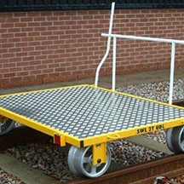
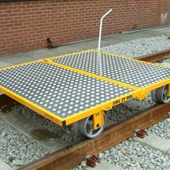
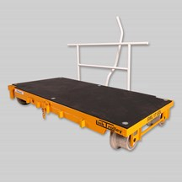
Infrastructure Plant Manual
Gradient Restrictions of Rail Trolleys and Rail Handlers
Types of Rail Trolleys and Gradient Restrictions
Type A trolley is a single platform trolley that weighs 90kg and can carry a UDL of 1000kg. Can be used in gradients up to a maximum of 1 in 50 as per Handbook 10 GERT8000-HB10.
Type B trolley is in 2 parts and weighs 130kg. This has a larger loading platform than the type A trolley and can carry a UDL of 1000kg. This trolley can be used in gradients up to a maximum of 1 in 50 as per Handbook 10 GERT8000-HB10.
Link type trolley has a smaller loading area and weighs 47kg. Each link trolley can carry a UDL of 1000kg Three link trolleys can be joined together, which can carry a UDL of 2000kg. This trolley can be used in gradients up to a maximum of 1 in 150.
The gradient restriction of 1 in 150 applies to link type trolleys and manually propelled rails handlers (ironmen).
If you are planning to work in an area with a gradient greater than 1 in 100, then control measures must be put in place to reduce the risk of runaways as per the standard NR/L2/OHS/019.
If you require any more information, contact: Keith Penn, RPSE
mailto:keith.penn@networkrail.co.uk
Notes:
When work is being planned, the responsible manager, person in charge and
planner shall seek to eliminate the risk of a runaway before implementing mitigation
measures.
Where available controls to prevent a runaway event reaching a site of work are not
achievable, a secondary warning system shall be deployed.

Slide 17
Safety Bulletins, Alerts, Advice
Lessons Learnt Near Miss at Woking Jn 150419.pdf
Shared-Learning-NRL19-06-Sundon-near-miss.pdf
Lessons Learnt Dislocated knee at Dunbridge 040419.pdf
Lessons Learnt Ankle injury at Vaggs Lane 110419.pdf
Lessons Learnt Late Reported Foot Injury 020419.pdf
Safety Bulletin Needle Stick Injury WNB1913.pdf
Safety Alert Transferrable lessons ECRO error 220319.pdf
Wessex Route Cable Theft Bulletin - Update 12APR19.pdf
Safety-Alert-NRX19-02-Railway-security-and-safety.pdf
NR-OPS-053 Ops Irregularity Henwick.pdf
NR_L3_OPS_052_defective Signallers chair in TVSC.pdf
CIRAS-Poster-2019.pdf

Slide 18


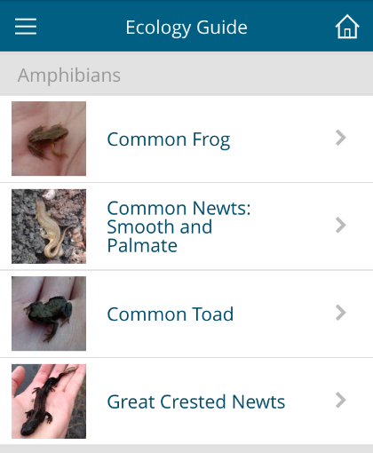

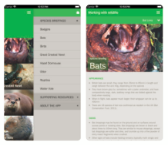
Environment
Species Identification Apps
‘EcoReporter’ is a Network Rail App that contains a guide to assist the identification of key plants and animals on site.
The app can also be used to log sightings of animals and plants. This information can be used to inform future planning and management of works. Please also ensure you report any confirmed sightings to a WHSEA so that it can be added to the hazard directory and the invasive species treatment schedule when applicable.
The ‘Working With Wildlife App’ provides more in-depth practical advice on how to recognise common protected species out on site.
Further information includes why and how they are protected.

Slide 19

Health & Wellbeing

Slide 20
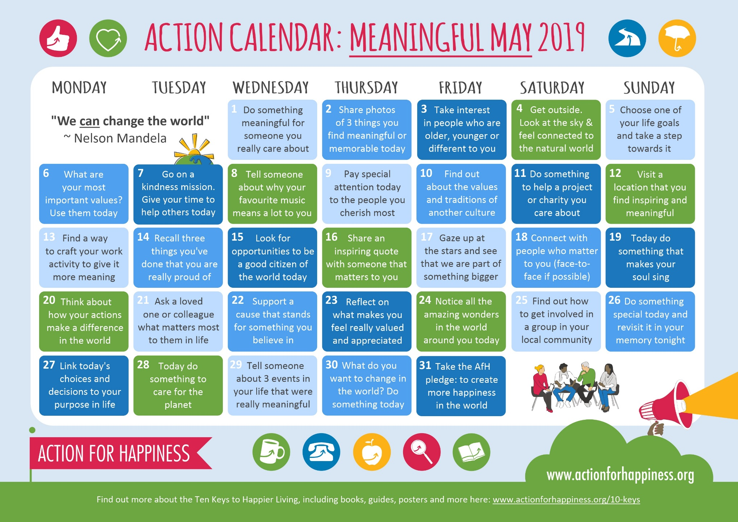
Health & Wellbeing

Slide 21
Diversity and Inclusion
Ramadan is expected to begin on the 5th May and end on 4th June– this is one of the five pillars of Islam and is a time of fasting for Muslims around the world.
During Ramadan most Muslims will eat a meal before dawn, and then again when daylight is over. No food or drink is consumed during the day and it is important we recognise the impact on an individual, as well as the opportunities available to them for support during the month of Ramadan. Some of the effects of fasting could include:
Dizziness or light-headedness
Headaches
Tiredness
Heat related issues e.g. heat stroke, heat exhaustion
Reduced concentration
Irritability
These will not be the same for everyone, and some people may show no effects. It is different from person to person. You can support fasting colleagues by talking about fasting in team meetings, acknowledge that it is coming up and make sure your other colleagues are aware of it. Encourage discussion so that a fasting colleague feels they can come to you if they need some support. The person who is fasting will know how it may effect them and will be the best person to tell you about this. Don’t make assumptions.
We can play a major role in supporting those employees who observe fasting. This can in turn benefit our business. It should be appreciated that Muslims observing the fast have a longer day than usual.
If possible make allowances and provide access to relevant health and well-being guidance to employees.
Be sensitive to what fasting means and look out for each other when out on track
For more information, please contact your local D&I champion or email diversityandinclusion@networkrail.co.uk

Slide 22
Thank you and keep safe

