Slide 1
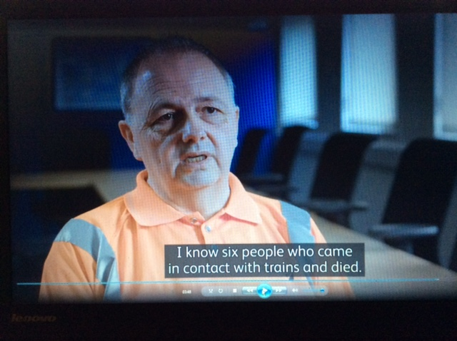

Wessex
Route
Network Rail
See the film..
Think RISK Launch!
Health, Safety and Environment Period Cascade for P2. 2018/19

Slide 2

Welcome
Welcome to your Health, Safety and Environment Cascade for Period 2 2018/19.
In this cascade;
Workforce Accidents
National Safety Think RISK Campaign
Ancillary PPE catalogue
SWP/019 Authority Numbers
Parking Near Level Crossings
Health and Wellbeing
  Mens Health Week
  HAVS
  Hot weather preparedness
Executives ‘Adopt a Section’
Safety Bulletins
Operational Notices
Life Saving Rules Revisited
Close Calls
Environmental
Appreciation
Remember to
Check out the THINK RISK Launch film for the full story of the trackman on the front cover

Slide 3

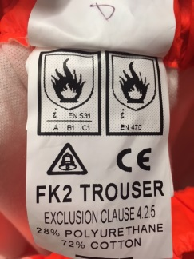
Workforce Safety
Lost time injuries
Location | Department | Injury | Circumstances | Lessons Learnt/Discussion
Trackside | INNER DU Wimbledon P-Way | Back pain | As the IP lifted part of a stressing kit (68kgs) from the track onto a track trolley he sustained a back injury. | What is your personal lifting capability? Assess the load, don’t take on more than you can comfortably lift. See Lessons Learnt Circular.
Trackside | INNER DU Wimbledon P-Way | Acute Knee pain | Whilst carrying out a Track Patrol the IP reported that he felt sudden acute pain in his left knee and could no longer walk. This occurred where the underfoot conditions were flat and stable.
ROC Training area | INNER DU Clapham P-Way | Minor Burn to right shin. | While undertaking training for the rail mounted disc cutter, the PPE he was given caught fire and melted from sparks from the disc cutter. The fire was quickly extinguished and the PPE which, it transpired was not flame retardant was removed . | Always check the label to confirm the PPE you are giving or are given is the right equipment. For our Flame Retardant PPE this is the symbol and the EN number is EN 470

Slide 4
Workforce Safety
No lost time injuries
Location | Department | Injury | Circumstances | Lessons Learnt/discussion
Depot office | INNER DU CRE | Cut finger | IP sustained the cut when his finger came into contact with damage to the underside of a chair armrest which was not visible. | Hazards exist in the office environment.
Signal Works Yard | Works Delivery Wimbledon S&T | Cut below eye | IP was holding a punch to remove bolts from a P-way sole plate, his associate was using a 2lb hammer to hit the punch, the hammer slipped off the side of the punch and hit the IPs face. | When working in close proximity to one another clear communication is essential… a bit of Risk Based Commentary maybe?
Tapnage Tunnel | OUTER DU D&P | Twisted ankle | IP sustained the injury whilst walking on troughing when his right ankle gave way on uneven lids.
Woking sidings | INNER DU Woking P-Way | Hydraulic fluid in eye | Another member of the team removed the pipe from the ram, a small amount of excess fluid contained within the pipe escaped and caught the Team Leader on the side of the face close to his left eye. | Clear the area and issue a warning to those nearby. Move to a safe place when cleaning ones Safety Glasses. See Lessons Learnt Circular…

Slide 5

Workforce Safety
No lost time injuries
Location | Department | Injury | Circumstances | Lessons Learnt/discussion
Eastleigh Office | B&C RAM Cleaning Contractor | Cut to hand | A Cleaner sustained the injury when handling a broken cup with a sharp piece that cut into the IP's hand between outside of thumb and wrist, approx’ 5mm deep x 1 inch long. | Another office based hazard to be aware of. If you break a cup please dispose of it properly.
Epsom Junction | INNER DU Wimbledon S&T | Back strain | Whilst walking in 6ft adjacent to 840b pts, the IP caught his left foot on cable causing him to trip forward and stumble whilst holding/carrying tool bag. The IP felt very slight discomfort of lower back and knee. | This occurred in during the hours of darkness, do we have sufficient lighting available to clearly allow the route to be seen?
Guildford Depot | OUTER DU ATME B’stoke | Small lump on head | IP was tidying the Technical Store Room with a colleague. Whilst tidying at ground level, his colleague was moving items on top of a shelf above him. IP believes that his colleague must have knocked the wall bracket placed on a high shelf, this resulted in the bracket falling from height striking the IP's head. | Tidying the store room is a brilliant thing to do. Maybe clearer communication and personal space in a confined area.
Witley | OUTER DU S&T Havant | Electric shock | Whilst conducting wire correlation / checking within LOC 97, the IP received a significant electric shock, the current entered through his left hand and travelled across the chest before exiting from his right hand. | Still subject to investigation and a Lessons Learnt will follow but NOTE All members of staff who suffer an electric shock will immediately go to A&E for a medical assessment.

Slide 6

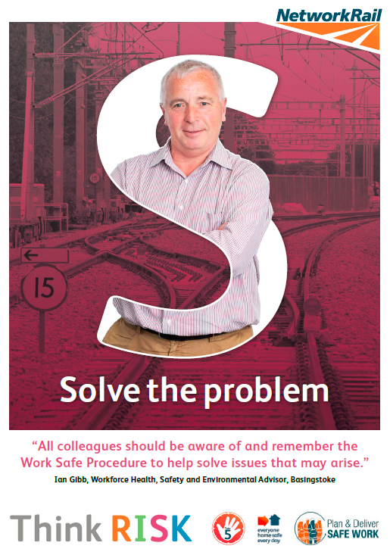

National Safety Campaign
Think RISK
Separate presentation attached to this Safety Cascade for managers.
Make sure you use the link below to the
THINK RISK Launch film in this briefing
Think RISK Launch Film
Safety Hour material, posters and other Think RISK material can be found on Safety Central.

Slide 7

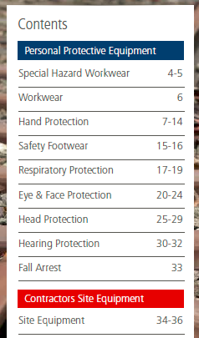
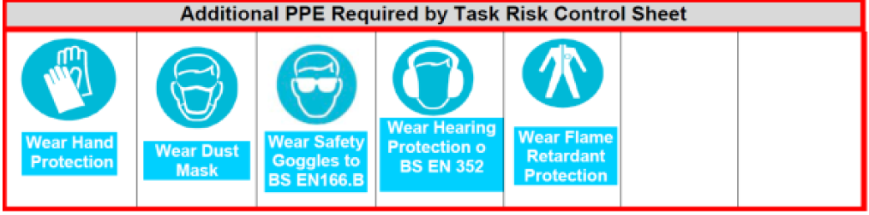
Personal Protective Equipment
Do you have everything you need?
A typical Task Risk Control Sheet (TRCS) will state what additional PPE is required for task risk controls. (see below)
Make sure you;
Read the Task Risk Control Sheet for all tasks,
Have the right additional PPE for the task,
If information is missing from the TRCS or additional PPE is not available please raise a Close Call.
The Ancillary PPE Catalogue should cover all of our needs. (Copy attached to this cascade.)

Slide 8
019/Safe Work Packs
Authority numbers for SWPs
What is the purpose of an Authority Number?
  To confirm a Responsible Manager understands and agrees change to the plan,
  A conversation between PIC and RM is necessary before an Authority Number can be given.
These are the circumstances when a Responsible Manager can issue an Authority Number for a SWP only after it has been verified by the PIC;
  There is requirement to move down the Hierarchy of Operational Control,
  A significant change to work content and/or risk controls is required,
  Changes to planned details are not supported by information in the SWP,
  Site of work limits need extending to cover additional work,
  Unforeseen absence of the named PIC has meant that another PIC has to be nominated for the work by the RM in the previous 24 hrs.
NEW:
  There is now an Authority Number Record form to generate and record automatic Authority numbers on ‘Wessex App Forms’.
  At the moment it is for voluntary use but we will be moving to full use within the next two months for all Authority Number issued. Get in the groove now!

Slide 9
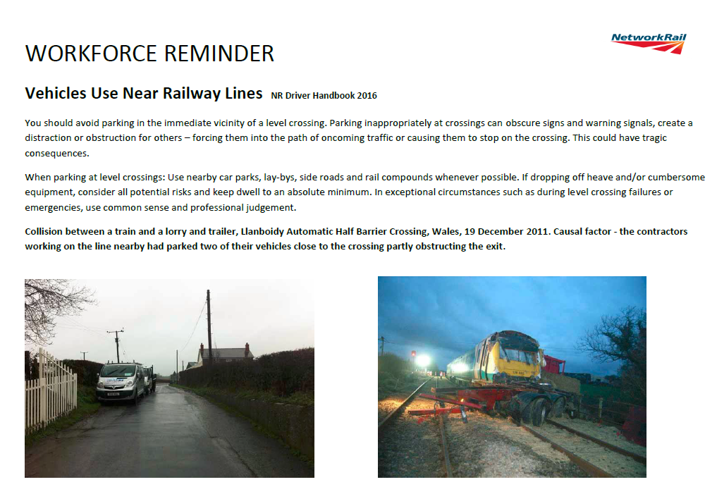
Parking Near Level Crossings

Slide 10

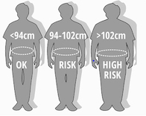

Health and Wellbeing
Men’s Health Week: 11 – 17 June
The BIG Picture:
Both Type 1 and Type 2 diabetes is more common in men.
Highest prevalence of Type 1 is between the ages of 45 to 54 years.
Both Type 1 and Type 2 diabetes is significantly higher in Black Caribbean, Indian, Pakistani and Bangladeshi men than in the general population.
Over 1 million people in the UK are living with undiagnosed diabetes. The likely majority being men.
Causes of Diabetes:
The principle cause of type 2 diabetes is being overweight or obese
Men with a waist circumference of 102cm is 5x more likely to diagnosed with diabetes than those without a raised waist circumference.
Regular smokers are at higher risk for developing diabetes compared to non-smokers.
.
Prevent:
Reduce risk of type 2 diabetes by achieving a healthy weight.
Attend NHS Health checks.
.

Slide 11

Health and Wellbeing
HAVS Surveillance 18/19
The Programme
Tier 2: Questionnaire | Tier 3: Face-to-face
Employees will be given a paper questionnaire. Complete and sign and return it to their SM. SM will scan it and email it back to OH Assist for processing. | Employees will need to be booked onto a clinic closest to their depot: Outer DU: Eastleigh and Basingstoke ROC Inner DU: Wimbledon Stable block Woking Depot
Call to attendance:
If you have used vibrating tools on a regular basis within the last 2 years than you need to attend HAVS surveillance.
.

Slide 12


Health and Wellbeing
Hot weather precautions
Drink more water; do not wait until you are thirsty & continue drinking throughout your shift.
Wear loose fitting light weight clothing, cover arms with long sleeved shirts.
Use sun screen on exposed skin.
Wear a safety helmet
Keep out of the sun, take to shaded areas if available.
We provide
  Tinted Safety glasses
  Sun protection
  Water bottles.
Ask your line manager if you need any of the above.

Slide 13
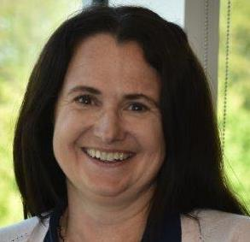
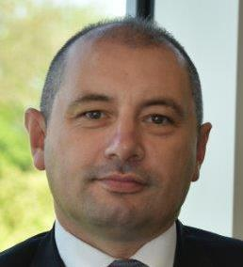
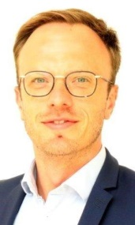
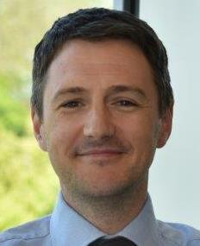
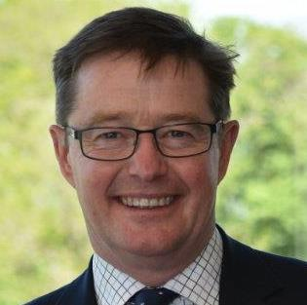
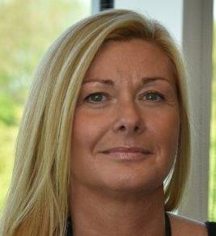
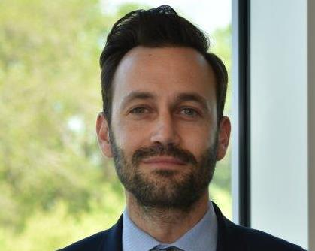
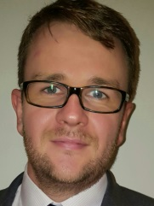
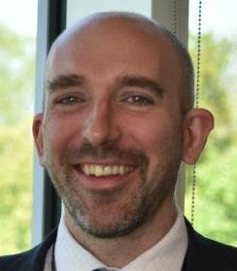
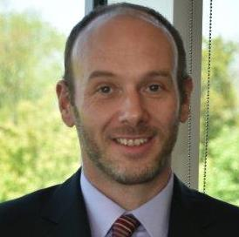
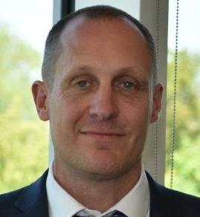
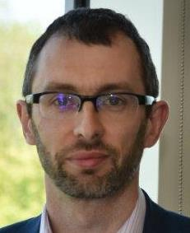
Wessex executives adopt a section
If you haven't seen yours yet invite them over for coffee; adoption is a two way thing!
Name | Role | Designated locations
Sam McCarthy | Director of Finance | Woking, Winchfield & Bournemouth Signal Box
Jason Bridges | Chief Operating Officer | Basingstoke & Havant
David Langton | Head of Communications | Salisbury
Stewart Firth | Director of Sponsorship | Eastleigh & Bournemouth
Chris Perkins | Director Business Change | Wimbledon
Sandra Lloyd | Head of HR | Guildford & Woking
Chris Cornish | Director Works Delivery | Works Delivery
Paul Richmond | Director Business Development | Raynes Park & Feltham
Stuart Kistruck | Director of Route Asset Management. | Feltham
Charlie Usher | Head of Maintenance | Waterloo & Clapham
Giles Baxter | Head of Operations | Signal Boxes
David Smith | Head of Route Safety Health & Environment | Eastleigh & Yeovil

Slide 14
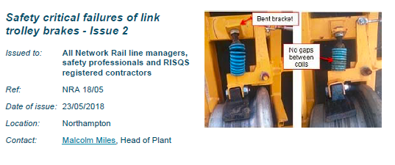
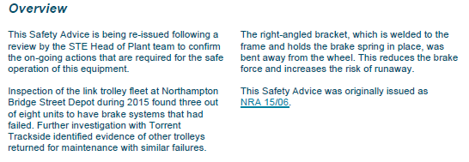
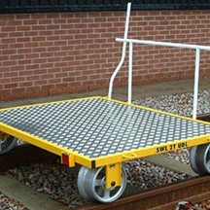
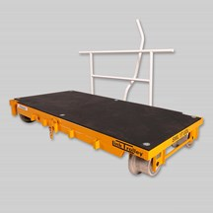
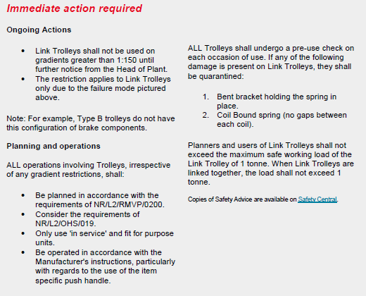
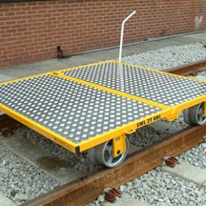
Safety Bulletins
Re-issue: link trolley brake failure
TYPE A Trolley
Smaller Link Trolley this is the affected by the 1:150 ban.
TYPE B Trolley – not affected by the 1:150 ban

Slide 15
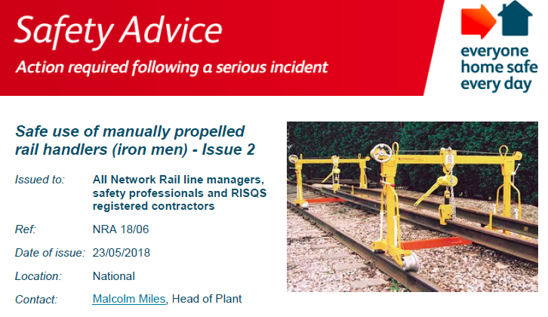
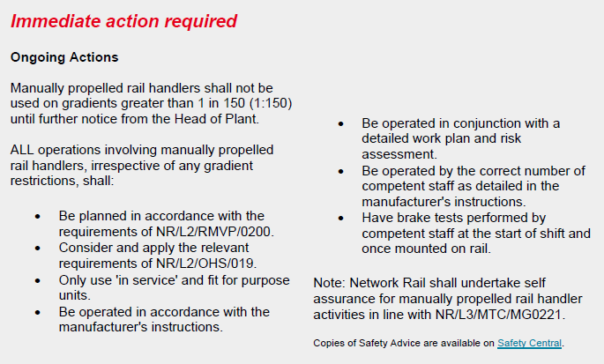
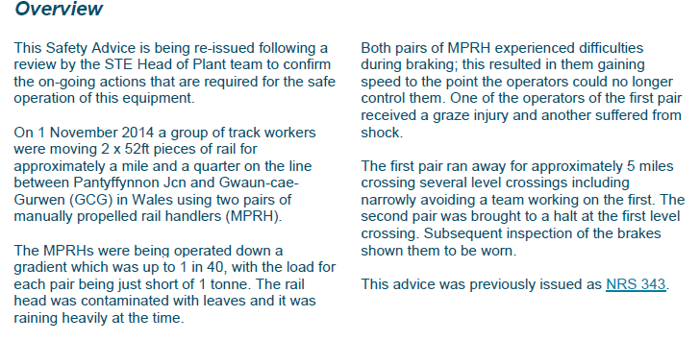
Safety Bulletins
Re-issue: MPRH

Slide 16
Operational Notices
Connect the links before brief, important information for all are contained in these Notices.
NR-OPS-015 Up Ludgate Line Blockage Irregularity.pdf
NR-OPS-016 Line Blockage Irregularity Epsom Station.pdf
NR-OPS-017 Line Blockage Irregularirty Highbury and Islington Station.pdf
NR-OPS-020 Foley Signaller assault.pdf

Slide 17
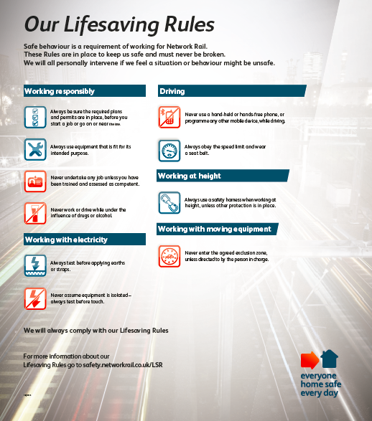
Life Saving Rules Revisited
What do these really mean to you?

Slide 18
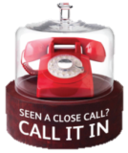
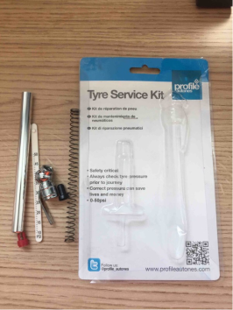
Close Calls
Call it in to prevent future accidents
    Seen something that doesn’t look or feel right? Call it in
    By calling in an incident that has the potential to cause damage or injury, you can help prevent it occurring in the future
    Apparently if everyone can find two a week we will reach our Corporate Scorecard target... Please make them meaningful,
    Interesting Close call of the period… reported by the lovely Billy Ball from Works Delivery
    Incident Location:
    Works delivery outer yard. Campbell road, SO50 5AD
    Incident Description:
    While carrying out tyre checks and using pressure gauge on rear tyre.
    The gauge blew apart.
    What event could have resulted from this unsafe act/condition:
    Could have caused injury due to flying parts.
    Has the risk been removed?
    Yes - Non use of the said gauge.

Slide 19
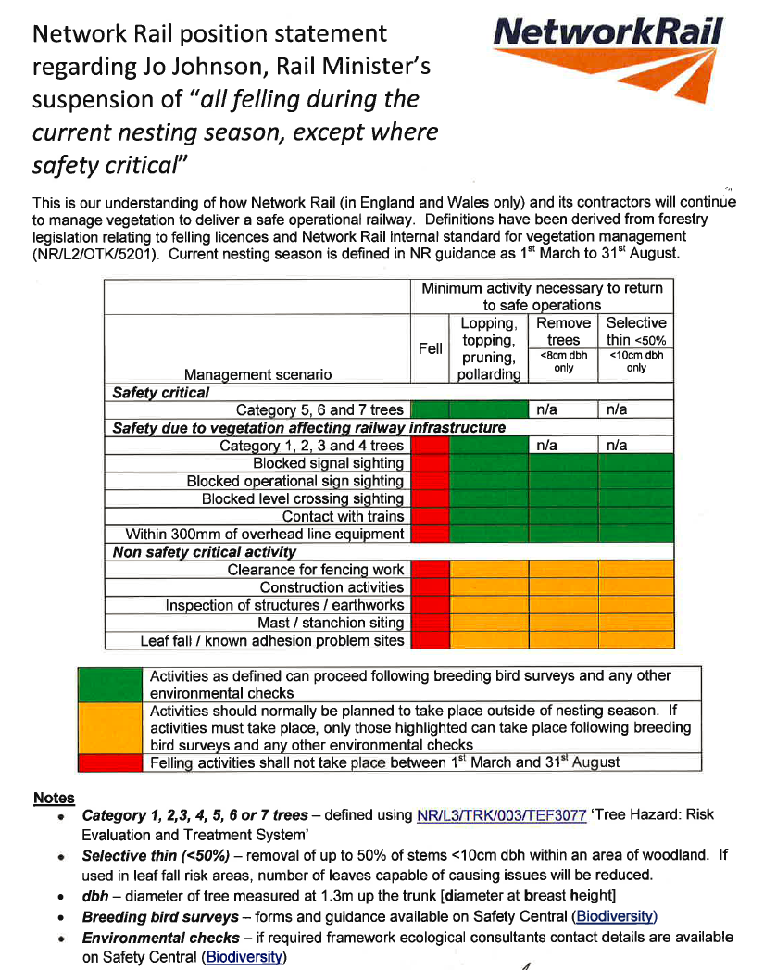
Environmental
Felling of trees
Just in case you missed it, there are limits and processes to be followed regarding tree felling during Bird Nesting Season (1st March to 31st August)
For further information refer to;
NR/L2/OTK/5201 - Lineside vegetation management manual
NR/L3/TRK/003/TEF3077 - Tree Hazard risk Evaluation and Treatment system
Check out Safety Central (Biodiversity) for further information and guidance on a multitude of subjects
https://safety.networkrail.co.uk/home-2/environment-and-sustainable-development/environment/ecology-biodiversity/

Slide 20
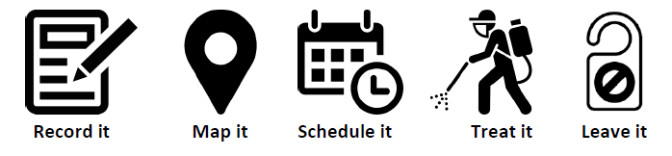
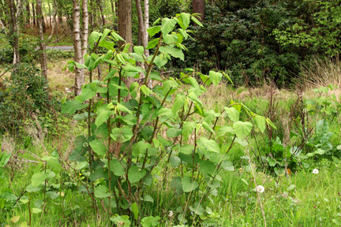
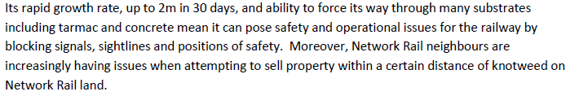
Environmental
Japanese Knotweed
Is an invasive non native plant.
Is a nasty piece of work and is planning to illegally take over the world so:
Record it
Map it
Schedule its’ destruction
Treat it
Leave it

Slide 21
Appreciation to……
The S&T Safety Rep who correctly challenged another member of staff appearing not to have a Safe
System Of Work in place for himself or outside parties whilst on or about the line.
The S&T team from Feltham; Lyndon Goodluck, Daniel Tilley and Thomas Mansell who arrived on site, found a suicidal male was attempting to access the track. They talked to the individual, and created a physical barrier (putting themselves between the person and the infrastructure) to separate the male from the track.

