Slide 1
GUIDANCE ON THE USE OF THE HSE FATIGUE & RISK INDEX FOR INVESTIGATIONS

Slide 2
Purpose
The purpose of this document is to provide all investigators and designated competent persons a brief and awareness of how to use the Fatigue and Risk Index (FRI) as part of investigations. We are providing this guidance document to ensure that fatigue, including the FRI, is adequately considered as part of the Level 1 investigation (and Levels 2 & 3) as a potential causal factor of an incident.

Slide 3
Background
A common factor of fatigue is inadequate rest and sleep caused by a reduction in sleep duration, extended waking hours or a disruption in the timing of sleep-wake periods. However, it can also be influenced by factors external such as workload, the individual's interest in the task or their motivations associated with the task.
There are 3 main agreed groups of factors that cause fatigue:
Work related factors; such as timing of working and resting periods, length and number of consecutive work duties, intensity of work demands.
Individual factors; such as lifestyle, age, diet, medical conditions, drug and alcohol use, which can all affect the duration and quality of sleep.
Environmental factors such as family circumstances and domestic responsibilities, adequacy of the sleeping environment

Slide 4
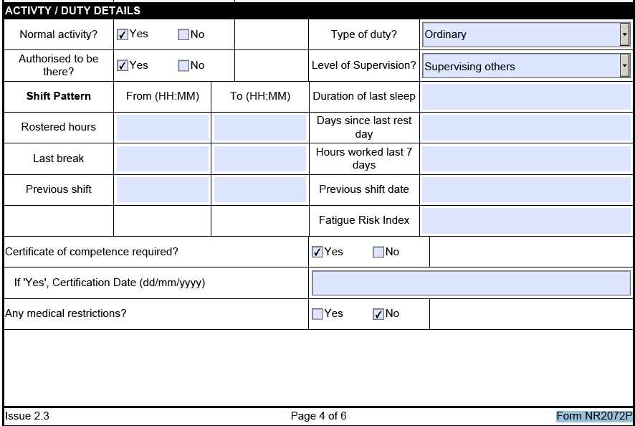
All investigations should consider these factors in reaching any conclusions about fatigue. The Level 1 investigation form (Form NR2072P) requires a fatigue risk index to be calculated. This is to be calculated via a Fatigue and Risk Index provided by the HSE www.hse.gov.uk/research/rrhtm/rr446.htm.

Slide 5
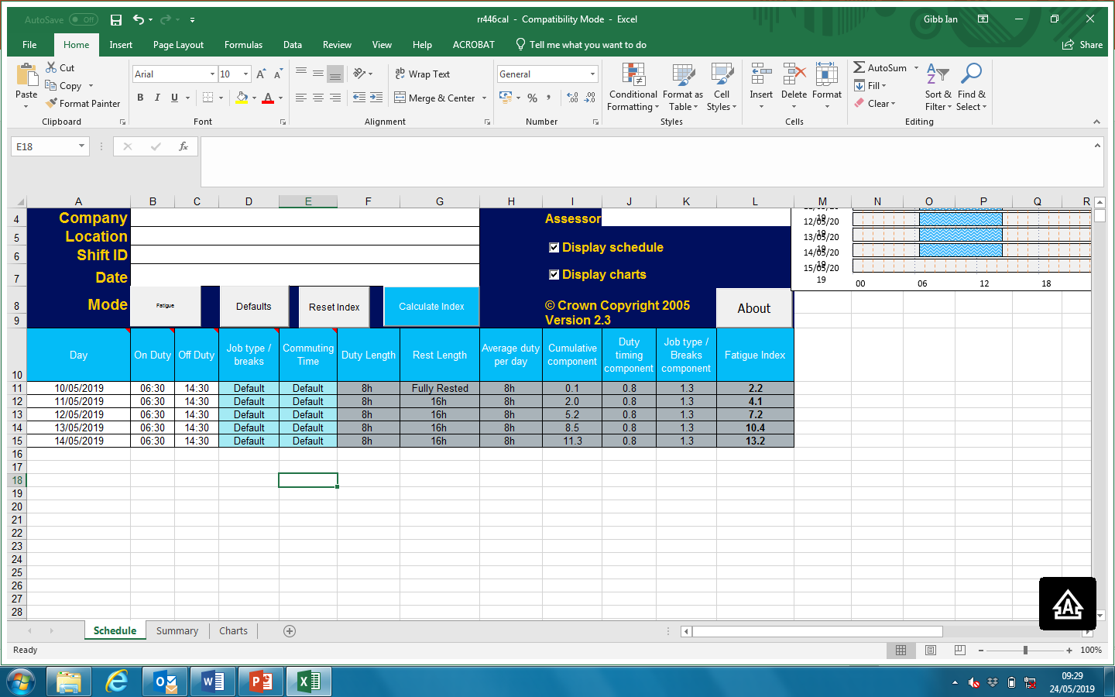
Using the FRI Index
The roster or timesheets are required and as shown below and are inputted to the columns to the left. Clicking the “defaults” button (circled) will calculate the normal travelling time, length of break, etc. and then the date and times on and off duty in the relevant columns.
The more dates you input the more relevant the result should be but as a rule you should input a minimum of the hours worked since last 48 hours period of rest.
You need only do this for the days they are actually at work

Slide 6
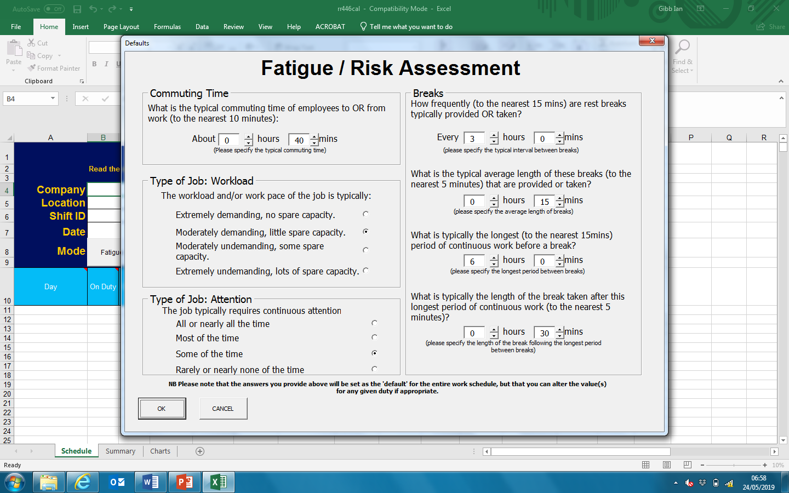
SETTING DEFAULT VALUES
On opening the spreadsheet for the first time a default window will appear.
Before a Risk or Fatigue Assessment can be made, the appropriate values for the defaults should be entered, as these will be used as the defaults for all duties entered in the spreadsheet.
When you have chosen your default settings, select OK. The default settings that have used will be listed in the ‘Summary’ worksheet.

Slide 7
For the FI (Fatigue Index)
The Fatigue & Risk Index calculator is to be used in two different modes, fatigue and risk, that can be switched between once the hours worked have been input. Each of these provides a single numerical score.
it is expected that day shifts will score 30-35 and 40-45 for night shifts. If after you input the hours worked, you have a value significantly below these figures it is reasonable to conclude that the working pattern of the individual did not contribute to any fatigue. If the value is above these typical values the investigation should be extended to question and understand the reasons why this has been allowed to occur.

Slide 8
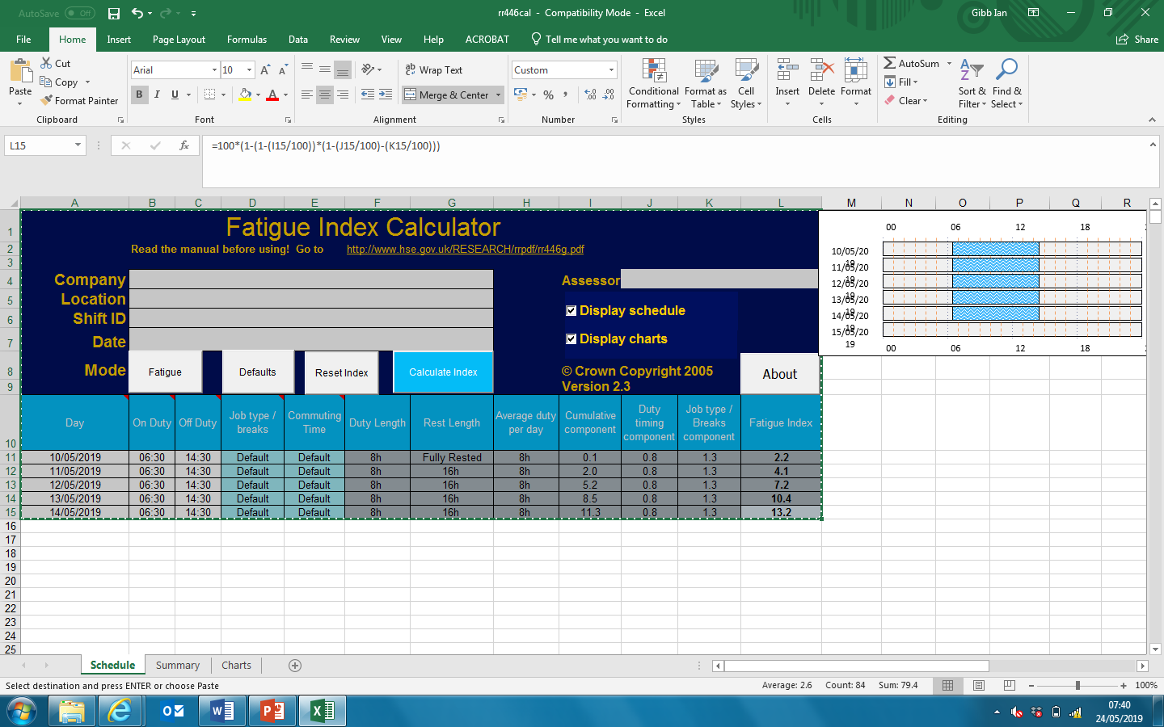
Click on the “Summary” button highlighted in red and this will display a summary of the results for the “Fatigue Index”.
(See next slide)

Slide 9
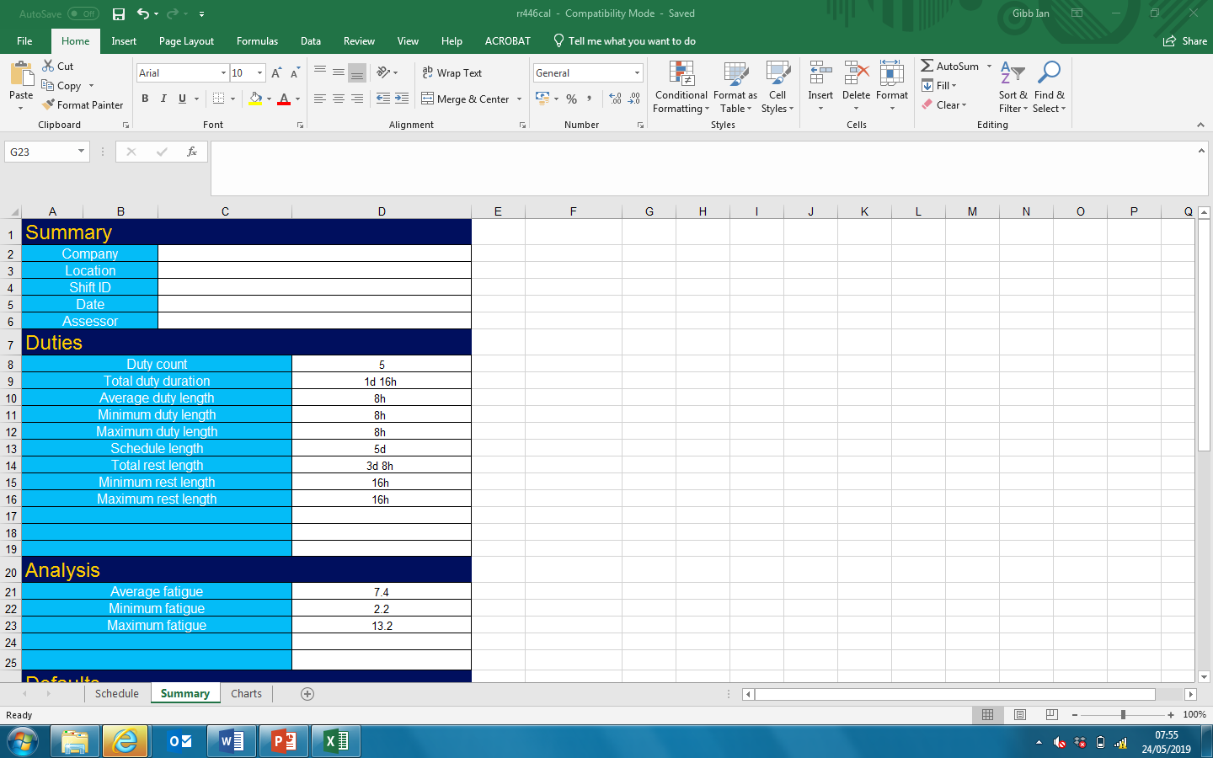
The “Analysis will display;
Average fatigue: 7.4
Minimum fatigue: 2.2
Maximum fatigue:13.2
The maximum fatigue result of 13.2 should be recorded on the level 1 investigation report from the Fatigue & Risk Index values

Slide 10
For the RI (Risk Index),
A comparison between 2 shifts is made. A base shift pattern is allocated a score of 1. Consequently, a risk score of 2 would indicate the risk of a fatigue-related incident occurring to be double in the analysed shift pattern, with a value of >1.6 giving rise for concern.

Slide 11
Click on the “Fatigue” button highlighted in red and this will change the display to show the results for the “Risk” Index.
(See next slide)

Slide 12
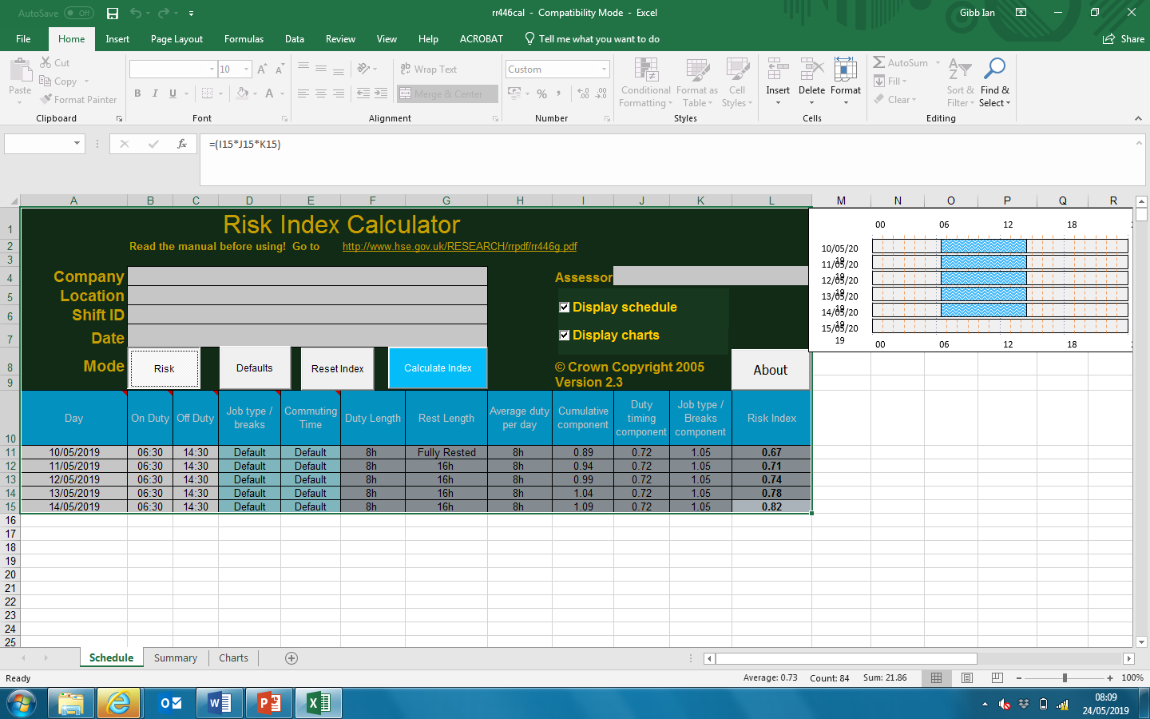
Click on the “Summary” button highlighted in red and this will display a summary of the results for the “risk Index”.
(See next slide)

Slide 13
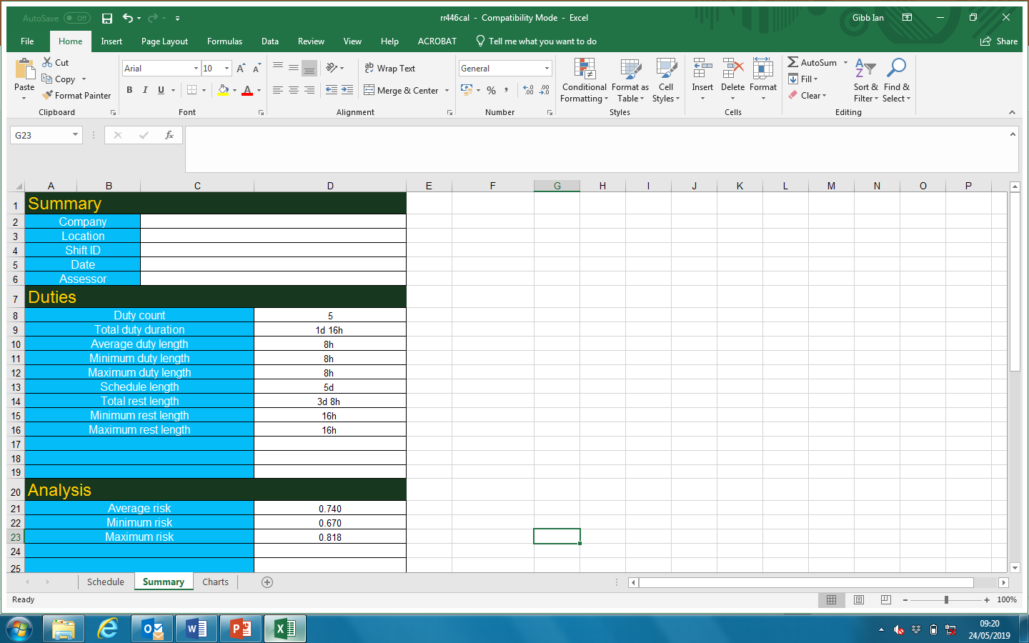
The “Analysis will display;
Average risk: 0.74
Minimum risk: 0.67
Maximum risk:0.81
The maximum fatigue result of 0.81 should be recorded on the level 1 investigation report form the Fatigue & Risk Index values

Slide 14
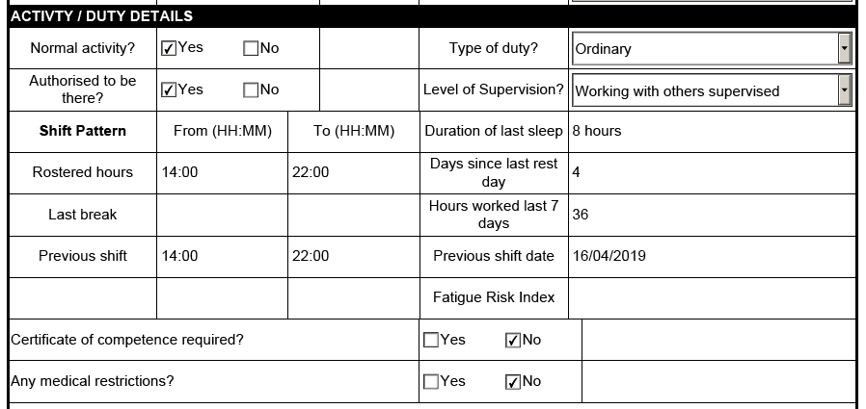
Recording the results
On the level 1 investigation report form the Fatigue & Risk Index values must be included in the highlighted box (for example 13 / 0.81, where the FI value is 13 and the RI one is 0.81). For level 2 and 3 investigations the results should be included in the Factors Discussed section of the report.
13 / 0.81

Slide 15
Further reading, guidance and information
NR/L2/OHS/003/01 Fatigue Risk Index Principles Investigators Handbook (Part 8 Appendix A) https://www.rssb.co.uk/Pages/fatigue-and-you.aspx http://www.hse.gov.uk/humanfactors/topics/fatigue.htm

