Slide 1
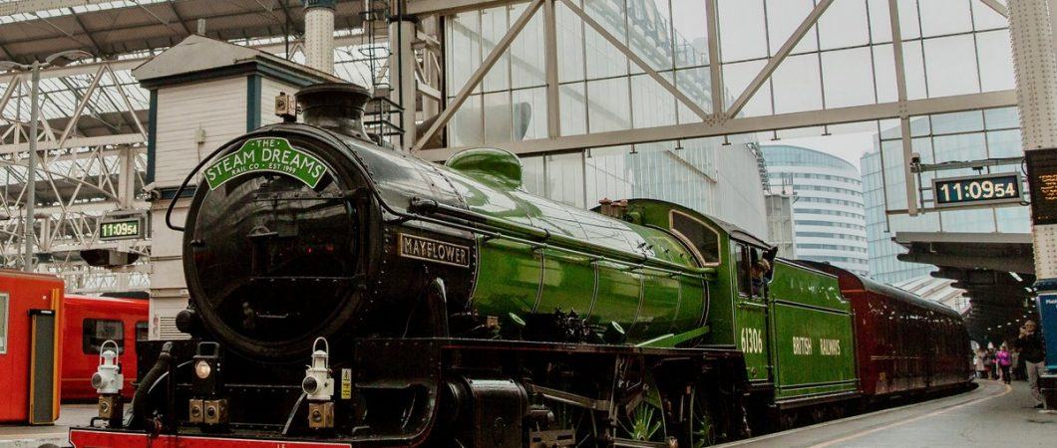

Health, Safety and Environment Period Cascade for P02 2019/20

Slide 2
Content
Welcome to your Health, Safety and Environmental Cascade for Period 02 2019/20. Please discuss and share the items that are relevant to your teams and display any relevant Safety Bulletins or Lessons Learnt on your notice boards.
Front Line Focus Episode 85 - Front Line Focus Episode 85 - May 2019.mp4
Significant Workforce Events
Line Blockage Irregularity
Near Miss at Havant Junction
Staff Injury - Muscle Sprain Under Arm and Right Side of Chest
Near Miss Sunningdale Level Crossing
Lower Back Strain Feltham S&T
Fatigue Risk Index Calculator and Investigations
New Starter Mentoring Process
Community Safety
Safety Bulletin; Malicious Act- Items placed on the line
Plant Manual Update
Environmental Update
Drug and Alcohol Policy Reminder
Health and Wellbeing

Slide 3


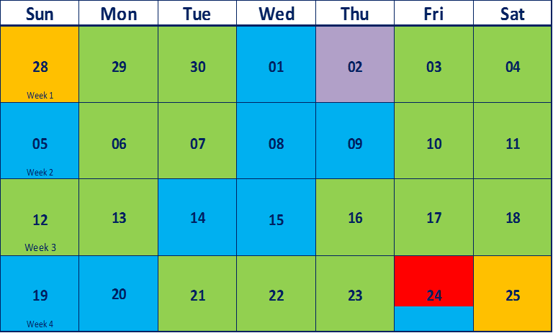

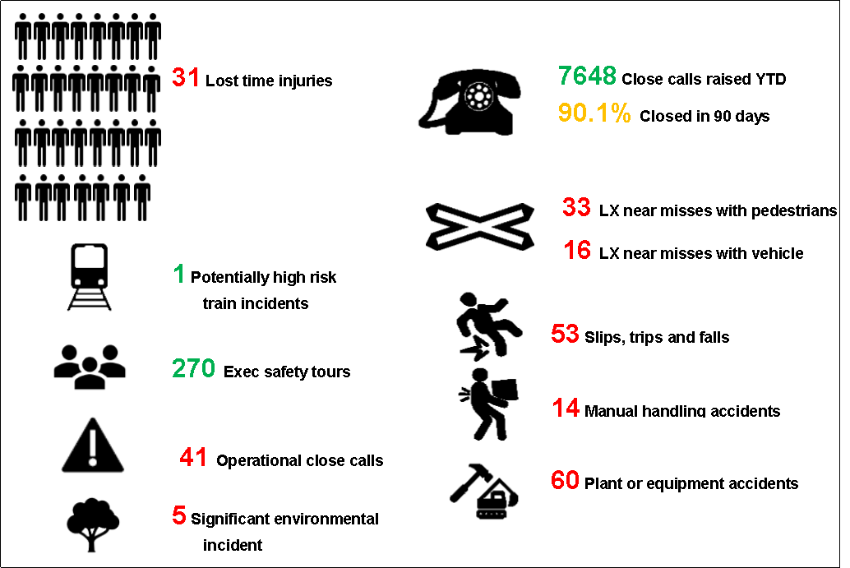

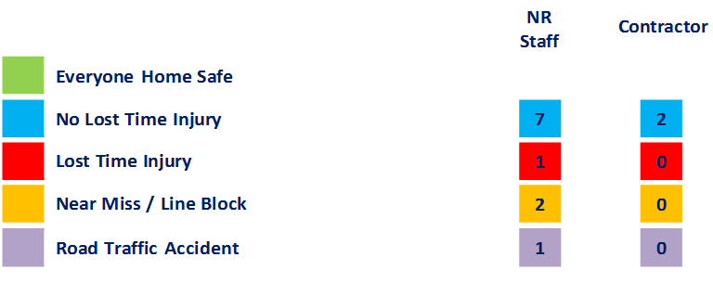

Workforce Safety
Slips, Trips and Falls
24/05/2019 Walking in the cess, caught foot on old rusty metal L bracket, tripped and twisted body, fell and landed heavily onto right shoulder on the ballast, sustained pain and unable to lift shoulder, muscle sprain under arm and right side of chest, hospital visit required.
Manual Handling
14/05/2019 Lifting boom into position at level crossing, felt aches and pains in their lower back, suffered stiffness in back afterwards, no absence anticipated.
Person interacting with tool/equipment
01/05/2019 Injured little finger whilst undoing a nut on a point detector, hand slipped and upon impact with adjacent equipment pierced the skin causing 2 x 1/4" cuts, wound cleaned and dressing applied
Near Miss
28/04/2019 COSS/PIC in UMF knocking pandrol clips in when train approached, Driver sounded horn, Driver sounded second warning and the PIC moved into a position of safety - currently under review.
Update The details of this near miss were included in the Period 01 HSE Cascade. During the investigation it was established that the COSS/PIC failed his “For cause” D&A testing
Discussion: All staff aware of the NWR Drugs and Alcohol Policy (incl. in this cascade)
25/05/2019 ES on Down Line, collecting protection in anticipation of clearing possession, driver could see ES ahead of train, ES was caught between the train and the fence - currently under review
OCC
02/05/2019 – The Eastleigh ECRO re-energized Item 78 Pirbright by mistake after SCS’s were applied. The maintenance staff were shaken up.
Discussion: Under investigation
Line Blockage Irregularity
09/05/2019 - 2R09 traversed through the LB on the Up Windsor Slow/Windsor Reversible after the limits of the LB were confirmed and the authority number was issued to the COSS (Waterloo S&T team). The initial investigation identified breakdown in communication and a failure to reach clear understanding.
Discussion: How do you remain focused at all times?
Significant Events in the Period

Slide 4
Operational Incident
Line Blockage Irregularity
On Thurs 9th May at 08:24 hrs the Signaller operating panel 2 at Wimbledon Area Signalling Centre was contacted by a Waterloo S&T COSS in connection with line blockages (LB) necessary to attend a track circuit failure at West London Junction on the Windsor lines.
Earlier agreement had been reached with the maintenance and signaller functions and WICC that staff would attended to the fault at a time when the Signal Centre was working under degraded conditions due to several causes.
The Signaller and COSS discussed the arrangements for taking the LB on the UP Windsor Slow/ Windsor Reversible for access only, in conjunction with a second LB on the UP Windsor &Down Windsor Fast lines.
At 08:26 hours the authority number for the first LB was given. The COSS requested the second LB, the Signaller stated she could not grant it, as there was a train movement in the vicinity and she would call the COSS back, at which point the call was terminated.
3 minutes later, 2R09 (07:15 London Waterloo to London Waterloo) traversed through the limits of the LB on the Up Windsor Slow/Windsor Reversible line, this was observed by the COSS and the work group who had remained in a position of safety.
The incident is still under investigation, please consider the following points for discussion;
When the train service is affected, clear concise communication is necessary between all parties involved in putting people to work.
If you are a COSS, how do you know you have reached a clear understanding with the signaller.
Active listening is important, always raise concerns and ask questions if there is the slightest suggestion of an unclear statement.

Slide 5

Operational Incident
Near Miss at Havant Junction
On Saturday the 25th of May at 04:59 a near miss occurred at Havant Junction between an Engineering Supervisor and an empty passenger train.
The ES strayed outside of the worksite and possession limits, to watch a Rail Grinder out of his work site. At the same time he began to make phone calls to his teams to prepare for lifting the worksite protection.
As he was doing so he heard a horn being sounded and moved into the 4 foot of the adjacent road.
As the horn continued to sound he turned around and saw a train coming along the "Open Line" that he had stepped into. The ES then immediately moved into the CESS to avoid contact with the train.
This incident is currently under investigation to understand what factors contributed to this near miss.
Lessons Learnt;
This incident is still under investigation. While the details are being confirmed, please discuss with your team;
The importance of always being in a position of safety whilst using your mobile phone
The importance of staying within the limits of your safe system of work
The importance of remaining vigilant whilst walking trackside and not allow distractions.

Slide 6

Slips, Trips and Falls
Staff Injury- Muscle Sprain Under Arm and Right Side of Chest
On Friday the 24th of May a member of staff injured himself whilst walking in the CESS of the Aldershot down side, old siding, country end of Aldershot station on the PAA1 at 35m00ch. The IP was making his way along the CESS when his foot got caught on an old rusty metal L bracket attached to a sleeper.
The IP tripped and twisted his body, falling and landing heavy onto right shoulder on the ballast.
The individual was at the front of a work group, who were wearing head torches as there means of lighting and were carrying out routine maintenance.
Lessons Learnt;
Did you leave your worksite in a safe condition for others?
Did you report potential hazardous obstructions or others similar?
If so, did you follow up why it was not removed?
If you were unable to remove the hazard did you clearly mark it up to prevent other from walking into it.
Have you been provided with suitable lighting for your intended work?

Slide 7

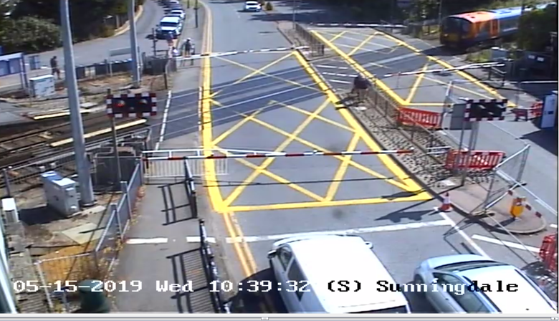
Level Crossing- Public Safety
Near Miss Sunningdale LC
On the 15th of May, there was a near miss at Sunningdale level crossing(LC) where two members of the public (MOP) crossed the road via the LC barriers, moments before a train passed through.
Contractors undertaking water pipe replacement works on behalf of a water company, closed off a section of the southbound lane and pedestrian crossing on the A30 London road near Sunningdale LC. A temporary pedestrian crossing was put in place and located at approximately 60 meters away from the normal crossing point, to allow MOP to safely access shops, restaurants located on the southside of the road.
At 10:39 am after the LC barrier had been lowered, two MOP crossed the road via the barrier from the southside pedestrian walkway, moments before a train passed through.
Following the incident, an inspection of the worksite showed that the contractor had not secured the point from where the MOP accessed the LC. Advance warning signs were not adequate and had not been positioned at appropriate locations.
Additional controls in the form of signages, heras fencing and 24 hrs road traffic marshals were put in place. This however proved inadequate, as further incidents were witnessed during inspection.
To ensure the safety of the public and operational railway, a decision was made to close the southside pedestrian walkway for the duration of the works.
Discussion points;
Are initial planning processes for worksites operating near the rail infrastructure, robust enough
The importance of reporting unsafe working practices and conditions near the rail infrastructure to the WICC or via the close call process
The importance of regular monitoring of worksite locations for changing conditions that might affect the safety of the public and operational railway

Slide 8
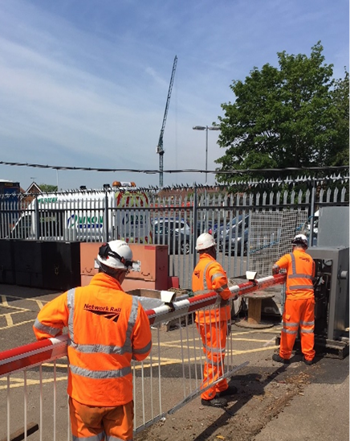
Workforce Safety – Manual Handling
Lower Back Strain Feltham S&T
On the 14th of May, a 3 person team from Feltham Signals and Telecommunications (S&T) (made up of the NR injured person, a PIC and a Contract member of staff) were replacing a 6 metre level crossing barrier boom into the ZO pedestal at Grove Park level crossing.
This was supposed to be a 6 –person S&T team attending to a fault report. However, only 3 members of the team were available due to various reason, and went on to repair the fault.
As the barrier boom was being replaced, the IP( circled) felt a pain in their lower back but continued to work and did not report it until they returned to the depot at approximately 03:40. By this time their back had begun to stiffen up.
As part of the initial investigation it was discovered that the level crossing barrier boom does not denote the weight, either on the boom itself or on the product information supplied with the boom.
It was subsequently found that the weight of this particular level crossing boom (6 metre long) is 90KG.
Lessons Learnt;
THINK; Do you know the weight of the equipment to be manually handled? Is the weight displayed on the equipment?
Do you have the resources to carry out the required work?
Check your posture, can you do something, even when sitting, that will make your back healthier?
Avoid twisting and keep the load close to your body.
Know your limits!
See the ‘Healthy Back’ presentation or the ‘Think Risk’ film on Safety Central for some helpful tips.

Slide 9

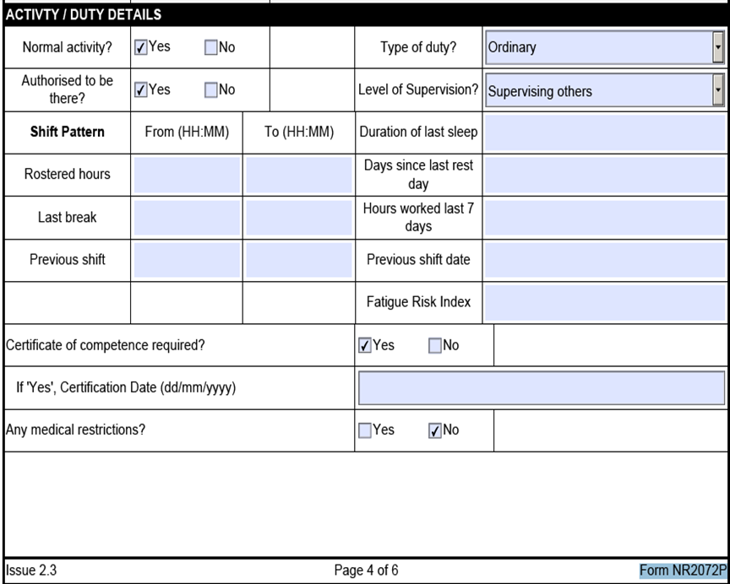

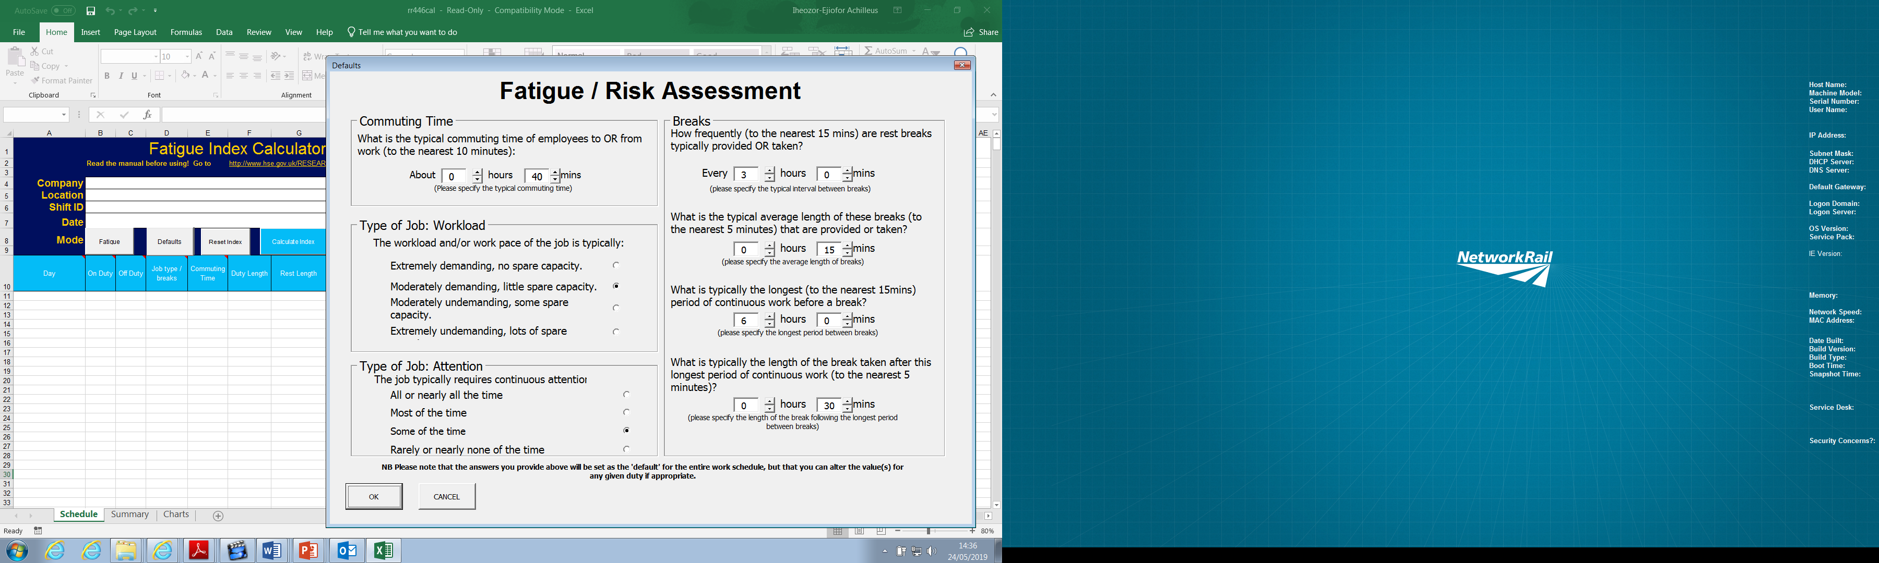
Workforce Safety – Fatigue Risk Index Calculator and Investigations
Background
Attention has been drawn to the omission on all L1 investigation, a demonstration that fatigue risk index (FRI) has been considered and recorded, as a potential contributory factor in an incident.
Moving forward, Wessex Route will assess and adequately consider fatigue as a potential causal factor of an incident as part of a Level 1 investigation.
This will be achieved by the use of the HSE’s FRI calculator and will be demonstrated by inserting both the Fatigue and Risk index number in the relevant box on all Level 1 forms.
Action Plan
ALL Wessex Route Investigators with L1(2&3) competence, will receive a BRIEF to be delivered by WHSEAs on how to understand and administer the HSE Fatigue Risk Index Calculator, which will then be used to complete the FRI score for all individuals during a Level 1 Investigation.
The date for full compliance, which will be the demonstration of consideration of fatigue risk in all individuals involved in an accident or incident by the completion of the calculation within the L1 document is 28th June 2019.
The Route Accident & Assurance Investigator will provide an assurance check to confirm compliance.
HSE Fatigue Guidance for Investigations.ppt
http://www.hse.gov.uk/research/rrhtm/rr446.htm

Slide 10

Workforce Safety – New Starter Mentoring Process
Network Rail, Wessex Route, New Starter Mentoring Process, May 2019
Introduction
The New Starter Mentoring (Safety Passport) Process NR/L3/MTC/SE00089 ceased to be mandatory in July 2012.
It is however recognised that it is vital to ensure the new starters are ready, before they are issued with a white hat, and deemed sufficiently competent and signed off for full duty.
This document is to confirm that Wessex Route continues to apply this standard in full.
Purpose
The passport scheme exists so that new, inexperienced personnel are identified and minded / mentored whilst working track side, to enable them to develop the necessary experience and safety awareness without inadvertently exposing themselves to risk.
Please refer to the Wessex Instruction for more details on the following link: New Starter Mentoring Process Wessex Route .pdf

Slide 11

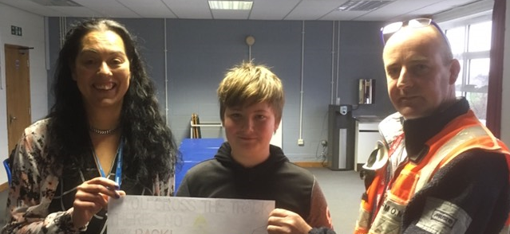
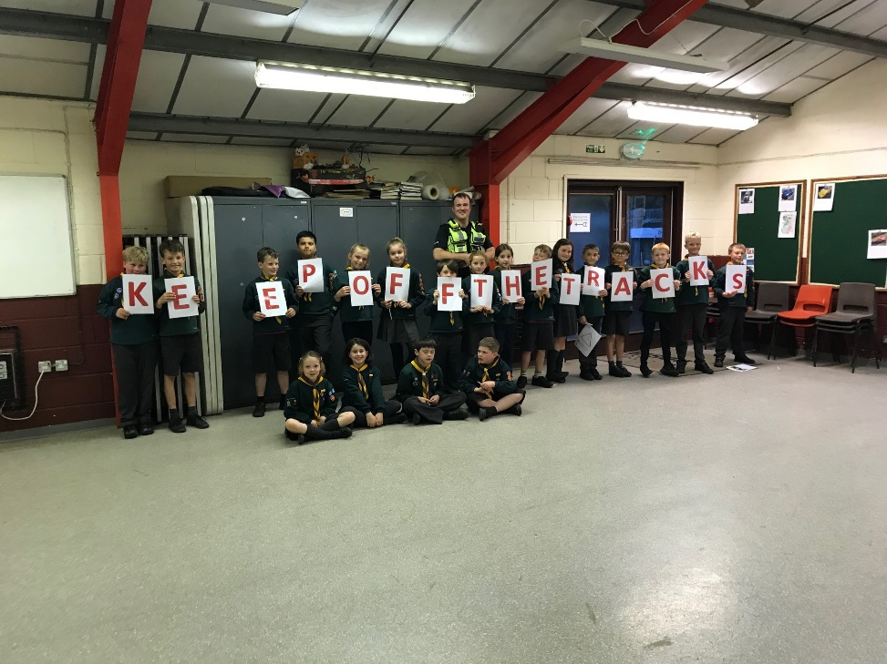
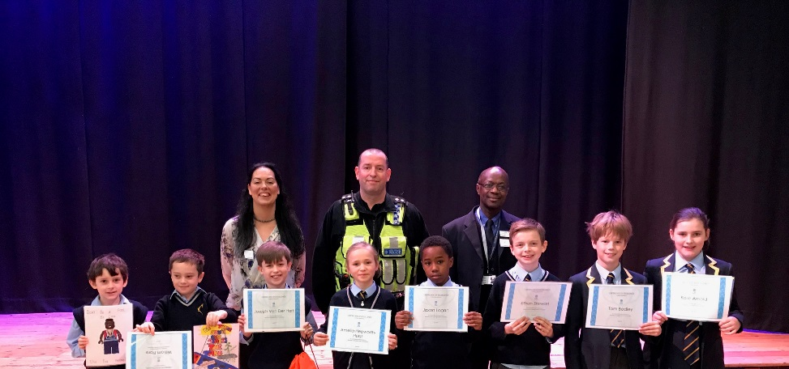
Community Safety
For the first time since 2014 the total number of trespass incidents recorded in the SHEP has decreased
We have delivered safety sessions to over 30,000 young people across the route to date
School children from across the route work with us on various rail safety projects
Woking Borough council youth workers are now delivering rail safety sessions on our behalf
Rail safety is now part of Hounslow Borough Council’s sustainable travel programme
Basingstoke and Deane Borough Council promote rail safety sessions in all their schools
Bournemouth FC, Southampton FC, Portsmouth FC and Brentford FC all work with us to deliver rail safety sessions
Partnership with Boxing England to deliver rail safety awareness in Bournemouth and Poole
Working with SWR and BTP to raise awareness of the dangers risk taking behaviours around the railway
Creating a safety film on the route with a 16 year old girl who injured herself on the route last Summer
Thomas the Tank engine rail safety books being delivered across the route
If you have issues with youth trespass please report WICC/close call and contact Marcia.Burnett@networkrail.co.uk

Slide 12
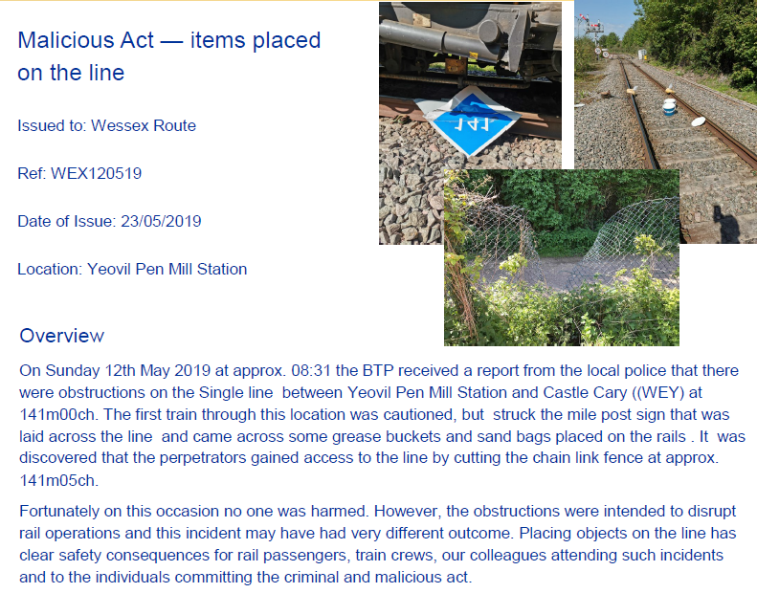
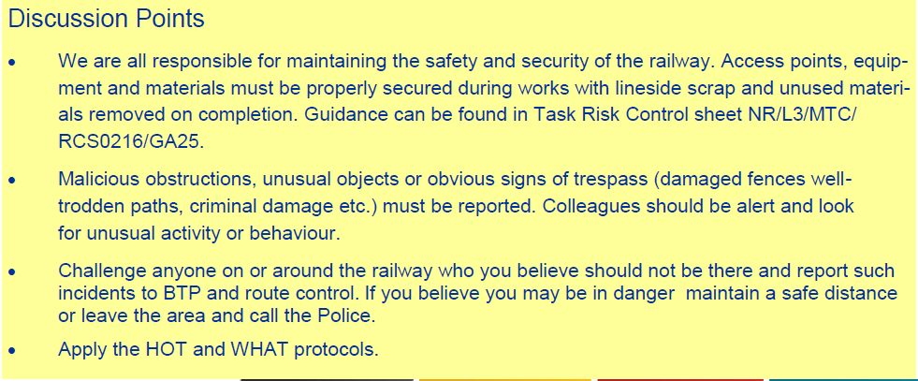
Safety Bulletin

Slide 13
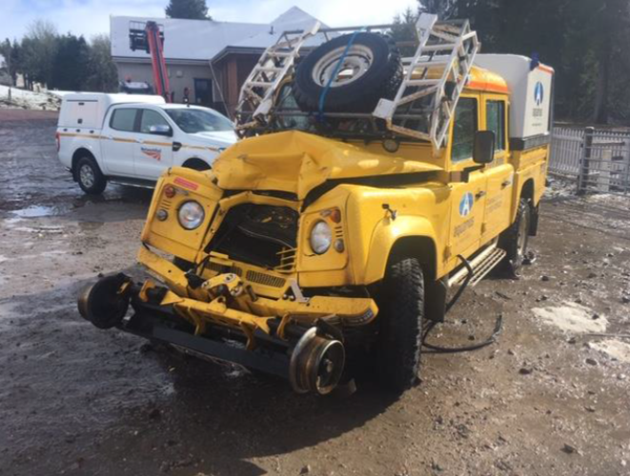
Infrastructure Plant Manual
OTP Speeds and Movements in a T3 Engineering Possession.
The Rule Book, Module T3, Handbook 9,11,12 & 15 were changed in December 2017 because of the need to make it clearer throughout the industry of the speeds that Engineering Trains, OTM’s and OTP must travel at in an engineering possession/worksite.
When things go wrong
All movements are to be made at a speed up to 5 mph unless authorised by an ES to travel at caution, up to a maximum of 25 mph.
There must always be an authorised method statement when on track plant is operated on Network Rail managed infrastructure.
Damage resulting from collision between 2x OTP in Scotland in March 2019.

Slide 14
Safety Bulletins, Alerts, Advice
Wessex Route Cable Theft Bulletin - Update 14MAY19.pdf
Sunsafety – IOSHpocket.pdf
Safety-Bulletin-NRB19-06-Dumper-overturn-incident.pdf
Safety-Alert-NRX19-3-Deliberate-safety-and-security-incidents.pdf
Safety-Alert-NRA19-07-Working-safely-near-level-crossings.pdf
Safety Bulletin - Malicious Act 120519.pdf
New Starter Mentoring Process Wessex Route.pdf
DNA Bulletin.pdf
HSE Fatigue Risk Index Calculator rr446cal.excel
Lessons Learnt Manual handling incident - 14-05-2019.pdf
Wessex Route Safety Alert Near Miss Havant Level Crossing 25 05 2019

Slide 15

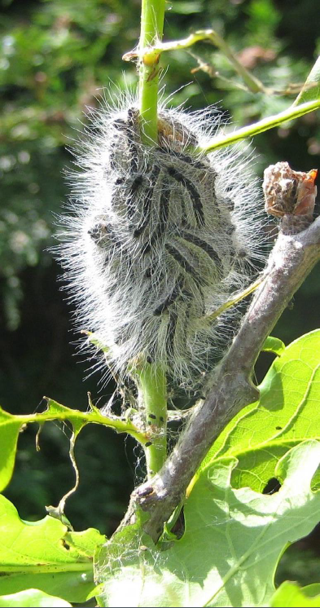
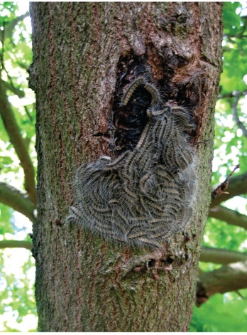
Environment
Oak Processionary Moth (OPM)
Caterpillars of the Oak Processionary Moth (OPM) are a pest which can be a hazard to the health of people as well as the tree itself.
• The greatest risk period is May to July, but nests should always be avoided.
• They have been recorded within Wessex Inner
• Their tiny hairs can be blown about by the wind and cause itchy skin rashes, eye and throat irritations and, occasionally, breathing difficulties.
DO
✓ Keep away from caterpillars
✓ Report suspected sightings to the WICC
✓ Call NHS111 or seek medical advice for serious allergic reactions
DON’T
✘ Start work on a suspected infested tree or process, remove arisings from site, until you have sought advice from the Route Environmental Specialist
Rebecca.Jones@networkrail.co.uk(07734649591)

Slide 16
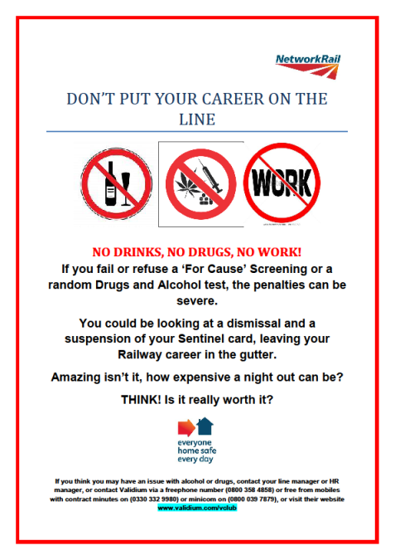

Health and Wellbeing
Drug and Alcohol Policy Reminder
Consuming alcohol and drugs, even in small quantities, might adversely affect your safety, performance, conduct or efficiency, as well as the safety and wellbeing of others
Random testing for drugs and alcohol are unannounced and take place without notification
NR alcohol testing limits are much lower than the drink drive limit.
A refusal to submit to drugs and alcohol testing is regarded as a positive (fail) result and will be dealt with accordingly
It is your responsibility to manage your lifestyle and ensure you are fit for duty
Employees and contractors are encouraged to declare to their line manager/supervisor or HR representative if they have, or believe they might be developing, a drug or alcohol misuse related problem for support
Support and assistance, is available via your line manager, HR or you can contact Validium on 03303329980, 08003584858 www.validium.com/vclub
DNA Bulletin.pdf
Drugs and Alcohol Policy NR/L1/OHS/051

Slide 17


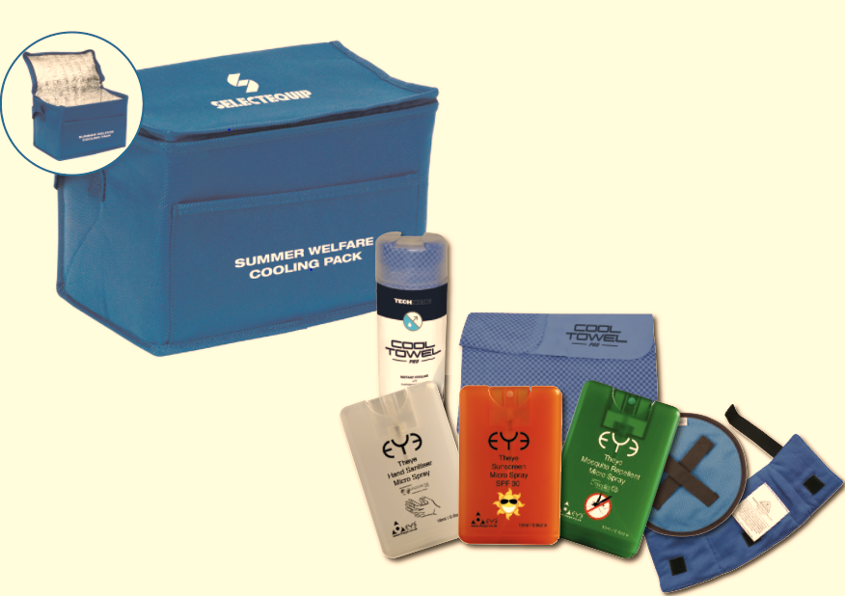
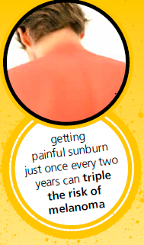

Health & Wellbeing
Skin cancer is the most common type of cancer in the world.
It’s also the easiest to avoid.
Cover up
Protect your head
Seek Shade
Use sunscreen
Be skin safe
Stay hydrated
Summer Welfare Cooling Packs are obtainable on IPROC(0111/120 623), or speak to your local WHSEA

Slide 18



Health & Wellbeing
June 10 - 16
Know your numbers, take action on high Blood Pressure
 | Systolic (Top Number): | Diastolic (Bottom Number):
Ideal blood pressure | 100 - 120 | 60 - 80
Pre-high blood pressure | 120 -140 | 80 - 90
High blood pressure | 140+ | 90+
Why is it important? | Where to check your BP:
High BP increase risk of stroke and heart disease. High BP doesn’t have any symptoms, so need to check | GP Some Pharmacies NHS Health check (40 -75years)
If high, then make an appointment with your GP and get it checked out.

Slide 19
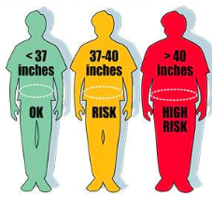
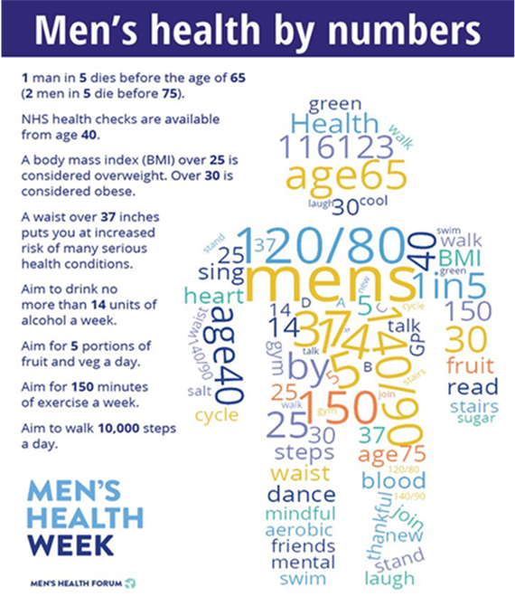
Health & Wellbeing
June 10 - 16
Know your numbers, take action on waist size:
Why is it important?
Carrying too much fat around your waist increase risk of heart disease, diabetes and cancer.
How to measure:
Measure around your belly button Breathe out naturally and take the measurement.
If high, then make an appointment with your GP and get support

Slide 20
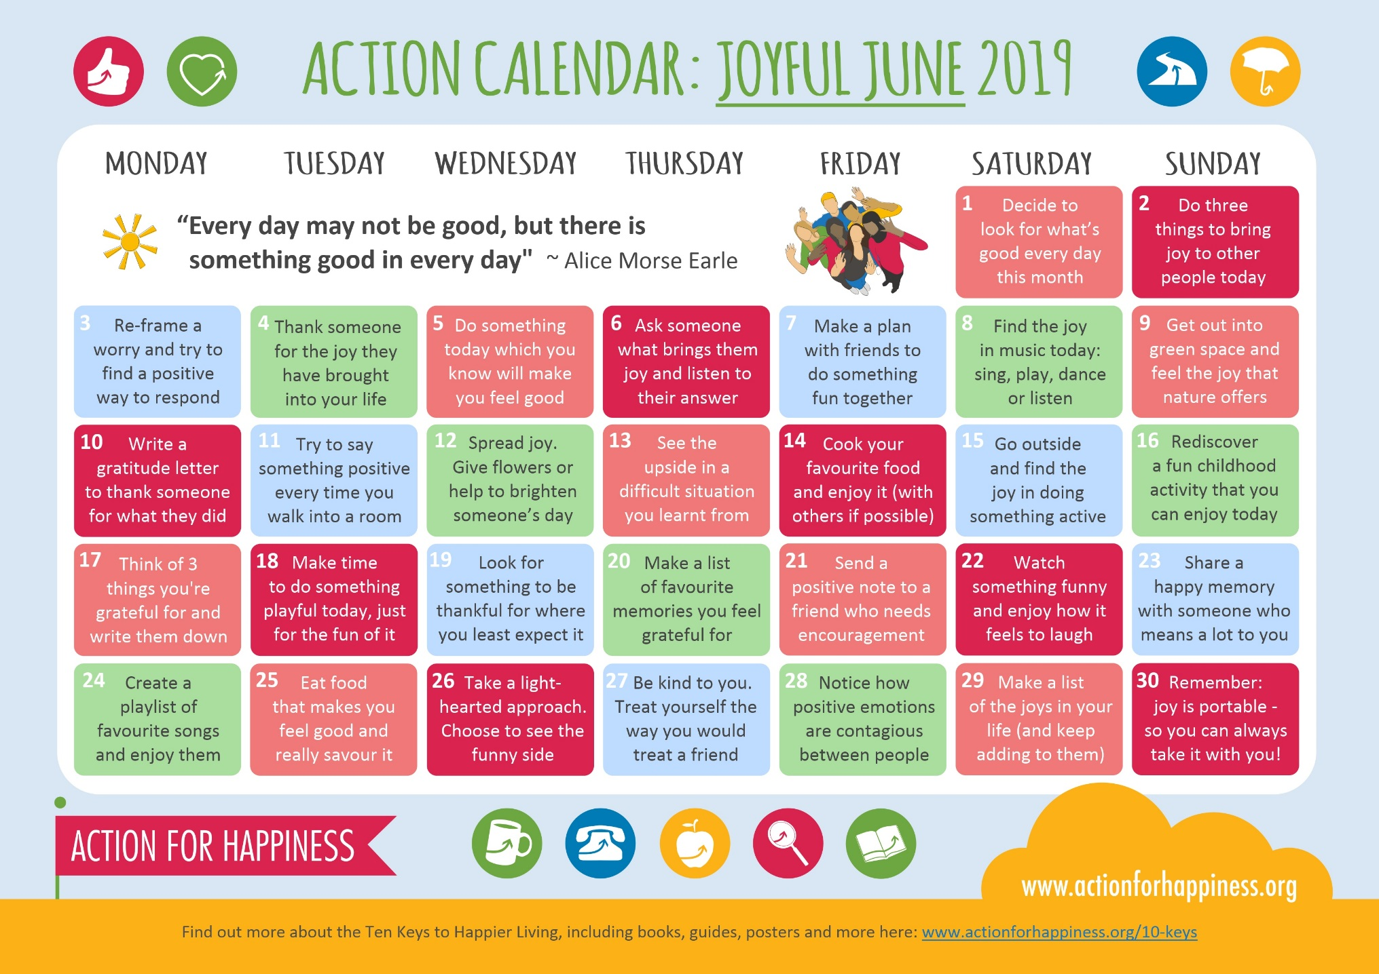
Health & Wellbeing

Slide 21
Thank you and keep safe

