Slide 1
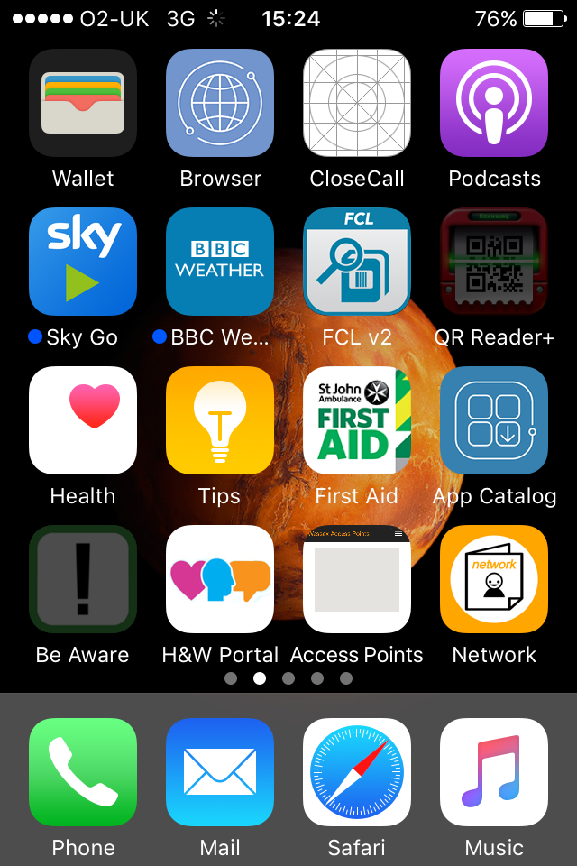
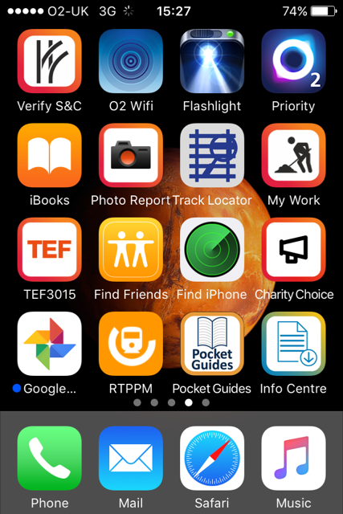
How to Guides
The ‘How to Guide’ is found on the Info Centre app, which in turn can be downloaded from the Mass 360 app catalogue (circled in red).

Slide 2
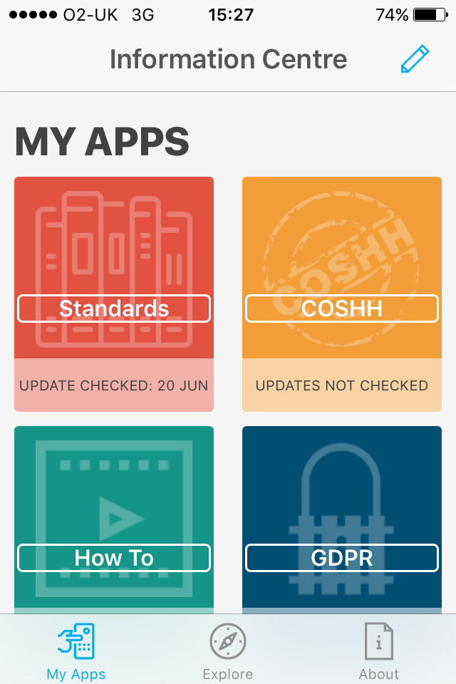
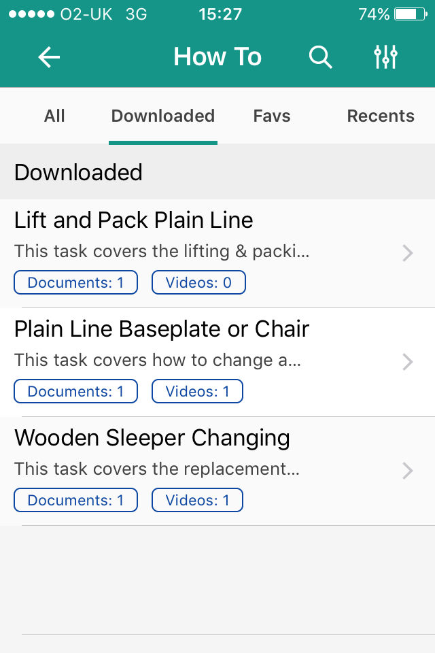
The Info Centre contains Apps for ‘Standards’, ‘COSHH’, ‘GDPR’ and ‘How to’ guides. Additionally, you can find ‘Signal Diagrams’, ‘Telecom QRG’s’ and ‘Telecom Manuals’.
Within the ‘How to’ guides are documents and videos on different tasks.

Slide 3
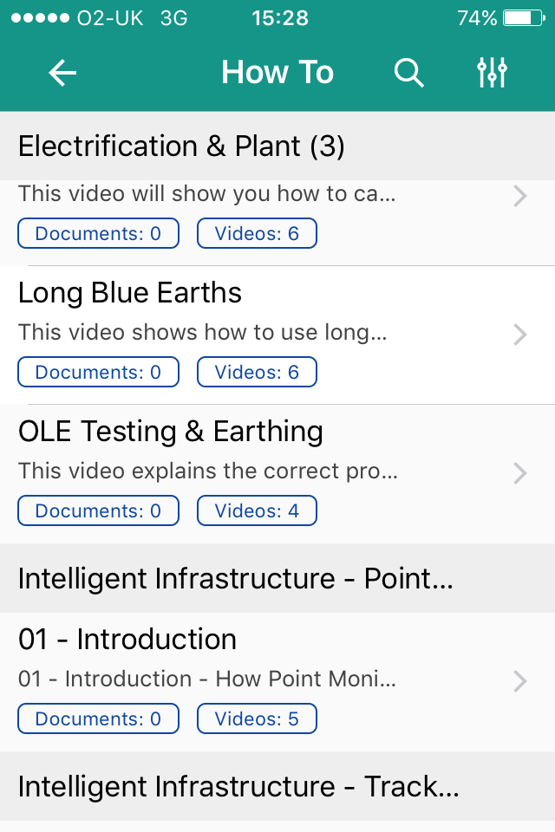
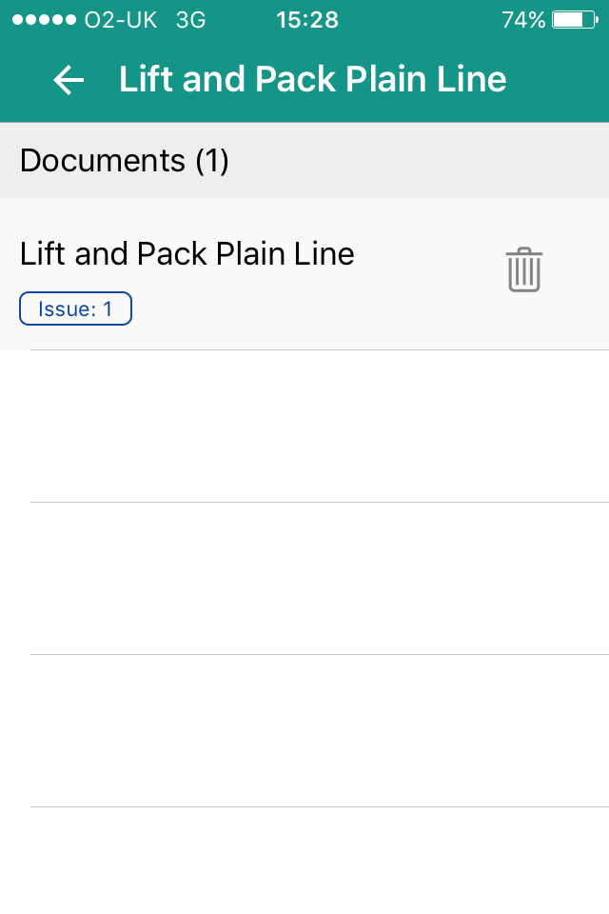
Certain guides are document only, while others are a combination of document and video.

Slide 4
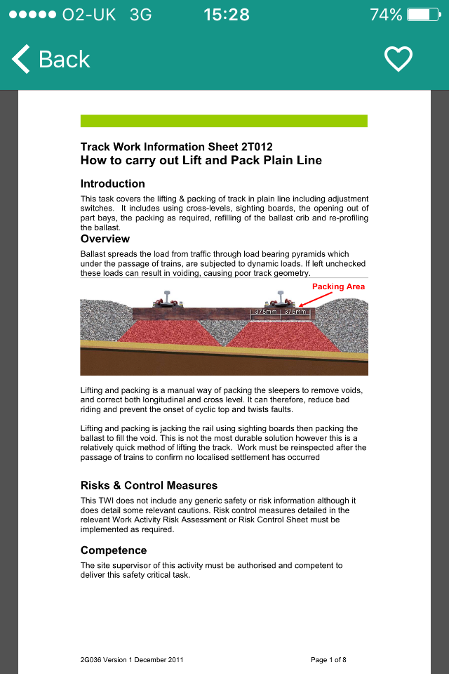
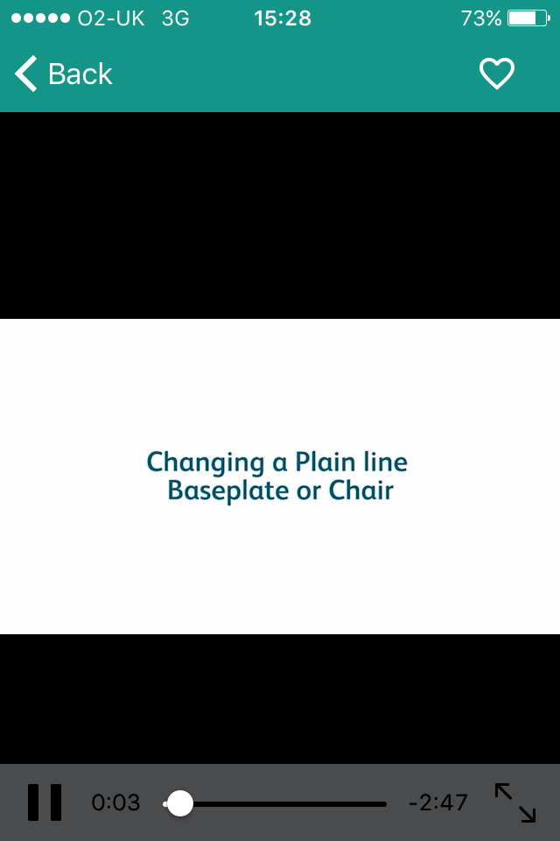
The document provides written instructions and diagrams, describing the task, as well as providing the required equipment and resource. The video provides a practical demonstration on how to carry out a number of these tasks. The Pocket Guide on the NR Wessex app may also provide practical help.

