Slide 1
Safety Critical Communications
MODULE THREE: STRUCTURE & RESPONSIBILITY

Slide 2
Briefer’s Introduction:
Welcome to the Structure and Responsibility module for rail industry communications.
This module looks at the following:
Intro – a reminder of what SCC is and why it is important
How to structure a safety critical message
Barriers to effective communication
SCC responsibility

Slide 3
How the Course Works:
The programme consists of six modules. We recommend that they are delivered in order, but you may select a particular module if required:
Foundation
Protocols 1
Structure and Lead Responsibility
Protocols 2
Confirming Understanding
Communication Skills
*Please read the Briefing Notes prior to delivering a module. They provide background information to enable you to manage the exercises and discussions.
*You will also be required to perform a short assessment at the end of the course to make sure attendees understand the content. See the Briefing Notes.

Slide 4


Welcome

Slide 5

Safety Critical Communications
…VO

Slide 6


All operational communication by front-line staff is safety critical.
VO

Slide 7

By ‘operational’ & ‘front line’ we mean:
Maintenance
TOC & Network Rail Control
Signalling
Station Operations
Driving
Shunting
…VO

Slide 8

VO

Slide 9

National
MINIMUM
Standard
VO

Slide 10
Structure
Lead Responsibility
Note: there will be a short test at the end of this module to confirm your understanding of the National Minimum Standard.
VO

Slide 11

Message Structure

Slide 12

Q. why would we need to structure/ organise a message?
Q. what structure should we put in place?
VO

Slide 13




Opening
Information
Actions
Confirmation
VO

Slide 14
Opening

Slide 15

Message Opening:
“Hello”
This is who I am
This is where I am
VO

Slide 16


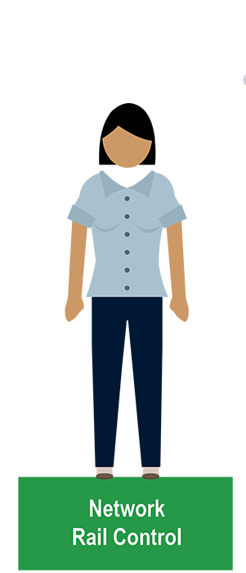

VO

Slide 17
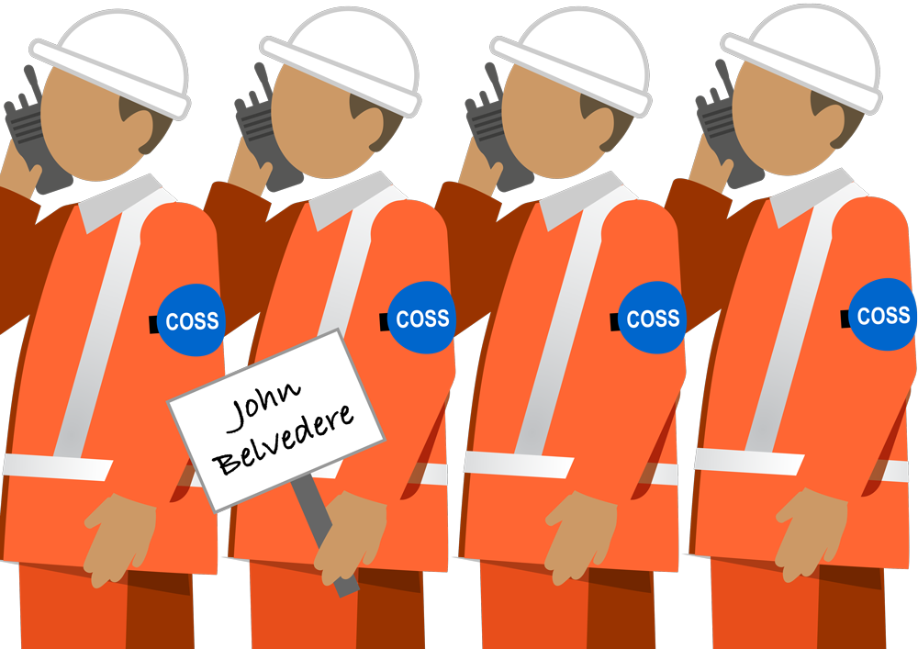
VO…

Slide 18



“two tango one five at bravo two six signal”
“Rugby workstation two”
“Slough platform two”
VO

Slide 19
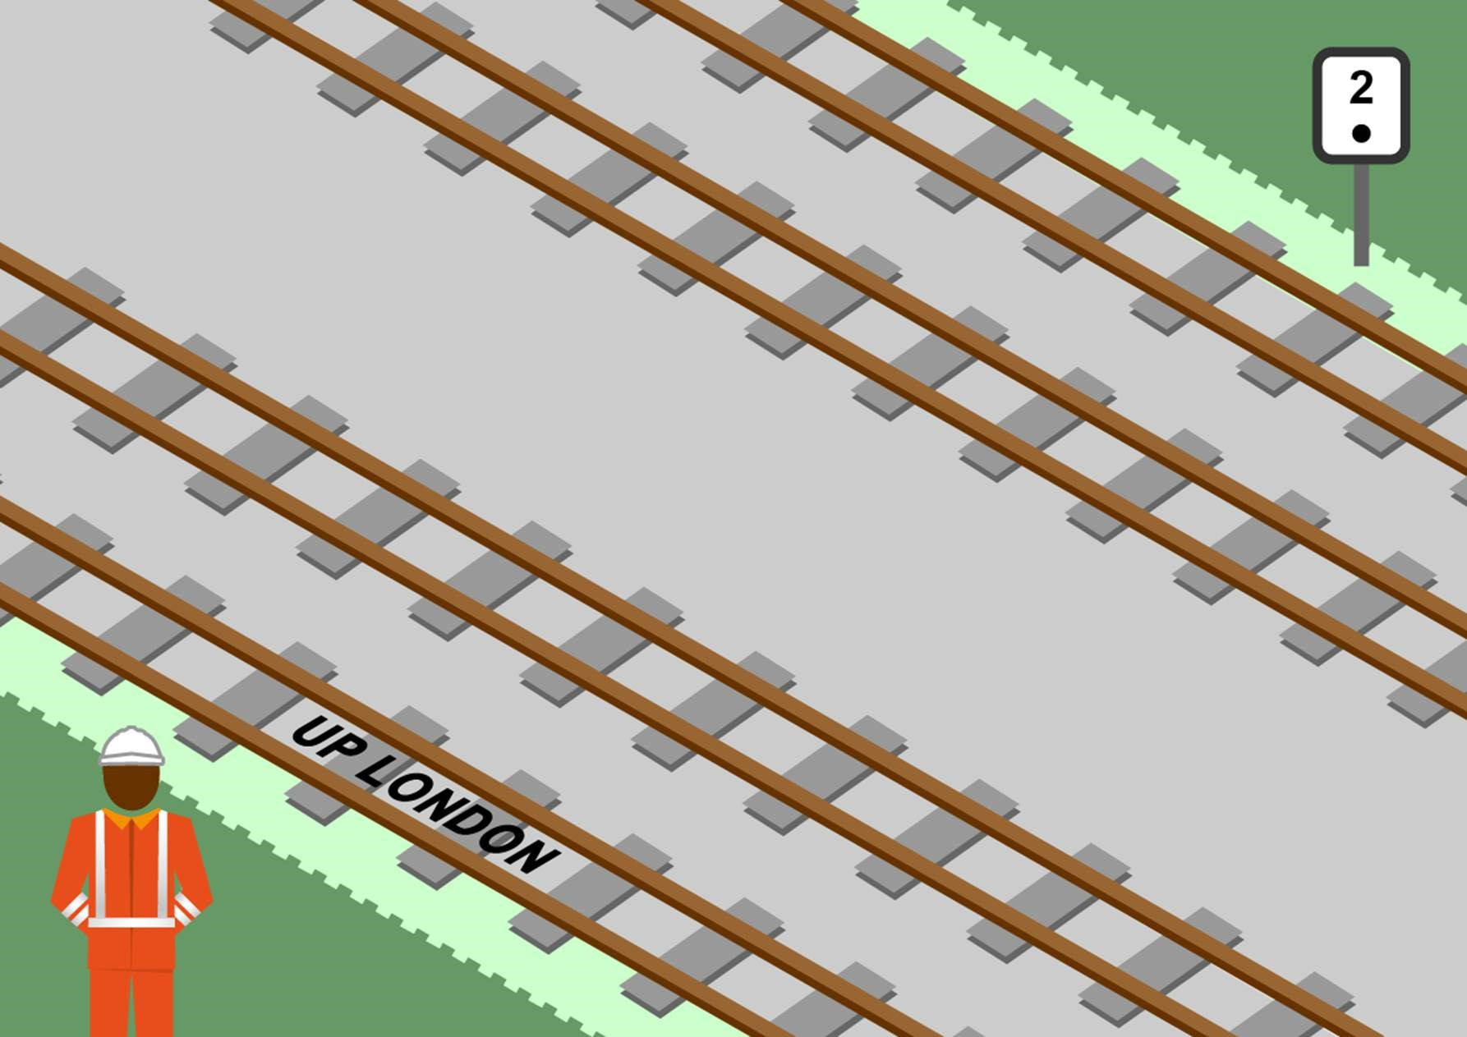
VO

Slide 20
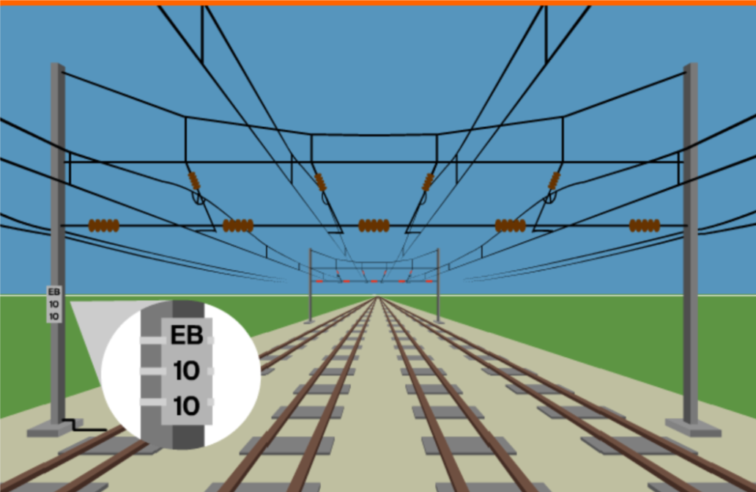
VO

Slide 21
“alpha, bravo, charlie…”
“one zero two five…”
“six miles and twenty five chains…”
VO…

Slide 22
Q. Exactly how should you identify yourself and your location
Do this for each role (dispatcher, shunter, driver etc.) represented in the room.

Slide 23



Play the recording and answer the questions (next page).
VO

Slide 24
Q. What structure did the message have? When were the actions given?
Q. What’s the problem with giving actions in this order?

Slide 25
In this version, the Signaller realises that the communication is losing structure and refocuses it.
The Signaller is demonstrating Lead Responsibility – our next subject.

Slide 26
Information & Actions
VO

Slide 27
Information
Actions
VO…

Slide 28
Opening
Actions
Information
VO…

Slide 29
Opening
Actions
Information
Actions
Information
Actions will sometimes ‘spill over’ into the information section. However, they must be
re-stated in the Actions section so that we have a clear, concise list to agree and repeat back.
VO

Slide 30
Why do we not want to mix up Actions and Information?
VO

Slide 31
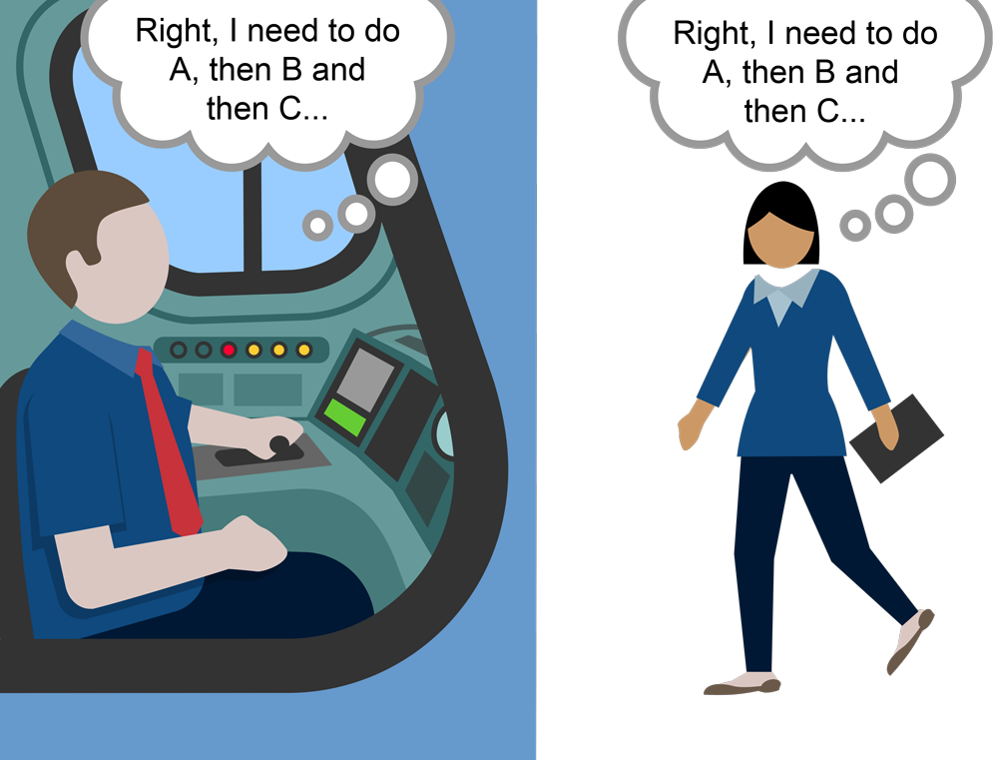
…VO

Slide 32
Can be passed in both directions
Actions should be definitive, eg. “You must…”
The instruction “Do nothing until…” is a valid action
They are an essential part of the communication contract
VO

Slide 33
Confirm
Understanding

Slide 34
Opening
Information
Actions
Repeat Back
Confirmation
VO

Slide 35
Repeat Back
The person with lead responsibility must always confirm everybody involved in the
conversation understands the message being passed.
This may require asking for a repeat back
VO

Slide 36
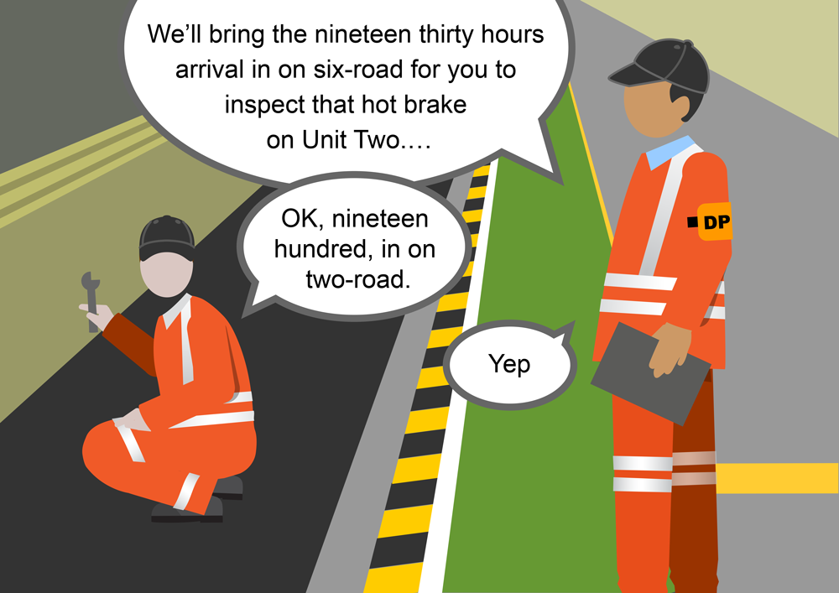
…VO
The repeated back information is wrong!

Slide 37
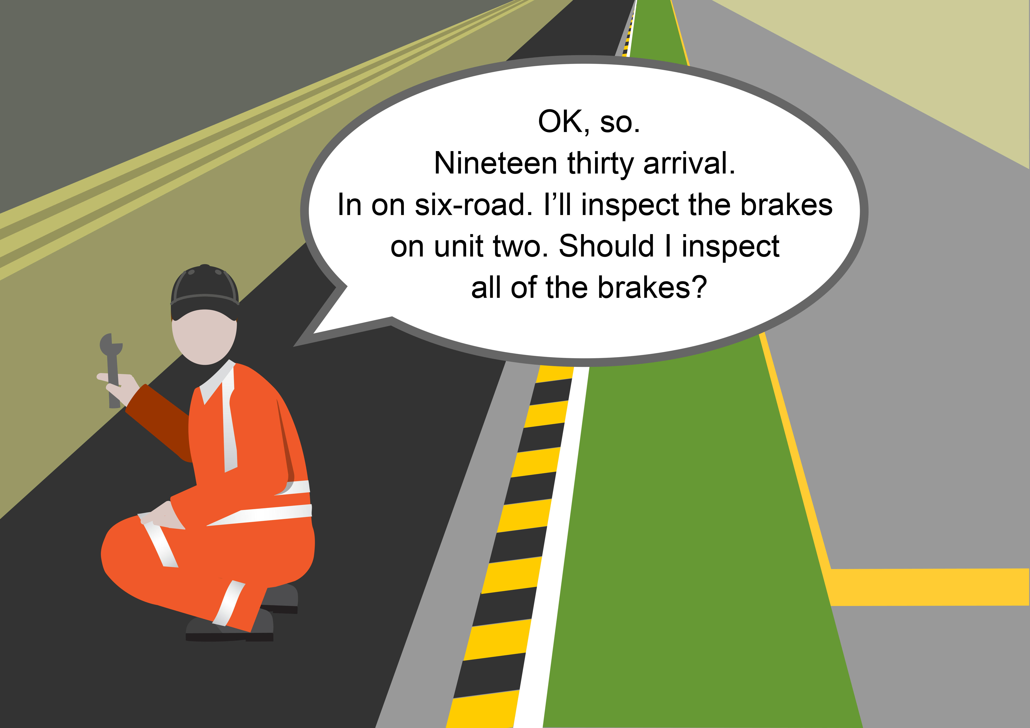
…VO

Slide 38

Lead Responsibility

Slide 39

VO…

Slide 40
Clarification
Clear Speech
Details
VO

Slide 41
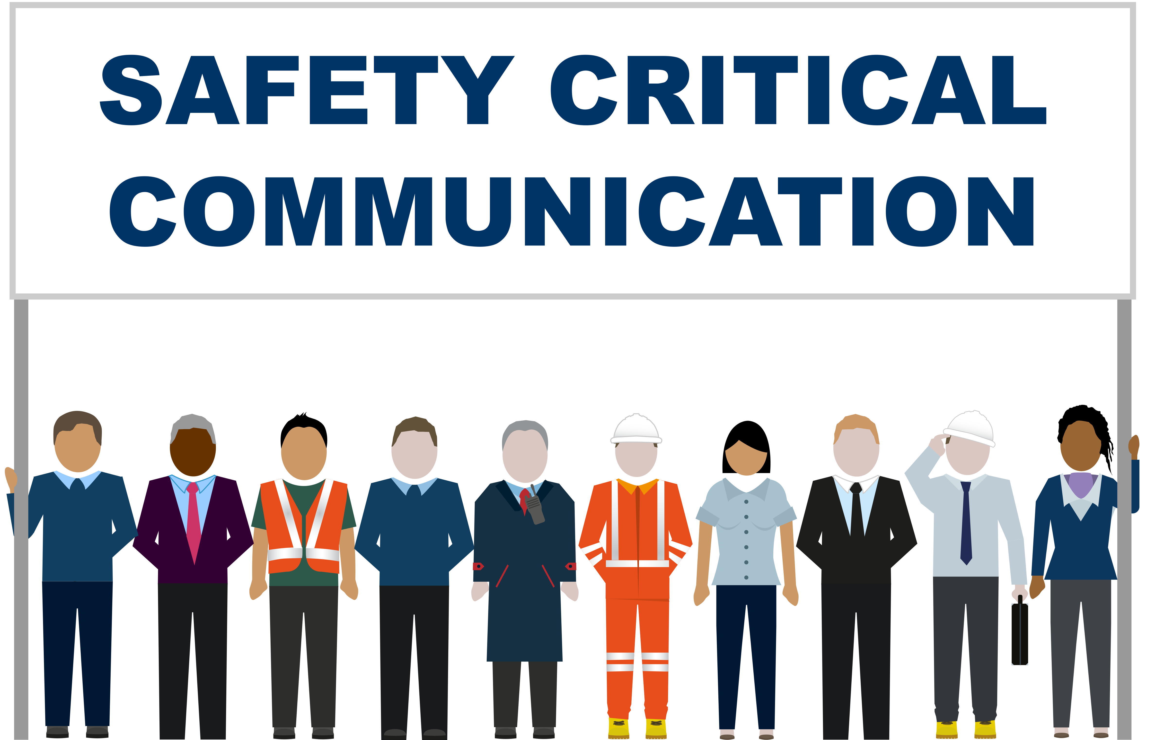
VO…

Slide 42
True or False?
Lead Responsibility is:
being in charge of the job
being in charge of the communication
giving instructions to workers
being most senior
VO

Slide 43

Opening
Information
Actions
Confirmation
VO

Slide 44
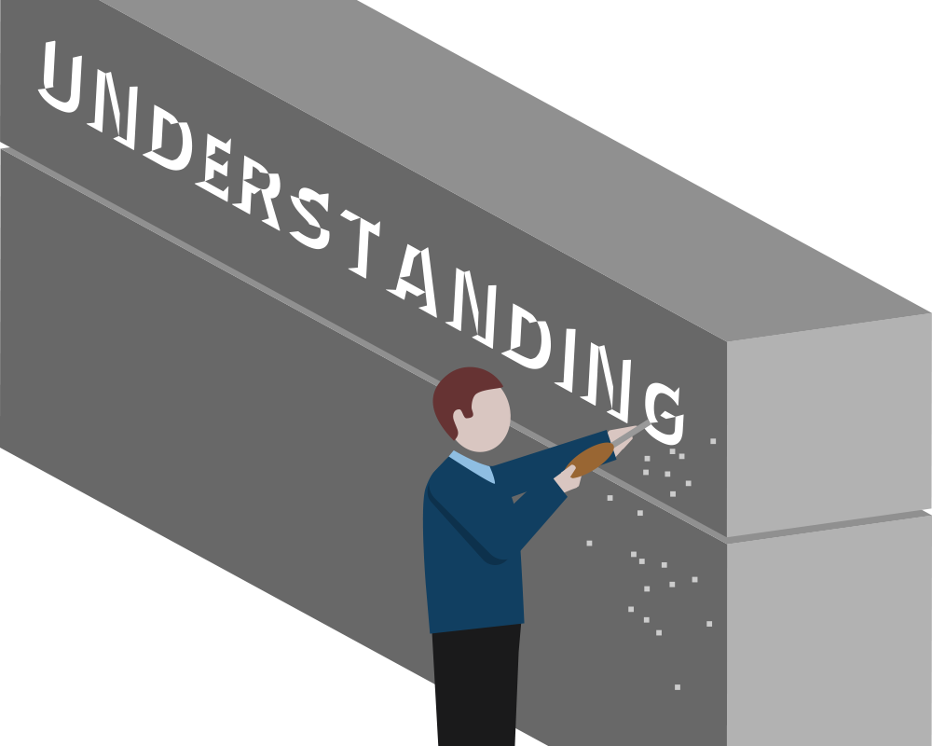
The person with Lead Responsibility must manage the communication and ensure that a clear understanding is reached.
VO…

Slide 45
Q. Who is likely to have Lead Responsibility in our operational communications?
Discuss relevant communication scenarios and who has Lead Responsibility.

Slide 46
Opening
Information
Actions
Confirm Understanding
VO

Slide 47
Clarify details
Correct mistakes
Summarise information
Calm the situation
Challenge poor communication
VO…

Slide 48
All be prepared take these actions
VO

Slide 49
clarify
correct
summarise
calm listen
challenge
repeat back
question
identify
structure
confirm
VO…

Slide 50
We must all support the person with Lead Responsibility.
and be prepared to do some of the leading, if necessary.
VO

Slide 51
Play the recording and
answer the question.
How is the Signaller taking Lead Responsibility for the communication? List…
SPAD: Signal Passed At Danger – a very serious and traumatic incident for a driver.
VO

Slide 52

Module Review
VO

Slide 53
1
A safety critical message should have four sections:
Opening
Information
Actions
Confirmation
VO

Slide 54
2
The person with Lead Responsibility must manage the communication and ensure that a clear understanding is reached.
3
We must all support the person with Lead Responsibility.
and be prepared to do some of the leading, if necessary (listening, repeating back, questioning...)

Slide 55

Module Conclusion
VO

Slide 56
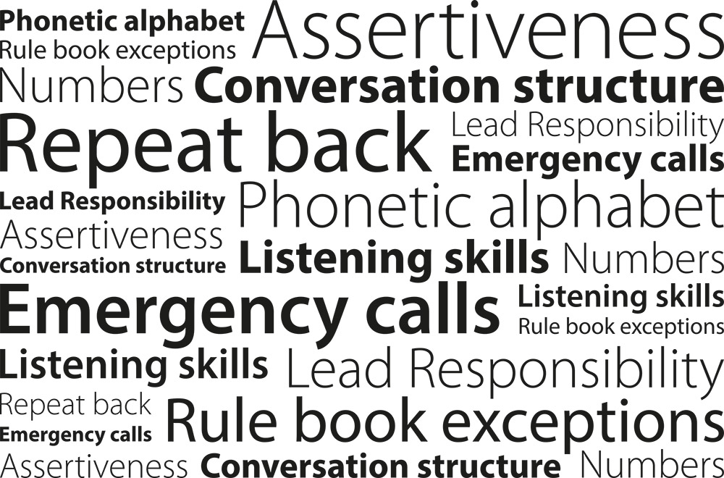
VO…

Slide 57

Every time we hold an operational conversation, we are agreeing a contract
- keep the contract tight
Your briefer will now conduct a short test to confirm understanding.
VO

