Slide 1
Safety Critical Communications
MODULE FOUR:
PROTOCOLS 2

Slide 2
Briefer’s Introduction:
Welcome to the fourth module in our course on safety critical communications. Here we return to the subject of ‘protocols.’
This module looks at the following:
Intro – a reminder of what SCC is and why it is important
Standard words and phrases
The Emergency Call
The effect of communications equipment

Slide 3
How the Course Works:
The programme consists of six modules. We recommend that they are delivered in order, but you may select a particular module if required:
Foundation
Protocols 1
Structure and Lead Responsibility
Protocols 2
Confirming Understanding
Communication Skills
*Please read the Briefing Notes prior to delivering a module. They provide background information to enable you to manage the exercises and discussions.
*You will also be required to perform a short assessment at the end of the course to make sure attendees understand the content. See the Briefing Notes.

Slide 4


Welcome

Slide 5

Safety Critical Communications

Slide 6

Protocol: an agreed way of doing something
VO

Slide 7

VO

Slide 8
A
ccurate
B
rief
C
lear
P
ABC- P
rofessional
VO…

Slide 9
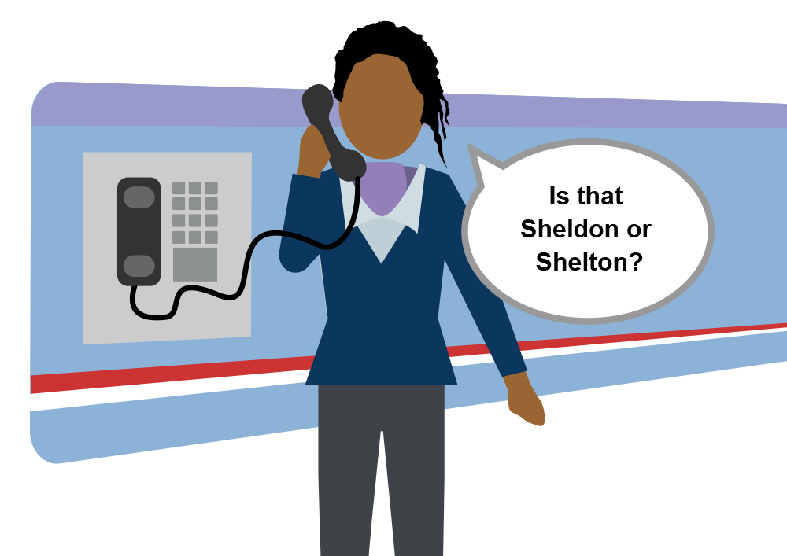
VO

Slide 10
“zero two zero… three one four two… five three zero zero”
“twenty-four miles”
“zero nine hundred hours”
VO…

Slide 11

Standard words and phrases
Emergency call
Effect of equipment
VO

Slide 12

National
MINIMUM
Standard
Note, there will be a short test at the end of this module to confirm your understanding of the National Minimum Standard.
VO…

Slide 13

Standard Words and Phrases

Slide 14
Q. Why do we have standard words and phrases?
Q. Which ones can you remember?
VO

Slide 15
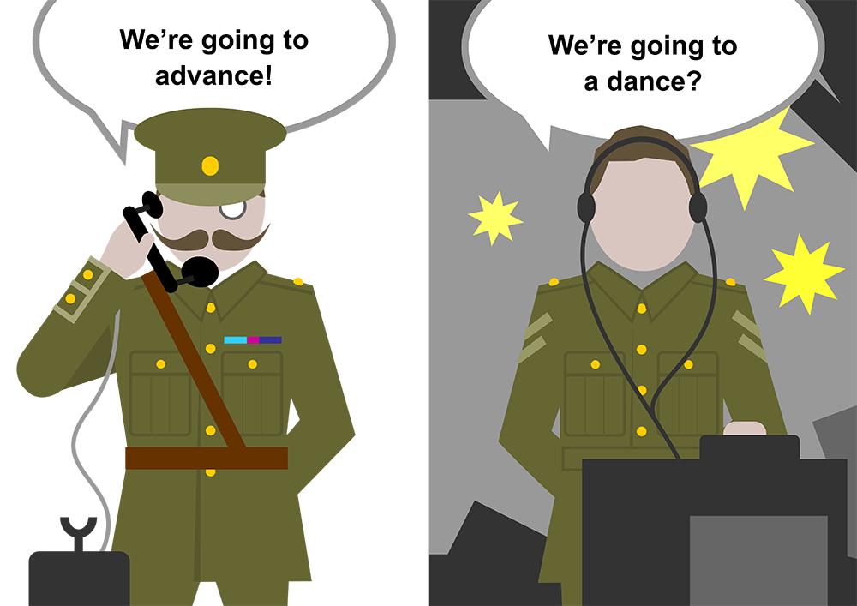
…VO

Slide 16
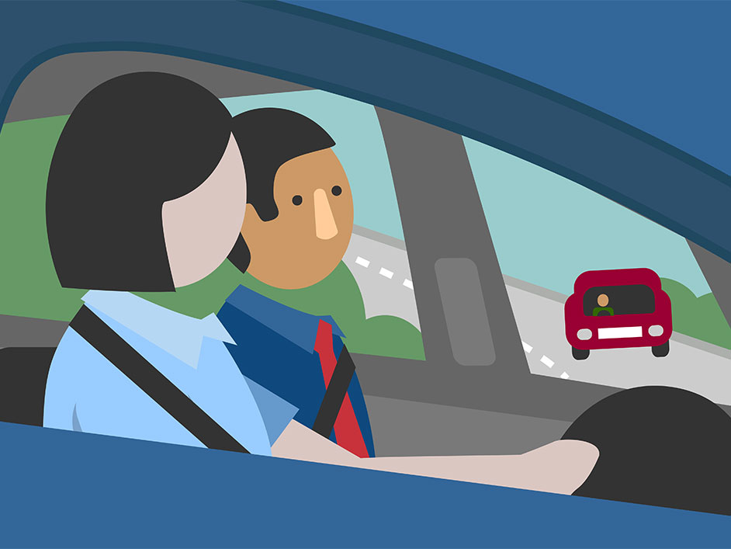
“Safe to go?”
“Go / No”
VO…

Slide 17
NOT CLEAR
VO

Slide 18
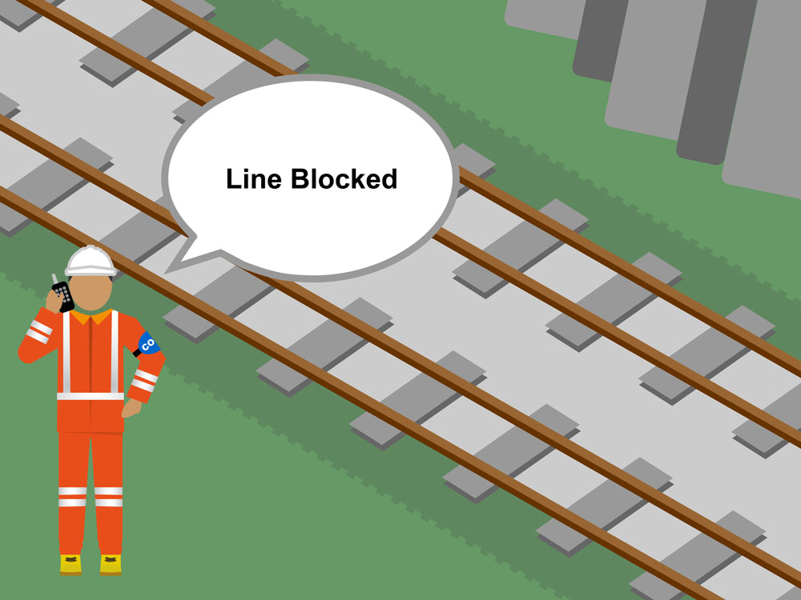
VO…

Slide 19
List of standard words and phrases:
Phrases to use when using a radio or telephone
Other phrases to use when using a radio and only one person can be heard at a time
Correction
I have made a mistake and will now correct the word or phrase just said.
Over
I have finished my message and am expecting a reply.
Repeat back
Repeat the message back to me.
This is an emergency call
This message provides information which needs immediate action to prevent death, serious injury or damage.
Out
I have finished my message no reply is expected
VO

Slide 20
“You now have my authority to pass mike echo two three signal at danger. Proceed at caution as far as mike echo two five signal.”
VO

Slide 21

Here are some more phrases that a Signaller may use:
“Make no further movements…..”
“Await signal…..”
Skip this section
“Obey all other signals.”
“When I give you permission….”
“Proceed at caution.”
On the approach to…. And beyond…..
VO

Slide 22
Here are some more phrases that a Signaller may use:
“What I require you to do driver…….”
“Make a wrong direction movement from………. to…………”
“Proceed up to.….”
“Stay in a position of safety..…”
“You now have my authority to…….”
VO

Slide 23
Here are some more phrases that a Signaller may use:
“Obey signal….”
“Report your findings at/to……..”
“The line is now clear and safe for trains to run on.”
“The …. Line is blocked”

Slide 24
Here are some more phrases that a Signaller may use:
“Driver, I’m detaining you at……signal because of……….. (give a reason)
Or
When authorised, I require you to pass……… signal at danger.
Proceed at caution through the signal section / as far as ……….ONLY.
VO

Slide 25
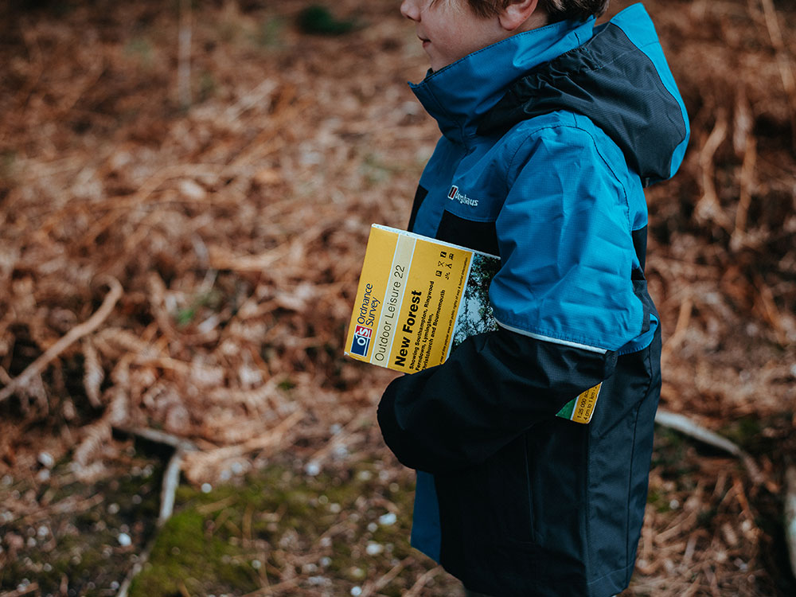
Correction

Slide 26
CORRECTION
use when correcting our own verbal mistake
VO…

Slide 27


What effect does the Signaller’s
mistake have on the message Opening?
Model
Answer
Example
This example, and the one on the next page, are both taken from recorded communications.
VO

Slide 28
Which version is more ‘ABC-P?’
Example
Model
Answer
Note, these may sound strange if you are unfamiliar with shunt moves. The communication takes place over a radio in a yard. Tracks in yards and depots are called ‘roads’ and these are given names such as ‘stables’ or numbers such as ‘six road.’
VO

Slide 29
Say ‘CORRECTION’ and then
RESTATE THE MESSAGE CORRECTLY
VO

Slide 30

Repeat Back

Slide 31
REPEAT BACK
Repeat the message
back to me
VO

Slide 32




Opening
Information
Actions
Confirmation
“Repeat Back”
VO

Slide 33

Opening
Information
Actions
Confirmation
“Repeat Back”
Note, the ‘repeat back’ in the Confirmation should focus on the agreed actions.
VO

Slide 34
Use the standard words and phrases:
a) using a radio or telephone
b) using a radio and only one person can be heard at a time
Correction
Over
Repeat Back
This is an emergency call
Out
VO

Slide 35
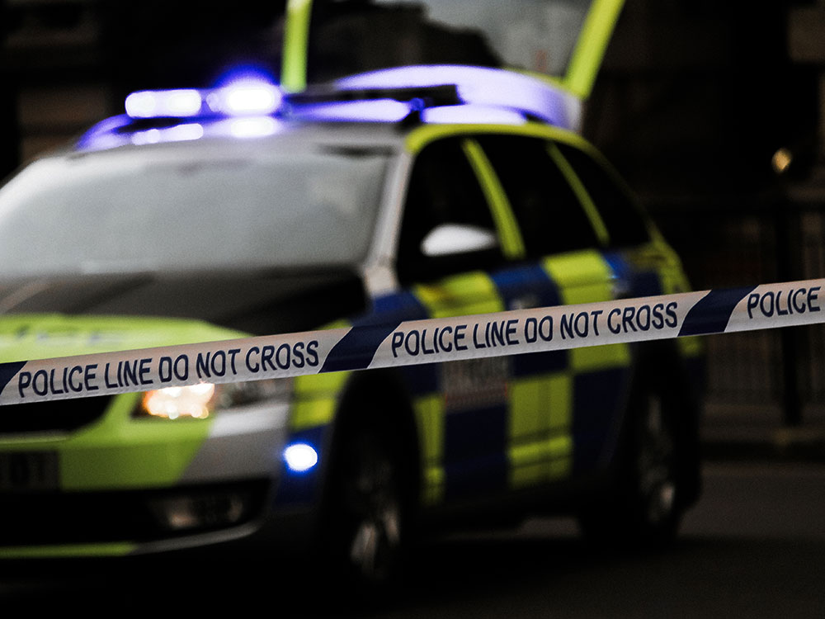
Making an Emergency Call

Slide 36
This is an emergency call
VO…

Slide 37
Opening
Information
Actions
Confirmation
VO

Slide 38
“This is an emergency call”
“My name is…”
“I am a…”
“I work for…”
“I am standing at…”
“I require (which emergency services…)
It is important to give this information first, in case contact is lost.
VO

Slide 39
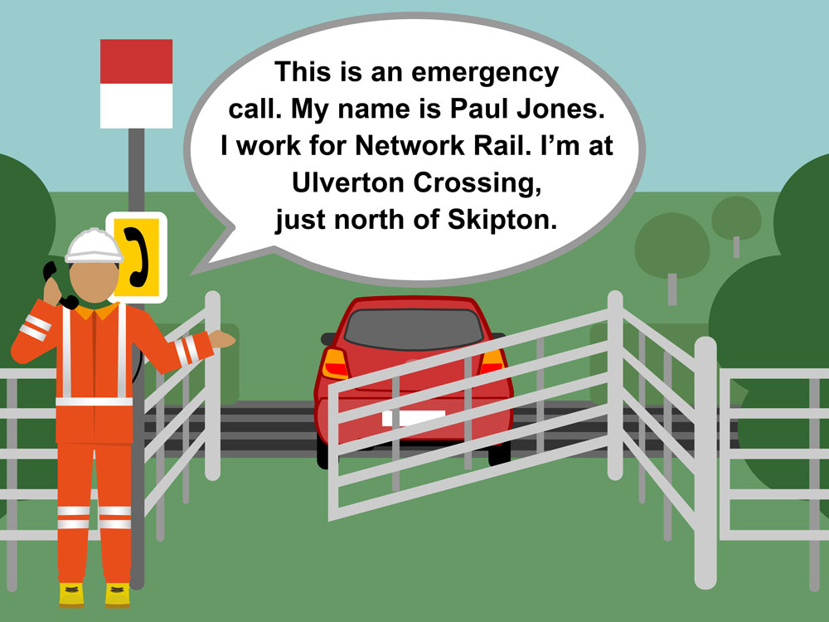
.
.
…VO
.

Slide 40

Opening
Concise Information

Slide 41
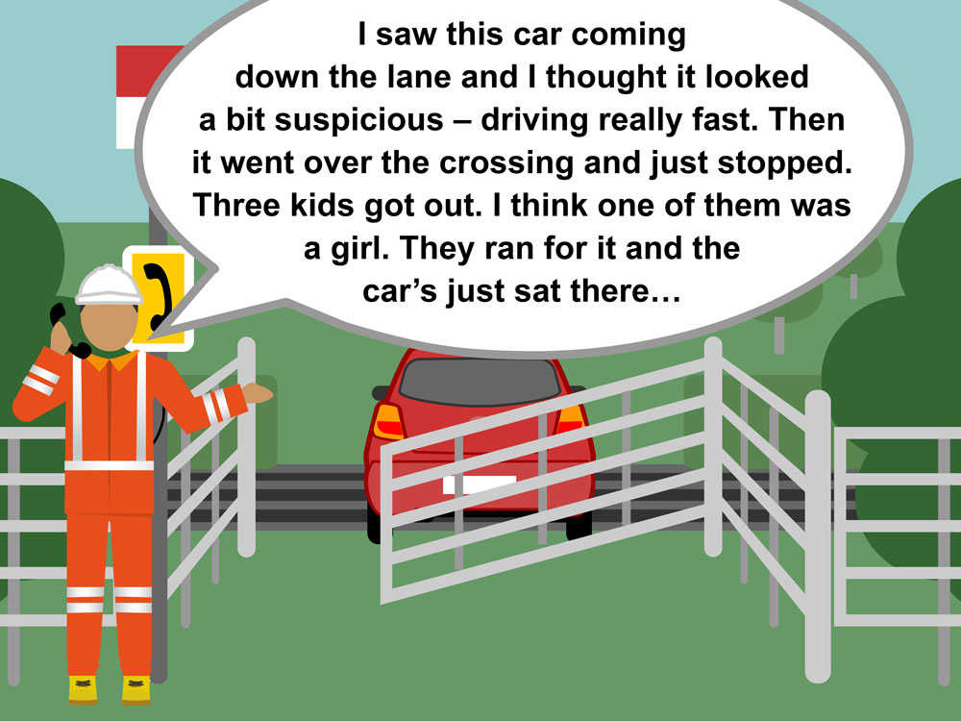

Slide 42
Opening
<Pause>
Concise Information
Pause for a couple of seconds to form a coherent message.
VO…

Slide 43
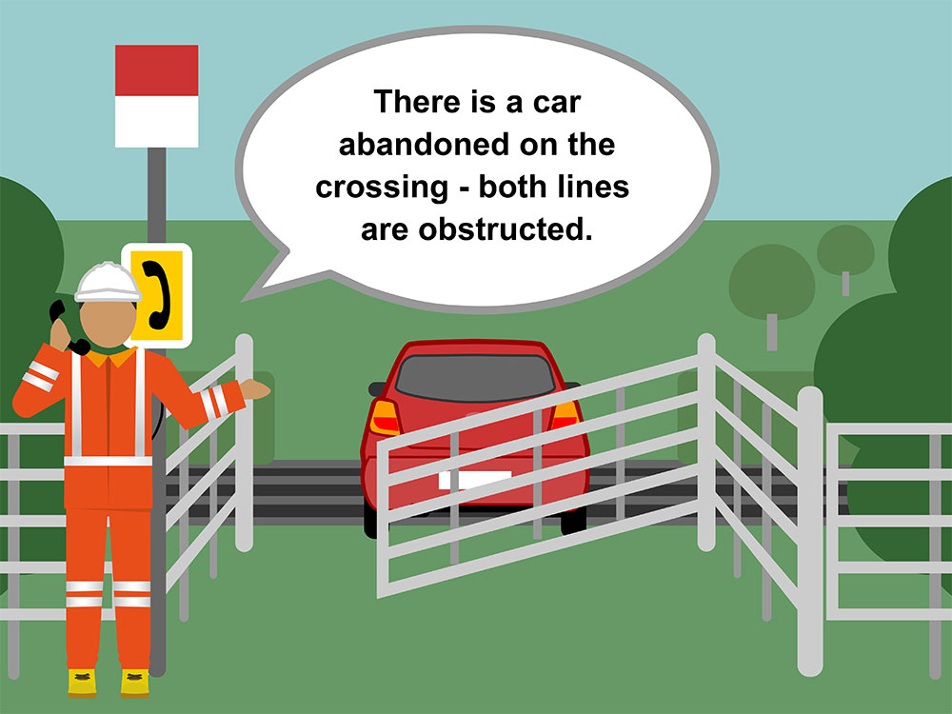
…

Slide 44
Opening
<Pause>
Concise Information
Actions
Confirmation
VO…VO

Slide 45
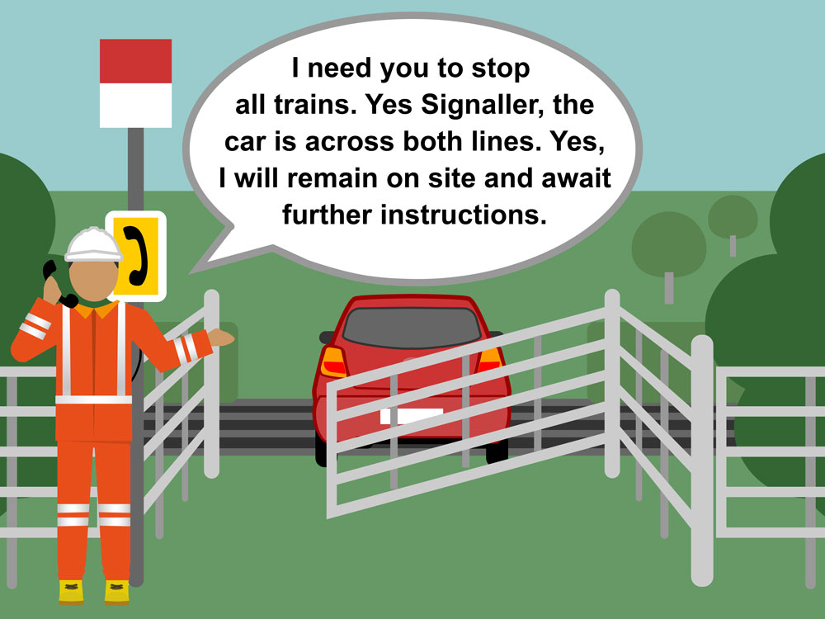
…

Slide 46
Split into groups.
Each group should write a realistic emergency scenario, relevant to their job function.
One member of each group should make the emergency call while the rest listen in.
Mini Workshop
Whilst it is stressful to make a call in front of your peers it is more stressful to make an emergency call in a real emergency situation.

Slide 47
Learn to make an Emergency Call
It is important to practice making an emergency call on a regular basis
VO

Slide 48
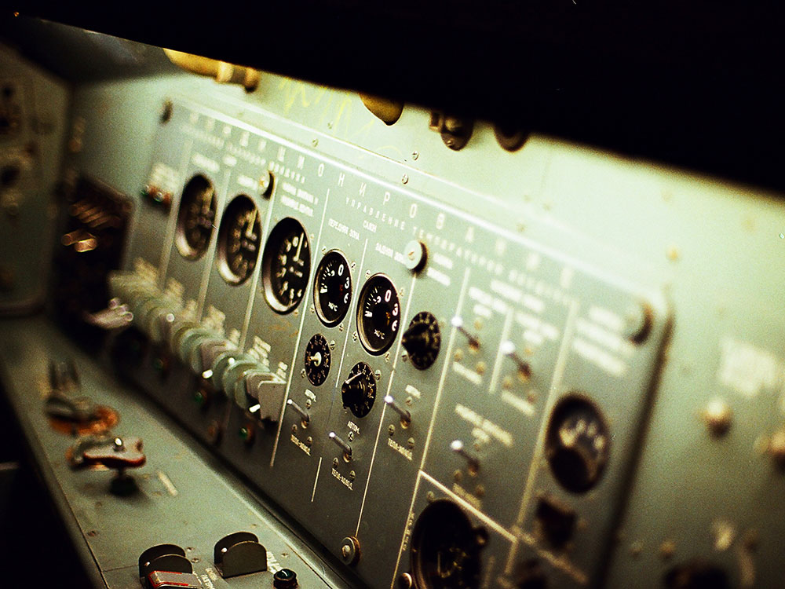
Communication Equipment

Slide 49
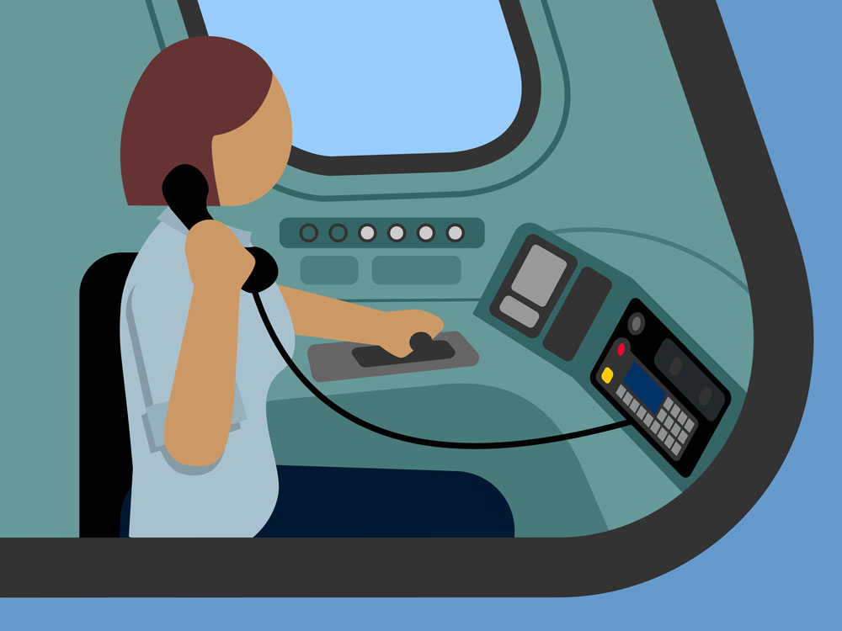
Technical note: simplex, sometimes called ‘half duplex’ or ‘press to talk,’ allows communication in one direction at a time.
Duplex allows simultaneous communication in two directions, like a mobile phone.
Multiplex supports many-to-many communication, like a conference call.
Note on Emergency Call:
Emergency calls made using the GSM-R system red button are simplex – ‘press to talk.’ This is different to normal operation. Make sure it doesn’t catch you out.
VO

Slide 50

Improved Reception
Specific Emergency Call feature
Caller Identification
Full duplex operation
VO

Slide 51
In what manner are the participants talking to each other?
Specifically, what is happening?
What happens as a result?
The hand signaller is standing track-side, talking on a GSM-R radio.
VO

Slide 52
What effect has the ‘press to talk’ equipment had? (think ABC-P)
VO

Slide 53
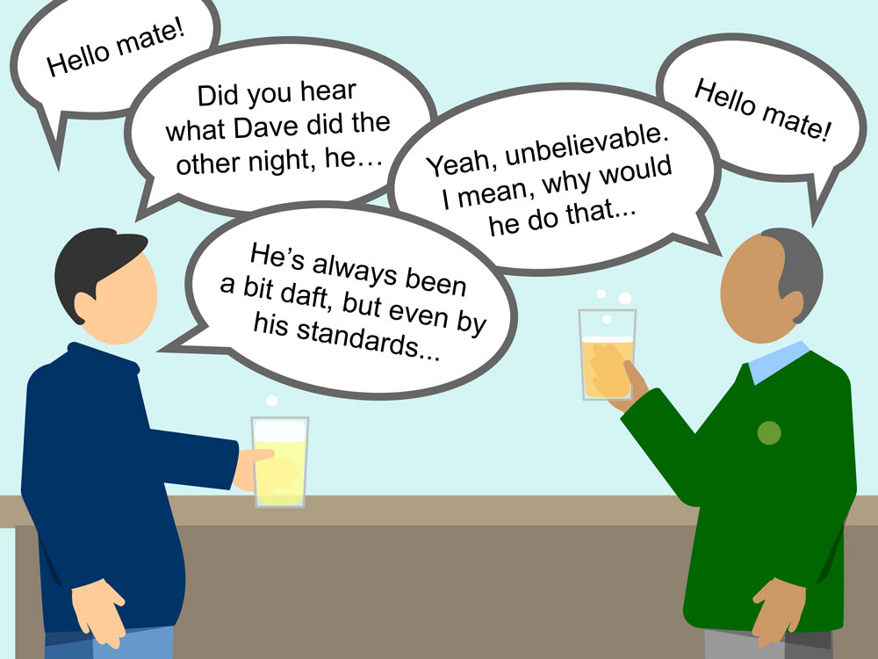
…VO

Slide 54
Safety Critical Communications is a formal conversation.
VO

Slide 55

Module Review
VO

Slide 56
1
Use the standard words and phrases
2
Learn and practice to make an Emergency Call
Safety Critical Communications are a formal conversation
3
VO

Slide 57

Module Conclusion
VO

Slide 58
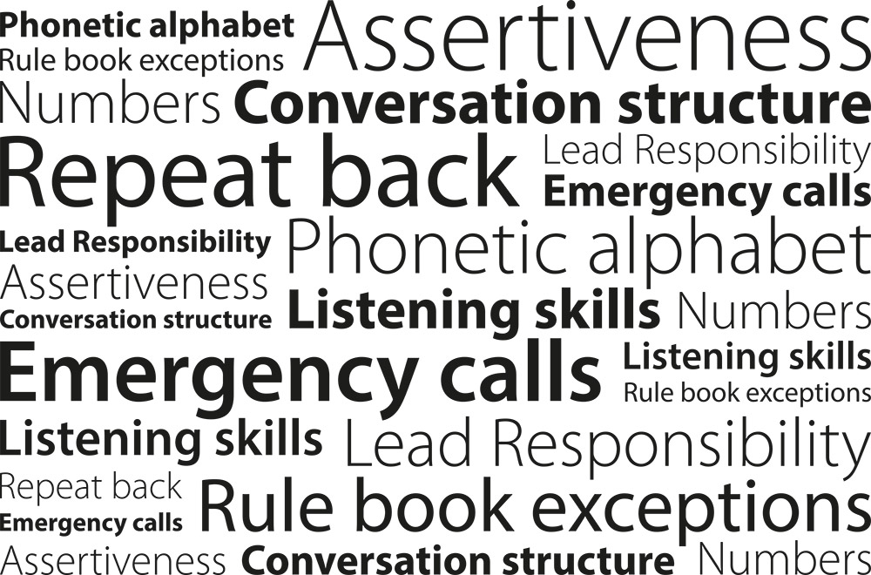
VO…

Slide 59

Every time we hold an operational conversation, we are agreeing a contract
- keep the contract tight
Your briefer will now conduct a short test to confirm understanding.
VO

