Slide 1
Safety Critical Communications
MODULE FIVE:
CONFIRMING UNDERSTANDING

Slide 2
Briefer’s Introduction:
Welcome to the fifth module in our course on safety critical communications. Here we look at confirming understanding.
This module looks at the following:
Review of the course to date
Barriers to understanding
Recap and further detail on Repeat Back
Listening and Questioning skills

Slide 3
How the Course Works:
The programme consists of six modules. We recommend that they are delivered in order, but you may select a particular module if required:
Foundation
Protocols 1
Structure and Lead Responsibility
Protocols 2
Confirming Understanding
Communication Skills
*Please read the Briefing Notes prior to delivering a module. They provide background information to enable you to manage the exercises and discussions.
*You will also be required to perform a short assessment at the end of the course to make sure attendees understand the content. See the Briefing Notes.
The next page is a holding page, designed to sit on the screen while attendees enter the room.

Slide 4


Welcome

Slide 5

Safety Critical Communications
…

Slide 6

Module 5: Confirming Understanding
VO

Slide 7
Foundation
Protocols 1
Structure and Lead Responsibility
Protocols 2
VO

Slide 8

All operational communication by front-line staff is safety critical.
VO

Slide 9

By ‘operational’ & ‘front line’ we mean:
Maintenance
TOC & Network Rail Control
Signalling
Station Operations
Driving
Shunting
By ‘operations’ we mean anything relating to train movement, signals, track, stations, infrastructure…
…

Slide 10

VO

Slide 11
A
ccurate
B
rief
“alpha, bravo, charlie…”
C
lear
“tango two six signal’
P
rofessional
VO…

Slide 12




Opening
Information
Actions
Confirmation
VO…

Slide 13

Confirming Understanding:
Overcoming barriers
Repeat back
Listening and questioning
VO

Slide 14

National
MINIMUM
Standard
Note, there will be a short test at the end of this module to confirm your understanding of the National Minimum Standard.
VO

Slide 15

Barriers to Communication
…

Slide 16
Q. What barriers to understanding are there?
- what prevents us from communicating well?
- what might happen if we don’t communicate well?
VO

Slide 17
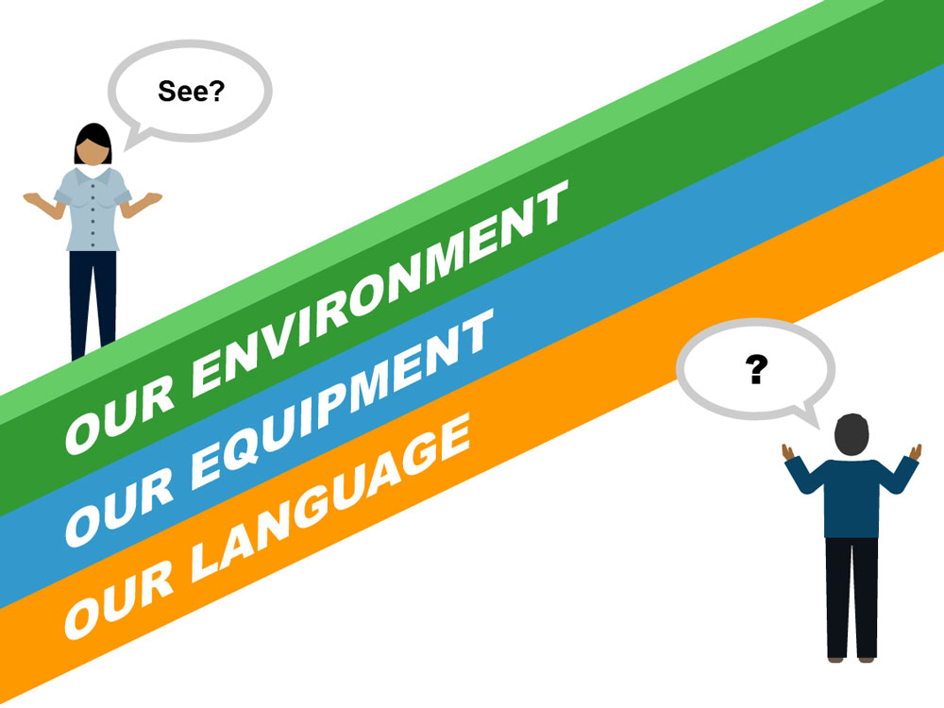
VO

Slide 18
Environmental Barriers
…

Slide 19
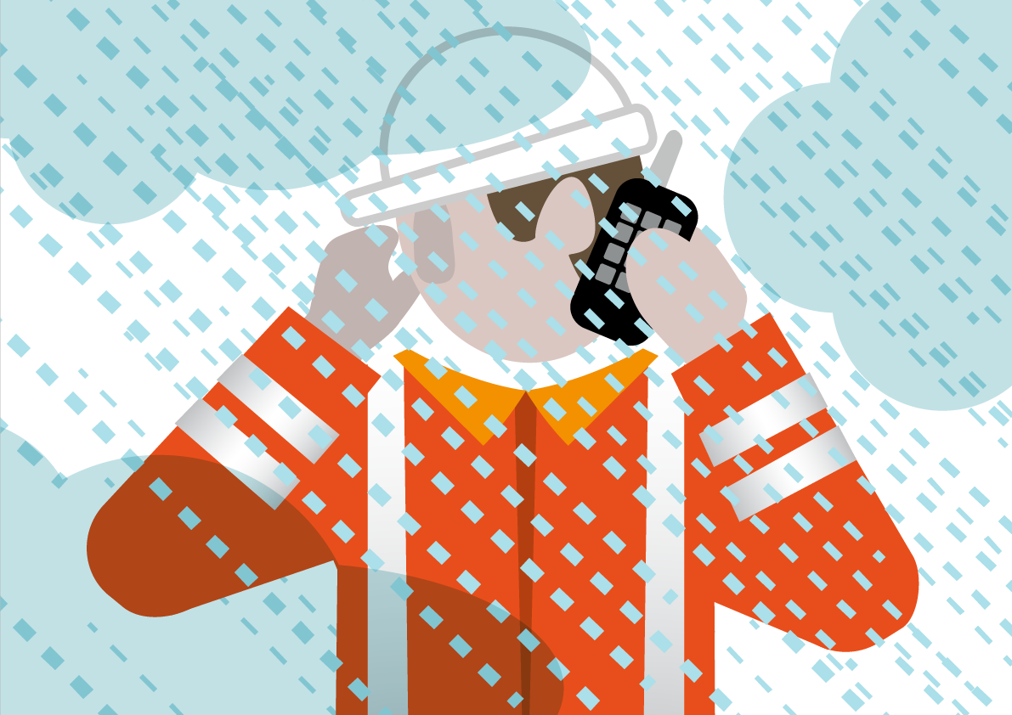
VO

Slide 20
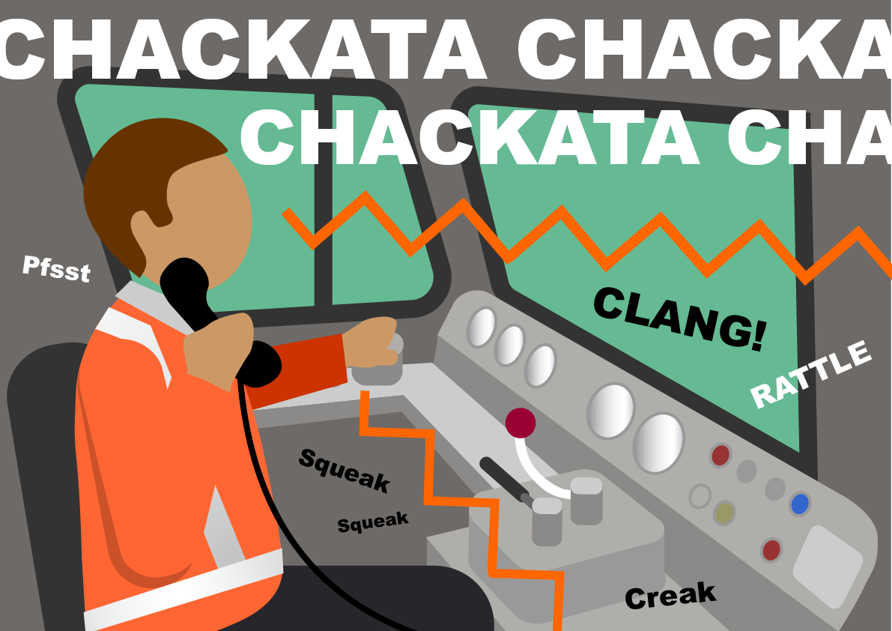
VO

Slide 21
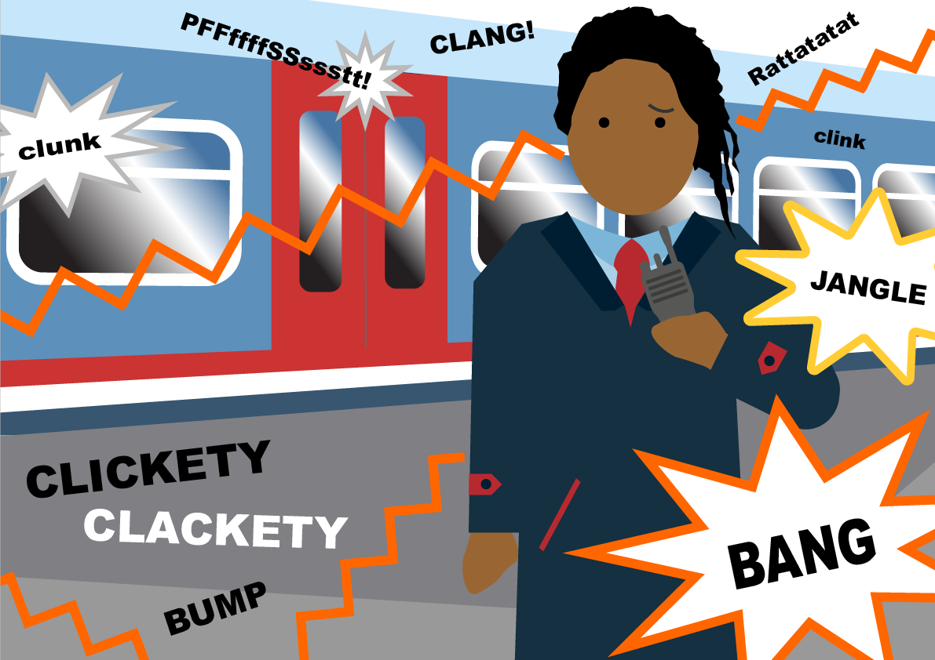
VO

Slide 22

)))))) NOISE ((((((((((
>>>>>>>>> RUSHED SPEECH
((( SHOUTED MESSAGES )))
Giving up
VO

Slide 23
Equipment Barriers
…

Slide 24
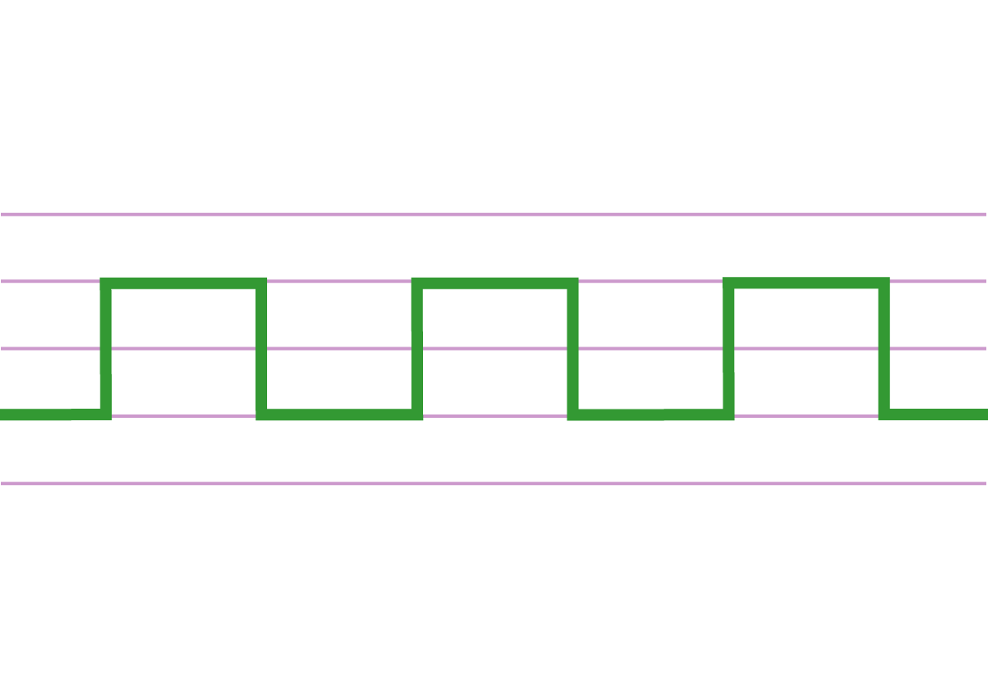
VO

Slide 25
“The line is now ZZZZZZZZZZZZZZZ and dup for trains to run on.”
VO…

Slide 26
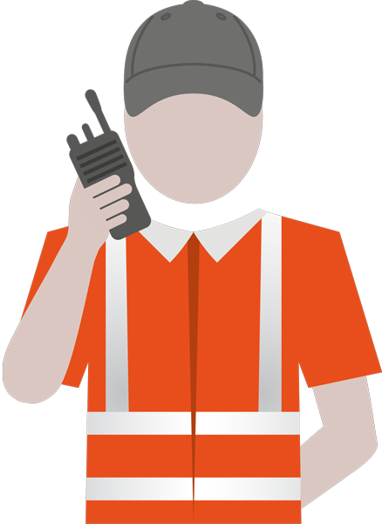
VO…

Slide 27
Linguistic Barriers
…

Slide 28

Vague Language
Jargon
Regional Words
VO

Slide 29
“over there”
“he’s still got it”
“it’s near the station”
“as we did last time”
“call back in a few ticks”
“I’ll just ok it”
Imprecise, meaningless phrases:
Which ones have you heard?
VO

Slide 30
Spot Quiz 1
?
Q. What is a Twichell?
An alleyway
A bird table
A small screwdriver

Slide 31
Spot Quiz 1
?
Q. What is a Twichell?
An alleyway
VO
VO

Slide 32
Spot Quiz 2
?
Q. What is a Cob?
A round loaf of bread
A building material
A seagull
VO

Slide 33

A round loaf of bread
A building material
A seagull
VO

Slide 34
Dalek
Metal Mickey
Bang Move
The Peg
One on
Slack
Juice rail
Rhubarb
The Full Monty
Billy Bunter
Dusty Bin
It’s best to avoid Jargon. Be aware of possible confusion and be prepared to ask for confirmation/ clarification
…VO

Slide 35
Overcoming Communication Barriers
…

Slide 36
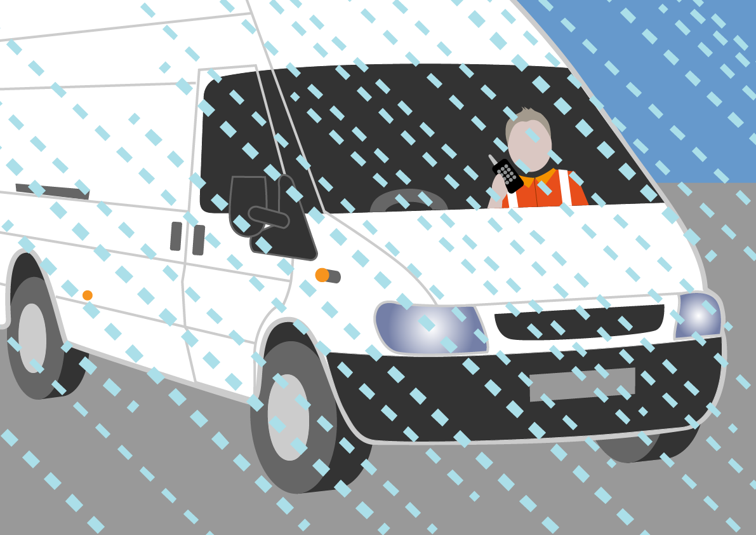

1. Best communication position
We may have no choice. We may need to make the call while ‘exposed to the elements.’
VO…

Slide 37
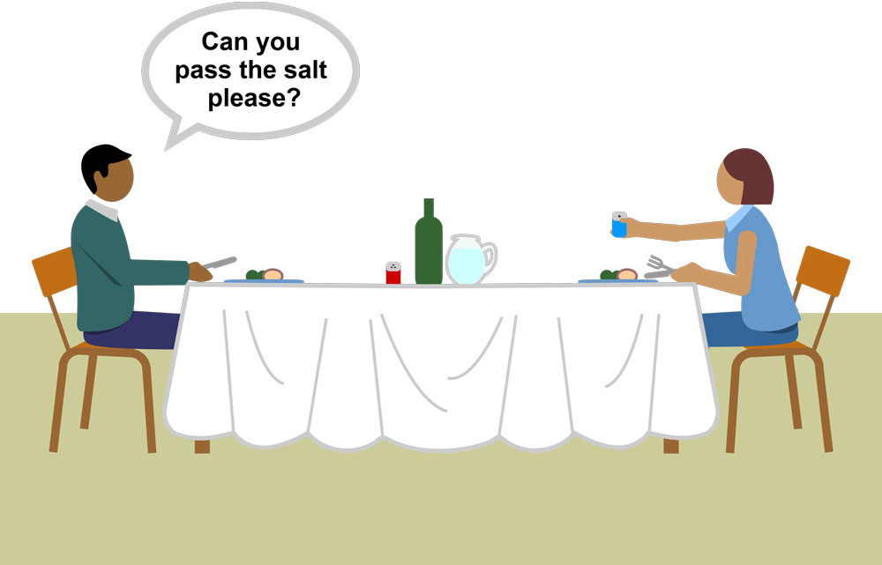
2. Speak slightly slower at a good volume
Technical note: communications equipment has a maximum transmission volume. You can reach this volume without shouting. How volume is interpreted at the receiving end is down to their settings and equipment
VO…

Slide 38
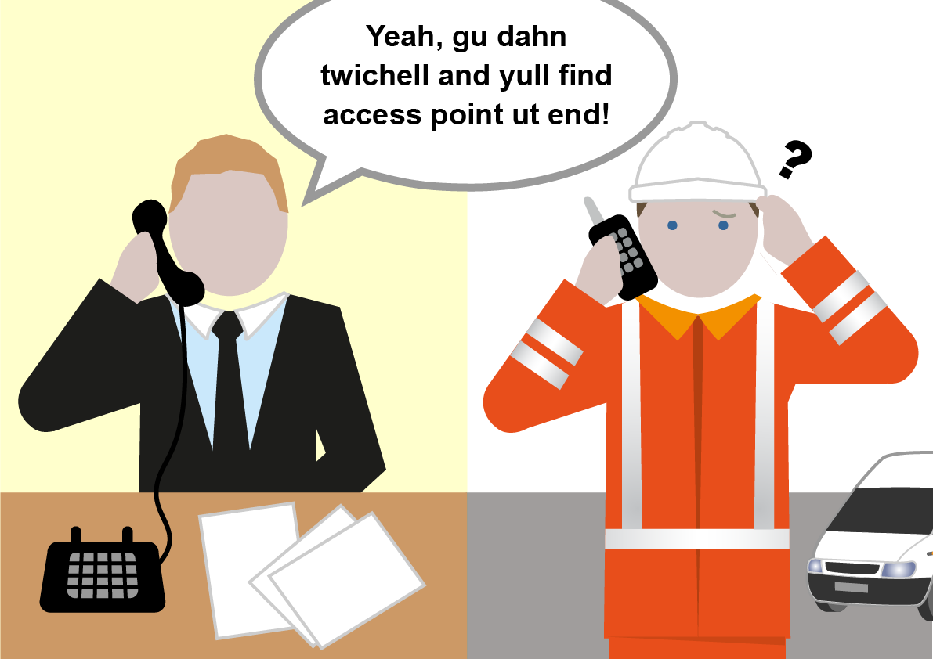
3. Avoid ambiguous language and regional words; keep jargon to a minimum
VO…

Slide 39
1. Best communication position
2. Speak slightly slower at a good volume
3. Avoid ambiguous language and regional words; keep jargon to a minimum
4. Use the protocols
5. Confirm understanding – repeat back
VO

Slide 40
Overcome communication barriers:
1. Use the best communication position
2. Speak slightly slower at a good volume
3. Avoid ambiguous language, regional words and jargon
4. Use the protocols
5. Confirm understanding – repeat back
VO

Slide 41

Repeat Back
…

Slide 42
Module 2
“one alpha two six”
“seventeen hundred hours”
“charlie alpha two two signal”
VO…

Slide 43
Module 3
Opening
Information
Actions
Repeat Back
Confirmation
VO

Slide 44
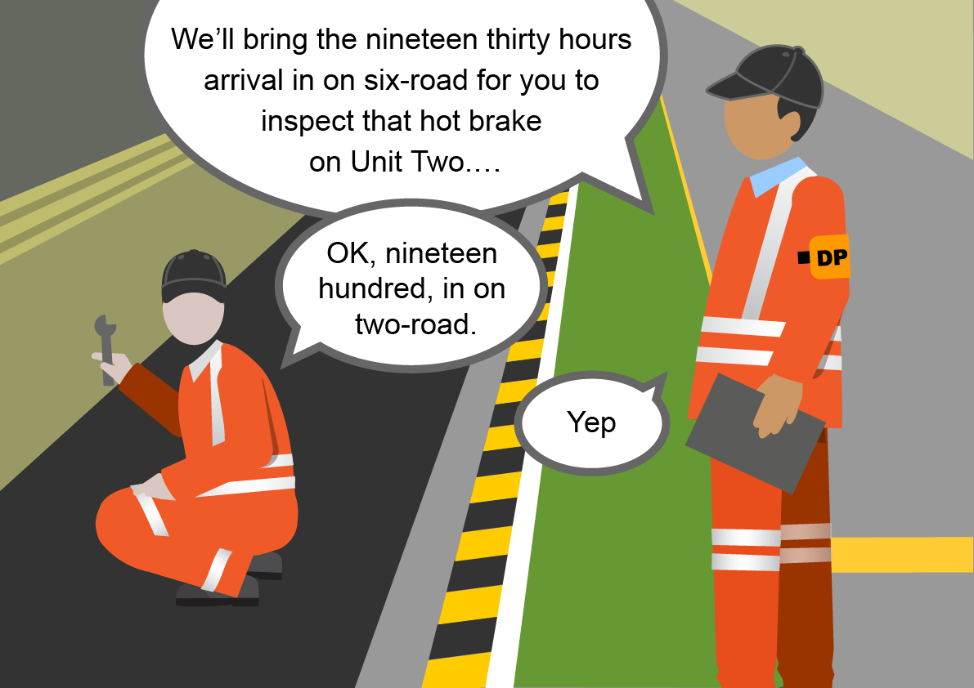
…VO

Slide 45

Opening
Information
Actions
Confirmation
“Repeat Back”
Note, the ‘repeat back’ in the Confirmation should focus on the agreed actions.
VO…

Slide 46
Avoid monotonous and unnecessary repeat-back of information; think about what you are saying and what it means
VO

Slide 47

VO…

Slide 48
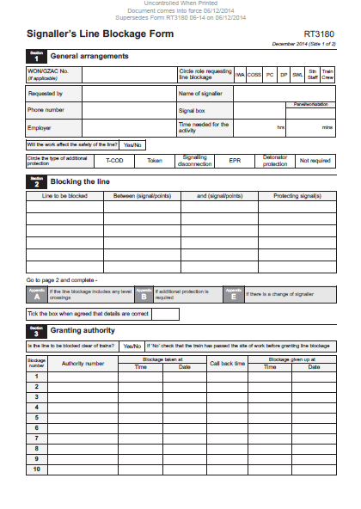
Note, this form has now been
superseded. Here, we are simply
using it as an example
VO

Slide 49


Q. Who was repeating parrot-fashion?
Q. What should the Signaller, who has lead responsibility, have done?
Note, this form has now been
superseded. This conversation is
based on a recording which uses
the old form.
Listening
Questioning…

Slide 50

Listening and Questioning
…

Slide 51
Listening
Questioning
VO

Slide 52
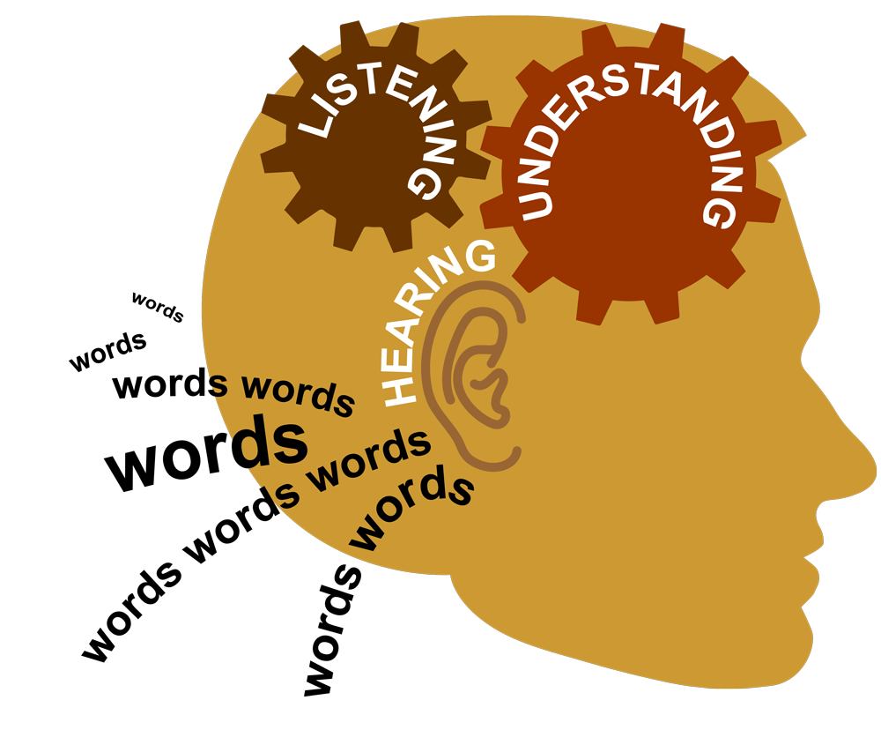
VO

Slide 53
Active listening =
hearing +
understanding +
appropriate response
VO

Slide 54
Yes
or
Ask a question
VO

Slide 55
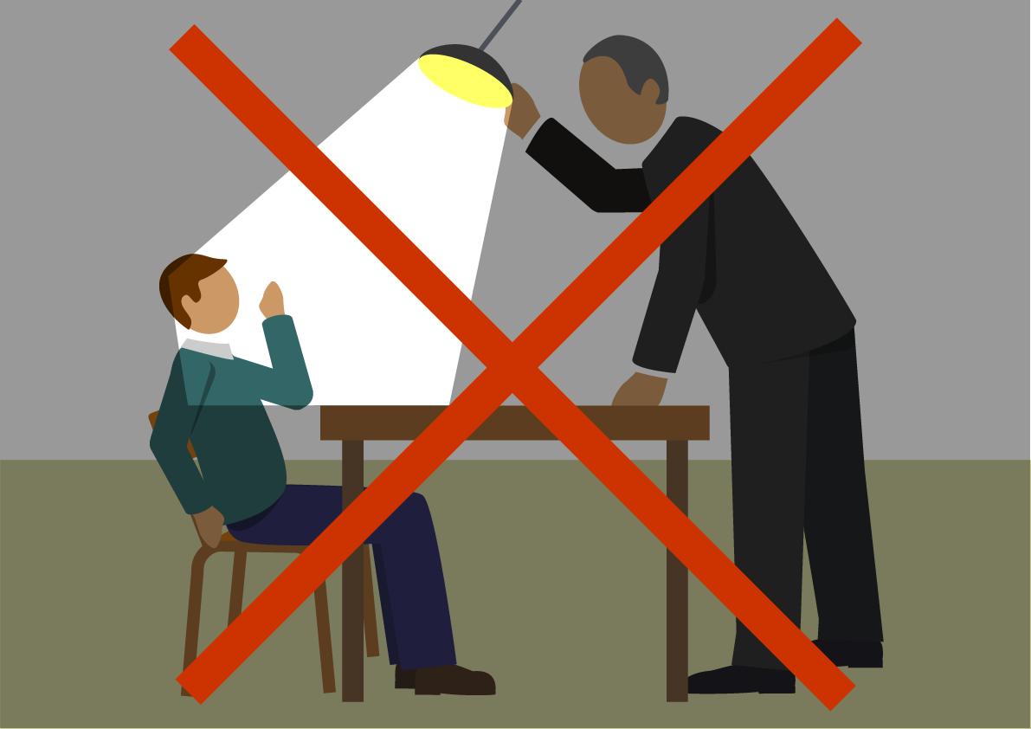
Only ask one question at a time and make sure that the person has time to answer
VO…

Slide 56
“I don’t think you’ve understood, what time did…?”
“Were you listening to that? Which signal…?”
“You’ve got that wrong. Repeat back again please.”
VO

Slide 57
“Can we just make sure we’ve got the time correct. What time…?”
“We need to confirm the signal please. Which signal…?”
“I’m confused. Repeat back please.”
VO

Slide 58
Audio snippets demonstrating good and bad questioning technique.
VO

Slide 59
Use active listening and neutral questions to confirm understanding.
VO

Slide 60

Module Review
…

Slide 61
1
Overcome communication
barriers:
Use the best communication position
Speak slightly slower at a good volume
Avoid ambiguous language and regional words; keep jargon to a minimum
Use the protocols and structure your conversation
Confirm understanding – repeat back
VO

Slide 62
2
Avoid monotonous and unnecessary repeat-back of information; think about what you are saying and what it means
Use active listening and neutral questions to confirm understanding
3

Slide 63

Module Conclusion

Slide 64
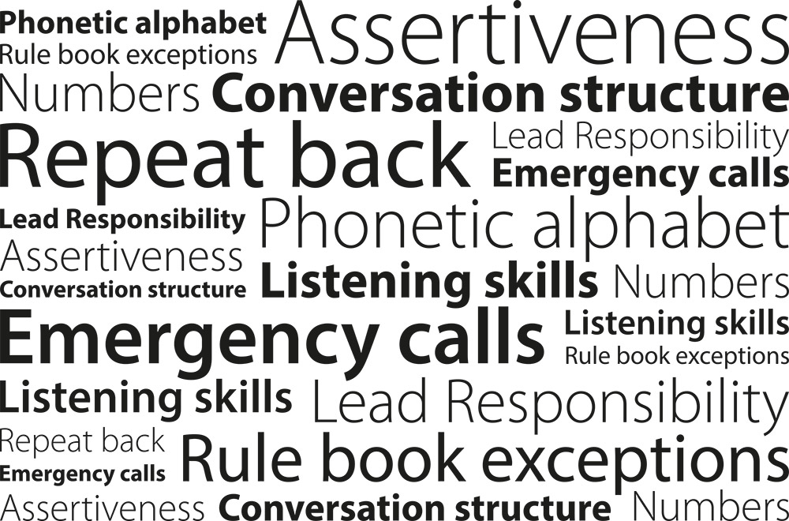
VO…

Slide 65

Every time we hold an operational conversation, we are agreeing a contract
- keep the contract tight
Your briefer will now conduct a short test to confirm understanding.
VO

