Slide 1
Safety Critical Communications
MODULE SIX: Communication Skills

Slide 2
Briefer’s Introduction:
Welcome to the sixth module in our course on safety critical communications. Here we look at non-technical skills:
Review of the course to date
Working with Others
Assertiveness
Challenging
Considering Other’s Needs

Slide 3
How the Course Works:
The programme consists of six modules. We recommend that they are delivered in order, but you may select a particular module if required:
Foundation
Protocols
Structure and Lead Responsibility
Protocols 2
Confirming Understanding
Communication Skills
*Please read the Briefing Notes prior to delivering a module. They provide background information to enable you to manage the exercises and discussions.
*You will also be required to perform a short assessment at the end of the course to make sure attendees understand the content. See the Briefing Notes.
The next page is a holding page, designed to sit on the screen while attendees enter the room.

Slide 4


Welcome

Slide 5

Safety Critical Communications
…

Slide 6

Module 6:
Communication
Skills
VO

Slide 7

Foundation
Protocols
Structure and Lead Responsibility
More Protocols
Confirming Understanding
VO

Slide 8

All operational communication by front-line staff is safety critical
VO

Slide 9

By ‘operational’ &‘front line’ we mean:
Maintenance
TOC & Network Rail Control
Signalling
Station Operations
Driving
Shunting
By ‘operations’ we mean anything relating to train movement, signals, track, stations, infrastructure…
…

Slide 10

VO

Slide 11
A
ccurate
B
rief
“alpha, bravo, charlie…”
C
lear
“tango two six signal’
P
rofessional
VO…

Slide 12




Opening
Information
Actions
Confirmation
VO…

Slide 13
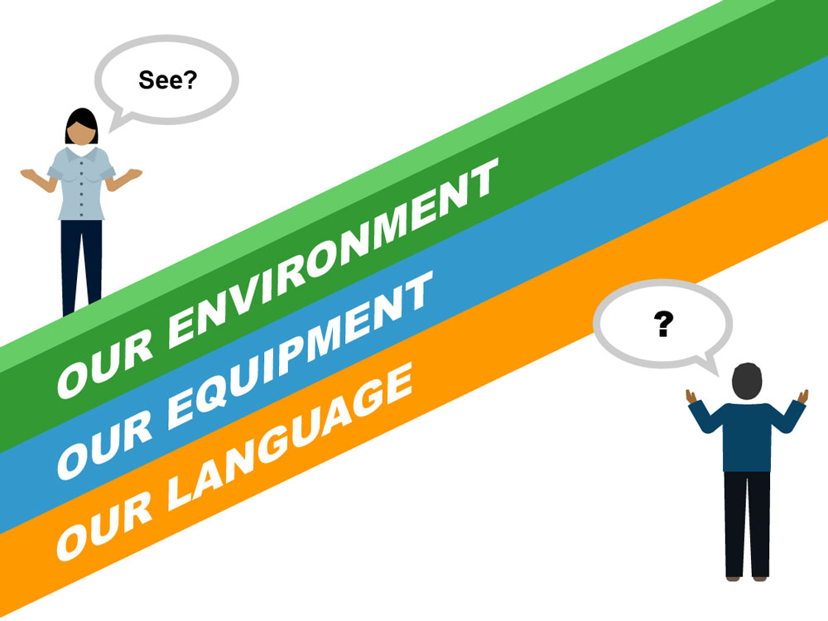
VO…

Slide 14

Opening
Information
Actions
Confirmation
“Repeat Back”
Note, the ‘repeat back’ in the Confirmation should focus on the agreed actions.
VO…

Slide 15

Active listening =
hearing +
understanding +
appropriate response
VO

Slide 16
Communication Skills
VO

Slide 17

National
MINIMUM
Standard
Note, there will be a short test at the end of this module to confirm your understanding of the National Minimum Standard.
VO

Slide 18

Communication Skills
…

Slide 19
Q. Which non-technical skills are you aware of ?
VO

Slide 20
working
with people
self control
assertiveness
conscientiousness
multitasking
control under
pressure
willingness to learn
attention management
Both RSSB and Network Rail have defined sets of non-technical skills relevant to different parts of the rail industry.
VO…

Slide 21
Working with Others
Assertiveness
Challenging
Considering Others
VO…

Slide 22

Working with Others
…

Slide 23

VO…

Slide 24







VO…

Slide 25

VO…

Slide 26
The Rail Industry Team
Positions = job roles
Plays = rule book & procedures
VO…

Slide 27
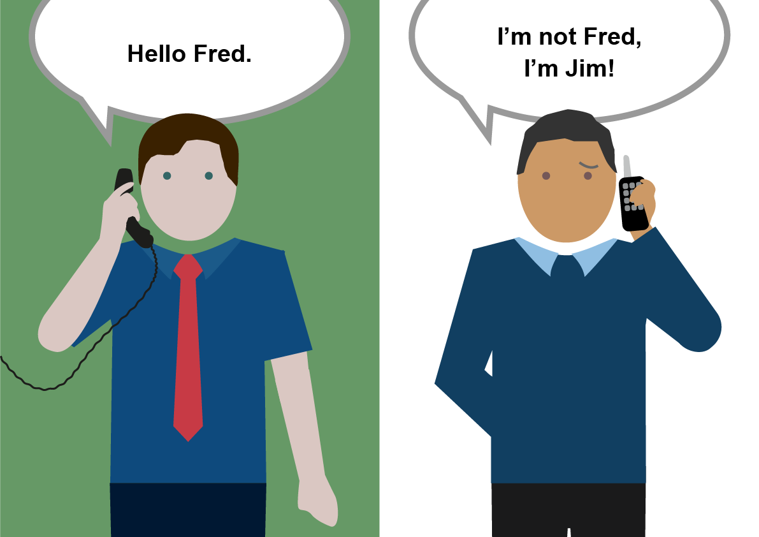
…VO

Slide 28
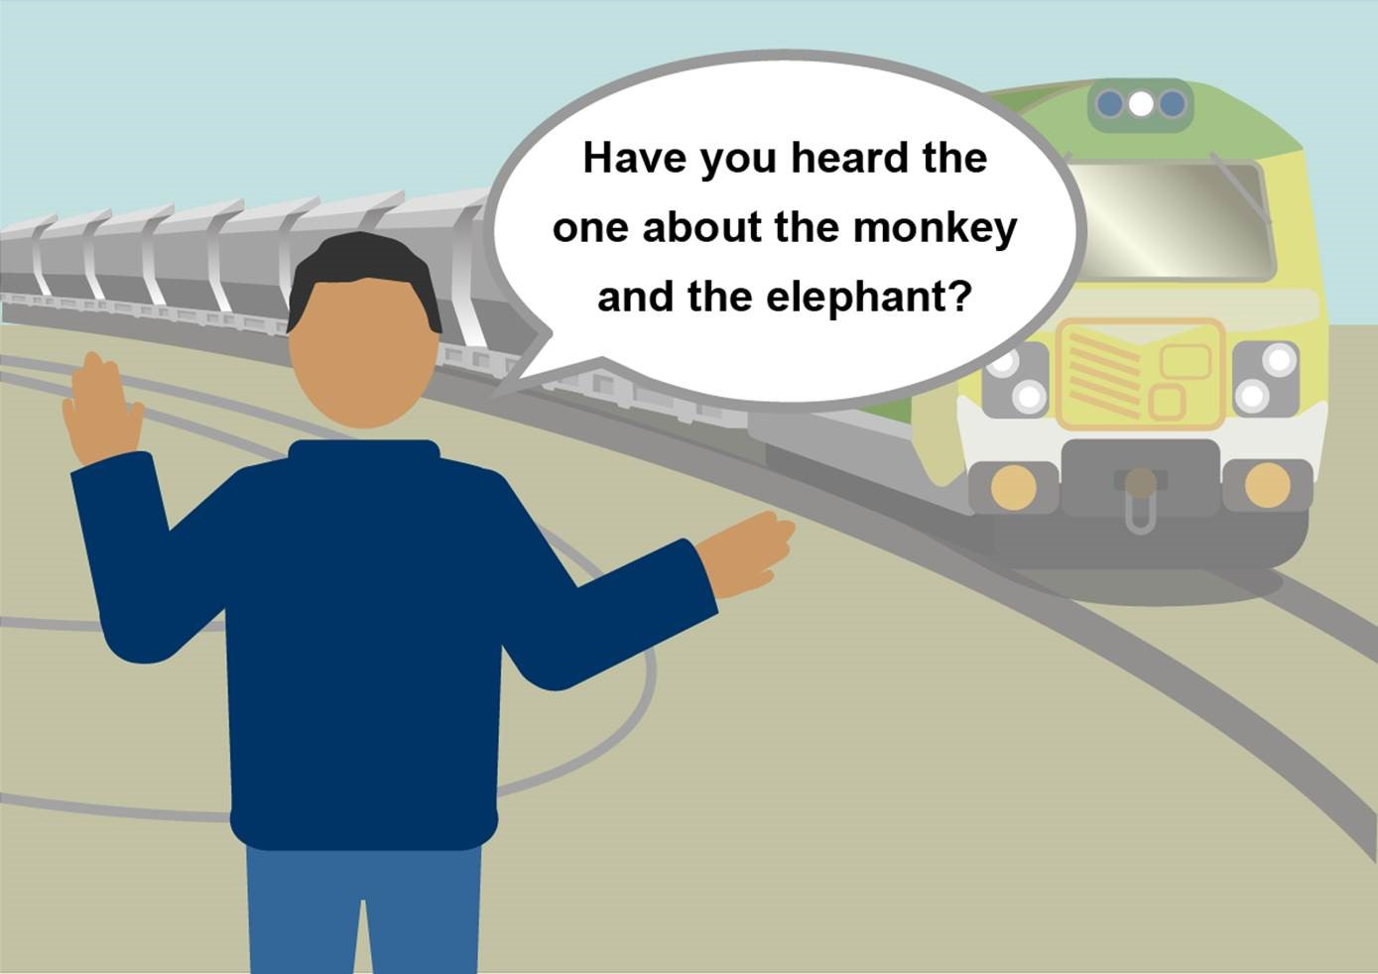
…VO

Slide 29
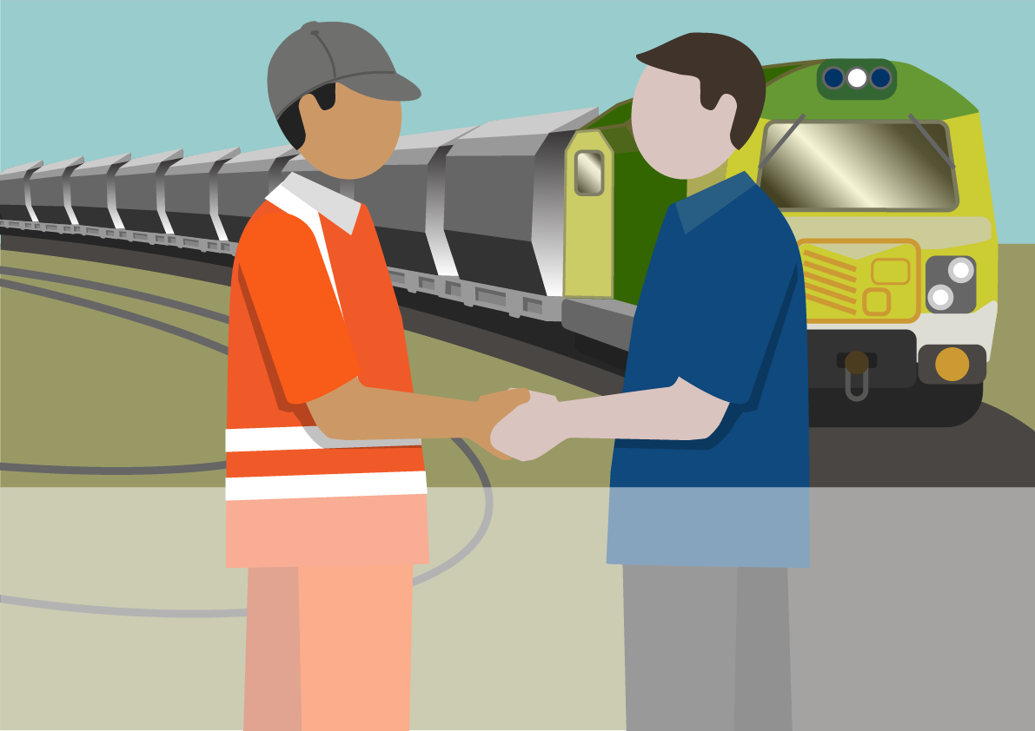
We need to develop a professional working relationship with our colleagues
VO

Slide 30
Be assertive
Challenge effectively
Consider other’s needs
VO

Slide 31

Assertiveness
…

Slide 32

…VO

Slide 33
Assertiveness:
confidently saying what we need, while maintaining respect for others.
VO

Slide 34
In practice…
VO

Slide 35
Mr AGGRESSIVE
Miss passive
Mr Manipulator
VO

Slide 36
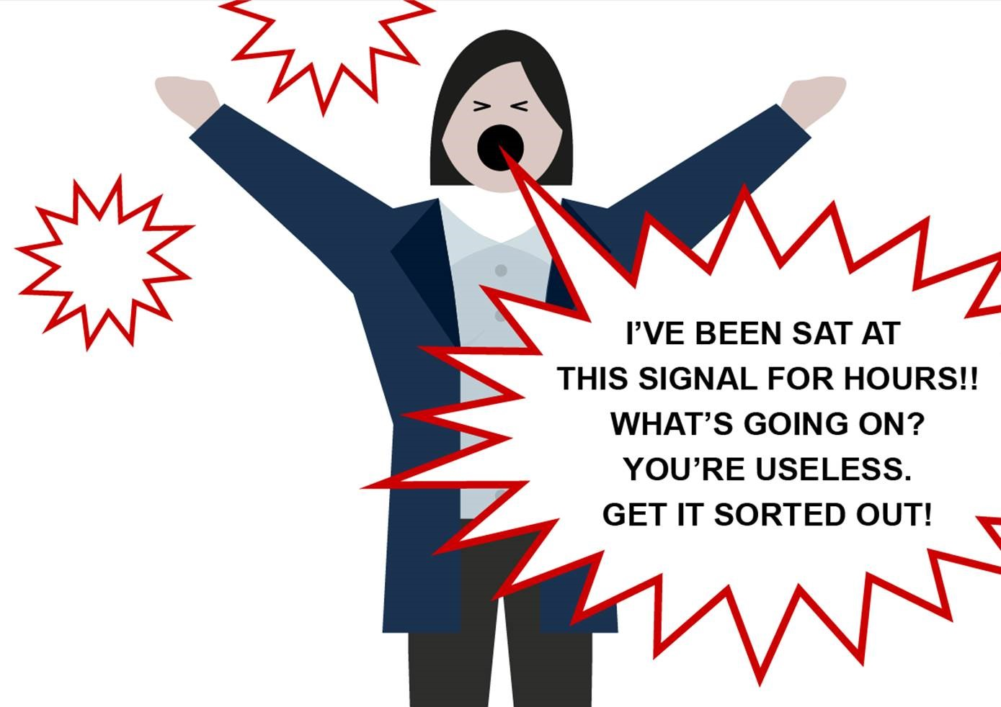
…VO…

Slide 37
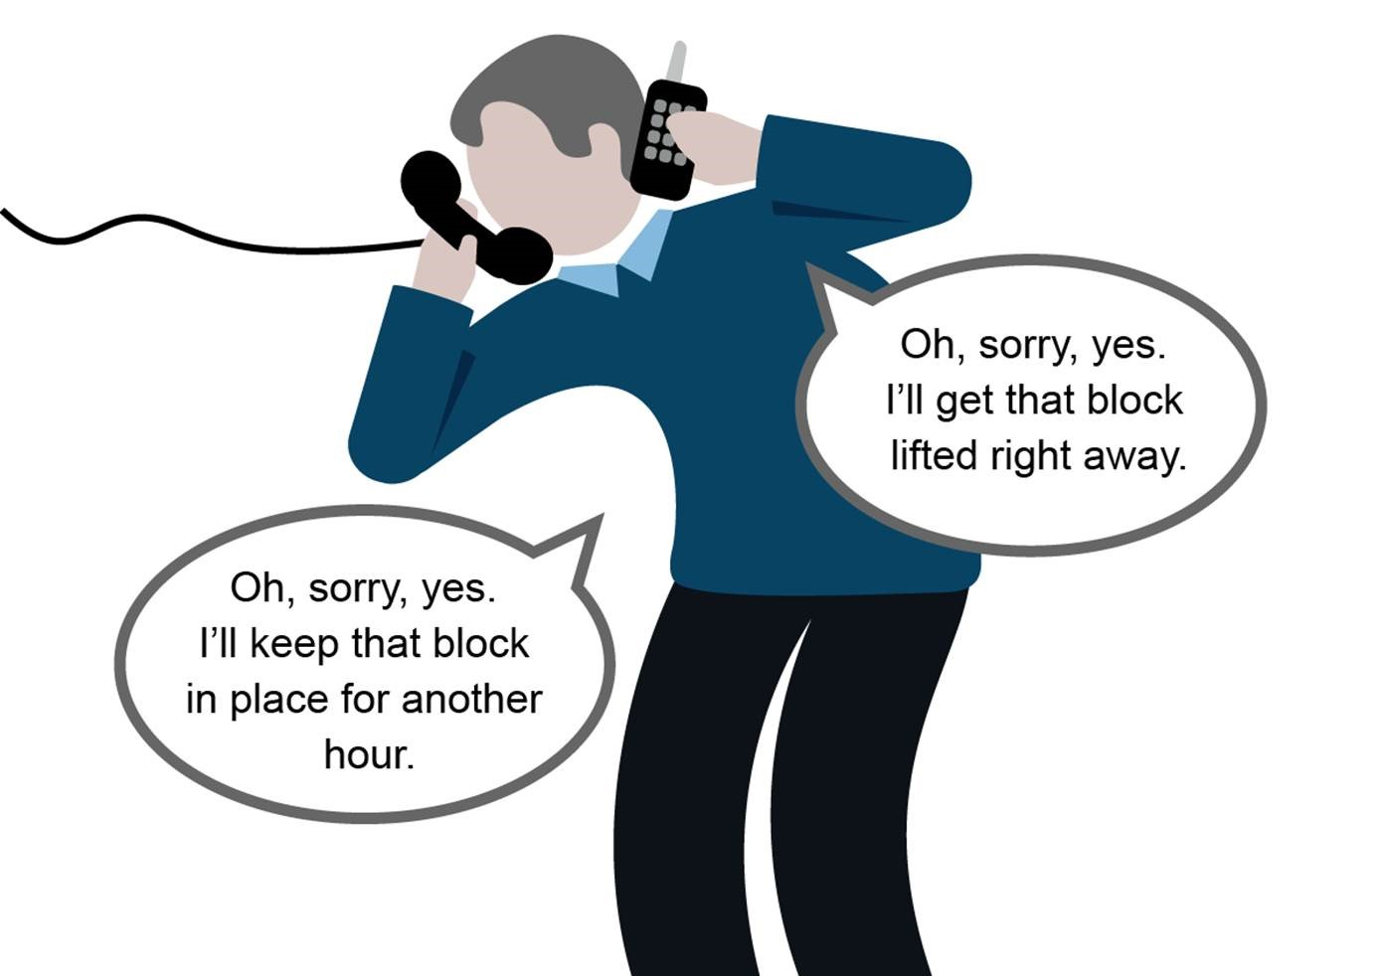
…VO…

Slide 38
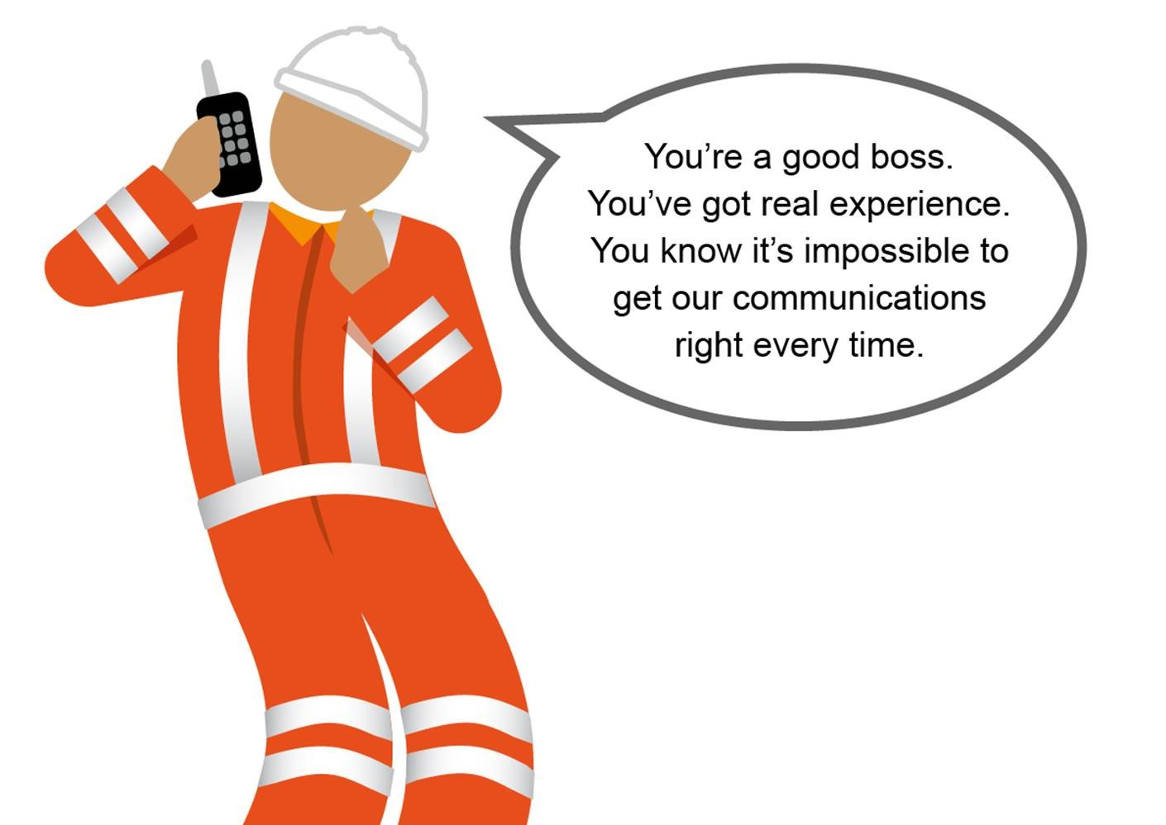
…VO…

Slide 39
State our needs clearly
Avoid shouting
Avoid sarcasm and mimicry
Argue our point but be prepared to compromise
Understand other’s needs
Criticise a point of view, not a person
Use ‘I’ statements, rather than ‘you’ statements
Be prepared to explain why we need something
VO

Slide 40
Decide which of these statements are Assertive and which are Aggressive.
“I don’t believe that’s the right thing to do – I can’t agree to that.”
“I need to let a passenger train through before I can get you out onto the main line.”
“[shouting] LISTEN TO ME, I NEED TO GET MOVING…”
“It doesn’t matter why, I’m just not letting you go yet. OK.”
“I need…”
“Oh, aren’t you the big boss. You know best, as usual ”
“I didn’t think you were the kind of guy to worry about petty regulations.”
“OK. So if we schedule that for nineteen hundred hours, that will give you time to complete your current job and me time to…”
“I can’t give you permission to cross yet because…”
“You’re wrong, just like last time.”
“So, the reason you’re in a hurry is…”
VO

Slide 41
Assertive or Aggressive
“I don’t believe that’s the right thing to do – I can’t agree to that.”
“I need to let a passenger train through before I can get you out onto the main line.”
“[shouting] LISTEN TO ME, I NEED TO GET MOVING…”
“It doesn’t matter why, I’m just not letting you go yet. OK.”
“I need…”
“Oh, aren’t you the big boss. You know best, as usual ”
“I didn’t think you were the kind of guy to worry about petty regulations.”
“OK. So if we schedule that for nineteen hundred hours, that will give you time to complete your current job and me time to…”
“I can’t give you permission to cross yet because…”
“You’re wrong, just like last time.”
“So, the reason you’re in a hurry is…”
VO

Slide 42
We must be assertive. Not passive or aggressive.
VO

Slide 43

Challenge
Effectively
…

Slide 44
Challenge
VO

Slide 45
VO…

Slide 46
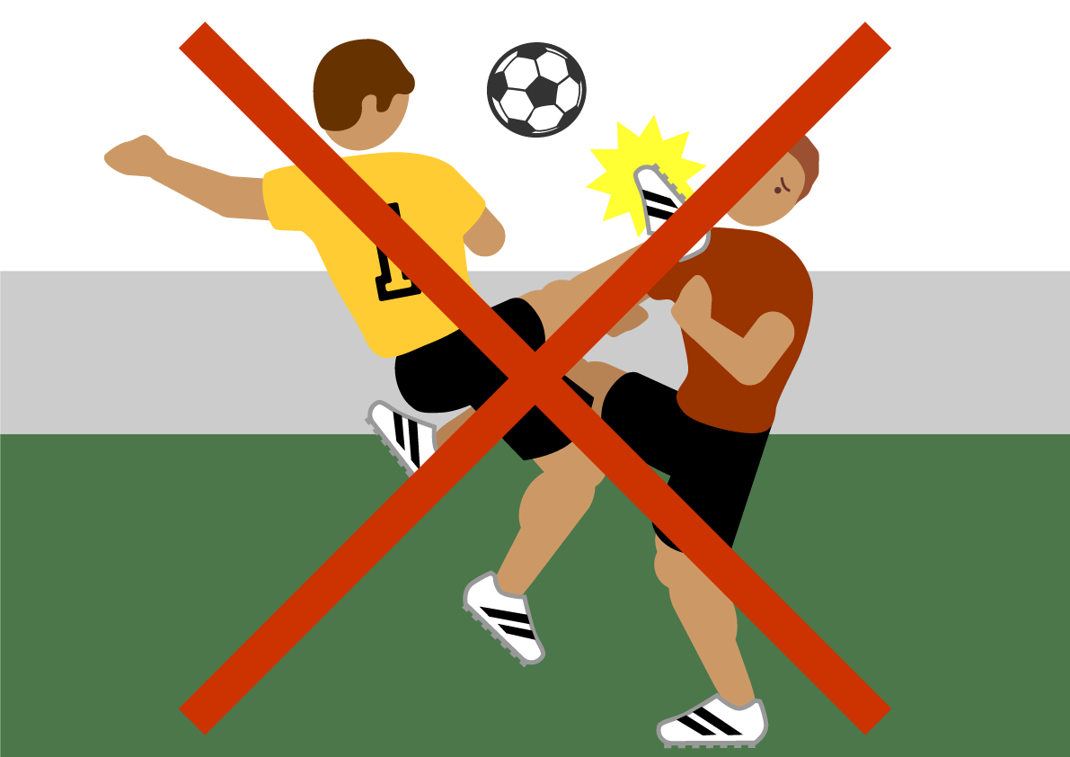
VO…

Slide 47
Failing to listen correctly
Fear of making a mistake and being made to look foolish
Over-respect for authority
VO

Slide 48
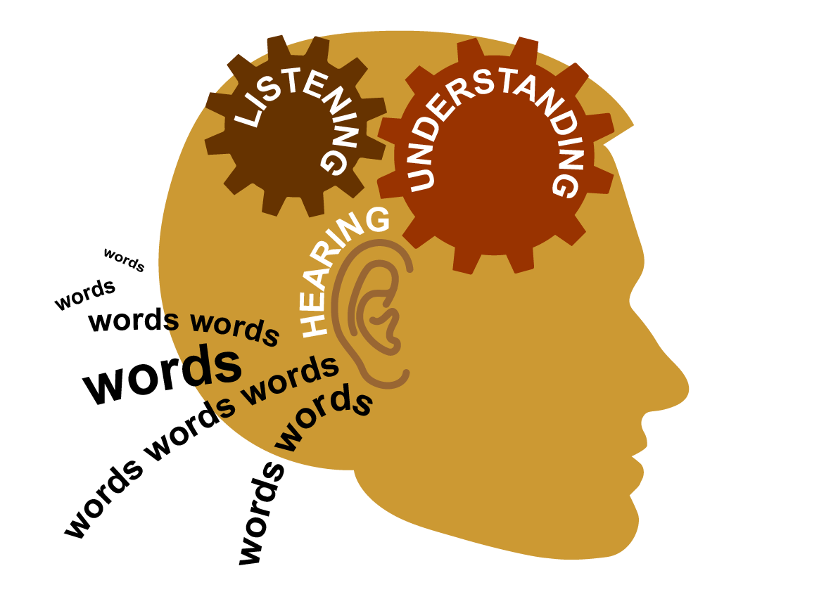
…VO

Slide 49
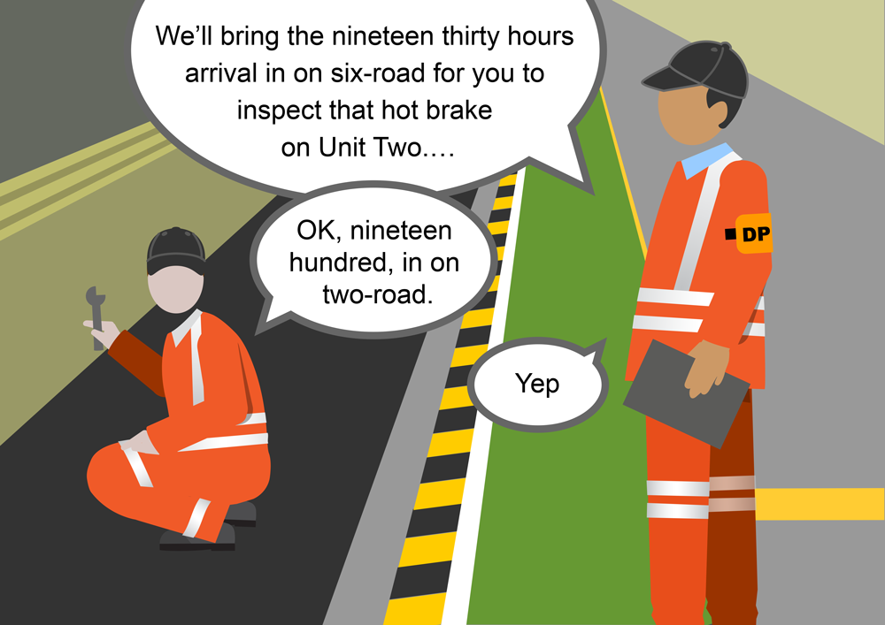
…VO

Slide 50
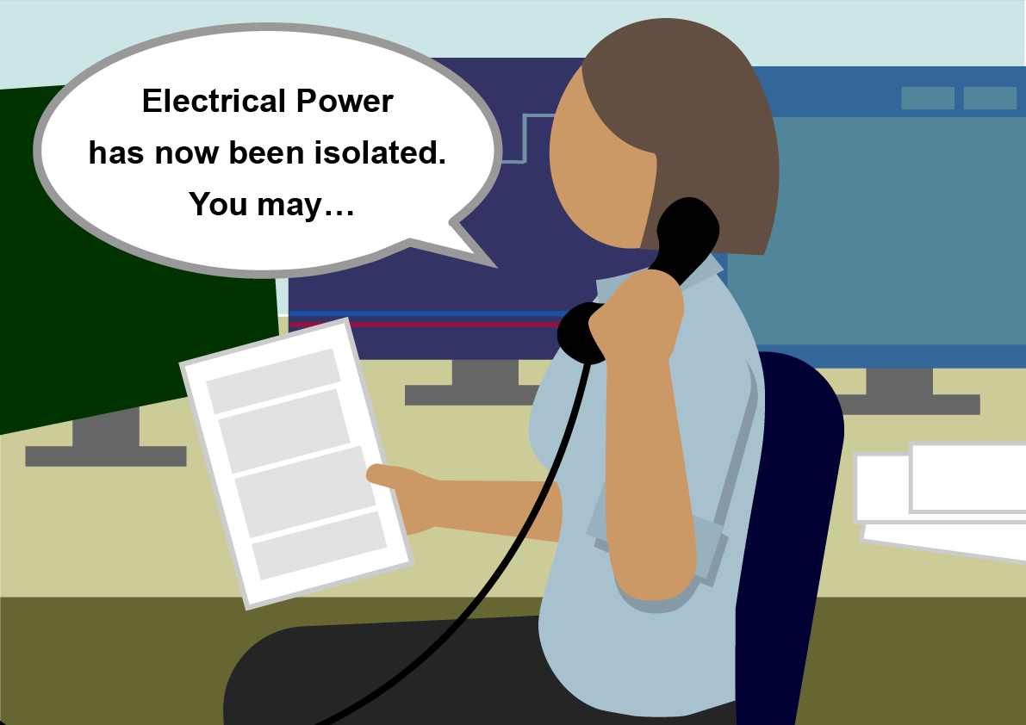
…VO

Slide 51
Prepared to challenge incorrect communication
polite not rude
assertive not aggressive
question the content don’t accuse the person
VO

Slide 52

Considering
Other’s Needs
…

Slide 53

VO

Slide 54
Considering
Other’s
Needs
  awareness
  of
  people
-
VO

Slide 55
appreciating what someone is having to think about
+
how they might be feeling
Considering
Other’s
Needs
=
VO

Slide 56


What do you think the driver is thinking about?
What do you think he is feeling?
VO

Slide 57
Spot people under - thinking and emotional pressure
Q. Identify 3 situations, relevant to your job, in which people might be under pressure
VO

Slide 58
Speak more slowly
Be prepared to repeat information and actions more often
Calm the other person by remaining calm yourself and showing understanding
Give them more thinking time
Resist the temptation to become agitated yourself
Cope with less structure in their communication (but keep yours correct)
Listen carefully and give verbal responses – a stressed person needs to know they are being listened to
VO

Slide 59
We must
consider others
– especially colleagues working under pressure
VO

Slide 60

Module Review
…

Slide 61
1
We need to develop a professional working relationship with our colleagues
2
We must be assertive. Not passive or aggressive
3
We must be prepared to challenge incorrect communication
polite not rude
assertive not aggressive
question the content don’t accuse the person
VO

Slide 62
4
We must
consider others
– especially colleagues
working under pressure

Slide 63

Module Conclusion
…

Slide 64
Verbal contract
What is SCC?
Protocols
Lead/Personal
Responsibility
Message Structure
Confirming Understanding
Communication Skills
VO

Slide 65

Every time we hold an operational conversation, we are agreeing a contract
- keep the contract tight
Your briefer will now conduct a short test to confirm understanding.
VO

