Slide 1
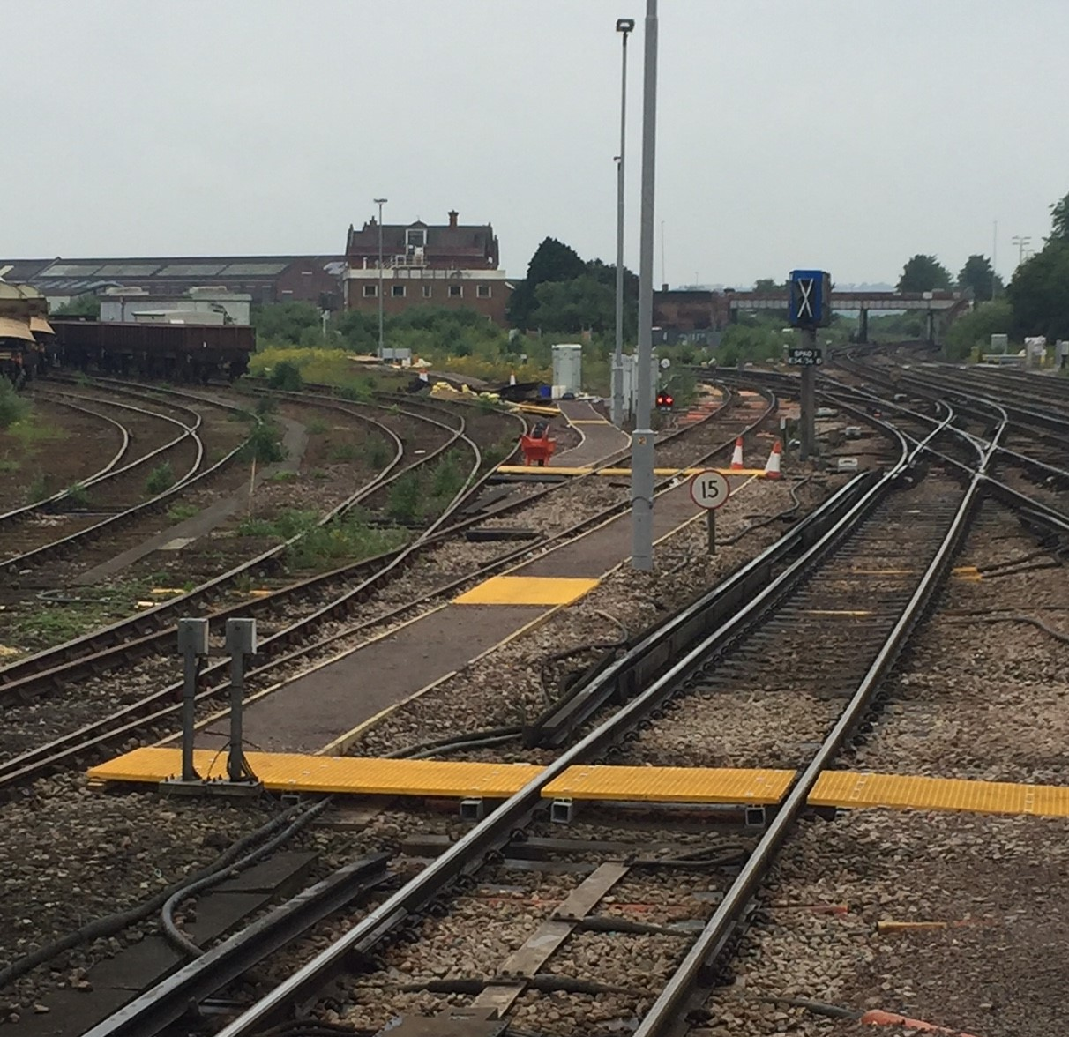
Health, Safety and Environment Period Cascade for P03 2019/20
Wessex Route
Recent upgrade of an authorised walking route at Eastleigh Down Carriage Sidings

Slide 2
Content
Welcome to your Health, Safety and Environmental Cascade for Period 03 2019/20. Please discuss and share the items that are relevant to your teams and display any relevant Safety Bulletins or Lessons Learnt on your notice boards.
Significant Workforce Events
Near Miss between Pooley Green Level Crossing and Egham
Laceration to the top of a right eye socket – LTI
2 x STF accidents whilst working in Location Cases
Gloves Update
Monitoring of Safety Critical Communications
Manual Handling
Vehicle Safety
Leptospirosis
Discarded needles
Plant Manual Update
Environmental Update
Health and Wellbeing

Slide 3



Workforce Safety
Slips, Trips and Falls x 6
12/06/2019 – Whilst the IP was walking in the cess to collect a gauge he tripped on an old chair that was discarded in the cess and obscured by the vegetation. The IP dislocated his left shoulder and sustained a small cut above his lip. LT
Lessons Learnt – Awareness of underfoot conditions/most suitable walking route. The COSS brief should cover site specific hazards including ground conditions where you may be more likely to slip, trip or fall.
18/06/2019 - The IP was testing a new cable when 2 timbers of a loc case base gave way. The IP fell through grazing his lower right arm and jarring his back as a result of the impact. LT
More detail included in the cascade.
Person interacting with tool/equipment
18/06/2019 - IP was struck from behind by an overloaded cage of goods being pushed by members of retail staff at Waterloo Station. LT
Lessons Learnt – trolleys not to be overloaded/piled up too high, ensure objects will not restrict the vision, exclusion zone maintained, keep a safe distance from other members of staff
06/06/2019 – The IP was using a track jack when the handle slipped flicking up and striking him in the face, cut required 25 stitches.
More detail included in the cascade
Person undertaking hot works
02/06/2019 - The IP was flame cutting a rail at Raynes Park when his overalls caught alight. The IP sustained burn blister on his left foot. It was established as part of the Level 1 Investigation that a Fire Extinguisher and a First Aid kit were not available on site.
Lessons Learnt – ensure you have a Fire fighting equipment and First Aid kit available on site (Safety Bulletins are included in this cascade)
Near Miss
06/06/2019 - Near Miss on the Down Main RDG1 between Pooley Green Level Crossing and Egham. More detail on the following slide
Significant Events in the Period

Slide 4
Operational Incident
Alleged Near Miss between Pooley Green Level Crossing and Egham on 06/06/2019
On Thursday 6th June 2019 the Driver of the SWR train 2C31 reported a Near Miss as he was approaching Egham Station on the Down Main RDG1.
The Lookout for a Telecoms team, who were working in the area earlier that morning, was crossing from the Up Cess into the Down Cess as the work was completed and he was returning back to the access point to join the rest of the team.
The Driver sounded his horn which the Lookout acknowledged and carried on across the Down Main into the Down Cess.
The Preliminary Investigation established the following:
The Lookout was in the POS for approximately 8 to 9 seconds prior to the train passing
The required sighting distance in the down direction is 550m but only approximately 390m can be achieved
Please refer to the Lessons Learnt for further information: Lessons Learnt - Near Miss Pooley Green Level Xing, Egham 060619.pdf
Train travelling along the Down Main
The Lookout crossing from the Up Cess into the Down Cess
Lessons Learnt
Please discuss with your teams the following:
The importance of testing the warning time before the work is allowed to start as per the GE/RT8000/HB7 - General duties of a controller of site safety (COSS)
The importance of ensuring that sufficient sighting distance can be achieved in all directions.
The use of Range Finders as a useful tool when checking the sighting distance.
If you believe something is not safe, CHALLENGE!

Slide 5
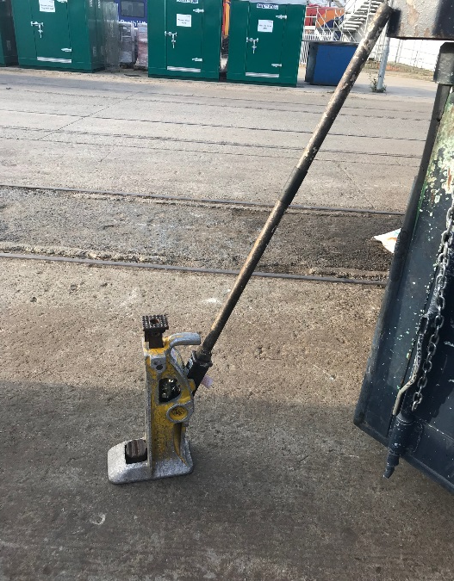
Workforce Safety
Lost Time Accident – Laceration to the top of a right eye socket
In the early hours of the 16th of June 2019, a Section Supervisor based at Waterloo P-Way suffered a severe laceration above his right eye.
The Supervisor was operating a Simplex Jack and was pushing the handle down into position. However, before it had ‘clicked’ into place, the handle slipped from the Supervisors grasp and sprung back up, striking him above the right eye and causing a severe laceration.
25 stitches were required at hospital to treat the injury.
The Supervisor was not wearing safety glasses at the time of the accident.
The Supervisor was wearing rigger style gloves that were wet and greasy so would have affected his grip on the handle.
Below is the Simplex Jack and handle in use at the time of the accident. Circled is the rubber grip which should be at the top of the handle.
Lessons Learnt
Have you checked that the equipment is in good condition, in date and not faulty before you use it?
Are you trained to use the equipment, no matter how simple it is to use? Don’t be fooled, there is a reason NR carry out small tools training.
PPE is the last line of defence:
  Are your gloves suitable for the task? Are they in good condition? Will they give you protection?
  Are you wearing your safety glasses?
Guidance on using rail jacks is available within the ‘How to guide’ in the Info Centre app. Further information on the “How to guide” can be found here - How to Guide.pptx
The full Lessons Learnt can be found on the following link: Lessons Learnt Simplex Jack eye injury 160619.pdf

Slide 6

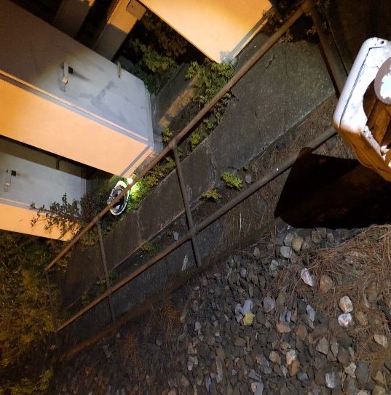
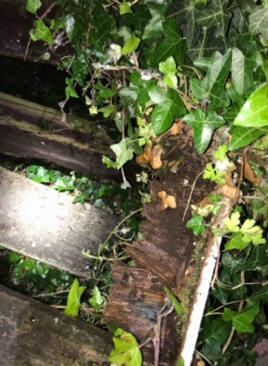
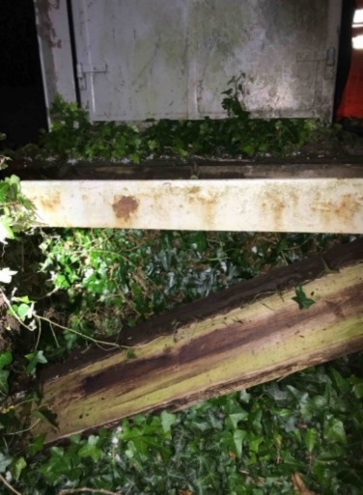
Workforce Safety
2 x STF Accidents whilst working in Location Cases
The barrier and Operatives hard hat (circled) following the accident, with Location cases behind.
The team began working within WD21 Location Case and an Operative who was part of the team (in the role of Site Warden) lent against the barrier, which is positioned in front of the Location Case and functions to prevent the inadvertent access to either the operational railway or the electrified third rail.
The barrier, which broke away at its base, gave way under the Operative, causing him to fall to the ground and resulting in him landing on his right forearm and suffering some pain to his lower back.
On 18th June 2019 a Wessex WDU S&T engineer was carrying out cable testing prior to planned change over on Location Case PF37A.
Whilst working at the rear of the location case, two of the decking boards snapped approximately two inches from the end without warning, and the engineer subsequently fell approximately 1 metre through the deck and landed on the embankment ballast scraping his arm and jarring his back.
First aid was administered on site but due to the injuries the IP was unable to return to normal duties
Lessons Learnt:
Do NOT lean against Location Case barriers. They are there to prevent inadvertent access to the operational railway and/or the electrified third rail!
EL21 Section 1.4 of NR/L3/SIG/10663 SIGNAL MAINTENANCE SPECIFICATIONS states that; as part of the external inspection, staff should check (if provided) that any guarding or staging are secure.
Lessons Learnt so far:
This location has not been upgraded to the current standard.
The location is surrounded by foliage therefore leading to the platform being kept in predominantly damp conditions which can lead to the rotting of timber.
The condition of the platform was not identified at the start of the works.
The full Lessons Learnt can be found on the following link: Lessons Learnt Location Case Barrier 270519.pdf
The full Lessons Learnt can be found on the following link: Lessons Learnt Location Case LT Accident 180619.pdf

Slide 7
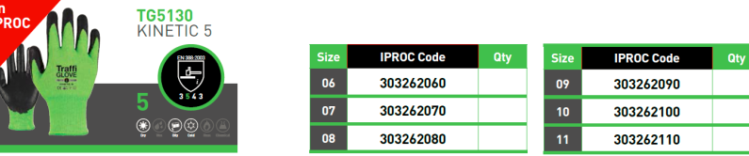
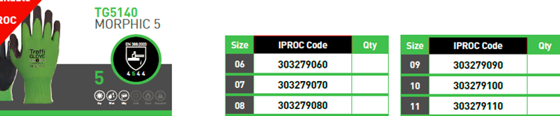
Workforce Safety – Wearing appropriate gloves for the task
Rigger gloves are being gradually phased out until the stock on I-store is gone
At the recent workshops we introduced some Cut 5 gloves from Traffiglove and staff had an opportunity to take a pair to try them out
Different coating/finish – provide different benefits and suitability for various tasks
They are available in sizes 6 to 11 so there should be a pair to fit everybody
Offering outstanding hot contact heat resistance and chemical contamination resilience
Providing excellent grip
Flexible and very comfortable
Excellent dexterity, highly tactile
Reinforced thumb crotch
Provide excellent grip in wet, dry and oily conditions

Slide 8

Workforce Safety - Monitoring of Safety Critical Communications
NR/L3/MTC/MG0173 Issue 3, Comp Date 07/09/19 – Scope expanded to include Works Delivery & Operations Delivery
We know that poor communication is a factor in almost all safety incidents. Its not just about knowing the phonetic alphabet.
Line Managers shall annually make a decision about an individual’s spoken communications competence.
Evidence of this may come from on the job or simulations undertaken as part of the ACC process.
DO YOU HAVE A PLAN IN PLACE FOR ALL YOUR SAFETY CRITICAL STAFF?
Effects:
All staff carrying out SCC including PICOP / ES / COSS / IWA / PC / PSS.
By Line Manager.
Annually (3 conversations and at least one of them an Emergency call)
Recorded on SMF/MG/467
Results viewed by WHSEAs & IMDM or equivalent in PDRs
Methods;
Voice recordings
Outputs from the CRG sessions
Post accident/incident tapes
Work place observations / assessments as part of PGAI
Simulated conversations

Slide 9

Workforce Safety – Manual Handling
Manual handling can be described as lowering, lifting, pulling, pushing, holding and carrying. In effect, any activity that requires an individual to lift, move or support a load, will be classified as a manual handling task.
The Management of Manual Handling Risk Standard NR/L2/OHS/00106 was updated and the Issue 3 came into effect on 01/09/2018.
The Primary Purpose of the Standard is to eliminate or reduce the risk of injuries from manual handling operations across Network Rail activities, from heavy engineering tasks, through operational activities, to office environments.
Key Principles are to:
  avoid manual handling operations at work that pose a risk of injury
  where not possible to avoid, assess the risk and reduce to as low as is reasonably practicable
2 new training courses are being designed and their completion will lead to either:
Basic competence in manual handling (which will be refreshed every 2 years)
Risk Assessor competence (which will also be refreshed every 2 years)

Slide 10
Workforce Safety – Manual Handling
There is a suite of 25 MH Risk Assessment Control Sheets available focusing primarily on the heavy/bulky items.
These “One pagers” are a record of controls derived from risk assessments and can be used during the planning stages.
A dynamic Risk Assessment can also be carried out on site by the PIC or nominated person in charge of the lift before the commencement of a task.
The following One page Control Sheets are available and can be found on the this link:
Manual Handling Risk Assessment Control Sheets single document.pdf

Slide 11
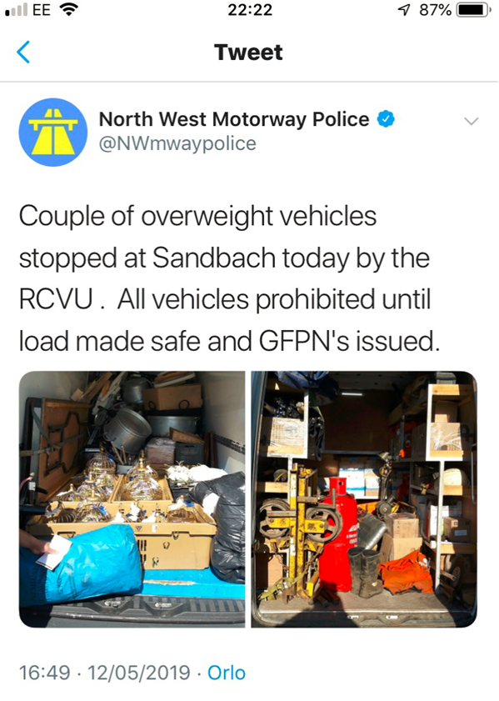
Worker Safety – Vehicle Overloading
Vehicle Overloading
Vehicle users must ensure that vehicles are not overloaded and do not pose any danger to themselves or other road users. Fines of up to £5,000 can be imposed on the driver and Network Rail for each offence committed.
What can I do to prevent my vehicle from being overloaded?
✔DO – Know the permitted Gross Laden Weight (GLW) of your vehicle
✔DO – Know what materials you are carrying and the weight of the overall load
✔DO – Distribute your load appropriately to avoid overloading axles
✔DO – Obey the on-board weighing indicator fitted within the vehicle
If you are stopped and your vehicle is found to be overloaded, you must inform your Line Manager, the ICC and the RS Road Fleet Team and Route Road Vehicle Compliance Manager without delay. This will be treated as a significant incident.
For more information please refer to the Driver’s handbook - p31
Are your vehicles overloaded?
Does the vehicle on the right look familiar?
A Guide on How to load vehicles safely will be produced and shared with teams

Slide 12
Safety Alert – Airbags in vehicles
Get your feet off the dashboard !
It can be tempting to put your feet up on the dashboard while travelling as a passenger in a car or van.
But a young woman recently received life-changing injuries after a low-speed collision where the airbag deployed and drove her knees into her head
She broke every bone in her face, suffered brain damage and had to have her forehead removed .
Please pass on this message to our colleagues, friends and family so we can all learn from this incident.
Never put your feet up on the dashboard
Airbags deploy at 200mph—so keep your feet away from them

Slide 13
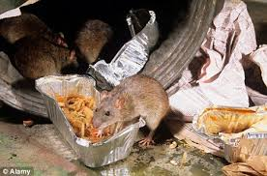
Worker Safety – Leptospirosis (Weil’s disease)
A serious and potentially fatal infection that is transmitted to humans by contact with urine from infected rats
The bacteria can enter your body through cuts and scratches and through the lining of the mouth, throat and eyes after contact with urine or contaminated water such as that in sewers, ditches, drains, ponds and slow flowing rivers and water ways
Symptoms:
Flu like illness with a severe and persistent headache, which can lead to vomiting and muscle pains and ultimately to jaundice, meningitis and kidney failure. In rare cases the disease can be fatal.
Prevention:
Don’t encourage rats – dispose of all your rubbish correctly
Avoid inadvertent entry or immersion into water that could be infected
Wash cuts and grazes immediately with soap and running water and cover all cuts and broken skin with waterproof plasters both before and during work
Wash your hands, forearms and all other exposed areas of skin after completion of tasks
Avoid rubbing your nose, mouth or eyes during work
Report any illness to your doctor who will prescribe antibiotics and you should make a full recovery in a few days

Slide 14

Worker Safety – Discarded Hypodermic Needles
Reminder about correct reporting – Fault and not a Close Call
REMEMBER
If you see any hypodermic needles on site:
DO NOT TOUCH THEM
Report them to the ICC giving as much detail about the exact location as possible (mark out the spot if you can and take photos)
A team with the correct equipment will go to site and remove
If you have any work planned in a known “hot spot” a competent contractor/team can carry out a sweep through of the area beforehand and remove the sharps

Slide 15
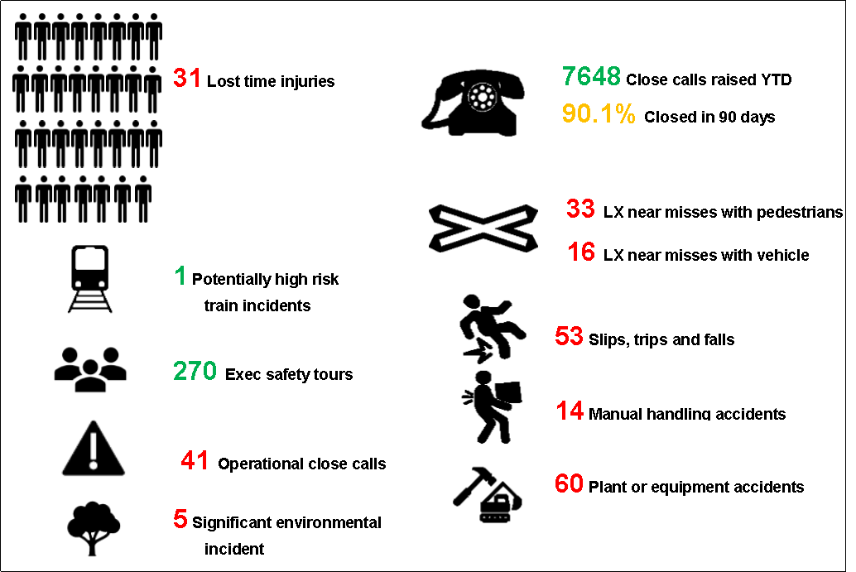
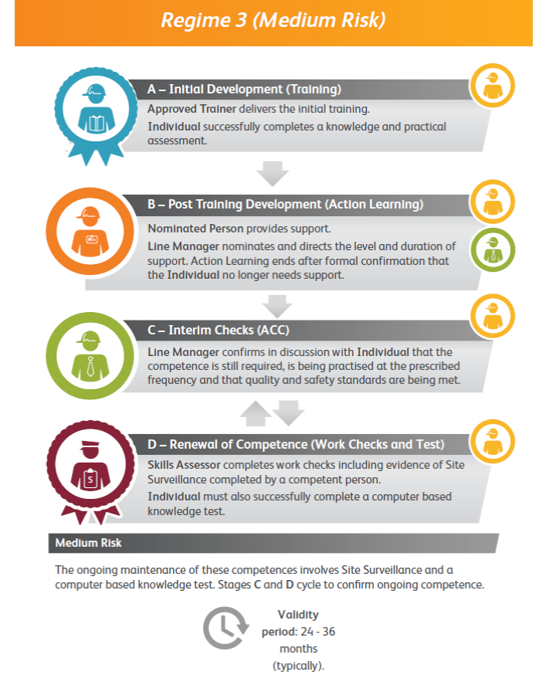
Infrastructure Plant Manual
On Track Plant and On Track Machine Lift Planner Competencies & Training (Regime 3).
All lifts should be planned by a competent person as identified in LOLER Regulation 8 and further defined in BS7121 Part 1 as the Appointed Person (Lifting Operations) known as ‘Lift Planner’ in this Code of Practice.
COP011-Code of Practice for Planning and Executing Lifting Operations
Always be sure the required plans and permits are in place, before you start a job or go on or near the line
Never undertake any job unless you have been trained and assessed as competent
The SMF/PL/0253 [ Issue: 9 ] OTP Work Plan
The On Track Plant lift planner competence is a hybrid Regime 3 competence and follows the usual path (left) with the exception of anyone who has been trained and is in the post training development (mentoring) stage, they must complete a post mentoring assessment test. They must have proof that they have used the competence the required number of times and that their mentor has recommended them for the assessment. The assessment must be carried out by a level 5 competent lift planner (typically a RPSE).
We currently have 10 lift planners in Wessex who are under mentorship.
There is also the requirement for a specific On Track Machine lift planner competence, there are training courses taking place later this year. This will cover safe planning of machines like the Plasser GP Crane and the Plasser TRAMM. If any of your staff require this training then please contact your Competence Delivery Specialist or
Keith Penn, RPSE
mailto:keith.penn@networkrail.co.uk

Slide 16
Safety Bulletins, Alerts, Advice
Safety-Alert-NRX19-04-Work-affecting-level-crossing.pdf
Shared-Learning-NRL19-09-Barnards-Lock-Environmental-Incident.pdf
Shared-Learning-NRLN19-10-On-track-plant-contact-with-overhead-line-equipment.pdf
Lessons Learnt - Near Miss Pooley Green Level Xing, Egham 060619.pdf
Lessons Learnt Location Case LT Accident 180619.pdf
Lessons Learnt Simplex Jack eye injury 160619.pdf
Lessons Learnt Location Case Barrier 270519.pdf
Wessex Route Cable Theft Bulletin - Update 24JUN19.pdf
Manual Handling Risk Assessment Control Sheets single document.pdf
How to Guide.pptx
FIRE FIGHTING EQUIPMENT PROVISIONS.docx
First Aid-Burns Kit notice.docx

Slide 17

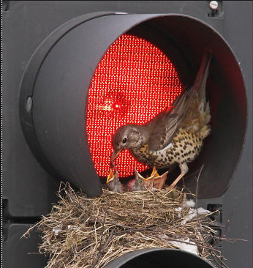
Environment
General Licences for Bird Control
All wild bird species, their eggs and nests are protected by law. Nesting bird guidance can be found on the Wessex Environment Hub site and Safety Central. The following information applies to instances where bird control is required for public heath or safety reasons.
Important Changes to licence requirements
Natural England revoked three general licences (GL 04/05/06) in April 2019. Defra have since issued a set of General Licences.
Licence WML-GL35 could apply to situations where Network Rail needs to control certain bird species for public health or public safety reasons.
  Subject to all the terms and conditions of this licence, this licence permits authorised persons: to kill or take wild birds of any of the species listed at (a) and (b) below, to take, damage or destroy their nests or to take or destroy their eggs:
(a)
  Carrion Crow
  Jackdaw
  Magpie
  Pigeon, Feral
  Rook
  (b)
  Canada Goose
  Monk Parakeet
WMl-GL35 will not apply to control on European Protected Sites or Sites of Special Scientific Interest
  If the species is not listed above (e.g. wood pigeon), licence A08 may need to be applied for.
Bird Control on Protected Sites
GM35 does not provide consent for actions in Sites of Special Scientific Interest (SSSI’s), European protected site (SAC, SPA or RAMSAR), or within 300 metres of those sites. Consent will need to be sought from Natural England. Protected site locations can be found on GeoRINM, Magic or via your planning team or WHSEA.
Any activities to control bird species carried out under licence should be recorded.
A record form can be found using this link or on the Wessex Environment Hub Site under the Protected Sites and Species Tab.
(https://wsxenv.hub.networkrail.co.uk/Pages/NRHome.aspx)

Slide 18
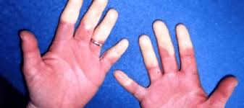
Health & Wellbeing
HAVS SURVEILLANCE: need to know
HAVS surveillance is run in a three year cycle
Tier 2: Always a questionnaire
Tier 3: A face-to-face assessment
Yr 1:
Tier 2
Once damaged, the nerve endings cannot be repaired
Yr 2:
Tier 2
Yr 3:
Tier 3
In any given surveillance year, an employee can be escalated from Tier 2 to Tier 3 to Tier 4
Tier 4: is an appointment with a trained doctor to make the diagnosis
HAVS surveillance is a legal requirement and participation is mandatory
REPEAT
An employee will keep repeating this cycle for as long as they continue to use vibrating tools

Slide 19
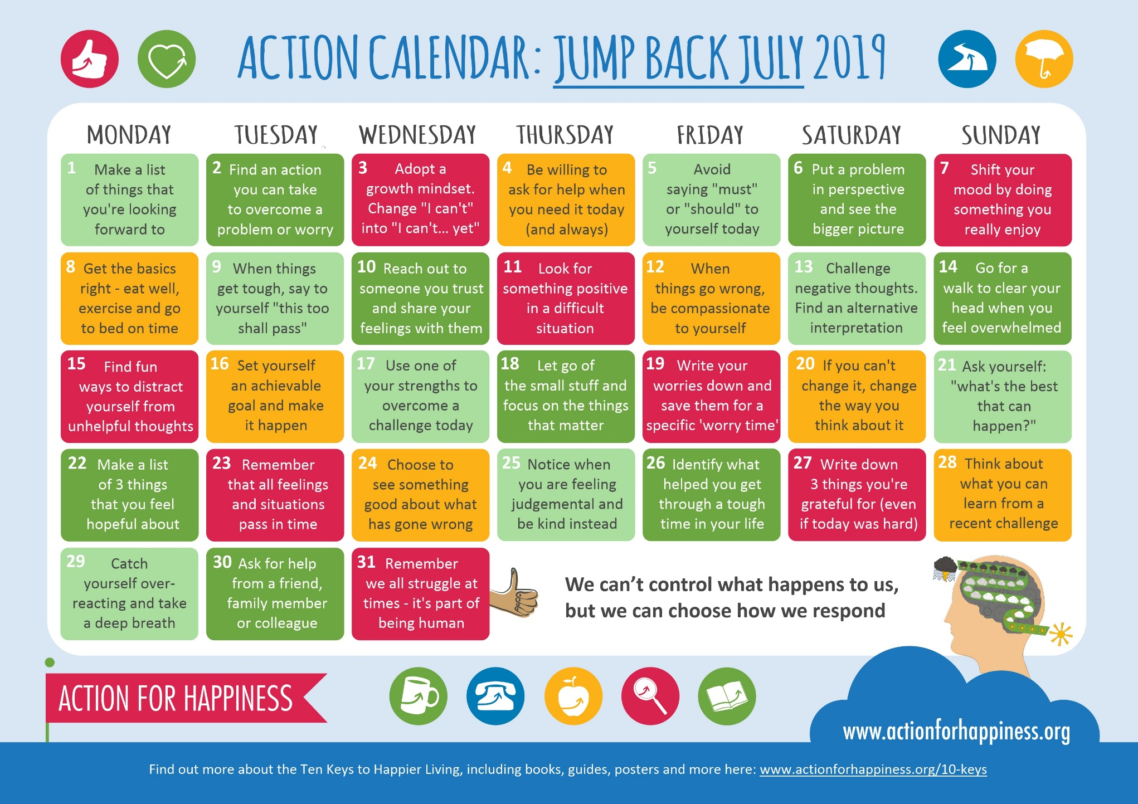
Health & Wellbeing

Slide 20
Thank you and keep safe

