Slide 1
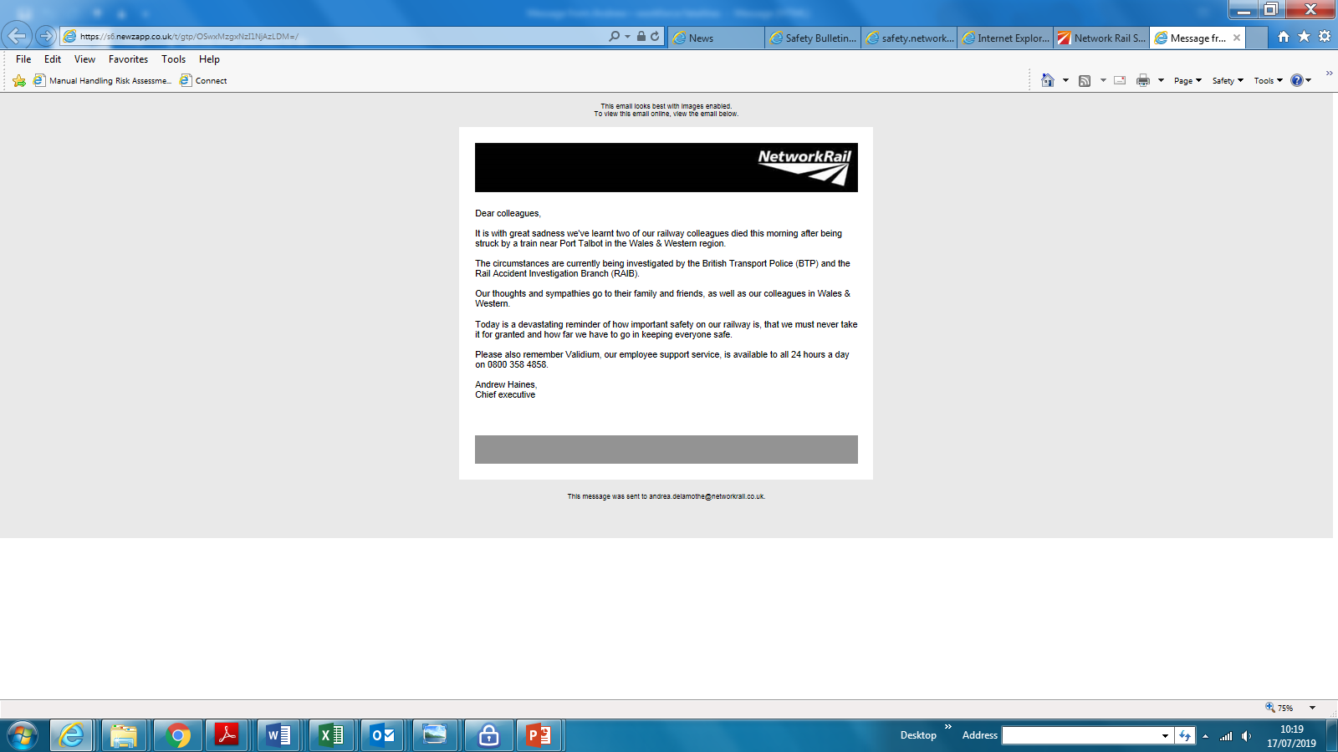
Health, Safety and Environment Period Cascade for P04 2019/20
Wessex Route
3rd July 2019

Slide 2
Content
Welcome to your Health, Safety and Environmental Cascade for Period 04 2019/20. Please discuss and share the items that are relevant to your teams and display any relevant Safety Bulletins or Lessons Learnt on your notice boards.
Significant Workforce Events
Unsafe Working Practices in the Early area
Use of Site Wardens
Eye injury
Electrical shock and minor burn
Safety Alert – Systems of work requiring touch lookouts
Correct disposal of batteries and detonators
Lyme disease
Sleepers treated with Creosote
Use of hand trolleys
Plant Manual Update – duplex communications for On Track plant
Community Safety – Tegan’s story
Environmental Update
Health and Wellbeing
Your Voice

Slide 3




Workforce Safety
Impact injuries x 2
25/06/2019 - The IP opened a cupboard door in the kitchen area but then bent down to retrieve an item from the freezer. As the IP was standing up he hit the back of his head on the opened cupboard door. LT
03/07/2019 - The IP was carrying out cleaning duties when she opened up a cupboard door. She promptly stood up hitting her head on the door sustaining a small laceration. NLT
Discussion: How do you ensure you stay focused and aware of your surroundings and any hazards?
Manual Handling
28/06/2019 - The IP was loading metal plates onto a flat bed at the end of the shift. One of the plates slipped out of his hand and landed on a handle which in turn flicked up and caught him on the eye. More details in the cascade. NLT
Discussion: Do you consider the risks associated with tasks you carry out when NOT directly on or near the line?
Electric shock/burns
15/07/2019 - The IP came into contact with exposed contacts on the rear of the fuse, giving a 430 volt electrical shock through the back of his hand. Minor burns to the back of the hand. More details in the cascade. NLT
Discussion: Is a total switch off possible? If not what measures can you take to reduce the risk?
Unsafe Working Practices
10/07/2019 – 3 men Nash team carrying out brush cutting were observed to work unsafely. More details in the cascade.
Discussion: Is your SSOW compliant and do you test it?
Significant Events in the Period

Slide 4
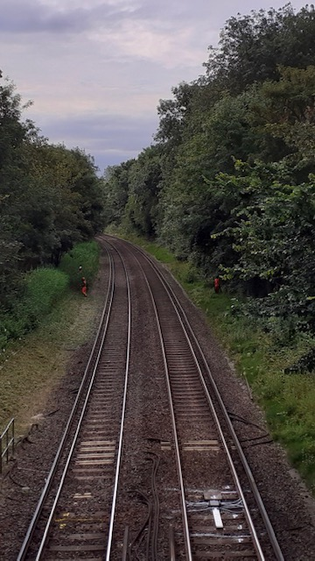
Workforce Safety
Unsafe Working at Earley
On the 10th July 2019 a 3 man Nash team were working on behalf of the Inner Off Track team in the Earley area on the RDG2 at 66m48ch. Another member of NR observed the team and was concerned that the SSOW was not adequate.
The PIC/COSS set up a SSOW under protection (Green Zone) whilst carrying out brush cutting in the Up Cess. This particular type of work must only be carried out under protection arrangements.
Due to the nature of the task the PIC/COSS and the other member of the team were wearing ear defenders.
The PIC/COSS positioned a Site Warden across the two lines in the Down Cess.
As a result the Site Warden was unable to adequately provide a warning should the team members have encroached closer than 2 metres (6'6'') towards the open line.
It also meant that the PIC/COSS had no control or visibility over the movements of the Site Warden should he have chosen to leave his position.
The PIC/COSS and his colleague
The Site Warden
Points for Discussion:
Are your safe systems of work suitable, implemented correctly and then tested prior to work starting?
Where should a site warden be situated?
Please refer to the following slide for more information
The Lessons Learnt can be found on the following link: Lessons Learnt Earley irregular working 100719.pdf

Slide 5

Workforce Safety – Use of Site Wardens
What is the purpose of a Site Warden?
  Where there is a distance of at least 2 metres (6 feet 6 inches) between the nearest running rail of an open line and the site of work, a site warden will be appointed.
  The Site Warden must watch the group and make sure that no one moves beyond the safe limits laid down by the PIC/COSS.
  The individual acting as a Site Warden must NOT take any part in the actual work.
  The Site Warden must warn anyone who attempts to move beyond the safe limits by shouting ‘GET BACK’. If they do not immediately move back into the safe area, the Site Warden must give a series of short sharp blasts on the whistle or horn until they do move back into the safe area.
  There must be an identifiable limit to the site of work.
  If it is only you and one other person in the group, you do not need to appoint a site warden. However, you must make sure neither of you go any closer than 2 metres (6 feet 6 inches) to the nearest running rail of the open line.
  When working within an ES worksite and before you can treat your safe system of work as site-warden protected, the instructions shown in section 4.6 of handbook 7 must be carried out for any adjacent open line.

Slide 6


Workforce Safety
Eye injury and oil/dirt contamination
On Friday 28th June 2019, following a completion of a job at Byfleet and New Haw, a member of the Woking P-way was loading up kit onto the flat platform of a vehicle.
The IP was lowering a pair of fishplates from his shoulder when he lost his grip. The plates dropped 6 to 9 inches onto a trolley handle which flipped up and struck him directly on his right eyeball. He instinctively put his hand up to his eye, contaminating the area with grease and dirt.
Eye wash was used on site and the IP taken to hospital where he was advised that he scratched his cornea and was given a temporary protective contact lens and two types of eye drops to promote the healing process. The IP was not wearing safety glasses when the accident occurred.
As well as protection, the Cornea is responsible for 65-75% of the eyes total focusing power!
Lessons Learnt:
Do you consider the risks associated with tasks you carry out when NOT directly on or near the line?
What stops you from wearing your safety glasses when loading/unloading vehicles at the start and end of your shift?
If it was a sunny day would you keep your sunglasses on at all times?
Prescription eye-wear is available through NR on My Connect - apply for a safety eyewear eVoucher
This is the second accident within 2 weeks when the individual lost his grip on a piece of equipment/materials due to gloves being contaminated by grease and dirt.
Kinetic and Morphic Cut 5 gloves are available, details in HSE Cascade from Period 03
The Lessons Learnt can be found on the following link: Lessons Learnt Byfleet and New Haw eye injury 280619.pdf

Slide 7
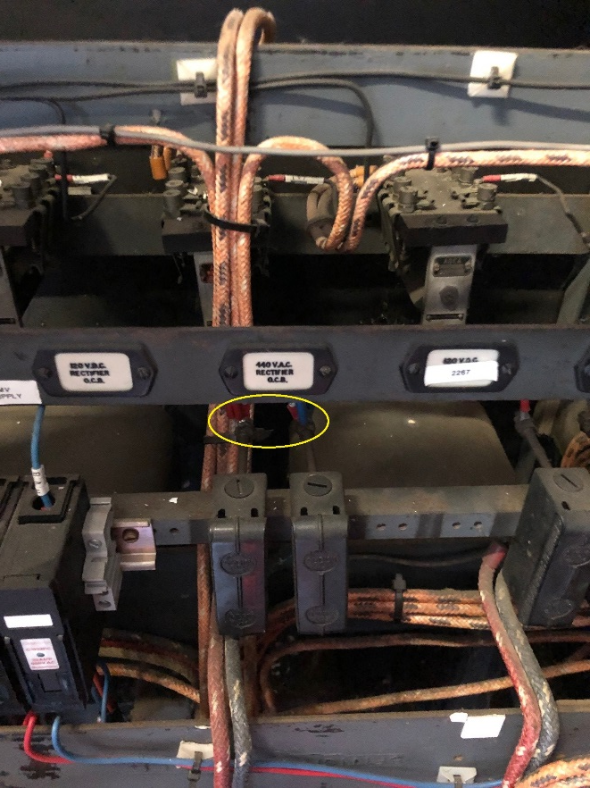
Workforce Safety
Electrical shock and a minor burn
Whilst investigating a suspected rectifier fault at Brookwood Substation, on Monday 15th July 2019, the IP came into contact with the exposed live 435v terminals.
The preliminary investigation established that due to the age of the equipment it was not possible to isolate the whole panel, so live equipment sources were still present.
No gloves were worn at the time as neither the Class 0 or Class 00 electrician’s gauntlets provide the required dexterity.
The IP was taken to hospital as a precautionary measure, where an ECG (Electrocardiogram) and blood test were carried out. These tests all came back clear and the IP returned to work the following day.
The only sign of injury were 2 small burns on the base of his thumb.
Discussion Points:
Where ‘Live’ exposed electrical equipment is present, what can you do to protect yourselves? (Think RISK!)
Can a protective matting be used to remove the risk of accidental contact?
How can you highlight the potential risks to your colleagues?
Where any contact with ‘Live’ electrical equipment takes place, DON’T CHANCE IT, GET CHECKED. Visit your local hospital or A&E.
This incident took place AFTER the task had been completed, think RISK at all times.
The exposed live terminals
The Lessons Learnt can be found on the following link: Lessons learnt - Brookwood Sub electrical shock, minor burns 150719.pdf

Slide 8
Safety Alert – Systems of work requiring touch lookouts
Wessex Work Instruction will be issued in due course

Slide 9


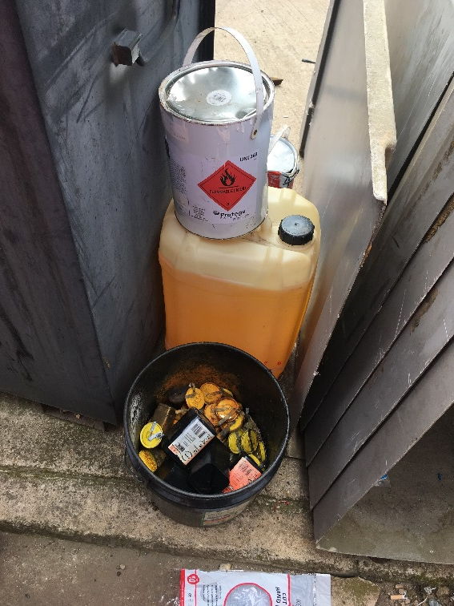
Workforce Safety
Disposal of batteries and detonators
The picture to the right was taken at an equipment store in a depot within the Wessex Inner.
The bucket contained zinc chloride lantern batteries, discarded detonators and drill bits.
Behind this bucket were two tins of flammable liquid.
Can you see the potential risks?
NR/L3/MTC/RCS0216/GA16 states: Detonators must be disposed of in accordance with NR policies using APPROVED disposal procedures (please refer to the notes for the information on disposal).
NR/L3/MTC/RCS0216/GA12 states: Dispose of batteries safely using the correct disposal bin.
How confident are you that this was not found in your depot?
Notes:
NR/L3/OPS/045/4.17Detonators may be colour coded and embossed with the date of manufacture. Detonators should be safely disposed of if they are:
• More than five years old.
• Showing any sign of rust.
• Showing any signs of damage (including missing lead tags) or decay.
Detonators should be disposed of using the process described in Section A.11 of Appendix A.
Detonators that are lost, stolen or unaccounted for should be reported to the British Transport Police or Civil Police. There is a considerable risk to the general public arising from their possible misuse.

Slide 10
Worker Safety – Lyme disease
When out and about check your exposed skin for any signs of ticks
Lyme disease is a bacterial infection, passed on to humans by infected ticks.
While it’s difficult to estimate the total number of UK cases, they are understood to have increased more than fourfold in the past 10 years. The peak season is April to October, though they are active all year.
What are the symptoms?
• A high temperature or feeling hot and shivery
• Headaches
• Muscle and joint pain
• Tiredness and loss of energy
• A red, circular skin rash around a tick bite, which usually appears up to 30 days after being bitten by a tick. It can also look like a bullseye.
Some people with Lyme disease develop more severe symptoms months or years later. This is more likely if treatment is delayed. These more severe symptoms may include:
• Pain and swelling in joints
• Nerve problems – such as pain or numbness
• Heart problems
• Trouble with memory or concentration.
How to remove a tick
1. Use fine-tipped tweezers or a tick-removal tool
2. Grasp the tick as close to the skin as possible
3. Slowly pull upwards, taking care not to squeeze or crush the tick. Dispose of it when you've removed it
4. Clean the bite with antiseptic or soap and water.
How to avoid tick bites
There are no vaccines to defend against the tick-borne disease. Therefore, the best defence is to avoid being bitten.

Slide 11
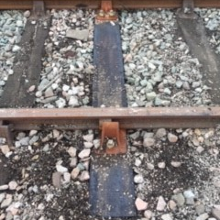
Worker Safety
Sleepers treated with Creosote
2 of our staff were recently exposed to some creosote treated sleepers. The staff were only wearing short sleeved polo shirts ,as it was a warm day and they were unaware that creosote is being used to treat soft wood sleepers.
The employees used timber/sleeper nibs to initially move the sleepers but then decided to use their hands to do the final adjustments.
Please remember to :
Use the sleeper nips to move the sleepers into & out of the bed
Protect your hands with gloves
Keep your skin covered at all times
Wash your hands before Smoking & Eating
First Aid:
Ingestion – Do Not induce Vomiting unless told to do so by a doctor
Eyes – Irrigate with water for at least 15 to 20 minutes. If contact lenses are worn, remove after the first 5 minutes and continue rinsing eyes
Skin – Take off contaminated clothing. Rinse skin immediately with plenty of water for 15-20 minutes
The Safety Alert to be displayed on the notice boards is on the following link: Sleepers treated with Creosote.pdf

Slide 12
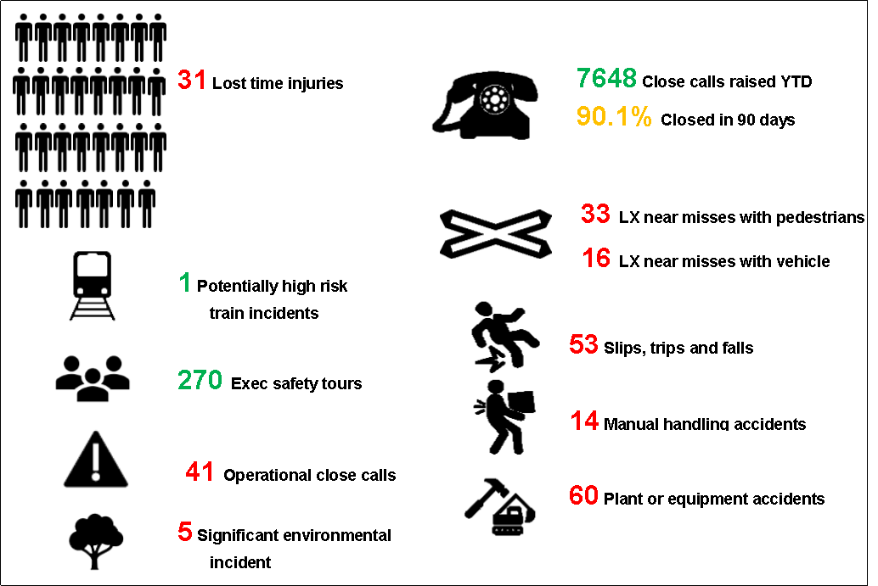
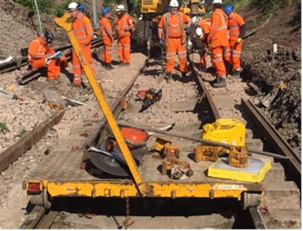
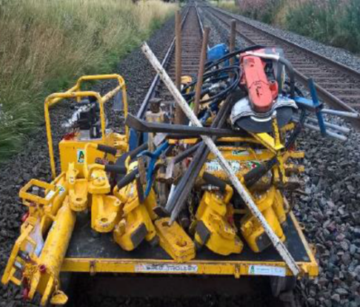
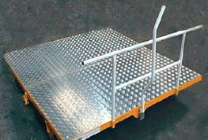
Infrastructure Plant Manual
Use of Hand Trolleys
Overview:
There have been several incidents nationally where staff pushing trolleys fell and were hit in the face by the trolley brake handle. This would not happen if the trolley push bars were in position.
It was discovered that staff are using the brake handle to push the loaded trolley. This is unsafe and unsuitable.
IS this a Life Saving Rule breach?
As a result, staff had fallen forward and released the brake handle which then sprung up and hit them in the face.
All trolleys should come with push bars and a proper brake handle. Also, the brake handle should never be tied or secured in the “Off” position!
This creates the potential for a runaway, push handles have been mandated.
No push handles in place Brake handle tied in the “off” position Correctly set up trolley
Hand Trolley’s must be properly assembled in accordance with the (OEM) Original Equipment Manufacturer instructions
A visual check of the brakes must be made before placing the Hand Trolley on the line, and its brakes must be tested by a push
test before it is loaded or used. Push bars, Side boards and End boards must be the correct type supplied by the OEM.
Only the braking lever supplied by the OEM may be used to operate the brakes.

Slide 13
Infrastructure Plant Manual
Duplex Communications for On Track Plant
There have been incidents on the Wessex route recently where Duplex Comms were not being used.
The Infrastructure Plant Manual NR/L2/RMVP/0200 Module P505, States:
OTP operations shall not commence if the full duplex communications system fails prior to the start of work.
7: On site communications
Only use an approved digital full duplex communication system when undertaking safety critical activities with plant either on or off the track.
Check the communication system for correct functionality prior to any work commencing. Check it again if a change in conditions that could affect the method of communication occurs.
If a full duplex communication system fails after work has started and the problem cannot be resolved, the machine or crane controller shall:
attempt to source replacement equipment;
b) agree an alternative safe system of work with the operator if the time required to source alternative equipment will import risk to completing the task within the given possession working time;
c) record on the OTP Work Plan/Work Package Plan (WPP)/POS checklist/Machine/Crane Controller (MC/CC) checklist why an agreed alternative SSOW is being used. Report the defect to the site or line manager; and
d) report the failure and consequent actions through the Close Call system.
If you require more information then please contact your On Track Plant Specialist or Keith Penn, RPSE
Also an approved supplier to purchase or hire Duplex Comms systems are available if you follow this link:
http://www.dbdcommunications.co.uk/

Slide 14
Safety Bulletins, Alerts, Advice
Safety-Advice-NRX19-06.pdf
Safety-Advice-NRA19-08-Systems-of-work-requiring-touch-lookouts.pdf
Safety-Bulletin-NRB19-08-Train-makes-contact-with-site-material.pdf
Lessons Learnt Byfleet and New Haw eye injury 280619.pdf
Lessons Learnt Earley irregular working 100719.pdf
Lessons learnt - Brookwood Sub electrical shock, minor burns 150719.pdf
Sleepers treated with Creosote.pdf
Sharps safety notice.pdf

Slide 15

Community Safety
Tegan’s Story
Tegan is a brave young woman from Basingstoke. She made a mistake last year and wanted to use her story to warn other young people of the dangers of the railway.
Tegan’s story was filmed on the Wessex Route in June and was released in time for the first anniversary on 7th July 2019.
The film was aired on BBC, ITV and gained coverage from various local media channels including radio and local newspapers. Our media team are estimating the viewing figures will reach near 10 million.
We wanted to create a film about the dangers of the third rail, following the “You vs Train” campaign last year that highlighted the dangers of the overheads.
We will continue to use the film when educating young people about the dangers of the railway.
We know that trespass on the railway is increasing and we are doing everything we can to reduce trespass particularly amongst young people.
Watch Tegan’s story on the following link: Tegan's Story - HD MP4.mp4
We see increasing levels of trespass in the school holidays.
With the summer break imminent we need to keep vigilant.
LOCK ALL ACCESS POINTS, KEEP YOUR EYES OPEN AND HELP KEEP YOUNG PEOPLE SAFE!

Slide 16


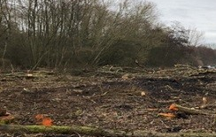
Environment
Barnard's Lock Environmental Incident
Ref: | NRL19-09
Date of issue: | 05/06/2019
Location: | Barnard's Lock, Newbury, West Berkshire
Contact: | Suzanne Kay, Head of S&SD IP Western and Wales
Overview
Network Rail, IP Western were undertaking a bridge deck replacement over the River Kennett using a 1200 tonne crane. The work was being undertaken in a Site of Special Scientific Interest (SSSI) with the potential for water voles, reptiles, birds and bats. Planned vegetation clearance works were set to take place removing 10,000sq metres of wet woodland ready for the installation of a work area.
The works commenced without an Environment Management Plan on-site (Required for GRIP projects).
Throughout the works there were numerous misunderstandings of the locations of ecologically sensitive areas.
Underlying Causes
There was no handover information communicated between the Project managers (Required ecology information not handed to the Site Operator in time for the works)
Ecological constraints of the works were not briefed to the site team.
Key Message
Ensure locations of environmentally sensitive areas are known in relation to works
Ensure the environmental permits/licences and/or assents are in place prior to works commencing
Communicate ecological constraints to site teams
When there is a change in personnel, whether this be in Network Rail or a contractor, a formal handover session must be undertaken
Please refer to NR/L3/MTC/EN0099 (Protected sites and species management) for further information

Slide 17
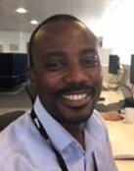
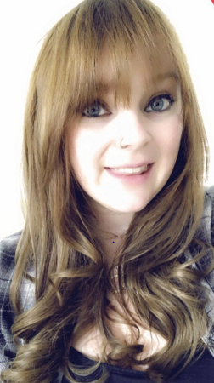
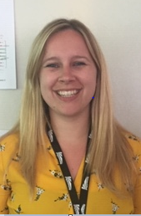
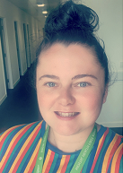

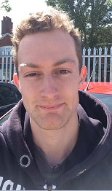
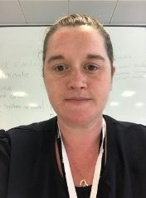
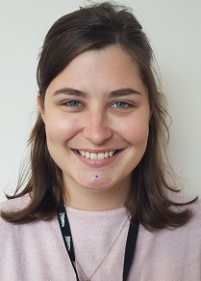

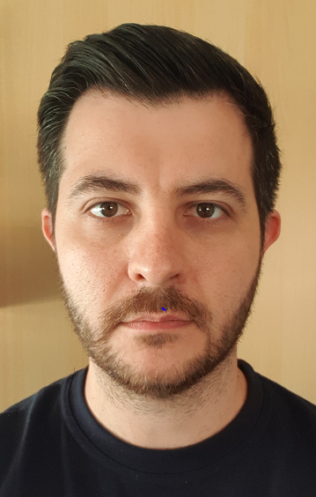
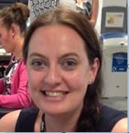
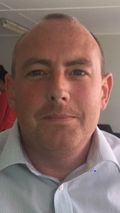
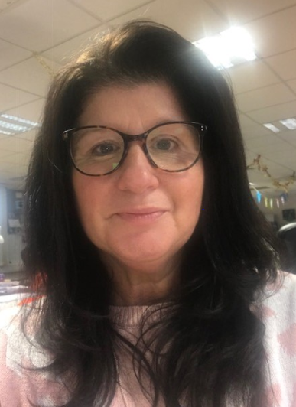


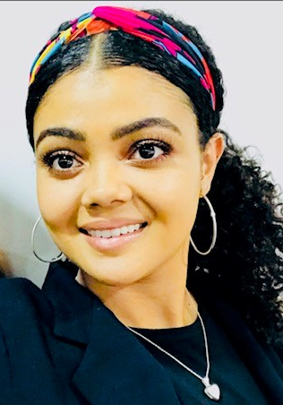
Health & Wellbeing
Please meet the latest group of our Mental Health First Aiders who were trained up last month
Augustus Brako-Asamoah
Rebecca Spreadborough
Hannah John
Warren Fellows
Fred Worger
Nichola Adams
Jill Stone
Tonye Altraide
David Lewis
Emily Day
Basingstoke ROC
Basingstoke ROC
Basingstoke ROC
Basingstoke ROC
Basingstoke ROC
Eastleigh –Campbell Rd Depot
Waterloo
Waterloo
Waterloo
Feltham Depot
If you would like to join these lovely people and become a MH first aider yourself there is a course planned for September. Please check with Grazia Elsehimy if you would like to book a place
Samantha Parsons
Marc Brereton
Lisa Courtney
Paul Hoey
Charlotte Cropp
Georgia Bowen-Jones
Clapham Depot
Clapham Depot
Clapham Depot
Wimbledon Depot
Wimbledon Depot
Wimbledon Depot

Slide 18

Health & Wellbeing
Mental Health:
“Survive and thrive campaign”
If you have gone through a period of mental ill health, have walked the path to recovery and are now thriving.
Have you thought of sharing your story?
We need those brave volunteers amongst you to tell your inspirational story and demonstrate to others there is light at the end of the tunnel.
If you would like to know more about how you can help, contact
Grazia.Elsehimy@networkrail.co.uk
My mission in life is not merely to survive, but to thrive; and to do so with some passion, some compassion, some humour and some style
Maya Angelou
Survive and
Thrive

Slide 19
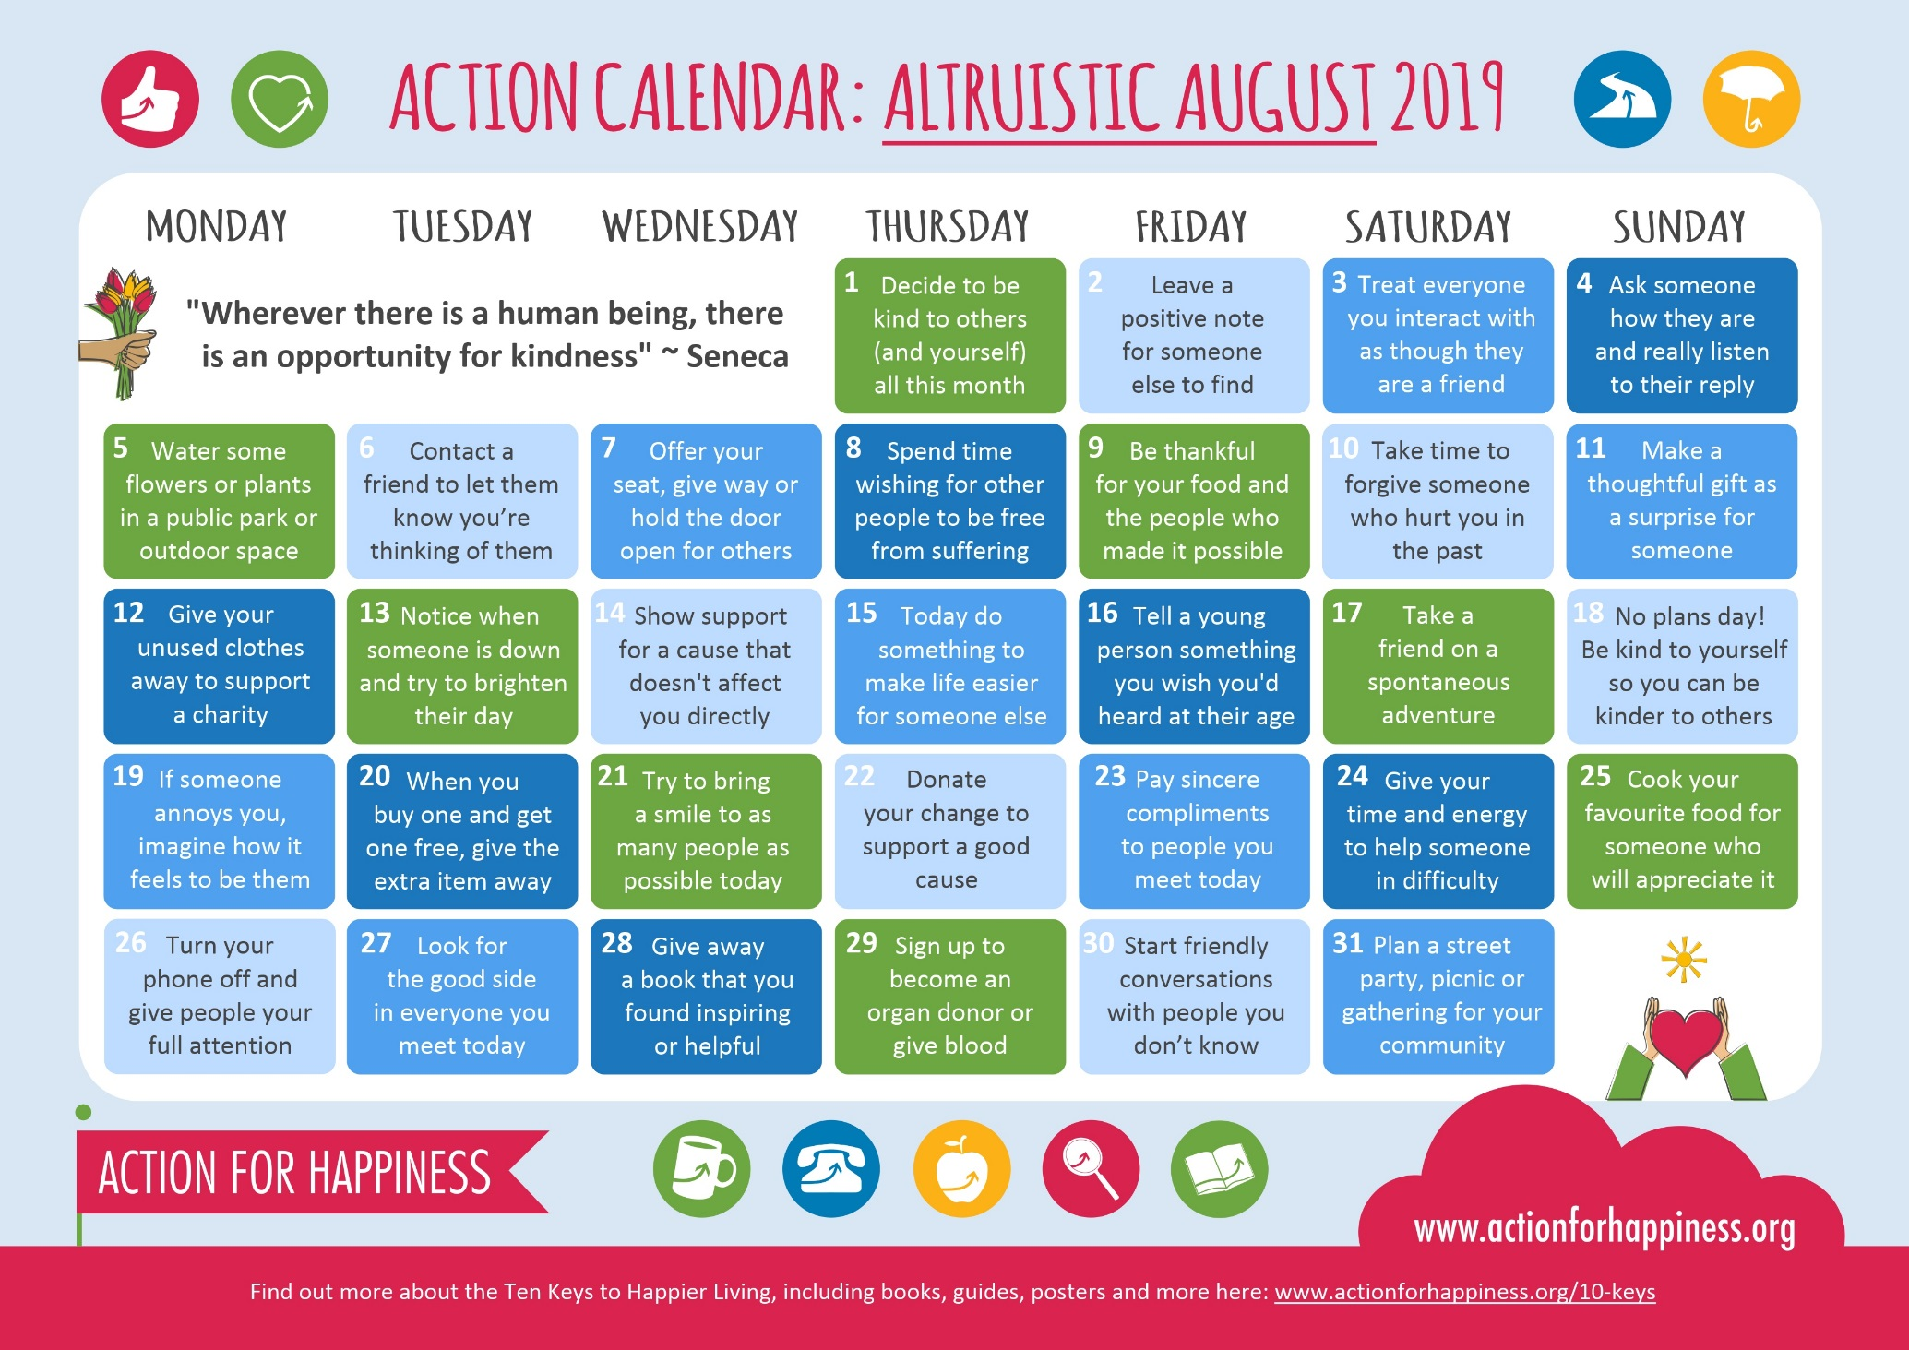
Health & Wellbeing

Slide 20


We want to hear what you think about working here. You can let us know by taking part in this year’s employee opinion survey (from 1-30 September 2019); the survey covers things like your job, your wellbeing, safety and training needs.
Your feedback really can make a difference not only in making our working lives better every day, helping us to safely connect our people, businesses and communities to ‘put our passengers first’ and provide the service they deserve. To do this we must make sure everyone is working together.
It’s your time to act – taking part in the survey will help us better understand what we are doing well and where we can improve.
The survey itself should only take 10-15 minutes to complete – the answers you give are completely confidential and no-one at Network Rail will see your individual answers. The results will be used to put action plans in place across the whole organisation to build and support a more engaged environment.
More details to come in the coming weeks.

Slide 21

Well done to Woking P-way team who invoked the Work Safe Procedure!
The team were asked to clamp up a 2C defect. But when they got to site, the
COSS assessed the situation and made the decision that it was not safe to carry out the task with open line working. The Line Manager was made aware and supported the decision made by the COSS. The work was re-planned to be done in a Line Blockage.

