Slide 1
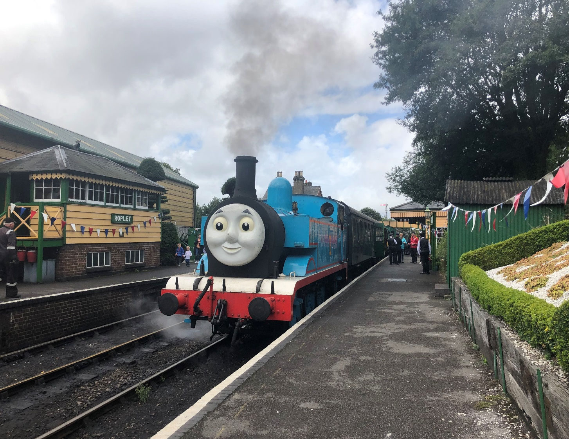
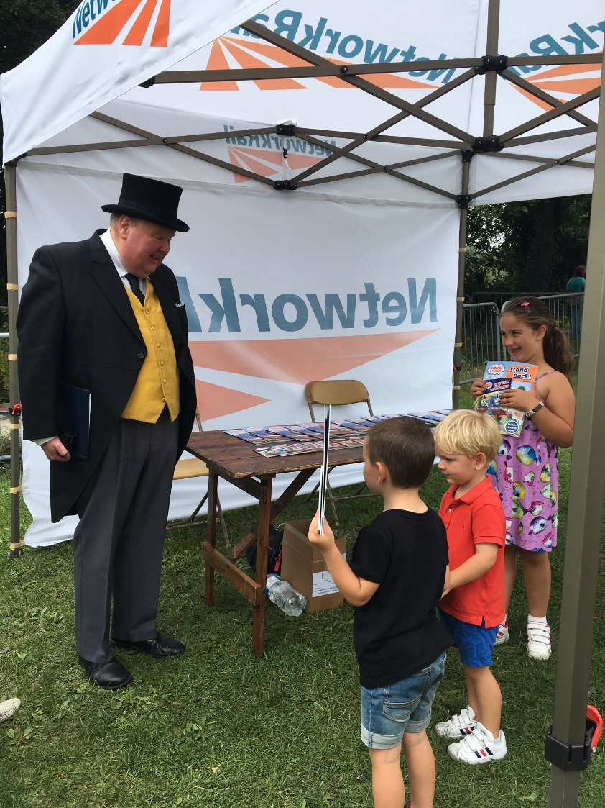
Health, Safety and Environment Period Cascade for P05 2019/20
Wessex Route
A Day out with Thomas on the Watercress Line August 2019
Notes:
7,000 Stay Safe with Thomas reading and activity books distributed over 9 days

Slide 2
Content
Welcome to your Health, Safety and Environmental Cascade for Period 05 2019/20. Please discuss and share the items that are relevant to your teams and display any relevant Safety Bulletins or Lessons Learnt on your notice boards.
Front Line Focus Episode 86 - Front Line Focus Episode 86 - July 2019.mp4
Update on the Margam fatality investigation
Significant Workforce Events
Line Blockage Irregularity at Queenstown Road Station
Serious Accident – Burns to hands
Lower back injury
Contact with Hazardous Substance – Oak Processionary Moth
Failure to open a NSCD
Unsafe Working Practice ASPRO
Golden Hour and P.R.I.C.E Reminder
Transport of detonators
Fair Culture
Plant Manual Update - Task Risk Control Sheet: NR/L3/MTC/RCS0216/MP02
Environmental Update
Health and Wellbeing

Slide 3

Workforce Safety
Margam double fatality – investigation factual update published on 30/07/2019
On Wednesday 3 July 2019 at 09:52 two track workers, Gareth Delbridge and Michael Lewis, were struck and fatally injured by a passenger train at Margam on the South Wales main line. A third track worker came very close to being struck. These three workers were part of a group of six staff, who were undertaking scheduled track maintenance on lines that were open to traffic; there was no line blockage in place.
The train, was travelling from Swansea to London Paddington, on the up line at around 73 mph (117 km/h). The driver saw three track workers walking away from him on the adjacent down line and, beyond them, three more track workers on the up line ahead of his train. Two of the workers on the up line were standing in the 4-foot and the third worker was in the 6-foot. The three track workers on the up line were working on a set of points, using a petrol-engined tool for loosening and tightening large nuts.
The driver sounded the train horn and applied the emergency brakes. The track workers walking on the adjacent line became aware of the train approaching and tried to warn their colleagues as the train passed them. The workers at the points around 150m away were wearing ear defenders. CCTV images taken from a camera at the front of the train suggest that the workers did not become aware of the train. By the time of collision, the train had reduced speed to around 50 mph (80 km/h) and stopped very soon afterwards.
The Network Rail investigation undertaken by a team independent of the Route is underway and will identify the sequence of events that led to the accident and consider:
•the implementation of safe systems of work, including the protection or warning arrangements that were in place
•the arrangements for planning the tasks, resources and work timings
•the relationship between the selection and use of PPE, the safe systems of work being used and the tasks and equipment
•what might have influenced the actions of those on site
•the planning of the work and the implementation of Network Rail’s standard for keeping people safe on or near the line
•relevant underlying management or organisational factors

Slide 4


Workforce Safety
Significant Events in the Period
Manual Handling
07/08/2019 - The IP was lifting an ironman onto a running rail when a piece of ballast gave way underneath his foot and the IP experienced shooting pains in his lower back. More information in the cascade. LT
Contact with Hazardous Substances
06/08/2019 - A member of the Inner Off Track team was recently exposed to hairs from oak processionary moths. More information in the cascade. LT
Line Blockage Irregularity
15/08/2019 - Signaller routed 2U33 over 611 pts which entered the line blockage on the Down Windsor line. More information in the cascade.
Electrical Safety
21/07/2019 - 2 members of Ganymede staff placed earthing straps on both Up and Down Line without a short circuiting bar or a proving unit at Totton (BML2).
Discussion:
04/08/2019 - NSCD R125N was not properly operated and the PICOP unable to hand back the isolation to Raynes Park. More information in the cascade.

Slide 5
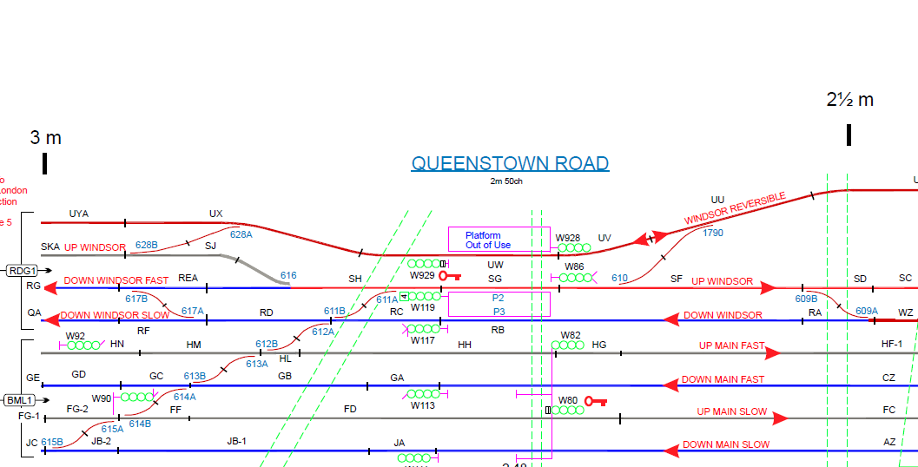
Workforce Safety
Line Blockage Irregularity at Queenstown Road Station
On Thursday 15th August 2019 at approximately 12:31 the Signaller operating panel 2 at Wimbledon Area Signalling Centre (ASC) received a request for a LB that was required to undertake daily inspections on a cracked crossing associated with W612A points at Queenstown Road.
The COSS was calling from a POS and required the LB to provide a safe access back to the platform at Queenstown Road after having previously taken the same LB at around 12:00 hours. At this time the Signaller was already dealing with another two planned LBs in the same geographic area and advised the COSS he would call him back once there was a suitable gap in the train service.
At approximately 12:35 the Signaller contacted the COSS and advised him that he was in a position to grant the LB, confirmed the protection limits and issued an authority number.
Shortly after, at approximately 12:38 the COSS contacted the Signaller to advise that he had observed a train (2U33) traverse W611 points, which were within the limits of his LB.
Line blockage that was in place for the Track Patrol team and where the Asset Inspector and his Lookout went following 2U33 entering their line blockage on the Dn Windsor/Dn Windsor Slow.
The passage of 2U33 which was routed into the line blockage over 611 points.
The line blockage (GZAC ref; 6352383) on the Down Windsor/Down Windsor Slow between 609A pts and 617A pts, which was in place for a cracked crossing inspection.
Items for discussion:
This incident is currently under investigation but the initial findings suggest that the Signaller was dealing with 6 different line blockages at the time
The review of voice comms also showed that the Signaller had 17 Safety Critical Communication conversations in a space of 45 mins, 15 of these were associated with the 6 line blockages
Maintenance are working with the local Operations team on the reduction in multi-part line blockages

Slide 6
Workforce Safety
Serious Accident – burns to hands
Overview
A serious safety incident occurred on South East Route in the early hours of Wednesday morning 7th August 2019 when a colleague setting up site lighting came into contact with a live conductor rail floater which was believed to have been isolated (example of a floater on the right).
The IP suffered severe burns to their hands. However, this could have been a lot worse but the IP was wearing flame retardant PPE and gloves at the time. The investigation is currently ongoing but we’d like to issue a few immediate reminders.
Actions/ Discussion Points
Always assume that the third rail is live and test before touch
Are you aware of the location of live floaters in your worksite?
Always wear the correct PPE for the task
Are you indicating live floaters on site using devices such as self con rail indicator devices?

Slide 7
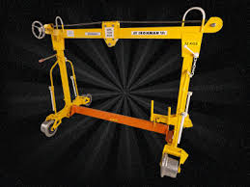
Workforce Safety
Lower back injury
On the 7th of August 2019 a Team Leader from Woking P-Way was part of a 4 man team lifting an Iron Man onto the running rails at Woking East (23m70ch, BML1).
The Team Leader was acting as the PIC and took charge of the Iron Man lift.
The team lifted the Iron Man close to the rail, then lifted it onto the Up Fast line, crossing over the running rail and conductor rail.
The Team Leader was situated on the back left end of the Iron Man and whilst lifting it into place, a piece of ballast gave way beneath his foot and he experienced a pain shooting up his back. The IP was unable to return to work on his next shift.
The lighting was deemed sufficient as the team had their head torches and there was also light coming from the lights within the siding and from the street lamps along the nearby road.
Items for discussion:
If you are working in the hours of darkness is your lighting suitable and adequate so you can identify any potential hazards?
Do you ‘Take 5’ before, during and after a task, to risk assess the hazards and discuss how the task will be done safely?
Do you consider alternatives to manual handling? Is there a way to complete tasks by the use of mechanical means?
Lessons learnt - Iron Man back injury 07082019.pdf

Slide 8
Worker Safety – Occupational Ill Health
Exposure to Oak Processionary Moth (OPM) resulting in skin irritation and a breathing impairment
A member of the Inner Off Track team was recently exposed to hairs from oak processionary moths.
After completing the task the individual was removing his protective coveralls. It is believed that it was at this time the hairs were released and came into contact with the skin on his arms as he was wearing a short sleeved shirt underneath.
The individual later noticed a rash on his arms and during that evening had impaired breathing. The contact exacerbated his asthma. Medical advice was sought.
Items for discussion:
If an oak tree is identified as containing an OPM nest, it must be reported to the WICC and the caterpillars kept away from.
This is due to the following complication that could arise from a contact:
Inhalation: The hairs are known to cause bronchial / throat irritations and breathing difficulties in some people. Hence symptoms may include coughing, wheezing, chest tightness and/or runny/stuffy nose and possible allergic reactions in some people similar to hay-fever.
Skin: The fine hairs can cause a skin irritation, sometimes severe on some people causing lesions.
Eyes: The dust and fine hairs can cause irritation to the eyes in some people.
Ingestion: Unlikely route of exposure however may occur during tree surgery operations.
The OPM caterpillars gathering on the trunk of an oak tree.
Lessons learnt - Esher OPM exposure 06082019.pdf

Slide 9
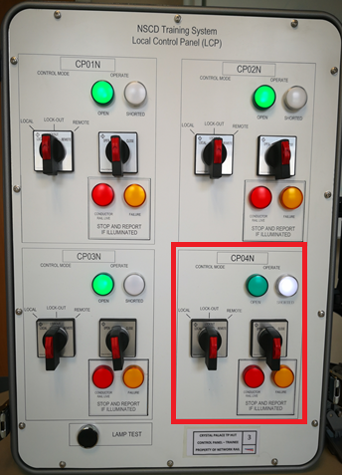
Workforce Safety
Failure to open a NSCD on Sunday 4th August 2019 at Twickenham
Event
When operating NSCDs at the end of a planned B4 isolation, an NSCD operator correctly removed the protection but failed to open all required NSCDs, leaving one in the closed position
This prevented the ECRO from being able to properly reenergise the section concerned
Staff had to attend site to correct the mistake, which led to an overrun of the planned work
Discussion points
What could have contributed to this incident?
Are you consistently using proper coms and reading and repeating back when giving or taking safety critical instructions? Would you state each NSCD individually as below?
ES: “Please open NSCDs charlie papa zero one november, charlie papa zero two november, charlie papa zero three november & charlie papa zero four november”
NSCD operator: “I can confirm I have successfully opened NSCD charlie papa zero one november, charlie papa zero two november, charlie papa zero three november & charlie papa zero four november”

Slide 10
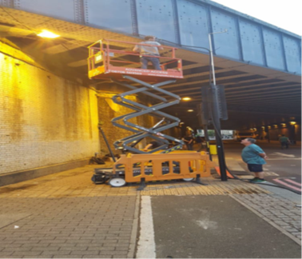
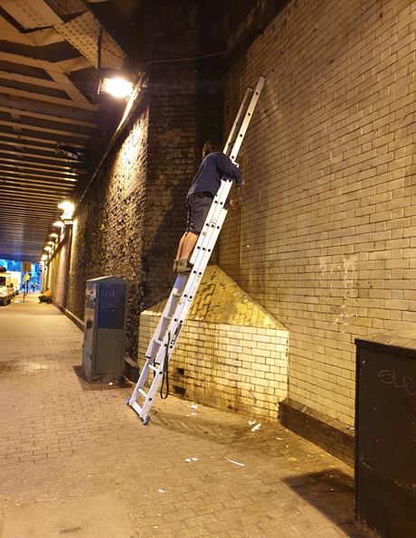
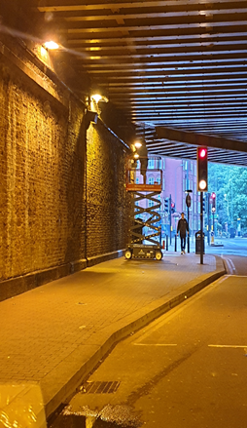
Worker Safety
Failure to challenge Unsafe Working Practices
Two contractor rail safety supervisors RSS working for NWR Asset Protection and Optimization (ASPRO) , whilst supervising works by a film company’s contractor installing lights to the iron work underneath the South Lambeth Place bridge in London, observed unsafe working practices which they photographed but didn’t challenge and report.
The film company’s contractor was working under a Basic Asset Protection Agreement (BAPA) which allows NWR to supervise third party works in an around its assets.
The RSS were tasked to ensure there was no damage to NWR asset during the project and that it was being done safely in line with the lifesaving rules and H&S standards.
Post project, ASPRO asset manager whilst reviewing the RSS site reports, came across some photos taken by the RSS depicting the unsafe work.
The RSS explained they were of the impression their role was only to ensure there was no damage to the asset and, were unaware they could challenge unsafe work. They further stated that they were not given a formal briefing before they were put to work.
Discussion Points:
Regardless of your job role, you have a moral and legal responsibility to take reasonable care for your health & safety and those of other persons affected by your acts of omission
Do you feel empowered to challenge unsafe work, and what is your attitude to being challenged?
How can you highlight potential risks to those you work with?
Are we providing our people with the necessary information they need to carry out work safely?
Lessons Learnt: Unsafe Working Practice

Slide 11

Golden Hour Reminder
We introduced the enhanced Golden Hour process in May 2019.
The aim is to improve the collation of initial and subsequent information in order to establish all the facts, have better understanding of immediate and underlying causes of these events in an efficient and timely manner to improve our overall safety performance in the long term.
We need to get better at securing the evidence immediately after the incident/accident which includes photos of any injuries, equipment being used and also importantly the site where the event took place.
Our first response to an injury is critical. The sooner we respond, the quicker the recovery will be. Once any emergency response has been made, you should follow P.R.I.C.E if appropriate to do so:

Slide 12
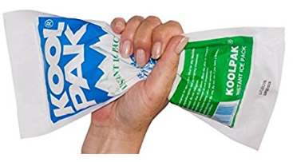
Workforce Safety
“I” is for Ice
The application of an ice pack to the site of sprain and strain injuries, immediately after an accident occurring, has been proven to significantly reduce swelling at the injury site and subsequently the risk of further injury/discomfort occurring.
Please ensure sufficient stocks are ordered and available in the depots and vehicles and can be taken to site as part of the first aid kit.
They can be ordered off I-procurement / Office Depot - Product code 7890097
Get the ice on quickly
Icing is most effective in the immediate time period following an injury. The effect of icing diminishes significantly after about 48 hours. In an effort to reduce swelling and minimize inflammation, try to get the ice applied as soon as possible after the injury.
Watch the clock
Ice for 15-20 minutes, but never longer. You can cause further damage to the tissues, including frostbite, by icing for too long.

Slide 13

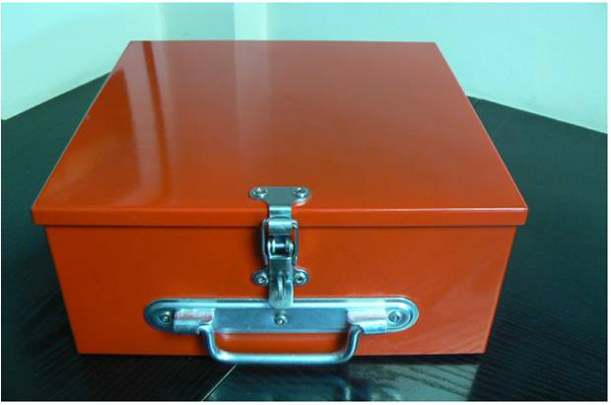
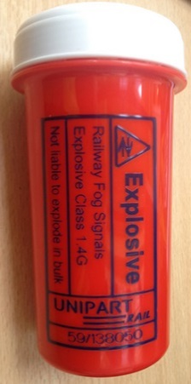
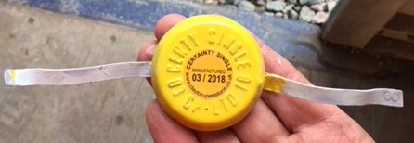
Workforce Safety
Transport of detonators
Detonators should always be carried in approved carrying tubes and should be prevented from rattling around in those tubes by filling any excess space with paper or cloth.
Detonators should never be left lying around in vehicles, accommodation or on site. They should either be within the personal responsibility of an individual who has them for a specific purpose, or they should be locked away in a secure location.
For Network Rail vehicles a maximum of 24 detonators can be kept in the manufacture’s containers and stored inside a locked metal storage container within the vehicle.
Detonator
Approved Carrying Tube
Approved Lockable Metal Storage Container
Security and Storage of Detonators

Slide 14

Fair Culture Process
Our Fair Culture principles allow us to identify why rules may have been breached and make sure the consequences of any breach are fair and proportionate. The Fair Culture principles also help us understand where there may be underlying problems in our business which, if we solve, will make working safer for all of us.
Our Fair Culture principles are applied for all safety investigations and support the implementation of our Lifesaving Rules
To support the process a Fair Culture Flowchart is used during accident/incident investigations.
The Fair Culture Flowchart is specifically for use following a safety accident or incident. The flowchart should be applied to the immediate cause identified by the investigation where it is an unsafe act and any other unsafe acts identified by the
investigation.

Slide 15
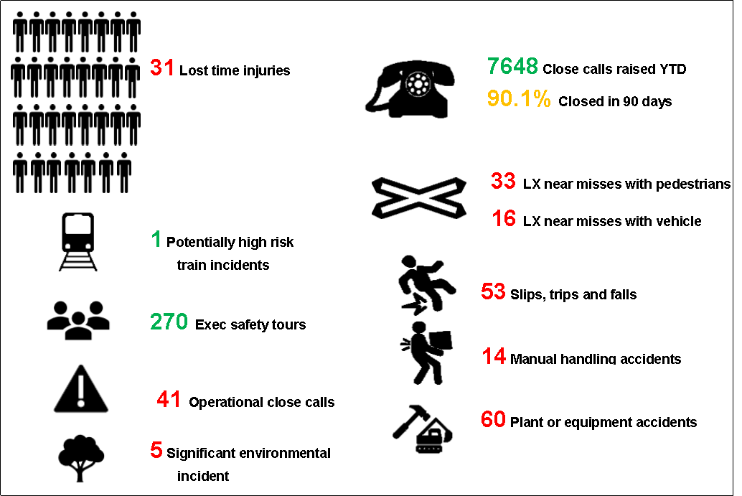
Infrastructure Plant Manual
Task Risk Control Sheet: NR/L3/MTC/RCS0216/MP02
The Task Risk Control Sheet (TRCS) for the delivery and safe storage of OTP and transit from storage point to the ON/Off tracking point has been updated to issue 3 with a compliance date of 07/09/2019.
The changes are due to an incident where a 3 tonne RRV trailer fell onto an operator, lifting & delivering the trailer whilst working alone, causing serious life changing injuries. The TRCS was found to have insufficient controls to prevent this from happening in the future.
Key Changes to the TRCS are:
Delivery/Collection-Collision:
All deliveries/collection of OTP and associated equipment shall be undertaken using the meet and greet equipment delivery process. (guidance can be found in the Infrastructure Plant Manual NR/GN/RMVP/0200 Section 9)
NR/GN/RMVP/0200 [ Issue: 1 ] Infrastructure Plant Manual Guidance
NR_L3_MTC_RCS0216_MP02
Individuals shall not work alone unless a suitable risk assessment/ SSoW is in place for the activity.
Lifting operations:
A lift plan shall be utilised when off loading/loading equipment.
Lifting operations shall not be undertaken by an individual working alone.
If you require any further information then contact: Keith Penn, RPSE
mailto:keith.penn@networkrail.co.uk
3 tonne Trailer Dropped from Crane

Slide 16
Safety Bulletins, Alerts, Advice
Shared-Learning-NRL19-11-Fall-from-height-staff-injury.pdf
IPSIG-SL010-Streatham-Common-OCC-April-2019.pdf
Safety_Bulletin_LBfloater_incident_060819.pdf
Fair Culture Principles-signed-121214.pdf
Safety bulletin Swale Near Miss 310719.pdf

Slide 17


Environment
Environmental Inspections
The Planned Environmental Inspection template (PEI) has been updated to reflect changes in legislation and also accommodate works and sites outside the original scope of maintenance depots. These PEIs are carried out by the Route Environmental Specialist and findings are now captured in CMO.
The PEI depth and topics covered can be filtered dependant on site size and/or work scope. There are 45 possible questions in the following categories:
The full list of PEI questions can be found on the Wessex Route Environment Hub (under Guidance Documents and Form Links) page and using this link.
Waste | Water Consumption | Materials (source and use)
Chemical , fuel and oil (Storage and use) | Protected Species | Nuisance
Air | Land | Water
Environmental Management System | Flooding
What next?
All maintenance depots are mandated to be inspected once per control period. Maintenance WHSEAs and Route Environment Specialist are to agree a programme of depot inspections for CP6.
All other inspections to be agreed and arranged with the relevant function/team.

Slide 18

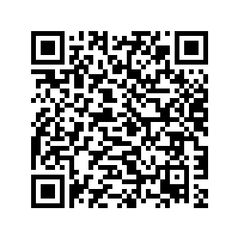
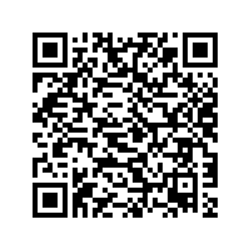
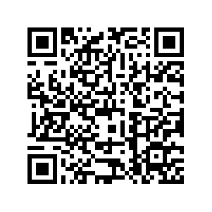
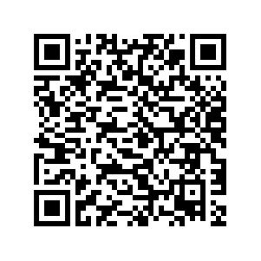
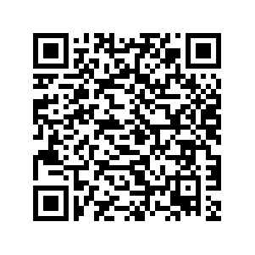
Health & Wellbeing
Mental Health First Aid Awareness Course
Book onto a course by following the link or scanning the QR code
Course: | Date: | Time: | Training Room: | Location: | Link to booking page: | QR Code:
Mental Health First Aid Awareness (Half day) | 14 Nov 19 | 09:00 – 13:00 | Training room 4&5 | Basingstoke ROC | https://www.eventbrite.co.uk/e/mental-health-first-aid-awareness-tickets-65097905588
Mental Health First Aid Awareness (Half day) | 05 Dec 19 | 09:00 – 13:00 | Training room 6&7 | Basingstoke ROC | https://www.eventbrite.co.uk/e/mental-health-first-aid-awareness-tickets-65098456235
Mental Health First Aid Awareness (Half day) | 16 Jan 20 | 22:00 – 02:00 | Training room 6&7 | Basingstoke ROC | https://www.eventbrite.co.uk/e/mental-health-first-aid-awareness-tickets-65101636748
Mental Health First Aid Awareness (Half day) | 20 Feb 20 | 09:00 – 13:00 | Training room 6&7 | Basingstoke ROC | https://www.eventbrite.co.uk/e/mental-health-first-aid-awareness-tickets-65098480307
Mental Health First Aid Awareness (Half day) | 20 March 20 | 09:00 – 13:00 | Training room 4&5 | Basingstoke ROC | https://www.eventbrite.co.uk/e/mental-health-first-aid-awareness-tickets-65098384019

Slide 19

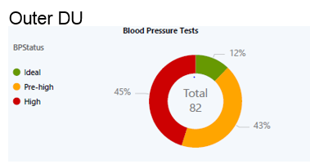
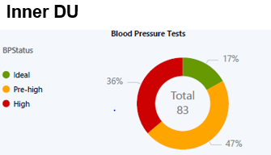
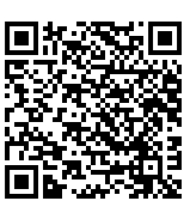
Health & Wellbeing
9th to 15th September
1/3
of UK population have high blood pressure, but most don’t know it.
10%
of Wessex employees used a Wellbeing Kiosk between Jan to March 2019.
Find your nearest free BP station:
Notes:
Know your Numbers week – blood pressure testing and awareness week. High blood pressure usually has no symptoms, which is why is it often referred to as the silent killer. The only way to know you have it is to have a check.

Slide 20
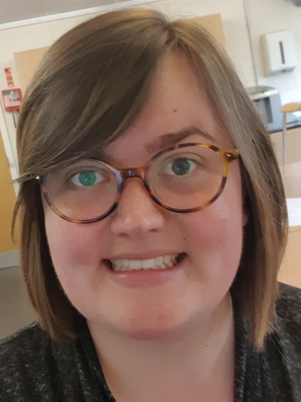
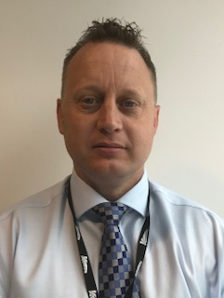

New Health, Safety and Environmental Advisors for Stations and Works Delivery
Chloe Vickers
I am on a six month secondment in the role, looking after London Waterloo, Clapham Junction and Guildford stations.
At present I am mainly focusing on station accidents and improving the reporting/reviewing process with the aim of reducing the future reoccurrence. My role will eventually cover all things related to station safety.
Aaron Cousins
My role is to provide workforce health, safety and environmental advice to the Route Programme Director (WD) and teams. Monitor compliance with legislative and corporate requirements. Promote a positive cultural and behavioural change in all aspects of welfare, health , safety and environment management.
Prior to my career in NWR I served 24 years in the Corps of Royal Engineers, part of the British Army deploying to various countries around the world, and gained my knowledge of H&S within the Armed Forces.
Station Safety, Health and Environment Advisor
Works Delivery Workforce Health, Safety and Environment Advisor

