Slide 1
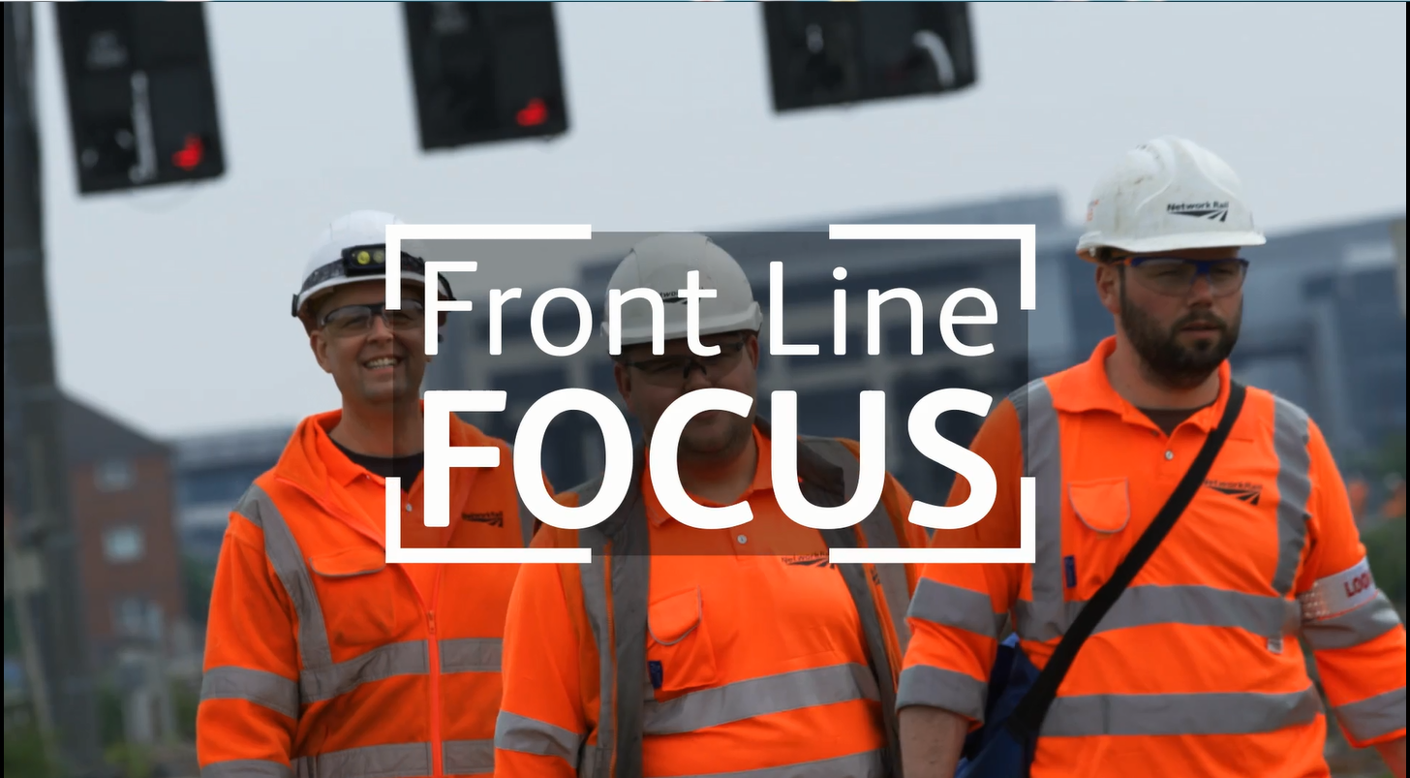
Health, Safety and Environment Period Cascade for P06 2019/20 Wessex Route
Episode 87 of Front Line Focus can be found here

Slide 2
Content
Welcome to your Health, Safety and Environmental Cascade for Period 06 2019/20. Please discuss and share the items that are relevant to your teams and display any relevant Safety Bulletins or Lessons Learnt on your notice boards.
Front Line Focus Episode 87
Significant Workforce Events
Safety Bulletin – Continuing near misses with track workers
Eastleigh Yard Hand Barrier Irregularity
RTA – unsafe vehicle
Manual Handling accident – back strain
STF accident whilst pushing an Iron Man
Manual Handling accident – dislocated shoulder
Timely Reporting of accidents
Acknowledgement of approaching trains
Use of vibrating tools and HAVS
Aggressive wasps are active
Plant Manual Update
Community Safety – Welfare Officers
Environmental Update
Health and Wellbeing

Slide 3




Workforce Safety
Significant Events in the Period
Manual Handling x 2
10/09/2019 – MOM dislocating his shoulder when picking a point clip from the back of the van. More details in the cascade. NLT
10/09/2019 – the IP injuring his back whilst using a metal bar to move a rotten timber bearer. More details in the cascade. LT
STF accident
30/08/2019 – The IP was part of a team moving a rail with ironmen. Whilst walking in the 4ft his ankle rolled on some ballast. More details in the cascade. LT
RTA
12/09/2019 -.NWR hire vehicle driven on the A3 at approx. 50mph, the airbag failed to deploy on colliding with the car in front. More details in the cascade.
Wasp stings x 2
21/08/2019 – Member of the Off Track team stung multiple times by wasps whilst clearing vegetation. NLT
28/08/2019 – 3 members of the PSS were stung by wasps next to a track isolation switch. NLT
Discussion: Are you aware of any members of your staff that are allergic to wasp stings?

Slide 4

Workforce Safety

Slide 5
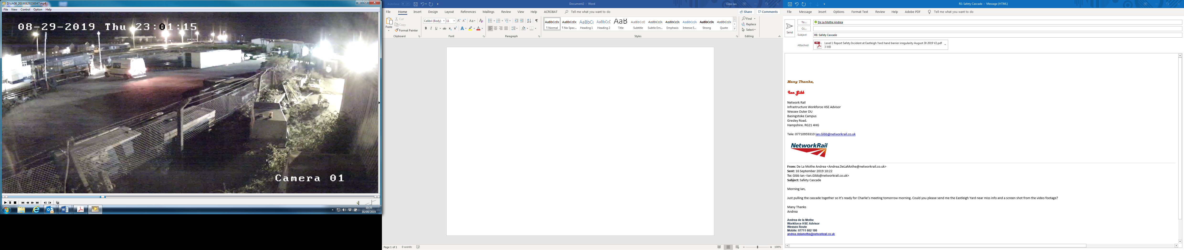
Workforce Safety
Eastleigh Yard Hand Barrier Near Miss
In the early hours of Friday 30th August 2019, the Outer DU RT&L team reported that a close call took place at Eastleigh Yard.
The team were leaving their depot to travel over the crossing into the material yard, when they noticed an approaching shunter without any lights. The driver was at the back and there was an operative hanging off the front of the unit. The hand barriers were not lowered but the NR driver managed to stop the van in time.
When challenged why the barriers were not lowered, the operative informed the NR driver that he was not briefed to lower the barriers.
During the preliminary investigation it was established that in the past, DB Cargo instructed their staff not to operate the barriers. The drivers were briefed to proceed with extreme caution when approaching the crossing and there was a sign at the crossing, warning road vehicles.
Stand Down briefing was held on Wednesday 4th September by GBRf (who now operate the Eastleigh Yard on behalf of SCO) and an instruction issued to all staff working at Eastleigh Yard to always lower the hand barriers to road traffic when rail movements are taking place.

Slide 6
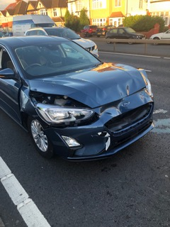
Workforce Safety
Road Traffic Accident
On Thursday 12th September 2019 at approx. 08:00, a NWR hire car was involved in a RTC.
The vehicle was being returned to the hire company after the driver reported feeling vibrations through the steering wheel, the day before.
The vehicle was being driven on the A3, at approximately 50mph.
A 3rd party vehicle, 2 cars in front of the NWR vehicle, suddenly braked which led to the vehicle directly in front of the NWR vehicle also breaking.
The NWR hire vehicle drove into the back of the car immediately in front and the airbag failed to deploy on colliding with the other car.
The driver was considerably shaken up and suffered pain to the neck, back and shoulders and was advised to take some time off to rest and recover.
Items for discussion:
The vehicle will be a subject to further investigation to establish the cause of the vibrations, the reason for the airbag deployment failure and whether the breaks were functioning correctly.
If you think that there is a problem with your vehicle, don’t drive it. The hire company can collect it, it’s not worth taking the risk.
Seatbelts save lives, the evidence is above.
Carry out your vehicle checks before you set off.
Lessons Learnt - link

Slide 7
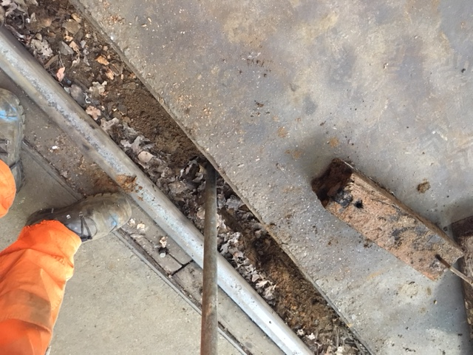
Workforce Safety
Lost Time Accident – Back strain
On the 10th of September 2019, an Operative from the Off-Track Team suffered a painful back strain when he was prying up a timber bearer using a heel bar.
The team was tasked with manually removing rotten timber bearers and the inlays, which sit alongside the running rails, throughout the 4 lines within the Effingham MPV sheds.
The scope of the required works had been raised a number of times, however the decision was made to carry out these works manually, as opposed to using mechanical means.
This work was strenuous and repetitive.
An inlay and a heel bar within the MPV sheds
Items for discussion:
Are we using the right tools? Manually carrying out work maybe the easier option, but it might not be the right one.
Do we protect our people? Have we given them every chance to succeed, without putting them at risk?
Are we taking the repetitive nature of our manual handling into account? A one off lift may place incredible strain on our bodies, but it is short lived. Work of the type identified in this incident may not be so straining in the short term, but by the nature of its repetitiveness may cause longer lasting effects.
Lessons Learnt - Link
Notes:
Due to the safety risks of the sheds themselves and the threat of performance related issues (because of the seasonal work that the MPV’s provide), the Off Track Team attempted to carry out any necessary remedial work by hand.

Slide 8
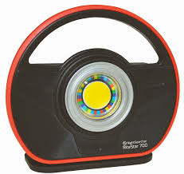
Workforce Safety
STF Accident whilst pushing an Iron Man
On Friday 30th of August 2019, a Technician from Wimbledon P-Way was part of a team pushing a 30ft rail on an Iron Man at L/E of Earlsfield (BML1). During this process, whilst walking in the 4ft, the Technician rolled his ankle.
The team were carrying out the task at night, using only head torches for lighting.
The underfoot conditions (ballasted track) were uneven.
The Technician, who is a qualified First Aider, followed the P.R.I.C.E protocol. His immediate actions, appropriate for the type of injury, potentially reduced the severity and he only suffered minor swelling to his ankle.
RiteStar 700 NightSearcher magnetic light
Items for discussion:
Is the site lighting suitable for the work being undertaken? Head torches are useful, but consider other lighting, such as the RiteStar 700 NightSearcher light. This magnetic light could be attached to your Iron Man or a trolley.
Beware of your underfoot conditions and watch out for any uneven ballast surface
Think P.R.I.C.E.
Lessons Learnt - Link

Slide 9
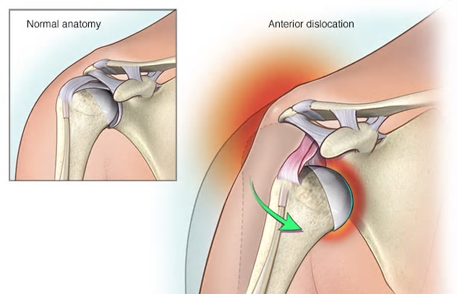
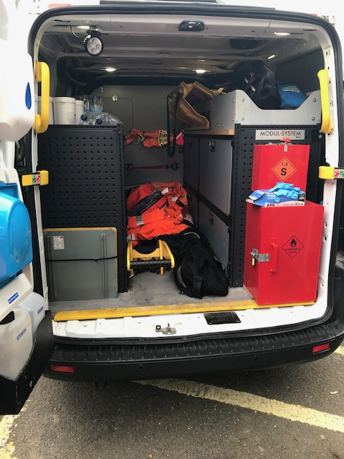
Workforce Safety
Manual Handling Accident – Dislocated shoulder
On the 10th of September 2019, a MOM responding to a fault dislocated his right shoulder.
The IP was retrieving a point clip from the shelving unit at the back of his van. The point clip got caught on another item and this led to his shoulder being pulled out of it’s socket.
The IP suffered dislocations in the past and is now prone to a shoulder weakness.
He was able to put his shoulder back himself but attended hospital afterwards to check for any potential damage to muscles, ligaments, nerves or blood vessels.
Taking 5 and doing a quick visual inspection first, could have identified the obstruction.
Items for discussion:
Do you consider your physical fitness and capability before you commence a task?
Simple things can lead to major problems if you are not aware and don’t take action
If you have any known/pre-existing conditions that could affect your ability to carry out a task, you need to talk about it and make your line manager/colleagues aware
What to do if you dislocate your shoulder:
Get medical help right away for a shoulder that appears dislocated. While you're waiting for medical attention:
Don't move the joint – you could do more damage
Ice the injured joint – can help reduce pain and swelling

Slide 10

Workforce Safety
Timely Reporting of accidents – Wessex Route Golden Hour process Reminder
All accidents/near miss events are reported immediately (or as soon as it is practicable and safe to do so) to the WICC and an initial accident form is completed by the ICC and the reporter.
1
DCP to consolidate findings and ensure Lessons Learned document is completed; this will be submitted to the Safety Team for inclusion in the period safety cascade. Responsible manager to discuss with team at safety hour and implement any safety improvements recommended.
5
5
Discuss in the Periodic Safety Cascade and implement improvements
Report accidents/near miss events to the WICC
4
Accident Reporting & Investigation
1
Investigate the event
Gather all available evidence, photos
of injury & site
It is vital to gather all available evidence as soon as it is practicable to do so. Take photos of the injury, the location where the accident occurred and of any tools/equipment that were used at the time and quarantine these so they can be examined during the investigation. Remember we are trying to understand what happened so we can prevent reoccurrence!
2
3
6hr ICC update & 24 hr H&S Manager telecon
2
Level 1 report to be completed and submitted to the DCP within 7 days. The DCP will appoint a Lead Investigator if a further investigation is necessary.
4
Responsible Manager to;
Call ICC and provide a 6hr update
Call into 24 hrs teleconference with the Health and Safety Manager..
3
If an accident is not reported in a timely manner, it is very difficult to prove the accident did in fact occur at work.
Evidence will be required to back up any late reported accidents and the individual will need to justify the reasons for late reporting!

Slide 11

Workforce Safety
Acknowledgement of approaching trains
Recent feedback has indicated that teams do not always acknowledge approaching trains.
Timely acknowledgement by ALL members of the team, by raising their arm, is very important as it signals clearly to the driver that all the members of the team are aware of the approaching train.
Remember to always:
Acknowledge the train
Eyes on
Watch it past.
Do you remember how to stop a train in an emergency?
During daylight
You must show a red flag. If you do not have a red flag,
raise both arms above your head. If you are riding on a
vehicle, raise one arm held out horizontally.
During darkness or in poor visibility
You must show a red light to the driver or wave any light
violently.

Slide 12
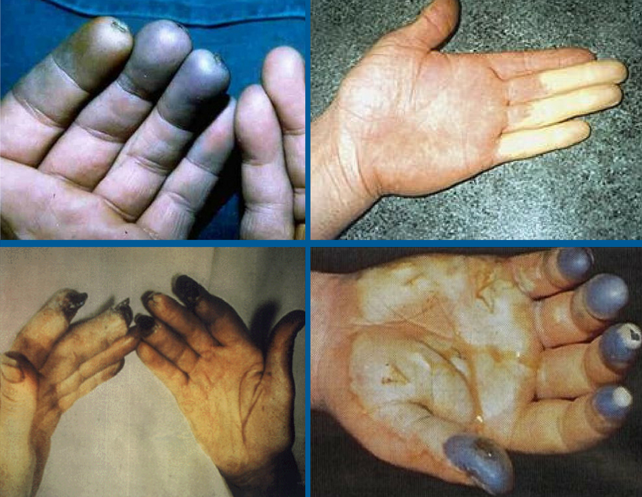
Workforce Safety
Use of vibrating tools and HAVS
If you use vibrating tools on a regular basis, health surveillance is not optional – you must take part. There is legislation which governs the management of vibration at work and the health surveillance is a part of it.
It is imperative that you complete the Tier 2 questionnaire in a timely manner so it can be submitted to the OH provider for further scrutiny.
Effects of HAVS can be permanent and disabling. They can make everyday life and work difficult.
Health surveillance is used to detect any effect of using vibrating tools as early as possible, advising appropriate action and therefore protecting employees health.
Failure to complete the Tier 2 questionnaire within 30 days of the due date will lead to a suspension of your small plant competencies on Sentinel.

Slide 13
Workforce Safety
Aggressive wasps are active
Some people are highly allergic to wasp and bee stings. However, being stung by a swarm of wasps can ruin anyone’s day...!
Remember: wasps are still active and can become aggressive towards the end of the summer period.
The most common symptoms of a wasp sting are:
• Pain in the area stung
• Minor swelling and redness
• Itchiness
More severe symptoms which may indicate an allergic reaction include:
• Difficulty breathing and swallowing
• Increased heart rate
• Fainting
Treatment of wasp stings:
remove the sting or tick if it's still in the skin and wash the affected area with soap and water
apply a cold compress (such as a flannel or cloth cooled with cold water) or an ice pack to any swelling for at least 10 minutes
raise or elevate the affected area if possible, as this can help reduce swelling
avoid scratching the area, to reduce the risk of infection
Are you aware of any members of your team who are allergic to wasp stings?

Slide 14
Safety Bulletins, Alerts, Advice
Safety Bulletin NRB19-12 - Continuing near misses with track workers.pdf
Safety-Advice-NRA19-10-OTP-Travelling-Speed-and-uni-directional-OTP-assets.pdf
Safety-Advice-NRA19-08.pdf
Exclusion Zone poster.pdf

Slide 15
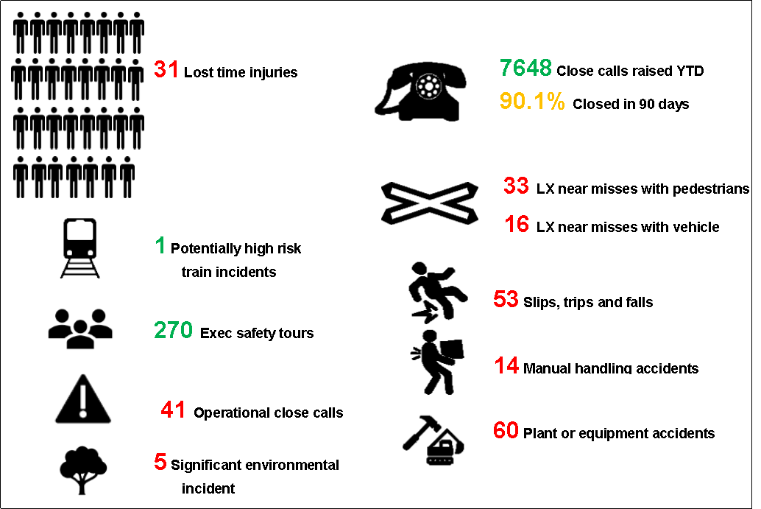
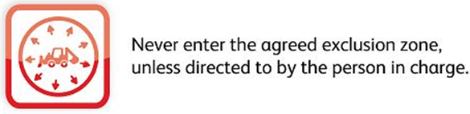
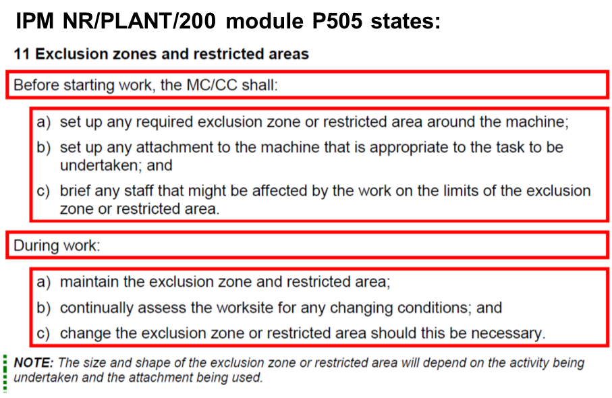
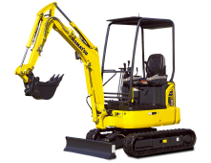
Infrastructure Plant Manual
Plant Exclusion Zones
The Exclusion Zones around plant vary depending on the type of work and the attachments that are being used. For example the minimum Exclusion Zone when working with mobile plant is 5m, working with an RRV its 10m, and up to 100m if carrying out Flailing operations.
The Task Risk Control manual details the required Exclusion Zones.
Plant Safety: Task Risk Control Manual
Working
Zone
No-Go
Zone
Sometimes is good to be excluded" poster can be found here

Slide 16

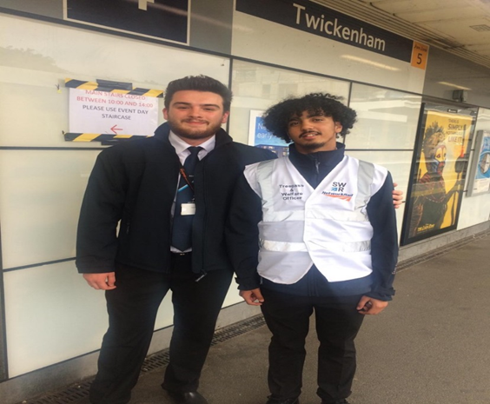
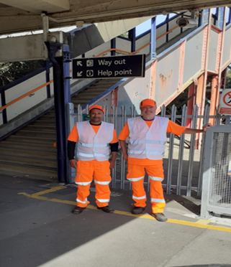
Community Safety
Welfare Officers
Over the last 12 months we have sadly seen an increase in the number of trespass and fatality events across the route.
We do have a number of mitigation plans being developed to help address this situation and one of those is the introduction of welfare officers. We have three teams in place including Land Sheriffs, Vital and STM and they are now operational at a number of stations with their focus being on platforms engaging with our passengers and providing support where required. If an intervention is required then normal processes will apply – reporting to the Incident Controller in the Wessex Integrated Control Centre and calling the British Transport Police.
If you see anything untoward or have concerns over access/egress points, lineside fencing then please do report it through to our Incident Controllers.
It has been a particular tough time recently and the work, focus and support from our teams both in our train and freight companies and in Network Rail has been amazing.
Please remember that we do have Validium, STRAW and Samaritans who are there to listen and help if you need support.

Slide 17

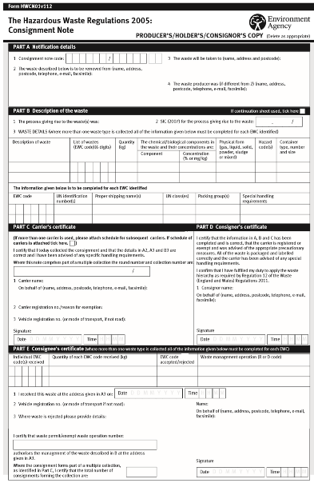

Environment
Waste Documentation – Legal Requirements
A crucial element of our legal duty of care requirements is to keep a traceable record of our waste to ensure its safe management and transfer.
The key types of waste documentation are as follows:
A Waste Transfer Note (WTN) or an Annual Waste Transfer Note (AWTN) is required for movements of non hazardous waste.
A Consignment Note is required for the movement of hazardous waste. The location where the waste will be taken to, must be recorded on the consignment note.
These are legal documents. WTN and AWTN must be retained for 2 years and Consignment Notes for 3 years.
They must be completed correctly and be accessible on demand for any authorised authority.
We are currently non–compliant in multiple areas across Wessex.
ACTION REQUIRED: Each business area must ensure there is a process in place to retain such documents, with all applicable staff aware of their responsibilities. Assurance checks within each business area are also recommended.
Additional info: Example Consignment Note Form , Example WTN Form , Consignment Note Guidance (GOV Website) , How to complete a Consignment Note (Summary Guidance) , NR Waste Management Guidance Note or contact your WHSEA for further advice.

Slide 18


Health & Wellbeing
Over the past year we have trained 26 Mental Health First Aiders in the Route
Delivered Mental Health First Aid Awareness training to 125 Wessex Employees
Trained 1 in 10 Line Managers on how to support mental health at work.
Do you feel where you work your mental health is protected and when you are suffering with poor mental health you are supported?
On the 10th of October – “Say your say”
Mind’s Wellbeing Survey goes live in Wessex Route

Slide 19
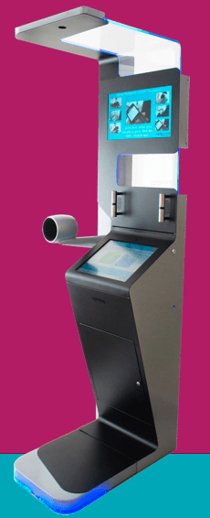
Health & Wellbeing
Route Wellbeing Kiosk programme
Location | Date:
Feltham Depot | 14/10/19 – 04/11/19
Clapham Depot | 04/11/19 – 25/11/19
Wimbledon Pway | 25/11/19 – 16/12/19
Guildford Depot | 16/12/19 – 13/01/20
Woking Depot | 13/01/20 – 31/01/20
Location: | Date:
Basingstoke Pway | 14/10/19 – 04/11/19
Havant Depot | 04/11/19 – 25/11/19
Eastleigh Pway | 25/11/19 – 16/12/19
Salibury Depot | 16/12/19 – 13/01/20
Bournemouth Depot | 13/01/20 – 31/01/20
Health Check – Results – Signpost to support
Empowered to make better health choices.

Slide 20
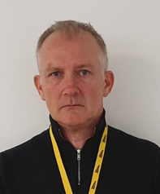
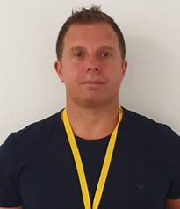

Maintenance Site Safety Support
Dean Gale
Tel TBC
Adam Lewis
Tel 07808 731249
Meet our new Site Safety Support team for Maintenance. Their purpose is to fact find and problem solve on site to inform us on next step for our cultural improvement.

