Slide 1
Health, Safety and Environment Period Cascade for P07 2019/20
Wessex Route
For more information please contact Grazia Elsehimy

Slide 2
Content
Welcome to your Health, Safety and Environmental Cascade for Period 07 2019/20. Please discuss and share the items that are relevant to your teams and display any relevant Safety Bulletins or Lessons Learnt on your notice boards.
Margam could it happen here? The discussion pack can be found here to aid you in your conversations on the topic of planning, supervision and safety arrangements of your worksites
Significant Workforce Events
Failure to operate a circuit breaker at New Haw
Sprained Ankle Tendon
Unsafe Working Practices at Waterloo and Guildford Station
Site Safety Support Team Update
Good News Story - Designated Strapping Points
Be aware – medical cannabis and cannabis oil
Plant Manual Update
Environmental Update
Health and Wellbeing

Slide 3


Workforce Safety
Significant Events in the Period
STF accident x 6
18/09/2019 – The IP missed her step whilst walking down the stairs and fell down on her ankle. This resulted in some swelling but the IP was able to return to work on the next shift NLT
30/09/2019 - The IP was leaving the depot to attend a failure and whilst walking down the stairs, went over on his ankle, resulting in a sprain NLT
01/10/2019 – The IP got his foot trapped underneath some tree arisings, fell over and sprained his ankle tendon. More details in the cascade NLT
02/10/2019 – The IP was attempting to access the track from a platform edge when he got caught and fell down head first. The IP put out his arm to break the fall and landed heavily across the adjacent 6ft side running rail NLT
07/10/2019 – The IP slipped on some damp scrap wood discarded in the cess whilst in the process of taking a LB NLT
11/10/2019 – The IP tripped on a raised coping stone on the platform at Hilsea station, causing a ligament damage to his ankle NLT
Discussion: Taking 5 and paying attention to underfoot conditions, reporting unsafe conditions via the Close Call system
Manual Handling x 2
28/09/2019 – 2 x Late reported accidents that occurred whilst the team were manually manoeuvring rails in the Totton area NLT x 2
Discussion: What is stopping us from reporting accidents in a timely manner? Will you be able to justify the lateness and provide some evidence to confirm you sustained the injury at work?

Slide 4
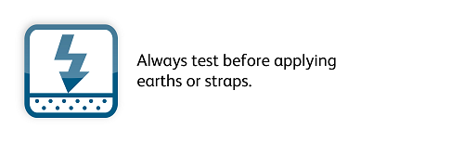
Workforce Safety
Failure to operate a circuit breaker at New Haw
An operational irregularity occurred on 2nd October 2019 at approx. 01:21 within a Wessex Inner possession.
After confirming all of his LB’s were in place the PICOP for Item 62 requested the Eastleigh ECO to open the relevant direct current CB’s and controlled track switch required to facilitate current isolation CJ404.
The ECO repeated these details back, both before and after opening the DCCB’s and gave the PICOP authority to test. The strapping team then notified the PICOP that the live line tester (LLT) indicated the UP BYFLEET CURVE was still live.
After rechecking the relevant DCCBs, the ECO realised that E485 at New Haw substation was still incorrectly in the closed position.
The ECO then opened the DCCB, and the isolation continued as planned.
Items for discussion:
The importance of following the strapping process that works as a safeguard. The team carried out the live line test as per the lifesaving rules, before applying the short circuiting bar and the short circuiting straps. They were able to identify that the current was still on and informed the PICOP.

Slide 5
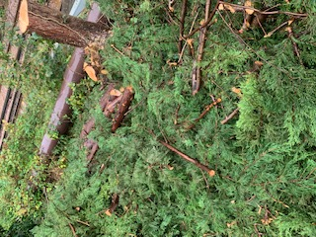
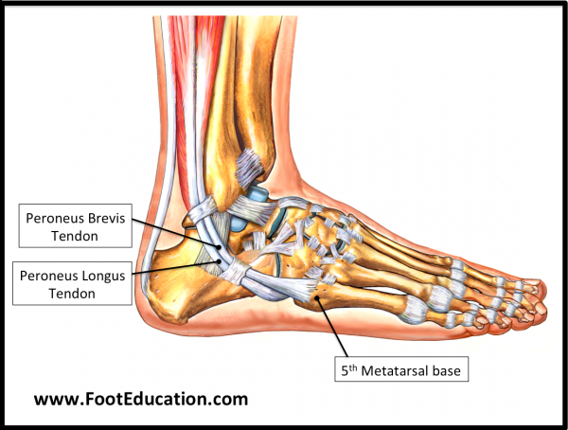
Workforce Safety
Sprained Ankle Tendon
On 1st October 2019, a vegetation contractor, working on behalf of the Off-Track Team suffered an ankle strain when his foot got trapped in arisings and he fell backwards.
The 3 man team had been tasked with removing Leylandii trees, identified as a risk to the running of the operational railway.
The task consisted of one man climbing the trees and cutting off the limbs. One man clearing and mulching these limbs (arisings), as the team dismantled the trees, and one man protecting the public from these works.
As the operative was clearing the arisings, his left foot sank into the vegetation and became trapped. As he tried pulling his foot clear, he lost his balance and fell backwards.
The IP was assisted off the site and taken to hospital for X-rays where he was advised that he sprained a tendon in his ankle. The IP followed the P.R.I.C.E (Protect, Rest, Ice, Comfort, Elevate) process and was able to return to work on the following shift.
The arisings that the Injured Person was stood amongst.
Items for discussion:
Do you ensure your site of work is managed correctly and is clear of any potential hazards? Does your work add to the hazards present?
Do you take your surroundings and the conditions into consideration? Do you continue to do this if they deteriorate?
Would you ask for help if you needed it? The operative here suffered the accident because he tried removing his foot on his own and didn’t ask for assistance.
This team had curtailed work a week earlier due to poor weather conditions, would you do the same?
Lessons learnt ankle injury.pdf

Slide 6
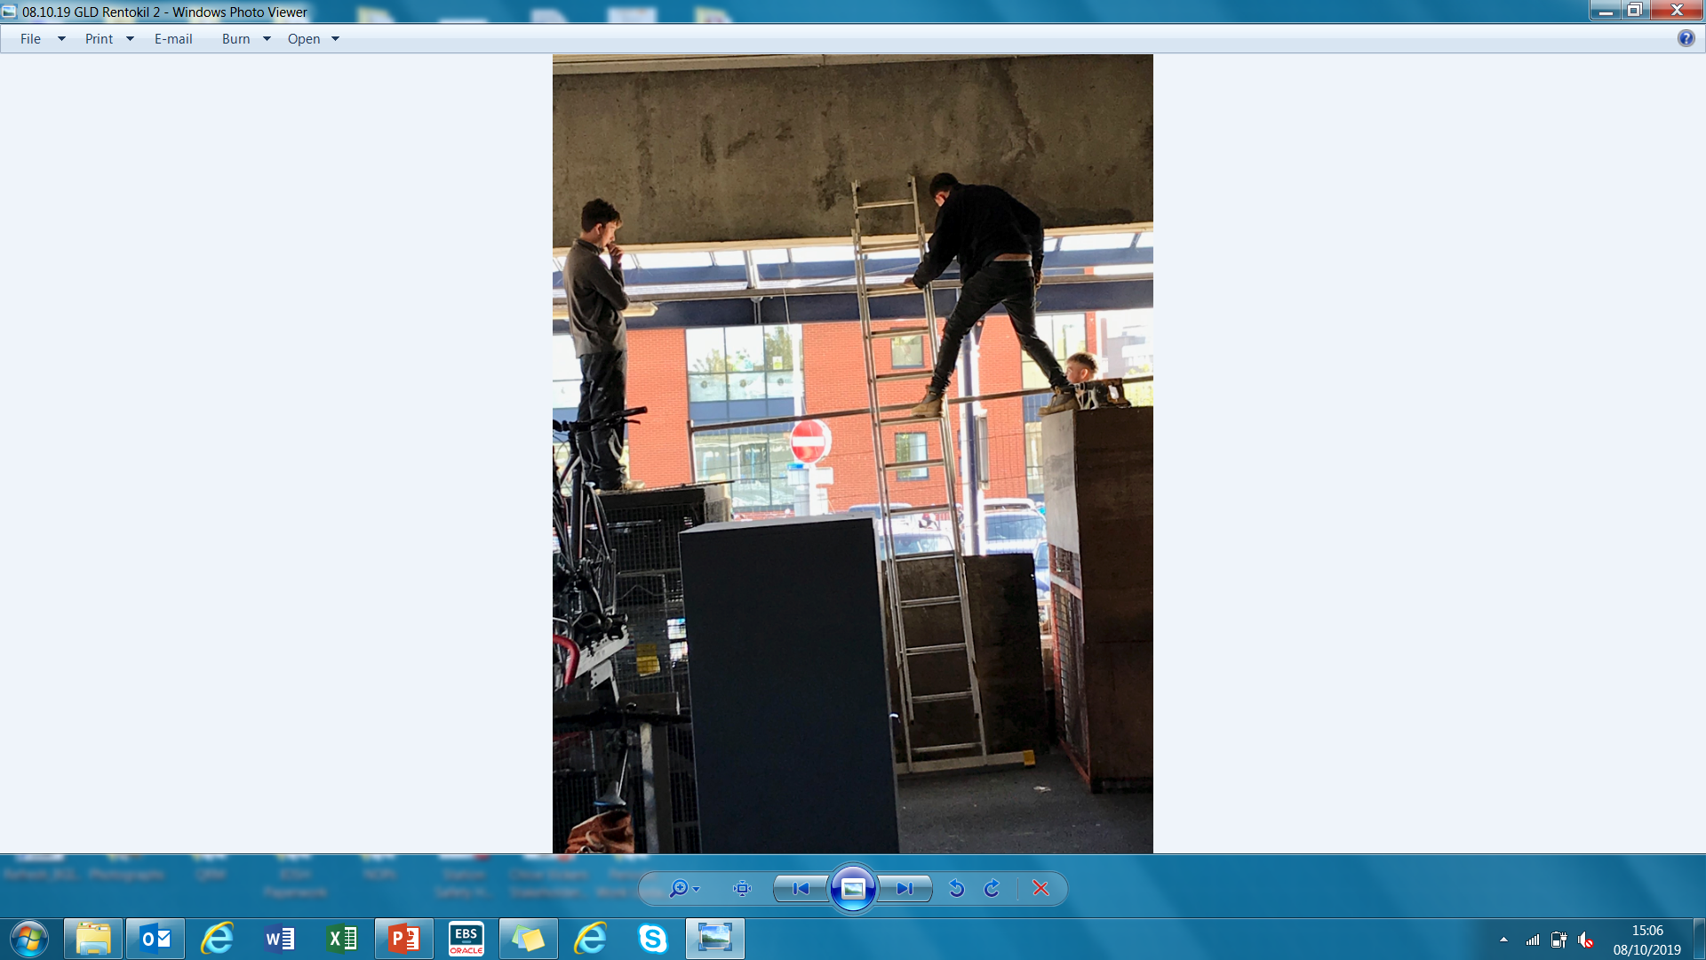
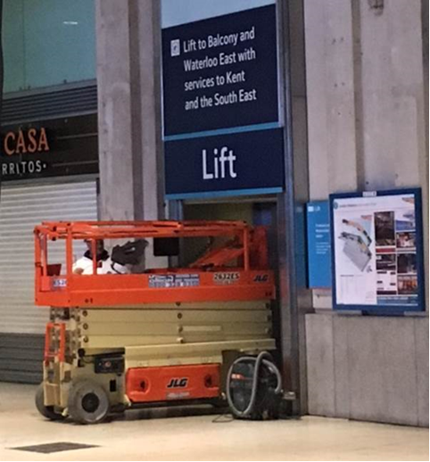

Workforce Safety
Unsafe Working Practices
Items for discussion:
We all have a moral and legal responsibility for our own health and safety and those who may be affected by our actions!
Do you plan and risk assess your work activities including routine tasks?
Do you feel empowered to challenge unsafe work, and what is your attitude to being challenged?
Why do you think this team thought it was acceptable to work like this?
Are we doing enough to support and encourage our teams to “Take 5” and invoke a Worksafe procedure if they feel something is unsafe?
08/10/19 – Guildford Station
The Station Interface Manager for Guildford station stood down members of workforce and asked them to leave the station as they were working unsafely whilst installing pigeon netting at the station.
06/10/19 – Waterloo Station
A contractor attending to reports of a leaking on the upper concourse, overloaded a passenger lift with a scissor lift, which resulted in a fault while the station was in operation

Slide 7
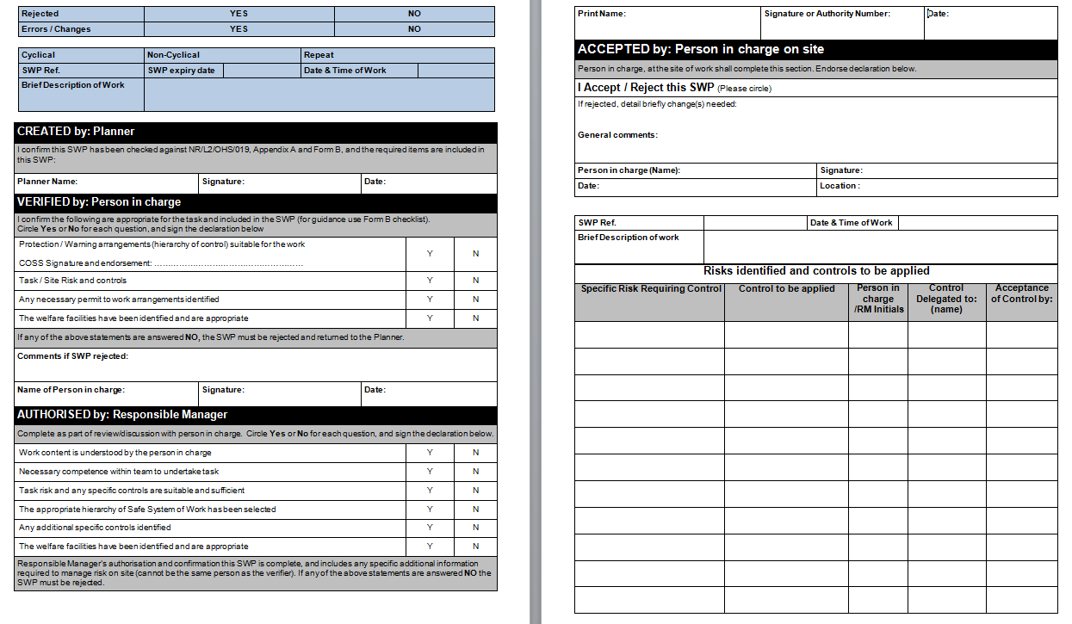
Workforce Safety
SWP’s and issuing of an authority number
There are only four instances when a deviation from a pre-planned SWP is permitted and must be authorised by the Responsible Manager (RM)/On Call Manager.
These instances are:
Change of the Person in Charge (PiC) on the shift, due to unforeseen circumstances. The PiC must have sufficient time to verify the SWP
Change from an authorised level of the hierarchy of operational risk control and implementing a lower level
Significant change of the task risk on the shift
Change of the site of work from the pre-planned site of work if the task risk remains the same
Please use our 019 Authority Number App to generate your authority number.

Slide 8

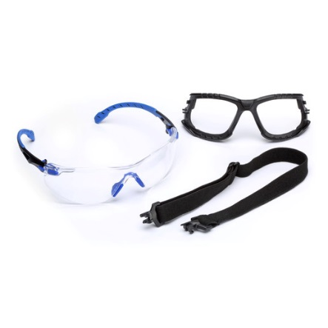
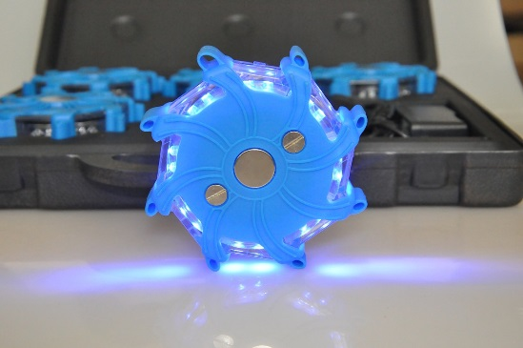
Workforce Safety
Site Safety Support Team Update
Our maintenance SSS team has visited a number of different sections across both the Inner and Outer DU since they started 5 weeks ago.
The team spend a week with the night duty teams, focusing on relationship building, safety behavioural change through encouraging individuals and sections to work together and promoting peer group engagement for long term change.
The common issues that the team come across are around wearing of PPE e.g. glasses and gloves and the lack of adequate lighting on some sites. Numerous pairs of safety glasses and cut 5 gloves were issued by the SSS team to the night staff together with some “Night searcher” hazard LED lights
We are in the process of constructing the ultimate section kit guide that will be made available to all the sections. Please get in touch if you have any suggestions on what should be included!

Slide 9
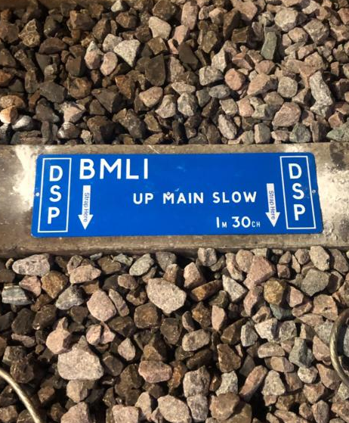
Workforce Safety
Good News Story - Designated Strapping Points
Designated Strapping Points (DSP) signs have been installed on sleepers at key locations around Waterloo which are used for short circuit strapping.
This aids possession support staff to identify these locations quickly, particularly where the layout is complex or the mileage is difficult to determine.
These signs are track mounted and have a blue background with white text detailing the location of the strapping point.
More information can be found on the link below, alternatively you can contact Matthew McEwen - Matthew.McEwen@networkrail.co.uk
DSP - Installation Notice_.pdf

Slide 10
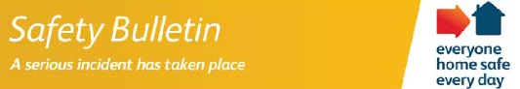
Workforce Safety
HV Cable Strike - Updated bulletin
Ref: WDSER01OCT01
Date of Issue: 1 October 2019
Location: Clock House
Discussion points:
Overview
An alert was issued on 26 September regarding a contractor working on behalf of South East Works Delivery, who was carrying out the installation of lineside fencing and struck a live 11Kv UKPN cable.
The IP received burns to his hands and is receiving ongoing medical treatment via outpatient care for the injuries sustained.
The incident is part of an ongoing investigation between Works Delivery and the Principal Contractor; both parties are also working in collaboration with the ORR.
•Do you undertake sufficient checks to understand the cables and type of services which are present on site? i.e. desktop survey, site investigation, physical identification (trial holes and/or tracking devices etc)?
•Guidance on working near and/or above HV cables can be found within NR/L3/ELP/22001 and near buried services within NR/L2/INI/CP1030. Overall guidance can be found within HSE booklet HS(G) 47, which can be downloaded free from HSE website
•How are delivery teams made aware of the dangers of buried and hidden services in the work area?
•Do your teams know how to challenge when something on site doesn’t feel safe?
•Are teams fully briefed and inducted to locations to ensure full understanding of risks, controls and mitigations in place?

Slide 11

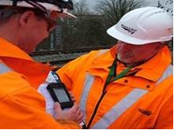
Workforce Safety
Managing staff competence
Issued to: Network Rail line managers
Ref: NRA19-12
Date of issue: 27/09/2019
Location: National
Contact: Network Rail Training
Immediate action required
Everyone with a Personal Track Safety competence or Industry Common Induction can and should have their Sentinel cards scanned by a COSS or card checker to ensure that competences are valid. This should be repeated before each shift. If the competences required cannot be seen, the individual should be denied access to work on the infrastructure and directed to contact their line manager.
Check that all individuals appointed as Skills Assessor are trained and competent to undertake this role.
Discuss why is it important to have an ACC and understand which line manager is accountable for ensuring the ACC process is followed.
Discuss the Skills Assessment Scheme and ACC process and how this helps you remain compliant with the Life Saving Rule.
Review the ACC status of all your team. Where the ACC status is 'Critically Overdue' or 'Completion Failure', corrective action must be taken in accordance with NR/L3/CTM/306/01.
For help and support with conducting ACCs and managing competence please contact your local CDS (Competence Delivery Specialist) or Training Evaluation and Assurance Specialist. Further information can be found on the Skills Assessment Scheme page on MyConnect or by emailing the Skills Assessment mailbox.
For enquiries specifically related to Sentinel please email the Sentinel Helpdesk or phone 24/7 on 0330 7262 222.
Overview
During a recent audit, two key areas of concern were found relating to the Skills Assessment Scheme (SAS). The requirement to carry out an Annual Capability Conversation (ACC) was not being followed and non-competent Skills Assessors were being used.
The Skills Assessment Scheme is an essential element of Network Rail's competence assurance process, outlining the way competences are gained, maintained and renewed.
The ACC is a formal conversation between an individual and their line manager and is a mandatory requirement in the Skills Assessment Scheme. It determines an individual's Authority to Work.
An ACC is classed as 'Critically Overdue' if it has not been held for 18 months and competences are suspended on the Sentinel system. Once competences are suspended on Sentinel, the individual does not have an Authority to Work on or near the line. If they work this is in breach of the Life Saving Rule 'never undertake any job unless you have been trained and assessed as competent'.
The ACC status changes to 'Completion Failure' after 21 months, and ALL SAS competences must be ended in Oracle Competence Manager by the line manager, resulting in the need for retraining if the competences are still required.
The Skills Assessment Scheme standard, NR/L3/CTM/306, outlines how competences that fall within its scope should be managed.

Slide 12
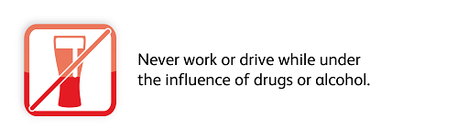
Workforce Safety
Be aware – Medical cannabis and cannabis oil
Medical cannabis" is a broad term for any sort of cannabis-based medicine used to relieve symptoms.
Many cannabis-based products are available to buy online, and some, such as "CBD oil" or hemp oil, are available to buy legally as food supplements from health stores.
In order to be sold in the UK, it must contain less than 0.2% THC which is deemed not to cause psychoactive effects.
The use of CBD oil is not advisable for any Network Rail employee, due to a lack of definitive evidence that performance or judgement is not impaired. Furthermore, the rail industry does not support the use of CBD oil.
If you currently take CBD oil it is recommended that you speak to your GP to understand all potential side effects and request that your line manager refers you to occupational health.
Network Rail has a zero tolerance to drugs and alcohol at work. Should you take CBD oil, you could be at risk of failing a drug and alcohol test.
DON’T GET CAUGHT OUT!
For more information please refer to CBD-Oil-FAQ-STE.pdf

Slide 13
Safety Bulletins, Alerts, Advice
Safety-Bulletin-NRB19-13-On-Track-Machine-Runaway-at-Taunton-Operating-Base.pdf
Safety-Bulletin-NRB19-15-Insecure-access-points.pdf
Safety-Bulletin-NRB19-14-Injury-to-a-member-of-the-public.pdf
Safety-Bulletin-NRB19-16.pdf
Safety-Advice-NRA19-11-Stop-use-notice.pdf
WDSER011019 - HV cable strike updated bulletin.pdf
Product Recall Notice - Teufelberger Braided Safety Blue, T-VEE with Slaice.pdf
DSP - Installation Notice.pdf
Lessons learnt STF ankle injury at Fullwell.pdf
Lessons learnt - Heater incident.pdf
mind-wellbeing-index-a4-landscape.pdf
mind-wellbeing-index-a4-portrait.pdf

Slide 14
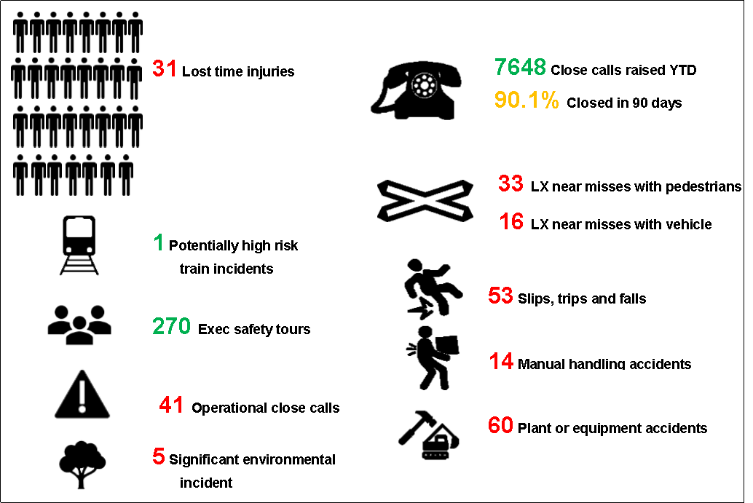
Infrastructure Plant Manual
Plant Operations Scheme (POS) Representative
The POS Representative (POS Rep) can act as Machine Controller / Crane Controller (MC/CC) if there is only one item of OTP at the site of work. If there are multiple items of OTP, then a ‘standalone’ POS Rep is required.
We have a derogation in place (34325) to permit the POS Rep to undertake the duties of Controller of Site Safety (COSS) and Person in Charge (PIC) for the OTP only on single machine sites.
The POS Rep can not undertake the duties of PIC for another workgroup or the duties of Engineering Supervisor (ES).
On Track Plant and POS information can be found on the Wessex Plant HUB.
The On Track Plant Team would be happy to come and brief this information to you if required – please contact us using details below.
Keith Penn
RPSE– Wessex
M: 07739779590
E: keith.penn@networkrail.co.uk
Luis Williams
Area Plant Manager – Wessex
M: 07732 644671
E: luis.williams@networkrail.co.uk

Slide 15



Environment
Wessex Ecology Survey Report Register
Large numbers of ecological reports are commissioned every year by multiple parts of the Wessex route and Network Rail as a whole. This can lead to unintentional and inefficient duplication.
Although an ecological survey has 2 year period during which it is valid, an older survey can still act as an indicative guide in the early stages of work planning.
Currently Wessex Route has a register of 30 ecological surveys that is held on the Wessex Route Environment Hub’s Protected Sites and Species page. The more surveys added the more valuable the register will become as a resource.
There is also ongoing efforts to collate Route and Capital Delivery surveys on to GeoRINM by the central Network Rail Environment Team. The Wessex route register will feed into this.
ACTION REQUIRED:
Forward all newly received ecological surveys to the Wessex Route Environment Specialist for collation.

Slide 16

Health & Wellbeing
Free flu vaccination for all Network Rail employees
Wessex Programme:
Flu vaccination programme will run from the 14th of October to the 31st of December
Wessex Route is offering a voucher only programme
Last date a voucher can be ordered is the 23rd of December
Voucher holders will receive their vaccinations through their nearest participating Boots pharmacy
How to get your free flu voucher?
Email NR.Flu@optimahealth.co.uk with the following information:
  Your name
  Your job title
  Your role location
  Your email address
Optima Health will process your request and email you a voucher for use in Boots within 72 working hours. Including details of how to book your appointment via the Boots website.
Poster to be displayed around your depots can be found here - Free Flu Vaccination Poster.pptx
FAQ can be found here - Flu Vaccination Final Briefing note and FAQs.pptx

Slide 17
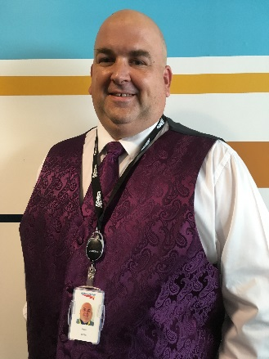
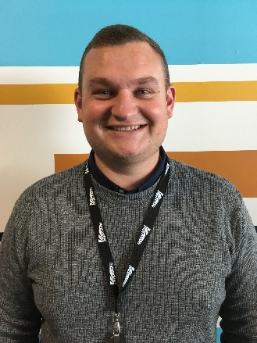
New members of Wessex Area Services Team
Luis Williams
Working with Keith Penn RPSE and the wider plant community within the Southern Region, Luis and his team will be supporting the Delivery Units and Works Delivery organisation with their On Track plant and Plant Operation Scheme (POS) requirements along-with providing the route with compliance and assurance monitoring.
Luis has a vast knowledge of on track plant, with previous experience working for Ready Power, TRS and more recently Balfour Beatty.
David Griffith
Reporting to the Area Plant Manager, David will be working primarily in the Wessex Inner DU, and will be supporting the route to achieve compliance with the On-Track Plant Operations Scheme (POS).
David joins us following a 27 year career in both the Wiltshire police and London Metropolitan police.
Area Plant Manager
On Track Plant Specialist

Slide 18
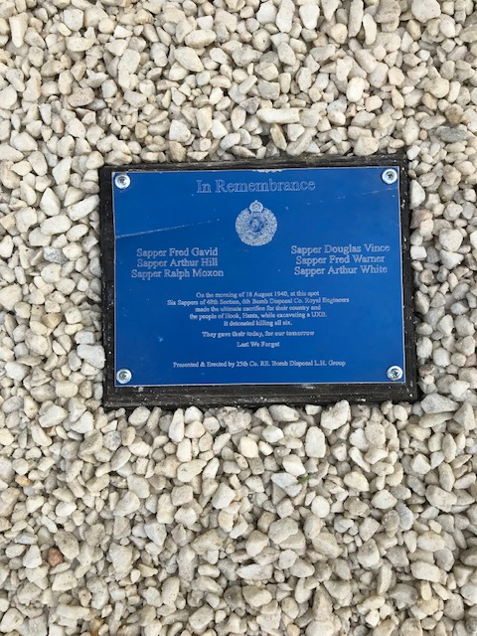
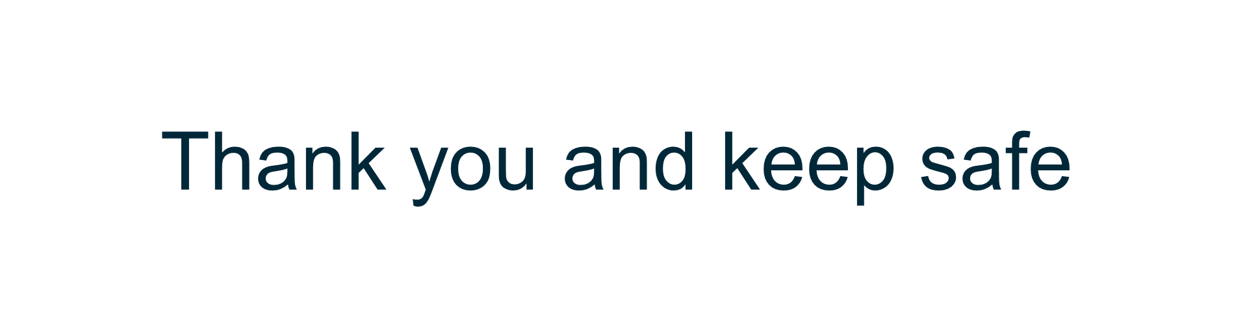
Thanks and recognition to Richard Burt and Ron Gaylor from the Telecoms maintenance teams, who have recently restored a WW2 memorial near Crown Lane Down Access Point.
This cross and plaque commemorate the sacrifice of 6 soldiers from 6th section of the 48th Bomb Disposal Company, Royal Engineers who lost their lives whilst trying to defuse a bomb near Hook Railway Station on the morning of August 18th 1940.
Please contact Ron Gaylor if you would like any further information regarding this historic event.

