Slide 1
Everyone Week
Epilepsy – Fitting In
Karl Bates

Slide 2
Epilepsy Within The Workplace – The Facts
66% of people with epilepsy are uncomfortable talking about their condition with their employer
A YouGov survey shows 26% of workers in the UK would be concerned about working with someone with epilepsy, with 63% saying this was because they would not know what to do if a co-worker had a seizure.
Notes:
This is why I am really keen to speak out about Epilepsy and also why I think First Aiders need to know what to do if someone has a seizure, as you will see in the presentation it is a very high number of people who live with the condition and also you will be glad to know it is VERY easy to administer first aid to someone having a fit

Slide 3
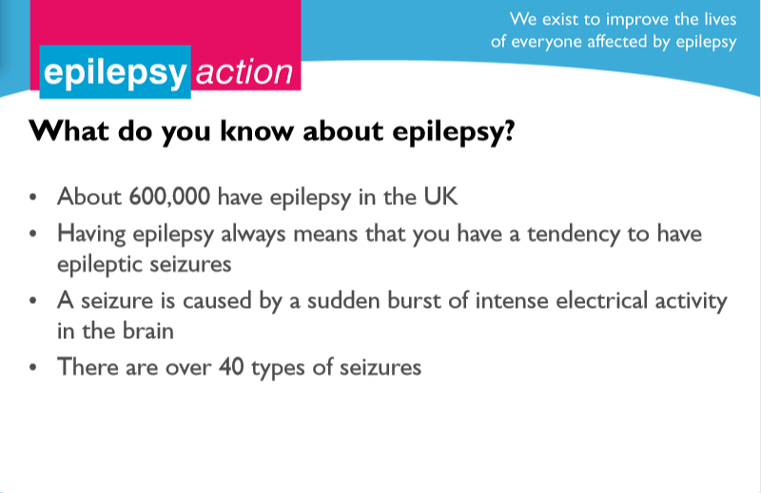
Notes:
Telephone Switchboard example

Slide 4
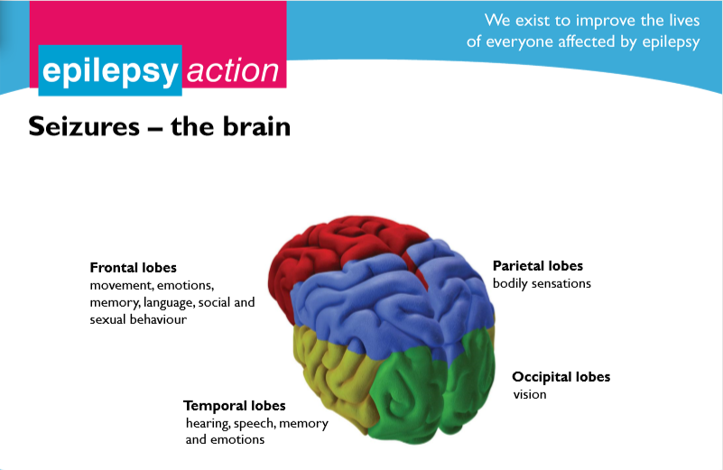

Slide 5
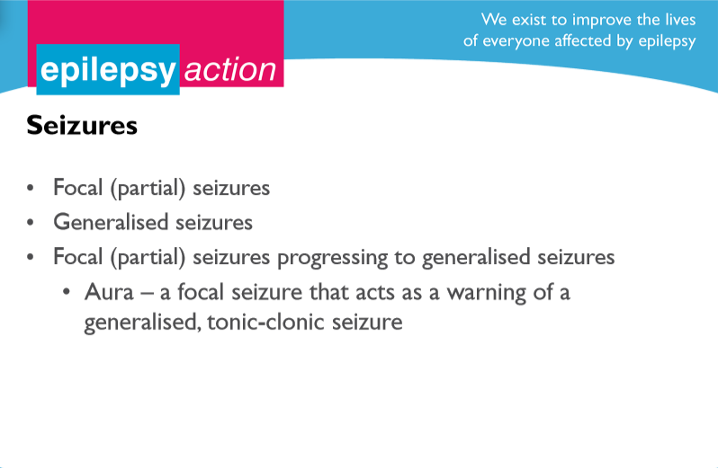
Notes:
Focal Partial Seizure
Generalised Seizures – Will be talking about on next page

Slide 6
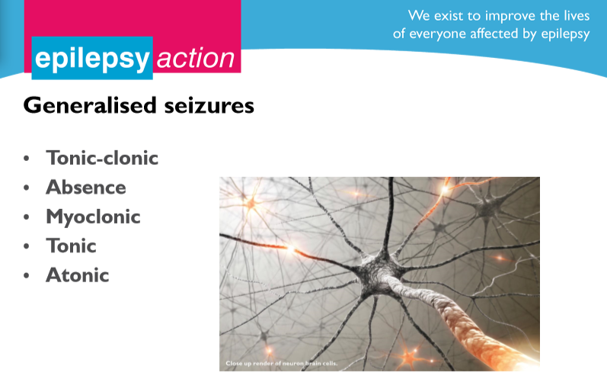
Notes:
Tonic-Clonic
Person loses consciousness & falls to the floor
Body stiffens as all muscles contract
Breathing pattern changes
Person may bite tongue & the inside of cheeks
Muscles contract and relax, limbs jerk
Post-ictal state – tiredness, confusion, memory loss, confusion, headache
Absence
The old name for an absence seizure is a petit mal seizure
Is often mistaken for lack of attention or other misbehaviour
Can occur many times a day & can take weeks to months before they are picked up on
They interfere with school & learning
They only last a few seconds & often involve staring episodes
Myoclonic
Myo = muscle, Klon-nus = means jerking or twitching of a muscle
The sudden jerking or twitching of a muscle or group of muscles
You can have 1 episode or many in a row & can last as long as a few minutes
Usually you are awake & able to think clearly during an episode
Even people without epilepsy can experience Myoclonus in hiccups or in a sudden jerk that may wake you up as you’re just falling asleep – this is normal
Myoclonic seizures usually cause abnormal movements on both sides of the body at the same time
Tonic
The body, arms or legs will suddenly become stiff or tense
A person may have only a small change in awareness during an episode
Usually happens whilst the person is asleep, affecting both sides of the body
They are usually short, less than 20 seconds
The person may fall if standing when the episode starts
Atonic
Means loss of muscle tone, with the person’s head or body going limp – also known as drop attacks – falls like a rag doll
If standing the person often falls to the ground
Typically last less thank 15 seconds
Usually begins in child-hood – may last into adult-hood

Slide 7
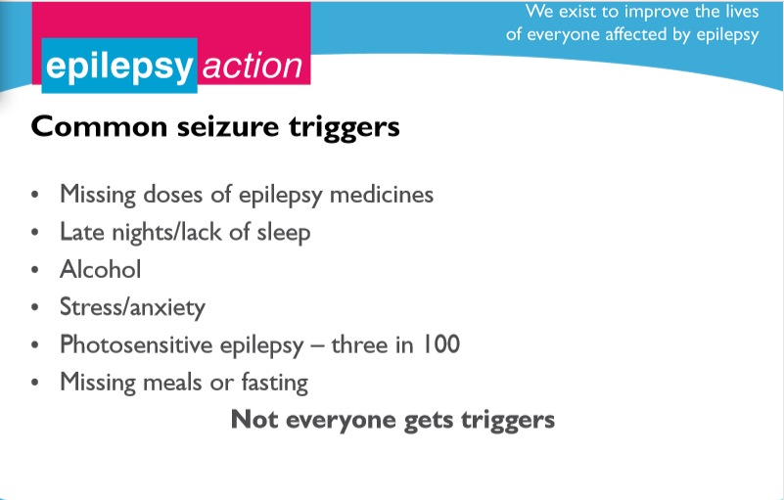

Slide 8
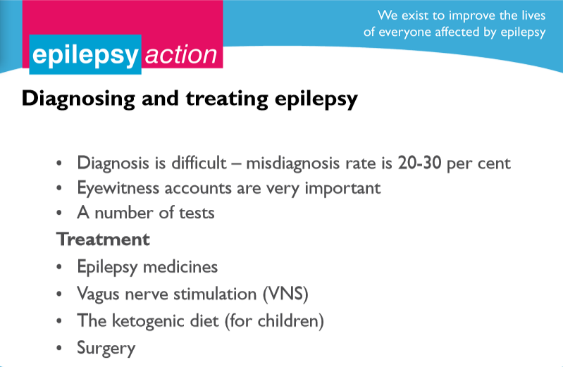

Slide 9
Managing epilepsy – the seizure
First aid for tonic-clonic seizures –
do
Protect the person from injury
Cushion their head
Aid breathing by gently placing them in the recovery position when the seizure has finished
Stay with them until recovery is complete
Be calmly reassuring
Notes:
Catch Them – Help them to the floor
Once they are on the floor, in a safe position, then call 999
If you remember and want brownie points from the emergency services, note what time the seizure started

Slide 10
Managing epilepsy – the seizure
First aid for tonic-clonic seizures –
don’t
Restrain the person’s movements
Put anything in their mouth
Try to move them unless they are in danger
Give them anything to eat or drink
Attempt to bring them round

Slide 11
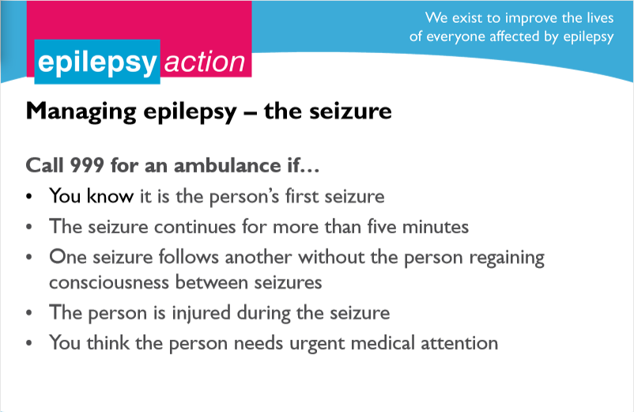

Slide 12
Surprising Facts about Epilepsy
Only in about 30% of cases is the cause of epilepsy determined. The other 70% remain unanswered, in what is referred to as idiopathic epilepsy
Notes:
.

Slide 13
Surprising Facts about Epilepsy
You cannot swallow your tongue during a seizure; you cannot swallow your tongue now, can you?
Notes:
.

Slide 14
Surprising Facts about Epilepsy
What percentage of epileptics are sensitive to flickering light, or photosensitive epilepsy?
0% - 25%
26% - 50%
51% - 75%
76% +
Surprisingly, Only 5% !
Notes:
.

Slide 15
Surprising Facts about Epilepsy
In the UK, 600,000 or one in every 103 people has epilepsy.
Every day in the UK, 87 people are diagnosed with epilepsy
Around five people in every 100 will have an epileptic seizure at some time in their life. Out of these five people, around four will go on to develop epilepsy.
Notes:
.

Slide 16
Surprising Facts about Epilepsy
Epilepsy is usually not a lifelong disorder, with only 25% of those who develop seizures developing difficult to control seizures. And in my experience, those who have lifelong seizure disorders have more serious conditions at play
Notes:
Introduce yourself.
Give brief explanation of your role.

Slide 17
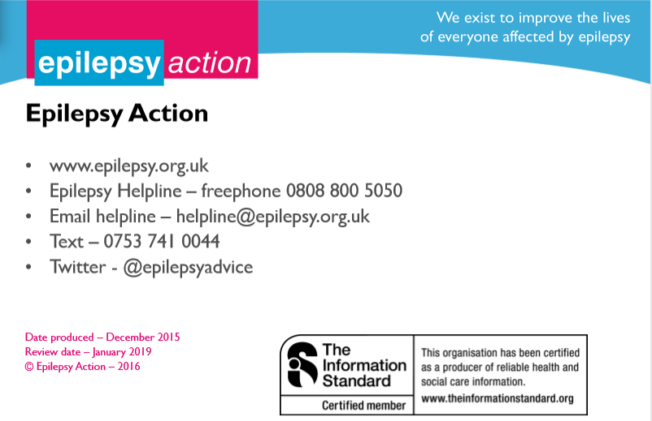

Slide 18
“Epilepsy is a condition I LIVE with
not an illness I SUFFER from”

Slide 19

I hope this has helped you in someway understand a very misunderstood condition……Thank you for listening
Any Questions ??
Notes:
Involve the audience
Ask what they know about epilepsy, going through each question.
Answers
Around 600,000. About 87 new cases are diagnosed each day.
A tendency to have recurrent seizures.
Over 40 different types of seizure
At any time. You don’t have to be born with it – any of us could develop epilepsy at any time in our lives. 1
1. Joint Epilepsy Council, JOINT EPILEPSY COUNCIL - Joint_Epilepsy_Council_Prevalence_and_Incidence_September_11_(3).pdf. Available at: http://www.epilepsyscotland.org.uk/pdf/Joint_Epilepsy_Council_Prevalence_and_Incidence_September_11_(3).pdf [Accessed December 16, 2015].

