Slide 1
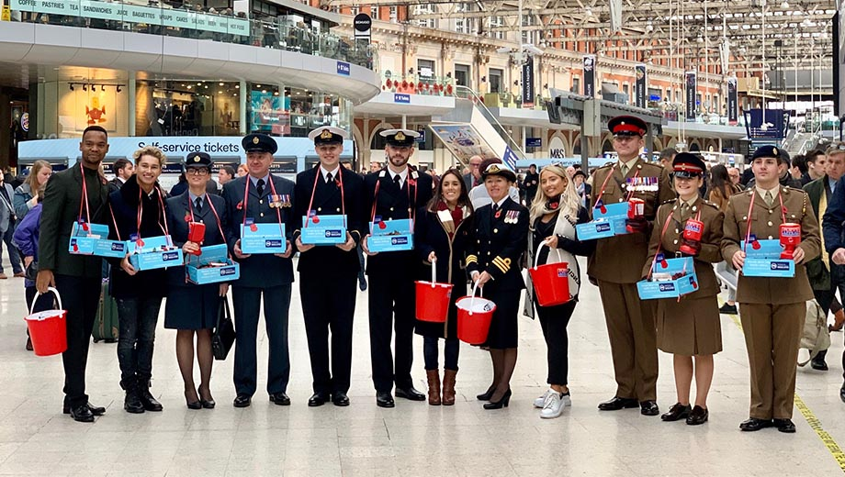
Health, Safety and Environment Period Cascade for P08 2019/20 Wessex Route

Slide 2
Content
Welcome to your Health, Safety and Environmental Cascade for Period 08 2019/20. Please discuss and share the items that are relevant to your teams and display any relevant Safety Bulletins or Lessons Learnt on your notice boards.
Front line focus Episode 88 can be found here
Swale Near Miss Cut 2 can be found here
Significant Workforce Events
Road Traffic Collision at Epsom resulting in a LT accident
Operational Close Call – Electrical Flashover at Wimbledon Park Depot
Finger laceration whilst carrying out a drainage survey
Shared Learning – Near Miss with a track worker
Winter Safety Brief
Driver Safety – Seat Belts
Mandatory PPE
Plant Manual Update
Community Safety
Environmental Update
Health and Wellbeing

Slide 3





Workforce Safety
Finger laceration x 2
25/10/2019 – During a drainage survey the IP was searching for a drainage cover obscured by soil and leaves when he cut his left hand index finger on a sharp piece glass NLT
25/10/2019 – The IP was lining up a weld when he accidentally struck his left hand index finger with a hammer causing a deep laceration NLT
Discussion: Do not place your hands where you can’t see the hazards, task appropriate gloves to be worn, situational awareness
Slip, Trip & Fall
25/10/2019 – The IP slipped and fell over whilst walking across a wheeltimber bridge. The underfoot conditions were wet and slippery and no anti slip board was installed NLT
Discussion: Are you aware of any other bridges where anti slip is missing? Report any unsafe locations, missing anti-slip boards immediately
Manual Handling
29/10/2019 – Whilst on light duties in the depot, carrying out some preparation work for the weekend, the individual twisted his back and aggravated a pre-existing issue
Discussion: Is your line manager aware if you have any pre-existing condition or are restricted when carrying out some duties? Do you use the correct manual handling technique? Remember avoid, assess, review
Road Traffic Collision
06/11/2019 – The IP was a passenger in a NWR van when he suffered a whiplash. More details in the cascade LT
Significant Events in the Period

Slide 4
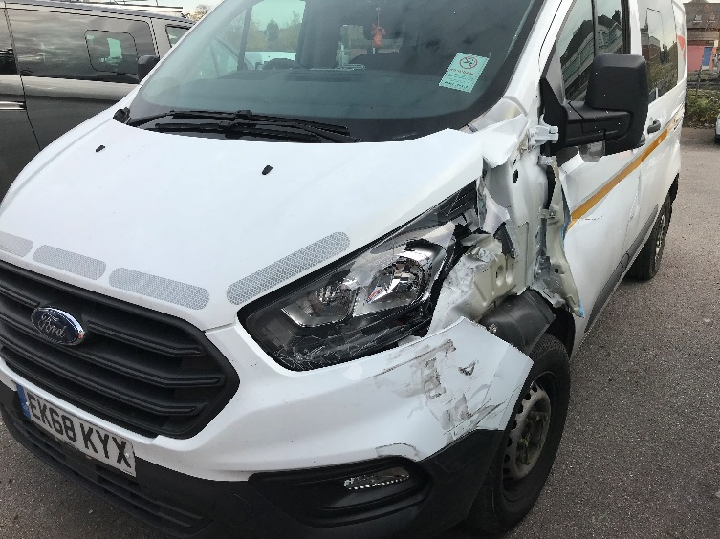
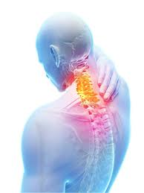
Workforce Safety
Road Traffic Collision resulting in a LT accident
On Wednesday 6th November 2019 a Team Leader from Wimbledon P-Way was a passenger in a Network Rail vehicle that was involved in a Road Traffic Collision (RTC).
The NR vehicle collided with the back of an unmarked van illegally parked on the one-way system in Epsom, half on double yellow lines and half on the pavement. The driver believed there was enough space for him to get past.
Following the collision, the injured person (IP) reported having a stiff neck and soreness in his left shoulder. It was later discovered that he had pulled two muscles in his neck and was signed off work for one week with anti-inflammatories and painkillers.
The NR vehicle suffered much greater damage than the 3rd party van.
Items for discussion:
When a moving object collides with a stationary object an impact force is exerted by one object on the other.
Expect the unexpected. Not all hazards can be anticipated.
Our logo is emblazoned on our vehicles and other traffic users know who we are, we are not so lucky with some other road users.
Full Lessons Learnt can be found on this link
Notes:
Park with consideration to others
Drive courteously
Obey the speed limit
Never use a mobile phone or handheld device while driving

Slide 5
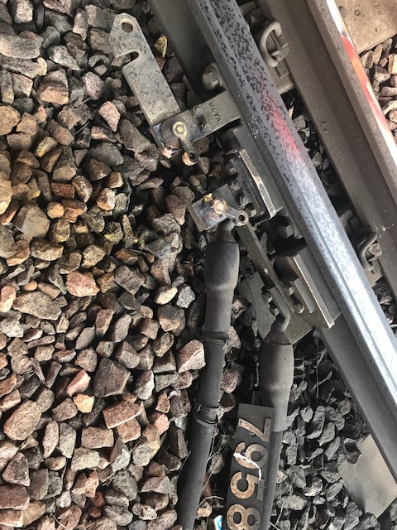
Workforce Safety
Operational Close Call - Electrical Flashover
On Sunday 3rd November at 0830 hrs : An Authorised Person (working for SWR) requested and was given authority for a local isolation for Wimbledon Park Depot reference WD/ISO/BF, this isolation involved closing H/S 7958 as an alternate feed before opening any circuit breakers or any other switches.
He removed the sleeve from the blade of H/S7958 and using an insulated H/S pole whilst wearing rubber gauntlets applied the pole to the eyelet of the H/S, this immediately resulted in an electrical flashover but luckily no injuries were sustained.
The ECRO realised that H/S 7958 was affected by an existing isolation for a possession including the Up Slow Line Item 53.
This operational close call is currently under investigation but it was established that there was no prior arrangement for the local current isolation request
The isolation for Item 53 was already in place when a shift handover between the ECRO’s occurred on Sunday morning

Slide 6
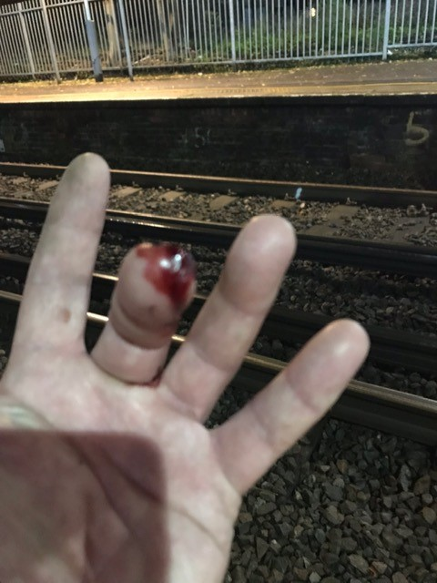
Workforce Safety
Finger laceration during a drainage survey
On the 25 October 2019 a member of Wessex Works Delivery Off Track was carrying out a drainage survey at Kew Bridge. The injured party (IP) was clearing some leaves and soil with his hands to try and find a buried catch pit.
A piece of broken glass that was hidden from view cut his left hand middle finger.
The IP was wearing gloves at the time of the event. These were not Cut 5, but a more waterproof glove due to the nature of the task.
Wound was cleansed and first aid applied then IP returned to task.
Items for discussion:
Should the IP be using his hands to clear around the catch pit?
Do you ‘Take 5’ before, during and after a task, to risk assess the hazards and discuss how the task will be done safely?
What would have happened if it was not glass but a dirty needle?

Slide 7
Workforce Safety
Near miss with a track worker
Ref: NRL19-14
Date of issue: 21/10/2019
Location: Between Horley & Gatwick Airport Station (Southern)
Overview
At 23:24 hrs on 2 December 2018, a track worker narrowly avoided being struck by a train between Horley and Gatwick Airport stations.
The track worker was a controller of site safety (COSS) and moved out of the path of the train, around one second before it reached him, when it was travelling at around 35 mph.
Key message
• It is essential that track work is undertaken in accordance with the approved safe system of work.
• Challenging inappropriate safety behaviours, and applying a work safe procedure, are essential for everyone's safety.
• Safe work planners must seek additional information to plan tasks safely.
• The value of sounding the train horn as a warning if drivers see people in, or possibly in, a position of danger was demonstrated during the Gatwick incident when it almost certainly saved the life of a worker involved. The rule book requires the warning to be given as repeated short horn blasts.
Underlying causes
BAM Nuttall planners lacked the information needed to establish the exact location of work.
The planners lacked the skills and experience and the system of work provided no protection from train movements at the actual location.
The COSS recognised the lack of adequate protection from train movements but undertook the task regardless. He wasn't challenged by his colleague.
NR isolation processes did not provide planners outside NR with sufficient information in order to plan safe systems of work.

Slide 8
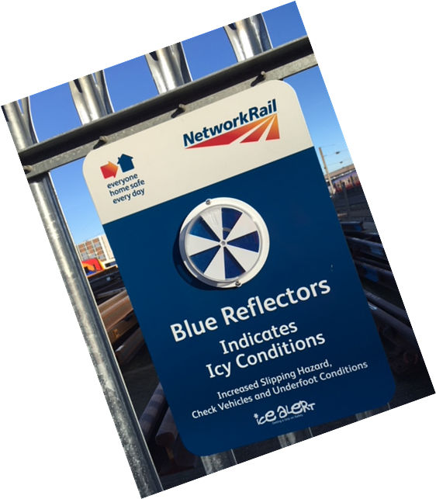
Workforce Safety
Look out for each other this winter
Winter safety advice can often tell us things that we already know.
For example, we all know that pavements and roads become slippery in cold and wet weather, and we should take extra care.
Even though we know this, more accidents happen in the winter months because many of us forget the risks we take when we’re in a rush.
We need to look out for each other and highlight dangers to make sure that we all get home safely every day.
The full Winter Safety Brief covers the following topics:
Winter driving
Slips, Trips and Falls
Drugs and alcohol
Mental Wellbeing
and can be found on the this link - Winter-Safety-Brief
Do you have the Icy Conditions Indicator displayed in your depot and is it in a good condition?

Slide 9
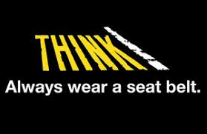
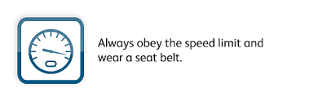
Workforce Safety
Driver Safety – seat belts
Please take into account that the failure to wear a seat belt is a ‘Life Saving Rule’ breach and is against the law.
Anyone in breach of this LSR is putting their life at risk.
In a crash you're twice as likely to die if you don't wear a seat belt.
Drivers and passengers aged 17-34 have the lowest seat belt-wearing rates, combined with the highest accident rate.
People are less likely to use seat belts on short or familiar journeys – putting them at serious risk of injury in a crash.

Slide 10
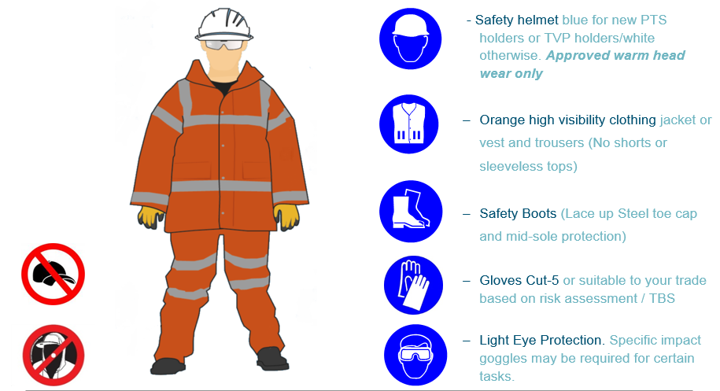
Workforce Safety
Mandatory Personal Protective Equipment for Network Rail staff (additional PPE may be required as per your task risk assessment)

Slide 11
Safety Bulletins, Alerts, Advice
Shared-Learning-NRL19-14-Near-miss-with-a-track-worker
NRA19-13-Access-gate-safety
Lessons learnt - RTC at Epsom 061119
NR OPS 063 Passenger train signalled through line blockage at Queenstown Road Station
NR-OPS-064 Thameslink Line Blockage Irregularity
NR-OPS-065 Charing Cross Line Blockage Irregularity
NR-OPS-066 Grove Park Line Blockage Irregularity
NR-OPS-068 Asfordby AHBC Irregularity
Transferable Lessons - Stoke Gifford 25-10-2019
TSA-Trolleys-poster-2019_11-09-003

Slide 12
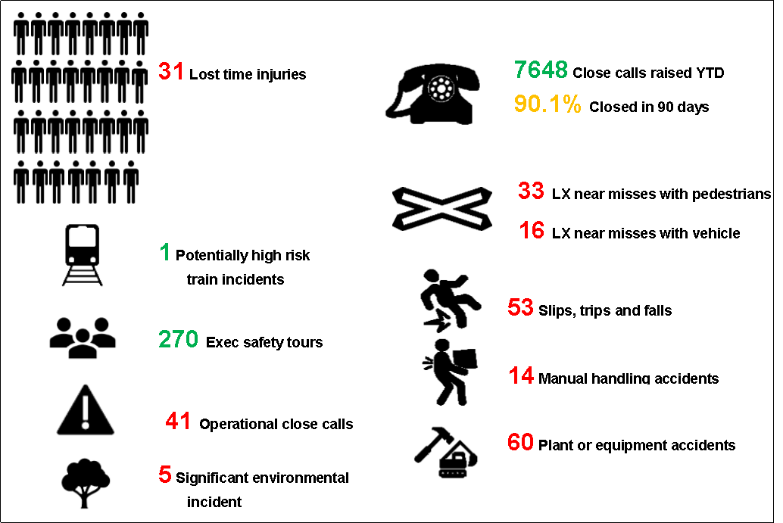
Infrastructure Plant Manual
Plant Road Rail Access Points (RRAPs)
IPM NR/PLANT/200 module P301 States:
Fig 8 Level Crossing
Road rail access points (RRAPs) are either semi-permanent or temporary.
See the examples, Figure 8 to Figure 12.
NOTE 1: If using a level crossing as a RRAP, unobstructed road width is required to allow two-way traffic flow. Where such widths cannot be provided, traffic control will be required.
NOTE 2: Temporary Timber Decking (also known as Bog Matting) needs to be restrained, supported and removed at the end of the possession and a specific risk assessment must be carried out by the POS provider.
NOTE 3: The minimum requirement for OTP to on track at a RRAP should be identified from any restrictions there may be on the machines engineering certificate, requirements within the Operations manual or specification. The most appropriate access for use to be identified.
Lineside cables shall be protected, suitably supported and retained to mitigate the risk of crushing, cutting, stretching or any other foreseeable damage.
Information about Wessex access points can be found on the Wessex Access Points Web site
Link: Access Points (if you require login, please speak to Adam Stewardson)
For more information contact the Wessex Plant Team: WessexOnTrackPlant@networkrail.co.uk
Fig 9 Depot or Yard
Fig 10 Secured Timbers
Fig 11 Consolidated Ballast
Fig 12 Temporary track access systems
Notes:
Note 1 – refer to Code of Practice Safety at Street Works and Road Works published by the Department of Transport
Note 3 – Each specific item of plant may have different minimum requirements, and this should be established as part of the planning process for OTP

Slide 13


Environment
Protected Sites and Species Standard NR/L3/MTC/EN0099
Standard Refresher: This maintenance standard released in 2008, details processes and responsibilities for reducing the risk of harm to protected sites and species. The standard covers;
Protected sites & species locations | Requirements for signage, planning checks and surveys
Site Management Statements (SMS) | Site specific conditions assented (approved) by Natural England for routine maintenance activities within protected sites.
Natural England Assent | Approval of works that have a potential to damage a protected site (above those detailed in a SMS)
Protected species licences | Approval of works that have a potential to damage protected species
Other licences and conditions | Such as those required to working on or over watercourses or liaison required when working on trees with Tree Protection Orders
ACTION REQUIRED: Remind or familiarise yourself with your responsibilities. Roles with defined responsibilities include; IMDM, Maintenance WHSEA and Section Manager. Additional roles to play in ensuring checks are made and conditions are met while on site. All staff have a responsibility to reduce the risk of harm to protected sites and species.
Notes:
For each it covers who is responsible for ensuring checks area carried out, applications completed, as well as communication of any applicable conditions in defined areas. Two decision flow charts are also included within the standard

Slide 14
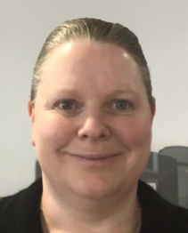
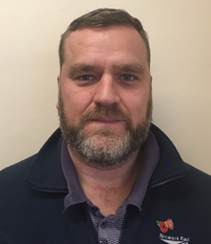

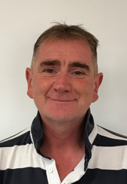
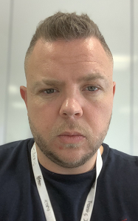
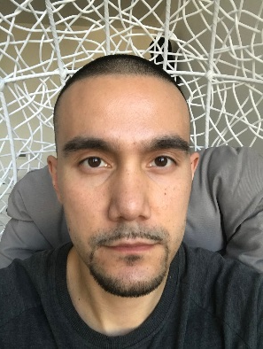

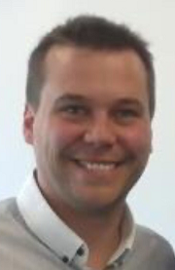

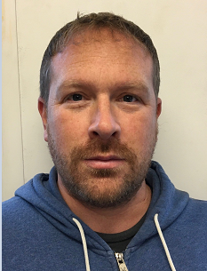
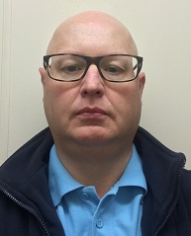
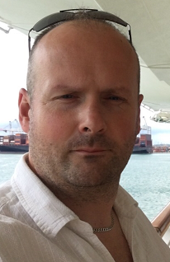
Health & Wellbeing
Please meet the latest group of our Mental Health First Aiders
Julie Emmerson
Janos Porcincula
Louis Dymond
Rebecca Green
Adam Biscoe
Lewis McDougall
Basingstoke ROC
Wimbledon ACC
Salisbury Depot
Eastleigh Depot
Yeovil Depot
Havant Depot
Steve Eastment
Karl Bates
Victoria Mckillen
Steve Fagan
Andrew Smyth
Alan Waterman
Basingstoke ROC
Waterloo
Eastleigh Depot
Eastleigh Depot
Wimbledon Stable
block
Wimbledon Stable
block

Slide 15
Health & Wellbeing
There is still time to request your free Flu vaccine voucher
It is a really simple process - email NR.Flu@optimahealth.co.uk with the following information:
Your name
Your job title
Your role location
Your email address
The window will close on the 23rd December 2019
Flu Campaign 2019 Poster

Slide 16

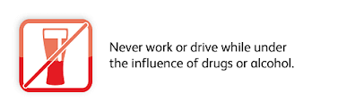

The Holiday Season is upon us, please enjoy it responsibly!
We want everyone to enjoy the Christmas holidays and the parties and celebrations that come with it. But it is imperative that we are fit for duty and not under the influence of alcohol and/or drugs.

