Slide 1
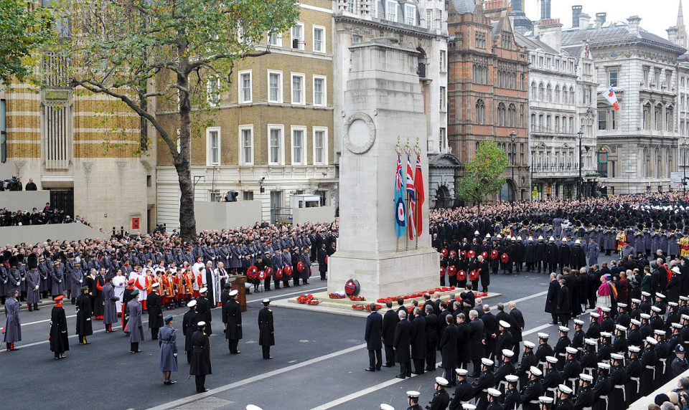
Wessex
Route
Network Rail
Health, Safety and Environment Period Cascade for P8. 2018/19

Slide 2
Welcome
Welcome to the Health, Safety and Environment Cascade for Period 8 2018/19.
In this cascade;
Fatal accident on South East Route
RMD statements
Safety Bulletin
Back to basics to keep safe
Lets talk Supervision
Workforce Accidents
Golden Hour
Slip trip fall accidents
Slip, trip & fall reminder
Lymington Viaduct (STF)
OCC – SCS application
Manual Handling injury
Health and Wellbeing
Epilepsy
D&A policy reminder .
Electrical Risk; Close Calls please
Driver reminder
Operational Bulletins

Slide 3

RMD statements following the tragic fatal accident last week in SE Route last week..
Dear colleagues
I have some very sad news to share below from the South Eastern route, where a colleague was fatally injured in the early hours of this morning while working on the railway.
The details of this tragic incident are still being investigated, but it is worth reflecting that we have had a number of recent high potential near misses on Wessex.
Please do take this moment to pause and think about your own safety, and the safety of those around you.
Becky Lumlock
Route Managing Director
Wessex
I have to inform you of the very sad news that one of our colleagues , a member of a possession delivery team employed by one of our contracting companies – has suffered a fatal accident while working for South East route.
The worker was struck by a train at Stoats Nest junction, between Purley and Coulsdon, at around 00.30 this morning.
After the initial on-site investigation the circumstances are still currently unexplained but, as you would expect, BTP, ORR and the Rail Accident Investigation Branch will be carrying out a full investigation.
The worker’s immediate family have been informed but BTP are not yet releasing any further details of his identity.
Naturally our thoughts are with his family and friends at this sad time.
It’s healthy to talk, so remember that Validium, our employee support service, is available 24 hours a day. If you need to speak to someone please contact them on 0800 358 4858.
John Halsall
Managing Director
South East Route

Slide 4
Workforce Safety PSS Staff
Wessex Route Comment:
PSS staff will only work in pairs,
PICOPs will check during briefing that the PSS are in pairs
PSS staff will make sure they report to the PICOP any change in circumstances

Slide 5
Wessex Route
Title: Back to basics to keep safe
Planners and Responsible Managers.
Are you providing your workforce with;
good quality information in the Safe Work Packs,
the best operational protection possible.
Has a PiC been identified and given the opportunity to verify the contents of the SWP within timescales?
Everyone.
‘Take 5’ for yourself and each other, stay and work together to keep safe.
Look after and communicate with rest of the group, be alert to any changing circumstances and pass the information to the PiC.
If anything changes before leaving the depot, on reaching site or during the work activity. Stop, think, assess - Take 5 and another 5 if you need to!
Person in charge (PiC)
Before you sign the SWP, ‘Take 5’ to check it before you ‘verify’ it, in particular;
the protection and/or warning system for the operational risk for the group under your control,
the location and layout of the infrastructure where you are going,
the access and egress points are the right ones for the site of work,
the right controls for any significant risks created by the task and the site.
At the site of work ‘Take 5’ to check if it reflects what you expected. If so, then you can ‘accept’ and enact the SWP. If not work through what the next steps are. Do you need to change anything and if so what does that mean?
‘Take 5’ to brief those under your control effectively. Has everyone in the work group been briefed clearly and do they understand what has been briefed and how it affects them.

Slide 6
Lets talk Supervision Because when something goes wrong this IS scrutinised
The HaSAW Act requires the employer to provide ‘supervision’ for its staff including contractors ‘as far as is reasonably practicable’.
The way we discharge this legal obligation is by Line Managers conducting either PGSIs or Senior Manager Safety Conversations.
It is important Managers conduct PGSIs/Safety Conversations on their staff particularly when they are exposed significant risks.
These are the issues:
How do you know what your staff are doing unless you go out with them?
How do you prove you have done this if you do not document it?
What should you focus on, probably your departments high risk areas.
Some suggestions are
Implementation of operational risk controls
Manual Handling practises
Work where there is exposure to electrical risks
Exposure in a worksite to OTP and OTM
Would your ‘supervision’ regime stand up to scrutiny?

Slide 7


WESSEX ROUTE - GOLDEN HOUR
You must report any accidents immediately
1Hour
The injured person must report the accident immediately
6 Hours
24 Hours
Responsible Manager hands over duty of care & care plan to Line Manager
Wessex ICC issues control report form (NR2072R) - 6hr
Responsible Manager refines the care provided if necessary – consider both physical and mental wellbeing
Responsible Manager provides updated event and injury details to Wessex ICC
On site lead identified and immediate actions undertaken
Responsible Manager liaises with on-site lead to gather initial facts
Responsible Manager undertakes a re-assessment of the injury severity
Line Manager undertakes medical referral / occupational support if necessary
Line Manager commences Preliminary Report and Investigation Form
Wessex ICC issues updated control report form (NR2072R) – 24hr
Responsible Manager appointed by Wessex ICC
Responsible Manager ensures appropriate duty of care is provided and initiates the care plan
Wessex ICC issues alert to existing ‘Accident Forms’ distribution list
Line Manager owns duty of care and confirms injury severity
Line Manger provides further event and injury details to Wessex ICC

Slide 8

Workforce Safety 8 (4 lost time)Slip Trip and Fall injuries
Works Delivery | 14/10/2018 | Two injuries occurred in a team pulling cable at Cooksbridge, the location was problematic with heavily vegetated and moss ridden underfoot conditions. One individual suffered pain in an elbow and shoulder, the other in the right knee.
Inner | 16/10/2018 | At Stoneleigh the IP stepped out of the 4ft into the cess over ballast retaining boards, the boards moved causing the ballast to give way. He stumbled and fell into the cess landing on his left side sustaining injuries to his left wrist and thumb as he landed and tried to break his fall.
Outer | 01/11/2018 | Whilst walking over the wooden walkway on Lymington Viaduct during an inspection, the IP fell through rotting timbers, had to pull himself out sustaining pain in his back (See next slide)
Outer | 22/10/2018 | At Willey AHB a member of S&T was walking back to an access point, when he slipped off a troughing route, twisted his right knee sustaining bruising and swelling to that area..
Inner | 28/10/2018 | At Ewell West a Technician was assisting with the installation and stressing of a 30' rail, as he walked along the track he slipped and landed on his hip, sustaining bruising and swelling to that area..
Works Delivery | 28/10/2018 | At Byfleet and New Haw whilst walking through the work site, the IP tripped on a piece of lose ballast in the 4ft and fell over. He put his left elbow out to break fall and hit it on the ballast sustaining a break in his elbow as a result.
Outer | 30/10/2018 | At Parkstone the IP rolled his foot as he stepped on a piece of ballast whilst walking trackside, sustaining a sprain injury in his foot as a result.

Slide 9
Workforce safety Slips trips and falls
As the weather deteriorates and the light diminishes the risk of slip, trip and fall accidents rise, this period saw 8 injuries
Watch out for those potholes and steps at access points, report any defects to WICC
Good boots with good grip and done up properly,
Bright lighting; personal and worksite,
Pick your walking route carefully,
Careful steps require more time, don’t rush,
Report and mark up for others site tripping hazards,
Get those extra clothing layers on - keep warm,
Keep hydrated – water is for life, not just summer.
Get that Roc Salt anti-ice treatment ready.

Slide 10
Trackworker safety Lymington Viaduct
This picture shows the hole and rotten boarding where a member of staff fell through. The risk of hypothermia in cold water is serious as well as injuries sustained during any fall.
Please report any similar defects to structures immediately so an assessment of the structure can be done either in close call system or WICC as a fault, and arrange for signs to be displayed warning others of the risk.

Slide 11
Operational Incident Application of short circuit straps
An incident is being investigated where a member of staff suffered minor burn injuries whilst applying short circuit straps (SCS).
Reminder:
Follow the instructions in the training course and in particular;
Take all the equipment you need with you,
Make sure you are in the right location,
Test the conductor rail with the Live Line Testers to prove the rail is isolated, and
Apply the Short Circuit Bar to the conductor rail before applying the SCS.
Failure to do any of the proper steps will cause circumstances where you could get seriously injured.
Discuss; why would you expose yourself or anyone else to the potential of an electrical current or flashover?
Short circuit bar
Live Line Tester

Slide 12
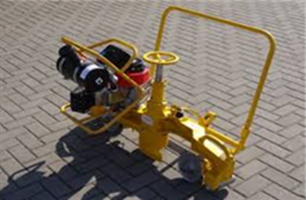
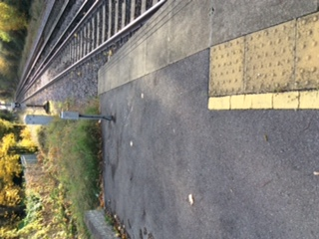
Trackworker Safety Manual Handling.
Significant lost time back injury sustained.
On 28th of October, 2 members of the Welding and Grinding (W&G) dept were assisting the maintenance team installating and stressing of 30-foot rail at Ewell West.
After completing some work, the 2 man team returned to the station platform to collect the MP12 grinder, they handled the plant down from the platform to the track. As the grinder (68KG approx.) was being passed down from the platform to the track, one of the team experienced a sharp back pain.
Consider;
Alternative easier access arrangements before handling heavy items of equipment.
Seeking assistance from others
Your stance when lifting and carrying; avoid twisting.
Keep the load close to your body.
This sloped access to the track at the end of the platform approximately 100 yards away would have been a better alternative..
Attached to this Cascade are the 1 page Manual Handling Risk Assessments completed on Grinders and other heavy equipment.

Slide 13

Health and Wellbeing
Epilepsy
There are varying degrees of seizures, the Gran Mal being the most serious category.
What would a Gran Mal seizure look like..
The type you usually see on the television on a show like Holby City, where the patient shakes violently, bites on their tongue and thrashes around with their arms and legs.
The way to look after someone having a seizure is;
Protect the Person from Injury (for example help them to the floor if sitting/standing and move tables etc away from them)
Cushion their head to stop them banging the floor
Once the patient is in a safe position, call an ambulance
Aid breathing by gently placing them in the recovery position when the seizure has finished
Stay with them until recovery is complete
Be calmly reassuring
Karl Bates is giving a talk in MK on Tuesday 4th December. See attached presentation for full information.

Slide 14
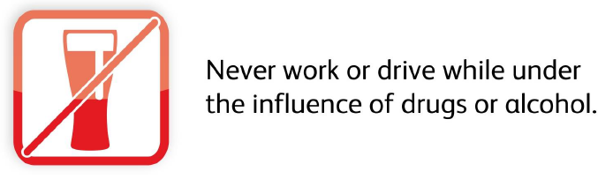
Health and Wellbeing
Drugs and Alcohol – Policy Reminder
Alcohol testing can take place for a number of criteria under the D&A policy, these include
grounds to suspect that an employee or contractor is unfit through drugs or alcohol
Post incident or for cause -following accidents or serious incidents;
Random testing can take place at work locations – on-site and in the office without prior notification.
Failure to consent to testing, or leaving site before testing is completed, will be regarded as a refusal to submit to testing. A positive result would then be recorded and dealt with in the same way as someone who had tested over the limit

Slide 15

Sentinel Improvements – Go Live Reminder
Wednesday 24th October 2018 at 10am
What are the improvements?
• Swipe out reminder on Mobile devices
• Surfacing Medical Expiry when checking a card
• Show reasons for 'No Core Competence' and update existing ATW denial reasons
• Display 'Valid Until' Date in MySentinel profile
What do I need to do?
Make sure you download the latest version of the Sentinel APP to benefit from the latest improvements.
Depending on your phone settings, your phone will:
• Auto-update with the latest version of the APP when this is released
• Prompt you via a notification that an update is available for you to download .
For COSSs / PICs - Please note that manually updating the mobile APP mid-shift whilst you have a team swiped in could cause the team to be removed from the session. The same could happen if your phone settings are allowing automatic updates. To avoid this, you are advised to disable auto-updates via the Settings menu on your mobile device temporarily in advance of the App update and download the App when you have no team swiped in.

Slide 16
NR vehicle Drivers
We are aware that there are a number of issues with VSWS, the system is currently under review nationally on what changes are required to make it function as intended.
We would like thank those who continue to report and provide feedback on the system.
Don’t forget to complete the pre-use vehicle checks.
Departments need to think about changing tyres, seeking alternative vehicles and snow chains should the weather take a snowy turn… last year we could have been better prepared in some areas.

Slide 17
Operational bulletins
NR-OPS-039 Tram Inn blockage Irregularity.pdf
NR-OPS-040 Line Blockage Irregularity Hereford.pdf
NR-OPS-041 Operating Irregularity for a Speed Restriction V2.pdf

