Slide 1

Health, Safety and Environment Period Cascade for P09 2019/20
Wessex Route
Merry Christmas

Slide 2
Content
Welcome to your Health, Safety and Environmental Cascade for Period 09 2019/20. Please discuss and share the items that are relevant to your teams and display any relevant Safety Bulletins or Lessons Learnt on your notice boards.
Significant Workforce Events
Near Miss at Leatherhead
Serious Accident – Burns to leg and hands (Kent Route)
STF Accident resulting in an arm laceration
Puncture injuries to hands and Dangers of Blackthorn
Make the right call
Lifesaving Rules – it’s as easy as 1, 2, 3…4
Plant Manual Update
Environmental Update
Health and Wellbeing

Slide 3



Workforce Safety
Slip, Trip & Fall
26/11/2019 – The IP was grinding a switch at Waterloo and whilst turning to pick up an angle grinder, he slipped on wet timbers and fell over onto a switch and stock rail, sustaining heavy bruising to his rib cage and left hip. NLT
28/11/2019 – The IP tripped on some steps and caught his lower right arm on ARMCO barrier. More details in the cascade NLT
02/12/2019 – The IP was carrying out ultrasonic testing and whilst crossing from the main line onto the Windsor lines slipped on some frosty/slippery sleepers at Waterloo, sustaining a palm laceration. Area is congested with point work leaving little room for movement. NLT
04/12/2019 – MOM responding to a fault was getting out of his van at an access point to retrieve his safety boots. The IP was wearing trainers to drive to site and slipped on some black ice, hitting his knee and ankle. The IP was unable to return to work on his next shift. LT
Manual Handling
24/11/2019 – The IP was using steel metal bar to reposition a guard rail laterally. Flexing of the guard rail caused the steel bar to flick longitudinally, striking the IP on the side of the head/ear/jaw. NLT
Discussion: Mechanical means, 2 RRV’s
06/12/2019 – Whilst rodding the drains the IP was turning the handle to get "a bite" when the handle sprung back and dislocated his left hand ring finger. The IP visited hospital where his finger was re-set. NLT
Line Blockage Irregularity/Near Miss
19/11/2019 - COSS requested a LB to carry out a track patrol on the Up Windsor Slow/Windsor Reversible. The Signaller placed his collars on signals and confirmed that signal protection was in place for the COSS to place down his protection. The Signaller then requested the COSS to call back so he could issue him with an authority number. The COSS forgot to call back
26/11/2019 – Near Miss at Leatherhead. More details in the cascade.
Significant Events in the Period

Slide 4
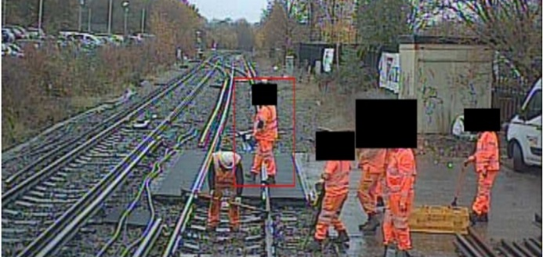
Workforce Safety
Near Miss at Leatherhead
On 26th November 2019 at approx. 11:32 the driver of 1I20, reported a group of 8 track workers from Wimbledon P-way, were working without a lookout on the 855 crossing on the Down Portsmouth line L/E of Leatherhead and had to rush out of the way of the train.
To achieve an adequate sighting distance in this location, as per the SWP, a site and a distant lookout are required. The PiC/COSS only appointed a site lookout and failed to test his warning time.
The PiC/COSS was also involved in the work. Some of the duties could have been delegated but the individual made a decision not to. There was an experienced COSS and another COSS under mentorship on site, but both failed to challenge the suitability of the SSOW.
The PiC/COSS experienced some exceptional personal circumstances 4 days prior to the event, and it is highly likely this had a negative effect on his judgement.
As part of the preliminary investigation it was confirmed that with a site lookout it is only possible to achieve sighting distance of 295 yds against the required 740yds.
The PiC/COSS using the track gauge with his back to traffic, the Site lookout in the 4ft
Items for discussion:
It is not acceptable to not challenge if you believe something is not safe. We all have a personal accountability and responsibility (as reiterated by our Regional Managing Director in his recent letter) to keep ourselves and each other safe! Remember the Work Safe Procedure and always challenge.
If you do not feel capable of carrying out your role or you have something on your mind that could affect your judgement, please speak to your line manager as they can support you.
If work is undertaken using lookout warning, should a separate PiC and a COSS be appointed? If also involved in the work, is the PiC fully in control of operational safety? – Please discuss this in your teams.
Notes:
Line managers have got duty of care and should take their staff’s concerns seriously and offer them support

Slide 5
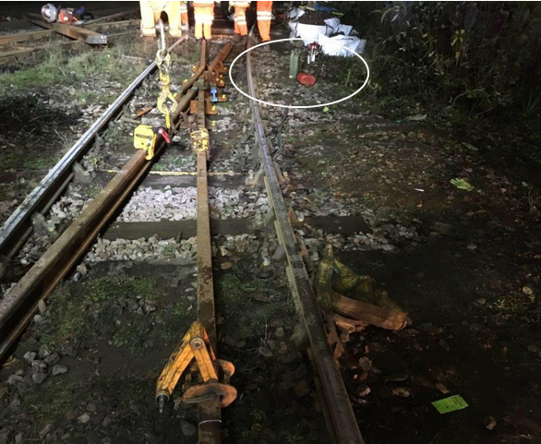
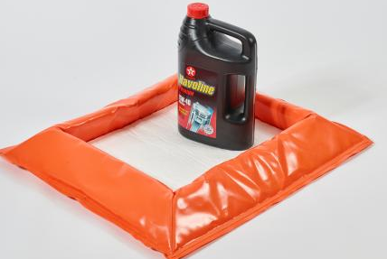
Workforce Safety
Serious Accident – burns to leg and hands
A serious accident occurred on Sunday 1st December 2019 in Mountfield Sidings (Kent Route).
The IP was refuelling a disc saw and spilt some of the fuel on his trousers. He informed his Team Leader (TL) who took over and started the next cut.
The ground caught light and the IP stepped in to assist the TL with extinguishing the flames. The IP’s trousers, soaked by the fuel, caught fire and the IP used his hands to put the flames out.
The IP is undergoing treatment at the hospital for the burns sustained to his leg and hands.
Items for discussion:
Please refer to the following TRC sheets for current controls: NR/L3/MTC/RCS0216/GA17; NR/L3/MTC/RCS0216/TK00 & NR/L3/MTC/RCS0216/GHE05
    Where possible fill all plant at the depot
    Refuel all plant at least 10 metres from any worksite, other machines or naked flames
    Make a fire extinguisher available at all fuelling points
    Spill mat or drip tray on site so any spills can be mopped up
    If fuel is splashed/spilled onto clothing, immediately move away and remove/replace the clothing
Only 5 litre fuel cans with spill proof nozzle to be used for refuelling on site. “Jerry” type cans must not be used for refuelling
Flame retardant PPE and nitrile gloves to be worn by all staff carrying out task involving the use of rail saws/disc cutters and refuelling
The Outer DU are investigating the use of portable Fuel Bunds to prevent leaks/spills – details will be shared in due course

Slide 6
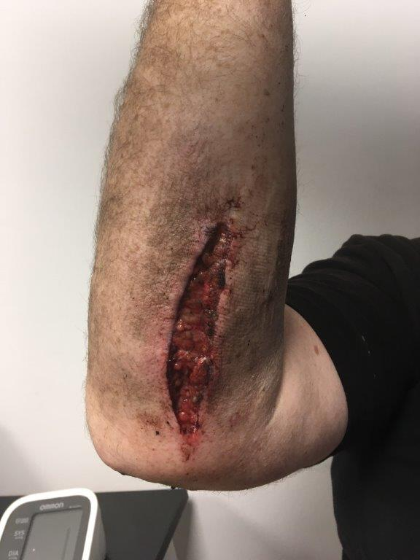
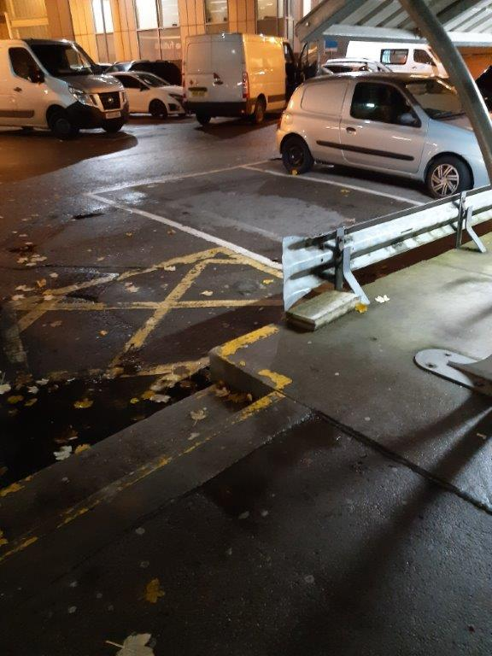
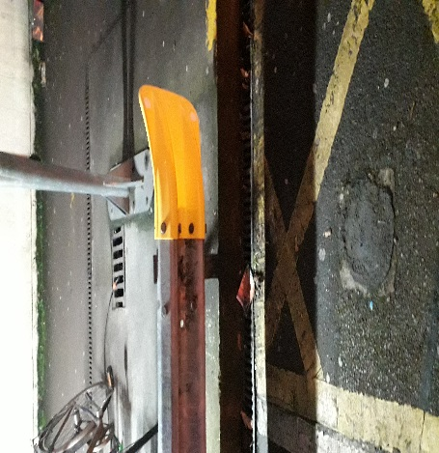
Workforce Safety
STF accident resulting in a severe arm laceration
On Thursday the 28th of November 2019 at 22:30, a Buildings and Civils contractor was part of a group of 3 persons who had completed a planned preventative maintenance (PPM) work at Richmond station and were returning to their vehicle in the station car park.
The injured party (IP) lost his footing on the steps to the car park and fell over, hitting his right arm on the vertical end section of an armco barrier, sustaining severe laceration to his lower right arm.
He attended the A&E where he received 20 stitches and was vaccinated against leptospirosis+ tetanus + polio and given a course of antibiotics.
The initial findings from the investigation indicate that, the IP became engaged in a conversation with his supervisor as they were returning to the van.
The end section of the armco barrier in a highly pedestrian location was unprotected.
Items for discussion;
The need to always remain alert and aware for the entire duration of work
Accidents can occur at any time including at the start and end of shifts, change of task, etc . We strive to go home safe everyday.
The commonality and risks of unprotected armco barriers and hoardings around pedestrianised locations across the rail assets.
Fish tail end cap

Slide 7

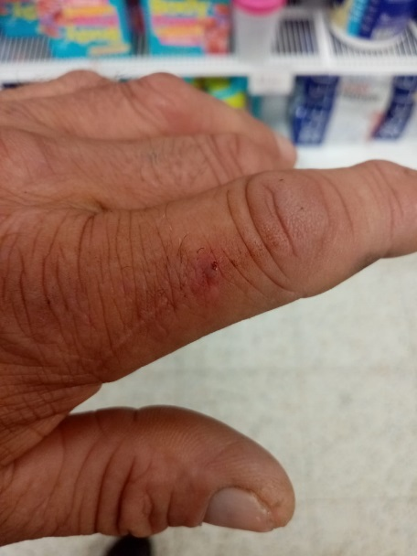
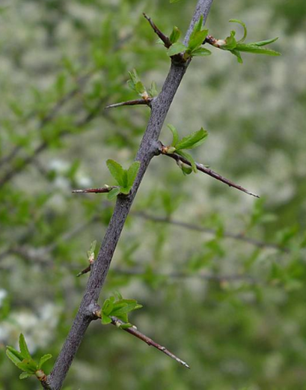
Workforce Safety
Puncture injuries x 2
Items for discussion:
Brief all operatives of the potential hazards of blackthorn and for individuals to check and monitor the condition of their PPE and to undertake pre-use checks.
Is this the best way to deal with blackthorn?
Use polesaws / extendable equipment to cut blackthorn, keeping the operator further away from the thorns.
Consider using mechanical devices such as mechanical flail or mulcher type equipment.
On Tuesday 19th November 2019, a team were tasked with cutting back vegetation with chainsaws in the Yeovil area. The appropriate PPE for chainsaw use was provided and worn.
Whilst carrying out the task, two operatives came into contact with Blackthorn, sustaining puncture type injuries to their left hand fingers. The chainsaw gloves, whilst chainsaw safe, were not puncture resistant.
Aware of the dangers that Blackthorn can cause if not treated, the IPs were taken to Salisbury A&E. They were given an intravenous drip and strong antibiotics as part of their immediate treatment and then discharged.
Dangers of Blackthorn:
A piece of blackthorn under the skin has the potential to cause swelling, pain, severe infection and blood poisoning. If left too long before treatment, amputation might be the result.
Blackthorns are covered in unpleasant bacteria. If you have a piece buried in your flesh, the best course of action is to get yourself to the hospital; don’t leave it until the area around the wound turns black.

Slide 8
Workforce Safety
Make the right call
Close Calls | Faults | Incidents & Accidents
A Close Call is defined as anything that could have the potential to cause harm or damage but has not done so on this occasion. A Close Call will be assigned to a Responsible Manager to action. | A fault is identified as an unsafe condition or defect within the railway infrastructure / property that has the potential to cause harm or damage or prevents correct operation of equipment and needs to be reported through the correct channels. All faults are assigned to a section based on discipline and geographical area. | An incident/accident is the occurrence of an event which has resulted in a safety loss incident, injury, accident or collision involving people and equipment.
A few examples: Scrap rail, materials or tools obstructing access points / walkways Slip/trip hazards across railway infrastructure / environment Exposed cables a trip hazard in meeting room Door hinges damaged – door loose Wires left exposed causing an electrocution hazard. Unsecured access gates | A few examples: Cracked/broken rails Hypodermic needles left on a walkway or lineside Signals not displaying the correct or any aspect. Track defects Trees or branches leaning dangerously close to operational lines or OLE Escalator at a station with damaged teeth Fire door damaged/blocked. Damaged stair nosings. | A few examples: Derailments Injury as a result of an accident Oil spills (environmental incident) Operational Close Calls / Irregularities: Unauthorised movement of a train in a possession Person trapped inside a CCTV crossing Theft Train striking objects Trespass where individuals are on the infrastructure
Phone: 01908 723500 (Option 1 then Option 2) Report by downloading the Network Rail Close Call App Report by e-mailing: closecallreporting@networkrail.co.uk | Report to your local Fault Control (085 73903 - Inner and 085 73905 - Outer) or Facilities Management (085 7477) or immediately to the signaller (e.g. broken rail) | Report to Route Control - 085 73901

Slide 9
Workforce Safety
Lifesaving Rules
One rule when leaving home
Remember – it’s easy as 1, 2, 3…4
Two rules on the road
Three rules arriving at work
Four rules when on site

Slide 10
Safety Bulletins, Alerts, Advice
Safety-Bulletin-NRB19-20-Staff-injury.pdf
Environmental Bulletin NREB19-01 - Network Rail to adopt Defra Biodiversity Metric.mht
Lessons Learnt - Near Miss at Leatherhead 261119.pdf
Lessons Learnt - Severe Laceration to Arm BC 281119.pdf
Lessons Learnt - Blackthorn Puncture Injuries 191119.pdf
Interactive Health Commitments Poster.pdf
Printable Health Commitments Poster.pdf

Slide 11
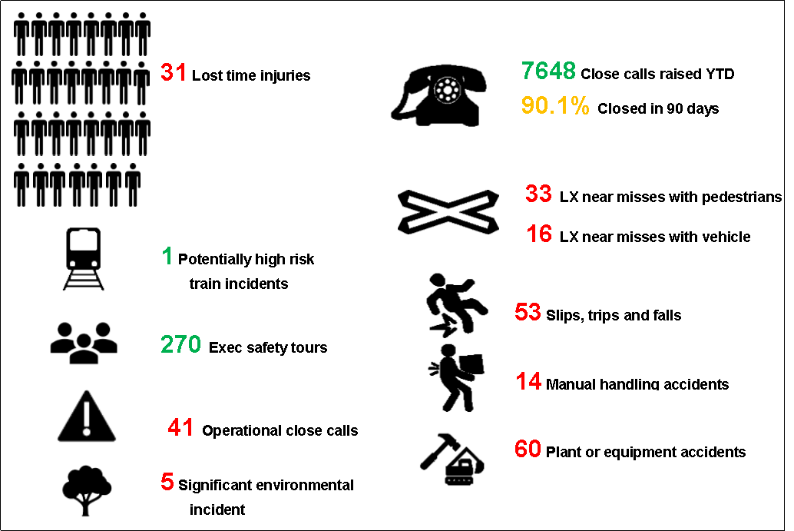
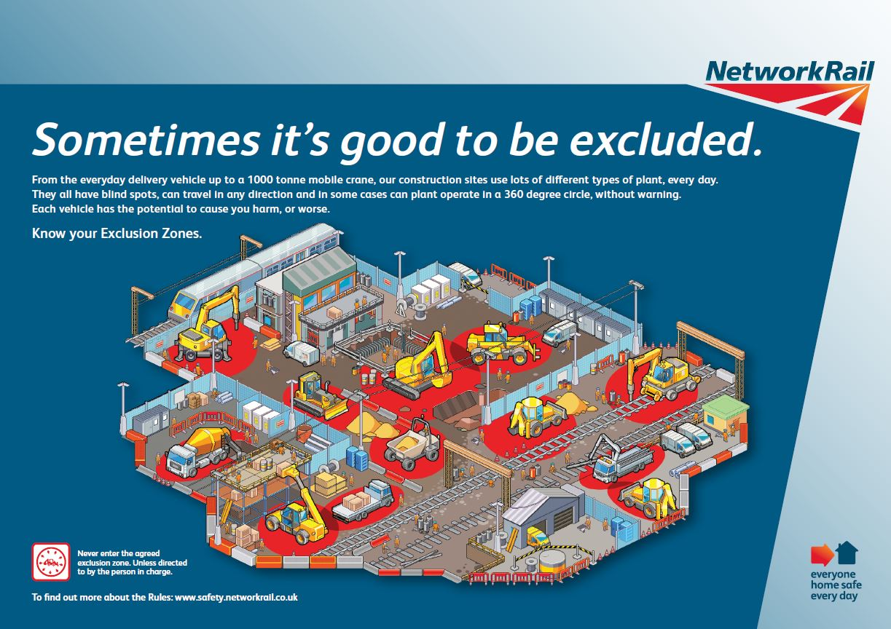
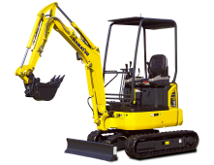
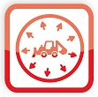
Infrastructure Plant Manual
Exclusion Zones – Reminder
There have been some incidents recently, where exclusion zones have been breached and this has caused or had the potential to cause injuries. Do you know what the exclusion zone is for the equipment and task that you are carrying out?
The Task Risk Control manual details the required Exclusion Zones.
Plant Safety: Task Risk Control Manual
Exclusion Zones vary depending on the task and the type of equipment being used. For example the minimum Exclusion Zone when working with mobile plant is 5m, when an RRV is working it is 10m.
This could also be relevant to decanting fuel and re-fuelling small plant when the exclusion zone is 10m – as per slide 5 of this cascade.
No-Go
Zone
Working
Zone
Never enter the agreed exclusion zone, unless directed by the person in charge

Slide 12

Environment
Environment and Social Minimum Requirements – Design and Construction NR/L2/ENV/015 v8.
NR/L2/ENV/015 has been updated and is now mandatory for all construction and design work within GRIP-managed projects, carried out by Network Rail and its contractors. It does not apply to maintenance works.
It has a compliance date of 31 December 2019.
There are two key elements of the standard, which are;
Environment and Social Appraisal (ESA) | The ESA works as a selection tool to identify the relevant high impact areas and help you to manage your risks and maximise your opportunities. The ESA will provide the user with an action plan, which will identify the mandatory sections of the standard. The ESA is part of the Network Rail GRIP product list. It is a live document but should be started at GRIP 2 and updated every GRIP stage or every 6 months.
Environment and Social Management Plan (ESMP) | The ESMP addresses each environment and social risk and opportunity that the ESA has indicated as applicable to the project. There is a mandatory ESMP template. Acceptance of the ESMP is through the competition of the ESMP review and acceptance form in the GRIP product list.
Links to the ESA Tool, ESMP Template and the ESMP Review and Acceptance Form can be found on Safety Central under E&SD Tools & Templates
ACTION REQUIRED:
For your works or discipline, establish the responsible person to complete and maintain the ESA and ESMP at each applicable GRIP stage.

Slide 13
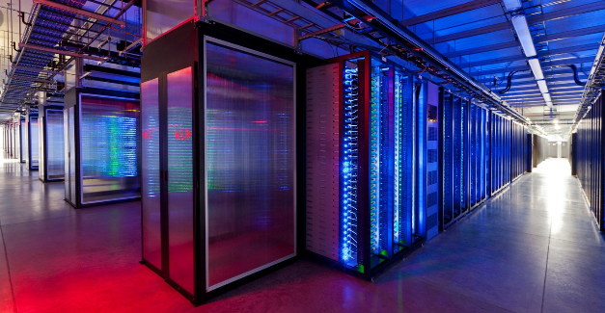
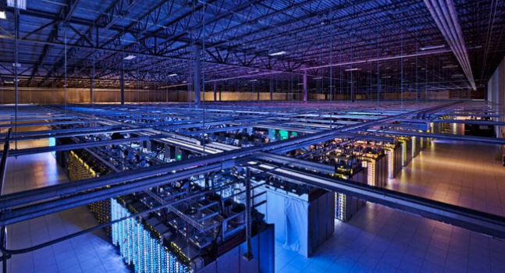
Environment
Energy and Carbon
There are many small and simple changes we can all make to reduce energy and carbon. Remembering to turn lights off when you leave a store or room is one of the more obvious examples.
Less obvious however, if every adult in the UK sent one fewer email a day we would save more that 16433 tonnes of carbon a year- equivalent to 81152 flights to Madrid or taking 3334 diesel cars off the road.
This carbon footprint reflects the energy used by the infrastructure which allows emails to be sent and stored (Servers and expansive data centres often require significant power to keep them cool).
ACTION REQUIRED:
Consider what small changes you and your team can make (which you have direct control over) to save energy and carbon.

Slide 14
Health & Wellbeing
Medication Enquiry Service (Chemist on Call)
This service is intended to help employees and managers to assess the possible impact of medication, or a change in dose of medication on the individual’s fitness for safety related work.
Employees must notify their line manager as soon as possible after being prescribed/taking a prescribed or over-the-counter medicine. This should be prior to starting work. They should also report any symptoms from an illness or medical condition which would impact on their ability to undertake safety critical duties.
Service is available 24/7 Online, via the Optima Health helpdesk; or the direct Chemist-on-Call on 08456 773001
Wessex PIN - 7600
Optima Health have recently issued initial guidance for managers on what medications are likely to be safe when undertaking safety critical work and which medications will require a medication enquiry. If a medication is not included a medication enquiry is required.
The full guidance can be found here: Medication Advice for Managers Final 2019.pdf

Slide 15

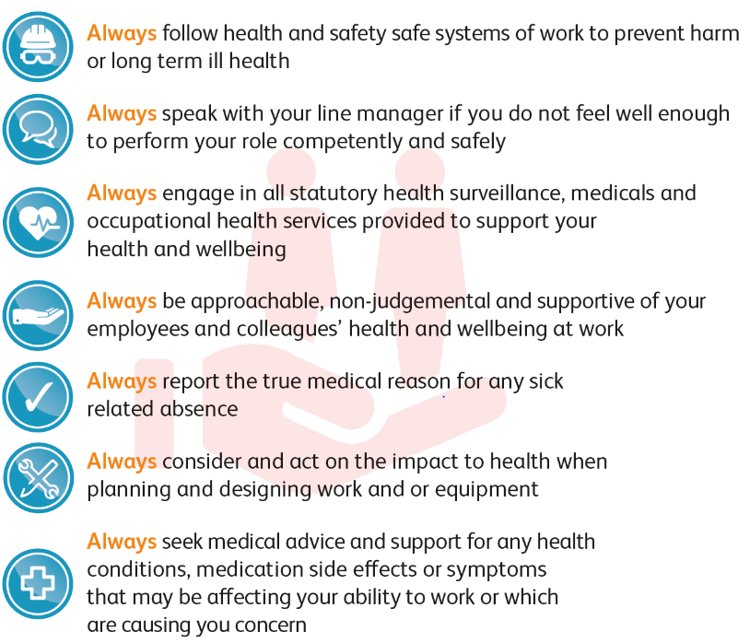
Health & Wellbeing
These commitments relate to your mental health as well as your physical health
Notes:
The seven Health Commitments encourage colleagues to take ownership and care of
their own health and the health of others. They should be considered as proactive
commitments, rather than rules that must never be broken.

Slide 16
