Slide 1

Health, Safety and Environment Period Cascade for P10 2019/20 Wessex Route

Slide 2
Content
Welcome to your Health, Safety and Environmental Cascade for Period 10 2019/20. Please discuss and share the items that are relevant to your teams and display any relevant Safety Bulletins or Lessons Learnt on your notice boards.
Significant Workforce Events
Line Blockage Irregularity at Clapham Jn
Strapping Irregularity at Chalk Tunnel
Accident resulting in a dislocated finger
Lookout Duties Reminder
Site Safety Support Team Update
Station Safety
Winter Safety
Plant Manual Update
Environmental Update
Health and Wellbeing

Slide 3



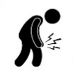

Workforce Safety
Slip, Trip & Fall
12/12/2019 – A member of the Woking S&T team was walking from the troughing to the ballast area, following completion of works on WK2236 points, when he slipped on wet conductor rail cables and fell between the down cess and down yard landing heavily on his right arm. NLT
Discussion: How can we remain focused and aware after the task has been completed? Cable management for better underfoot conditions.
19/12/2019 – Whilst completing a track patrol between Liphook and Haslemere the IP who was walking ballast to ballast came across a slightly shallower ballast bed. This led to him missing his step and stepping on a wet sleeper. As a result the IP slipped and sprained his ankle and was unable to return to work the following day. LT
Take 5: Focused and aware
Manual Handling
08/12//2019 – The IP was using a panpuller to pull keys in at North Sheen. The pan puller was not connected properly and the IP fell backwards, landing on his back. NLT
Take 5: Ensuring tools are fit for purpose and are used correctly by competent staff
Impact/Crush
08/12/2019 – After arriving at Liphook Station and whilst exiting and securing the vehicle the IP caught his right hand index finger in the door. NLT
22/12/2019 – A member of staff (WD) was using a hammer to insert a metal spike into a sleeper. Due to wet weather conditions the hammer slipped and swung, coming into contact with another individual’s knee. This resulted in a bruised tibia and the IP was unable to return to work. LT RIDDOR
Take 5: Focused and aware
Line Blockage Irregularity
13/12/2019 – LB Irregularity at Clapham Jn, more details in the cascade.
Significant Events in the Period

Slide 4
Workforce Safety
Line Blockage Irregularity at Clapham Junction
On Friday 13th December 2019 at approx. 11:49 the driver of 3S85 (MPV train) had to apply an emergency brake as he observed 2 members of staff and a PLB in his path as he was approaching Clapham Jn station on the Up Windsor Slow line (RDG1).
The signaller at Wimbledon ASC earlier granted 2 line blockages, one for the DWS and the other for the UWS. The signaller received a request to clear the line blockage on the DWS but removed the collars for the UWS line blockage and subsequently cleared the signals for the waiting MVP train.
Risk Controls:
An urgent review that looks at application of reminder appliances in association with each planned patrolling line blockage
Implementation of ZKL3000 remote control T-COD’s in this particular location
The MVP approaching on the UWS
Location of the PLB

Slide 5
Workforce Safety
Strapping Irregularity at Chalk Tunnel
On Friday 20th December 2019 at approx. 11:10 a strapping irregularity occurred at Chalk Tunnel, C/E of Guilford Station. Due to an earlier land slip that blocked both the Up and Down Main lines, the maintenance teams were clearing all the spoil from the site. It was established that a temporary isolation (TI) was required to enable the staff to carry out the task safely.
As part of the TI a number of circuit breakers and hook switches were open. A short circuiting bar was applied on the incorrect side of the H/S 921. This resulted in a flash and tripping of the circuit breaker E317. Fortunately there were no injuries.
Due to the Christmas season the incident is still under investigation and we will share the findings in due course.
The location of the landslip

Slide 6
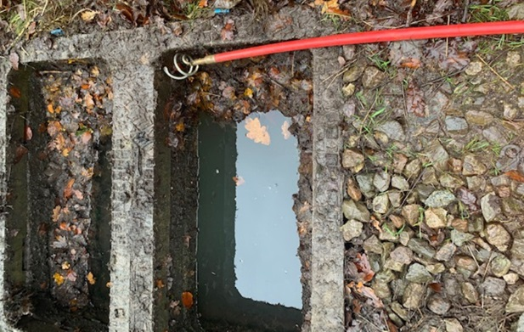
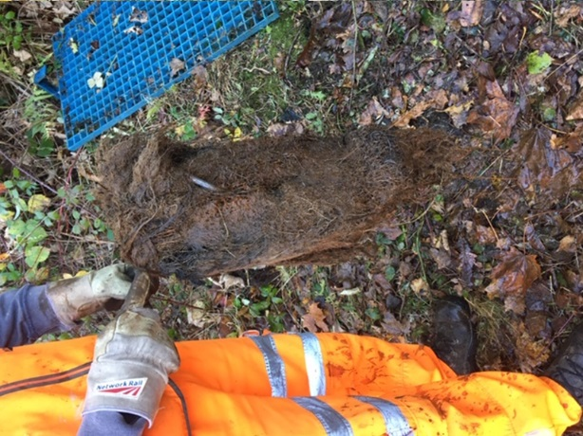
Workforce Safety
Dislocated Finger – End of Period 09
On Friday 6th December 2019 a Team Leader from Guildford Off-Track dislocated his finger whilst carrying out drainage works in the Haslemere area.
The team responded to an incident at Church Lane; where a suspected ingress of roots blocked a drainage run causing it to back up and flood.
A cork-screw or ‘pigs-tail’ was fixed to the first rod and further sections of rods were added until the blockage was reached and a handle was then attached. The IP began to wind the handle with his right hand supporting the rods with his left. Experiencing resistance, he attempted to use his strength to tear through the obstruction. The blockage did not yield and the torque built-up until the handle slipped from his hand, springing back, striking the IP and dislocating his left index finger in the process.
The IP was taken directly to A&E where he had his finger reset and was able to return to work the following day.
“Pigs Tail” attached to a drainage rod and roots removed using the attachment
Items for discussion:
Take 5 – could the team have thought of a better way to complete their work, or to assess what they were up against?
The IP attempted to force his way through using brute strength and tension built up in the rods rapidly. Would a slower, considered approach allowed the situation to be assessed more accurately?
Do not attempt to reset any dislocated fingers yourself, seek a prompt medical advice

Slide 7
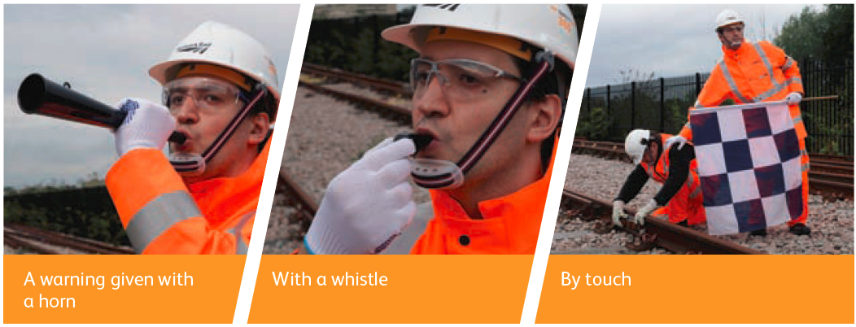
Workforce Safety
Lookout Duties – Reminder
Lookout warning is using an unassisted lookout, the warning is given by horn, whistle and touch if there is noise or the group are wearing ear protection. A lookout may also use a cut off device on noisy equipment or plant.
The COSS will brief you on which method is to be used.
The COSS will tell you:
• if you are to be a site lookout, a distant lookout or an intermediate lookout
• where to stand
• from which direction trains will approach
• on which lines trains will approach
• who you are to give the warning to
• how you are to give the warning
• where the position of safety is. (as the lookout, you must remain in this position of safety).
Whilst you are acting as a lookout you must:
• make sure your mobile phone is switched off
• stay alert and carefully watch for approaching trains
• give the warning and then tell the COSS if you can no longer give an adequate warning or your view becomes blocked.
You must not:
• take part in the actual work
• carry out any other duties
• allow yourself to be distracted.
Site lookouts are only allowed during darkness, poor visibility or in a tunnel if the maximum speed of all approaching trains is no greater than 20 mph and the site lookout has sufficient sighting available. Distant and intermediate lookouts are not allowed.

Slide 8
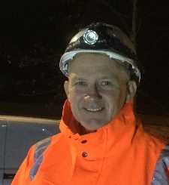
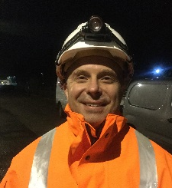
Workforce Safety
Site Safety Support Team Update
For the last 3 months Dean and Adam have been visiting our maintenance teams and supporting an improvement in track safety.
On average they spend a week with the night duty teams to build relationships, transfer knowledge and information regarding good practise between our sections with the intention of improving our safety record. This also includes best practise and support in respect of Safety Critical Communications.
Some of the feedback so far is below:
Issues Identified/Attention required | Good Practice | Issues Addressed/Changes Implemented
Concerns about PC having to accept a number of COSS’s to work in his LB | The stores compound is well lit up and well organized. There is a full time storeman | Reminder to wear insulated gloves when pulling hook switches – well received
Concerns about LB with adjacent lines open | Det comms used throughout, brake test carried out, both axle locks operated, exclusion zone maintained | Thermal cut 5 gloves and 3M anti mist and anti scratch glasses issued to the team
Accommodation and welfare facilities need an upgrade | Staff wearing correct PPE including glasses and gloves | Strapping equipment inspected and any shortcomings were addressed promptly
Strapping at 2 or 3 different locations which puts pressure on the team and the work they need to deliver | The COSS/PIC briefing was very thorough and delivered well | Nightsearcher Spector lights and nightsearcher hazard lights issued to the team
Poor application of the strapping process - team were asked to Take 5 and were taken through the correct process | Weekly safety/task meeting delivered on nights at the start of the shift - SWP's issued for the week ahead, all aspects of upcoming works covered | Helpful paperwork/aid given to the ES on site to assist him in managing permits and strapping teams - especially in large/busy possessions.
Lack of suitable access - teams often have to walk long distances from an access point to site of work | Exclusion zone for disc cutter in place and maintained | Time spent with staff going over a SWP, explaining the TRCS’s and who needs to control the risk
Lack of flame retardant clothing when using a disc cutter, spats available but they tend to slip down or fall off | Good lighting at access point and the worksite was well lit up | Reminder to the PiC/COSS to scan all Sentinel Cards at the start of the shift

Slide 9
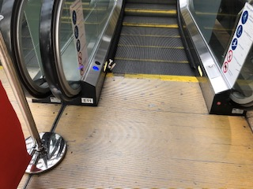
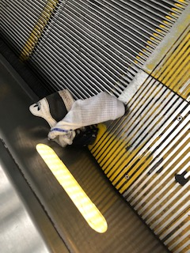
Station Safety
Staying safe when moving around stations on the network
An incident occurred at Waterloo Station before Christmas where a child got his shoe caught in the side of the escalator – luckily his parent was able to get his foot out of the shoe before a serious injury occurred.
Escalators are one of the biggest locations for accidents at stations, so please take care when moving around the stations, both when working and when travelling for leisure.
Share this with your families and friends to keep them safe.

Slide 10

Workforce Safety
Winter Safety
The Ice Guardian warns the users of a greater risk of black ice forming by flashing when the temperature drops to 3̊̊̊C and below.
Using super-bright LED technology, the Ice Guardian grabs attention by enabling the flash to be seen in the user’s peripheral vision.
For more information about these signs please speak to your Logistics Team.

Slide 11
Safety Bulletins, Alerts, Advice
Safety-Bulletin-NRB19-21-Burns-after-petrol-spill-while-refuelling.pdf
Safety-Bulletin-NRB19-22-Contact-with-Overhead-Line-Equipment-OLE-serious-injury.pdf
Safety-Advice-NRA19-15-Working-safely-on-scaffold-towers.pdf
Safety-Bulletin-NRB19-19-On-Track-Machine-runaway-and-collision-within-a-work-site.pdf
Network Rail_461 New Year Winter poster.pdf
Network Rail_471 Blue Monday Info sheet.pdf
Network Rail_710 New Year, New You poster.pdf
Network Rail_711 January Newsletter.pdf
Lessons Learnt Dislocated Finger 061219.pdf

Slide 12
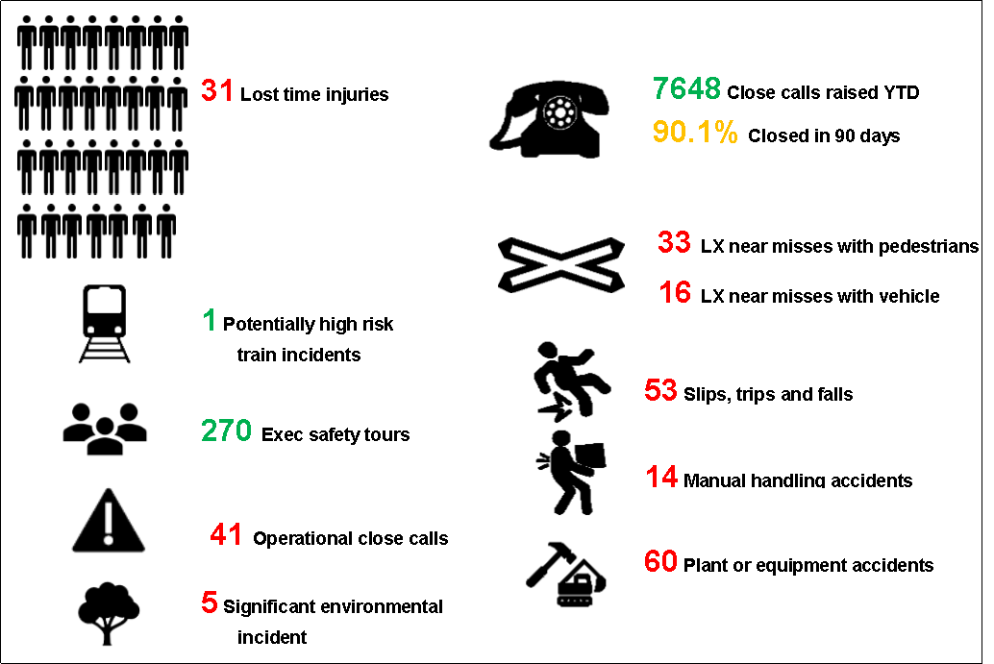
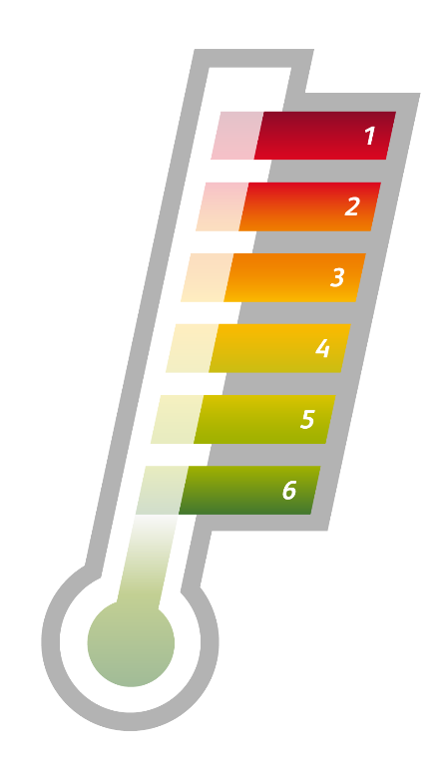
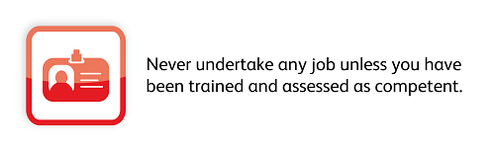
Infrastructure Plant Manual
Plant Operations Scheme (POS) Representative & Skills Assessment Scheme
The purpose of the Plant Operations Scheme (POS) Rules are to define the means of compliance for an organisation undertaking the provision and operation of On-Track Plant (OTP).
The scope of the POS Rules extends to all organisations carrying out OTP operations on Network Rail Managed Infrastructure.
The POS Representative (POS REP) is a key and vital role on site to help deliver the work safely.
We have approximately 140 NWR POS REPS on the Wessex route and a large number were trained in 2016 and the competence needs to be renewed.
The POS REP competence is a Regime 4 and has a 4 year validity. Renewal is via completed work checks and knowledge testing (completed by a Skills Assessor)
On Track Plant and POS information can be found on the Wessex Plant HUB.
The On Track Plant Team would be happy to come and brief this information to you if required – please contact us using details below.
Keith Penn RPSE– Wessex M: 07739779590
E: keith.penn@networkrail.co.uk
Luis Williams Area Plant Manager – Wessex M: 07732 644671
E: luis.williams@networkrail.co.uk

Slide 13

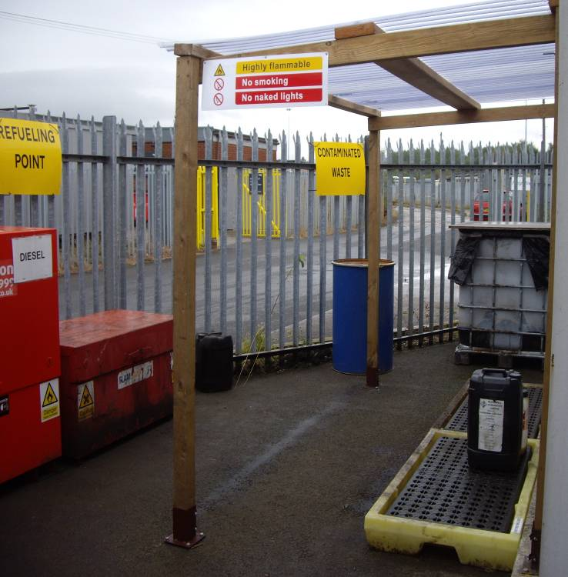
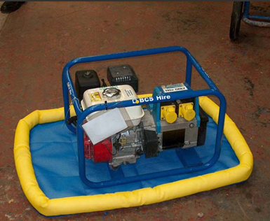
Environment
Storage and use of oils and chemicals
Why is it important to correctly store substances?
Substances such as oils and chemicals need to be carefully managed to prevent pollution to the environment. This includes small spillages, in particular where frequent spills in an area can accumulate in the ground over time.
Good storage
All chemicals and oils should be stored securely and in suitably labelled containers. Good practice is to ensure that all storage containers are appropriately bunded or stored on a drip tray and ideally under a shelter, these should be regularly inspected. Contaminated rainwater should be disposed of as hazardous waste.
Chemicals and oils should not be stored within 10m of a watercourse, gully or drain. Ensure that stocks are regularly reviewed and dispose of old or expired substances. Tanks and storage units should be secured and locked when not in use.
Up to date COSHH assessments should be completed for all substances stored on site, these should be reviewed to ensure that any specific storage guidance is followed.
Drip trays or absorbent mats should be placed beneath static and mobile plant during refuelling and a spill kit available.
Action required;
Check how your oils, chemical and mobile plant is stored.
Do not ignore any spillages on the ground or into a watercourse - this needs to be cleaned up promptly and reported.
Check that a copy your environmental emergency procedure is displayed within depots and/or included in the Depot Environment Pack.
Further information: Toolbox talks on pollution prevention can be accessed here. For additional information please contact your WHSEA or Route Environment Specialist.

Slide 14
Health & Wellbeing
WESSEX OCCUPATIONAL HEALTH Provision
What’s changing from the 3^{rd of} February 2020
New Medical:
New Service Model with:
A dedicated Wessex Route based OH facility (Basingstoke ROC)
Dedicated Wessex Route based OH staff (OH Technician and OH Advisor)
Dedicated Southern Regional Admin resources
Track Side Medical
Health, Safety & Wellbeing Medical
3 Yearly Review
becoming
Signaller Medical
Employees with certain medical conditions and those above 65’s review period remain unchanged

Slide 15

Health & Wellbeing
Alcohol Awareness
What is a unit of alcohol?
(Size of drink in ml x Alcohol strength)/ 1000
e.g. (568ml pint x 4.5%)/ 1000 = 2.6 Units
(175ml glass x 13%)/1000 = 2.3 Units
Do you know how much units of alcohol you drink a week?
Download the Try Dry app on your phone to get visibility of how much unit of alcohol you consume per week.
Are you drinking too much?
Follow the link below and complete the assessment:
https://www.drinkaware.co.uk/selfassessment
Are you considering cutting down?
For more information on no or low alcohol drinks and venues that provide no or low alcohol options consult:
https://www.clubsodaguide.com/search/venues

Slide 16



Does your colleague deserve some recognition?
If so then nominate them today for a Wessex Star Award for one of the following categories!
Care
Teamwork
Safety
Empowerment
PPF
To nominate a colleague simply send a few lines of who you are nominating, what category you are nominating them for and why they should win through to Wessexcommunications@networkrail.co.uk for their chance of winning a special prize every period! Get your entries in by January 17 to be eligible for consideration this month.

Slide 17

Thank you to all the teams who worked tirelessly, during the exceptional weather in the lead up to the Christmas, to open affected lines and to keep trains running.

