Slide 1
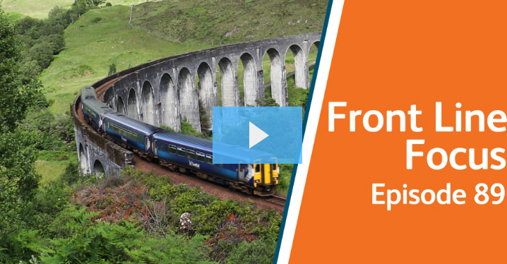
Health, Safety and Environment Period Cascade for P11 2019/20 Wessex Route
Link to the Frontline Focus Episode 89 can be found here

Slide 2
Content
Welcome to your Health, Safety and Environmental Cascade for Period 11 2019/20. Please discuss and share the items that are relevant to your teams and display any relevant Safety Bulletins or Lessons Learnt on your notice boards.
Frontline Focus Episode 89
Significant Workforce Events
Line Blockage Irregularity at Woking
Arc Flash PPE
Track Worker Safety Programme Update
Safer Isolations – NSCD Rollout
Incident Response Packs
Trespass and Welfare
Plant Manual Update
Environmental Update
Health and Wellbeing
Wuhan Novel Coronavirus

Slide 3






Workforce Safety
Slip, Trip & Fall
15/01/2020 - The IP was moving in the vicinity of Platform 1 barriers at Waterloo Station, when her walking route was unexpectedly obstructed by a trolley bag being dragged behind an individual. She tripped, fell forward and landed awkwardly causing pain and swelling in her upper arm and shoulder area, an x-ray revealed fractured humerus. LT RIDDOR
Manual Handling
15/01/2020 - The IP was attending to a points failure near Basingstoke Station and whilst moving point clips and winding points, he aggravated a pre-existing injury on his right shoulder and neck. NLT
16/01/2020 – The IP jarred his arm and sustained ligament damage to his right wrist whilst using a bar to prize free a clip which had become stuck on a trolley being used to unload equipment. NLT
29/01/2020 - The IP was lifting cattle guards on a foot Xing near Wraysbury when he slipped on an icy patch. As he fell down, the back of his left hand caught the con rail kick board bracket resulting, in a minor laceration and swelling to the hand. NLT
Assault
15/01/2020 - Member of the Welfare Team based at Raynes Park was verbally and physically assaulted on Platform 4. The IP was shaken but finished off her shift at Clapham Jn and was happy to return to Raynes Park the following day. NLT
Road Traffic Collision
06/01/2020 - NWR vehicle carrying 4 members of staff from Feltham Pway, collided with the back of a third party vehicle whilst travelling near Ascot High Street at approx. 20mph. Two colleagues experienced whiplash symptoms but were able to return to work the following day, with one person unable to return to work. LT
Line Blockage Irregularity
24/01/2020 - LB Irregularity at Woking more details in the cascade.
Significant Events in the Period

Slide 4
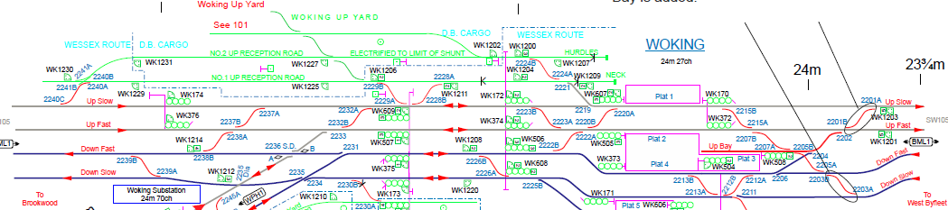
Workforce Safety
Line Blockage Irregularity at Woking on Friday morning 24/01/2020 at approx. 01:56
The Engineering Supervisor (ES) for the T3 Item 94 Weybridge to Pirbright Jn (3-line possession) was also acting as the Protection Controller (PC) for the parallel Line Blockage (LB) on the Down Slow line.
The LB (from WK155 to WK177) was booked via the GZAC system by the P-way team to allow the strapping team to place and remove their short circuiting straps. Woking S&T team requested an access into the LB to carry out their routine maintenance.
Once the ES/PC ensured that his worksite was set up, he contacted the S&T COSS by mistake and told him that the line was blocked, and he could start work. At no point did the ES/PC clarify which line was blocked and whether he was referring to the T3 or the LB.
The S&T COSS also failed to confirm which line the ES/PC was stating, so no clear understanding was reached between the two parties. On this occasion the LB was not taken for the strapping team.
The S&T COSS and his team accessed the Down Slow line at Woking, to start their work on WK2234pts when they noticed lights of an approaching train and were warned by the driver sounding the horn. The team stepped out into a position of safety in the cess.
Lines under the possession (T3)
Line under the Line Blockage (LB)
2234 points, on which the S&T team were working at the time of the irregularity
Notes:
Next Steps:
➢Establish why the LB was not taken for the strapping team?
➢What paperwork was the ES/PC working from?
➢Establish whether the ES/PC and the S&T COSS had been suitably mentored in their roles and whether they were competent to carry out the tasks?

Slide 5
Workforce Safety
Arc Flash PPE - Updated Requirements
Issued to:
All Network Rail line managers, safety professionals and RISQS registered contractors
Ref: NRA20-01
Date of issue: 24/01/2020
Location: National
Contact: Kyle Windsor, STE M&EE Power Distribution Team
Overview
Following a serious staff injury in Godinton dc traction substation in December 2018, Network Rail's arc flash PPE requirements have been reviewed and bench marked against our rail industry partners and Distribution Network Operators. Common work activities (for traction & HV non-traction power distribution staff) have been risk assessed to calculate the required level of arc flash protection for an uncontrolled release of electrical energy. A briefing pack, which includes a technical briefing presentation, a notice board poster and FAQs, has been produced to explain the updated arc flash PPE requirements when working on or near traction & HV non-traction power distribution equipment. The requirements have changed from those advised in March 2019.
Immediate action required
These materials are available on Safety Central at the following link to download. https://safety.networkrail.co.uk/safety/electricalsafety/national-electrical-power-distributionsafety-briefing/
This briefing is compulsory for all staff (Network Rail and contractors) that hold the following Traction Power Distribution competences:
• Level D Distribution (LD DIST)
• Level C Distribution (LC DIST)
• Level B Distribution (LB DIST ACi, LB DIST ACi+DCi)
• Level A Distribution (LA DIST)
The compliance date for completion of the briefings to all relevant staff and the issue of the required arc flash PPE is 6th June 2020.
The arc flash PPE requirements in this briefing pack supersede the previous requirements in the National Electrical Safety Briefing - Access to Distribution Sites March 2019, and also the National Safety Advice NRA17-09. In addition, for Network Rail staff, the Task Risk Control Sheet NR/L3/MTC/RCS0216/DP01 'Working on or near traction and HV non-traction distribution equipment', has been reviewed. The revised document and technical briefing materials can be found on the Network Rail standards intranet page.

Slide 6
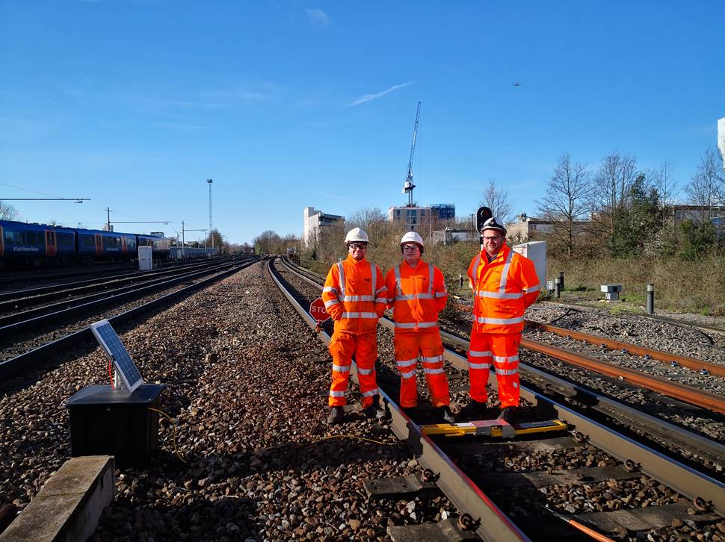
Workforce Safety
Track Worker Safety Programme - Wessex Response to the ORR improvement notices
Dedicated multi-functional team created to deliver sustainable changes to satisfy the improvement notices. Full programme to visit all areas of Wessex route to produce a safe access strategy.
Acceleration of the secondary protection programme including use of remote T-CODs. The first of these in the route have been installed and were used to provide additional protection to patrolling line blocks on 23rd January 2020.
Wider implementation of the Informed Line Blockage approach, matching Signaller workload to line blockage availability to provide industry visible plan and reliable blockage access in each location.
Enhanced funding for removal of lineside vegetation to improve the safety of the cess.
Maximising the use of PLPR and Eddy Current to reduce the requirement for track access.
Pictured are Bob Dawson (Supervisor Clapham Pway), Danny Jenkins (Team Leader Clapham Pway) and Jason Keen (TSM Waterloo Pway), who have led the process of installing and testing remote TCODs.
Wessex Route Track Worker Safety Lead is Eric Woodward

Slide 7
Workforce Safety
Safer Isolations – NSCD Rollout
The way we undertake isolations is changing. Negative Short Circuiting Devices (NSCDs) are being rolled out across the Region enabling a safer and more efficient method of applying short circuit protection. NSCDs are installed at traction supply points such as sub-stations; however, they are operated at Local Control Panel situated in a position of safety meaning, in the majority of cases, an isolation can be set up without having to go on or near the line.
The initial phase of NSCDs are installed and along with new B4 Isolation process, have been utilised by our Network Rail Maintenance teams for the past 12 months. The next phase will commence soon. This involves enabling the Southern Region supply chain to use the NSCDs, and the teams will need to be trained and competent before the phase commences.
More information can be found on the link below:
Safer Isolations - CP Southern Programme.pdf

Slide 8
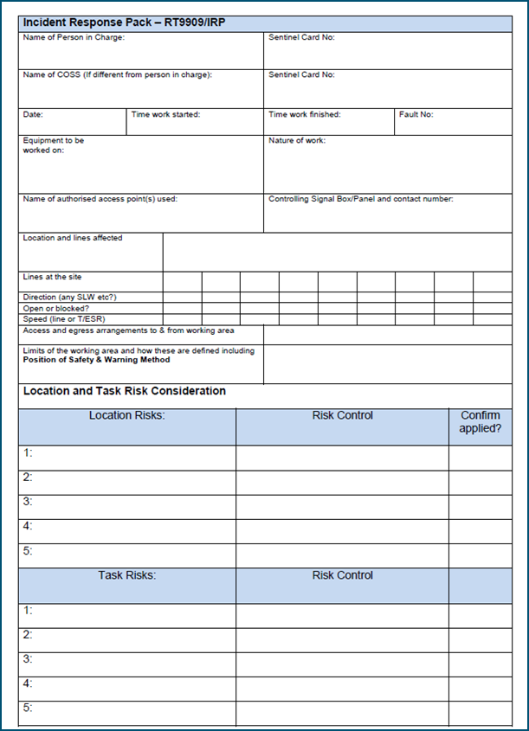
Workforce Safety
Incident Response Packs (IRPs)
Module 1 of NR/L2/OHS/019 covers the planning and implementation process relating to incident response.
This module only applies to unforeseeable events which cannot be pre-planned where:
the planning processes in NR/L2/OHS/019 modules 02, 03 or 04 cannot be applied;
an incident number has been generated by Route/Fault Control; or
situations where a Rail Incident Officer (RIO) or pilotman is appointed for an emergency or failure.
See the definitions in NR/L2/OHS/019. The following terms and definitions apply to this module only.
Term | Definition
incident | An unplanned event that requires staff attention, tasked by route control. A fault or incident number will be issued by Route Control.
incident response pack (IRP) | A pack of information produced by the person in charge that provides the safety arrangements for work when responding to an incident.
pilotman | Appointed by the Area Operations Manager to manage the movement of trains when the signalling system is degraded.
rail incident officer (RIO) | Appointed to manage operational incidents by Route Control.

Slide 9





Southern Region - Wessex Route
Our Safety Workshops Spring 2020 Sessions - ‘Personal Responsibility
INTRODUCTION
This year’s theme for the OSW is ‘Personal Responsibility’. Promoted in Regional Managing Director John Halsall’s letter of 8th August, this is a big topic so let’s continue the discussion. Personal responsibility does not imply personal priority over everyone else, rather it is intended to promote a collective responsibly and teamwork built from everyone realising their own contribution within the wider team. Whatever you do to contribute to the success of the Wessex Route, it is important that you, your team and those who work for you come and contribute to the OSW experience. We all take something away from it even if is it not apparent at the time. .
LOCATIONS DATES AND TIMINGS
Locations: Woking – HG Wells, Church Street East, Woking, GU 21 6HJ Southampton – Leonardo Royal Hotel Grand Harbour, West Quay Road, Southampton, SO15 1AG
Dates: Woking – Wednesday 4th March and Tuesday 31st March Southampton – Thursday 12th March and 7th April
Timings: Day Sessions – 0900hrs to 1400hrs (registration from 0830) Night Sessions – 2100hrs to 0200hrs (registration from 20:30)
Which session should I attend?
Due to this year’s theme we will be putting people into specific workshops at the booking stage. There will be three groups running in each daytime session and two during the night sessions. You should identify by role which sessions will be most appropriate. If you are unsure go for what you think is right, any issues will pick this up in the checking process. Contract staff who are regularly working with delivery teams (e.g. Regular PSS staff, P.I.G. team, T.G.T, ES staff) should be included in the event.
Day sessions: Office staff (primarily central and regional support services.), Operatives, Technicians, Team Leaders & MOMs, Supervisors, Planners and Line managers with responsibility for decision making and safety critical or work delivery staff to work.
Night sessions: Operatives, Technicians, Team Leaders & MOMs, Supervisors, Planners and Line managers with responsibility for decision making and safety critical or work delivery staff to work.
How do I book?
Contact the following personnel and they will book your place on a OSW using the central booking database and confirm your attendance to your line manager.
Inner Area Cecile Blackman cecile.blackman@networkrail.co.uk 07734 647 182
Rachel Pryer rachel.pryer@networkrail.co.uk 07701 053 569
Suzanne Wilson suzanne.wilson@networkrail.co.uk 07922 026 382.
Outer Area Linda Lloyd linda.Lloyd@networkrail.co.uk 07809 375456
Others Joynul Hoque joynul.hoque@networkrail.co.uk 07922 026985
What information will I be asked for when booking?
You will be asked for the following – which session you wish to attend, first and surnames, role, email address, function, DU if applicable, location, line manager, any dietary requirements and if you manage others. Places will be limited, in the event that we cannot fit you in to your chosen session you will be notified of other available sessions.

Slide 10
Safety Bulletins, Alerts, Advice
Gatwick_Significant_Near_miss_Line_Blockage_Irregularity.pdf
Issue 75 - Transferable Lessons - London Bridge 30-10-2019.pdf
Lessons Learnt OCC at Woking Jn 240120.pdf
Safety-Advice-NRA20-01-Arc-Flash-PPE-Updated-Requirements.pdf
National-Electrical-Safety-Briefing-Arc-Flash-PPE-formal-issue-Jan-20-final.pptx
Safety-Bulletin-NRB20-01-Prohibition-Notice-Vegetation-blocking-designated-PoS.pdf
Safety-Bulletin-NRB20-02-Mobile-elevating-work-platform-collision.pdf
Safety-Bulletin-NRB20-03-Planning-and-authorising-the-movement-of-engineering-trains.pdf

Slide 11

Trespass and Welfare
Due to the number of incidents of trespass and fatalities on the route there are now a couple of key initiatives in place:
Deployment of trespass and welfare officers at key locations across the route - 3 companies are being used – Land Sheriffs, Vital and STM Group:
STM currently cover 38 stations (static locations), these staff are trained in holding conversations with vulnerable people and do not possess railway qualifications.
Vital Rail staff currently cover 28 stations, 24 between Basingstoke and Poole (this is a mixture of static locations and covered by mobile patrols) and 4 static stations on the Portsmouth Line. These teams are PTS competent and will have at least one COSS with more than two years of railway experience. Can respond to trespass/concern for welfare and can also assist MOM’s.
Land Sheriffs currently cover 33 stations, they are mobile and their primary role is to prevent trespass and fatalities.
Platform End Gates, Bridge works and lineside fencing
A roll-out plan is currently being developed to install further fencing, treads, end gates at key locations across the route. A copy of the plan will be shared in the next briefing.
Please remember to report any issues of trespass and route crime through to Incident Controllers in the WICC on: 085 73903/4/5 | 020 7979 3903/4/5
Feedback on these projects is welcome.
Helen Yorke (Route Crime Manager) can be contacted on 07515 620167.
Grant Huggins (Project Manager looking after the trespass and welfare officers) can be contacted on 07502418990.

Slide 12
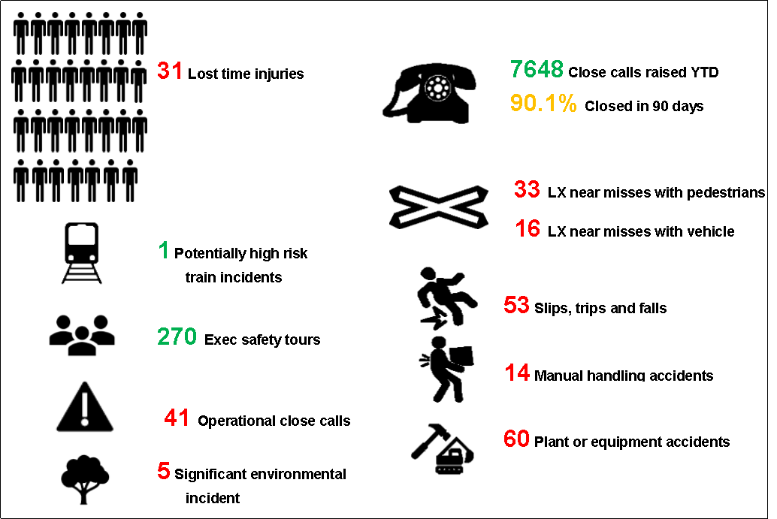
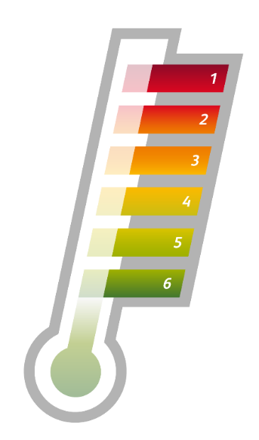
Infrastructure Plant Manual
Plant Operations Scheme (POS) Representative & Skills Assessment Scheme
Update: Knowledge Tests Questions are now Live on Question Tools (AITL)
The POS Representative (POS REP) is a key and vital role on site to help deliver the work safely.
The POS REP competence has a 4 year validity. Renewal is via completed work checks and knowledge testing (completed by a Skills Assessor).
The Knowledge Tests Questions for the POS REP competence are now Live on Question Tools (AITL).
On Track Plant and POS information can be found on the Wessex Plant HUB.
Please contact the Wessex on Track Plant Team for more information or if you require On Track Plant training : WessexOnTrackPlant@networkrail.co.uk

Slide 13


Environment
Nesting Birds Briefing
Bird breeding season officially starts 1st March, however care should be taken prior to this during milder weather.
In 2019 only 4% of breeding bird checks were carried out ‘perfectly’, for example;
• 28% used the wrong form
• 60% gave inadequate location details
• 30% surveyed faster than recommended
The central team are providing briefings on Network Rail breeding bird protocols. Details of the Wessex briefing are below.
Wessex Breeding Birds Briefing
13th February 2020
9.00am-11.00am
Basingstoke ROC, Conference Room
Invites have been sent out to key teams and information will be cascaded, however, anyone is welcome to attend this briefing.
The following links are the existing guidance (2019)
Briefing , Briefing with audio , Schedule 1 guidance , Reporting form

Slide 14

Health & Wellbeing
Time to talk
If you hurt your back moving house over the week end, would you tell your colleagues at work about how much your back is hurting? Would you tell your Line Manager?
If you were struggling to cope because the demands of work and home life was getting too much, would you speak to your colleagues? Would you tell your Line Manager?
If you feel mental health and physical health is treated the same where you work, then great. If not yet, then use some of the resources attached to this pack to start a conversation around mental health.
Please refer to the following supporting materials:
Am I really fine.pdf
Elephant in the room.pdf
TtC Wordsearch.pdf

Slide 15
Health & Wellbeing
Wuhan Novel Coronavirus
A coronavirus is a type of virus which affects the respiratory system. Some of the symptoms include fever and a cough that may progress to a severe pneumonia, causing shortness of breath and breathing difficulties.
Transmission of WN-CoV has been confirmed by the WHO as human to human.
Many of our teams work with members of the public, and even more of us commute to work, so it is important to be aware of the precautions to be taken to keep us all healthy and safe, ensuring everyone returns home safely and exposure is mitigated.
Minimising risk
Colleagues are advised to take precautionary steps to minimise the risk of exposure to viruses or bacteria by:
Washing your hands frequently with soap and water for at least 20 seconds. If soap and water are not available, use an alcohol-based hand sanitizer.
Avoiding touching of your eyes, nose, and mouth with unwashed hands.
Avoiding, where possible, close contact with people who are unwell. ‘Close contact' is defined as being within 2 metres of a person, for a duration of 15 minutes or more.
Staying at home if you are unwell.
Covering your cough or sneeze with a tissue, then throw the tissue in a waste bin as soon as possible – viruses can live outside the human body for a number of hours.
Cleaning and disinfecting frequently touched objects and surfaces.
Network Rail have produced the Healthy Hour pack that can be found on the link below:
Wuhan Novel Coronavirus Healthy Hour Briefing

Slide 16
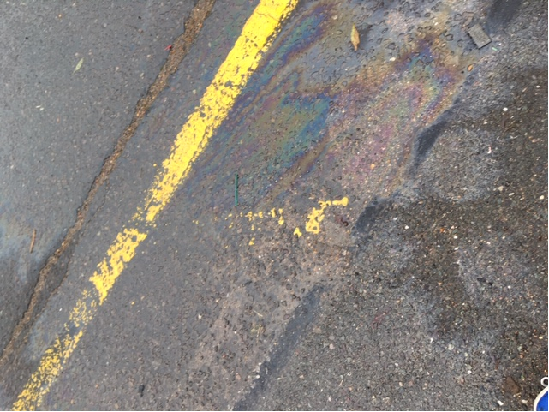
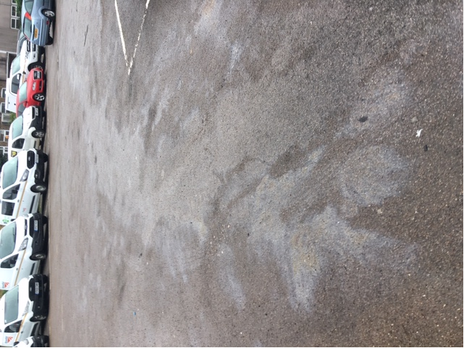
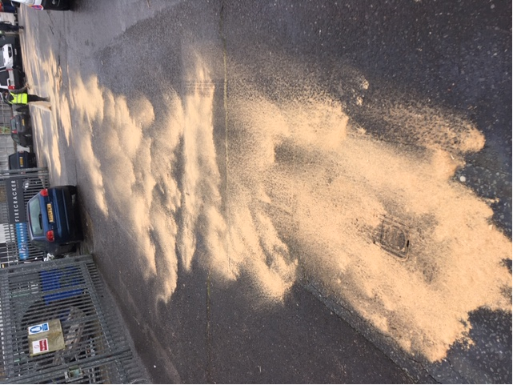

Many Thanks to Nick Murphy, Alan Waterman and Mark Slater who, following a diesel spillage from a poorly connected return fuel pipe, took the time to make the area as safe as possible for all the people who work there and then disposed of the waste generated in a suitable location.

