Slide 1

Health, Safety and Environment Period Cascade for P12 2019/20 Wessex Route

Slide 2
Content
Welcome to your Health, Safety and Environmental Cascade for Period 12 2019/20. Please discuss and share the items that are relevant to your teams and display any relevant Safety Bulletins or Lessons Learnt on your notice boards.
Significant Workforce Events
Near Miss Events – Anglian and Western Route
Irregular Working in Clapham Yard
Irregular Working at Yeovil Penn Mill
Crush injury caused by faulty van breaks – Sussex Route
Points Run Through at Twickenham – Southern Capital Delivery
Trauma – What you need to know
Introducing the weekly Southern Region Safety Conversation
Emergency and Non-emergency numbers – dialling from a company mobile
Fire Extinguisher Servicing and Replacement Contract Change
Community Safety
Plant Manual Update
Environmental Update
Health and Wellbeing

Slide 3




Workforce Safety
Slip, Trip & Fall
04/02/2020 – A TQS was blinded by the lights of the tamper when he turned around after talking to the PICOP on the phone at Poole. He stepped onto a slippery sleeper, lost his footing and fell onto his right side hitting his right knee, hip and lower back NLT
06/02/2020 – After completing the work at Effingham Substation the IP was walking along the Down Cobham cess back to Effingham Station when he tripped on uneven ground and fell over. No injuries were sustained NLT
18/02/2020 – A Signaller was walking on the board walk outside the Yeovil Penn Mill signal box that leads to the car park access gate, when she tripped on a section that was lower than the adjoining concrete. The IP hit her head on the gate, sustaining a swelling to her head and sprained her wrist during the fall NLT
24/02/2020 – Whilst walking along the ballast shoulder in the cess in the Botley area, the IP misplaced his footing, slipped and fell over, sustaining a cut to his right shin NLT
28/02/2020 - Whilst getting out of the van at Upwey station car park the IP put his foot down and his foot twisted a little bit under him NLT
Discussion Points: situational awareness, adequate lighting, boots in good condition
Manual Handling
06/02/2020 – A welder was carrying a gas bottle back to the access point at Earlsfield when he slipped on ballast. The IP fell down onto his knees, landing on a sleeper causing bruising and swelling NLT
Assault
01/02/2020 - Two land sheriffs were physically assaulted at Basingstoke Station whilst trying to remove 4 individuals involved in an altercation on platforms 2 and 3. No injuries were sustained but one of the sheriffs was pushed in face by one of the MoP NLT
Irregular Working
04/02/2020 – Irregular Working in Clapham Yard, details in the cascade
19/02/2020 – Irregular Working at Yeovil Penn Mill, details in the cascade
Significant Events in the Period

Slide 4
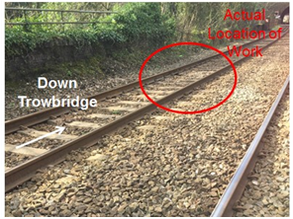

Workforce Safety
Western Route
Date: 26/02/2020
Greenland Mill near miss
On 26 February 2020 members of the Westbury Track team planned to work in a shared line blockage on the Up Trowbridge in order to undertake lifting and packing works. Whilst working on the Down Trowbridge with Hand Tampers, the team were involved in a near miss with a Colas light loco.
The team managed to get to a position of safety only 3-5 seconds before the train passed.
A Level 2 investigation is underway to establish why this happened, and a shared learning will be issued in due course.
Near Miss Events continue
Anglia Route
Date: 20/02/2020
Foxton near miss
Overview At 11:01am on 14th February 2020 a Network Rail track worker from Tottenham Delivery Unit had a near miss with a train. The person was part of a track team working on a reported defect on the Down line at Foxton.
9S25, a GTR service from Cambridge to Brighton was travelling on the Up line through Foxton station. The driver saw a track worker in the four foot of the Up line who was not moving to a position of safety. Another train was approaching on the Down line. The rest of the track team had safely moved to the Down cess.
The train was travelling between 70mph and 80mph toward the worksite. The track worker reacted to the approaching train when it was six seconds away and reached a place of safety with just three seconds to spare.
This event constitutes a significant near miss. This event is currently under investigation and once this has been concluded we will share our findings with you.
Discussion Points:
If all other options have been explored and unassisted lookout warning must be used, how do you test the Safe System of Work?
How do you make sure you have a designated position of safety?
How do you monitor sites to make sure people are following the Safe System of Work that has been applied?
How should the PIC agree what will happen and how people will remain protected?
How do you check that the location you are working in, or are accessing at, is correct as per your planned Safe System of Work?
When signing into a line block with a Protection Controller, how is the safety critical communication carried out? How is understanding checked before authority is given to share the line block?

Slide 5
Workforce Safety
Irregular Working in Clapham Yard
On the 4th February 2020 Waterloo S&T team were responding to faults on CY28 and 651 points at Clapham Junction. The COSS signed into the PC block (Item 28 Queenstown Road to Wimbledon) and then informed the Shunter in person that he had been given permission to work within the possession. He also informed the Shunter that his team would later carry out some maintenance work on W632A points, within the sidings. The COSS was told that shunt moves would cease at approx. 01:30.
The team's work on CY28 signal and 651 pts took longer than expected and they did not finish until approx. 03:30, when they made their way to 632A pts. Before any work commenced, the COSS spotted a train (unit 450014) approx. 300 metres away. As no work had been carried out, the team moved into the blocked UMF and the COSS called the Shunter.
When queried why a train was being signalled in the team’s direction, the Shunter admitted that even though the COSS informed him where his team would be working, he assumed they were still at CY28 signal. It transpired that the practice and process followed during the taking of the sidings possession was not followed by either party and the Occurrence Register had not been filled in correctly by the Shunter.
Actions Already Taken
South Western Railway have put in place a measure throughout their depots where a ‘Permit to Work’ must be issued to any Network Rail team working within their yards/sidings.
If you are not in possession of this permit, you do not have permission to work in the yard/sidings.
REMEMBER
A clear understanding must be reached by all parties prior to work starting.
CY28 (in red) & 651 pts (in green). 632A pts (in orange). Purple arrow denoting the unit 450014.

Slide 6
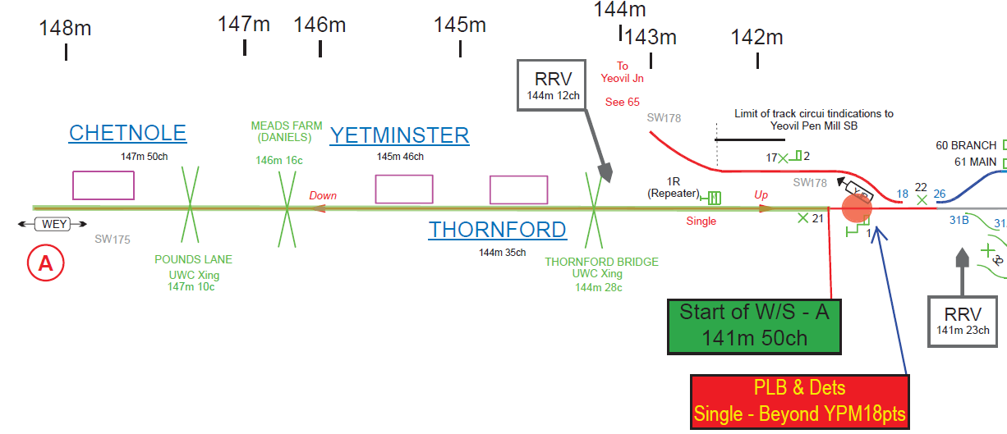
Workforce Safety
Operational Irregularity at Yeovil Pen Mill
On Wednesday morning 19th Feb 2020, following an earlier earth slip on the WEY line at Yeovil Pen Mill , a group of Buildings and Civils contractors signed in with an Engineering Supervisor (ES) of an existing possession (Item 121, worksite A), to undertake emergency earthworks inspection on a railway cutting.
Having received a face to face briefing from the ES, the group led by a Controller of Site Safety (COSS), were of the understanding that the single WEY line and the adjacent YJP line, were CLOSED to train movements at their location.
Whilst the group were standing on the YJP line to plan their task, they were approached by a COSS from another work group who informed them that the YJP line was in fact OPEN to trains . The COSS immediately moved the group to a position of safety (POS) and contacted the ES for clarification. The ES confirmed back to the COSS that they were outside the limits of the worksite and the YJP line was OPEN. Shortly after a train passed on the YJP line at 30mph.
Next steps:
to understand the information used in preparation of the SWP as the partially completed RT9909 showed all lines on site as blocked?
to understand the content of the ES briefing to the COSS and whether a clear understanding was reached?
Location of the worksite group
Line under the possession
Notes:
The work was classed as a rapid response work.
There were a series of conflicting text messages between the COSS and ES on which lines were OPEN.
The ES in his statement said he had provided the COSS with the track diagram of the worksite during his briefing.
Other groups working nearby, had confirmed taking a LB to access their worksite on the YJP line.

Slide 7

Workforce Safety
Crush injury caused by faulty van breaks at Victoria – Sussex Route
At approx. 00:40hrs on Thursday 21st November 2019 the driver of a NWR Movano van parked on the ramp down from Ebury Bridge Road at Victoria behind another vehicle. The other vehicle was a small Citroen caddy style van used by an S&T sub contractor.
The sub contractor was parked on the ramp waiting to access the track as his path was blocked by Road Rail Vehicles (RRV's). The NWR van driver left his vehicle with its engine running whilst enquiring about the access becoming clear.
Whilst the sub contractor was getting some water from the back of his vehicle, he noticed the vacant NWR vehicle heading towards him. He attempted to move out of the way but was crushed between the two vehicles. He sustained lacerations and bruising around the top of the right shin, damage to the knee ligaments and soft & deep tissue damage.
The investigation found the following:
the immediate cause - the handbrake on the NWR van was faulty and therefore not able to prevent the vehicle from moving forward down the slope
the driver’s log book showed that the driver of the van used this vehicle almost exclusively, with the last person using it two months earlier
the driver carried out a partial but not the complete vehicle check that is documented in the driver’s handbook

Slide 8
Workforce Safety
Points Run Through at Twickenham 09/02/2020 – Southern Capital Delivery
The Points Operator had taken the Til-dawn lamp off the “B” end of the 608 points at Twickenham, which had been wound to the correct position and was preparing to wind the “A” end of the points.
The Machine Controller did not check the route and authorised the RRV Operator to move over the points assuming they had been set correctly. This incident is under investigation by the Southern Capital Delivery.
Some common causes that led to previous events when points were run through:
The Machine Controller not walking in advance of the machine and checking that the points are correctly set before authorising the machine through the points.
Til-dawn lamps not used, removed or laying down with the Machine Controller incorrectly believing that this is authority to move through the points.
Poor communication in not reaching a clear understanding between key staff such as machine controllers, machine operators and points operators.
A lack of understanding on the correct position of points in complex layouts (such as switch diamonds or double slips).

Slide 9


Workforce Safety
TRAUMA: What you need to know
Traumatic incident is an experience that causes physical, emotional or psychological distress, or harm. Remember…not all traumatic incidents occur at work!
Some of the examples of traumatic incidents at work are: fatalities on the railway, near misses, accidents at level crossings, incidents of violence or verbal abuse, road traffic accidents or other serious accidents.
The other traumatic incidents that can have an effect and are not work related could include a death of a loved one, serious illness, break up of a relationship, loss of partner’s employment.
No two people will feel the same but these are some of the common effects in the first few days/weeks:
Physical – dry mouth, tension and headaches, shaking, sweating
Behaviour – anger, becoming withdrawn, increased use of alcohol and other substances
Feelings – denial or disbelief, mood swings, irritability
In many circumstances the human mind and body can recover without the need for an active treatment but help is available to all our staff if the need arises.
Validium Employee Assistance Program offers a 24/7 helpline for you to call about issues affecting you at home or in the workplace.
The service is confidential and can be accessed using the details below:
Telephone: 0800 358 4858 or 0330 332 9980
Network Rail dedicated portal: www.validium.com/vclub
• Username: NetworkRail
• Password: onlinesupport

Slide 10

Workforce Safety
Introducing the weekly Southern Region Safety Conversation
Please use in your Safety Hour
This document is to encourage safety conversations in your safety hours or team meetings. You don't have to cover everything in the document but do have conversations around what is relevant in your areas.
Have a good week and please stay safe.
Simon Morgan,
Quality, Health, Safety & Environment Director Southern region
The Safety Conversation is emailed every Monday morning to everybody with an email address and previous issues can be found here: Safety Conversation 240220.pdf
Safety_Conversation_020320.pdf

Slide 11
Our Safety Workshops
Have you signed up yet?
How to book
Inner area – cecile.blackman@networkrail.co.uk
rachel.pryer@networkrail.co.uk
suzanne.wilson@networkrail.co.uk
Outer area – linda.lloyd@networkrail.co.uk
Others - joynul.hoque@networkrail.co.uk
Be there or be square…

Slide 12
Safety Bulletins, Alerts, Advice
Safety-Alert-NRX20-01-Foxton-near-miss.pdf
Shared-Learning-NRL20-01-Hackney-Wick-double-fatality.pdf
Shared-Learning-NRL20-02-Collapsed-excavation-serious-injury.pdf
Issue 82 - Transferable Lessons - Line Blockage irregularity at Briton Ferry.pdf
Issue 83 - Transferable Lessons - CCTV Level Crossing irregularity - Alsager CCTV.pdf
Time-to-Change-Trauma Incident Support TIS.pdf
Lessons Learnt Clapham Yard Irregularity 04022020.pdf
Hand Hygiene - Infection Prevention.pdf

Slide 13

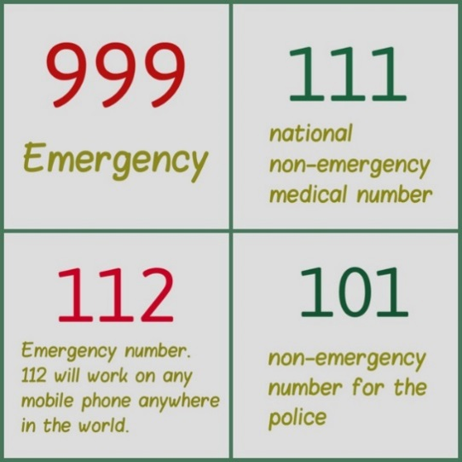
Emergency and Non-emergency numbers
Did you know?
When dialling 101 (non-emergency police) from a company mobile phone, you must use the 9 prefix.
You can make an emergency call from a company mobile phone by dialling 112 or 999 directly.
From desk telephones
To make an emergency call from a desk telephone, either dial 112 or 999 directly or add the prefix 91 and then dial 112 or 999
It is best not to use non-emergency short dial services (such as, 101 and 111) from a desk phone as they are not always supported at all locations due to their geographic nature. Instead, you should use the appropriate full long dial number to make non-emergency calls from a desk telephones

Slide 14
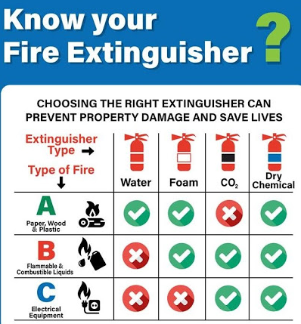
Fire Safety
Fire Extinguisher Servicing and Replacement Contract Change
The maintenance, servicing and replacement of Fire Extinguishers are covered under the following Standard:
NR/L3/FIR/108
Fire Extinguisher Maintenance Form
New Portable Fire Extinguisher Request Form
However, the supplier has now changed and the new contract for Fire Extinguisher maintenance, servicing and replacement is with Chubb Fire & Security
Whilst the Standard is amended, the link below provides all the details of the new supplier:
https://networkrail.sharepoint.com/sites/myconnect/routeservices/Pages/BuyorMaintainFireExtinguishers.aspx
Contract duties include:
Annual service of all portable fire-fighting equipment
Work arising out of the service, e.g. re-filling used extinguishers and replacement of defective and life-expired equipment
Call-outs to re-fill used extinguishers and call-outs for any other defects
Supply of new equipment on instruction from Employer's Representative
Maintenance of asset database including scheduled service dates
5 yearly maintenance procedure and test
10-year extinguisher maintenance procedure and test (inclusive of Hydraulic pressure test)
The contract runs until: 31 October 2021

Slide 15

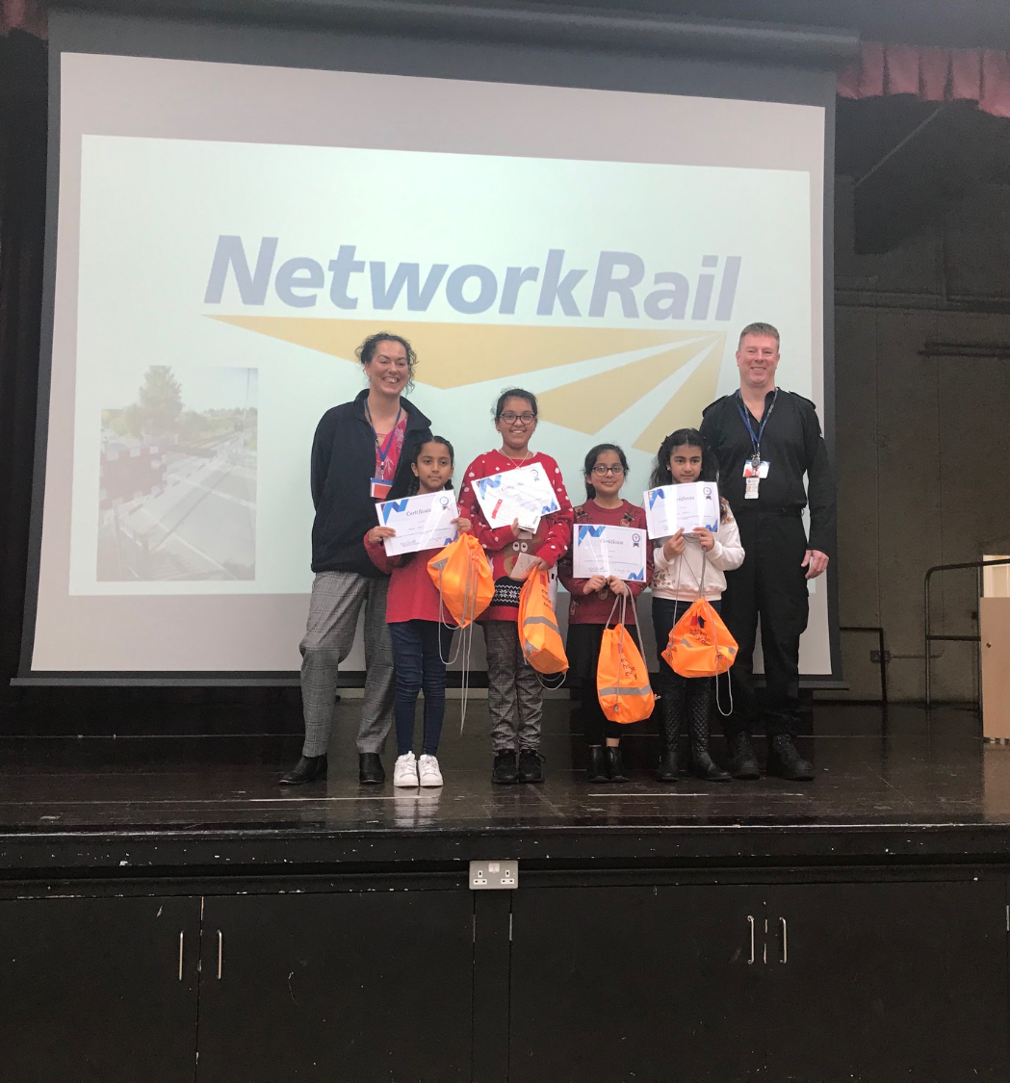
Community Safety
Rail safety sessions delivered to 8,000 young people across the route since the school year began – taking the total number to 48,500 since the program began in 2018
160 rail safety sessions delivered at 2 Junior citizens events
2 additional films created which look at the consequences of making the wrong choice on the railway
Media 1 - BTP.mp4
Media 2 - SWR.mp4
Working with Basingstoke and Deane Borough Council to improve railway underpasses in the Winklebury area
Brilliant project with Mount Pleasant Junior School in Southampton – the school children surveyed their local level crossing and designed safety leaflets and posters to encourage their local community to use the level crossing safely
Weymouth safety center now has tracks – donated and installed by Network Rail, a level crossing donated and installed by Strail and Dyer and Butler will donate and install a platform
Various local authorities from across the route are working in partnership with Network Rail to promote rail safety sessions
Various contractors are now volunteering and helping to deliver rail safety sessions

Slide 16
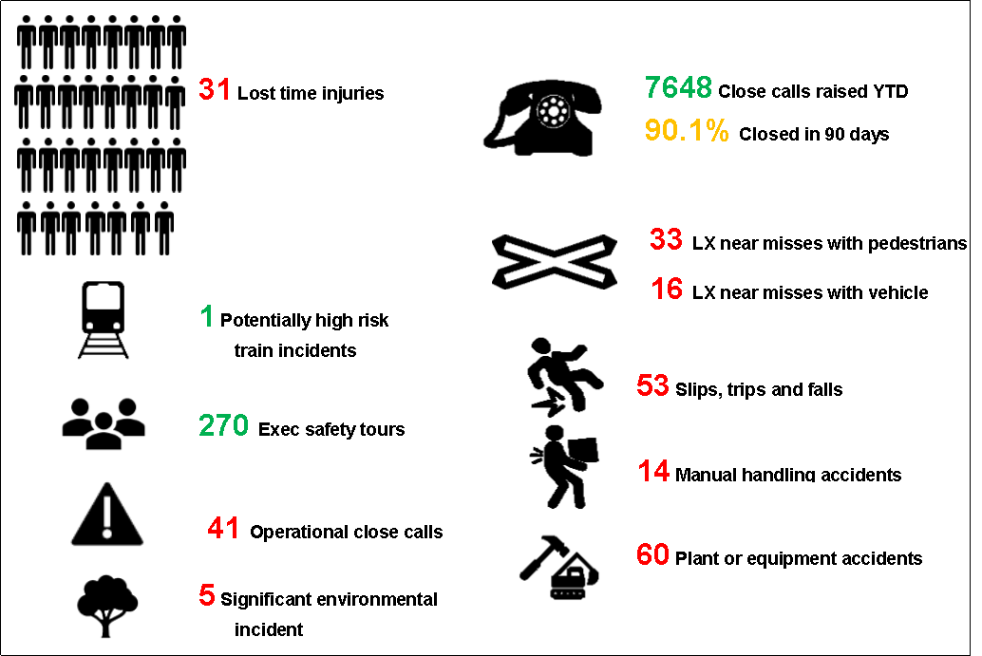
Infrastructure Plant Manual
Guidance for Planning Any Line Open (ALO)
Where plant can foreseeably foul an open line, then the Guidance in COP0032 must be followed and controls put in place.
Link to RSSB:COP0032.pdf
There must always be a documented risk assessment in place if there is an open line when plant is operated on Network Rail managed infrastructure. (See notes for further information).
The Wessex plant team has developed an ALO work plan that is currently being briefed across the route and is available on the Wessex on track plant Hub.
Any Line Open (ALO) - All Documents
If you or your team Plan, Operate or Control OTP, you need to consider ALO.
If you require a briefing or more information, contact the Wessex on Track Plant team:
WessexOnTrackPlant@networkrail.co.uk
Notes:
All lines must be considered as part of the ALO plans process and if there is no potential to foul then this must be documented. We are using the ALO plan as a means of proving onsite that it has been risk assessed and that there is no risk of fouling any open line.

Slide 17
Infrastructure Plant Manual
Guidance for OTP movements authority and associated speeds within an engineering possession, NR/GN/RMVP/0200 Issue 1
There have been a number of collisions between OTP on site, which could be attributed to the control and speed of OTP in worksites.
See NRB20-02 MEWP Collision
Handbook 15 States:
7.4 Speed of movements
The following movements are restricted to a maximum of 5 mph (10 km/h):
over points
anywhere within sidings
controlled from the ground
where speed has not been given by the ES, PICOP or SWL.
Other movements may be authorised by the ES, PICOP or SWL at a speed up to 25 mph (40 km/h).

Slide 18

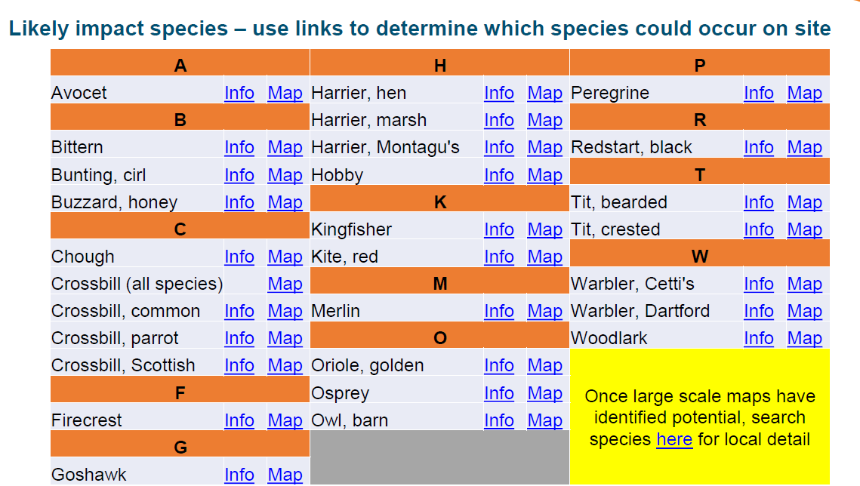
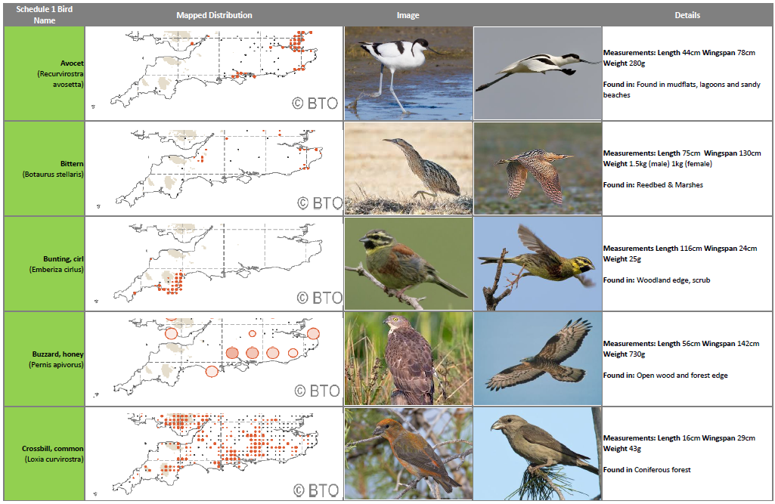
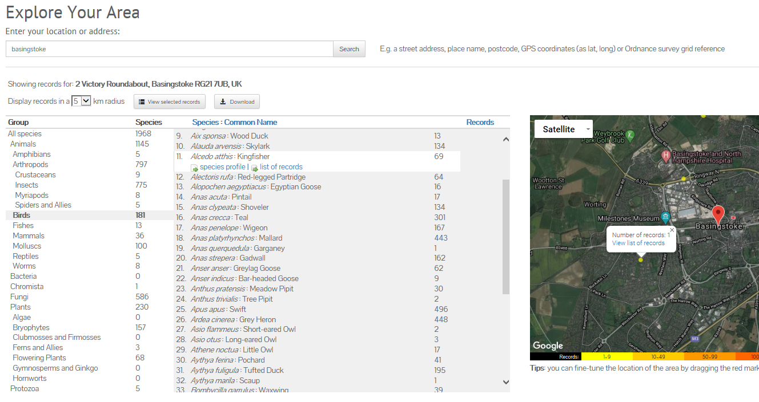
Environment
Schedule 1 Birds
All nesting birds have a degree of legal protection. However, Schedule 1 birds have additional protection and the defence of working to preserve health or public safety do not apply. More detail on legal restrictions can be found in the briefing link at the bottom of the page.
Below are images with embedded links to help determine if you are likely to encounter Schedule 1 birds on your worksite.
Image 1 Details 28 Schedule 1 species that could found on NR sites with more info and map links.
Image 2 details the 23 Schedule 1 species that can be found in the south of England- with high level maps, images & common habitats detailed.
Image 3 shows an example of how NBN Atlas can be used to find more detailed mapping of past species sightings.
The following links are the existing nesting bird guidance (2019), the 2020 updated slides have not yet been made available but will be loaded on Safety Central in due course. Briefing , Briefing with audio, Reporting form

Slide 19
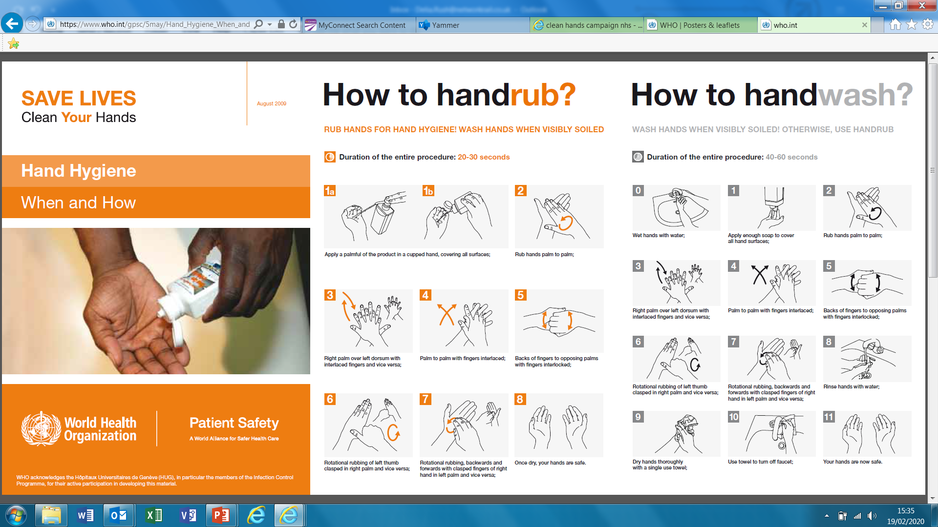
Health & Wellbeing
Good Hand Hygiene – Critical for Infection Prevention
Personal size hand sanitisers can be ordered from Office Depot via I-proc. Product code: 8590673

Slide 20
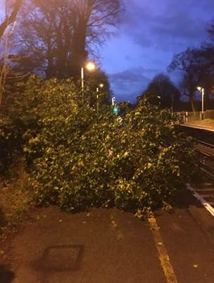
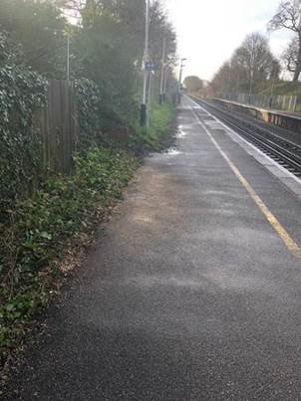
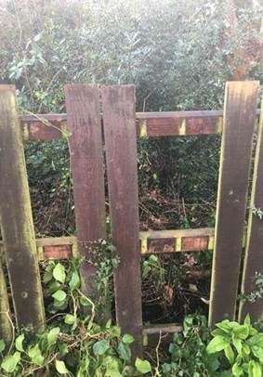
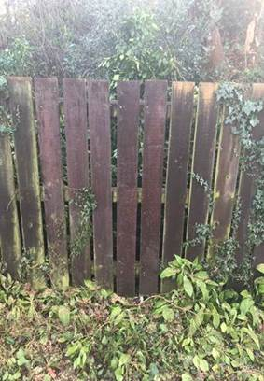
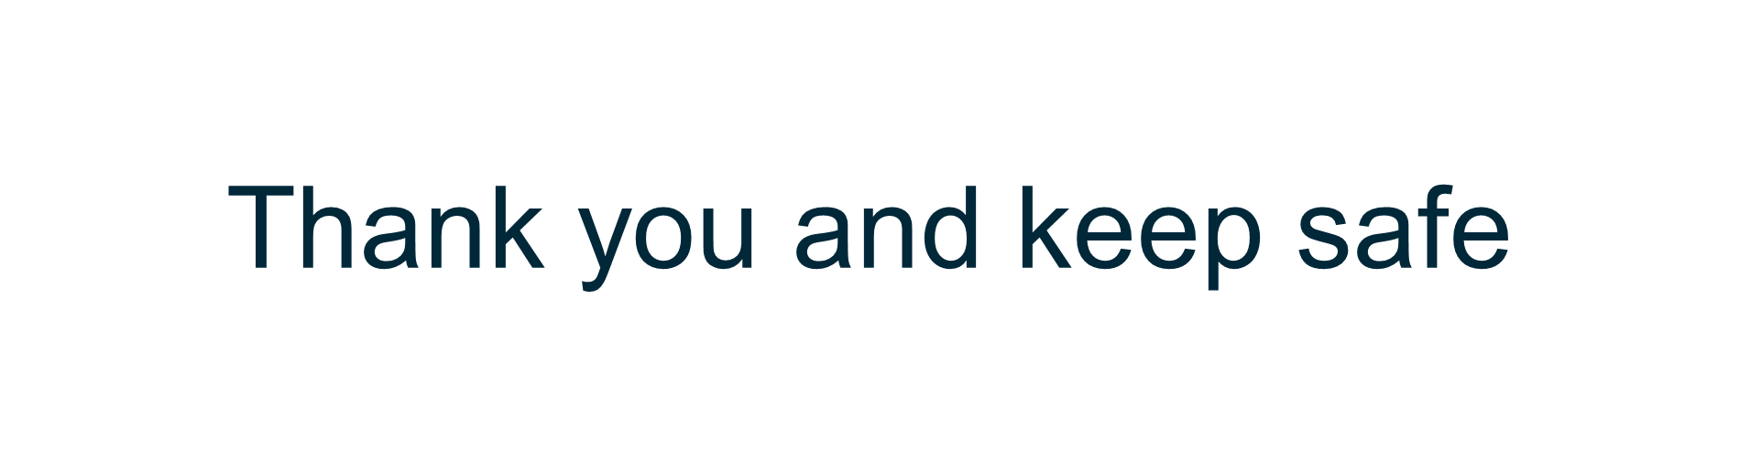
Number of storms battered the route this period but the teams raised to the challenge and worked tirelessly to respond to faults without experiencing any accidents or irregularities so well done to all.

