Slide 1

7
Notes:
Instructions to Managers
To view any links in the slides, you need to have PowerPoint in Slide Show mode

Slide 2

Safety
Significant Events Period 8
Fatality Weighted Injuries (FWI)
0.087 MAA against target of 0.059 for the route
Details of the Accidents:
Lost time injuries
18/10/2020 (Inner DU) IP carrying equipment tripped on a J bracket on the Richmond River Bridge, resulting in a right ankle sprain.
3 days lost time
03/11/2020 (Outer DU) IP caught his foot on top of the rail whilst carrying a stressing saddle in the Andover Up Yard and fell over with his chest landing on a screw spike, (see slide 4 for more information).
The IP is currently still off duty
Key Learning:
Obscured vision and awareness of underfoot conditions when carrying equipment/tools.
Discuss with your team the key learning points from the accidents this period
Notes:
FWI measure explained
Network Rail defines a work place injury as any injury sustained by staff, both direct employees and contractor/suppliers, while undertaking activities connected with Network Rail’s business.
All reported injuries are to be entered into SMIS, the companies corporate Safety Management Intelligence System.
Fatality weighted injury rate (FWIR) is a KPI that uses the following calculation:
The number of fatalities, plus the (number of specified injuries / 10) plus the (number of 3+ lost day injuries / 200) plus the (number of all other injuries / 1000) divided by the hours worked, multiplied by 1,000,000, over the last 13 periods
RIDDOR reporting shall be based on the requirements of the RIDDOR 2013 regulations and the ORR guidance http://orr.gov.uk/__data/assets/pdf_file/0010/2332/riddor-guidance.pdf.

Slide 3
Safety
Significant Events Period 8 continued
Operational Close Calls
29/10/2020 (Outer DU) the driver of 2N23 reported an alleged near miss on the Down Frimley line with a team carrying out HV cable inspections between Camberley and Bagshot station, (see slide 7).
02/11/2020 (Inner DU) whilst installing a temporary speed magnet in a line blockage on the Up Main Slow line at Wimbledon the magnet fell from the shoulder of one of the staff onto the running and conductor rail.
03/11/2020 (Outer DU/Ops) a miscommunication between the signaller and PSS led to the signaller believing that signal EW209 was keyed to danger and subsequently sending a tamper down whilst the signal was still showing a green aspect. The PSS gave up his line blockage without making the signaller aware he did not key the signal to danger, confirming the line was clear and safe for passage of trains.
08/11/2020 (Inner DU) the driver of 2C54 reported striking a possession limit board and detonators at Queens Town Road on the Windsor Reversible after the possession was given up. The PSS confirmed that he failed to remove the protection from the line.
12/11/2020 (Inner DU) whilst lifting and packing in the vicinity of 1570b pts at Waterloo a shovel came into contact with a live floater adjacent to the worksite.
14/11/2020 (Inner DU) a track trolley was moved from a blocked Up Main Fast line onto an open Up Main Slow line at Clapham Junction and a rail grinder came into a contact with a live conductor rail, (see slide 5).
Key Learning common throughout:
Importance of local knowledge and good understanding of plans and permits.
Stop, Think and Take 5 for Safety and always challenge if you think something is unsafe.
Importance of dynamic risk assessment.
Good quality of Safety Critical Communications and clear understanding.
Discuss with your team the key learning points from the incidents this period

Slide 4
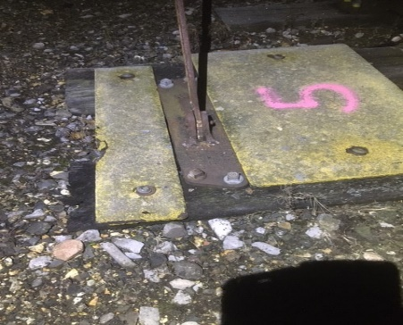
Serious Accident
Andover Up Siding/Yard, BAE1 66m20ch
Overview
On Wednesday 4th November 2020, a member of staff was setting up a worksite in preparation to fix a rail defect. With the assistance of another team member the Injured Person (IP) had collected the Stressing Saddle from the vehicle and proceeded to carry it, to the rail trolley to be transported to the site of work. The team thought about the requirement for manual handling and parked their vehicle as close as possible to reduce the carrying distance.
On stepping over a rail, the IP missed his footing catching the rail. Unable to stop the fall, the IP struck his left leg on the rail, but his right side of chest landed on a screw spike.
Initial assessment and First Aid were given on site, but a decision was made to transport the IP to hospital for a check-up. Whilst X-ray’s and scans identified no breaks or internal damage, the bruising to the chest area was significant and the IP was kept in hospital for four days followed by a significant period off work to recover.
The full Safety Bulletin can be found here
Key Learning and Discussion Points:
How you assess the worksite to identify potential hazards that could cause an incident and/or injury.
Being aware of worksite hazards and taking extra caution when moving heavy equipment.
Being aware that even the most innocuous fall could result in potentially serious injury that should not be overlooked or dismissed. A hospital check-up should always be considered.
Discuss with your team the above points

Slide 5
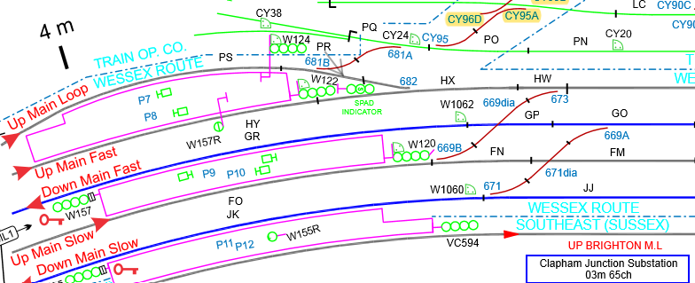
Serious Incident
Clapham Junction, Up Main Slow line BML1
Overview
On the 14th of November 2020 at approx. 04:00, after completing work in an ES worksite under T3 protection with an isolation, a maintenance team (consisting of P-Way and Welding staff), moved out of a protected and isolated area into an open line and caused an electrical incident when an item of grinding equipment came into contact with a live conductor rail.
The group, under the control of a PiC/COSS carried a hand trolley and their equipment from the Up Main Fast line, crossed over one line and then into adjacent Up Main Slow line which was open to the movement of trains.
The decision to move from the protected line was made by the PiC/COSS, because it was believed a set of points were set against the movement, this was not questioned by others within the team.
This incident is currently under investigation.
The full Safety Bulletin can be found here
Discussion Points:
Do you have the necessary local knowledge and are you fully conversant with the diagrams and maps within your Safe Work Pack and the information included in your Conductor Rail Permit? Do you know where you are?
Do we take the time to ‘Stop, Think and Take 5 for Safety’ or do we let the situation that may be unfolding around us take the lead in the decisions that we make?
Do we feel empowered to challenge our colleagues, no matter their position or standing if they are doing something that we think may be unsafe?
Discuss with your team the above points

Slide 6
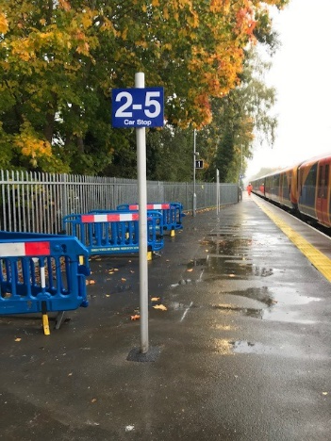
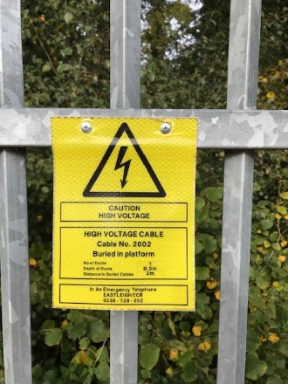
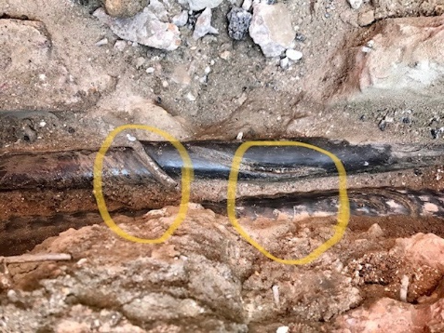
Potentially Significant Incident
Cable Strike at Fleet Station
Overview
On Monday 26th October 2020, a contractor working on behalf of SWR was erecting car stop signs on Platform 1 at Fleet station.
The team proceeded with the excavation without having a buried services survey carried out first. Whilst digging they saw the cables but still chose to place the pole for the sign.
The team came unbelievably close to cutting in to a 33kV cable that would have had serious, if not fatal, implications. In the process they damaged the pilot cable which required some remedial repairs by the Outer E&P team.
This incident is currently being investigated by our SWR colleagues.
Discussion Points:
Did you know that it is quite common for our HV routes to run through platforms?
Importance of using CAT scanners and buried services surveys before any work involving excavation on or near the line.
Should you require buried services information in response to an emergency, please call 01904 386390 to confirm your requirements.
Refer to NR/L2/AIF/1020 for more information
Notes:
The Worksite Survey team based in York provide information on buried assets and services to allow planning for safe ground disturbance works. The standard pack covers all Network Rail assets and services, plus third party information

Slide 7
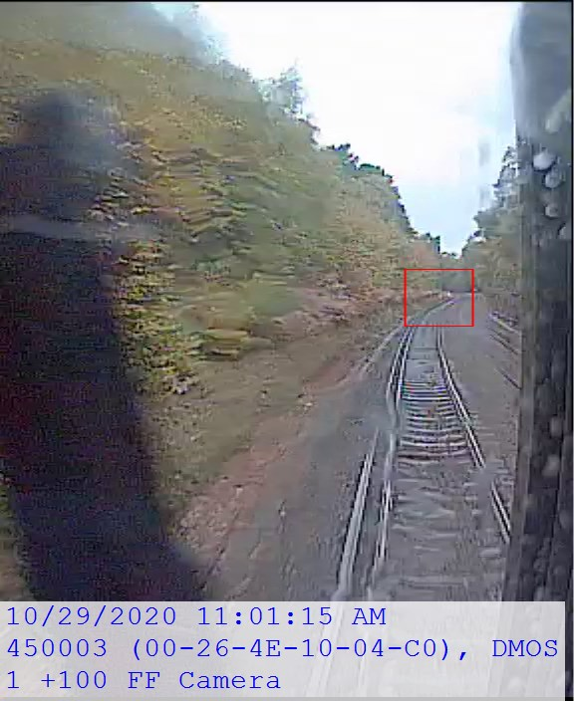
Potentially Significant Incident
Operational Close Call at Bagshot
Overview
On Thursday 29th October 2020 at approx. 11:05 hrs, the driver of 2N23 travelling from Ascot to Aldershot on the Down Frimley line (AVV), reported an alleged Near Miss with a group of 3 members of staff carrying out HV cable inspections between Camberly and Bagshot Station.
The team were walking/inspecting the HV cable route in the cess but when they reached an area with a particularly wet and slippery overgrowth and troughing, they stepped into the 4 foot to walk past the hazardous section.
The lookout positioned at the front of the group gave a warning of an approaching train just before the driver sounded his horn, and the team moved into the position of safety in the cess.
Key Learning and Discussion Points:
The preliminary investigation established that the group were in a position of safety in the Down cess for approximately 11 seconds before the train reached their location, therefore this was not deemed to be a Near Miss.
It was also established that the train was travelling at 44mph but with the line speed of 60mph it would not had been possible to achieve the minimum required sighting distance and therefore the SSOW implemented was not appropriate for the location. The event was classified as an Operational Close Call.
Importance of a dynamic risk assessment to ensure the SSOW in a moving worksite is sufficient and adequate.
How do you ensure/check that you can achieve the right sighting distance, could range finders be used as an aid to assess distance on the ground more accurately?
Discuss with your team the key learning points from this event

Slide 8
Protecting our colleagues
COVID-19 Safe Working Practices
Maintain Social Distancing – you must work at least 2 metres apart.
Where this is not possible and not safe to do so only whilst working outside, follow the good practice:
  Wear safety glasses and gloves to reduce the spread of the virus,
  Cough/sneeze into a tissue and safely discard, if no tissues available, use the crook of your elbow.
  Refer to Southern Region TRC sheet for minimising risk when working under 2 metres - link
If you are required to work within 2 meters of your colleague/s you must wear a face mask or a face shield.
Wash your hands or use hand sanitiser if soap and water are not available more frequently and for at least 20 seconds.
Road vehicles must be single occupancy only unless an approved barrier is installed in the vehicle, then 2 people are permitted. If not practicable to maintain single occupancy, maximum distance between occupants must be achieved by sitting diagonally from the driver, not achievable in small crew cab vans.
Vehicles and communally used desks should be cleaned with sanitizing wipes before and after use.
If you can’t follow any of the steps you must inform your line manager.
If you are told by NHS Test and Trace that you need to self-isolate, you need to notify your line manager who must make sure you do not return to work before the 14 day self-isolation period is complete.
If you or a member of your household are displaying any symptoms of the virus you must stay at home, inform your line manager and order a test immediately at nhs.uk/coronavirus or call 119 if you have no internet access.
Line Managers - If somebody in your teams tests positive and has been to work in the preceding 7 days, you must notify your OHW Manager (Grazia Elsehimy).
Please refer to NR/L3/MTC/CP009 (link) and Southern COVID-19 response FAQ (link) for more information
ACTION

Slide 9
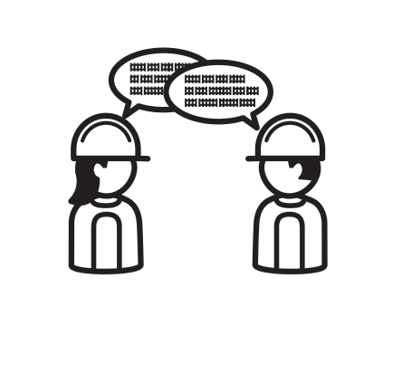


Track Worker Safety (TWS) programme
Update
What we’ll do​
Work with you to remove need for unassisted lookout​ working
Improve the way we plan work
Enable additional protection for line blocks– using technology to protect our track workers​
Reduction in single point of failure​
Supporting effective signaller workload assessment to protect signallers.​
Our survey said…​
​
You said you wanted to interact with technology
Tech demo days
Videos coming
You are concerned there are more night shifts
Your FAQ on MyConnect
You want more information
Newsletters, drop-in sessions, focus groups
Visit MyConnect page
What we’ve been up to​
Reviewed over 130,000 Maintenance Scheduled Tasks to give them highest form of protection
Focus Groups on additional protection
Zoom into safety regional call
Sharing forum for section Planners
Search ‘Southern Track Worker Safety’ on MyConnect
WessexTWS@networkrail.co.uk

Slide 10
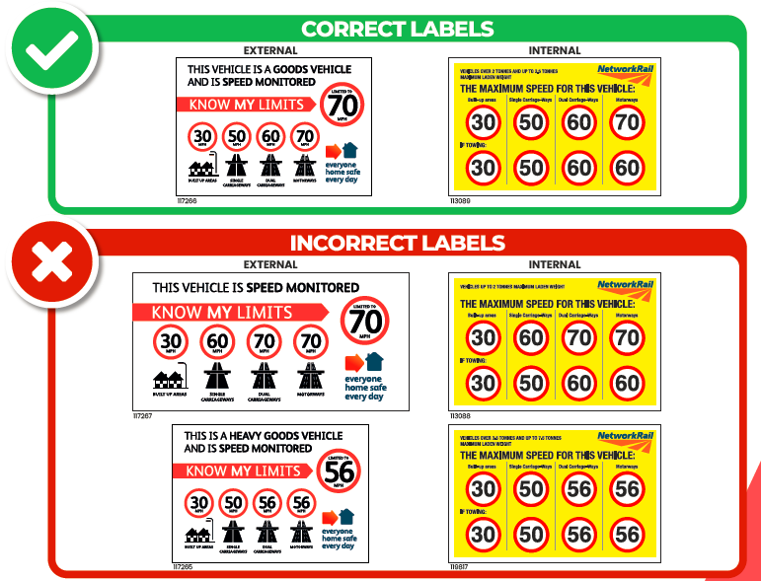
Road Safety
Incorrect Speed Limit Labels
We have been made aware of a batch of Ford Transit Connect vehicles that may have been supplied with an Incorrect Speed Limit label. Could you please check these vehicles to ensure the correct label (please see below) is in position on these vehicles.
To obtain the correct stickers please contact the Road Team Fleet SouthernRegionRoadFleet@networkrail.co.uk
they can then arrange supply of replacement labels.
ACTION
Check the speeding stickers on your vehicles

Slide 11
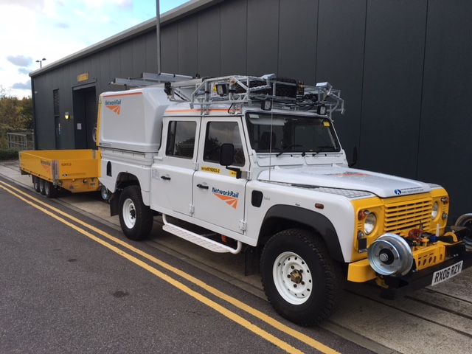
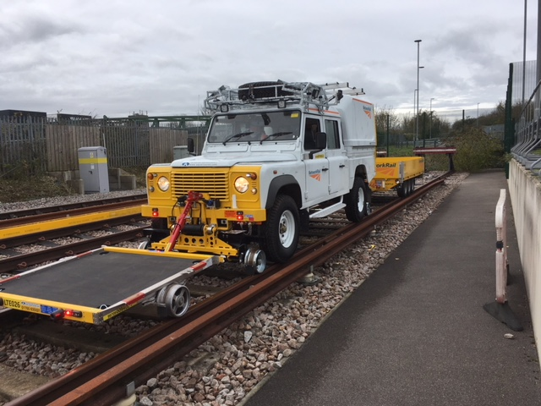
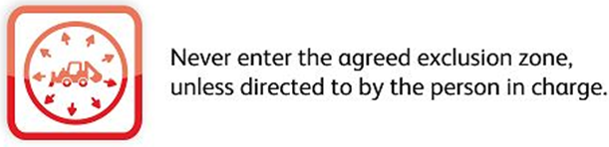
On Track Plant
Upgraded Rail Land Rover and R2R Trailer
The third upgraded Rail Land Rover was delivered to Wessex in October
The list of Safety improvements and upgrades include:
A Road and Rail R2R trailer with a payload of 2400kgs on the road and 3000kgs on rail.
Load Tray Extension trailer with a load carrying payload of 480kgs with Up & over roof rack to transport it on the road.
New directional LED lighting at the front, rear and on the sides to improve site lighting all around the site of work.
A 360 degree camera system to give the driver/operator a 360 degree view to assist with maintaining the exclusion zone.
Repainted white to comply with the our NWR road fleet with new NWR signage.
Seating for 6 occupants with seatbelts and personnel carrier MC controls in the rear compartment.
This Rail Land Rover is currently being used for training purposes at the Basingstoke ROC but will be allocated to Havant P-way.

Slide 12


Environment
Environmental Training
An Environment and Sustainability training catalogue has been produced by the region to provide you with details of all the environmental and social training available within Network Rail. This can be accessed on the Southern Sustainability Hub site. The catalogue is your one stop shop to accessing environmental and sustainability eLearning available on the Network Rail eLearning site, as well as the classroom-based courses such as the IEMA Environmental Sustainability Training. The guide provides examples of key roles that each classroom course is suitable for, as well as the steps to finding the e-learning courses on the Network Rail E-Learning site. The region is ready to deliver the first virtual IEMA training courses before on 15/16th December 2020.
Environment Induction*
This eLearning provides a basic introduction on environmental awareness, including legal requirements and why they are important, company specific information such as the policies, Lifesaving Rules, and the safety vision.
Duration 30min-1hr
Suitability: All
*If you have any access issues using Internet Explorer please try using a different browser.
Book yourself onto the waitlist via oracle now

Slide 13
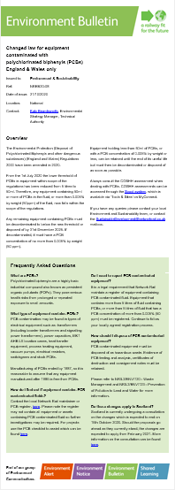
Environment
Legal Update: PCBs (Polychlorinated biphenyls)
The Technical Authority have released an environmental bulletin detailing legal changes associated with PCBs. For the full bulletin visit the Southern Sustainability Hub Site. What are PCBs? PCBs are a highly toxic fluid and prolonged or repeated exposure to small amounts can pose serious health risks. Where are PCBs found? They are usually found in the following types of electrical equipment manufactured before 1986: transformers (including booster transformers & signalling power transformers), power capacitors, MK1 AHB LX location cases, heat transfer equipment, process heating equipment, vacuum pumps, electrical resistors, switchgears and stock PCBs. If the volume of the PCB fluid is greater than 50ml, decontaminate or dispose of the equipment by 31st December 2025.
Please refer to NR/L2/ENV/120 - Waste Management and NR/L2/ENV/123 - Prevention of Pollution to Land and Water for more information.
ACTION

Slide 14



Health and Wellbeing
Reminder to complete the process
REQUESTED
BOOK
PROTECT
Your voucher
your jab
yourself
If you requested your flu voucher, then follow the link in your email to book your jab today!
ACTION
Remember the scheme only runs until 31/12/2020!

Slide 15
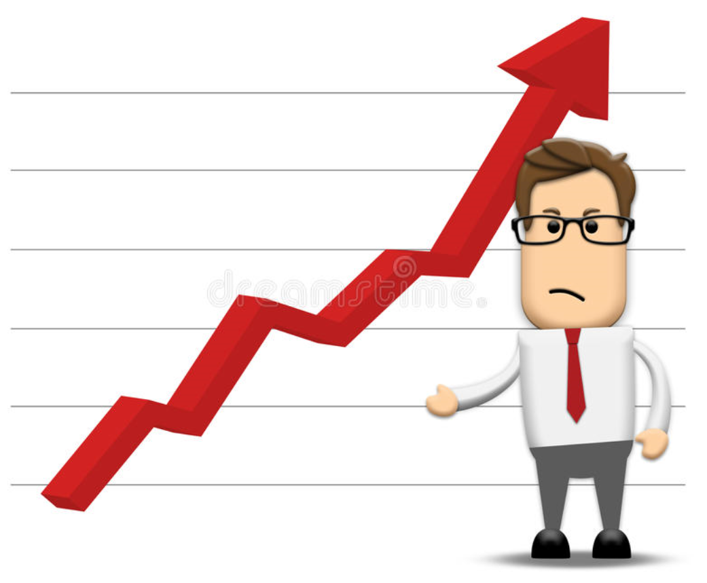
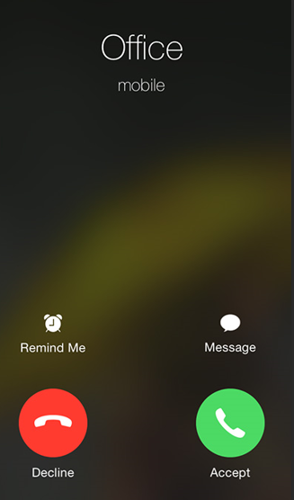
Health and Wellbeing
Talk Money
Money related worries often have a significant emotional impact and recent research shows that being in debt has a negative impact on individual’s mental health.
With this in mind, Validium have recorded a short podcast (LINK) to help with raising awareness of support that is available to our staff.
There really is help available and it costs nothing more than a few minutes of your time to pick up the phone and speak to one of the team to see how they can help. Validium can support you to help you to manage your worries, coping strategies to minimise the feelings of anxiety or stress. They can also link you in to PayPlan who are one of the UK’s leading free debt advice providers.
Validium
0800 0833324
£
WORRIES
Impacts on wellbeing
Anxiety
Stress
Depression
You can get the help you need to stop debt from spiralling.

Slide 16
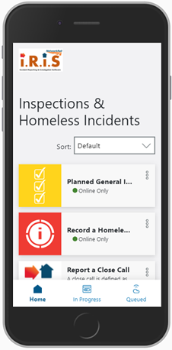
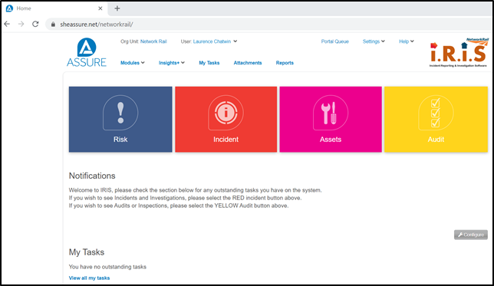

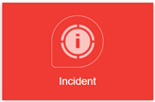
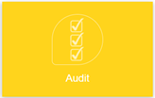
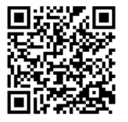
Safety Investigations & PAISS
IRIS system
IRIS is a web-based safety management system that brings together investigations, assurance inspections, Close Calls, and TOC incident reviews (performance), to enable effective management of actions and drive better insights from the data, so we can avoid risks materialising. Watch period 4 Team Talk for more information.
To access safety investigations,
go to https://sheassure.net/networkrail
Username is firstname.surname
Key Benefits
Brings a number of key activities into one place which means one system to access and a single version of the truth
Efficient action management, tracking and notifications
Ability to store evidence and photographs
Greater assurance on the quality of these activities
Easier to facilitate best practice sharing of findings
To access the PAISS inspections, go to https://mobile.sheassure.net/networkrail/p/Assurance-mSkmDcreKW
or scan the QR Code
Ensure you use the IRIS system for safety investigations and PAISS inspections (guidance and video in notes)
ACTION
Notes:
Instructions to Managers
The safety investigation process was reviewed as part of the Southern region’s Quality Improvement Programme (QIP) and that review highlighted a number of gaps in terms of the ability to track L1 investigations & actions, duplication in L1 & L2 investigations and sub-optimal insights from the data captured. The solution was clear – an integrated end to end system. Following a procurement process the SHE Assure system was purchased (branded IRIS by Network Rail). This is the same system used by HS2, and in the configuration process we have worked extensively with frontline staff and experts.
Safety Investigations:
An extensive training programme is largely concluded with most competent safety investigators trained on IRIS and given appropriate access.
Link: https://sheassure.net/networkrail
As a reminder the Username is: firstname.surname
User guides and videos can be found in the attachments area from the IRIS landing page
PAISS (previously known as PGSIs):
As per the requirements from Standard (SE0117), certain roles are expected to undertake PAISS inspections (previously known as PGSIs). Pre-COVID these were either undertaken on CMO or via spreadsheets/paper forms. Since March 2020 there was a new MS Forms question set launched predominantly to manage COVID risks. The Regional team have now worked with colleagues to develop a revised PAISS form which takes elements from the old CMO PAISS form and the COVID MS Forms questionnaire to combine to a single PAISS form, which better reflects the balance of risk between BAU safety risks and COVID. This is the new agreed way of doing PAISS inspections and overall compliance will be reviewed at various governance forums, including Route and Regional BACs (Business & Assurance Committees). To access the PAISS inspection, Open up the Safari web browser on your iPhone or iPad and copy this link into the search bar: https://mobile.sheassure.net/networkrail/p/Assurance-mSkmDcreKW
The process for undertaking PAISSs can be found at
https://networkrail.sharepoint.com/sites/myconnect/southern/Documents/Forms/AllItems.aspx?id=%2Fsites%2Fmyconnect%2Fsouthern%2FDocuments%2FPAISS%2Epdf&parent=%2Fsites%2Fmyconnect%2Fsouthern%2FDocuments
And a video tutorial can be found here https://web.microsoftstream.com/video/9d9ee531-5d29-4a98-be05-ba964a07ea6f

Slide 17

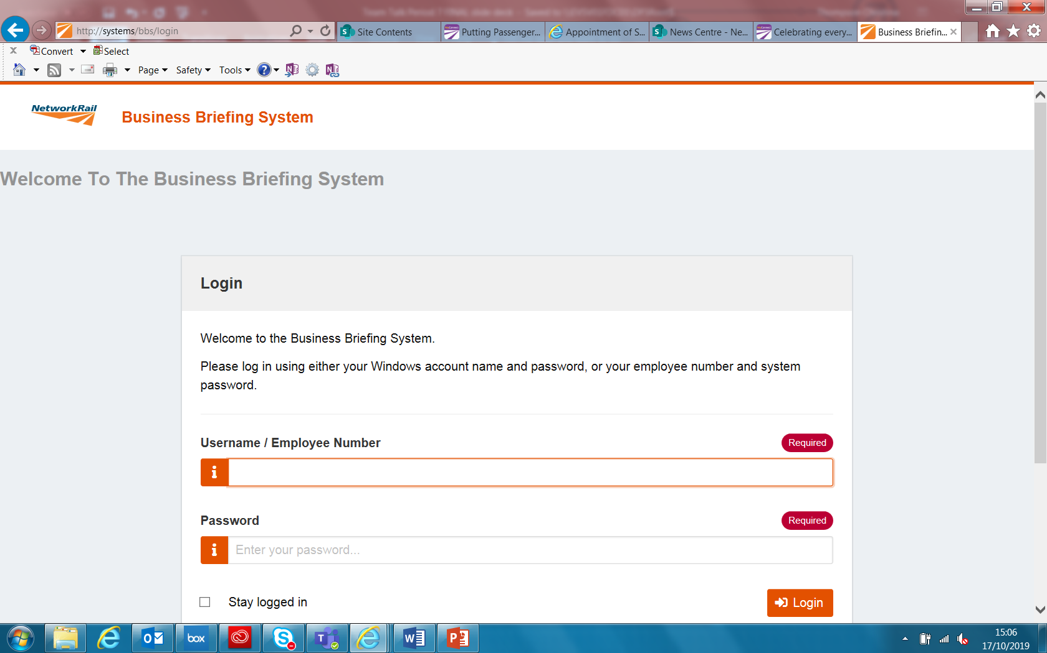
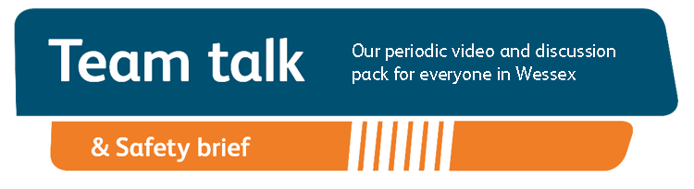
Remember to record that you have watched Team Talk
Click here for a guide on how to use the new Business Briefing System to do this
7

