Slide 1

7
Notes:
Instructions to Managers
To view any links in the slides, you need to have PowerPoint in Slide Show mode

Slide 2
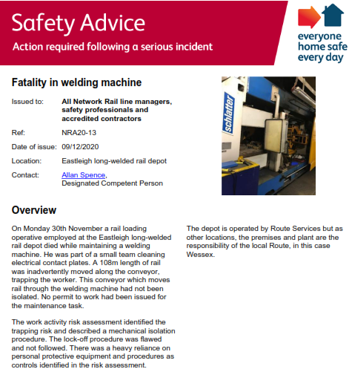
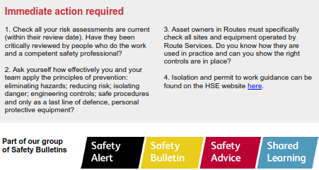

Safety
Fatality at Eastleigh Long Welded Rail Depot
If you or your colleagues are affected by this tragic event please use our employee assistance programme Validium on 0800 358 4858.
Safety-Advice-NRA20-13-Fatality-in-welding-machine.pdf

Slide 3
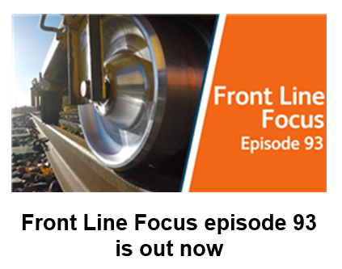
Safety
Front Line Focus Episode 93
Watch the latest episode with your teams - link
ACTION

Slide 4

Safety
Significant Events Period 9
Sun | Mon | Tue | Wed | Thu | Fri | Sat
15 | 16 | 17 | 18 | 19 | 20 | 21
Week 1
22 | 23 | 24 | 25 | 26 | 27 | 28
Week 2
29 | 30 | 01 | 02 | 03 | 04 | 05
Week 3
06 | 07 | 08 | 09 | 10 | 11 | 12
Week 4
Fatality Weighted Injuries (FWI)
0.07 MAA against target of 0.059 for the route
Details of the Accidents:
Lost time injuries
29/11/2020 (Inner DU) a member of staff sustained a fracture to his left thumb as a result of a fall whilst carrying fish plates (see slide 7 for more information) 7 days lost time.
06/12/2020 (Inner DU) a member of staff suffered a low voltage electric shock from a track circuit and a foot injury whilst carrying out welding on 752a pts at Wimbledon during a renewal of a half set of switches. Under investigation, 7 days lost time.
Other injuries
05/12/2020 (Outer DU) a member of staff suffered discoloured vision and headaches as a result of a piece of tin foil , that was moved by wind, making contact with running and con rail and causing flashover.
10/12/2020 (Outer DU) crush injury to a hand after a bullhead chair was knocked off a sleeper whilst unloading a flatbed vehicle at Yetminster.
3 x slip, trip and fall (STF) accidents
1 x manual handling related accidents that resulted in a STF
Accidents
Notes:
FWI measure explained
Network Rail defines a work place injury as any injury sustained by staff, both direct employees and contractor/suppliers, while undertaking activities connected with Network Rail’s business.
All reported injuries are to be entered into SMIS, the companies corporate Safety Management Intelligence System.
Fatality weighted injury rate (FWIR) is a KPI that uses the following calculation:
The number of fatalities, plus the (number of specified injuries / 10) plus the (number of 3+ lost day injuries / 200) plus the (number of all other injuries / 1000) divided by the hours worked, multiplied by 1,000,000, over the last 13 periods
RIDDOR reporting shall be based on the requirements of the RIDDOR 2013 regulations and the ORR guidance http://orr.gov.uk/__data/assets/pdf_file/0010/2332/riddor-guidance.pdf.

Slide 5
Safety
Significant Events Period 9 continued
Operational Close Calls
15/11/2020 (Possession Management Group) Possession Irregularity in WON Item 41 as a result of a member of PSS placing a possession limit board and detonator protection beyond instead of on the approach to the protecting points E475 at Eastleigh Sth Jn.
03/12/2020 (Inner DU) Electrical tripping occurred at Norbiton as a result of an uninsulated spanner coming into contact with the conductor rail (see slide 8 for more information).
Operational Close Calls

Slide 6
Significant Accident
Fractured thumb at Pirbright
Overview
On Sunday 29th November 2020, a member of staff sustained a fracture to his left thumb. The team were taking equipment to site in preparation for the next shift at Pirbright Substation. The IP was carrying a pair of fishplates, weighing approx. 20 kg, in front of his body when he missed a step, falling forward. Whilst trying to break his fall his left thumb got trapped between the concrete step and the fishplates. At the same time as the IP was ascending the steps with the load, another member of the team was on his way down, meaning they had to navigate to pass each other in the limited space.
It was established that only personal head torches were being used by the team at the time. A RRV with a trailer was available and could had been utilised to take the equipment to site.
Initial Learning:
Suitable site lighting must be used not only in worksites but also for accessing/egressing,
Considerate behaviours and looking out for your colleagues to keep each other safe,
Use of mechanical aids to avoid any unnecessary manual handling.
Discuss the initial learning points

Slide 7
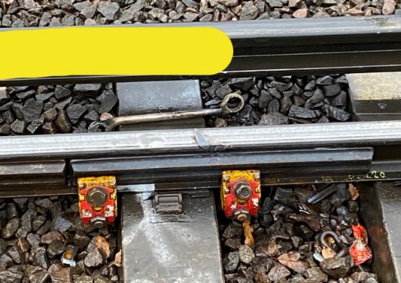
Significant Incident
Electrical Tripping at Norbiton
Overview
On Thursday 3rd December 2020, a two man maintenance team based at Feltham P-Way were requested to attend a fault at Norbiton. A Robel Short Clamp had become detached from a set of plates within the station limits and required replacing. Following a Lineside line blockage being granted, the team began the process of trying to replace the clamp and tighten the other clamps on the plate.
This was done from within the four foot (compliant with TRCS risk level 3) and the team additionally applied a conductor rail shield as a best practice, but a non-insulated ring spanner was used. Due to the severely poor conditions (heavy rain) at the time, the spanner slipped from the top nut of the clamp and the hand of the individual and ‘flipped’ over, making contact with the conductor rail and running rail, producing a flash/bang.
Fortunately there were no reported injuries but the individuals were slightly shaken by the event.
It was established that the team involved were comprised of staff who had recently worked within the night teams and gained their experience working within isolated possession worksites.
Conductor Rail Shield position
Initial Learning:
Insulated and non insulated tools must be stored separately on vehicles – how are you ensuring this is happening? Themed PAISS vehicle inspections must be carried out to ensure that this is undertaken,
Individuals moving from nights to days must be briefed to ensure that they understand the different risks associated to days.
Discuss the initial learning points

Slide 8
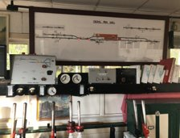
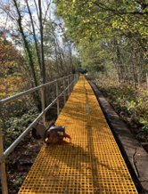

Track Worker Safety (TWS) programme – an update
WessexTWS@networkrail.co.uk​
LINE BLOCKAGES
Yeovil Pen Mill signal box is now live with using the Informed Line Blockage process and Standardised Line Blocks. This means cyclical maintenance line blocks are secured giving certainty of access and reducing Planner workload.
5 more ZKLs (remote TCODs) have been commissioned for use in Wimbledon.
Signal Disconnections available 24/7 at Bournemouth SB and Havant ASC.
Line Blockage Access guides completed in conjunction with Operations to provide visibility of good times to plan access to optimise work.
BETTER TRACK ACCESS
15 locations for new access points of walkways to be delivered by March 21.
Work completed on a new walkway at Effingham Junction
Work continuing on site at Hampton Court.
REDUCING RED ZONE
Locations with good day line blockage availability throughout the day have been identified with operations.
From 1st December red zone working was prohibited for all Wessex Route Maintenance Staff on TTF, LAV and YJP.
Further locations are currently under review with maintenance teams.
Search ‘Southern Track Worker Safety’ on MyConnect​

Slide 9


Track Worker Safety
Front Line Safety Challenge – coming in January 2021
The Wessex Track Worker Safety Programme is launching a Front Line Safety Challenge in January 2021, further details will be shared in due course.
We want to hear your ideas for improvements so get in touch.
Please email your suggestions to the Track Worker Safety Programme - WessexTWS@networkrail.co.uk
Put your thinking caps on
ACTION

Slide 10
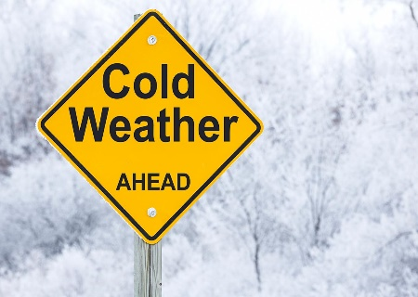
Safety
Focus on Winter Preparedness
Winter safety advice often tells us things that we know already and apply in our day to day life.
For example, we all know that pavements and roads are likely to be slippery when the weather is cold and wet and we know that we should take extra care.
But, even though we all know this and it is common sense, more accidents occur during the winter period as many of us will forget the risks we take when we are in a hurry!
We need to keep each other safe by looking out for each other and highlighting dangers to make sure we all go home safe every day.
Now the winter is upon us, are you and your teams prepared for the inevitable adverse weather?
Do your teams have access to sufficient wet weather PPE?
Are your vehicles winter ready?
Are your depots winter ready?
For more information about Winter preparedness please refer to - Winter-Safety-Brief.pdf
Are you winter ready?
ACTION
Notes:
In 2018-19, 40 injuries were reported between Period 9 and Period 12. Last year 2019-20 saw 37 of our colleagues not going home safe.

Slide 11
Protecting our colleagues
COVID-19 Safe Working Practices
Maintain Social Distancing – you must work at least 2 metres apart.
Where this is not possible and not safe to do so only whilst working outside, follow the good practice:
Wear safety glasses and gloves to reduce the spread of the virus,
Cough/sneeze into a tissue and safely discard, if no tissues available, use the crook of your elbow.
Refer to Southern Region TRC sheet for minimising risk when working under 2 metres - link
If you are required to work within 2 meters of your colleague/s you must wear a face mask or a face shield.
Wash your hands or use hand sanitiser if soap and water are not available more frequently and for at least 20secs.
Road vehicles must be single occupancy only unless an approved barrier is installed in the vehicle, then 2 people are permitted. If not practicable to maintain single occupancy, maximum distance between occupants must be achieved by sitting diagonally from the driver, not achievable in small crew cab vans.
Vehicles and communally used desks should be cleaned with sanitizing wipes before and after use.
If you can’t follow any of the steps you must inform your line manager.
If you receive a notification from NHS Test and Trace and you inform your line manager, the manager must make sure you are advised to self-isolate for 10 days and do not attend the workplace.
As soon as you experience any of the symptoms you must self-isolate for at least 10 days and order a test immediately at nhs.uk/coronavirus or call 119 if you have no internet access.
If someone in your household or support bubble becomes symptomatic, you should not return for 10 days after the onset of symptoms of the first person who became ill.
Covid Co-Ordinator hotline (0330 330 0148) provides support and assistance to the Line Managers if one of their staff tested positive.
Please refer to NR/L3/MTC/CP009 (link), Southern COVID-19 response FAQ (link) and COVID Flowchart (link) for more information
ACTION

Slide 12

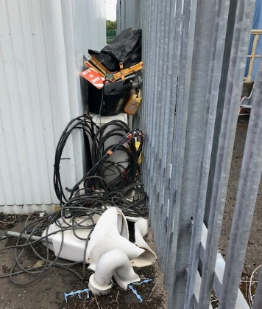
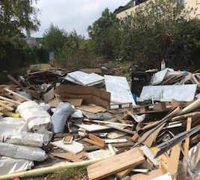
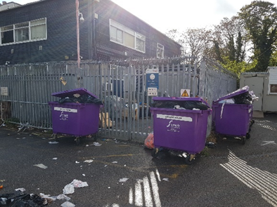
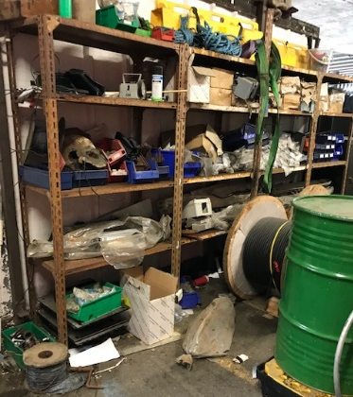
Environment
Depot and site housekeeping Part 1
Housekeeping is more than just clean floors and removing dust and clutter. Good housekeeping also provides the following benefits:
Improves morale.
Helps reduce risk of incidents/accidents (environmental & H&S).
Materials and kit are less likely to get damaged and need to be replaced.
Improving/maintaining stakeholder reputation.
Reduces unnecessary costs in fines.
Improves productivity.
Reduces risk of vermin (there are an estimated 20,000,000 rats in London alone).
Improves security and reduces theft (Wessex has numerous designated Critical National Infrastructure buildings).
Efficient use of available space and improves access
Compliance with H&S at Work Act Section 2.7.
Examples of poor housekeeping
Are your depots and sites tidy?

Slide 13
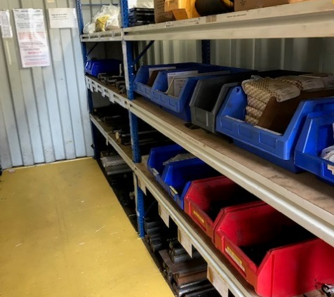
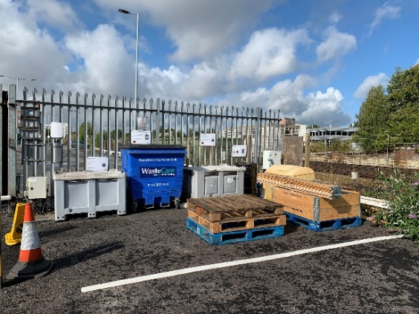
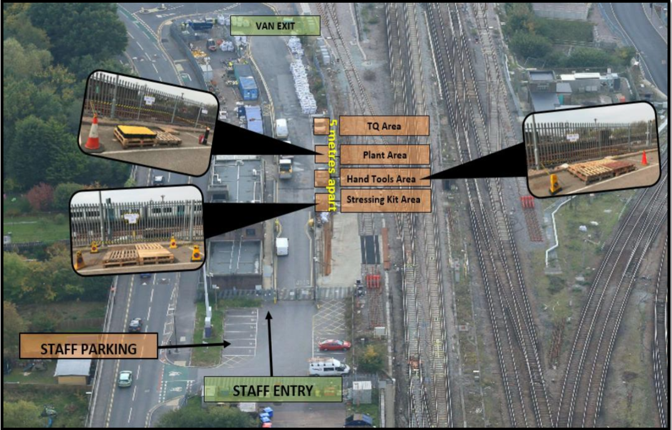
Environment
Depot and site housekeeping Part 2
Housekeeping tips for maintaining a safe and productive railway.
Don’t rely on others to put away your materials or equipment
Define storage locations for specific kit or materials both outside and within storage containers.
Define/specify areas waste management.
Dispose of waste, and surplus materials appropriately. (NR SurPlus App can be utilised to enable reuse).
Conduct weekly walkabouts to identify and rectify emerging issues.
Work with your Maintenance Protection Co-ordinator to assist with the removal of third party waste.
Designate an environmental champion for your depot/location.
Well organised labelled storage, with no trip hazards
Designated and well signed waste area
Site Plans and Maps with defined locations for specific kit etc
ACTION
The standards you walk past are the standards you accept.

Slide 14
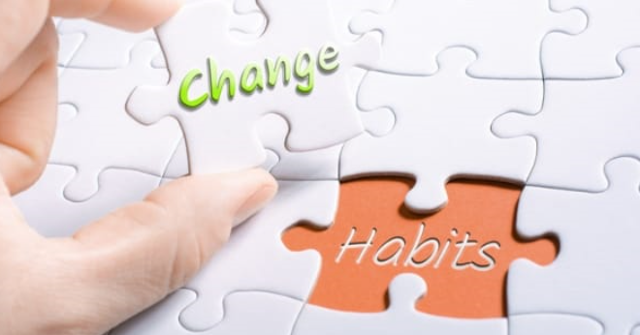
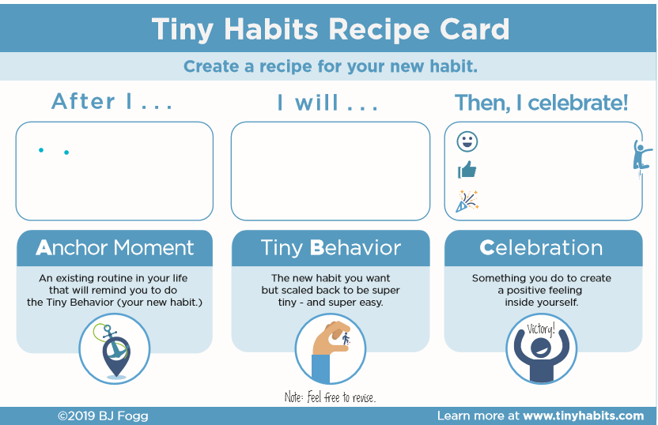
Health and Wellbeing
New Year Resolutions vs Old Habits
Define what you want to change | Go for a 15min walk three times a week – the more specific the better
Use your environmental cues to your advantage. | Link the above activity to an environmental cue. After I finish eating my lunch I will go for a 15min walk.
Celebrate your success – create a buzz | Celebrate the achievement. The more pleasant feelings linked to the 15min walk the higher the chance I will do it the next time.
You can listen to the behaviour expert, Dr Heather McKee on 6th Jan 2020 at 11am. https://www.railwellbeinglive.co.uk/wellbeing-wednesdays/
ACTION
Changing your habits are hard, but NOT impossible.

Slide 15
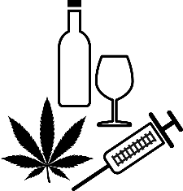

Health and Wellbeing
Alcohol Awareness
If you're looking for some simple tactics for managing the amount of alcohol you drink or you're worried the amount of alcohol you drink may have become a problem, Validium, our Employee Assistance Programme provider have produced two guidance documents:
When is drinking a problem?
Strategies for bringing alcohol consumption under control
Whilst Validium is not a specialist in supporting people with addictions, they would be keen to ensure anyone who calls would be supported and can identify where more specialist help can be found. Telephone: 0800 358 4858 or 0330 332 9980
Network Rail has a zero tolerance approach to individuals attending work whilst under the influence of drugs and/or alcohol.
Do you know how much units of alcohol you drink a week?
Download the Try Dry app on your phone to get visibility of how many units of alcohol you consume per week.
How healthy is your drinking?
Follow the link below and complete the assessment:
https://www.drinkaware.co.uk/selfassessment
More information can be found in Guidance for Line Manager –
here and Safety Hour - here

Slide 16

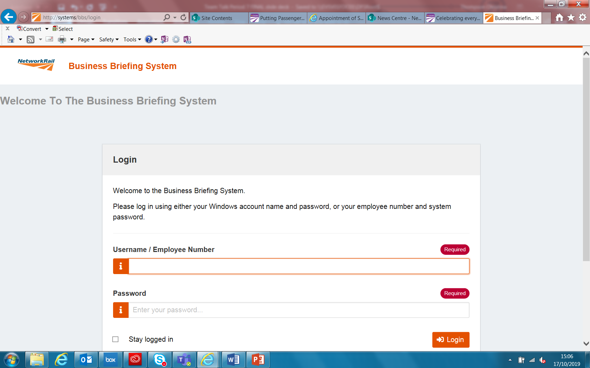
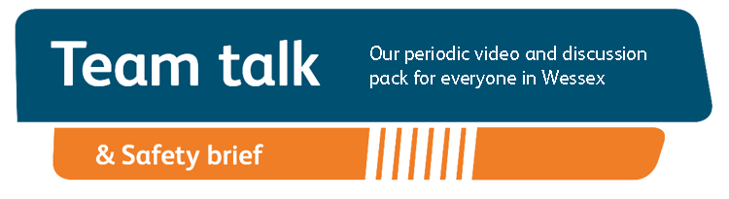
Remember to record that you have watched Team Talk
Click here for a guide on how to use the new Business Briefing System to do this
Also remember to record that you have received Safety Briefing via the Business Briefing System or via the dedicated person in your Business Unit.
7

