Slide 1

7
Notes:
Instructions to Managers
To view any links in the slides, you need to have PowerPoint in Slide Show mode

Slide 2

Safety
Accidents and Operational Close Calls Period 10
Significant Accidents;
STF accident resulting in broken leg bones.
30/12/2020 (Area Services) a member of contracting team working on behalf of Coombes Forestry in the Whitchurch area, slipped whilst walking along an ice-covered troughing route. The individual’s right boot slipped forward on the ice and almost immediately regained traction and grip. During this motion his body twisted whilst his ankle stayed in the same position, he heard a ‘pop’ prior to falling to the ground where he felt the pain in his right lower leg. He was unable to put any pressure on his leg but managed to call for help and was assisted by his colleagues to the nearest access point and then taken to Winchester A&E. It was confirmed that the IP fractured both his fibula and tibia and required surgery. The estimated recovery time is 6 weeks. Investigation ongoing.
Other Accidents
18/12/2020 (Inner DU) whilst lining up a weld in Wimbledon area, a member of staff was struck on his right foot by a pandrol track fastening clip. The individual was part of a team changing defective section of track and one of the clips sprang from it’s housing as it was being secured into place. Investigation ongoing.
Fatality Weighted Injuries (FWI)
0.087 MAA against target of 0.059 for the route
Lessons learnt from these events will be shared once the investigation has been concluded
Notes:
FWI measure explained
Network Rail defines a work place injury as any injury sustained by staff, both direct employees and contractor/suppliers, while undertaking activities connected with Network Rail’s business.
All reported injuries are to be entered into SMIS, the companies corporate Safety Management Intelligence System.
Fatality weighted injury rate (FWIR) is a KPI that uses the following calculation:
The number of fatalities, plus the (number of specified injuries / 10) plus the (number of 3+ lost day injuries / 200) plus the (number of all other injuries / 1000) divided by the hours worked, multiplied by 1,000,000, over the last 13 periods
RIDDOR reporting shall be based on the requirements of the RIDDOR 2013 regulations and the ORR guidance http://orr.gov.uk/__data/assets/pdf_file/0010/2332/riddor-guidance.pdf.

Slide 3
Safety
Accidents and Operational Close Calls Period 10 cont.
Other Accidents continued
19/12/2020 (Station staff) a member of staff at Waterloo station was assaulted by a group of young people.
21/12/2020 (Inner DU) a member of staff driving a NR hired van noticed a broken down vehicle in the distance on the Southbound A3 at Guildford. He started to brake with the flow of traffic but was rear ended by the vehicle behind him and consequently shunted into the vehicle in front, sustaining muscle pain and discomfort.
22/12/2020 (Inner DU) whilst lifting a points tool bag out of a locker at Wimbledon, a member of staff experienced a sharp pain in his right shoulder. See slide 6 for more information.
25/12/2020 (Inner DU) a member of staff was involved in a Road Traffic Collision on his way home from his shift that resulted in a vehicle damage only. See slide 7 for more information.
Operational Close Calls
19/12/2020 (Operations) a Mobile Operations Manager (MOM), whilst responding to a report of an item thrown on to the down line of the operational infrastructure by youths, was involved in a near miss with SWR train 1P57 (Waterloo to Portsmouth Harbour) within the limits of Rowlands Castle station. See slide 4 for more information.
23/12/2020 (Outer DU) a 2 men S&T team were carrying out point maintenance on 2338a pts at Holybourne Oil Sidings outside their booked Line Blockage. Investigation ongoing.
27/12/2020 (Inner DU) a trolley loaded with tools was left in platform 9 at Waterloo after part two of the T3 possession involving this particular platform, was given up. Investigation ongoing.
05/01/2021 (Possession Management Group) a possession irregularity occurred when the PICOP for WON 40 Item 52 instructed 5 of the 6 possession support teams to place protection, failing to instruct the 6th team at Winchester. Investigation ongoing.
05/01/2021 (Operations) a possession irregularity occurred as result of the Wimbledon Signaller granting a Line Blockage which directly conflicted and overlapped with the signal protection for WON 40 Item 16 possession. Investigation ongoing.
Lessons learnt from these events will be shared once the investigation has been concluded

Slide 4
Significant Incident
Near Miss at Rowlands Castle
Overview
On Saturday 19th December 2020 at approx. 19:14 hrs a Mobile Operations Manager (MOM), whilst responding to a report of an item thrown on to the down line of the operational infrastructure by youths, was involved in a near miss with SWR train 1P57 (Waterloo to Portsmouth Harbour) within the limits of Rowlands Castle station. Rowlands Castle station is situated on a curved section of track with a line speed of 70 mph. The signalling is under the control of Havant ASC. The incident occurred during the hours of darkness, all station platform areas on the Wessex Route are red zone working prohibited (RZP).
On his arrival at the station and before attempting to retrieve a bag from the down line, the MOM had contacted the signaller at the adjacent Petersfield signal box regarding train movements, this was not the signal box controlling the signals at this location. There was no formal communication between the MOM and any Signaller regarding use of line blockage protection arrangements. No formal line block protection was put in place.
After an unsuccessful attempt to retrieve the bag of rubbish from a sitting position on the platform edge the MOM jumped into the 4ft of the down line and immediately noticed the headlights of the approaching train travelling at line speed. He immediately jumped back onto the platform and rolled away from the edge on his back and within seconds the train passed through the platform. Investigation ongoing.
Initial learning and Discussion points:
In all circumstances whilst working ‘on or about the line’ the COSS/IWA must set up a safe system of work (SSOW) for the operational risk as defined in the Rule Book GE/RT 8000 and NR/L2/OHS/019 Operational hierarchy,
Your SSOW must be documented in a safe work pack (SWP) or an Incident Response Permit (IRP) prior to undertaking the work activity,
When setting up any SSOW, reference to the Hazard Directory is a pre-requisite; to identify any hazards that are relevant to your SSOW. Do you have access to this information?
The Safety Bulletin can be found here

Slide 5
Significant Incident
Line Blockage Irregularity between Vauxhall and Waterloo
Overview
Line blockage (LB) irregularity between Vauxhall and Waterloo occurred on 2nd October 2020 when the protecting signals were not keyed to danger. The limits were read out by the Signaller and repeated back by the COSS correctly, but there was no mention of any signals requiring to be keyed to danger. The Signaller confirmed that the signal protection was in place and granted the authority number but upon viewing the diagrams, he realised the error and contacted the COSS immediately to give up his line blockage.
The investigation established the following:
The LB was back to back with a possession and after the Signaller granted the possession and then called the COSS for the LB, he overlooked the fact the signals were not keyed to danger.
The Safe Work Pack (SWP) does not list signals that are required to be keyed to danger and therefore may not be apparent to the COSS.
The LB was initially planned for a S&T team and the COSS was aware of the requirements to key the signals to danger. However, on the night the LB was taken over by the local P-way team and the COSS did not know that any signals required keying to danger.
What can we learn:
Any protecting signals requiring to be keyed to danger should be documented in the Safe Work Packs. This will ensure the COSS is aware of the need and can therefore challenge the Signaller to avoid any future error,
When submitting a LB request to the Green Zone Access Coordinator (GZAC) enter “TO BE KEYED” after any protecting signal requiring this activity,
All Planners and Responsible Managers to implement immediately.
Discuss the learning points

Slide 6
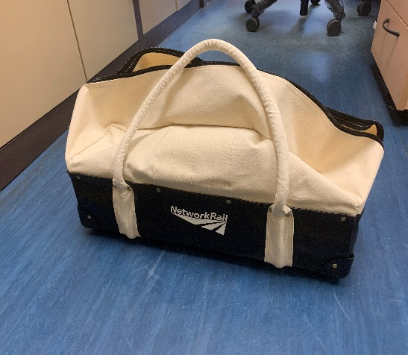
Manual Handling Accident
Shoulder strain
Overview
On the 22nd of December 2020, a Team Leader from Wimbledon S&T was removing a tool bag from a low level locker, to retrieve the tool that was required for the work that was to be undertaken. As the individual was lifting the tool bag (weighing approximately 10kg) out of the way, he experienced a sharp pain in his right shoulder.
The initial pain subsided after 5 minutes, but the Team Leader was still in some discomfort. He was able to continue with his normal duties, but refrained from lifting anything heavy throughout the remainder of the shift in order to prevent further damage to his shoulder.
It is believed that the injury sustained was a repeat of a previously suffered injury.
An S&T Technicians tool bag
What can we learn:
Taking into consideration any pre-existing injuries and how they can be aggravated. Ensure that you make your Line Manager aware,
Weight of the tools and the combined weight of a tool bag together with the repetitive nature of lifting it to and from the locker/work vehicle/site of work,
Good practice to manage an injury – the individual continued to work but implemented control measures to prevent any further damage. Would you had done the same?
Taking into consideration benefits of a warm up at the start of your shift especially if you have any previous injuries.
Discuss the learning points

Slide 7
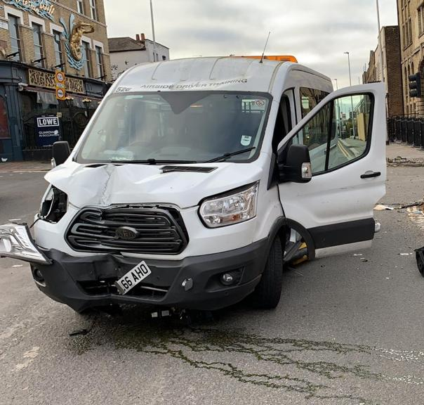
Road Traffic Collision
No injury incident
Overview
On the 25th of December 2020, at approximately 11:30 a member of staff was involved in a Road Traffic Collision (RTC) when his vehicle collided with traffic management lights, whilst on his way home from his shift. Fortunately the individual did not sustain any injury.
The Technician had been working between 23:00 and 11:00 on Christmas morning as part of a Heavy Maintenance Unit team, performing heavy refurbishment works and had been working constantly from the time the team had accessed the track (approximately 04:00) until he left the track at 10:30.
The Technician, had put the in-vehicle heating on and it was reported that by the time he left his depot to go home, the vehicle was very warm.
Investigation ongoing.
Initial learning and Discussion points:
Fatigue kills! The effects of being fatigued cannot be underestimated. The underlying factors that contributed to this incident included the length of the shift, night time working, waiting around to start the work followed by a continuous hard manual labour in cold weather conditions and finally the warm environment created by the vehicle heating,
Quick tips to fight tiredness when driving:
Take a 15-20 min nap,
Make sure you are in a safe place, don’t stop somewhere dangerous, like a motorway hard shoulder,
Drink 2 cups of coffee or another caffeinated drink.
Discuss the initial learning points

Slide 8
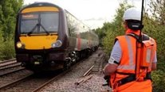

Track Worker Safety (TWS) adds protection
WessexTWS@networkrail.co.uk​
EXTRA PROTECTION GOES LIVE​
Basingstoke Track Section will benefit from Look Out Warning System (LOWS) to help keep track workers safe whilst they carry-out their inspections and maintenance on track from 11th January. ​
​Wider roll out is being planned with equipment on order for further teams and delivery of training locally to take place throughout next year. ​
CALLING SECTION MANAGERS AND MAINTENANCE ENGINEERS​
​
Chris Cornish, Infrastructure Director and Eric Woodward, TWS lead in Wessex, will be speaking to IMDMs, IMEs and their teams about the TWS programme and why we need your help to save lives. The call will take place on 26 January. Please do attend if you receive an invite.​
​
FIND OUT MORE ON TWS:​
​
Newsletters, drop-in sessions, calls, focus group​s​
Visit MyConnect p​​age
Or contact eric.woodward@networkrail.co.uk
Additional Protection for Line blockages
From 10th January all maintenance line blocks are being planned and taken with additional protection provided by a signalling disconnection taken by the Control Centre Technician. This is available for all departments, functions and disciplines and Bournemouth joins Havant ASC as the second location this has become available 24/7. ​
Search ‘Southern Track Worker Safety’ on MyConnect​

Slide 9
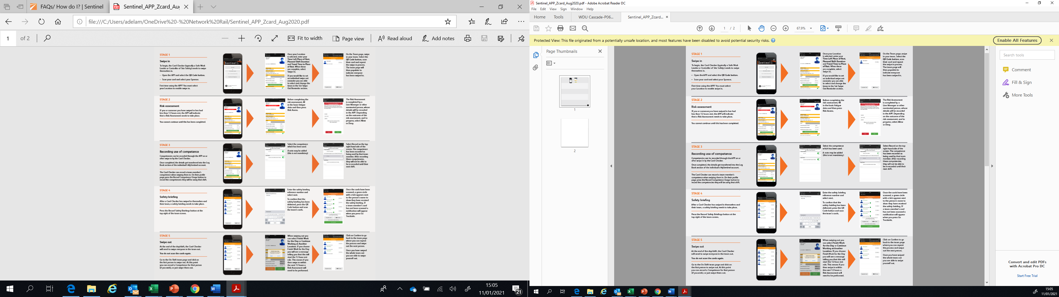
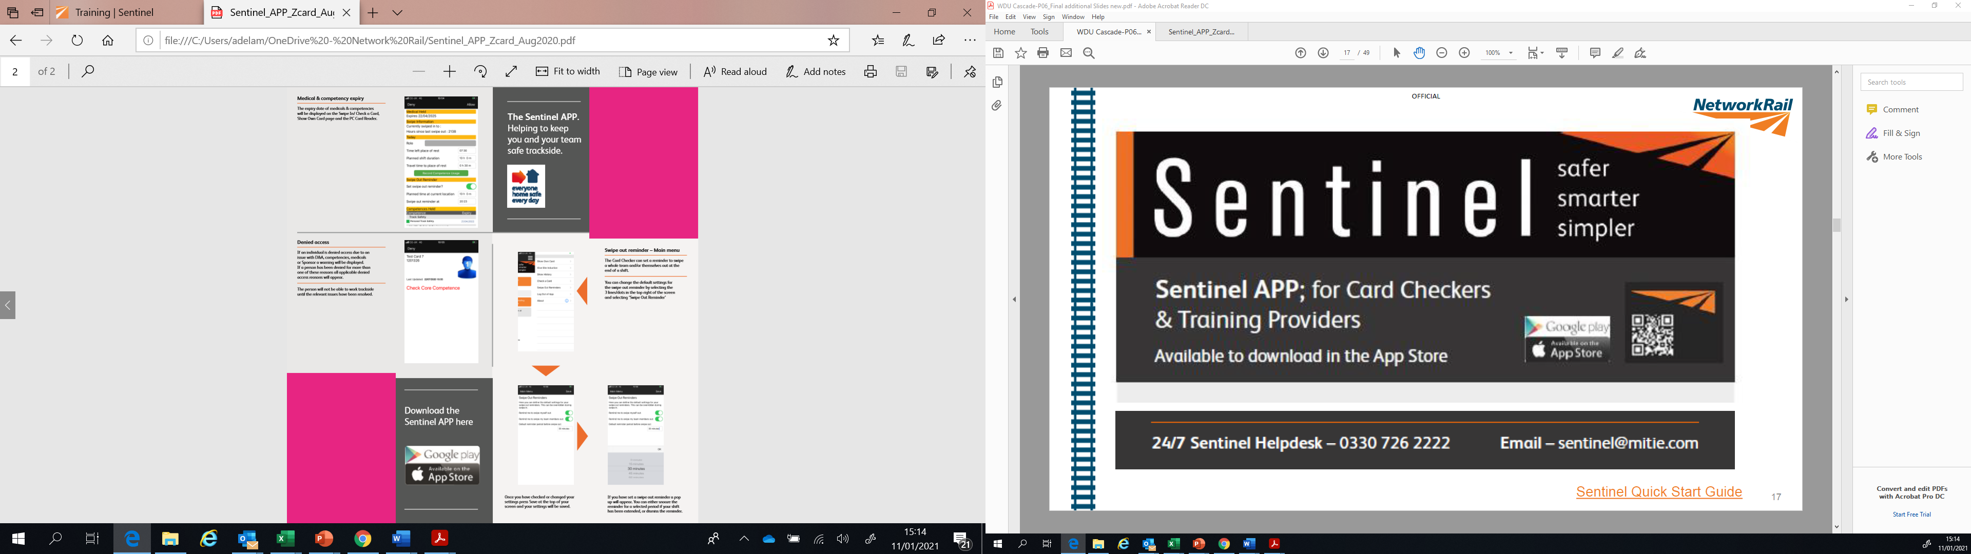
Safety
Sentinel – Helping to keep you and your teams safe
Download the Sentinel App from Google play or App Store
ACTION

Slide 10
Safety
Sentinel – continued
It is important for the PIC/COSS to swipe his/her team and themselves out at the end of the shift.
The card checker (PIC/COSS) can set a swipe out reminder. A pop up will appear and this can be snoozed for a selected period of time or the reminder can be dismissed. If the reminder is snoozed another pop up will appear after the selected snooze time. For more details please refer to Sentinel Quick Start Guide
Why swipe out? To make sure you have had 12 hours rest and to prevent double shifting
ACTION

Slide 11
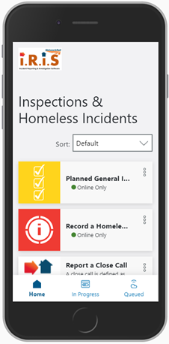
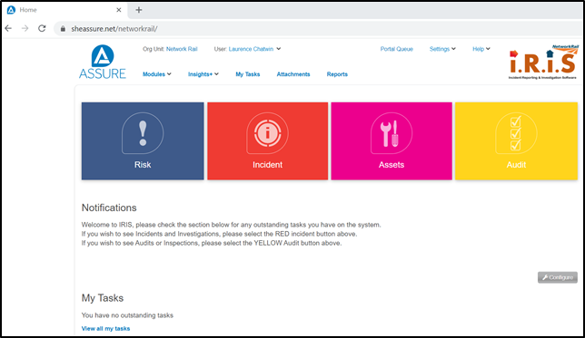

Safety
Planned Assurance Inspection and Site Surveillance (PAISS) and IRIS
As per the requirements from Standard (SE0117), certain roles are expected to undertake PAISS inspections (previously known as PGSIs).
PAISS are now undertaken on our IRIS system. Records are created in a web-based app accessible to all, and licence holders access the full system to manage the actions, data and formal records.
A useful guide has been created to assist staff with downloading the web based form and includes a step by step process of a PAISS completion.
Also included in the quide is a link to a video demonstrating the completion activity.
PAISS Briefing note and Instructions.docx
If you are experiencing any issues with the IRIS system please contact your WHSEA.
Managers should be completing two checks a period using the PAISS forms. This includes section supervisors
ACTION

Slide 12
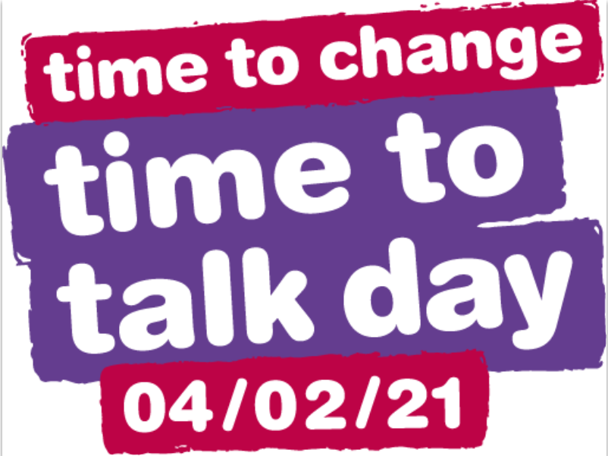

Health and Wellbeing
Time to talk day 04/02/2021
REMEMBER:
Keep it simple
Chat over a cuppa, send a text or go for a walk
You don’t have to be an expert
Just being there means a lot
Ask questions and listen
Show you want to know how someone is really doing
Don’t try and fix it
Often just listening is enough
ACTION
The power of small talk

Slide 13


Health and Wellbeing
Workplace Wellbeing Index
Take 20 minutes to tell Mind how we support your mental health.
mind.org.uk/index-survey
Pin: 7519
4th of February to the 3rd of March
Mind will give us recommendations on how we can improve our support.
ACTION
The Mind Wellbeing Index Poster can be found here

Slide 14
Resource Library
Safety Bulletins, Alerts, Advice and Shared Learning
Wessex Route Safety Bulletin Near Miss Rowlands Castle 12_20 Final.pdf
Safety-Advice-NRA20-14-Safe-isolations-access-and-competence.pdf
Safety-Advice-NRA20-15-Safe-use-of-devices-on-or-near-the-line.pdf
Safety-Advice-NRA20-16-Sheffield-testing-irregularity.pdf
Shared-Learning-NRL20-08-Clear-possession-communications.pdf
Issue 101 - Transferable Lessons - Bradford Jn - Pilotworking irregulairty.pdf
Issue 102 - Transferable Lessons - Exmouth T3 Irregulairty.pdf
Shared Learning Dorchester South December 2020.png
PAISS Briefing note and Instructions v0.4.docx
mind-wellbeing-index-a4-portrait.pdf
Resource Library

Slide 15

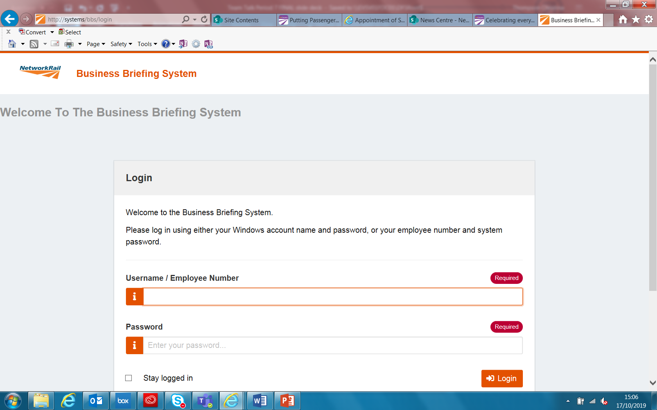
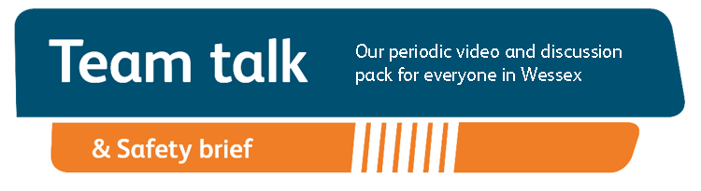
Remember to record that you have watched Team Talk
Click here for a guide on how to use the new Business Briefing System to do this
Also remember to record that you have received Safety Briefing via the Business Briefing System or via the dedicated person in your Business Unit.
7

