Slide 1

7
Notes:
Instructions to Managers
To view any links in the slides, you need to have PowerPoint in Slide Show mode

Slide 2
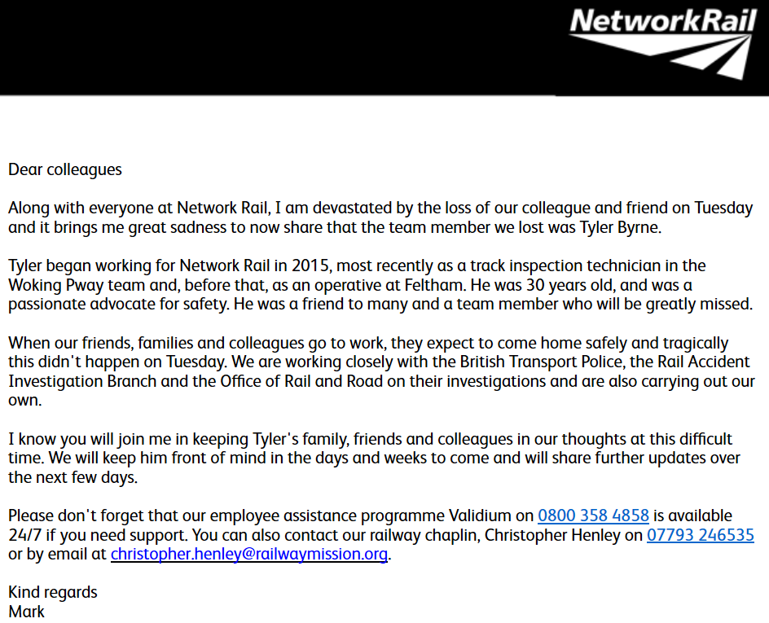
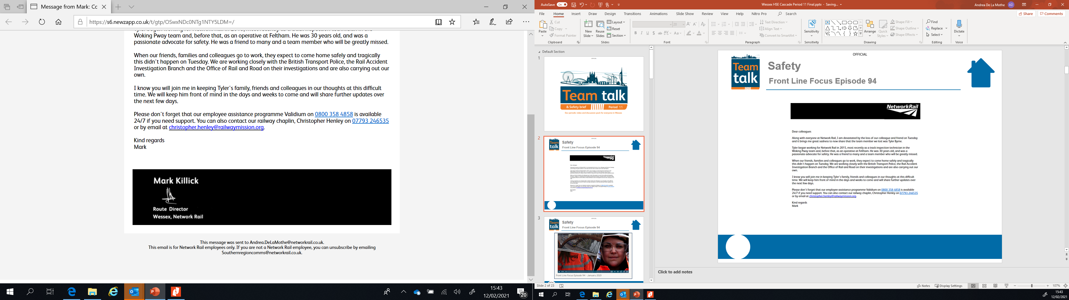
Wessex Route
Loss of our colleague
Additionally, the following information from Validium may be of support over the coming days and weeks:
Bereavement - Understanding Your Reactions
Trauma & Recovery Help Sheet
When Someone at Work Dies

Slide 3
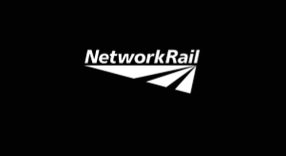
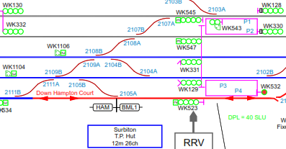
Wessex Route
Loss of our colleague
On Tuesday 9 February at 11:38, a track patroller was struck by a Waterloo to Salisbury South Western Railway train (1L29) and sustained fatal injuries.
The patroller was one of a team of four inspecting the switches and crossings immediately west of Surbiton station. All of the lines were open to traffic and the system of work used unassisted lookout warnings.
The three other members of staff were acting as site lookout, distant lookout and patroller's assistant. All of the team were experienced at undertaking this activity, familiar with the location and had worked together previously. The inspection was a cyclical task done each week.
The line speed is 80mph. 1L29 was a through-train, travelling on the Down Fast line. Part of the asset to be inspected included a crossover between the Up and Down Fast lines at the location the patroller was struck.
The accident is being investigated by the Rail Accident Investigation Branch, the Office of Rail and Road and in a formal industry investigation.
While we don't yet know what led to this tragic accident, there are some immediate points for everyone undertaking, supervising and managing track patrols which inspect switches and crossings to consider.
Learning/Discussion points
• How do you check patrol diagrams* are clear, understood and always followed? How does everyone know what version to use?
• Does the Safe Work Pack (SWP) work with the track patrol diagram, if your SWP is wrong, what stops you challenging any errors?
• Consider how each track patrol team safely covers the entire crossover where trains may arrive from different directions?
• Never step out of the confines of the agreed safe system of work.
• What arrangements could you use to avoid unassisted lookout working?
*Company standard NR/L2/TRK/001/mod02
Losing a colleague and a member of the railway family is devastating and impacts us all, whether you knew him or not. Please can we encourage you to talk about how you are feeling with family, friends, your line manager or members of your team.

Slide 4
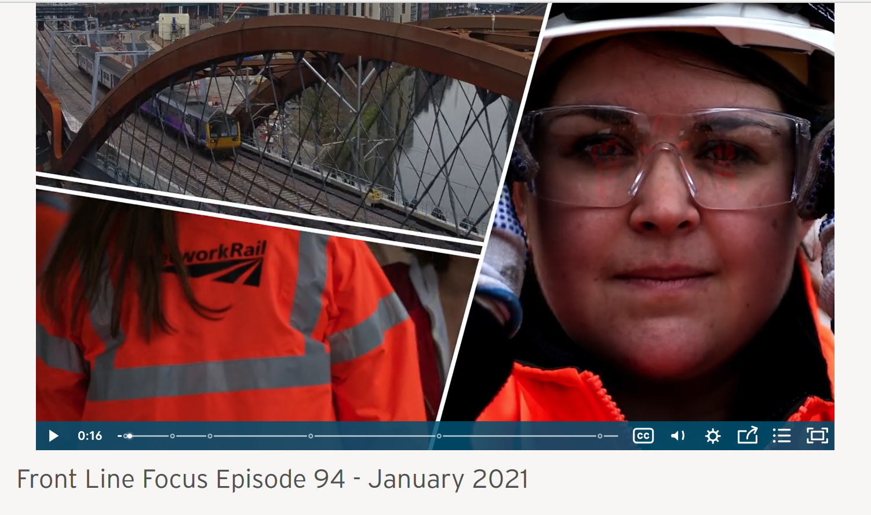
Safety
Front Line Focus Episode 94
ACTION
Watch the latest episode with your teams - link

Slide 5

Safety
Accidents and Operational Close Calls Period 11
Significant Accidents
STF accident resulting in ankle ligament damage;
17/01/2021 (Inner DU) a Principal Technical Officer (PTO) damaged his left ankle ligament whilst exiting a stoneblower in Wimbledon area. See slide 10 for more information.
Electric shock;
30/01/2021 (Outer DU) a member of staff reported receiving an electric shock that caused tingling through his arms and subsequent chest pains. The injured party (IP) was in the process of tightening a bolt underneath a holding down strap as part of the wheeltimber renewal on Shottermill Bridge (WPH2). The traction current was isolated and this was confirmed with live line testers. The IP was able to return to work on his next shift. Investigation ongoing.
STF accident resulting in shoulder injury;
05/02/2021 (Outer DU) a member of staff walking in the cess in Portcreek Viaduct area (WPH2), tripped on a lose, raised metal grid. The IP fell over and hit his shoulder on a running rail (non con rail side). The fall aggravated a pre-existing injury which warrantied further medical attention and the IP was unable to return to work on his next shift. Investigation ongoing.
Fatality Weighted Injuries (FWI)
0.072 MAA against target of 0.059 for the route
Lessons learnt from these events will be shared once the investigation has been concluded
Notes:
FWI measure explained
Network Rail defines a work place injury as any injury sustained by staff, both direct employees and contractor/suppliers, while undertaking activities connected with Network Rail’s business.
All reported injuries are to be entered into SMIS, the companies corporate Safety Management Intelligence System.
Fatality weighted injury rate (FWIR) is a KPI that uses the following calculation:
The number of fatalities, plus the (number of specified injuries / 10) plus the (number of 3+ lost day injuries / 200) plus the (number of all other injuries / 1000) divided by the hours worked, multiplied by 1,000,000, over the last 13 periods
RIDDOR reporting shall be based on the requirements of the RIDDOR 2013 regulations and the ORR guidance http://orr.gov.uk/__data/assets/pdf_file/0010/2332/riddor-guidance.pdf.

Slide 6
Safety
Accidents and Operational Close Calls Period 11 cont.
Other Accidents
10/01/2021 (Operations) a member of staff hit his head on an aerial post outside the Wimbledon office when he stood up after emptying a bucket down the drain. Lessons Learnt – the importance of being situationally aware.
11/01/2021 (Operations) a Trespass and Welfare officer was assaulted by an aggressive member of public at North Sheen.
19/01/2021 (Outer DU) a member of staff suffered minor bruising and swelling as a result of a wooden sleeper falling approx. 25cm onto his right foot. The team were tasked with moving 28 sleepers over the distance of 1.5m in Basingstoke Sidings using the sleeper dogs. To do the final adjustments the injured party (IP) together with a colleague were manoeuvring one sleeper into position by hand. Investigation ongoing.
19/01/2021 (Outer DU) a member of staff bent down to retrieve paperwork at Ash Vale and whilst standing up, hit her lower back on a raised location cabinet, later experiencing slight pain. Investigation ongoing.
24/01/2021 (Operations) a member of staff grazed his right hand index finger whilst attempting to operate the seized dial on the front gate at Basingstoke ASC. Lessons Learnt – prompt reporting and knowing how to identify and report a fault. Please refer to the Making the right call guide here
25/01/2021 (Operations) a member of staff slipped on some snow covered ice whilst exiting his vehicle at Bentley station. The IP did not fall and managed to catch himself but in the process strained his lower back. Lessons Learnt – the importance of being cautious and situationally aware under challenging weather conditions and importance of dynamic risk assessment.
25/01/2021 (Inner DU) a contractor sprained his wrist whilst lifting a fuel (jerry type) container from the van in order to refuel plant at Chiswick. The approx. weight of the container was 10 kg but it was an extremely cold morning which would have affected the IP’s joints/movement. Lessons Learnt – benefits of a warm up at the start of the shift.
Lessons learnt from these events will be shared once the investigation has been concluded

Slide 7
Safety
Accidents and Operational Close Calls Period 11 cont.
Operational Close Calls
10/01/2021 (Works Delivery) the short circuit straps and worksite marker boards (WSMB’s) were placed on the wrong lines. These lines were in the possession but were not the lines that should have been strapped. Authority to work was given by the Engineering Supervisor (ES) without all lines being correctly strapped and worksite set up. Worksite was suspended and the ES and strapping team placed the straps and WSMB’s in the correct location. The investigation established that the ES had a lot of COSS’ to sign into his worksite and 10 strapping teams to navigate. He accidentally sent the incorrect access gate information to the strapping team. Once he realised his error he helped the strapping team to set the worksite up correctly. Lessons Learnt – Communications and Responsibilities – remember to brief on communications and reporting back on where straps are to be placed. SWP for each strapping location – ensure the access gates are clear and shown on site diagrams and possession pack for the strapping team.
20/01/2021 (Possession Management Group) a contract possession support staff (PSS) after placing the detonator protection at WK442 signal and confirming back to the Person in charge of a Possession (PICOP) when done, was instructed by the ES to place WSMB’s and fit short circuit straps at 41m25ch. The PSS used the mileage on the access gate to work out the mileage where to place the WSMB’s, test and fit straps and confirmed their actions back to the ES. Later in transpired that the PSS placed the WSMB’s and straps the wrong side of the detonator protection. The investigation established that the individual was experienced in blocking duties but less experienced in strapping duties and he lost his orientation. Lessons Learnt – importance of asking questions to confirm instructions and using the work environment and track layout as another aid to ascertain correct location.
26/01/2021 (Works Delivery) a driver of 1P27 London Waterloo to Portsmouth Harbour, reported that a member of staff was overhanging the edge of platform 2. The initial investigation established that a team from Railscape were tasked with installing anti-trespass mats and were in the process of taking a line blockage (LB). Whilst waiting for the LB to be granted, one of the mats was being placed in position and one of the team members proceeded to fix the mat before the LB was in place. Investigation ongoing.
Lessons learnt from these events will be shared once the investigation has been concluded

Slide 8
Safety
Accidents and Operational Close Calls Period 11 cont.
Operational Close Calls
28/01/2021 (Inner DU) the ES for Worksite A, Item 70 Wessex WON 43, instructed the strapping team to remove short circuit straps and WSMB’s at 18m60ch on the Up/Down Main Line, accessing the track from platform 2 at Weybridge which was outside the protection limits and was not covered by the Safe Work Pack (SWP). Investigation ongoing.
28/01/2021 (Inner DU) after a proactive speak out by Wimbledon P-way team, a request was made for all present to submit to a D&A test. After the request was made, three members of staff left the depot and failed to return. It later transpired two of them together with three further members of staff failed the D&A test. Investigation is ongoing.
Reminder to all staff – For cause or Random D&A testing can be undertaken at any time.
Guidance for line managers who need to arrange a For cause or Post incident D&A testing can be found in NR/L2/OHS/0012 Testing for drugs and alcohol - http://networkrailstandards
02/02/2021 (Works Delivery) late report of staff from Switch Rail working on behalf of XYZ rail working outside a Line Blockage (LB) at Basingstoke. Allegation was made that a GWR train passed the staff on the Down Reading line when it was believed by those on site that the Down line was blocked as well as the adjacent Up line. Investigation ongoing.
04/02/2021 (Works Delivery) self reported allegation of a Near Miss at Bedhampton. Three members of staff consisting of a NWR PiC/COSS, one distant and one site lookout from Vitals were carrying out survey work between 37m50ch and 39m73ch at Bedhampton. Investigation ongoing.
Lessons learnt from these events will be shared once the investigation has been concluded

Slide 9
Significant Accident
Fractured Leg at Whitchurch (Period 10)
Overview
On Wednesday 30th December 2020, a contractor working in the Whitchurch area, slipped whilst walking along an ice-covered troughing route on the Down Exeter Line (BAE1) at 63m50ch. The individual was returning to join his team, after visually inspecting the previously cleared area between the boundary fence and the embankment. The low overnight temperatures resulted in a widespread frost and increased risk of slips, trips and falls due to icy underfoot conditions.
The individual’s right boot slipped forward on the ice and almost immediately regained traction and grip. During this motion, whilst trying to stop himself from falling, the IP’s body twisted but his right ankle stayed in the same position. The transfer of his body weight caused a fracture to his Tibia and Fibula above the boot line and below the knee. He was assisted by his colleagues to the nearest access point and then taken to Winchester A&E. The following day the IP underwent a surgery and it is estimated that the full recovery will take 6 to 8 weeks.
The IP was wearing a pair of class 2 chainsaw boots which offer the correct protection against any potential chainsaw related injuries and the ankle protection. But the energy resulting from the transfer of his body mass and the angle of his body twisting were contributing factors to his bones breaking at the weakest point above the boot line and had a direct impact on the severity of his injury.
What can we learn:
The PIC has the overall responsibility for safety of all team members on site and should identify and communicate site-specific risks including slip, trip and fall related hazards, sometimes there is a need to continually remind everyone when situations change.
Management of less experienced members of staff; this was the individual’s first winter working on the railway infrastructure and first experience of how treacherous ice covered troughing can be.
Troughing routes are not authorised walking routes.
The Safety Bulletin can be found here

Slide 10
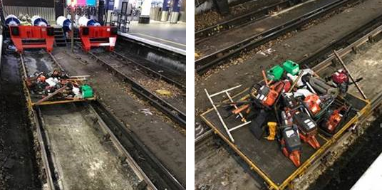
Significant Incident
Trolley left in confines of Platform 9 at Waterloo (Period 10)
Overview
On the 27th of December 2020, the Wimbledon signaller reported the track circuit at London Waterloo within platform 9 was showing as occupied after the T3 possession had been given up and it was found a trolley loaded with tools was still on the track 15ft away from the buffer stops. A maintenance team accessed the track from platform 12 to carry out heavy renewal work on 1518 and 1524 points and crossings and took various tools onto site using 3 hand trolleys.
The investigation established the following:
Access to the worksite was delayed at the start of the shift and this had a knock on effect on all work taking place.
After the work was completed, the three hand trolleys were cleared from site, with two of them going to platform 11 and the third one was pushed to platform 9.
The trolley was positioned at the ramp ends of platform 9 but consequently moved to the buffer stops, so the points could be operated.
The team on site assisted with investigating an issue related to the VH1 track circuit, after which they egressed from access at 00m28ch, as opposed to using the station. As a result nobody walked past the trolley within the platform limits.
The team assumed that all equipment had been removed, but no check were made to clarify the right number of tools and trolleys had been cleared from site.
What can we learn:
Ensuring the requirements of GE/RT8000/HB10 Duties of COSS or SWL and person in charge when using a hand trolley are followed - GERT8000-HB10 Iss 4.pdf
Confirming back to the ES that all trolleys/plant and equipment are clear of operational railway.
At the start of the shift the PiC/COSS shall appoint a person that will be responsible for checking what equipment is being taken to site and ensuring all equipment is accounted for at the end of the shift.
Discuss the learning points

Slide 11
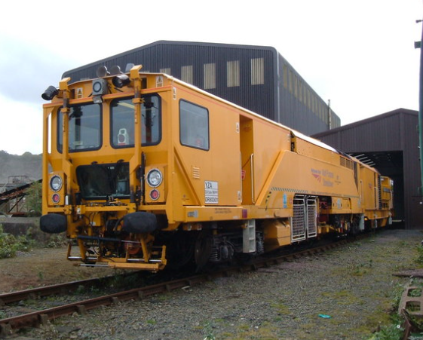
Slip, Trip and Fall Accident
Ankle ligament damage
Overview
On the 17th January 2021 at approx. 14:00, a Principal Technical Officer (PTO), working as a Track Quality Supervisor (TQS), was on board of a multipurpose stoneblower, checking the on-board computer for the design being implemented.
Whilst exiting the machine to go back on track, the PTO used the designated exit steps. As he stepped down and let go of the step railings, his left foot was on the side of a cable, which caused his ankle to roll and resulted in instant pain and swelling.
Initial first aid was administered and the PTO elevated his ankle and tightened his boot to provide additional compression around the injury.
On visiting his local hospital, the following day, it was discovered that the individual had suffered a potential Achilles tendon rupture to his left ankle and was unable to resume his duties for 7 days.
Multipurpose Stoneblower (stock photo)
What can we learn:
Check where you are putting your feet, don’t just assume that you will be stepping onto a level surface without any obstructions.
If you have suffered an injury and are unsure of the severity, get it checked by a health care professional. Untreated injuries may not heal properly and may cause issues for years to come.
The importance of following the P.R.I.C.E process
  PROTECT the injury from further damage
  REST avoid activities that cause stress to the injured area
  ICE reduces swelling
  COMFORTABLE (formerly compression) provide support
  ELEVATE prevents pooling fluid
Discuss the learning points

Slide 12
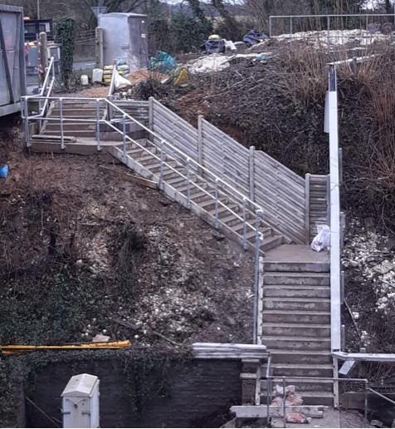
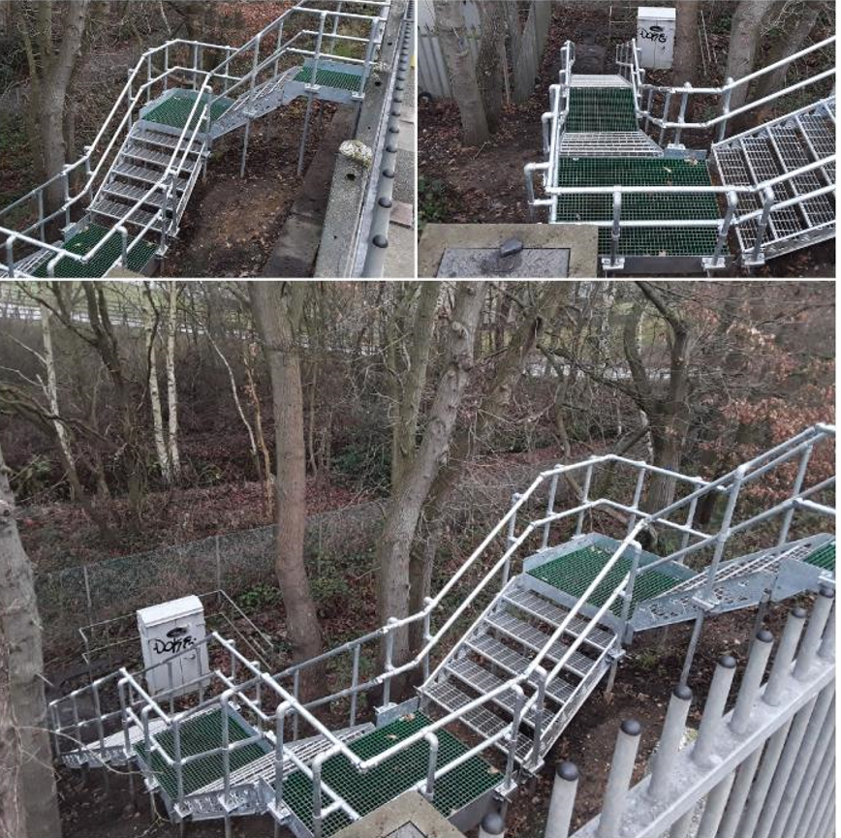
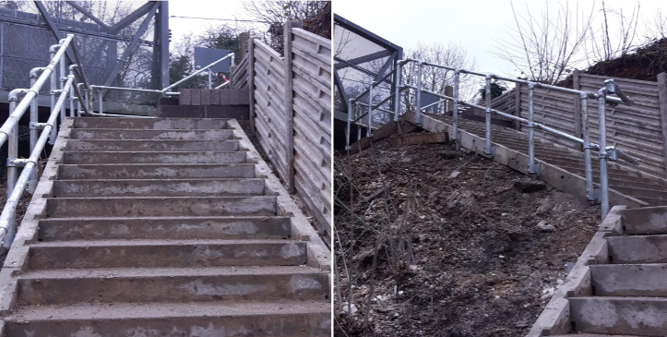

Wessex Safe Track Access Alliance
The ‘Wessex Safe Track Access Alliance’ is a collaboration of teams from across the Southern region consisting of Inner and Outer DU, Wessex Safety Team, Regional Safety, Track Worker Safety - Wessex and Route Business.
Working from a list of sites identified by the delivery units, prioritising locations with known safety issues, close call sites and working closely with the depots to deliver safer access and improving working environments across the route
Contacts:
If you would like further information about the work we have planned you can contact Emma Bhui (Regional Safety Team) and/or Aaron Bever (Track Worker Safety)
From the DU’s you can contact Jack Roberts (Inner DU) or Wayne Norbury (Outer DU) - if you would like to add a site to the list for consideration, then please email either Jack or Wayne
Search ‘Southern Track Worker Safety’ on MyConnect

Slide 13
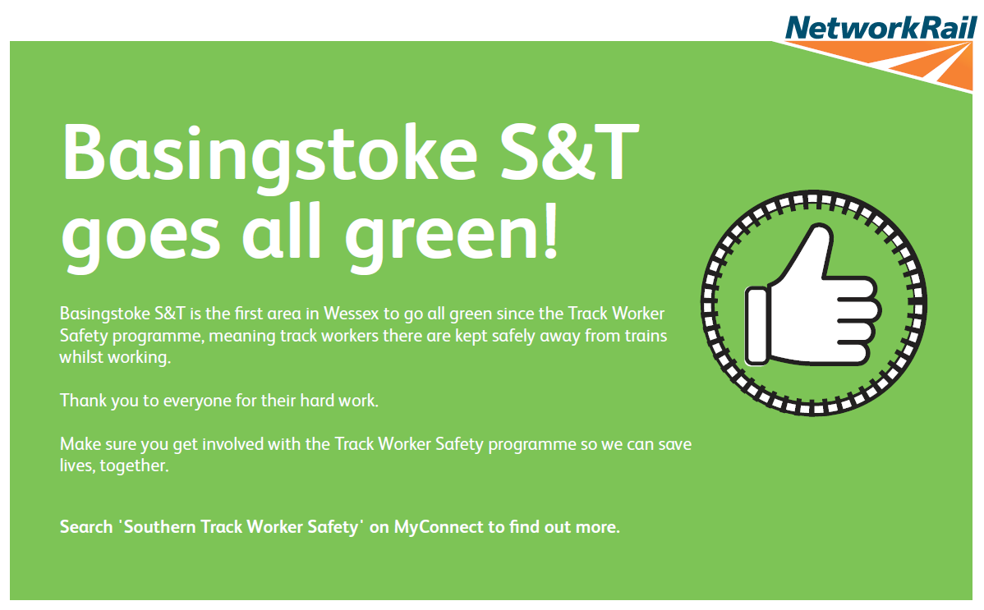
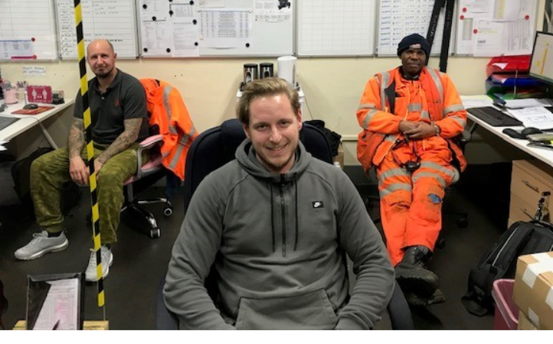
Track Worker Safety (TWS) programme – moving to Green
From 29th January Basingstoke S&T have transitioned to deliver all maintenance and response activity in green zone access since the Track Worker Safety programme.
On 8th January Woking and Guildford Pway Sections commenced a pilot of all faulting and response work to green zone access.
Well done to Richard Gostling and Welding & Grinding Inner who have followed suit and moved all their work to green zone access.
Search ‘Southern Track Worker Safety’ on MyConnect

Slide 14
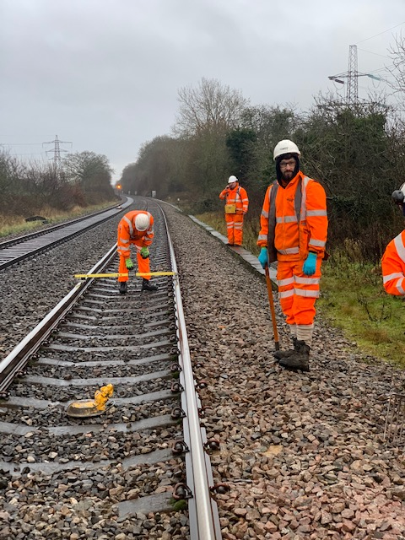
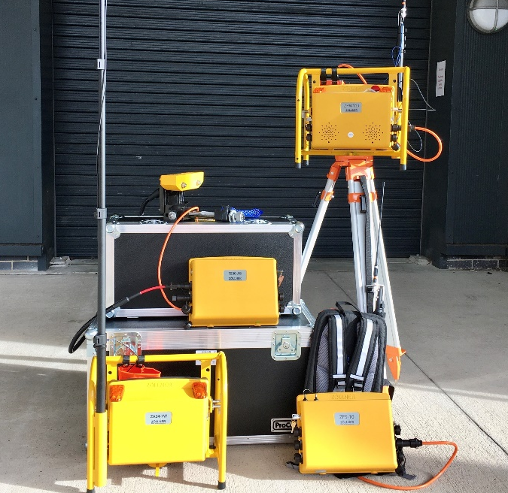
Track Worker Safety (TWS) programme – technology
Lookout Operated Warning System (LOWS) and Semi-Automatic Warning System (SATWS) training kits have arrived in Basingstoke allowing Wessex to deliver training locally.
Mapping and Designs for the route have continued with Basingstoke, Woking, Havant, Guildford and Wimbledon areas either completed or in progress.
Please contact Ross Blair (ross.blair@networkrail.co.uk) to arrange training, mapping or demonstrations for your area.
Search ‘Southern Track Worker Safety’ on MyConnect

Slide 15
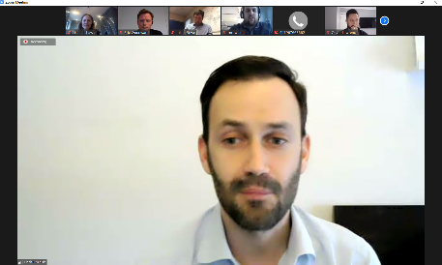
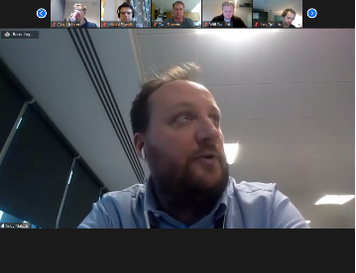
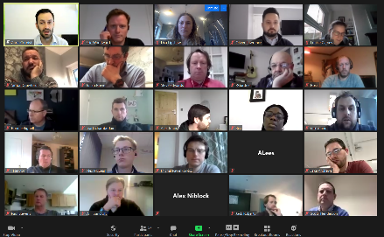
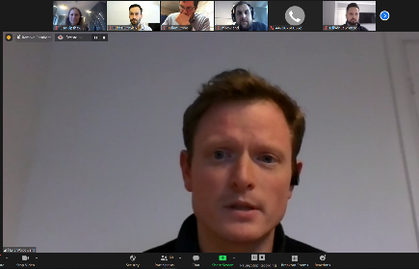
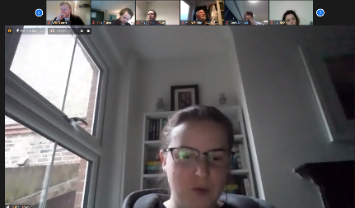
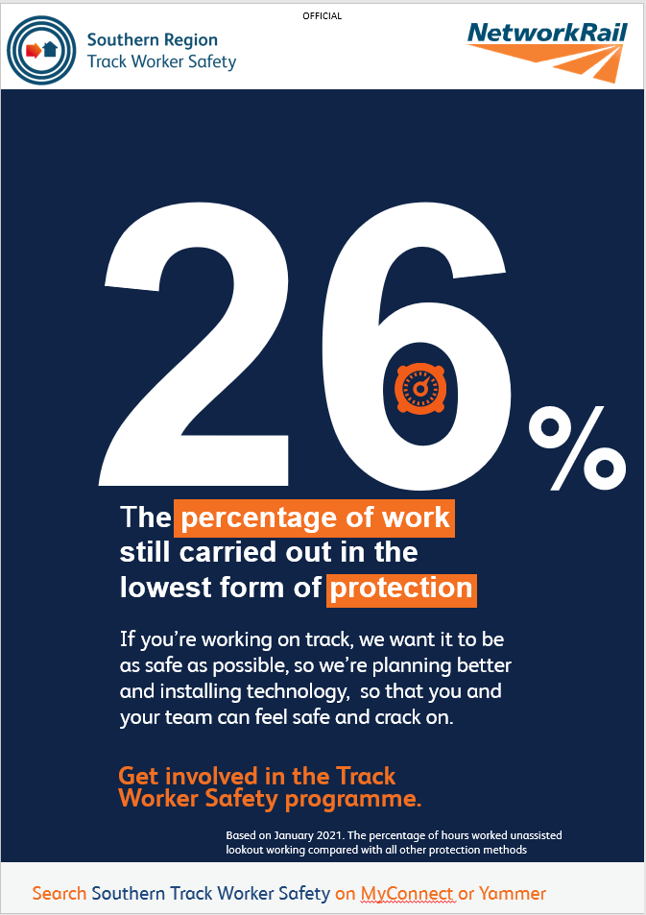
Track Worker Safety (TWS) programme – speaking to our people
Chris Cornish, Infrastructure Director met with over 60 members of the Wessex maintenance team including Section Managers, Section Supervisors and engineers. He was joined by Eric Woodward, heading up Wessex TWS, IMDMs and guests from Sussex and Western.
The call focused on the importance of the programme and what progress had been made in the route. It also was an opportunity to ask questions. The full call can be heard here: https://web.microsoftstream.com/video/a6b46c20-42ff-4bbe-aff6-c9b7a8c29cd4?list=studio
Our new bank of posters highlighting the important numbers we need to know in the programme are out now. Keep a lookout for them at your place of work…
Search ‘Southern Track Worker Safety’ on MyConnect

Slide 16
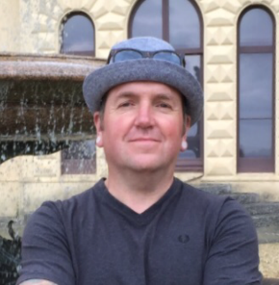
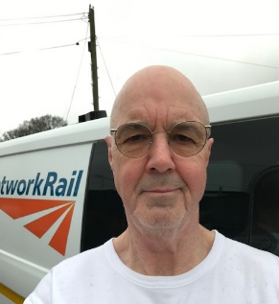
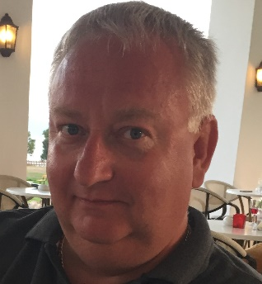
Safety
Introducing some of the Wessex Area H&S Reps supporting Infrastructure Director teams
Graham Gibbs, RMT Area Health & Safety Rep, Wessex Outer, Maintenance
Based in Bournemouth, Graham joined British Rail’s Permanent Way Department in the role of Trackman in 1992. Graham went on to work in the position of ETM Lineman and finally Patrolman before transferring to the S&T in 1996 to present day.
Graham has been acting as a Health & Safety Rep for ten years now, representing and supporting our Frontline Track based staff across the various departments.
In his Health and Safety role he regularly engages with senior, Local, Area and Route Mangers, along with the Workforce Health & Safety Team, taking your concerns and ideas to all levels of management.
Graham can be contacted for advice or to take on your concerns, on 07710959281 or graham.gibbs@networkrail.co.uk
Ron Gayler, TSSA Area Health and Safety Rep, Wessex Outer, Maintenance
Based in Eastleigh, Ron has been a member of TSSA for over fifteen years and has been a member of various unions since 1972 starting with the AUEW being an apprentice diesel mechanic. Ron first became a union rep for TSSA in 2009, when the Telecoms was insourced back into Network Rail (NWR). Safety of himself and his colleagues has always been a priority for Ron. He decided to put himself of the Area H&S Rep in 2010 to continue using his on tools experience to help and advise on the real issues and concerns of staff on the ground.
Ron is involved with all levels of management and is the TSSA observer for the fail culture process and stands in for the lead H&S Rep when required. Lately Ron has been assisting with the COVID protections in buildings/depots.
One thing he is most proud of is the raising of the priority of asbestos within NWR buildings, including silica dust on track and the possible effects on staff.
Ron would ask you to consider being a TSSA H&S Rep and can be contacted on 07899934379 or ronald.gayler@networkrail.co.uk
Paul Mangan, TSSA Lead Health and Safety Rep, covering Southern (HS1), Western and Wales
It goes without saying that safety is paramount, but Paul believes that much more needs to be done to tackle health, wellbeing and welfare issues amongst Network Rail's staff. We all have a part to play. Paul sees his role as Lead H&S rep as being an ambassador for TSSA and its members, identifying members' concerns and finding ways to addressing them. Too many in Network Rail (NWR) have excessive workloads leading to stress and mental ill-health. Fatigue is a major challenge. And we have much more to do to improve track worker safety. We need more TSSA members to become Health & Safety reps, and more of those to get involved!
Paul would like to see better collaborative working in NWR, making the company a better place for all colleagues in the business to work in. We can only achieve this by working together, with our TSSA colleagues and members, with the other trade unions, with the company, because we all have a vested interest in good health and safety.
Paul can be contacted on 07710961043 or paul.mangan@networkrail.co.uk
Do you know your H&S Reps?

Slide 17

Safety
We are looking for staff to become H&S Reps
If you are interested, please get in touch
ACTION

Slide 18
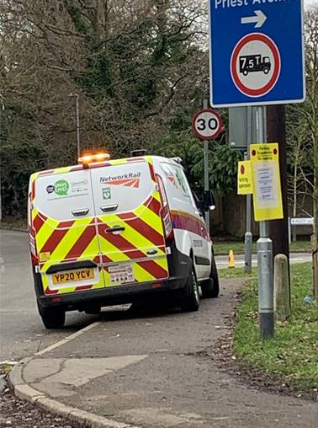
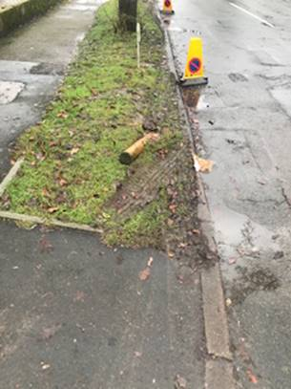
Safety
Road safety and reputational damage
A member of public has reported that a NWR member of staff was driving whilst using their mobile phone near Liphook.
This is against the law, is a lifesaving rule breach, poses a risk of an accident and injury to themselves and other road users.
A member of public has reported that a NWR vehicle parked partially on a pavement obstructing the visibility of an exit road and restricting the footway for pedestrians in the vicinity of Waterloo Road Level Crossing.
The vehicle is also parked within a section of highway covered by double white lines approaching the level crossing, forcing drivers to cross the lines in contravention of the Road Traffic Act 1988, as well as ignoring a parking suspension under the Road Traffic Regulation Act 1984.
In addition, damage caused by a NWR vehicle to council owned property which had recently been planted with bulbs and flowers, was also reported .
All the above events damage NWR’s reputation in the eyes of public. Please remember that when at work, driving a NWR vehicle, or at any time that you are dressed in your PPE, you are representing the rail industry as a whole as well as NWR specifically.
ACTION
It is essential that all of us behave impeccably at all times

Slide 19
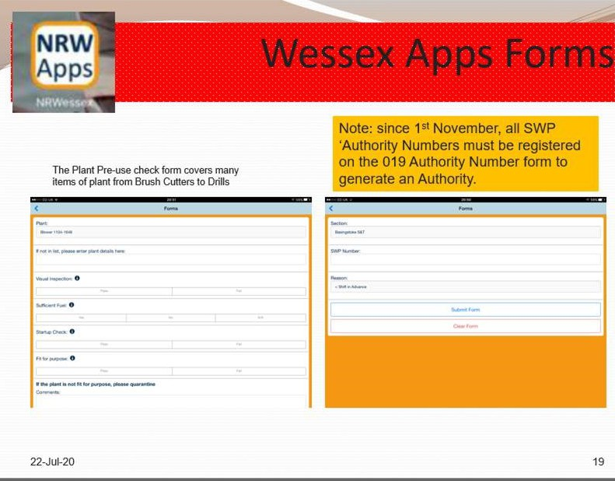
Safety
Issuing and recording of an Authority Number
There are only four instances when a deviation from a pre-planned SWP is permitted and must be authorised by the Responsible Manager (RM) or an On-Call Manager.
These instances are:
  Change of the Person in Charge (PiC) on the shift, due to unforeseen circumstances. The PiC must have sufficient time to verify the SWP.
  Change from and authorised level in the hierarchy of operational risk control and implementing a lower level.
  Significant change of the task risk on the shift.
  Change of the site of work from the pre-planned site of work if the task risk remains the same.
Since the 1st November 2018, all SWP Authority Numbers must be registered on the 019 Authority Number form (Wessex Apps Forms) to generate an authority. These records can be used for auditing purposes.
It is vital that when you are registering your Authority Number on Wessex Apps forms, you select the appropriate department/team and not just the first option on the drop down list. Recent reviews have concluded that generated Authority Numbers are not always recorded against the correct team/department.
If an audit of your section were carried out next week, would you pass?
ACTION

Slide 20
Safety
Completing PAISS in IRIS and selecting the correct location
When completing your PAISS checks in IRIS it is important to select the correct team, otherwise your checks could be allocated to a different area or team. Please refer to the simple guide on the right.
Guide on How to use Insight in IRIS to review PAISS by individual sections can be found here
ACTION

Slide 21
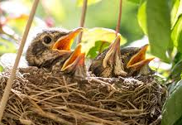

Environment
Bird nesting checks
It is an offence to
Intentionally kill, injure or take any wild bird,
Intentionally take, damage or destroy the nest of any wild bird whilst it is in use or being built,
Recklessly disturb any wild bird listed on schedule 1 while it is nest building, has eggs or young, or disturb the dependent young of such a bird.
Click here for details and exclusions.
When to complete a bird nesting check
A breeding bird check should be completed prior to ALL vegetation work and before any activity that could impact nesting birds, this can include structural work and low level work.
Checks should be carried out between dawn and 08:00, ideally in good weather and on the first day of work, but can be up to a week prior to planned work.
For emergency safety critical work, undertake a check immediately before starting work.
How to complete a bird nesting check (Form)
2-minute slow walk then stop for 10 minutes. Repeat for length of work site plus 10m beyond.
Mark on plan all locations where observation took place with a dot
Take 1 hour to complete check for every 220 yards
Record every bird seen & heard in site with an ‘X’
Record every suspected nest/nest site with the letter ‘N’ circled. Photograph any likely evidence
Mark exclusion zones on form. Photograph marked exclusion zone(s)
For further information please contact our Environment Specialist Becky Jones – rebecca.jones@networkrail.co.uk
ACTION
Be aware of your responsibility to nesting birds
Notes:
Further information
Exclusions
It may be a defence if it can be shown that the activity was necessary for the purpose of preserving public health or public safety
O this does not apply to schedule 1 birds
O advice should be sought to determine if the exception can be relied upon
O pre-planned work is unlikely to be considered safety critical
The Network Rail L2 and L3 vegetation management standards (see Standards website) instruct how to manage vegetation, but these must be used in consultation with the L2 Environmental Biodiversity standard to ensure environmental considerations are also taken into account.
• Be aware, records may be subject to external scrutiny
• If no checks are undertaken, demonstration of compliance with legislation could be challenged
The Technical Authority will be offering a remote programme of briefings, starting in 4-6 weeks’ time which will be available to all staff able to access a Teams enabled device

Slide 22



Health and Wellbeing
Workplace Wellbeing Index
Take 20 minutes to tell Mind how we support your mental health.
mind.org.uk/index-survey
Pin: 7519
4th of February to the 17th of March
Mind will give us recommendations on how we can improve our support.
ACTION
The Mind Wellbeing Index Poster can be found here

Slide 23
Resource Library
Safety Bulletins, Alerts, Advice and Shared Learning
Safety-Bulletin-NRB21-01-Workforce-near-miss.pdf
Safety-Advice-NRA21-02-Staff-electric-shock.pdf
Road Safety Factsheet - Winter Driving Tips.pdf
Safety-Alert-NRX21-01-Surbiton-workforce-fatality.pdf
Resource Library

Slide 24

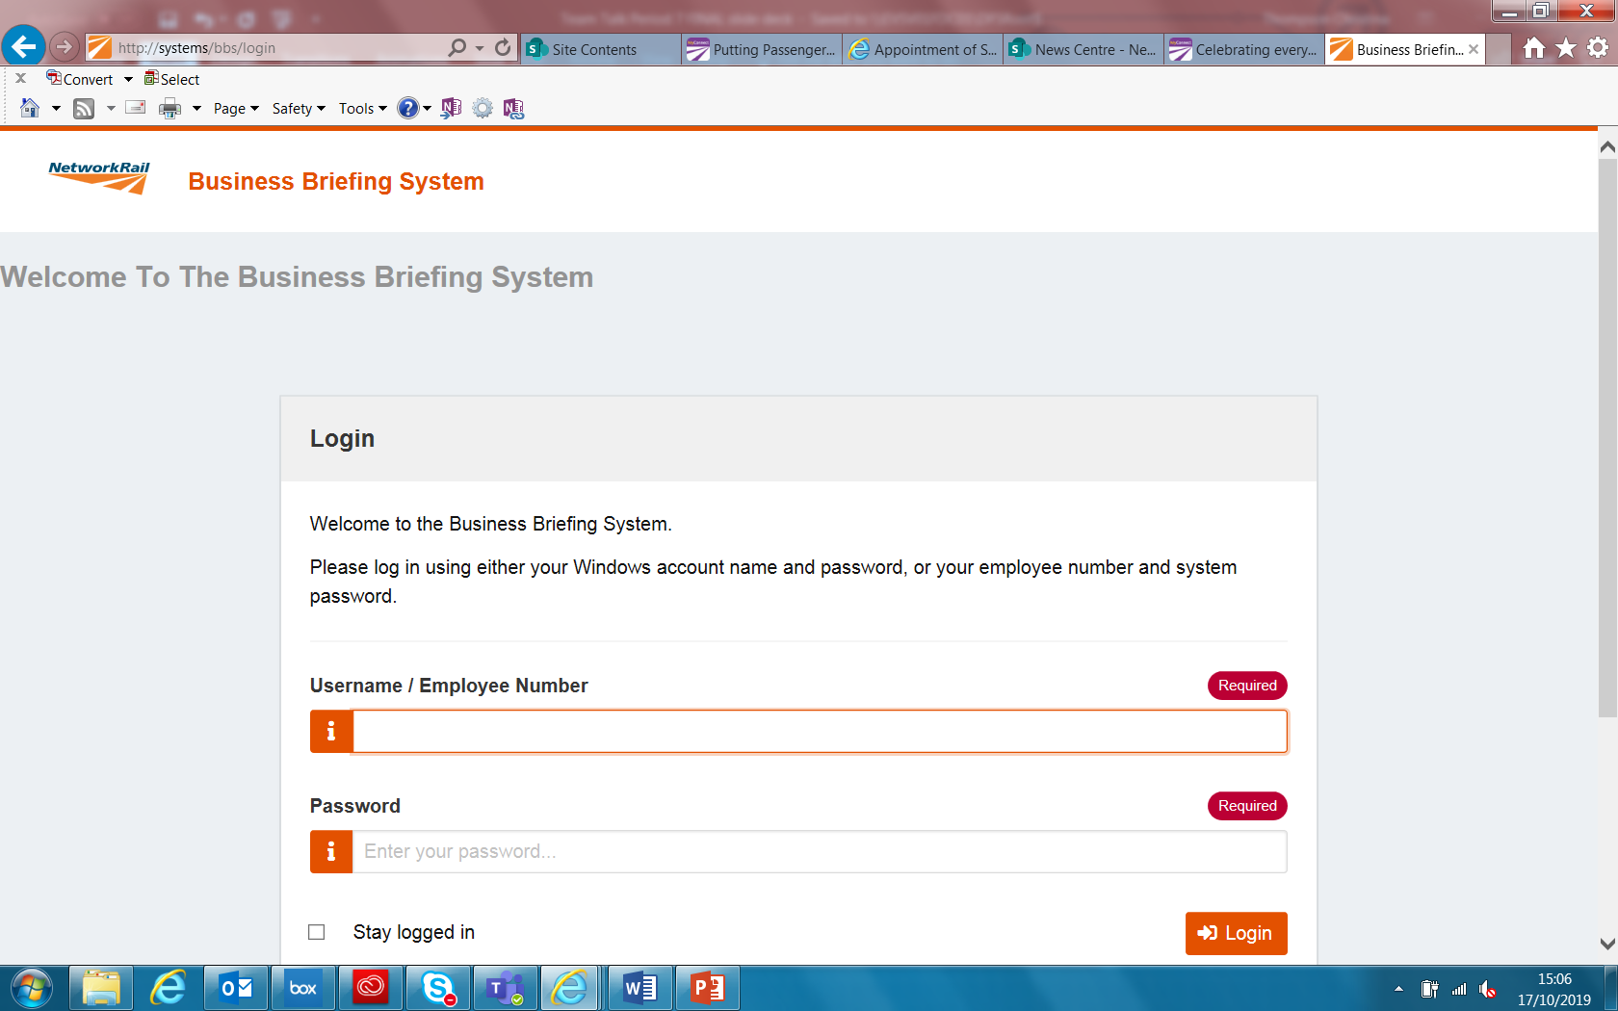
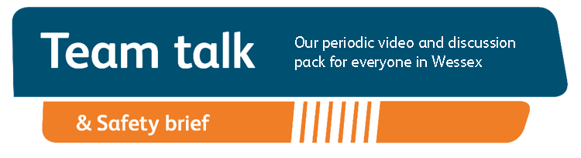
Remember to record that you have watched Team Talk
Click here for a guide on how to use the new Business Briefing System to do this
Also remember to record that you have received Safety Briefing via the Business Briefing System or via the dedicated person in your Business Unit.
7

