Slide 1

7
Notes:
Instructions to Managers
To view any links in the slides, you need to have PowerPoint in Slide Show mode

Slide 2

Safety
Accidents and Operational Close Calls Period 12
Significant Accidents
Tragic fatality at Surbiton; 09/02/2021
Damaged finger tendon;
20/02/2021 (Outer DU) a member of staff carrying out maintenance on E465B HW 1000 points machine, sustained tendon damage to his right middle finger after the points motor powered up rotating the clutch mechanism and catching his finger. Investigation ongoing.
Significant eye injury;
26/02/2021 (Outer DU) a member of staff acting as a machine controller (MC) for an RRV with a ballast brush attachment in the Warminster area, was struck by a projectile that may have been ejected by the ballast brush and caused a significant injury to his left eye and his cheek bone. Investigation ongoing.
Other accidents
10/02/2021 (Inner DU) a member of staff walking across the car park at Guildford depot slipped on some residual ice and experienced pains in his left wrist after falling over. The yard is regularly gritted in cold weather but a patch had been missed and the IP was in a hurry to start work. Lessons Learnt – the importance of being cautious and situationally aware under challenging weather conditions. Process for gritting should be reviewed as part of the PAISS (depot inspection).
Fatality Weighted Injuries (FWI)
1.116 MAA against target of 0.059 for the route
Lessons learnt from these events will be shared once the investigation has been concluded
Notes:
FWI measure explained
Network Rail defines a work place injury as any injury sustained by staff, both direct employees and contractor/suppliers, while undertaking activities connected with Network Rail’s business.
All reported injuries are to be entered into SMIS, the companies corporate Safety Management Intelligence System.
Fatality weighted injury rate (FWIR) is a KPI that uses the following calculation:
The number of fatalities, plus the (number of specified injuries / 10) plus the (number of 3+ lost day injuries / 200) plus the (number of all other injuries / 1000) divided by the hours worked, multiplied by 1,000,000, over the last 13 periods
RIDDOR reporting shall be based on the requirements of the RIDDOR 2013 regulations and the ORR guidance http://orr.gov.uk/__data/assets/pdf_file/0010/2332/riddor-guidance.pdf.

Slide 3
Safety
Accidents and Operational Close Calls Period 12 cont.
Other Accidents continued
12/02/2021 (Outer DU) a member of staff felt a sharp pain in his lower back whilst retrieving an item out of a van at Weymouth. He carried on with his duties but later reported pains in his inner hip/groin when stepping from cess onto ballast shoulder. The IP overstretched whilst retrieving the item from the van. Lessons Learnt – the importance of following TRC sheets (NR/L3/MTC/RCS0216/GH01) and correct manual handling.
19/02/2021 (Works Delivery) a member of staff carrying out manhole cover renewals at Virginia Water sustained a minor injury to his right ring finger. The IP removed the cover in order to break away the concrete surround around the frame. He then attempted to lift the frame out of position when it sprung back and trapped his finger between the frame and the concrete surround. Lessons Learnt – prior to lifting the frame out ensure it is loosened completely or if needed, use a wrecking bar to assist with the removal of the cover.
20/02/2021 (Inner DU) a member of staff collecting his PPE from the drying room at Feltham, turned around and hit his head on a recently installed key cabinet attached to the wall, sustaining a 2cm laceration to the right side of his head. The location of the cabinet will be reviewed. Lessons Learnt – importance of situational awareness.
26/02/2021 (Outer Telecoms) a member of staff involved in a RTA when a member of public rear ended his vehicle on the A326 at Staplewood Lane, after he stopped at mobile road works. As a result the individual was experiencing slight concussion, grogginess and stiffness in his shoulder.
02/03/2021 (Inner DU) a member of staff was part of team changing wooden sleepers and S&C timbers during the daylight hours at Chessington South. A number of beds were dug out with some of the sleepers laid out approx. 30cm apart. The IP tripped over one of the sleepers, his right foot twisted, and he fell over also sustaining some minor grazes to his forearm. PRICE protocol followed and the application of an ice pack significantly reduced the swelling. Lessons Learnt – importance of situational awareness and following the PRICE (Protect, Rest, Ice, Comfortable and Elevate) protocol.
Lessons learnt from these events will be shared once the investigation has been concluded

Slide 4
Safety
Accidents and Operational Close Calls Period 12 cont.
Late reported Accident
15/02/2021 (Inner DU) a member of staff experienced lower back pain whilst removing a welding metal works box from a RRV at Woking. This was not reported at the time but resulted in the individual being unable to return to work on his next shift. Investigation ongoing.
All accidents and incidents should be reported as soon as it is safe to do so to your line manager or supervisor and Control.
All line managers have a duty of care to their staff and as such need to know if anyone comes to harm so they can make sure all the necessary first aid, care and support is given to the individual.
We will investigate all accidents to prevent reoccurrence but this is so much more difficult if an accident is not reported or is reported late.
Operational Close Calls
22/02/2021 (Possession Management Group) hook switch 2159 was operated in error. Hook switch 2159 feeds platform 14 at Waterloo and as a result of it being open, there was no traction current present in the platform. The hook switch operated in error was within the possession and was safe to operate.Investigation ongoing.
22/02/2021 (Works Delivery) a team of 3 contract staff (Supervisor and 2 Operatives) working with Tamper in Wessex WON 47 Item 172 Worksite B were found to be on or near the line at Guildford without a COSS and after their COSS returned his conductor rail permit to the ES. Investigation ongoing.
Infrastructure Damage
15/02/2021 (Works Delivery) whilst back filling with tonne ballast bags at Yeovil Pen Mill, a bag was attached to the boom of a RRV (PC138). A member of staff became aware of the boom that was being moved to unload the ballast, catching a cable and as a result pulling down a telegraph pole onto the track and damaging a dual head lighting column. Lessons Learnt – despite a number of site visits, the overhead cable was not noted as a hazard. A review established that there was no formal form to capture such hazards. A more formal method of capturing hazards has now been implemented.
Lessons learnt from these events will be shared once the investigation has been concluded

Slide 5
Safety
Reporting of Significant Incidents
Introduction
The need to enhance the process of reporting of Significant Incidents was identified and we must improve the collation of initial and subsequent information in order to establish all the facts and to reach a better understanding of all the causes.
Scope
This process is applicable to the following business units operating within the Wessex Route and any sub-contractor staff working on their behalf, Infrastructure Maintenance, Operations, Works Delivery, Asset Management Team, Area Services Team, Wessex Incident Control Centre, Wessex Planning and Possession Management.
It will be utilised for reporting of all significant incidents including but not limited to:
Near Miss with a Train whilst using Lookout warning,
Near Miss with a Train whilst using Line Blockage Protection,
Line Blockage Irregularity as a result of incorrect protection limits,
Possession of a line given up with equipment left on the line,
Electrical Incident as a result of inadvertent contact with a live conductor rail,
Electrical Incident occurring in a Substation, TP Hut or a lineside cabinet.
Please note that this list is not exhaustive and other types of events may warrant the need to deploy this process based on their significance.
Copy of the Process can be found here

Slide 6

Safety
Reporting of Significant Incidents - continued
Process
At the time of reporting a Level 1b (1 page) report will be completed by the WICC and distributed to the Line Manager of the involved party, the On Call manager if applicable, and the appropriate Distribution List.
This will enable the timely collation of any initial and subsequent information that is crucial to reach a better understanding of the causes and will support the creation of Lessons Learnt.
The 24-hour update via a teleconference call with a member of the Wessex Route Safety Team will also apply in line with the Golden Hour process that was updated in May 2019.
This process will be adopted from Saturday 13th March 2021.
Wessex Golden Hour Process can be found here

Slide 7
Learning from Previous Accidents
Electric Shock (P11)
Overview
On 30/01/2021 at approx. 1426hrs, a member of staff reported receiving an electric shock that caused tingling through his arms and subsequent chest pains. The injured party (IP) was in the process of tightening a bolt underneath a holding down strap as part of the wheeltimber renewal on Shottermill Bridge (WPH2). The traction current was isolated and this was confirmed with live line testers. The IP was able to return to work on his next shift.
The investigation established the following:
Follow up inspection was carried out to test the current and potential voltage on the bridge work to running rails. No significant voltage was detected between the running rails and metal work on the bridge structure.
Extremely wet weather on the day had the potential to lead to a short from a track circuit on the bridge structure.
What can we learn:
Following the correct processes at all times. In this instance the conductor rail was isolated and it was checked and confirmed again immediately after the incident to ensure that there were no issues with the isolation of the worksite,
Taking the extreme weather into consideration and how the challenging conditions can affect the safety on site.
Taking into consideration the touch potential risk between running rails and other structure in wet conditions.
Discuss the learning points

Slide 8
Learning from Previous Accidents
Slip, Trip, Fall accident resulting in Lost Time (P11)
Overview
On 05/02/2021 at approx. 12:00, a member of staff after completing a patrol, was returning to his vehicle and whilst walking in the cess in Portcreek Viaduct area (WPH2), tripped on a metal grid. The IP fell over and hit his shoulder on a running rail (non con rail side). The fall aggravated a pre-existing injury which warrantied further medical attention and the IP was given painkillers and was signed off work by his GP.
The investigation established the following:
The individual was wearing appropriate footwear that was in a good condition.
The metal grid was lose, slightly raised and presented a trip hazard.
The IP was not paying attention to the underfoot conditions.
What can we learn:
Importance of being situationally aware and taking the underfoot conditions and any changing hazards into consideration. How can you remain focused?
Importance of reporting any unsafe conditions/hazards so they can be remedied.
If it is safe to do so, making the location safe to stop your colleagues from getting injured.
Discuss the learning points

Slide 9
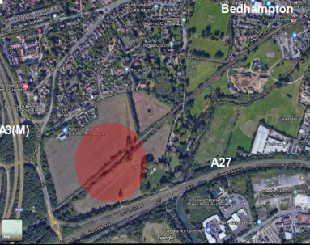
Learning from Previous Incidents
Near Miss at Bedhampton – Works Delivery (P11)
Overview
On 04/02/2021, Wessex Works Delivery Track Outer Tech member of staff with assistance from two Vital Rail contractors acting as lookout support were scoping future works in the Bedhampton area.
The PiC/COSS had set up his safe system of work (SSOW) and positioned his Distant lookout in a position to achieve sufficient sighting distance.
At approx. 1110hrs, the 10:00 1S16 train from Brighton to Portsmouth Harbour approached on the Down Line (line speed of 85mph). A horn warning and flag was used by the Distant Lookout to inform the team a train was approaching, however the Site Lookout failed to notice the warning. The Person in Charge (PiC) did notice the warning and the team were in a position of safety (POS) for approx. 7 to 8 seconds before the train passed their location.
It is worth noting that the train driver did not report a near miss and it was raised by the PiC/COSS in charge of the workgroup.
The initial investigation established that the Site Lookout was tired following his journey to site. It transpired that the lookout had to make a 3 hour journey each way.
What can we learn:
How are suppliers of contract or contingent labour monitoring fatigue in the staff they supply?
How do you confirm the use of locally sourced contractors or the provision of accommodation to minimise fatigue risk?
As a PiC/COSS are you asking the workgroup if they have any fatigue issues when giving your brief and are you scanning sentinel cards for information prior to going on or near the line?
Do your teams PiC’s/COSS’ test their SSOW at the site of work to ensure it is suitable, prior to starting work?
Discuss the learning points

Slide 10
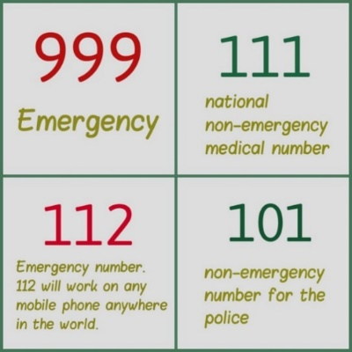
Safety
Dialling of Emergency and Non-emergency numbers
A recent investigation into a significant accident recognised the need to raise awareness about the requirement of using a prefix if dialling a non-emergency number.
Did you know?
When dialling 101 (non-emergency police) from a company mobile phone, you must use the prefix 9.
You can make an emergency call from a company mobile phone by dialling 112 or 999 directly.
Making a phone call from an occupational or emergency telephone (at access points) or using a desk telephone
Unless you are dialling an emergency number (either 112 or 999), you will need to dial the prefix 91.
It is best not to use non-emergency short dial services (such as, 101 and 111) from an occupational/emergency telephone or a desk telephone as they are not always supported at all locations due to their geographic nature. Instead, you should use the appropriate full long dial number to make non-emergency calls.
ACTION
Ensure you dial the appropriate prefix

Slide 11
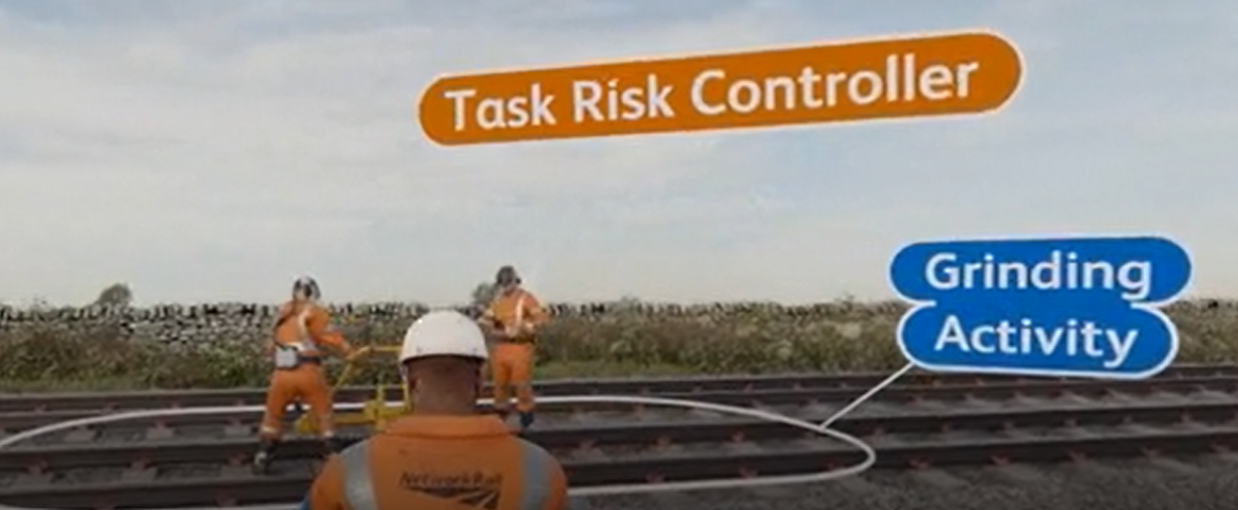

Safety
Delegating task risks to a ‘Task Risk Controller’
As you will have seen, as part of your 019 Principles briefing (in the ‘How to SWP guide’);
The PIC has the overall accountability for on-site safety.
However, the PIC may choose to delegate a risk and control. For example, if the PIC is part of a P-Way team but there is a welding activity taking place, the lead welder will be responsible for controlling the risk/s associated with the welding.
The PIC does not have the technical understanding of the grinding activity, so has delegated the task risk controls to the Task Risk Controller (in this case), the Grinder.
PIC
The deadline for the 019 Principles briefing to be delivered to all PTS competence holders and Planners has been extended until 31st August 2021.
The ‘How to SWP Guide’ can be found here

Slide 12
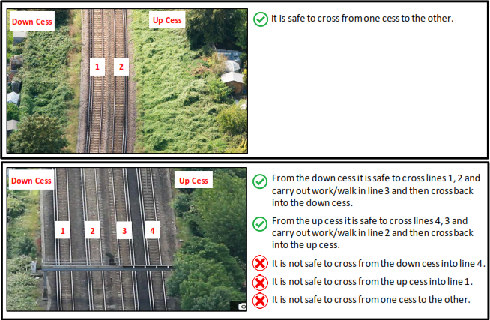
Safety
Crossing open lines to reach a position of safety when using lookout warning
Compliance with Rule Book places limits on the number of open lines that can be crossed to reach a position of safety when working under lookout warning system.
The Rule Book GERT8000-HB7 Issue 7, General duties of a controller of site safety (COSS), Section 4.8 Safe system of work using lookout warning states that a COSS can set up a Safe System of Work (SSOW) using one or more lookouts if the following criteria can be met;
There will be no need for anyone to cross more than two open lines to reach the position of safety (POS).
This means that the team/individual team members can leave the line they are working/walking in and cross two more complete lines in order to reach their POS, please refer to the below examples for clarity.
PLEASE NOTE - This briefing does not refer to “Crossing the line procedure” as per Section 2.3 of Handbook 7 (GERT8000-HB7)

Slide 13
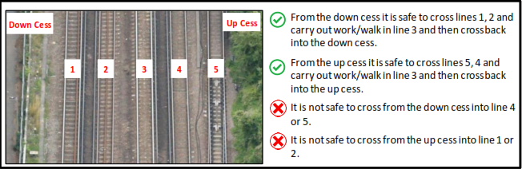
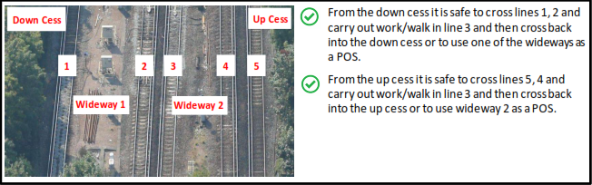
Safety
Crossing open lines to reach a position of safety when using lookout warning - continued
The list of the examples above is not exhaustive and there might be different scenarios out on site. But it is important to remember that the same principle will apply, and teams can only cross two more lines except the line they are working/walking in.
Whilst we work to move as much of our work as possible from SSOW using warning into SSOW using protection, it is important to ensure at the planning, verification and authorisation stage (as per NR/L2/OHS/019 – Safety of people at work on or near the line) that we do not plan any SSOW that would require the teams to cross more than two lines.
Note:
Although addressed to the Route Infrastructure Team the information contained in this briefing note is in line with GE/RT8000 and as such is applicable to all groups or individuals working on or about Network Rail Infrastructure.
The full Briefing Note can be found here

Slide 14



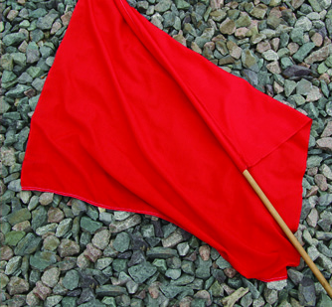
Safety
Site Warden/Lookout duties and correct equipment
Although we are significantly reducing the use of lookout warning by 3rd April 2021, there may be situations when the lookout duties will still be required.
If you are acting as Site Warden/Lookout, you must wear a white armlet or badge.
You must also make sure you have the following equipment with you and check that it works properly:
Whistle or horn (ideally carry both),
Blue and White chequered flag on a wooden pole,
Red flag on a wooden pole (during daylight),
Six or more (in date) detonators,
Hand lamp, capable of showing a red aspect (if required),
Track circuit operating clip (if required),
Valid Sentinel track safety competence card endorsed as competent.
There have been instances when the red flag was not on a pole but was folded inside the bag.
Do you know that it can take up to 25 to 30 seconds to change the blue/white flag over for the red one?
If there is an emergency and you need to stop the train, will you have 25 to 30 seconds to change the flags over?
ACTION
Is your red flag on the wooden pole?

Slide 15
Resource Library
Safety Bulletins, Alerts, Advice and Shared Learning
Safety-Alert-NRX21-01-Surbiton-workforce-fatality.pdf
Safety-Advice-NRA21-03-Camera-mast-winch-failure.pdf
Safety-Alert-NRX21-03-Supply-of-incorrect-safety-gloves.pdf
Safety-Advice-NRA21-04-Staff-accident-maintaining-HW-1000-points-machine.pdf
Safety-Alert-NRX21-04-Unsafe-access-into-machinery.pdf
Issue 104 Transferable Lessons - Stop Examine_.pdf
SAFETY BULLETIN_NEAR MISS_BEDHAMPTON_.pdf
Resource Library

Slide 16

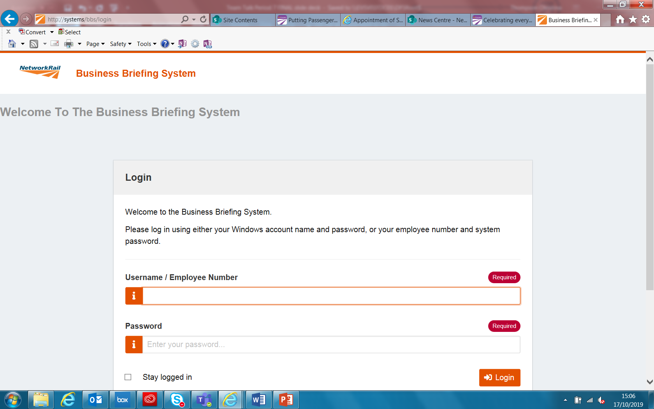
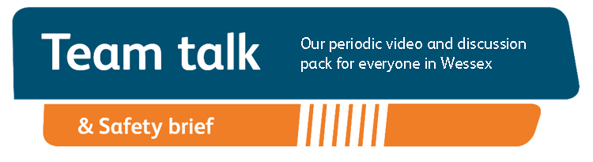
Remember to record that you have watched Team Talk
Click here for a guide on how to use the new Business Briefing System to do this
Also remember to record that you have received Safety Briefing via the Business Briefing System or via the dedicated person in your Business Unit.
7

