Slide 1

7
Notes:
Instructions to Managers
To view any links in the slides, you need to have PowerPoint in Slide Show mode

Slide 2
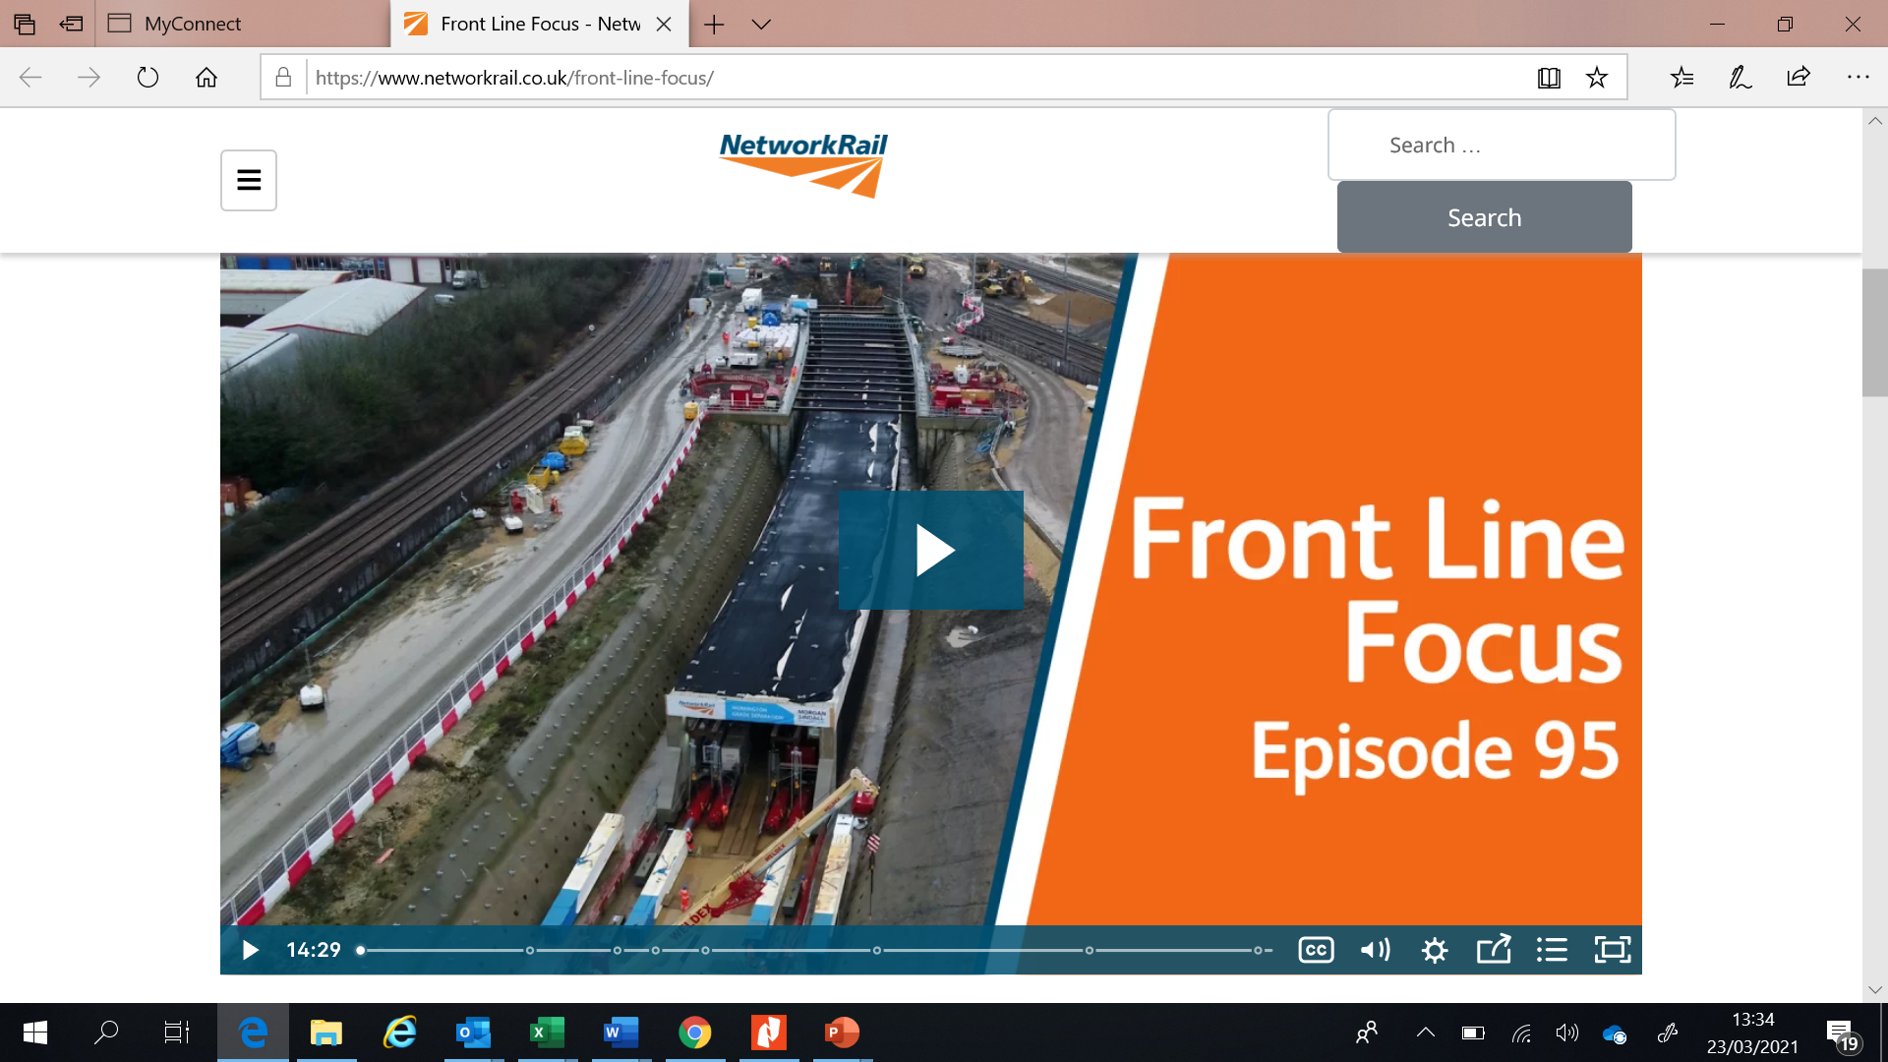
Safety
Front Line Focus Episode 95
ACTION
Watch the latest episode with your teams - link

Slide 3
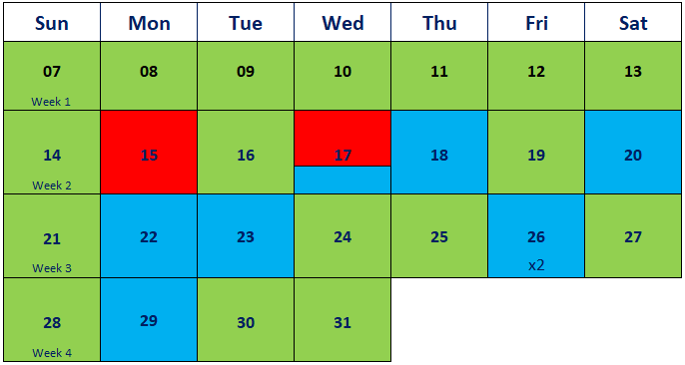
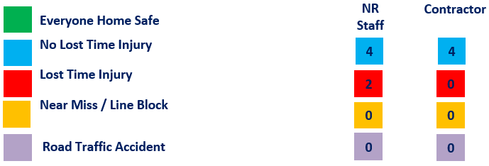

Safety
Accidents and Operational Close Calls Period 13
Significant Accidents
Fractured Thumb;
17/03/2021 (Possession Management Group) a member of staff sustained a fracture to his left thumb as a result of a Slip, Trip and Fall accident. More information on Slide 6
Other accidents
18/03/2021 (Outer DU) a member of staff dislocated his right ring finger as a result of a Slip, Trip and Fall accident. More information on Slide 7
23/03/2021 (Ops) During a routine patrol of the platform at Berrylands station , a Trespass and Welfare Officer witnessed a fatality where a member of the public was struck by a fast train approaching the station. He was shaken by the incident.
17/03/2021 (Ops) - A welfare and trespass officer was racially abused by a drunken male passenger when he asked him to move away from the platform edge at Kingston station.
20/03/2021 (Ops) A Trespass and Welfare Officer at Pokesdown station, was punched repeatedly by an intoxicated female passenger when he intervened to stop the female from assaulting other passengers on the platform. No injuries sustained. The female passenger returned to the station on the 22/03/2021 and verbally threatened the Trespass and Welfare Officer.
Fatality Weighted Injuries (FWI)
0.015 MAA against target of 0.059 for the route
Lessons learnt from these events will be shared once the investigation has been concluded
Notes:
FWI measure explained
Network Rail defines a work place injury as any injury sustained by staff, both direct employees and contractor/suppliers, while undertaking activities connected with Network Rail’s business.
All reported injuries are to be entered into SMIS, the companies corporate Safety Management Intelligence System.
Fatality weighted injury rate (FWIR) is a KPI that uses the following calculation:
The number of fatalities, plus the (number of specified injuries / 10) plus the (number of 3+ lost day injuries / 200) plus the (number of all other injuries / 1000) divided by the hours worked, multiplied by 1,000,000, over the last 13 periods
RIDDOR reporting shall be based on the requirements of the RIDDOR 2013 regulations and the ORR guidance http://orr.gov.uk/__data/assets/pdf_file/0010/2332/riddor-guidance.pdf.

Slide 4
Safety
Accidents and Operational Close Calls Period 13 cont.
Other Accidents continued
26/03/2021 (Inner DU) verbal altercation at Sunningdale, a contractor became abusive towards a Supervisor after he was asked to move his car that was parked on a private driveway.
26/03/2021 (Ops) A Mobile Operations Manager (MOM ) attending to an incident involving 20 youths who were engaged in anti-social behaviour at Wimbledon Station Centre Court Gate, was pushed as he tried to prevent the youths from fleeing the area after the police had been summoned . No injuries were reported.
29/03/2021 (Ops) A Mobile Operations Manager (MOM) sustained scratches to his right wrist and bruising to his right ankle when he became involved in a scuffle whilst assisting BTP officers to apprehend , a male passenger who had been riding an electric scooter beyond the yellow line on platform 15 at Clapham Jn Stn.
Lessons Learnt- Prioritise your safety and welfare when attending an incident and always summon help when required.
31/03/2021 (Inner DU) – no injury accident. A member of staff was walking along the cess in Staines area when the ground gave way underneath him and he subsequently fell into the hole but not suffered any injury.
15/03/2021(Inner DU)- a member of Wimbledon welding team whilst loading a welding mould box from the stores onto a van, aggravated a pre-existing condition of his left hand side sciatica and was unable to return for his following shift.
Lessons learnt from these events will be shared once the investigation has been concluded

Slide 5
Safety
Accidents and Operational Close Calls Period 13 cont.
Operational Close Calls
06/03/2021 (Possession Management Group) at approx. 0142hrs an Engineering Supervisor arriving to setup a worksite, reported that a possession support staff (PSS) placed two worksite marker boards (WSMB) with detonator protection on the Down Hounslow Spur (HUW) instead of a possession limit board (PLB). The PSS admitted that he had no batteries for his PLB and made a decision to place the WSMBs instead of the PLB and then left the site without the PICOP’s permission in order to obtain some. The individual had his PSS and COSS competencies suspended pending assessment and mentoring.
Lessons Learnt – ensuring the equipment is fit for purpose prior to the shift, informing the PICOP about any broken equipment and getting a permission to source a replacement
22/03/2021 (Works Delivery) at approx. 0415hrs 5P12 left Portsmouth and Southsea Down Carriage Siding (DCS) on No. 1 road and came into contact with 2 waffle boards in the 4ft. One board was wedged underneath the train. Investigation ongoing.
28/03/2021 (Possession Management Group) a possession support staff failed to close a hook switch 7337 at Eastleigh East Jn when the possession WON 52 Item 54 was given up on Sunday morning at 0704hrs. This resulted in the passenger train 1T24 loosing power at Eastleigh. Investigation ongoing.
Allegation of a Near Miss
19/03/2021 (Outer DU) an alleged Near Miss was reported by the driver of 2S19 on the Down Test Valley Line at Romsey. CCTV footage from the train was reviewed and it was confirmed that the team were in a position of safety for more than 10 seconds. Feedback was provided to the TOC.
Lessons learnt from these events will be shared once the investigation has been concluded

Slide 6
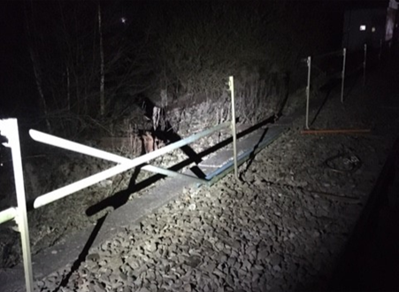
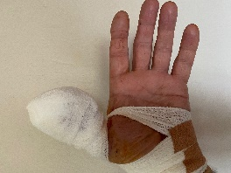
Significant Accident
Fractured Thumb
Overview
On 17/03/2021 at approx. 0127hrs, a member of staff carrying out a site audit with a strapping team at Eastleigh Sth Jn at 74m12ch, sustained a fracture to his left thumb as a result of a Slip, Trip, Fall accident. The individual was standing on the troughing route and in order to maintain social distancing from the strapping team took a step back, losing his balance and falling backwards to the ground.
He initially hit the ground with his lower back/pelvis with both his hands outstretched behind him to try to support himself. His left hand hit an obstruction in the grass and the IP believes this caused the injury to his palm and thumb.
The individual was unable to recollect exactly how the accident occurred on the night.
The investigation established the following:
The IP was wearing full PPE with the exception of gloves as he was not carrying out any work, only observing,
The troughing route on the cess side was not level with the ballast/ground and this contributed to the IP losing his balance,
The IP stepped back without checking the underfoot conditions first.
What can we learn:
Importance of being situationally aware and considering whether you are standing in the most appropriate place , taking underfoot conditions and any changing hazards into consideration.
Walk forwards and if you need to move/step back, turn around to carry out a visual check for any obstructions first.
Avoid walking/stepping on any cables or pipes.
Full PPE should be worn including task appropriate gloves.
Discuss the learning points

Slide 7
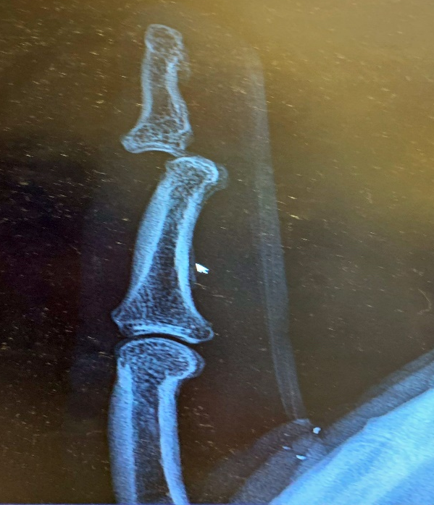
Slip, Trip, Fall Accident
Dislocated Finger
Overview
On the 18th March 2021 at approximately 0200hrs a Team Leader (TL) was working on a re-railing site around Rowlands Castle. In the course of his duties, he turned to observe the work in progress and unexpectedly fell forward. In an attempt to brace his fall he dislocated and cut a finger on his right hand.
The TL has confirmed that he is not clear on what exactly caused him to fall, but believes it occurred due to a momentary lapse in concentration and that he may have caught his foot on the running rail or a key housing causing him to lose his balance.
The TL was assessed at the scene and transferred to hospital where his finger was relocated and stitches placed in the wound. The TL was able to return to work, after a period of planned leave, in a supervisory role until the stitches were removed after 7 days.
What can we learn:
These types of accidents are a regular occurrence and highlight the need for continuous concentration, especially at night.
SSOW Planning needs to consider potential worksite hazards and document them in the SWP.
Worksite Safety Briefs need to identify all potential hazards and communicate the risks to the workforce.
Time pressure and rushing to complete a task must not compromise workforce safety.
Discuss the learning points

Slide 8




Combating Violence and Aggression at Work
Our pledge to your safety
Do you work in one of our stations and come in to contact with passengers? Do you work on the frontline and come in to contact with the public? Or do you work in an office and don’t regularly come in to contact with people outside of Network Rail?
Either way, this pledge is for all of you.
Jointly, with South Western Railway (SWR) and British Transport
Police (BTP) we are committed to improving the personal safety of each employee, while at work, from unpleasant behaviour from members of the public.
If you experience any form of aggression, please raise it immediately with your line manager so that it can be followed through. You will receive full support during the process. If line managers require further assistance, please contact Katherine.Styles@networkrail.co.uk
You can view our pledge to you here.

Slide 9
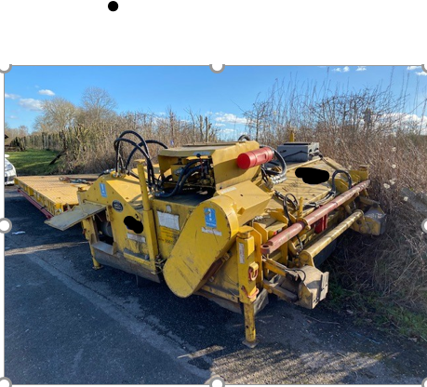
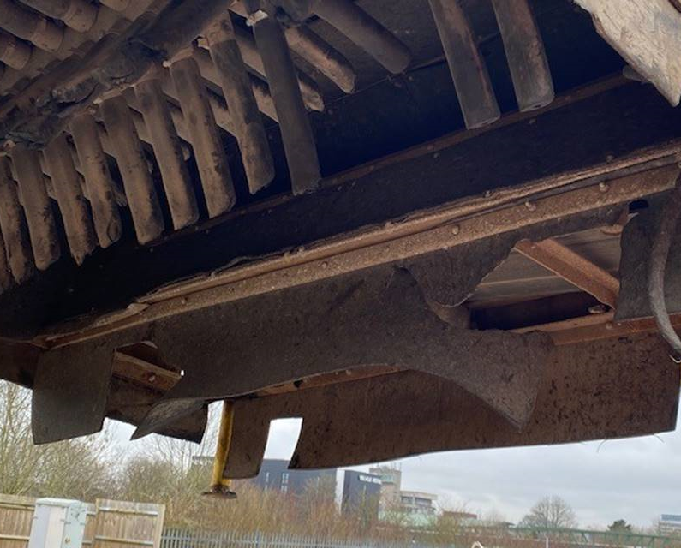
Learning from Previous Accidents
Significant Eye injury (P12)
Overview
On 26/02/2021 at approx. 0121hrs a member of staff was acting as a machine controller/POS for a machine and a ballast brush attachment operated by a machine supplier in the Warminster area. The individual was struck by a projectile that may have been ejected by the ballast brush and caused a significant injury to his left eye and three fractures to his cheek bone.
It is not known at this time whether the injury will result in permanent loss of sight in the eye.
Following an initial investigation, the ORR has issued a prohibition notice on the use of this Rexquote ballast brush attachment, Fleet No 1080.
There has also been a National Incident Report (NIR) created that will affect all suppliers across NWR.
Investigation is still ongoing but there are some immediate actions required:
Before a ballast brush is used to carry out a task, ensure the rubber skirt is in a good condition and is not worn out and that the rubbers/tines on the actual brush are also in a serviceable condition and are not missing.
The Exclusion Zone is set up and maintained throughout the activity
If you need to approach the machine/ballast brush, inform the Person in charge so he/she can stop the machine before entering the exclusion zone.
Ensure you wear the correct, task appropriate PPE at all times.
Discuss the learning points

Slide 10
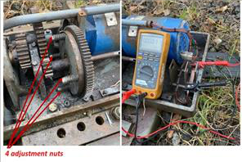
Learning from Previous Accidents
Damaged Finger Tendon (P12)
Overview
On the 20/02/2021 at approximately 0230hrs a S&T member of staff was conducting fault maintenance on a HW 1000 points machine (E465B) on the BML1 at Eastleigh Railway Station when he sustained a deep laceration to his right index finger.
The incident occurred whilst the team member was making adjustments to the clutch. The dry plate clutch is adjusted mechanically by increasing or decreasing the clutch spring pressure by means of the four nuts on the clutch gear. The points had been switched to manual to prevent the points motor energising.
Although the cut-out switch had been operated, a multi-meter set to measure current had been connected across the cut-out switch in preparation for taking a clutch slip current reading.
As the clutch was being rotated manually, movement of the clutch mechanism caused the operating contacts to make contact and caused the points machine to power up and run.
What can we learn:
Always follow Risk Controls Manual NR/L3/MTC/RCS0216/MANUAL [Issue: 18] Risk Control Manual - GA15 part SIG002 – Points.
Always isolate the points machine prior to any inspections and adjustments and where any protective covers are removed for inspection and adjustment, these shall be refitted prior to operating the points on 'power’.
Only carry out tasks you are trained and competent to do.
The method of work for Clutch Slip Current Measurement and Adjustment is being reviewed.
Discuss the learning points

Slide 11
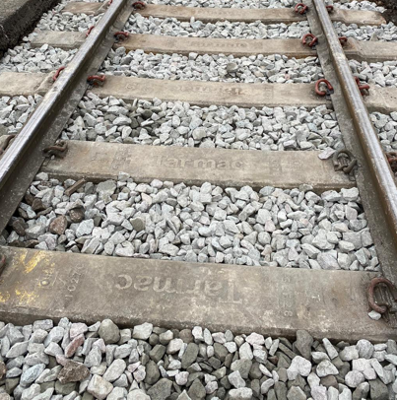
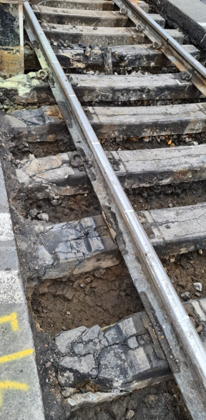


Learning from Previous Incidents
Changing site conditions
Overview
In the last few periods, a number of Slip, Trip and Fall accidents that resulted in a number of injuries to our staff were reported. Some were fractured/dislocated fingers and others led to various injuries to legs and ankles.
A few of these occurred track side/whilst working while some accident took place whilst accessing/egressing track side using access steps.
We are all aware of the hazards that we come across every day but are we really situationally aware? Do we take the changing conditions into consideration and apply additional measures to keep ourselves and our colleagues safe?
In the last period cascade, we discussed an accident, where a member of staff tripped and then trapped his leg between two timbers, causing an ankle twist. The images opposite show how work affects underfoot conditions through the course of the day. Would the brief from the PiC be the same for both situations? Would our PiC’s provide additional or further briefings as the site risks changed?
In period 9, a member of staff fractured his finger after missing his footing whilst carrying fishplates up a set of stairs whilst another member of staff passed him on his way down. This compromised the IP‘s stepping technique and caused distraction.
Should the brief from the PiC take this risk into consideration and should a one way system had been implemented?
Remember: The Person in Charge (PiC) has overall responsibility for the Operational, Site and Task Risk. Any changes to these risks must be controlled and briefed to the teams on site. See standard NR/L2/OHS/019.
Discuss the learning points

Slide 12
Safety
Use of 1.25 metres as separated protection for WALKING in a position of safety
On Friday 25/03/2021 the Southern Region issued a Letter of Instruction that clarifies our position in relation to the provision of Safe Work Pack (SWP) and safe system of work (SSOW) under the operational hierarchy within SSOWPS2.5 system or other similar systems used by contractors to produce SWPs.
This instruction addresses two main subjects;
Identification of the position of safety to be adopted whilst WALKING on or about the line, this is not a change but highlights the Rule Book position as it always has been.
The provision of a documented safe system for WALKING within a SWP created by the SSOWPS2.5 system, in relation to the distance between the nearest open running line and the position of safety whilst WALKING on or about the line.
The full Letter of Instruction can be found here
Are all your staff aware of this instruction?

Slide 13
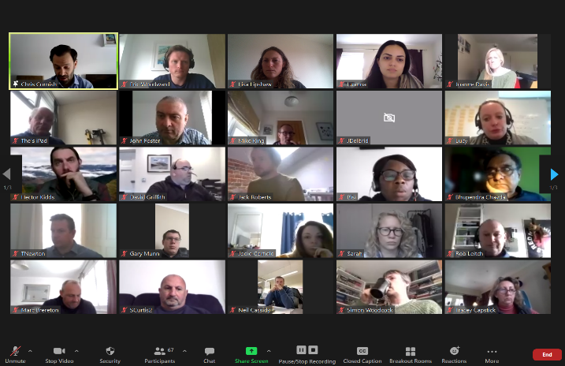
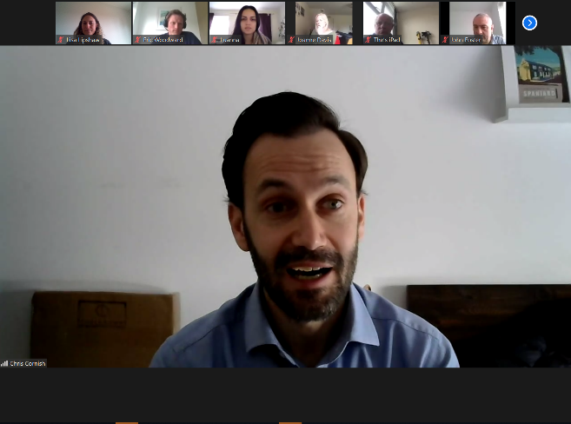
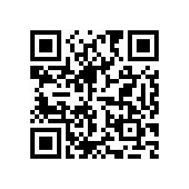
Track Worker Safety (TWS)
WessexTWS@networkrail.co.uk​
Update
Chris Cornish updated maintenance colleagues on the accelerated and expanded Track Worker Safety programme.
Teams were thanked for their hard work as a considerable amount of work has moved into green zone working.
There were a number of really important questions on fault response, how we’re working with the Department for Transport, train operators and contractors and access.
The full call can be watched here.
We’re also asking for feedback on how we communicate the programme. You can feed back here:
Search ‘Southern Track Worker Safety’ on MyConnect

Slide 14
Track Worker Safety (TWS) cont.
WessexTWS@networkrail.co.uk​
Moving away from red zone working
Wessex route are committed to ending use of unassisted lookout working, lookout operated warning systems and individual working alone (in a 'red zone' environment) by the end of July 2021.
Period 13 has seen a 64% reduction in hours recorded in red zone compared to same Period last year.
This is a fantastic achievement by everyone involved!
Search ‘Southern Track Worker Safety’ on MyConnect​

Slide 15
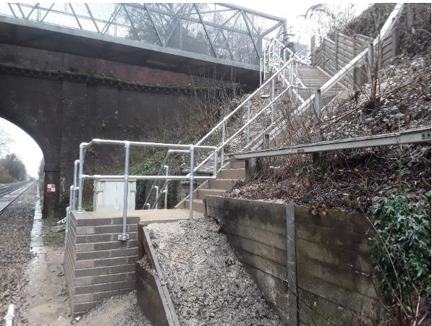
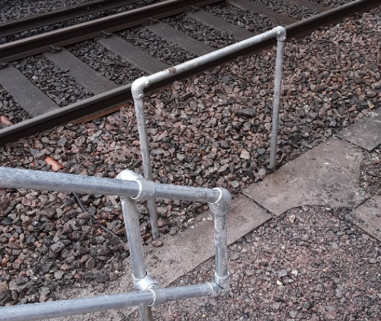
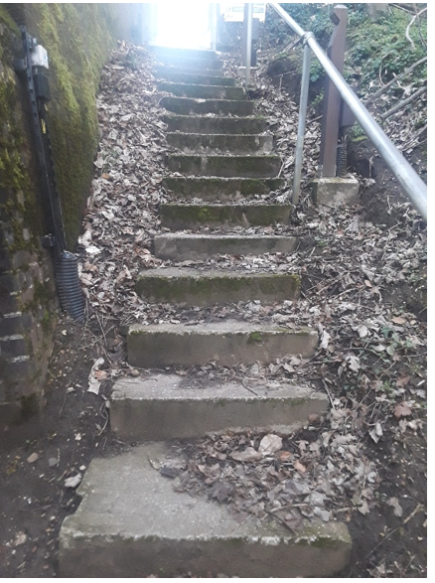
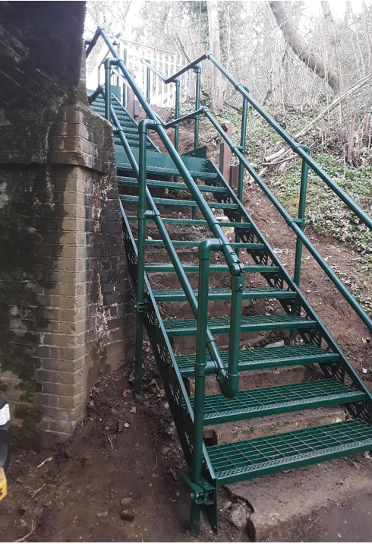
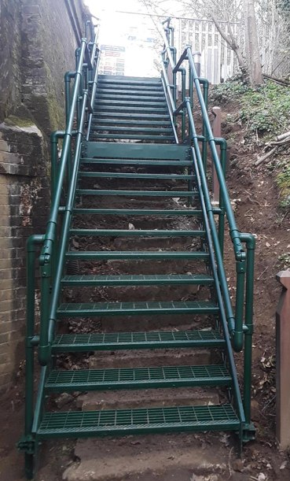
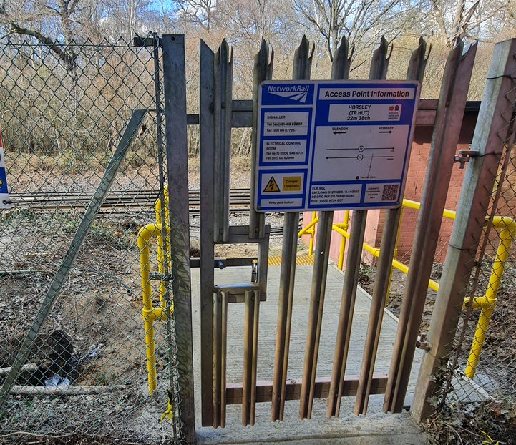
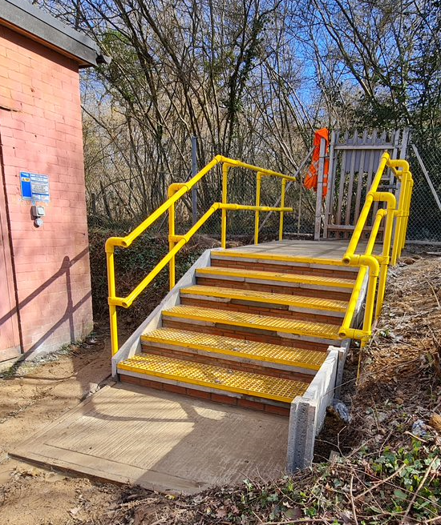
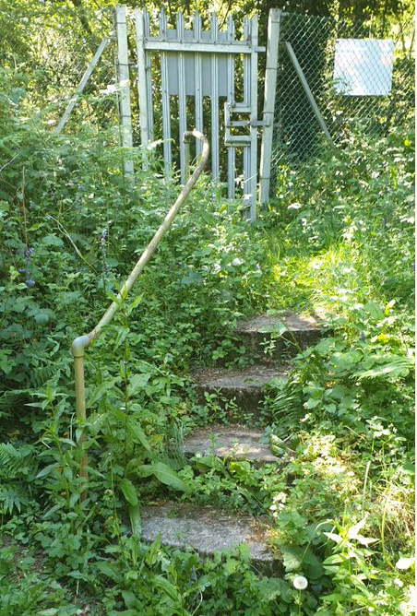
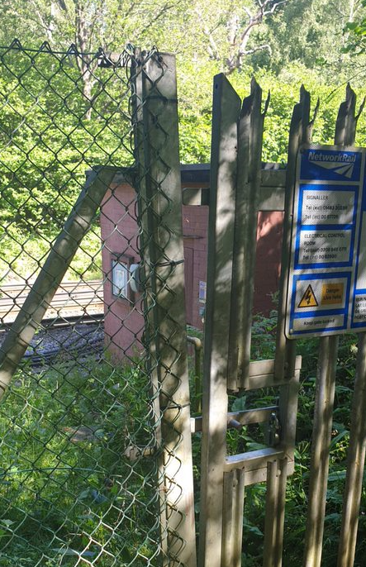
Track Worker Safety (TWS) cont.
WessexTWS@networkrail.co.uk​
Wessex Safe Track Access Alliance
ENTON MILL (WPH1 DN Main/Fast 37m10ch) - Poor Steps Narrow and Steep
St John’s Access (BML1 DN 51m51ch) – Reinstate old Access
Access point has been upgraded to new KITE step system. Access is used for staff to carry tools side by side for possession work and/or to access under Line Block for inspections purposes. It is also a location used for strapping staff to assist with possession duties.
Access point has been reinstated to new step system. Access now direct to S&T location cases and signal. Removing the need for working ‘on or near the line’
HORSLEY TP HUT (NGL DN LINE 22m38ch) - Access returned back into use
Access was signed out of use, bringing this access back into use enables direct access to get to the TP Hut eliminating the need for line blocks or red zone access.
Work undertaken includes, new steps, gate, signage, new GRP handrail, De-Veg and Fencing.
Search ‘Southern Track Worker Safety’ on MyConnect​

Slide 16

Safety
WorkSafe Procedure NR/L2/OHS/00112
Nobody should be asked to ignore or break safety rules and colleagues should be able to say no and challenge unsafe situations or behaviours.
The WorkSafe Procedure was introduced in 2009 to empower colleagues to raise safety concerns without fear of recrimination.
This revised national standard should give employees the confidence that they can raise concerns at the time and not feel under pressure to return to work until such times that the cause of the concern has been addressed.
The Procedure applies to all Network Rail staff and all staff supplied through the Supply Chain Operations, whether frontline or office based.
All new employees shall be briefed on the procedure during the induction day and any frontline staff will be briefed as part of their PTS training course.
The WorkSafe Procedure can be found here
Please refer to Notes for examples of instances when WorkSafe Procedure could be applied
Notes:
WorkSafe Procedure could be invoked where there are concerns about:
the safe method of working,
the working environment,
the level of training provided,
the competence of those involved in the work activity,
the resources available for the work activity or the tools/equipment to be used.

Slide 17
Safety
WorkSafe Procedure NR/L2/OHS/00112 – cont.
Applying the WorkSafe Procedure – PLEASE NOTE THE UPDATES/CHANGES TO THE PROCESS
Stop work and move to a position of safety.
Immediately contact Route Control/Supply Chain Organisation Control (SCO) 24/7, inform them the WorkSafe procedure has been applied and explain why the activity has been suspended. (New)
Route Control/SCO 24/7 create a log reference and fill in section A of NR/L2/OHS/00112/F01 with the caller before contacting the responsible manager (RM) or on call manager if out of hours. (New)
The RM shall contact the Responsible Person at the location or site and determine whether there has been a suitable and sufficient risk assessment of the task, the system of work is safe and if the activity can be restarted.
The RM and the responsible person will try and reach an agreement on the restarting of the work with agreed additional controls in place, if appropriate, or by amending the safe system of work.
The RM shall then propose a return to work, or agree the task is unsafe.
If the RM agrees the task is unsafe, or an agreement is not reached, the work shall cease, and the work site left safe, with colleagues assigned to other work.
Where work has ceased, suitable controls must be in place before the activity is resumed. The responsible manager shall inform Route Control/SCO 24/7 of the outcome and fill in section B of NR/L2/OHS/00112/F01. Route Control/SCO 24/7 shall send a copy of the completed form to the work group/employee who originally applied the WorkSafe procedure and to the responsible manager. (New)
The Main Changes from the previous version of the Standard can be found in the Notes
Notes:
The Main Changes from the previous version of the Standard
Informing the appropriate Route Control (Maintenance of Works Delivery) or SCO24/7 (Capital Delivery) – Section 5
Ability to carry out a formal review of the Safe System of Work including Task Risk – Section 4
Two-part capture form NR/L2/OHS/00112/F01, to record the reason for raising the Procedure and the outcome. The copy of the completed form will be send to the employee who applied the Procedure – Section 6
Responsible Person at the location or site as the standard is applicable to all staff, not only frontline – Section 3
If a WorkSafe Procedure is applied, the appropriate DCP will identify a Level 1 investigator to manage an independent investigation or lesson learnt review – deviation from Section 7 (Southern Region)
Application of the procedure is now detailed in a flowchart that should be readily available and displayed on notice boards in all locations – Section 5 and Figure 1 on page 10
The signed policy statement should be displayed on notice boards in all locations and distributed at inductions - Appendix ‘A’

Slide 18
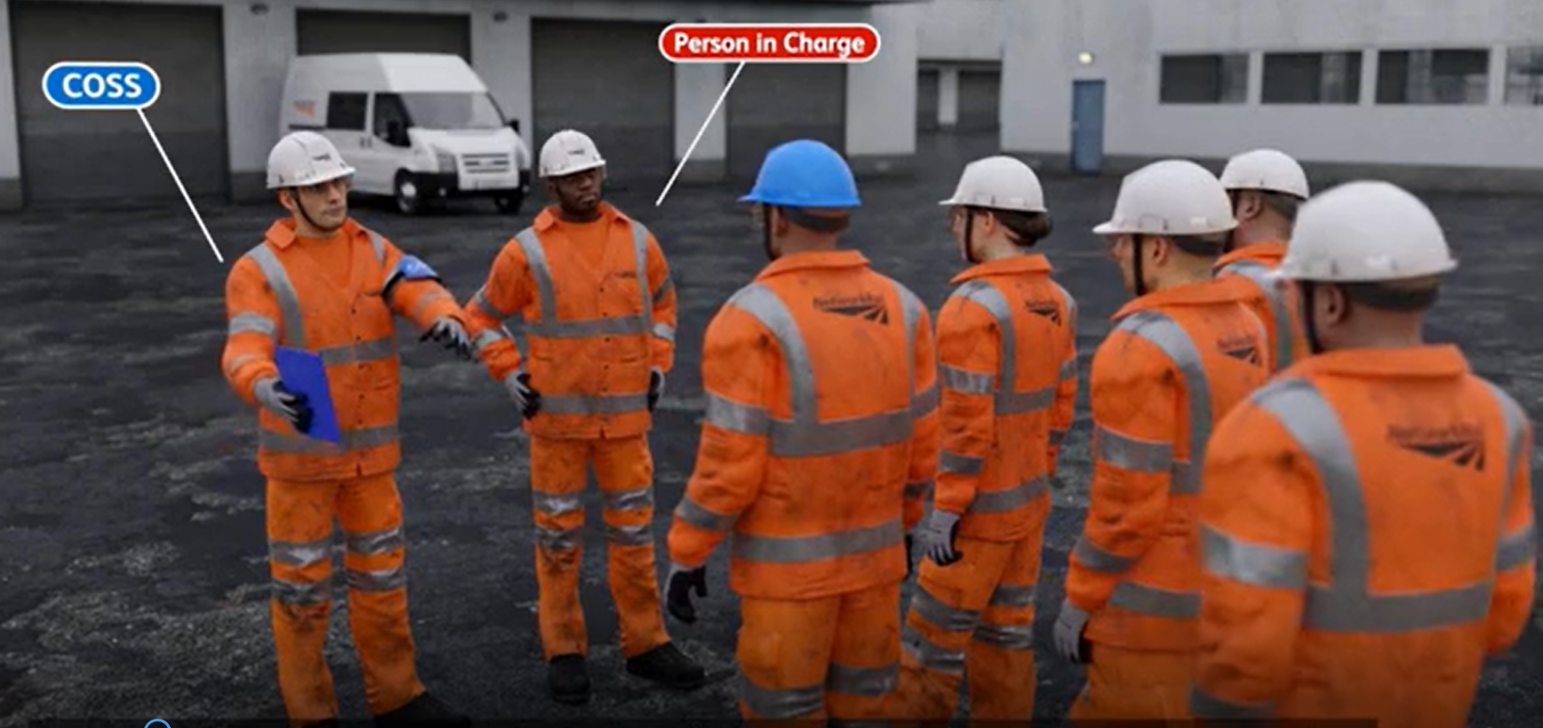

Safety
Delegating COSS duties
As you will have seen, as part of your 019 Principles briefing (in the ‘How to SWP guide’);
The PIC has the overall accountability for on-site safety (Site, Task and Operational Risk).
However, the COSS duties (operational risk) can be delegated at the planning stage.
When this has taken place, the COSS must sign the F01.1 ( on the SWP) prior to the PIC verifying the pack.
The PIC is there to make sure that the operational, task and situational risks are controlled. The PIC does not have to do all these tasks, some can be delegated (such as COSS duties), but the PIC must make sure that effective controls are in place.
The deadline for the 019 Principles briefing to be delivered to all PTS competence holders and Planners has been extended until 31st August 2021.
Have you checked with your Line Manager that you’re booked on?
The ‘How to SWP Guide’ can be found here

Slide 19
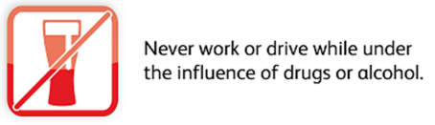
Safety
Drug and Alcohol Testing
Attending work under the influence of alcohol or certain drugs presents a significant safety risk to our colleagues and our passengers.
All staff performing safety critical duties who are prescribed any medication, MUST disclose this information to the Chemist on Call service.
A pharmacist will then advise if it is safe to continue working in a safety critical role.
Chemist on Call can be contacted on 0800 0833 324 option 1 or 08456 77300.
For non-safety critical staff concerns about the medication they are taking, referral can be made to Occupational Health.
Key points to be aware of
Safety critical roles will be tested at random, where there is suspicion a colleague is under the influence, or following an accident or incident.
Colleagues in non-safety critical roles will be tested where there is suspicion a colleague is under the influence, or following an accident or incident.
Failing a drugs and alcohol test is gross misconduct. A disciplinary investigation will follow and unless there are exceptional circumstances, the consequence will be dismissal and a five-year Sentinel ban.
In line with other rail industry organisations and emerging trends in recreational drug use, we will also be testing for Ketamine and Tramadol from 1 April 2021.
We support colleagues who ask for help before they fail a drugs and alcohol test. If you have concerns about your substance misuse please let your line manager know and you will get the support you need from Optima Health or Validium.
More information can be found in the following Drug and Alcohol Standards NR/L1/OHS/051 and NR/L2/OHS/00120

Slide 20
Safety
Changes to Speeding Investigations
From 29th March 2021 we are changing the way we are investigating speeding events.
We all have both moral and legal duty to follow the law, an approx. 65% of all NWR’s Life Saving Rule breaches are related to driving with the majority speeding.
What’s Changing?
• Formal Speeding Investigations are being removed.
• All speeding events will follow a new Speeding Matrix.
• Matrix is based upon the Association of Chief Police Officers speeding guidelines.
• Fair Culture principles still apply.
Why change?
• Transparency – the matrix sets out clearly the support and consequences of speeding events.
• Supportive – the intent is that colleagues receive a range of training to improve their driving should they make errors and prevent re-occurrence. Hold colleagues to account for major speeding offences.
• Reduce the burden, and bring clarity to line managers.
• Current process takes time, causes stresses, doesn't tell us anything. 35% of investigations never reach conclusion.
Any new speeding offence dated 29/03/21 onward will be processed using the new matrix.
All Designated Competent Persons (DCPs) and registered NWR drivers have been briefed on these changes.
The link to the briefing video can be found here

Slide 21
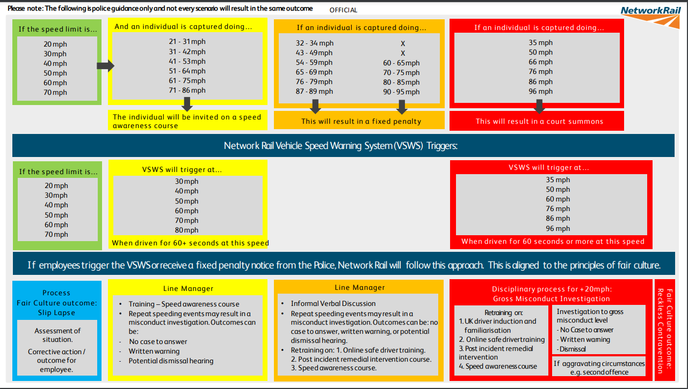
Safety
Changes to Speeding Investigations cont.
Speeding Matrix
The copy of the matrix can be found here

Slide 22

Environment
New Environment Standards, Briefings & Training
NR/L2/ENV/122 Biodiversity (manual & modules)
Standard NR/L2/ENV/122 was released March 2021 for compliance January 2022. The standard applies to all colleagues and contractors. It provides a process to help colleagues make decisions that will reduce the risk of breaching environmental legislation and help Network Rail to achieve its environmental commitments.
Briefing material and FAQ document to be available in due course.
2021 Breeding Bird Briefing
An updated 30 mins briefing video has been made by the Technical authority and is currently only available to NWR staff.
There is an opportunity for an MS Teams briefing for Wessex Route contractors, depending on the level of uptake.
'An Introduction to Sustainable Land Use’ eLearning
A new eLearning module titled 'An Introduction to Sustainable Land Use' has also been created by the team to raise awareness of Network Rail's new environment and sustainability commitments and help colleagues understand why Sustainable Land Use is important to everyone at Network Rail and its partners.
ACTION
The Breeding Bird Briefing can be found here

Slide 23





Health and Wellbeing
Mental Health Awareness Week
Connect with Nature: 10 – 16 May
Use your senses to…
Taste wild garlic.
Grow in shady and damp conditions, in your local woodland or riverbank
Season starts in late winter and lasts until the end of spring
Leaves and flowers are edible
Great in pasta, salad and soup
Feel the en grass under your feet when you walk barefoot.
Walking bare feet has positive effects on your well being.
Smell the bright new flowers blooming around you.
See the first butterflies of the year
Hear the song of birds returned from their warm winter getaways. Can you notice different birdcalls coming from the trees and gardens around you?
Lunch and Learn events: 12:00 – 13:00
13 May – Helping nature, Helping you
19 May – Nature and your wellbeing

Slide 24


Health and Wellbeing
Health Surveillance 2021/ 22
Health Surveillance Programme Timeline 2021/ 22
April:
Health Surveillance list is sent to the Route to verify
April
Optima provide the Route with Health Surveillance clinic dates
May – Jun:
Priority employees ‘not seen’ during last year’s programme attend appointments
Jun - Dec:
Complete Health Surveillance Programme
Jan - March
Mop up and escalations of the programme
Telephone Assessment
Key facts:
Employees are identified for Health Surveillance based primarily on the vibrating tool competencies they hold on Oracle.
Employees who undertake work activities that expose them to one or more of the Occupational hazards (HAVS, Noise, Respiratory, Skin and Night Work) must attend Health Surveillance.
2/3 of ALL employees due health surveillance will have a telephone appointment booked
1/3 of ALL employees due health surveillance will complete their Health Surveillance as part of their Health, Safety and Wellbeing Medical
February 21:
Employees due their Competency Medical between April 2021 - Jul 2024 are identified by HRSS
April 21 to March 22
Optima book this group of employees to attend their Health, Safety and Wellbeing medical
As part of their Health, Safety and Wellbeing Medical employees will also have their Health Surveillance screening
F-2-F Health Surveillance Medical
ACTION
Please ensure to book your teams in for their surveillance

Slide 25
Resource Library
Safety Bulletins, Alerts, Advice and Shared Learning
Safety-Advice-NRA21-05-Preventing-water-ingress-to-25kV-Track-Sectioning-Cabin.pdf
Letter of Instruction 1.25m Position of Safety v1.0.pdf
Speeding Matrix.pdf
Resource Library

Slide 26

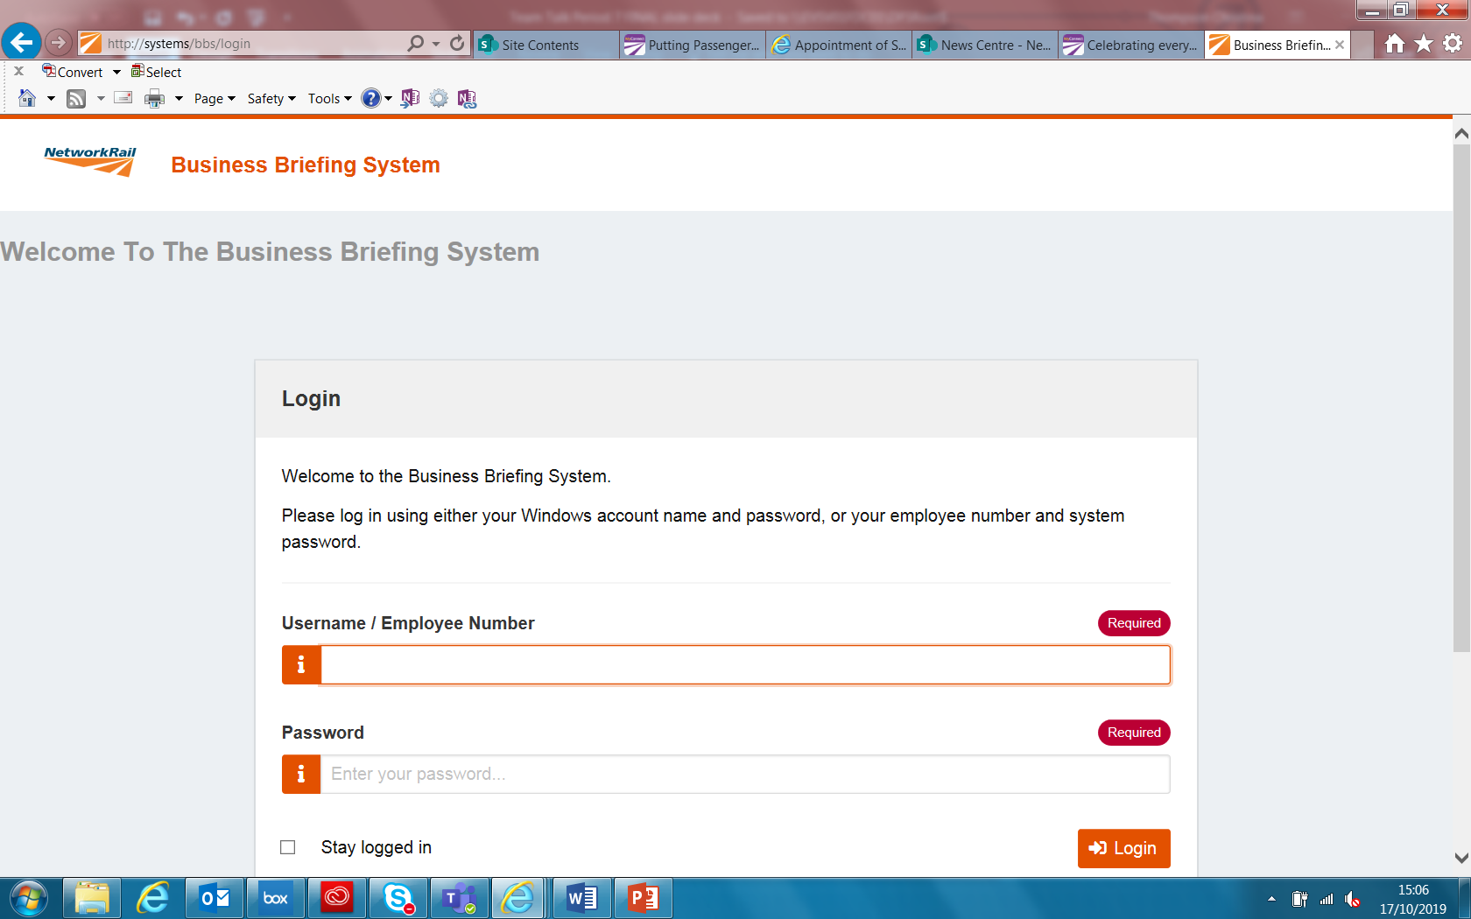
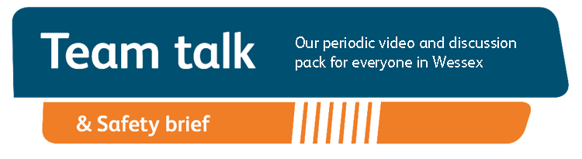
Remember to record that you have watched Team Talk
Click here for a guide on how to use the new Business Briefing System to do this
Also remember to record that you have received Safety Briefing via the Business Briefing System or via the dedicated person in your Business Unit.
7

