Slide 1
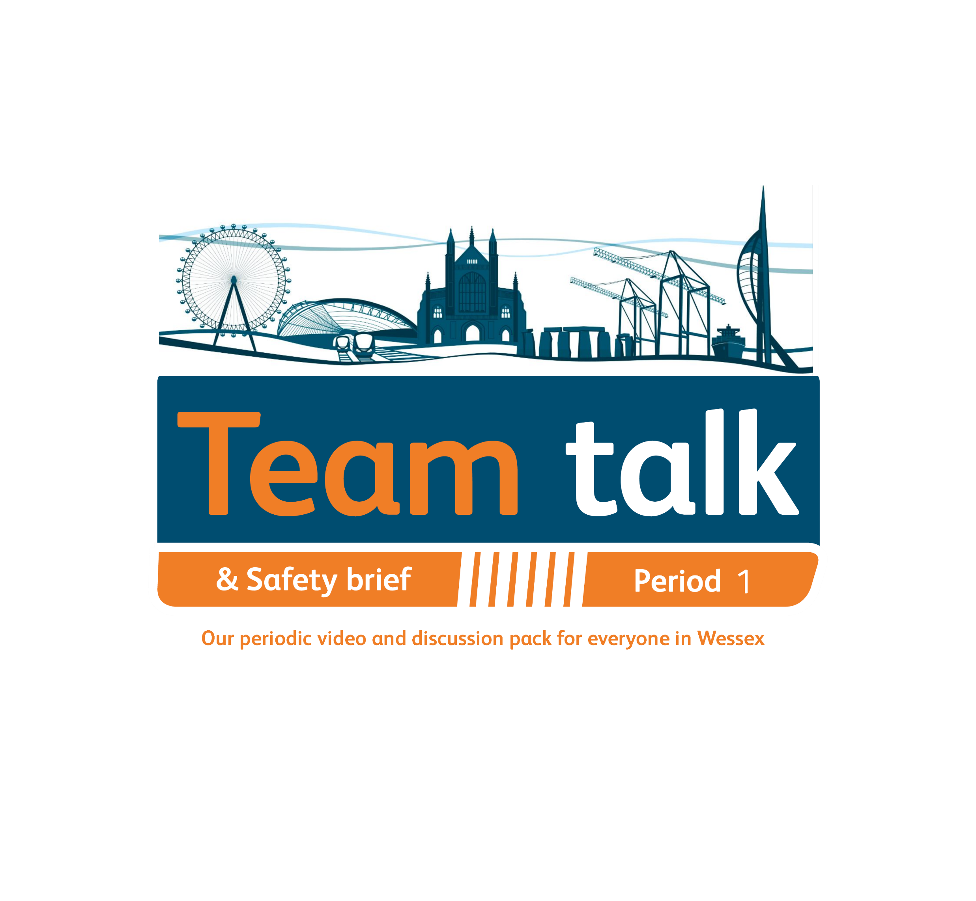
7
Notes:
Instructions to Managers
To view any links in the slides, you need to have PowerPoint in Slide Show mode

Slide 2

Safety
Accidents and Operational Close Calls Period 1
Significant Accidents
Other accidents
16/04/2021 (Operations) physical assault on a Trespass and Welfare Officer at Pokesdown Station. Lessons Learnt – prioritise your safety and welfare when attending an incident and summon help when required.
Please refer to the pledge to your safety we shared in the last cascade - link
24/04/2021 (Operations) member of staff sustained a laceration to his right wrist at Wimbledon ASC after accidentally dropping a bowl in the kitchen sink.
Operational Close Calls
08/04/2021 (Possession Management Group) the PICOP for Item 505 Wessex WON Week 1 gave the ES for Worksite Alpha permission to test and apply straps as per the current isolation BS304 Issue 1. Whilst the strapping team on the Down Main at 52m40ch were testing the conductor rail , they discovered it was still live. It transpired that the BS304 Issue 1 was missing two circuit breakers and therefore the isolation did not cover the strapping location. Investigation ongoing.
09/04/2021 (Outer DU) Line Blockage Irregularity at Andover reported by the Basingstoke Panel Signaller. More information on Slide 4.
Fatality Weighted Injuries (FWI)
0.002 MAA against target of 0.059 for the route
Lessons learnt from these events will be shared once the investigation has been concluded
Notes:
FWI measure explained
Network Rail defines a work place injury as any injury sustained by staff, both direct employees and contractor/suppliers, while undertaking activities connected with Network Rail’s business.
All reported injuries are to be entered into SMIS, the companies corporate Safety Management Intelligence System.
Fatality weighted injury rate (FWIR) is a KPI that uses the following calculation:
The number of fatalities, plus the (number of specified injuries / 10) plus the (number of 3+ lost day injuries / 200) plus the (number of all other injuries / 1000) divided by the hours worked, multiplied by 1,000,000, over the last 13 periods
RIDDOR reporting shall be based on the requirements of the RIDDOR 2013 regulations and the ORR guidance http://orr.gov.uk/__data/assets/pdf_file/0010/2332/riddor-guidance.pdf.

Slide 3
Safety
Accidents and Operational Close Calls Period 1 cont.
Operational Close Calls continued
11/04/2021 (Possession Management Group) the Salisbury Signaller reported that the possession limit board (PLB) and detonator protection on the Up Main Line (BAE1) at Salisbury were placed the wrong side of the protecting signal SY46, beyond SY46 vice on the approach. More information on slide 5.
22/04/2021 (Outer DU) report of incorrect ESR boarding at Grateley Station showing 20/90mph vice 20mph. More information on slide 6.
27/04/2021 (Operations) Line Blockage (LB) Irregularity on the Down Main Line (BML1) between E567pts at Redbridge and E572pts at Totton as a result of 1W55 being mistakenly routed into the limits of the approved LB (GZAC 7186974) into a worksite where Southampton S&T team were undertaking work at Totton LC. Immediately after the mistake was realised the train driver was contacted and the train stopped approx. two sections to the rear of the actual worksite. Investigation ongoing.
Lessons learnt from these events will be shared once the investigation has been concluded

Slide 4
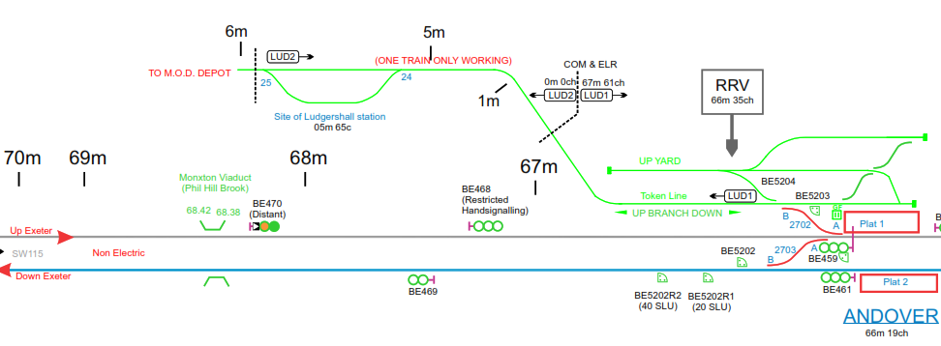
Significant Incident
Line Blockage Irregularity at Andover
Overview
On Friday 09/04//2021 at approx. 1344hrs, a Line Blockage (LB) Irregularity was reported by the Basingstoke Panel Signaller. Salisbury P-way team were tasked with fitting a track clamp on the Down Main Line (BAE1) and had a planned LB between BE461 and BE469 signals.
The initial LB was taken and given up with no reported issues.
Whilst the second LB was being taken, the process was briefly halted for a train to pass.
Location of the team
On hearing the train, which by that time passed the exiting signal BE469, the signaller concluded the team were the wrong side of the protection. It was established that the team were fitting a track clamp at 69m20ch, some 1.8 miles outside of the LB protection.
The investigations established the following:
Time pressure to meet the GZAC timescales to plan the Line Blockage and resourcing issues in the section.
Due to the substantive planner being on annual leave another planner assisted with the LB application but the request was only made over the phone and was not confirmed in writing.
A planning error went undiscovered as a result of assumptions being made during the verification and authorisation of the safe work pack (SWP) and the safety brief on site.
The SWP only contained an extract from the Sectional Appendix (SA) and the PiC/COSS was unable to check the signals and mileages as the SA does not provide this information.
What can we learn:
Current Wessex Track Diagrams must be available and must be used to verify all the protecting limits during the verification and authorisation stage of SWPs.
The importance of following all appropriate processes and not making assumptions.
Taking 5 and not letting the time pressure to get the better of us.
Discuss the learning points

Slide 5
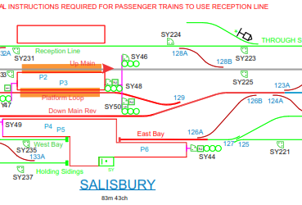
Significant Incident
Possession Irregularity at Salisbury
Overview
On Sunday 11/04/2021 at approx. 0013hrs, it was reported that the Possession Limit Board (PLB) and Detonator protection on the Up Main Line at Salisbury station had been placed the wrong side of the protecting signal SY46, beyond SY46 vice on the approach in association with the Wessex WON Week 02 Item 104 possession.
Additionally, the PICOP incorrectly believed that the Signaller had granted the PSS additional protection to move the detonator protection and instructed the ES for worksite Bravo to shorten the worksite in order to allow the PSS to move the protection to the correct side of the signal.
Before the Duty ODM got to site, the PSS had lifted the incorrectly placed protection with the authority of the PICOP but without appropriate protection from the Signaller (Line Blockage).
In order to correct the mistake, the detonator protection had been removed by the PSS and placed on the correct side of the signal SY46, leaving the line and the individual unprotected.
The full Safety Bulletin can be found here
What can we learn:
Being focused and paying attention to details and referring to all associated paperwork in order to manage tasks safely and effectively.
Always Take 5 and seek confirmation if something is unclear, never assume.
If PLB and detonator protection has been placed incorrectly, make sure the correct procedure is followed before moving it to the correct location – specifically that permission is given by the signaller and PICOP and the line is protected.
When planning substandard worksite/possession, you must provide suitable distance for placing of the PLB and detonator protection.
Discuss the learning points

Slide 6
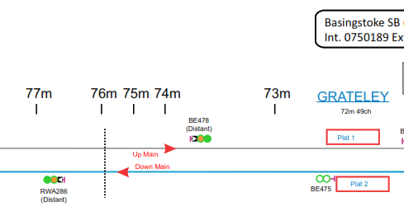
Significant Incident
Speed Board Irregularity at Grateley
Overview
On Thursday 08/04/2021 a PLPR train picked up a cyclic top fault on the Down Main Line (BAE1) at 77m00ch between Grateley Station and Salisbury Station that necessitated the implementation of a 30/90mph Emergency Speed Restriction (ESR).
On Tuesday 20/04/2021, a further rough ride report was submitted for the same area requiring all trains to be cautioned at 20mph until an ESR for 20mph could be put in place. A Team Leader (TL) was dispatched that afternoon to complete the task. Unfortunately, due to a misunderstanding of the requirement, the TL only replaced the 30mph boards with 20mph boards and left the 90mph board in situ.
Location of the ESR
On Thursday 22/04/2021, the Salisbury Signaller was advised by the Driver of 1L45 that the ESR boarding for WXESR1552B was showing as 20/90mph and not 20mph as was cautioned and expected.
The investigation established the following:
Both the Responsible Manager (RM) and TL have adequate training and experience of erecting/removing of ESR’s.
A miscommunication between the RM and TL on the requirement to remove a 30/90 mph speed boards and to replace them in their entirety for 20mph speed boards based on the rough ride report. Both parties failed to reach a clear understanding.
The TL thought that it was an unusual request but did not clarify/confirm the instruction with the RM.
What can we learn:
When conducting Safety Critical conversations the requirement to confirm understanding must be established using repeat back and open question technique. The importance of challenging/seeking confirmation if something is unclear.
That a Rough Ride report will always initiate a 20mph caution by the signaller through the affected area until a ESR of 20mph is in place.
That when amending an in place ESR board following a Rough Ride report, it must be made clear that all existing speed boards must be removed and that a single 20mph ESR Board must be erected.
Discuss the learning points

Slide 7
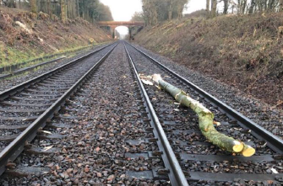
Learning from Previous Incidents
Train striking a tree log at Whitchurch (P13)
Overview
On 15/03/2021 at approx. 0535hrs, the Driver of SWR service 1L12 05:43 Salisbury to London Waterloo reported striking a large log ¼ of a mile on the approach to Whitchurch station at approx. 59m57 ¾ch. The train was travelling at approx. 60 mph and was already slowing down on the approach to the station. Planned vegetation clearance work was undertaken the previous day between Overton and Andover 55m 45ch to 65m 69ch by Coombes Forestry.
The train was carrying 35 passengers and fortunately there were no injuries.
The investigation established the following:
The area where the log was struck was an inactive part of the site and was only used to transport the timbers/logs to the unloading point, using a RRV.
The up line rises on a gradient of 1 in 194 at the point where the train struck the timber. It was also established that longer lengths of timber were added on top of shorter ones leading to voids between them and this coupled with the normal vibration from the track may have caused the loss of friction.
A failure of one of the RRV’s led to an increased workload and time pressure towards the end of the shift and this together with the failing light resulted in the Site Supervisor only completing site checks in the areas he deemed high risk.
What can we learn:
As part of the investigation a Best Practice Loading Brief was developed by Coombes and all loads are now being strapped to add a greater load security.
The importance of thorough visual checks before the worksite is handed back and the need for additional resources to ensure this is carried out.
Regular reviews during the shift so any loss of key resource can be identified and mitigated in a timely manner to minimize any potential for end of shift pressure.
Discuss the learning points

Slide 8
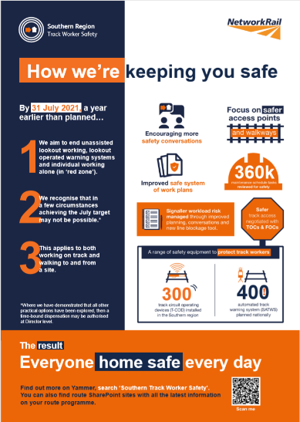
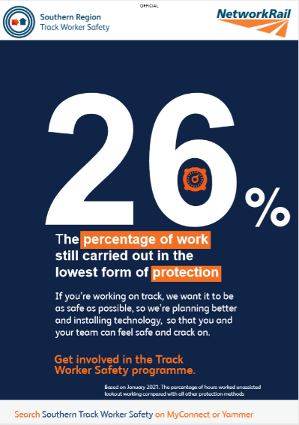
Track Worker Safety (TWS) - update
What we’ve been up to.
Chris Cornish hosted another TWS update call on 6 May 2021, joined by Project Operations Interface Specialist, Kez Edmonds to update teams on what Operations are doing.
A supplier event took place on 4 May 2021, giving them the opportunity to find out more about the programme and the impact for them.
There are 2 planner forums on Monday 17 May 10:00 – 11:00 and Tuesday 18 May at 14:00 – 15:00. Topic is ‘How have the changes affected you since the introduction of red zone removal. Challenges, impacts and what help do you need?’ Contact Aaron.Bever@networkrail.co.uk for an invite.
In the December rule book change and following engagement with TUs, Wessex is now exploring how to implement the Crossing the Line Procedure across the route. Updates to follow.
Search ‘Southern Track Worker Safety’ on MyConnect

Slide 9
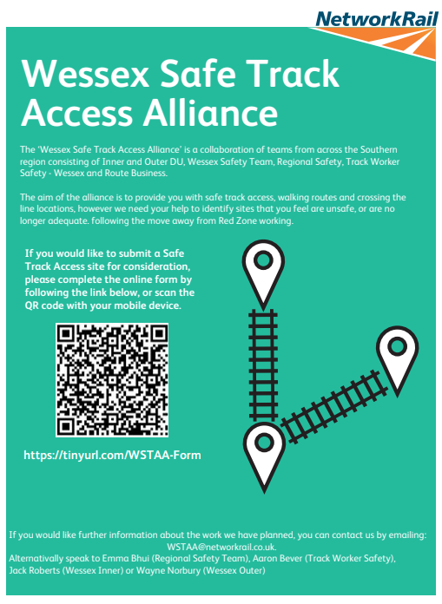
Track Worker Safety (TWS) - update
Safer walking ​
Wessex Safe Track Access Alliance
Identification and Logging of Unsafe Cess and/or Walking routes
If you see a Safer Cess opportunity, the following process should be followed:
Any new sites are now requested via the form on SharePoint which will automatically feed into the database where it will be reviewed and given a priority. There is also the ability to attach photos and any other supporting documentation.
The SharePoint database will also enable the requestor to view and see the current status of their request.
Search ‘Southern Track Worker Safety’ on MyConnect​

Slide 10
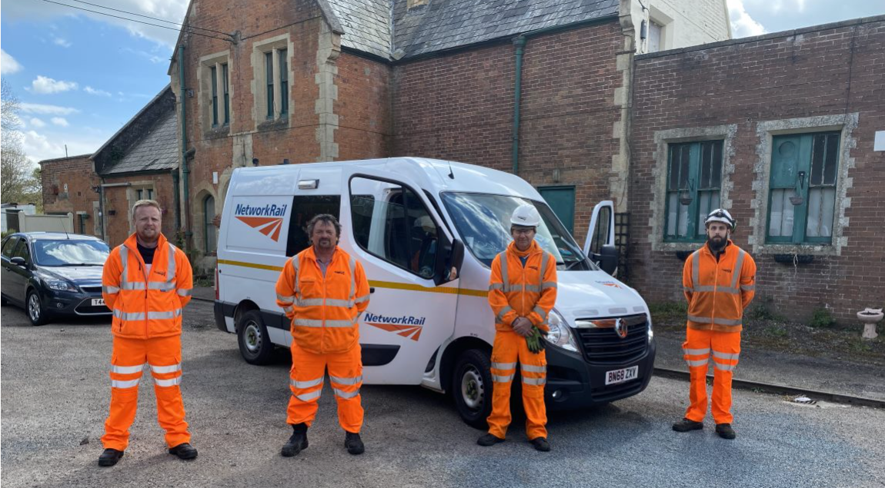
Track Worker Safety (TWS) - update
Thank you
Ben Wilkinson, Chris Donkin, Chris Mayhew, Chris Jackson and Shayne Ford for their time and determination in creating a new plan to move all BVIs from red zone to Line Blocks.
Scott Henderson, Marc Brereton and other members of team at Feltham for independently taking the lead on the planning for BVI inspections.
Inner HMU (Lee McCarthy and team) Jack Roberts and Outer DU Wayne Norbury for all for all their help delivering the Safe Track Access work over the last year.
Jeff Matthews and Dave Carnell for coming to Axminster and Seaton Junction and explaining some of the challenges the frontline staff have.
Search ‘Southern Track Worker Safety’ on MyConnect​

Slide 11
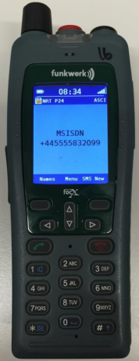
Safety
Poor network coverage and GSM-R telephones
Areas of poor or no network coverage/signal can be identified in the Access Point Register (Wessex Apps) during the planning stage.
To address the issue the teams can use the GSM-R telephones for any operational railway communications.
In Operational Use please note:
There may be occasions when calls cannot be made – in these instances, trackside telephones should be used as an alternative.
Safety must be observed at all times when using trackside phones – observe the GE/RT8000/HB1 – General Duties and Track Safety for Track Workers: Section 4.3 by ensuring you are in a position of safety when using the handset.
All calls are recorded to assist with incident investigations.
A useful Trackside Worker User Guide can be found here
Do your teams have access to GSM-R telephones?

Slide 12
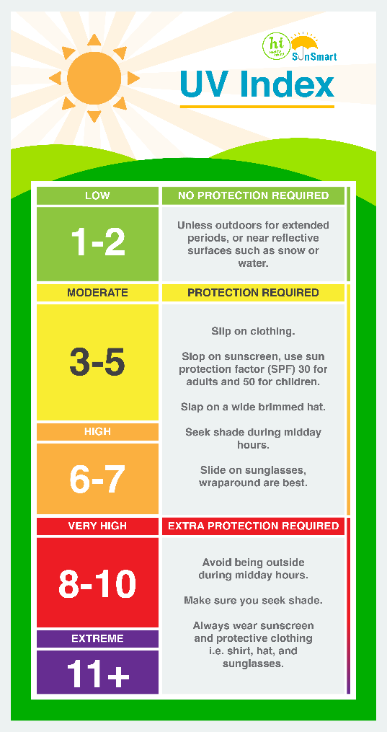
Safety
Here comes the sun…
Britain is known for its unpredictable summer weather. But even in this country people working outdoors for long periods, even when it’s cloudy, risk damaging their skin, or worse, unless proper precautions are taken.
These are some simple steps to protecting yourself whilst working:
Plan your day-carry out more strenuous works during the coolest parts of the day,
Walk and work in the shade as much as possible,
Take frequent short breaks, in a shaded cool area,
Stay hydrated-drink plenty of water,
Always use sunscreen on all areas of your skin and reapply regularly. Look for a sun protection factor of at least SPF30,
Avoid eating large meals before working in hot environments.
The strength of the sun’s rays isn’t connected to the temperature. You can check the UV index on many weather forecast apps and websites.
It is important to check your skin at least once a month for signs of skin cancer, if you have had exposure to sun light. Signs can include: growth of moles, moles that are growing, bleeding or changing appearance, scabby spots and sores that do not heal, skin discoloration.
ACTION
Stay safe in the Sun

Slide 13
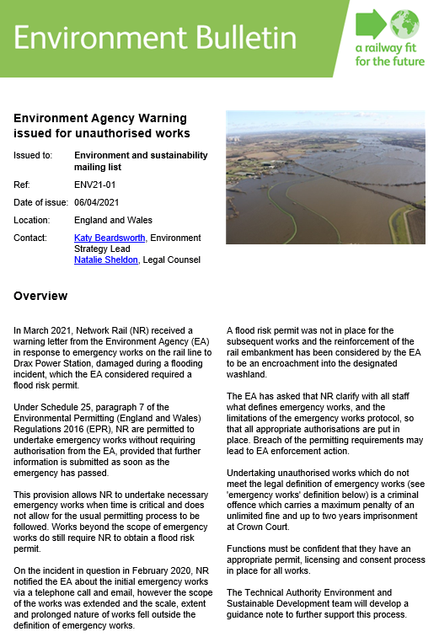
Environment
Emergency Works and Legal Permits
Network Rail received a legal warning from the Environment Agency for working without a flood risk permit during what we considered to be emergency work.
Legal definitions of ‘emergency’ vary depending on the legislation.
The legal definition under the Environment Permitting Regulations is the risk of:
Serious flooding
Serious detrimental impact on drainage
Serious harm to the environment
When undertaking emergency work, you must notify the EA in writing as soon as practicable.
Next steps
Knowing what defines emergency works, and the limitations of the emergency works protocol, ensures that all appropriate authorisations are put in place. Breaching permit requirements may lead to EA enforcement action. The person carrying out the emergency works activity must provide the EA with notice in writing as soon as possible.
Have all consents, permissions and licenses been identified?
Have the timescale for obtaining consents, permissions and licenses been included in the programme?
Are the requirements being monitored and complied with?
ACTION
Go through the learning points with your teams
Notes:
Learning points
Why is it important to know the difference between emergency works, urgent reactive/non-emergency unplanned works, and planned works?
How could you play a part in ensuring that your project has appropriate permits, licensing and consent process when necessary?

Slide 14
Health and Wellbeing
Vita Health - For your health and fitness
Network Rail has teamed up with Vita Health Group ​ to provide a physiotherapy self-referral service free for all employees (previously provided by RehabWorks). They will provide support with any muscle, soft tissue or joint pain regardless of whether this is work or non-work related.
The service is quick and easy to access, uses the latest medical evidence for the treatment recommendations, and is focussed on helping you return to your normal work and life activities.
Instead of waiting for a GP appointment, you can have a telephone assessment with a qualified physiotherapist within two working days of the request being made.
They will check that there is no underlying serious health condition, provide immediate assistance and advice, and decide the best next steps to help resolve the problem as quickly as possible.
Employees can self-refer for physiotherapy appointments by calling 0800 0833 324 selecting Option 5 or emailing a referr​al form​ to network@vhg.co.uk .
For management referrals the referral portal can be found here and the portal user guide can be found here.
You can find out more about the service by viewing this poster​.
ACTION
It’s for your benefit

Slide 15
Health and Wellbeing
Vita Health - For your health and fitness cont.
What will happen during the assessment?
A telephone assessment is carried out by a qualified and experienced chartered physiotherapist who will explain the process to you and will ask a few questions to find out more about your condition. This will enable him/her to make a diagnosis and decide on the best way forward to help you get back to your normal activities at home and at work.
The physiotherapist will also check that there are no serious underlying causes for your pain and will write to your GP if at all concerned.
This may involve a home exercise programme or a few face to face sessions with a chartered physiotherapist. These may be booked in a clinic near your home or work.
Treatment Options
Treatment options include guided self-management, face to face physiotherapy or a functional restoration programme. All chartered physiotherapists are trained to use the latest evidence base to choose the best way forward to restore you to your best possible self.
On the right is an account from one of our colleagues on why it pays to speak up and do something about your ailments, please read the true story.
ACTION
Don’t leave it too late

Slide 16
Resource Library
Safety Bulletins, Alerts, Advice and Shared Learning
Safety-Advice-NRA21-06-Using-lookout-operated-warning-systems-LOWS.pdf
Safety-Alert-NRX21-05-Fire-on-tamping-machine.pdf
Safety-Alert-NRX21-06-On-track-plant-collision.pdf
Safety-Bulletin-NRB21-02-Carnforth-SMTH-irregularity.pdf
Safety-Bulletin-NRB21-03-Exposure-to-Asbestos-Containing-Materials-ACM.pdf
Safety Bulletin Detonator Protection Placed incorrectly at Salisbury 110421.pdf
Trackside Worker GSM-R User Guide.pdf
Issue 110 Transferable Lessons Line Blockage Irregularity Lincoln.pdf
Issue 111 - Transferable Lessons - Port Talbot Stop and Examine Irregularity.pdf
Resource Library

Slide 17
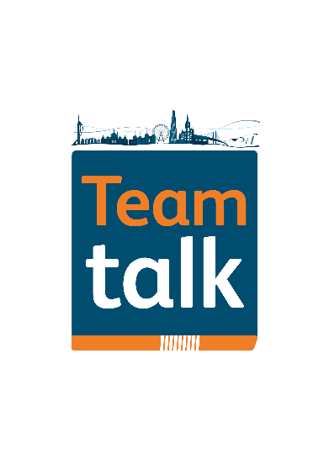
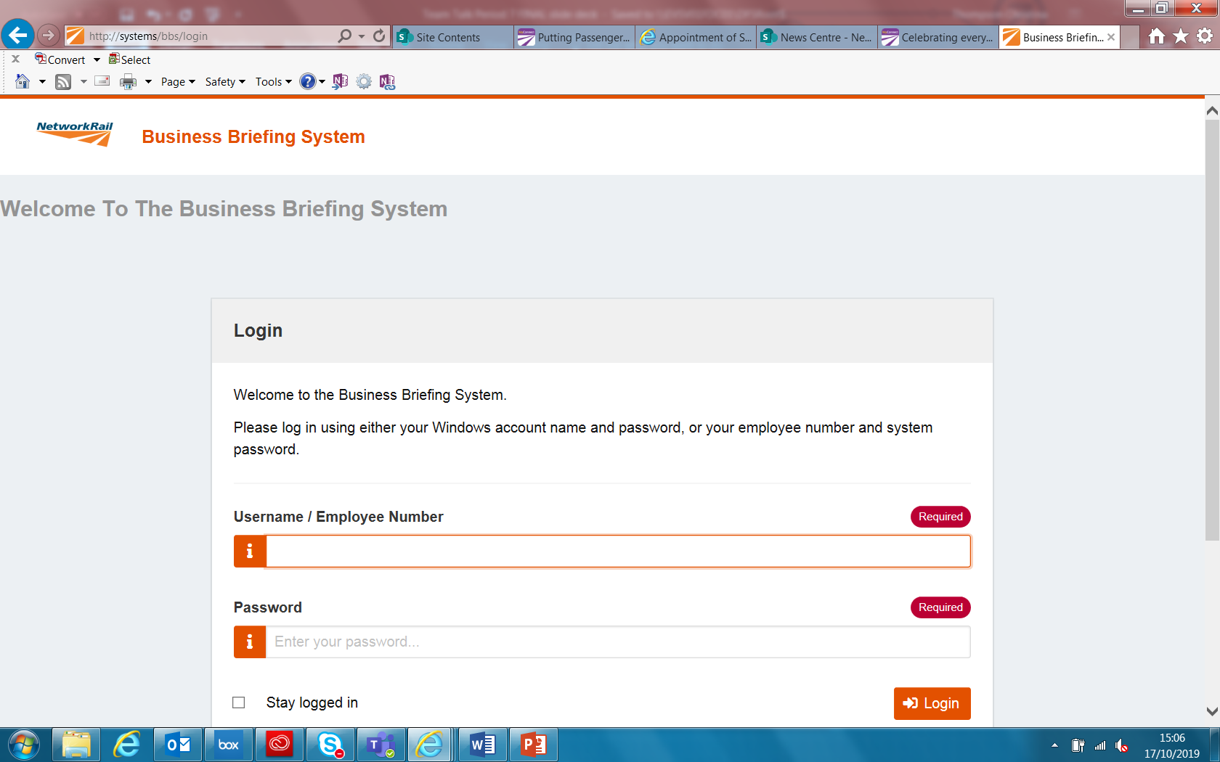
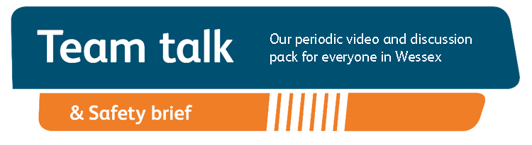
Remember to record that you have watched Team Talk
Click here for a guide on how to use the new Business Briefing System to do this
Also remember to record that you have received Safety Briefing via the Business Briefing System or via the dedicated person in your Business Unit.
7

