Slide 1

7
Notes:
Instructions to Managers
To view any links in the slides, you need to have PowerPoint in Slide Show mode

Slide 2
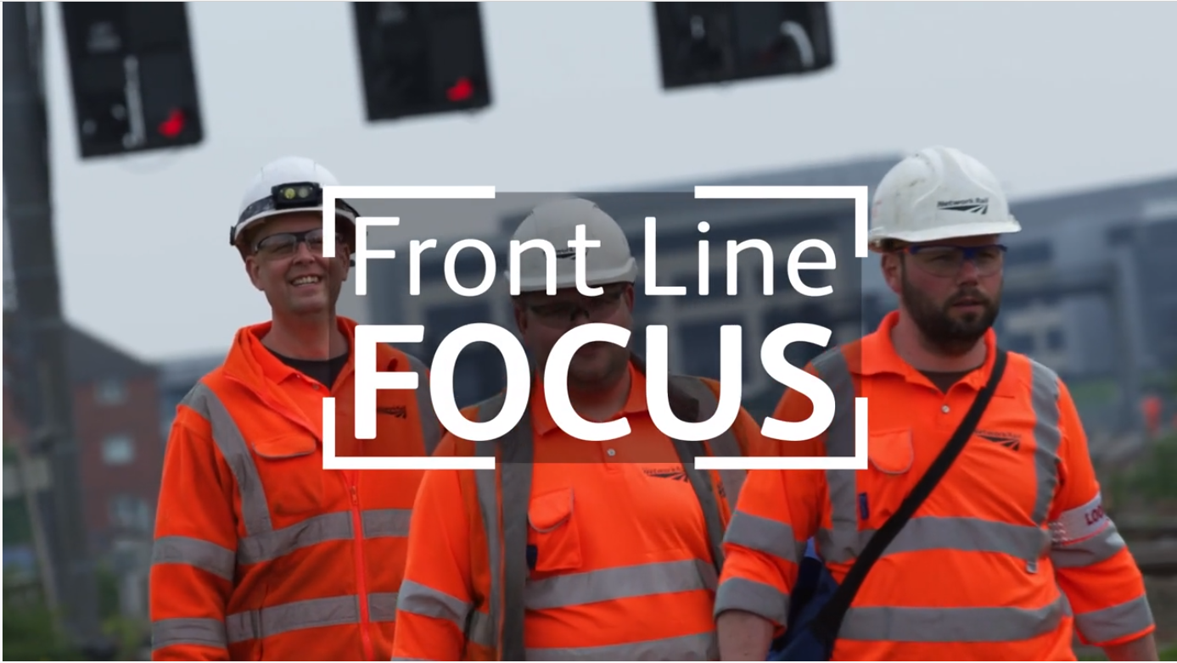
Safety
Front Line Focus Episode 96
ACTION
Watch the latest episode with your teams - here

Slide 3

Safety
Accidents and Operational Close Calls Period 2
Significant Accidents
05/05/2021 (Outer DU) a member of staff acting as a the PiC/COSS for a team carrying out planned maintenance and fault finding on axle counters sustained a fracture to his wrist as a result of a fall. More information on Slide 6.
Other accidents
06/05/2021 (Inner DU) a member of staff accessing through the platform gate at Hersham station slipped on some exposed wet wood. The anti slip on the platform ramp was substandard and missing in places. The individual fell and landed on his right knee and was unable to return to work for 4 days. Investigation ongoing.
06/05/2021 (Inner DU) a member of staff was flame cutting as part of a defect removal at Hersham, when a molten spark struck and caused minor burn to his eye lid. More information on Slide 7.
21/05/2021 (Inner DU) a member of staff injured his left shoulder after making contact with the platform surface at Putney whilst getting clear of the TRAMM approaching on the Up Windsor Fast line (RDG1). Investigation ongoing.
Fatality Weighted Injuries (FWI)
0.129 MAA against target of 0.059 for the route
Lessons learnt from these events will be shared once the investigation has been concluded
Notes:
FWI measure explained
Network Rail defines a work place injury as any injury sustained by staff, both direct employees and contractor/suppliers, while undertaking activities connected with Network Rail’s business.
All reported injuries are to be entered into SMIS, the companies corporate Safety Management Intelligence System.
Fatality weighted injury rate (FWIR) is a KPI that uses the following calculation:
The number of fatalities, plus the (number of specified injuries / 10) plus the (number of 3+ lost day injuries / 200) plus the (number of all other injuries / 1000) divided by the hours worked, multiplied by 1,000,000, over the last 13 periods
RIDDOR reporting shall be based on the requirements of the RIDDOR 2013 regulations and the ORR guidance http://orr.gov.uk/__data/assets/pdf_file/0010/2332/riddor-guidance.pdf.

Slide 4
Safety
Accidents and Operational Close Calls Period 2 cont.
Operational Close Calls
05/05/2021 (Operations) a request for a temporary isolation was made by a member of staff in order to deal with a ballast bag which became attached to the conductor rail at Shutters Foot Crossing. Authority to test was given and it was at this point discovered that the section was in fact live. Initial investigation established that an incorrect electrical section was discharged. Lessons learnt- Take 5 when interpreting multiple sources of information.
08/05/2021 (Possession Management Group) at approx. 1720hrs, the PICOP for Wessex WON Week 06 Item 135 received advice that possession limit boards (PLB’s) and detonator protection on the Up and Down Hounslow Spur lines had been placed within the worksite limits vice outside, approx. 2 chains towards the inside of the possession. Investigation established that this was a substandard possession and no specific instructions were given even though a clear understanding was reached between the PICOP and Possession support staff (PSS). The PSS failed to confirm the location and mileage where the protection was placed during the mandatory call back to the PICOP after the instruction had been carried out. Lessons Learnt – the importance of reaching clear understanding and seeking of clarification if anything is unclear. In the event of a substandard possession, the PSS should remain on site until the worksite is set up and it is confirmed that both the PLB’s and worksite marker boards are in correct position.
12/05/2021 (Inner DU) at approx. 0321hrs, an operational irregularity occurred within a planned line blockage at Waterloo after a Robel handheld tamper made an inadvertent contact with the live conductor rail and running rail. More information on Slide 7.
16/05/2021 (Possession Management Group) at approx. 0532hrs, the 5R01 empty coaching stock had come to a stand at incorrectly placed possession limit board (PLB) and detonator protection on the Down Windsor line (RDG1) at Nine Elms, within the Wessex WON Week 07 Item 6. The Possession support staff (PSS) placed the PLB and detonator protection at the tip of the points instead of on the approach to W608pts. Investigation is ongoing but a copy of the Safety Bulletin can be found here
Lessons learnt from these events will be shared once the investigation has been concluded

Slide 5
Safety
Accidents and Operational Close Calls Period 2 cont.
Operational Close Calls continued
21/05/2021 (Inner DU) at approx. 0340hrs, a member of a four man technical team working at Putney, in Worksite A Wessex WON Week 7 Item 175, had to get clear of the TRAMM that approached on the Up Windsor Fast line (RDG1) where the individual was positioned at the time carrying out technical inspections of sidewear. Investigation ongoing.
26/05/2021 (Inner DU) Line blockage (LB) of all four lines of the BML1 was in place between Weybridge and Hampton Court Jn and a 2-man ultrasonic team signed in with a Protection Controller who gave them a permission to start work. At approx. 0153hrs, it was discovered that the team were working outside the LB limits on the Up Main Line at Hampton Court Jn at 13m25ch. Investigation ongoing.
28/05/2021(Inner DU) a S&T team were carrying out maintenance between Gomshall station and Reigate on the Up/Down Reading lines (RSJ) and the members of the team were under the impression they had Line blockages in place on both the lines. At approx. 1700hrs a member of the team made a report of unsafe working when it became apparent that the Up Reading line was in fact open and no Lookout had been appointed. Previously the team were moving between both the lines believing they were blocked. Investigation ongoing.
28/05/2021 (Operations) at approx. 1146 hrs at Virginia Walters Panel 4, the Pic/COSS working for Cleshar HMU team Inner DU, took a Line Blockage (LB) on the Up Chertsey, from the protecting signal F302 to F294. When granting the LB the signaller failed to notice a train in the platform at Virginia Water. The presence of the train was identified to the signaller seconds after he had granted the LB, by a trainee signaller. The signaller immediately called the COSS to inform him that he could not have the LB. The time frame was circa 1m 45 seconds between the calls. The signaller had taken four similar LB on the same stretch of line all from the same protecting signal F302, but these only stopped at F296 and did not extend to F294. Investigation ongoing.
Lessons learnt from these events will be shared once the investigation has been concluded

Slide 6
Significant Accident
Fractured Wrist
Overview
On 05/05/2021 at approx. 0230hrs, a member of staff was carrying out planned maintenance and fault finding on axle counters, within a cyclical line blockage at Portsmouth Harbour. The individual was working as part of a team of three, and was acting as the team leader and PiC for the work.
When work at the faulty axle counter had finished, the individual was walking in the 4ft towards another axle counter head to perform a "sweep" of the section, when he tripped on a tie bar and fell. The IP put his left hand out to break his fall, which came into contact with a chair bolt, causing an impact on his let wrist. The IP was transported to hospital where a fracture was confirmed resulting in a long absence of sick leave to recover.
The investigation established the following:
The individual stated he did not see the tie bar prior to tripping over it as he was distracted by making a phone call on his mobile phone whilst on loud speaker, discussing the fault with the Control Centre Technician.
The individual was using a personal head torch and no other site lighting was in use due to a moving worksite.
What can we learn:
If you are required to use a mobile phone, stop, move to a position of safety and make the call safely.
These types of accidents are a regular occurrence and highlight the need for continuous concentration, especially at night.
Constant situational awareness to potential hazards must be maintained to prevent these types of accidents. You can improve your situational awareness by getting into a habit of regularly pausing to make a quick mental assessment of your working environment.
Discuss the learning points

Slide 7
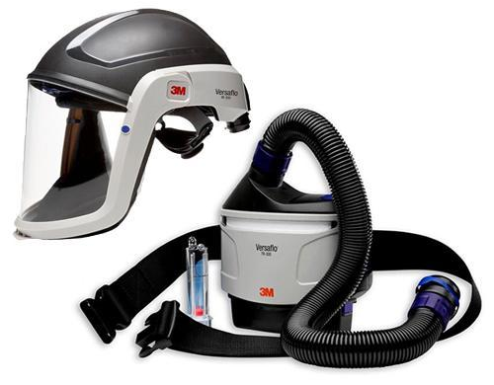
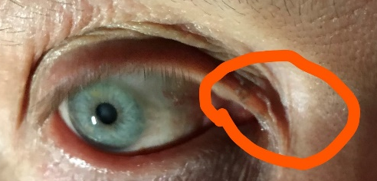
Workforce Accident
Burn to an eyelid
Overview
On 06/05/2021at approx. 0230hrs a member of the welding team was flame cutting as part of a defect removal at Hersham, when a molten spark struck and caused minor burn to his eye lid.
The investigation established the following:
The Task Risk Control sheet (TRCS) mandates that for this activity a positive air fed respiratory protective equipment (RPE) should be worn. This equipment provides protection for both lungs and eyes and is combined into one headtop.
The individual experienced problems with the RPE at the start of his shift but made a decision to carry on with the job without the mandatory RPE instead of sourcing a satisfactory replacement.
The PiC for the job did not delegate the task risks associated with the welding activity over to the welding team.
What can we learn:
Always wear the correct PPE as specified in the Task Risk Control sheets.
As per the slide in Period 12 HSE Cascade, the PiC may choose to delegate task risks to a Task Risk Controller as the PiC will not always have the technical understanding of the activity.
If any of your PPE/RPE/equipment is not fit for purpose, make the PiC/COSS aware and seek an alternative. Do not carry on regardless.
Discuss the learning points

Slide 8
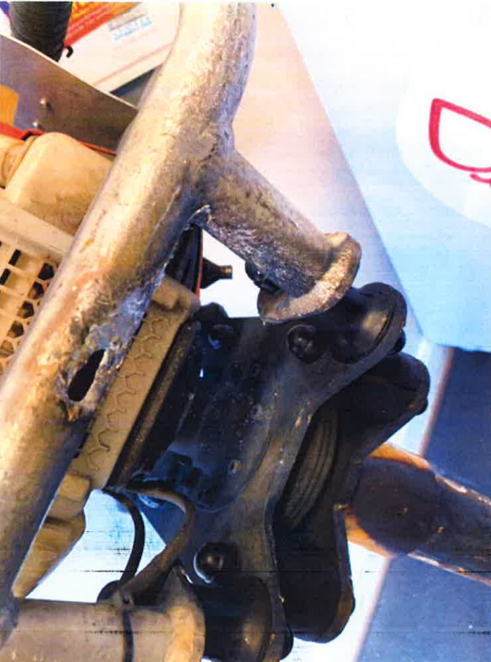
Significant Incident
Equipment in contact with live conductor rail at Waterloo
Overview
On 12/05/2021, a six man team were carrying out track geometry works within a Protection Controller’s (PC’s) line blockage at Waterloo. The work was being carried out at night and two conductor rail shields were being used to protect the team members from the live conductor rail.
Following the completion of the work, one of the team was in the process of laying a Robel handheld tamper down, when it slipped from his grasp and came into contact with, firstly, one of the conductor rail shields, before bouncing onto the live conductor rail and then the running rail causing an arcing between the two rails.
Fortunately no injury was suffered by any member of the team and only surface damage occurred to both rails as a result of the incident.
Investigation is ongoing.
The Robel Hand Tamper with damage circled
Initial learning and Discussion points:
Consideration should be given to the type of activity/task and whether it can be done safely with the conductor rail live or whether an isolation is needed. If the task is undertaken whilst the conductor rail is live, how many conductor rail shields would you consider sufficient?
Is the worksite that you’re working in sufficiently illuminated for the tasks being undertaken? Can the conductor rail be clearly seen by everyone within the team?
Has the PiC/COSS brief clearly highlighted the third rail to all members of the team and is there a continued vigilance and reminder of its risk throughout the task?
Are you wearing the ‘right’ gloves to maintain a secure grip of the tools that you are using? Are they clean, free from grease and in good condition?
Discuss the learning points

Slide 9
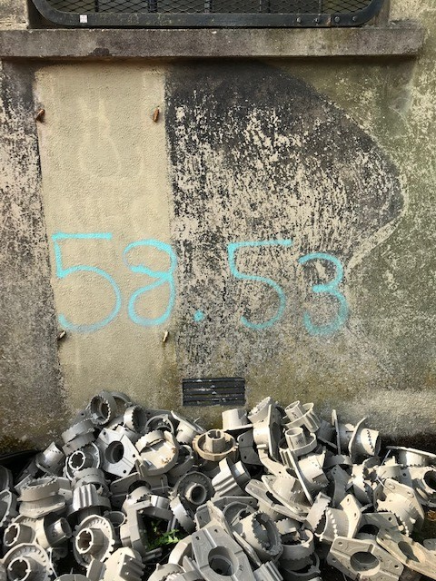
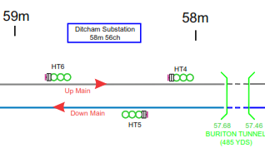
Learning from Previous Incidents
Significant injury resulting from electrical burns at Ditcham (P3 2020/21)
Overview
On Friday 12/06/2020 at approx. 0042hrs, a member of staff tasked with application of short circuit straps (SCS) as part of a T3 possession under a B2 current isolation on the Up/Down Main Line (WPH1) at Ditcham Substation, received an electric shock from the conductor rail that was energised at 750V d.c. This resulted in the individual receiving severe burns to his hands, face and legs and a significant period of recovery before he was able to return back to work.
A Level 2 (Local) investigation was carried out and the following was established:
The SCS were applied to an energised section of the conductor rail and the process for safely applying the straps was not followed.
Electrically insulated rubber gauntlets specified for this process were not worn.
The identification of the correct strapping locations was hindered by poor mobile signal on site resulting in inaccuracies in the GPS location. There was also conflicting (unofficial) location information painted on the substation wall (photo below).
The SWP provided clear location information that could have been used by the individual on the night, but they chose to rely on local knowledge, unofficial milage signs and GPS apps, in a known area of poor GPS app signal.
There was no historical evidence that on site safety tours or checks were carried out to assure the strapping process was being carried out correctly in line with the competency regime.
Discuss the learning points

Slide 10
Learning from Previous Incidents
Significant injury resulting from electrical burns at Ditcham (P3 2020/21) cont.
What can we learn:
Knowing your location - check the details in your SWP and isolation document. Refer to the information on the access gate and use location app if available. Confirm they all indicate the same information/mileage. If in any doubt check with the ES.
Always follow the correct SCS application process (you must be competent to do so) – to not do so will be a Life Saving Rule breach and will cause you severe injuries if you are in the wrong place.
  Put on rubber gauntlets and wear them throughout the application of the SCS.
  Apply the SCS clamps to the two running rails, starting with the rail furthest away from the conductor rail. Remember to clean the underside of the rails using a wire brush to ensure good contact.
  Use the Live Line Tester to undertake “Test Before Touch” test, to prove the conductor rail is de-energized. You do not know for sure if the conductor rail is isolated unless you test it.
  Apply the short circuit bar with sufficient force, push it down hard enough so it makes good contact with both the conductor and running rail, in close proximity where the SCS is being fitted.
  Use the wire brush to clean the underside of the conductor rail and apply the third leg of the SCS.
The ability to carry out Safety Critical Communications. Check the Hazard Directory and the Wessex Access Points App at the planning stage for any known locations of poor signal. GSMR phones can be utilised (briefing included in Period 1 HSE Cascade)
Line Managers can now conduct periodic PAISS on the teams carrying out blocking and strapping activities using the check in IRIS, please see Slide 12 for more information.
The importance of preserving the evidence that is essential for the investigation process. Following any significant event the site may need to be made safe to allow emergency services to attend but it is also crucial to preserve all the evidence.
It is also vital that Command and Control is established at the earliest opportunity. The WICC should lead on this and appoint an Investigating Officer who will implement a safe system of work during the incident response and will keep everybody informed.
Discuss the learning points

Slide 11
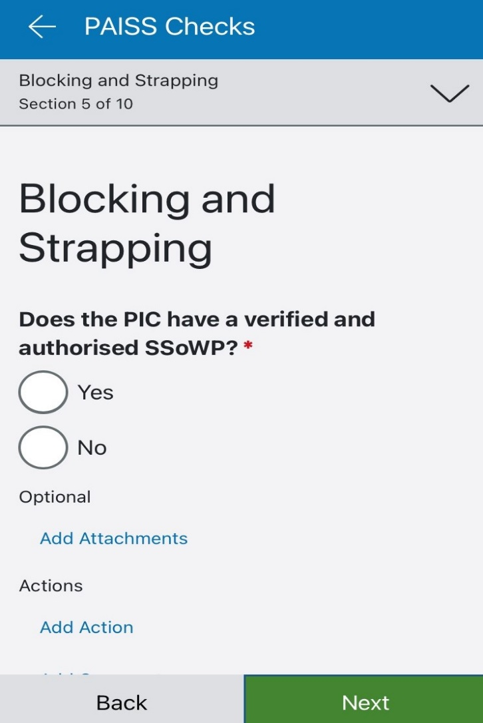
PAISS Update
Blocking and Strapping
Following the investigation of the Ditcham Conductor Rail Incident, a recommendation was made to improve the method and recording of competence management for all personnel involved in Blocking and Strapping activities.
As a result of this recommendation, an additional Planned Assurance Inspection and Site Surveillance (PAISS) Question Set has been added to the system.
From immediate effect, all those who operate within a third rail environment, a Blocking and Strapping PAISS is now live on the system and MUST be used to check the competence of all staff engaged in this activity.
It is recommended that the IMEs and the Possession Management Group amend their audit plans to incorporate Blocking and Strapping PAISS inspections on a regular/routine basis.
Amend your Audit Plans

Slide 12
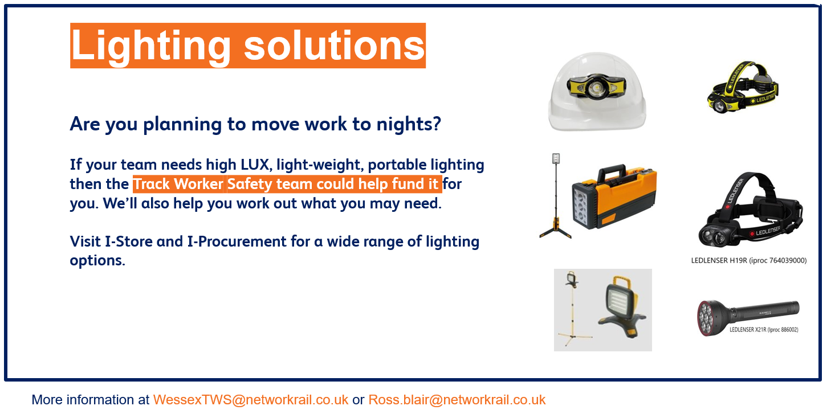

Track Worker Safety (TWS) update
Portable Lightning
Further guidance on lighting requirements will be shared in due course.
For more information contact WessexTWS@networkrail.co.uk

Slide 13
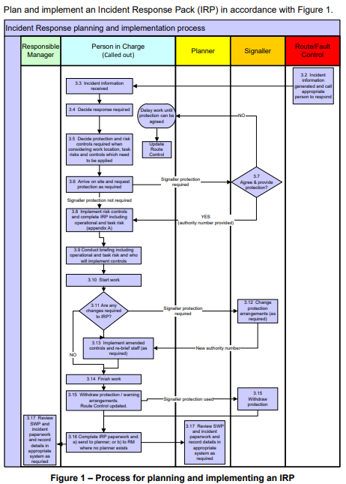
Safety
Use of Incident Response Pack during an incident
During the recent 019 Principles briefings, it was identified that the use of Incident Response Packs (IRP’s) in certain situations is not in line with the standard NR/L2/OHS/019/mod01.
This module only applies to ‘unforeseeable’ events which cannot be pre-planned where;
  a) the planning processes in NR/L2/OHS/019 modules 02, 03 or 04 cannot be applied;
  b) an incident number has been generated by Route/Fault Control; or
  c) situations where a Rail Incident Officer (RIO) or pilotman is appointed for an emergency or failure.
The use of IRP is not for situations where Safe Systems of Work can be pre-planned.
Are you using IRP’s correctly?

Slide 14

Safety
The IRP Process
The PIC will be contacted as the appropriate person to respond following an incident and he/she shall decide what response and resources are required for the incident.
The PIC shall arrange for the Signaller to be contacted to arrange appropriate protection (if required). The Signaller will confirm the protection arrangements they are able to provide.
If the Signaller is unable to provide the protection arrangements required, the PIC shall assess for alternative arrangements. If no suitable arrangements can be implemented, the PIC shall escalate the issue to Route Control or the on-call Responsible Manager.
The PIC shall arrange for the IRP to be completed, including Task, Site and Operational risks. The PIC shall arrange for the work group to be briefed on the protection arrangements including the Task, Site and Operational risks.
The PIC shall stop the work if any changes to the site conditions are brought to their attention. If site conditions change, the PIC shall reassess the Safe System of Work arrangements and amend the IRP accordingly.
When work is complete, the PIC shall check that the work group is clear of the track and that the track has been left in a safe state. The line must be handed back to the Signaller where protection has been arranged.
The PIC will send the used IRP to the Planner/Responsible Manager. Where an IRP has not been returned by the PIC, a record must be kept by the Responsible Manager.
IRP’s are not an alternative method to avoid planning a safe system of work and they are not a convenience.
IRP’s must not be used for a fault that was reported days or weeks ago, that would be work that could be pre-planned for.
Where it is not possible to suitably pre-plan a safe system of work, a fault number has been generated or a RIO or Pilotman is needed, IRP’s can be used.
IRP’s are only valid for the incidents they were generated for.
Is the process being followed in your depot?
Person in
charge

Slide 15

Health and Wellbeing
Five Ways to Wellbeing
Take Notice
Be curious. Remark on the unusual. Be aware of the world around you and what you are feeling.
On the 9th of July at 18:30 the Havant and Basingstoke combined Maintenance and Operations teams will be raising money for MIND and the Samaritans in a charity football match.
Give
Seeing yourself, and your happiness, linked to the wider community can be incredibly rewarding and creates connections with the people around you.
Both Clapham and Wimbledon P-way teams have self funded and created a space at their depots which helps them develop the habit to pause. It allows them the opportunity to prioritise their wellbeing by taking note and connect with nature.
You can support the team’s efforts by clicking on the links below.
MIND – https://www.justgiving.com/NetworkRailMentalHealthCharityFootballMatch.
Samaritans – https://www.justgiving.com/NetworkrailMentalHealthCharityFootballEvent.
ACTION
Be aware of the world around you

Slide 16
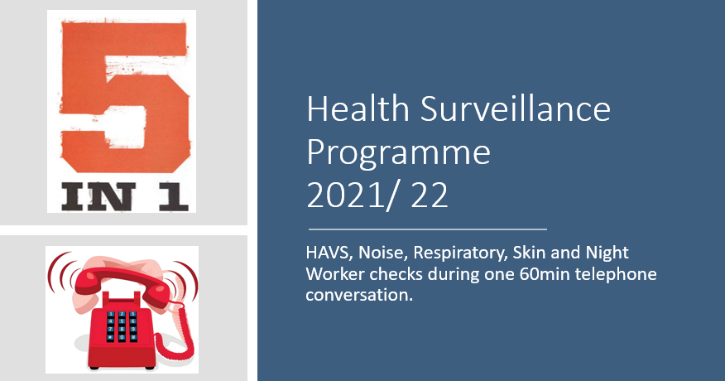
Health and Wellbeing
Health Surveillance Programme
Key facts:
Employees are identified for Health Surveillance based primarily on the vibrating tool competencies they hold on Oracle.
Employees who undertake work activities that expose them to one or more of the Occupational hazards (HAVS, Noise, Respiratory, Skin and Night Work) must attend Health Surveillance.
2/3 of ALL employees due health surveillance will have a telephone appointment booked.
1/3 of ALL employees due health surveillance will complete their Health Surveillance as part of their Health, Safety and Wellbeing Medical.
!
Attendance to Health Surveillance is required by Law…It is not a “nice to have”.
ACTION
Telephone Health Surveillance FAQ can be found here

Slide 17
Resource Library
Safety Bulletins, Alerts, Advice and Shared Learning
Safety-Advice-NRA21-07-Contractor-accident-while-using-Premier-Compact-110-Series-Soil-Sampling-M.pdf
Safety-Advice-NRA21-08-On-Track-Plant-machine-crane-controllers.pdf
Safety-Alert-NRX21-09-Contact-with-overhead-line-equipment.pdf
Safety Bulletin Detonator Protection Placed incorrectly at Nine Elms 160521.pdf
Resource Library

Slide 18

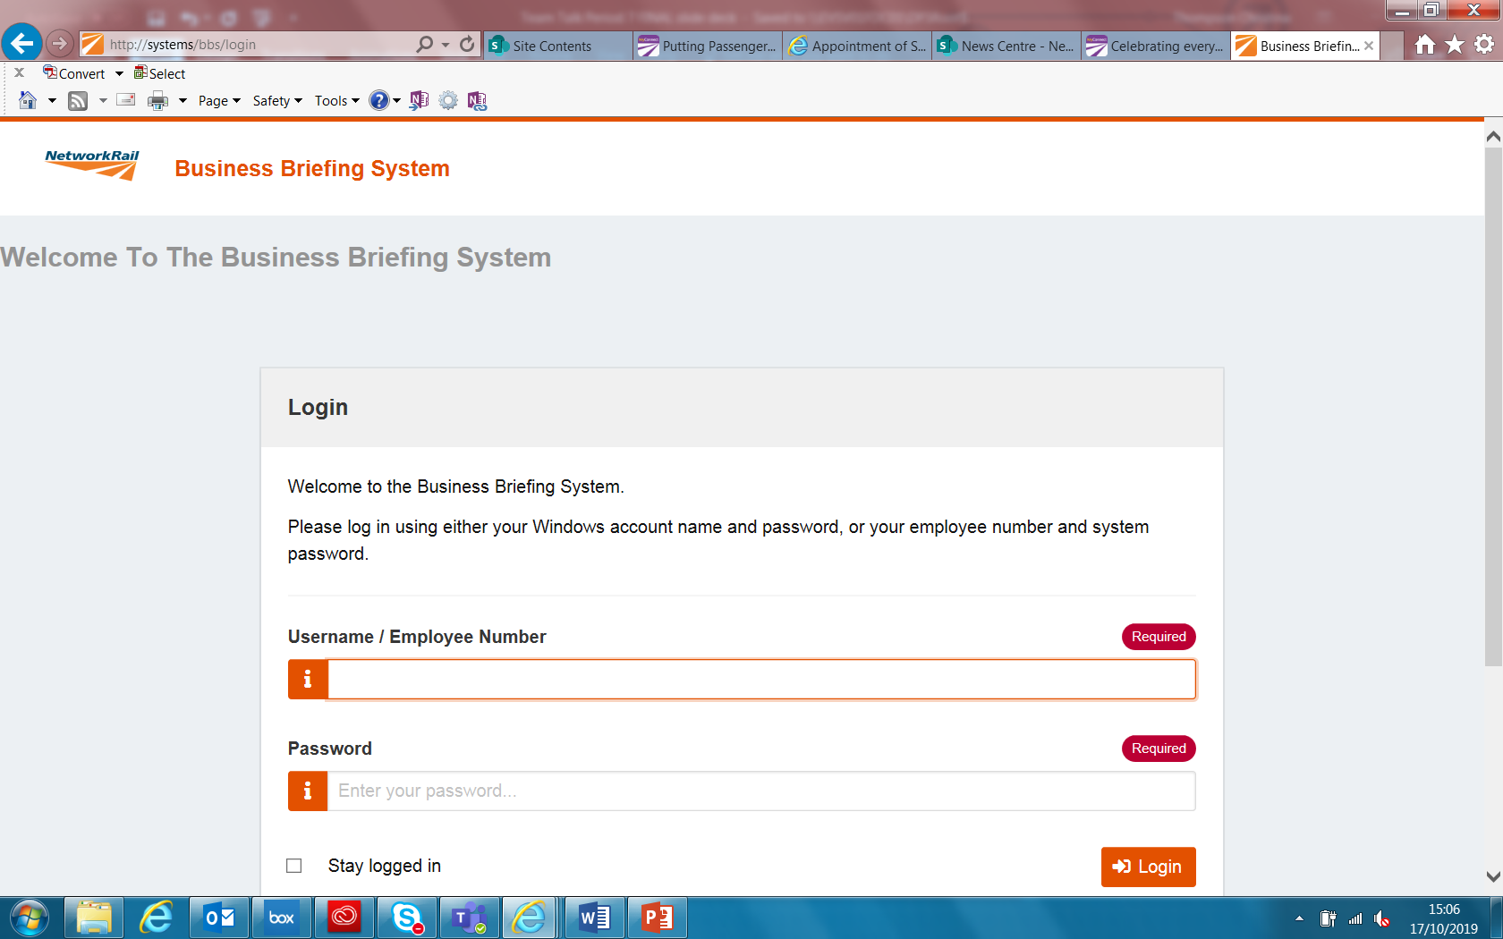
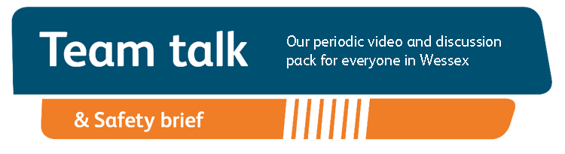
Remember to record that you received your Safety Cascade and have watched Team Talk
Click here for a guide on how to use the new Business Briefing System to do this.
Alternatively you can record you received the Briefing via the dedicated person in your Business Unit.
7

