Slide 1

7
Notes:
Instructions to Managers
To view any links in the slides, you need to have PowerPoint in Slide Show mode

Slide 2

Safety
Accidents and Operational Close Calls Period 3
Significant Accidents
11/06/2021 (Outer DU) a colleague suffered a radial/anterior dislocation to the right shoulder whilst attempting to carry a timber from the van to the site of work at Lower Thorne Crossing (WEY) and was unable to return to work on the next shift. Investigation ongoing.
15/06/2021 (Inner DU) a colleague sustained bruising and swelling to the right ankle whilst carrying out minor vegetation clearance. More information on slide 4.
Other accidents
30/05/2021 (Inner DU) a contractor dislocated his left little finger as a result of a pan jack he was loading onto the vehicle at Epsom falling backwards and trapping his finger underneath. Medical advice sought, finger manipulated back into position and the individual was able to return to work on the next shift. Investigation ongoing.
30/05/2021 (Outer DU) a member of staff tripped over a piece of rail that was removed during a stressing task at Basingstoke, causing minor swelling and bruising to the right ankle, able to return to work on the next rostered shift. The individual experienced a momentary lapse in concentration. Importance of continuous awareness of our surroundings/underfoot conditions and placing the rail in a different location to remove the risk of tripping.
30/05/2021 (Operations) a colleague hit her head on the frame of a sleeping pod located in the WICC lab at Basingstoke when she bent over, suffering slight bruising and minor headache. She was able to continue with her shift. Importance of situational awareness and applying caution when working in unfamiliar circumstances.
Fatality Weighted Injuries (FWI)
0.294 MAA against target of 0.059 for the route
Lessons learnt from these events will be shared once the investigation has been concluded
Notes:
FWI measure explained
Network Rail defines a work place injury as any injury sustained by staff, both direct employees and contractor/suppliers, while undertaking activities connected with Network Rail’s business.
All reported injuries are to be entered into SMIS, the companies corporate Safety Management Intelligence System.
Fatality weighted injury rate (FWIR) is a KPI that uses the following calculation:
The number of fatalities, plus the (number of specified injuries / 10) plus the (number of 3+ lost day injuries / 200) plus the (number of all other injuries / 1000) divided by the hours worked, multiplied by 1,000,000, over the last 13 periods
RIDDOR reporting shall be based on the requirements of the RIDDOR 2013 regulations and the ORR guidance http://orr.gov.uk/__data/assets/pdf_file/0010/2332/riddor-guidance.pdf.

Slide 3
Safety
Accidents and Operational Close Calls Period 3 cont.
Other accidents cont.
01/06/2021(Outer DU) a colleague tripped over a ladder he placed behind himself whilst loading timbers onto a rail freight wagon at the Eastleigh Material Yard, sustaining some bruising to his right buttock but also his left shoulder, which was a result of a glancing blow from the swing doors on the wagon. The individual did not consider his surroundings before placing the ladder on the ground and attempting to open the swing door. Awareness of the working environment/surroundings and placing the ladder in an appropriate place to remove the risk of tripping.
09/06/2021 (Operations) a colleague was operating a signal lever at Yeovil Pen Mill Signal Box when the signal lever catch sprung back towards her with significant force, striking her in the chest and knocking her to the ground. The individual was left shocked and sustained some bruising to her chest, arm and shoulder. Able to return to work on the next rostered shift. Investigation ongoing.
24/06/2021 (Operations) a Trespass and Welfare officer at Pokesdown station was physically assaulted by an aggressive male passenger. Investigation ongoing.
Operational Close Calls
01/06/2021 (Business Unit unidentified) a report of a near miss with two track workers on the Up Line (RDG1) on the approach to Twickenham. The identity of the track workers is yet to be determined.
18/06/2021 (Inner DU) short circuit straps were left in situ at Waterloo after the hand back of the possession WON 11 Item 36. The Possession Support Staff (PSS) reported to the Person in charge of the Possession (PICOP) that he had not been contacted by the Engineering Supervisor (ES) to lift his 4 straps, and from a position of safety he observed a ‘flashover’ on the track. By the time the report was made to WICC, the train service resumed and it wasn’t until later in the day that the infrastructure was inspected for damage. The visual inspection confirmed minimal damage to running rails and conductor rail only. Level 2 Investigation ongoing.
25/06/2021 (Inner DU) a group of six contractors and two Network Rail staff were tasked with clearance of overhanging branches that had created a canopy and were posing risk to running trains between Fareham and Portchester. They were working in a line blockage and were using extendable fibreglass pole saws, with the only exposed metal being the saw head. During the use, the blade became snagged and whilst trying to dislodge it one of the operatives lost his balance and let go of the saw. The saw fell across the track bridging the gap between the conductor rail and running rail causing a ‘flashover’. Investigation ongoing.
Lessons learnt from these events will be shared once the investigation has been concluded

Slide 4
Safety
RAIB – comments and learning from Roade fatality
We all recall the tragic accident on 8 April 2020, where a track worker was struck and fatally injured by a passenger train travelling at 90mph on the West Coast mainline near Roade, Northamptonshire.
With the recent release of the RAIB report, Simon French, Chief Inspector of Rail Accidents, has commented: “This tragic and unnecessary loss of another life was the third fatal accident to track workers that RAIB has investigated in the last three years. This year, in February, there has been yet another, at Surbiton in Surrey.
“Unsafe behaviour on site is a familiar theme. Everyone working on the railway has a responsibility to themselves and their colleagues, which includes not letting dangerous or non-compliant actions go unchallenged.
“Managers need to be aware of staff behaviour, and the management structure should make it a normal part of their work to be getting out there, and seeing what goes on. It’s all very well to check paperwork, but it’s important to know what is really happening on the ground.
“There still doesn’t appear to be sufficient management focus on what people are actually doing. In this case, the person who was killed was in the habit of walking in the four-foot when he didn’t need to. His co-workers knew he did this- but he hadn’t been picked up on it.
“What makes this even sadder is that the work he had been doing that morning wasn’t necessary: proper planning would have identified that there was no reason for people to go on the track every day during this project to apply and remove earthing straps. We are recommending that Network Rail reviews its processes with the aim of minimising the need for track access in connection with operating the electric traction supply system. I hope that this will help to prevent any more such tragedies.”
Learning Point
Perform routine on site checks, PAISS Inspections, on Safe Systems of Work that have been set up to protect staff from trains and other hazards, providing the evidence to support this.
Discuss the learning points

Slide 5
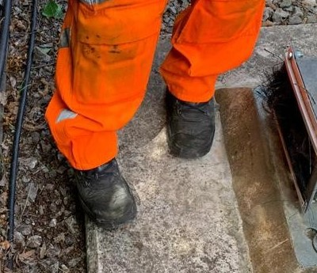
Workforce Accident
Ankle Sprain
Overview
On 15 June 2021, a Team Leader (TL) from Feltham S&T was carrying out minor vegetation works, within a line blockage close to Bracknell Station, to improve Train Drivers’ visibility of signal WM499.
The team were unable to carry out the initially planned signal maintenance due to an increase in the train service (a result of a sporting event in the area), however they identified the issue with the vegetation and had the tools to carry out the task.
The signal was positioned on a concrete base with no separation between the base and the surrounding ballast. As the TL was working his way around the signal, focusing on his work, his foot rolled from the concrete base onto the ballast and he twisted his right ankle.
The TL kept his boot on to protect and support the injury and after reaching home he elevated his ankle (in line with PRICE protocols), however the swelling to the injury prevented him from returning to work for his next shift.
The full Lessons Learnt/Bulletin can be found here
What we can learn:
If your planned work changed, would you have the tools to implement it correctly? Would you have the right Task Risk Control sheets and the right equipment for that job? But most importantly, would you have the right protection to carry it out safely?
Importance of maintaining focus on your surroundings when fully concentrating on the task you are undertaking.
When is the right time to report an accident? On reporting the accident, the Team Leader (TL) believed that no absence would be needed, however this proved not to be the case. The TL did the right thing, an injury can change over time and therefore we have the six- hour update and the 24 Golden Hour call.
Discuss the learning points

Slide 6
Learning from Previous Accidents
Twisted knee at Hersham Station (P2)
Overview
At 0304hrs on the morning of 6 May 2021 an Operative working for Woking Permanent Way slipped on a platform ramp at Hersham when accessing the track. The individual twisted his right knee and was absent for two shifts as a result.
The ramp was in a poor state of repair and had been for sometime but had been used up to that point without incident.
During the investigation it was found that the team responsible for the ramp was aware of the issue, as it was previously reported, and had started measures to correct it, however no protection or warning had been put in place to warn others.
The issue has since been rectified.
Before
and After
What we can learn:
If you report any hazard/unsafe conditions via the Close Call system, and it is safe to do so, please also mark the location to warn others.
Use site-specific examples during the Person in Charge (PiC) briefings rather than generic examples.
As a minimum, ask for photographic assurance of completion of tasks if your team is assigning work to others.
Do your teams have access to instant ice packs in their first aid kits? Early application of an ice pack has been proven to reduce the swelling, as well as decrease the pain. Instant ice packs can be ordered from I-procurement / Office Depot - Product code 7890097
Discuss the learning points

Slide 7
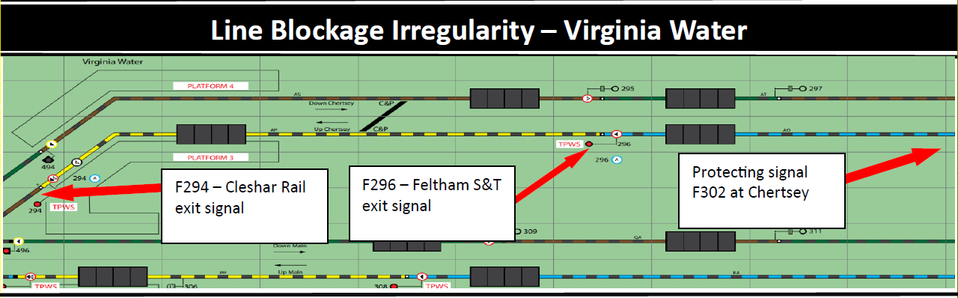
Learning from Previous Incidents
Line Blockage irregularity at Virginia Water (P2)
Overview
On 28/05/2021 at approx. 1146 hrs, a contractor Person in Charge/Controller of Site Safety (Pic/COSS) working for the Heavy Maintenance Unit (HMU) team from Inner DU, requested Line Blockage (LB) on the Up Chertsey, from the protecting signal F302 to F294. When granting the LB the signaller failed to notice that 2S32 train was on the platform at Virginia Water and within the limits of the LB. The presence of the train was identified to the signaller by a trainee signaller after the LB had been granted. The signaller immediately contacted the PiC/COSS to inform him that he could not have the LB. The signaller had taken four similar LBs which were all line side requests, from the same protecting signal F302, but these stopped at signal F296 and did not extend to F294.
The investigation established the following:
Although the LB taken by the contractor Pic/COSS had the same protecting signal as an earlier LB taken by another team, the Signaller did not check the GZAC paper work against their panel, which would have shown that the LB went one signal section further. As a result, the Signaller had discounted 2S32 train, which was still within the limits of the LB.
What we can learn:
ALWAYS double check the blocking limits. Using your finger to trace from the protecting signal to the exit signal on your signalling diagram can assist in highlighting any potential issues.
ALWAYS TAKE 5 FOR SAFETY where you have had multiple line blockages with similar line blockage limits.
NEVER assume the blocking limits of a line blockage are the same, especially if you have just completed similar blocks within the same area.
The importance of following all appropriate processes and not making assumptions.
Discuss the learning points

Slide 8
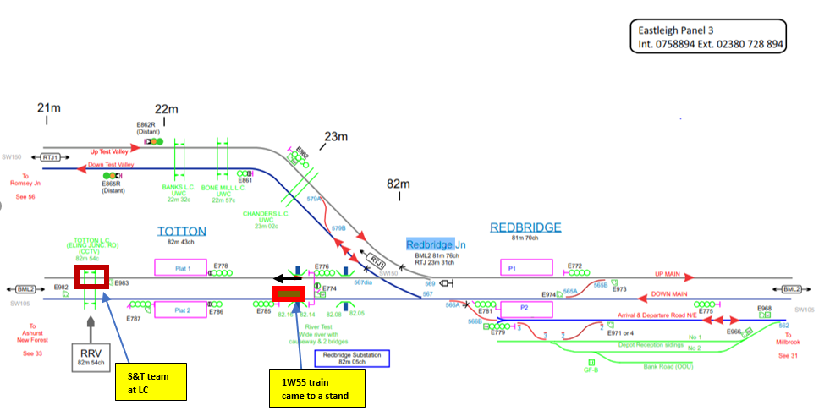
Learning from Previous Incident
Line blockage irregularity at Redbridge - Totton (P1)
Overview
On the 27/06/2021 at approx. 0900hrs the Signaller on Panel 3 at Eastleigh ASC mistakenly routed 1W55 from E781 at Redbridge to E785 at Totton on the Down Main, where a line blockage of the Down Main between Redbridge E567 points and Totton E572 points had already been granted for Southampton S&T team to undertake work at Totton level crossing.
Immediately after the mistake was realised, the train driver was contacted and the train was stopped between E781 and E785 signals. The worksite was beyond E787 signal.
The investigation established the following:
Just before the incident, the signaller received a call requesting another LB and at the same time, was preparing the paperwork for 3rd LB. This had become a distraction to the signaller.
The line block for the worksite was longer that necessary. The worksite could have been protected with a shorter line block from E785 signal rather than E781.
At the time of the incident, there was an increase in the amount of line blockages planned and taken which might have added to the signaller workload.
What can we learn:
ALWAYS TAKE 5 FOR SAFETY when processing multiple sources of information.
The importance of planning Line blocks as short as possible to improve worksite protection.
The importance of following all appropriate processes and not making assumptions.
Discuss the learning points

Slide 9
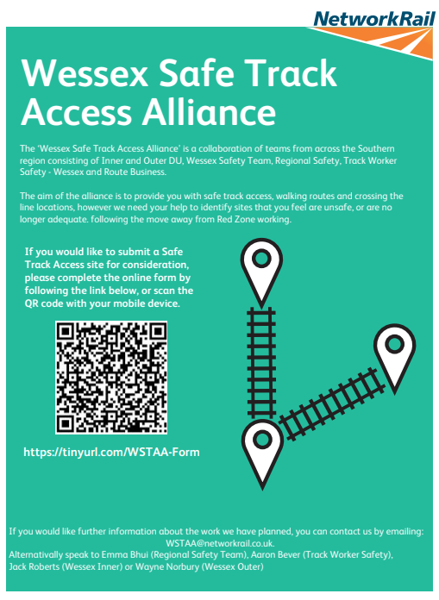

Track Worker Safety (TWS) update
Let us know of any unsafe cess and walking routes
The Track Worker Safety programme is committed to making walking and working safer.
We need help in identifying and logging areas with unsafe cess or walking routes, or opportunities where new access points would help get to site of work safer.
If you see an opportunity to create a safe Cess or walking route, the following steps should be followed:
Step 1) Request new sites via a form on SharePoint (follow link or QR code on picture)
Step 2) Attach any photos or supporting documents.
We’ll then review each request with the DU and set the priority. You’ll also be able to visit the SharePoint site and see the current status of the request.
For more information contact WessexTWS@networkrail.co.uk

Slide 10
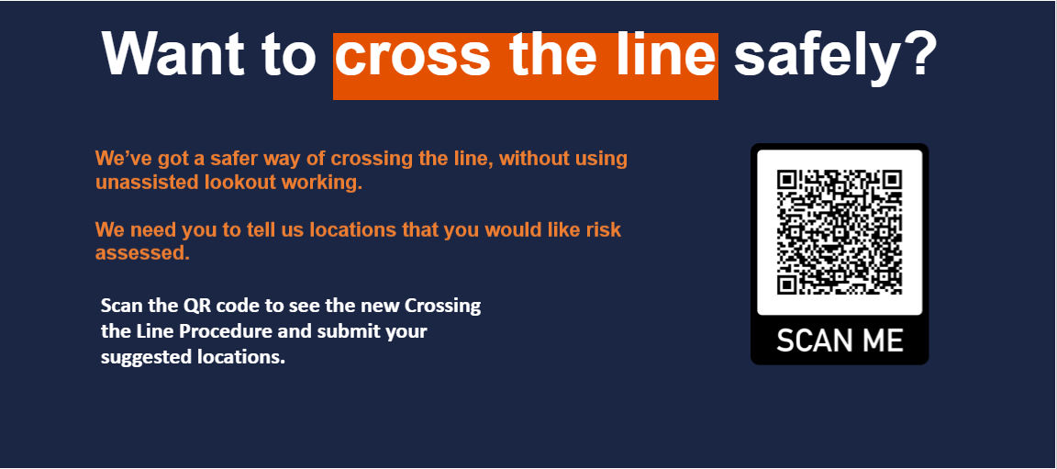
Track Worker Safety (TWS) update
Crossing the Line Procedure
For more information, contact Martyn.Shaftoe@networkrail.co.uk or head to Wessex SharePoint site
For more information contact WessexTWS@networkrail.co.uk

Slide 11
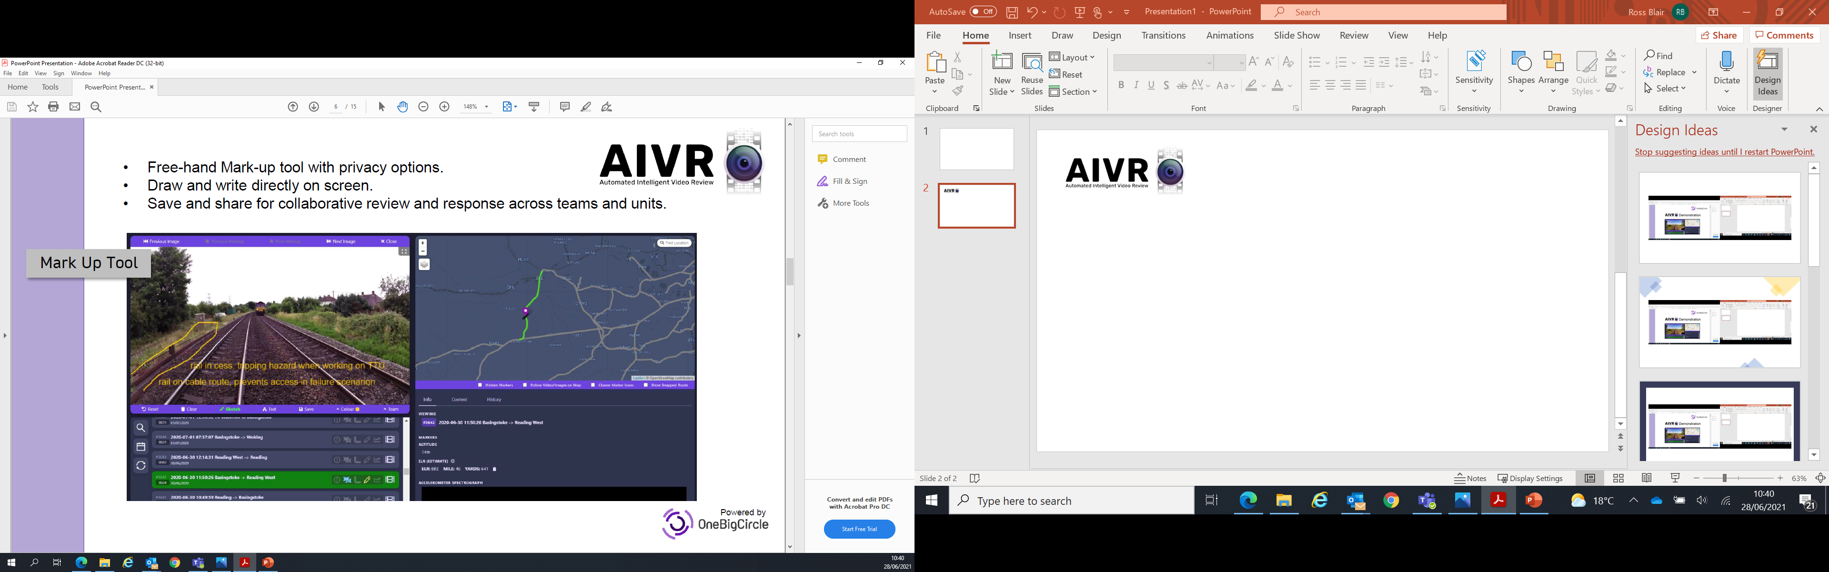
Track Worker Safety (TWS) update
Train mounted forward facing video
As part of the TWS programme, we’re using technology to help plan our work better.
Automated Intelligent Video Review (AIVR) is a powerful digital video capture tool linked to an easily navigable dashboard. It allows a collaborative remote review, monitoring, mark-up, measuring and planning.
Mark up tool
AIVR licences have started to be distributed across the route and short online training will be available on the following dates:
2 July 1100-1145
9 July 1100-1145
16 July 1100-1145
Please contact elaine.baluyut@networkrail.co.uk​ to book training.
For more information contact WessexTWS@networkrail.co.uk

Slide 12
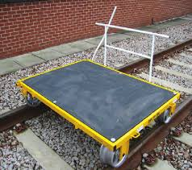
Workforce Safety
Hand trolleys
GERT8000-HB10 Duties of the Controller of Site Safety (COSS) and person in charge when using a hand trolley, contains a number of instructions that must be followed in order to use any hand controlled trolley and other manually propelled equipment mounted on rail wheels and runners, safely.
A competent person must to appointed to be in charge whilst a trolley is in use.
The PiC/COSS must make sure the line is blocked before the trolley is placed on line. He/she can also be in charge of the trolley.
The trolley must be fitted with an operational fail-safe braking system and a correct handle must be used when operated.
The person in charge of the trolley must make sure that the following is met:
The braking system is tested and is in good order
A permission is given by the PiC/COSS, before the trolley is placed on the line
The trolley is not used/placed on a line with a gradient greater than 1 in 50, unless authorised in a local instruction
The trolley is correctly loaded and not overloaded
Nobody rides on the trolley
The trolley or its load does not foul any other line
There are at least two people present when the trolley is moving, with one of them in charge of the brake. When not in use, the trolley must be placed well clear of the line and, if left unattended, it must be secured,
A red flag/red light is displayed on the trolley that is visible in both directions.
The link to GERT8000-HB10 can be found here

Slide 13
Workforce Safety
Changes to terminology in the National Hazard Directory
Planners, COSS's and other trackworkers will already be aware that the term Red and Green Zone working was removed from the Rule Book a number of years ago and any reference to Red & Green Zone terminology was removed from NR/L2/OHS/019 Safety of people at work on or near the line in 2017.
Any text referring to Red and Green zones in the National Hazard Directory was bulk updated on 30th June 2021.
The revised terminology, consistent with 019, will now become Warning SSOW and Protection SSOW to replace Red & Green Zone in the National Hazard Directory.
There will be no need for any of your existing plans (including cyclical) to be re-verified or re-authorised by the PIC & RM respectively if they have already been verified and authorised. Any plans you have produced or subsequently print out will contain the revised terminology.
No action is required by the users of the National Hazard Directory.
The link to the Safety Advice can be found here

Slide 14
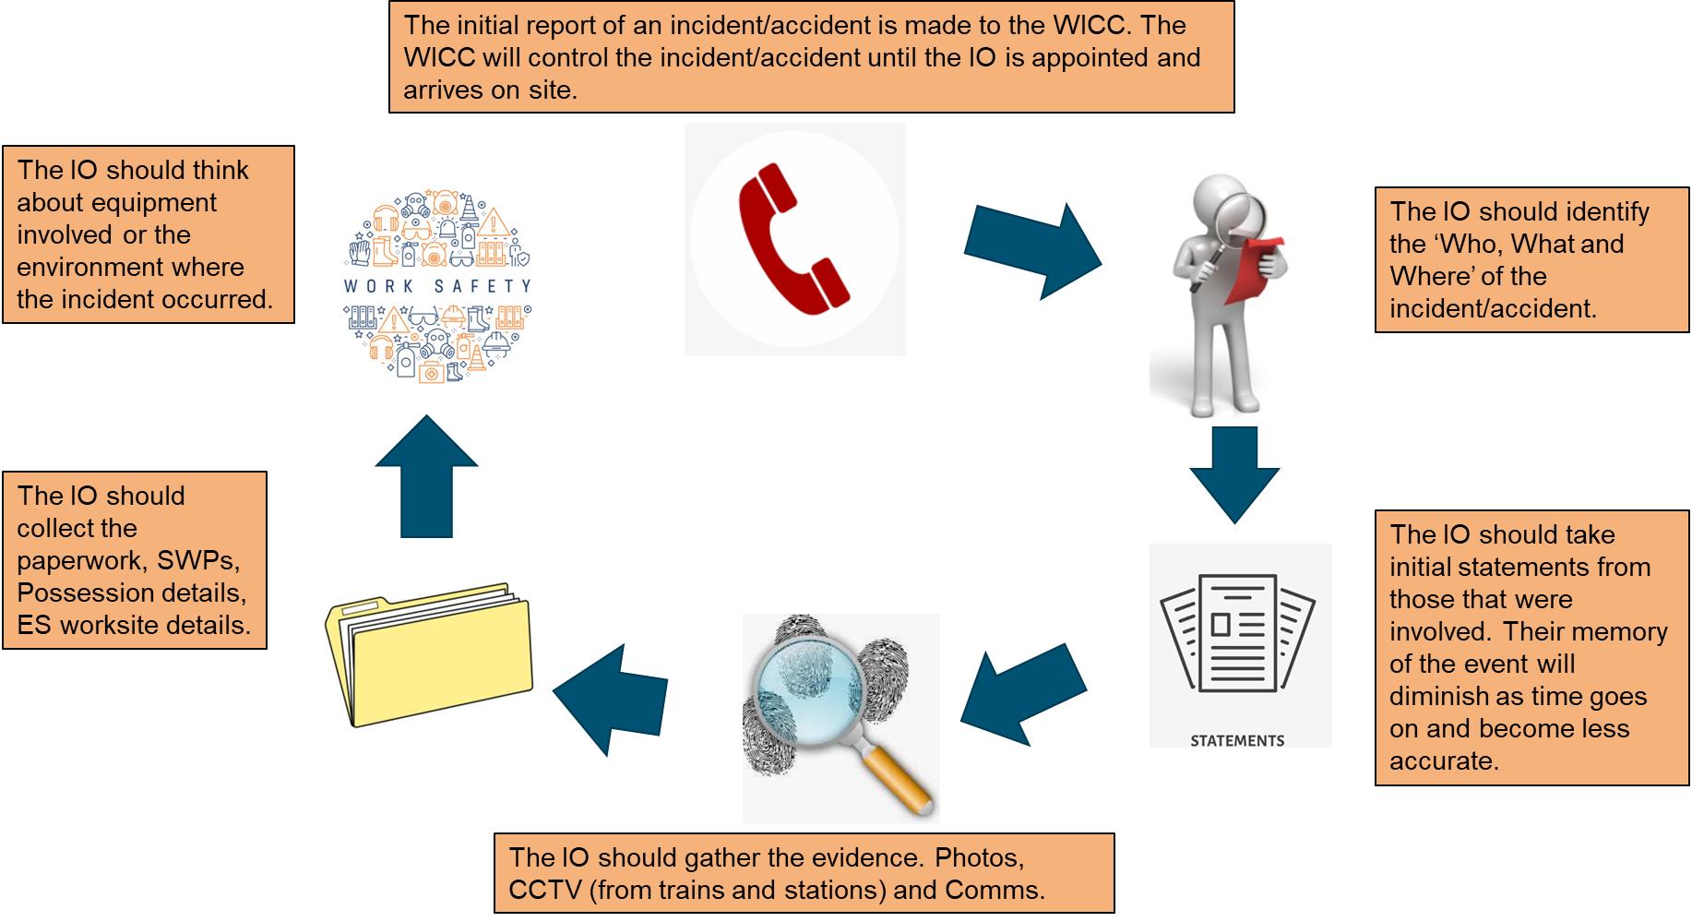
Accidents and Incidents
Investigating Officer (IO) Guidance
A FOR CAUSE SCREENING MUST BE ARRANGED THROUGH THE WICC FOR ANYONE WHO HAS CONTRIBUTED TO AN ACCIDENT / INCIDENT, EITHER THROUGH THEIR OWN ACTIONS OR OMISSION

Slide 15

Road Safety
Who is the Fleet Team and what do they do?
Southern Road Fleet – Kent – Sussex – NR (HS) - Wessex
Darren Matthias – Road Vehicle Compliance Manager – RVCM
Darren.Matthias@Networkrail.co.uk – 07809377557
Scott Bourne – Delivery Assistant
Scott.Bourne@Networkrail.co.uk – 07732639908
Paul Matthews – Delivery Assistant
Paul.Matthews2@Networkrail.co.uk - 07732643503
We are here to help support the route with compliance and fleet related issues.
Managing all compliance inc. road rail vehicles and drivers
Audits for Vehicle Operator Licence (O-licence)
Driver licence checking
Rules and Regulations – MOTs – TAX – Services
Fleet related issues
Fines – PCNs – NIPs
New vehicles
Fuel Cards
MODs
BERs (Beyond Economical Repairs)
HARs (High Authority Repairs)
Data Management - Reports
Site Visits
STH – Short Term Hires
Fleet Lists
Driver Training
Issues
Useful links
Type | Contact / Link
Hitachi Driver Line | 0343 351 9128
LeasePlan Driver Line | 0344 371 8071
Short term hire | Link
Vehicle Ordering Portal | Link
Driver Training (NFE Group) | Link
Licence Checking | Link
Grey Fleet / Private Owned Vehicles | Link
Fleet Website | Link
Escalations / Other | SouthernRegionRoadFleet@networkrail.co.uk
For any other information/questions contact SouthernRegionRoadFleet@networkrail.co.uk

Slide 16
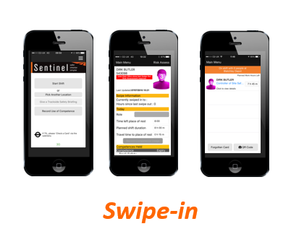
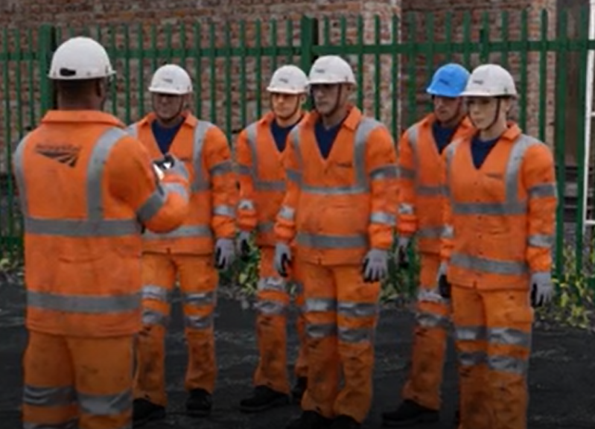
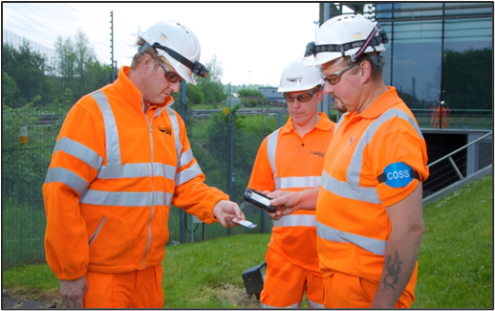
Sentinel
Checking the Checkers!
During a recent event, it was identified that the Controller of Site Safety (COSS) carrying out a task held ‘probationary’ COSS competence only.
This had not been identified prior to the work taking place, as the individual had not checked his OWN card.
Remember, swiping the Sentinel card determines whether an individual has the ‘Authority to Work’ on the railway infrastructure.
It checks that you’re competent, medically fit and have a valid sponsor, but it’s imperative that as a COSS, YOU CHECK YOURSELF FIRST.
You don’t want to have checked the competence of your group, only to then discover that you’re not competent yourself!
When using the Sentinel app, the first thing is for the Card Checker (typically a Controller of Site Safety) to swipe themselves in…
During the COSS site brief and while checking the competencies of those that you are working with, you should get into the habit of showing everyone in your group that you are trained and assessed as competent for the role that you are undertaking.
The only way to do this is to show your group your Sentinel scan.
Are you certain that you are competent to carry out your role?

Slide 17
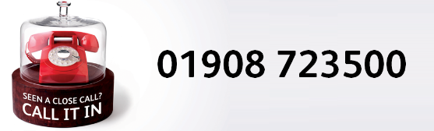
Close Call System
Improving the quality and integrity of close calls
You’ve told us the close call system isn’t working effectively
We’ve taken this criticism on board and are making changes – watch this short video to see how.
We’ve created a film which outlines when and how close calls should be reported; this will increase the quality of reported close calls
We’re also changing the way reported close calls are managed. Close calls will now be filtered before they are assigned to responsible managers for action – this means all allocated close calls will be verified before they are assigned for action
We will work with responsible managers to ensure that verified close calls are resolved with the right action taken to ensure hazards are removed - this will make the infrastructure safer for everyone.
These changes are designed to improve the close call system - watch the film to find out more
Remember to fill out the form correctly

Slide 18
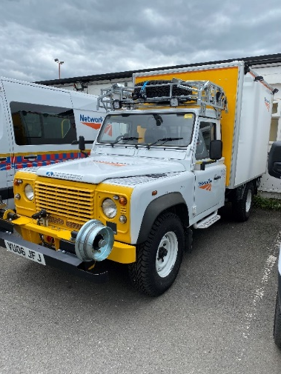
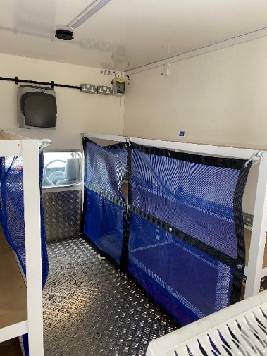
Upgraded Rail Land Rover
Now at Woking P-way
The list of Safety improvements and upgrades include:
New directional LED lighting at the front, rear and on the sides to improve site lighting all around the site of work.
A 360deg camera system to give the driver/operator a view to assist with maintaining the exclusion zone.
Repainted white to comply with the Network Rail road fleet and with new Network Rail signage.
New and improved racking for tools and material storage, with secured shelving to increase security whilst travelling.
New design of gas bottle holders for the new type of gas bottles.
Internally mounted hand wash facilities.
New charging points in the rear for charging battery powered portable plant whilst at the depot to eliminate the need to remove the tools from the vehicle for charging.
The fifth upgraded Rail Land Rover now delivered to Wessex

Slide 19
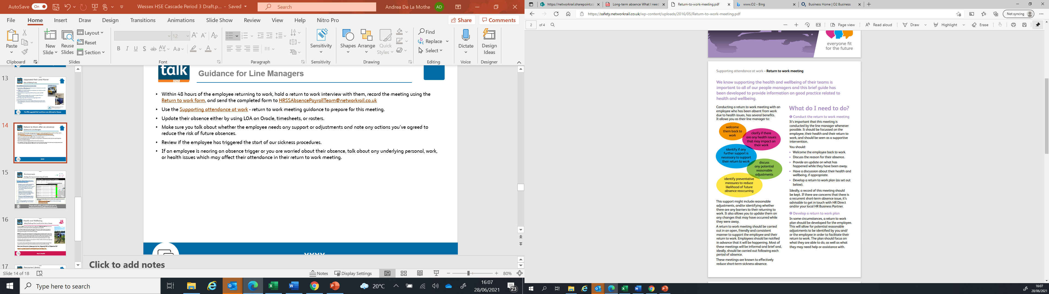
Return to work after sickness
Guidance for Line Managers
Within 48 hours of the employee returning to work, hold a return to work interview. In most cases this should be a short, supportive catch up, either face to face or over the telephone, to welcome them back, discuss the reason for their absence and see how they are feeling now.
A return to work conversation must take place after EVERY absence due to sickness.
Use the Supporting attendance at work - return to work meeting guidance to prepare for this meeting.
Record the meeting using the Return to Work Form, and send the completed form to EmployeeRecords@networkrail.co.uk.
Update their absence either by using LOA on Oracle, timesheets, or rosters.
Return to work discussion should be handled sensitively. Make sure you talk about whether the employee needs any support or adjustments and note any actions you’ve agreed to reduce the risk of future absences.
Note down any actions you have agreed with the employee to reduce the risk of future absence. If necessary, set a review period of around four to six weeks.
Review if the employee has triggered the start of our sickness procedures. Speak to HR Direct for any policy advice and to log a case on 0800 0 546 547.
If an employee is nearing an absence trigger, or you are worried about their absence, talk about any underlying personal, work or health issues which may affect their attendance in their return to work meeting.
Supporting the health and wellbeing of our teams is important

Slide 20
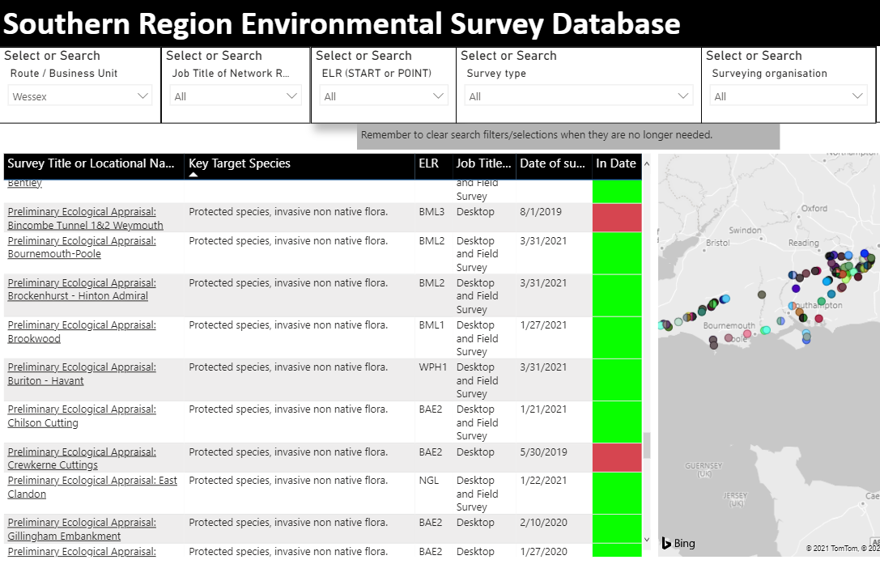
Environment
Ecology Surveys and planning of works
The Southern Sustainability Hub site holds a Ecology Survey Database (Link) which can be utilised while planning works.
Ecological surveys are often very specific to the work they were commissioned for. However, these surveys can still act as a guide for what maybe found in the area prior to new surveys or ecological checks being commissioned.
Records submitted to be added to the database are also sent to the Technical Authority quarterly to be included as in the ecology survey layers on GeoRINM*.
There are currently 144 ecology surveys in the database within the Wessex area, just over half were commissioned in the last 2 years.
*Wessex records submitted prior to June should appear on the GeoRINM layer in the next few weeks.
The Southern Sustainability Hub site also retains other ecological documents and links such as:
SSSI Site Management Statements (Listed at bottom of linked page)
Bird Nesting Briefing Video (2021)
Southern Ecology Handbook
Please send newly completed surveys to: SouthernSustainability@networkrail.co.uk
ACTION
Notes:
Learning points
Why is it important to know the difference between emergency works, urgent reactive/non-emergency unplanned works, and planned works?
How could you play a part in ensuring that your project has appropriate permits, licensing and consent process when necessary?

Slide 21
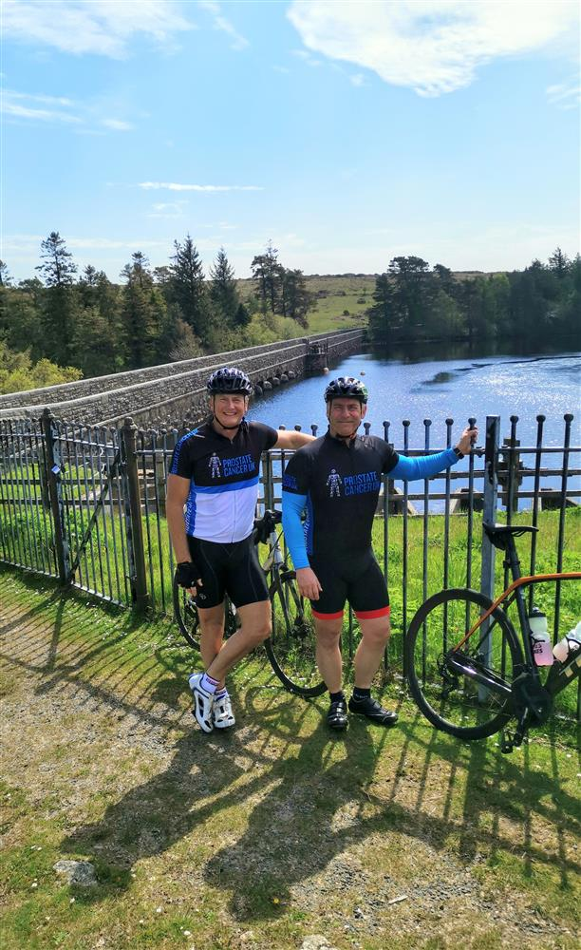
Health and Wellbeing
Riding Challenge from Land’s End to John O’Groats
Land's End to John O'Groats cycle ride, from 4 September 2021 to 12 September 2021
I am cycling 985miles, from Land's End to John o Groats for PROSTATE CANCER UK to help raise awareness of this disease, which is the third most common cause of cancer death.
I have always thought about completing the Land's End to John O'Groats cycle challenge but dismissed it due to the extremity of cycling 985 miles in 9 days, as well as the commitment of preparing and training for such an enormous challenge...
2020/21 has been a very challenging year for everyone, which has changed people's lives all over the world and many of us have lost loved ones due to Covid19. I had the chance to reflect during the lock-down period and saw the opportunity to help make a difference by supporting a charity which I have a connection with through my own personal health scare with prostate cancer symptoms. Thankfully I was cancer-free and was treated successfully through minor surgery.
I want to use this opportunity to raise more awareness of men's health issues and encourage men to come forward sooner and get help.
I will use this and the support from you to motivate me to complete this tough challenge. Please support this cause (link here), which will give me the motivation to train and complete this challenge.
Keith Penn, Rail Plant Support Engineer
Talk about what you could do to improve awareness of men’s health

Slide 22
Resource Library
Safety Bulletins, Alerts, Advice and Shared Learning
Safety-Advice-NRA21-09-Derailment-risk-following-engineering-work.pdf
Safety-Bulletin-NRB21-04-Kings-Cross-remodelling-runaway-MEWP.pdf
Safety-Bulletin-NRB21-05-Fire-involving-Network-Rail-laptop.pdf
Resource Library

Slide 23

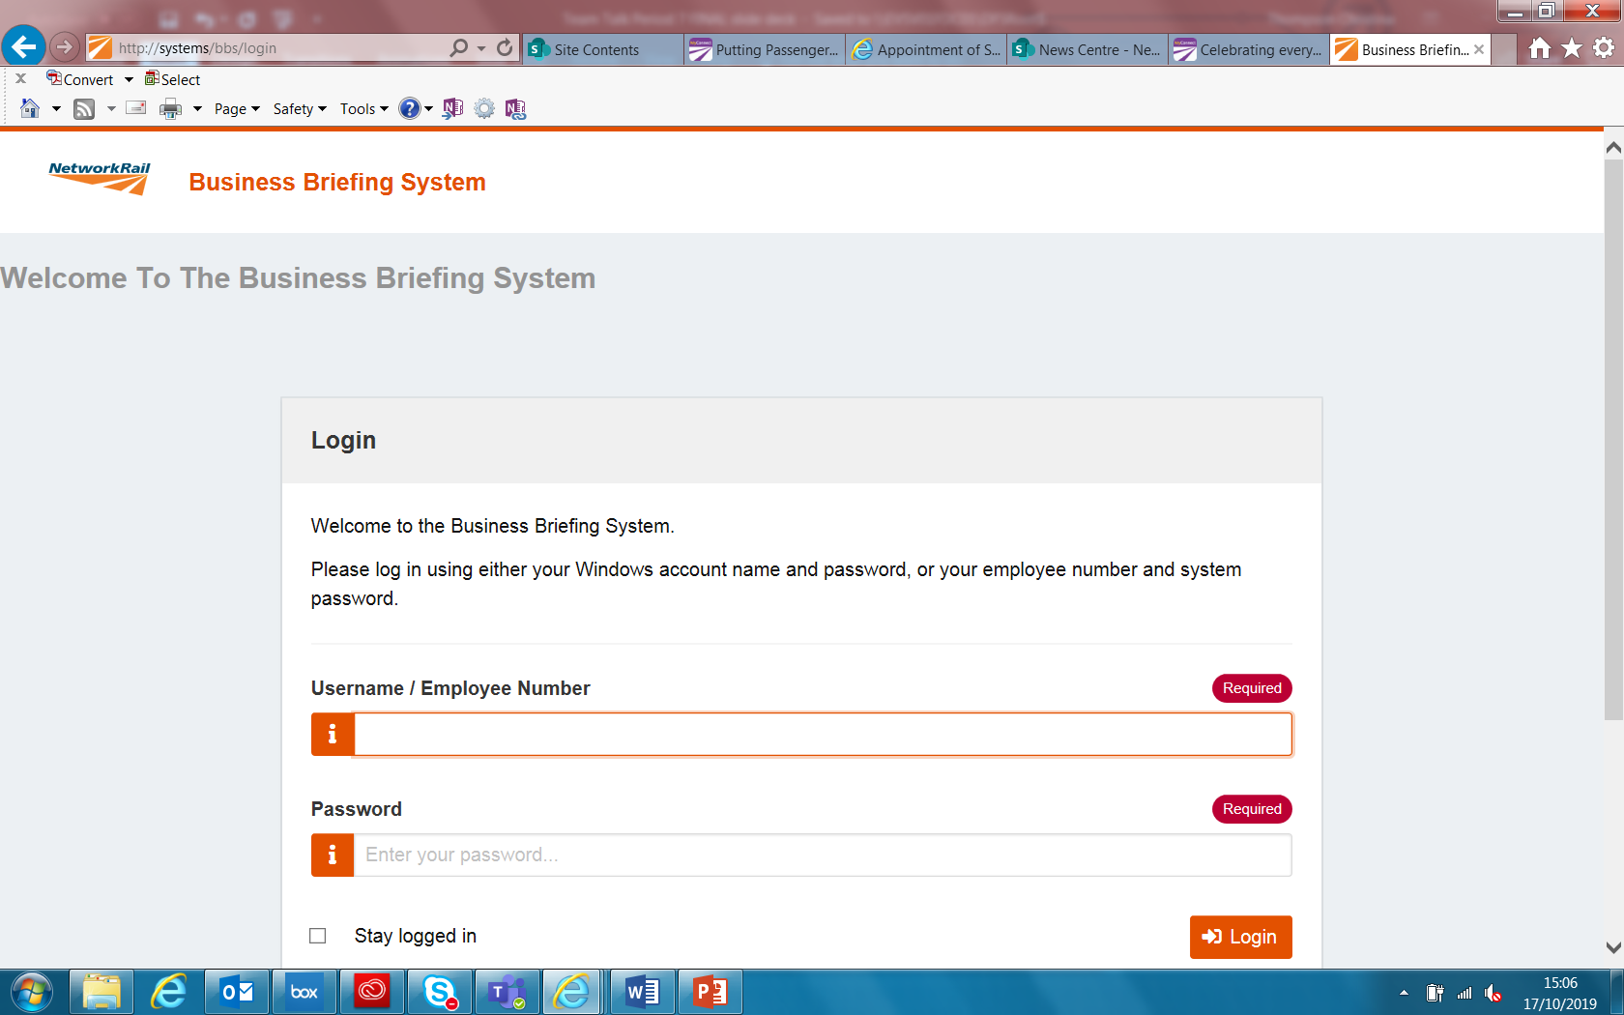
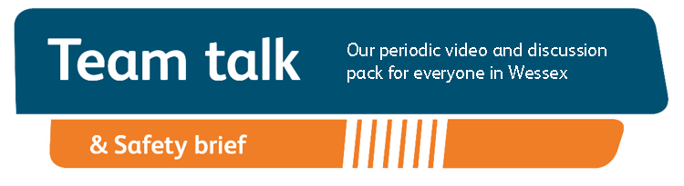
Remember to record that you received your Safety Cascade and have watched Team Talk
Click here for a guide on how to use the new Business Briefing System to do this.
Alternatively you can record you received the Briefing via the dedicated person in your Business Unit.
7

