Slide 1

7
Notes:
Instructions to Managers
To view any links in the slides, you need to have PowerPoint in Slide Show mode

Slide 2
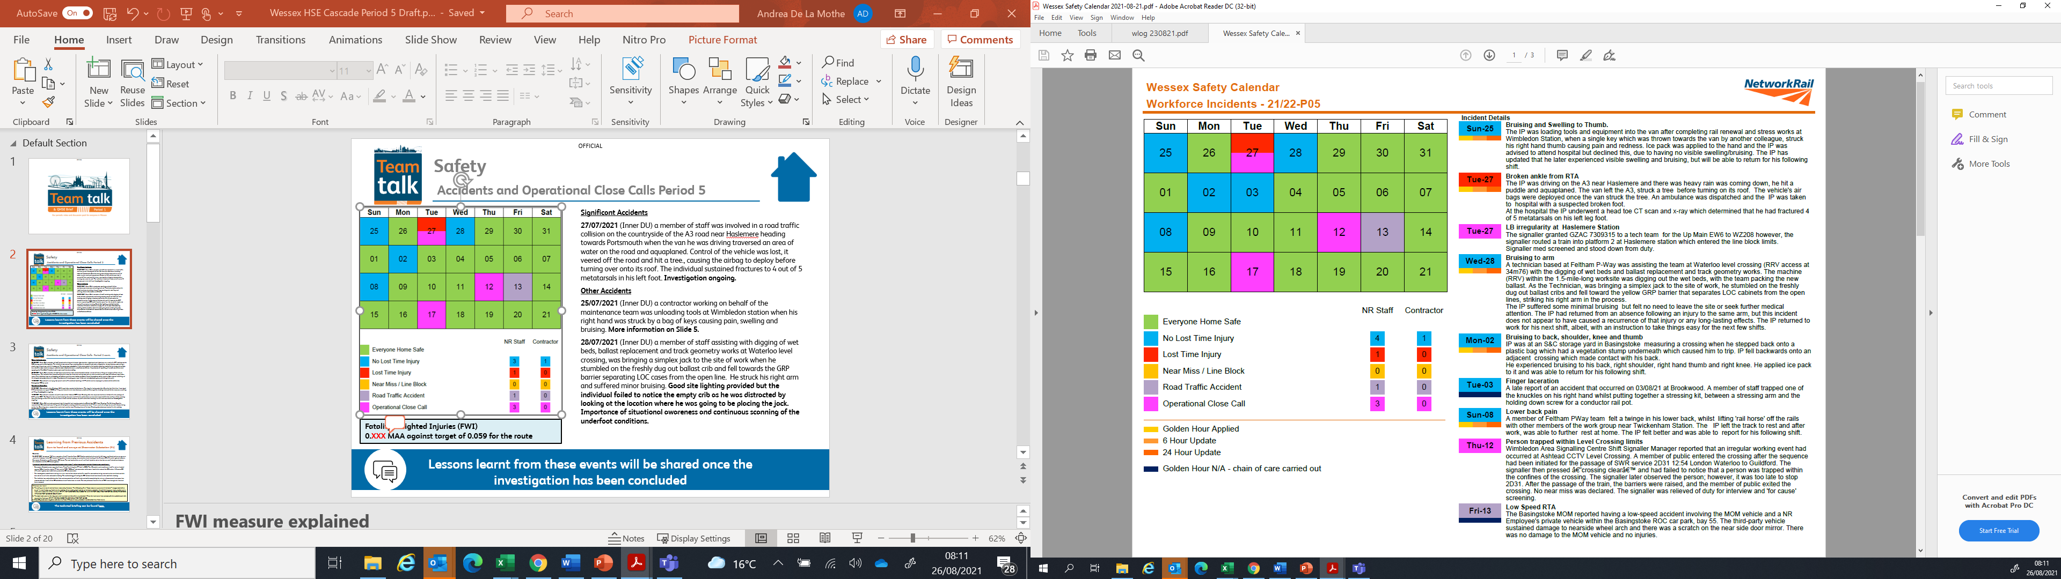

Safety
Accidents and Operational Close Calls Period 5
Significant Accidents
27/07/2021 (Inner DU) a member of staff was involved in a road traffic collision on the countryside of the A3 road near Haslemere heading towards Portsmouth when the van he was driving traversed an area of water on the road and aquaplaned. Control of the vehicle was lost, it veered off the road and hit a tree., causing the airbag to deploy before turning over onto its roof. The individual sustained fractures to 4 out of 5 metatarsals in his left foot. Investigation ongoing.
Other Accidents
25/07/2021 (Inner DU) a contractor working on behalf of the maintenance team was unloading tools at Wimbledon station when his right hand was struck by a bag of keys causing pain, swelling and bruising. More information on Slide 5.
28/07/2021 (Inner DU) a member of staff assisting with digging out of wet beds, ballast replacement and track geometry works at Waterloo level crossing, was bringing a simplex jack to the site of work when he stumbled on the freshly dug out ballast crib and fell towards the GRP barrier separating LOC cases from the open line. He struck his right arm and suffered minor bruising. Good site lighting provided but the individual failed to notice the empty crib as he was distracted by looking at the location where he was going to be placing the jack. Importance of situational awareness and continuous scanning of the underfoot conditions.
03/08/2021 (Inner DU) a late report of an accident at Brookwood resulting in a finger laceration. A member of staff trapped one of the knuckles on his right hand whilst putting together a stressing kit, between a stressing arm and the holding down screw for a conductor rail pot. The failure to report the accident meant the Golden Hour process was not followed and we were unable to apply due diligence and manage the injury appropriately. Investigation ongoing.
Fatality Weighted Injuries (FWI)
0.295 MAA against target of 0.059 for the route
Lessons learnt from these events will be shared once the investigation has been concluded
Notes:
FWI measure explained
Network Rail defines a work place injury as any injury sustained by staff, both direct employees and contractor/suppliers, while undertaking activities connected with Network Rail’s business.
All reported injuries are to be entered into SMIS, the companies corporate Safety Management Intelligence System.
Fatality weighted injury rate (FWIR) is a KPI that uses the following calculation:
The number of fatalities, plus the (number of specified injuries / 10) plus the (number of 3+ lost day injuries / 200) plus the (number of all other injuries / 1000) divided by the hours worked, multiplied by 1,000,000, over the last 13 periods
RIDDOR reporting shall be based on the requirements of the RIDDOR 2013 regulations and the ORR guidance http://orr.gov.uk/__data/assets/pdf_file/0010/2332/riddor-guidance.pdf.

Slide 3
Safety
Accidents and Operational Close Calls Period 5 cont.
Other Accidents cont.
02/08/2021 (Inner DU) a member of staff sustained bruising to his back, right shoulder, right hand and right knee as a result of a STF accident at the S&C storage yard at Basingstoke. The individual was measuring a crossing when he stepped back onto a vegetation stump that was covered by a plastic bag, tripped over and fell backwards. The overgrown vegetation in the area posed a risk but the crossing needed to be measured quickly so a decision was made to carry on with the task despite the poor underfoot conditions. Importance of reporting of unsafe conditions and applying the WorkSafe Procedure when work can’t be done safely.
08/08/2021 (Inner DU) a member of staff experienced minor lower back discomfort whilst a team of 4 were lifting an ironman off the rails at Twickenham . The individual was immediately told to leave the track and rest and was able to return to work on the next shift without any further issues. The individual has no pre-existing conditions and his usual duties are Basic Visual Inspections which require little manual handling, all his relevant competencies are in date. Importance of knowing your own limits and not attempting to push through the pain.
13/08/2021 (Operations) a no injury low speed road traffic accident involving a NWR vehicle and an employee’s private vehicle within the Basingstoke ROC car park.
Operational Close Calls
27/07/2021 (Operations) a Line Blockage (LB) Irregularity reported at Haslemere. The signaller had granted the LB on the Up Main Line from signal EW6 at Haslemere to signal WZ208 at Witley and routed a train into Haslemere platform 2 through the blocking limits whilst the team were working at Witley. Investigation ongoing.
12/08/2021 (Operations) a member of public entered the Ashtead CCTV Level Crossing after the sequence had been initiated for the passage of SWR service 2D31. The Signaller then pressed crossing clearance and failed to notice that a person was trapped within the confines of the crossing. After the passage of the train, the barriers were raised, and the member of public exited the crossing, no near miss was declared. Investigation ongoing.
17/08/2021 (Outer DU) on track equipment interfering with level crossing controls at Dunbridge CCTV Level Crossing. The Salisbury Signaller reported that PO track circuit was failing and affecting the crossing within the possession item 115 as a result of trolleys, horses and ironmen being on the line. Once they were removed the track circuit and the Level Crossing cleared. No Level Crossing attendant was booked for this activity. Investigation ongoing.
Lessons learnt from these events will be shared once the investigation has been concluded

Slide 4
Learning from Previous Accidents
Burn to hand and arc eye at Sheerwater Substation (P4)
Overview
On 06/07/2021 at approx. 1341hrs, a member of staff from the Inner D&P Section sustained a burn to his left lower arm/hand and an arc eye as a result of a flashover in the DC Annex building, where he was carrying out protection circuit testing of the Siemens DC differential system between Sheerwater Substation and Sheerwater DC Annex. The test involved the use of a millivolt injection set to simulate current fluctuations between the substation and the DC Annex system.
A technical investigation was completed together with a Level 1 safety investigation and the following was established:
Sheerwater Substation was upgraded from a Track Paralleling Hut (TP Hut) in 2005. The AC module and transformer/rectifier set are located approx. 350m from the original TP Hut and six 750V 1000mm² interconnector cables were installed to extend the DC busbar. A Siemens DC differential system was installed to protect the DC interconnector.
The investigation established a wiring error as a result of the shunt and buffer amplifier connections being reversed on the test block and this was not mirrored in the schematic drawing. The methodology of testing the DC isolated circuit was based on the available drawing.
The individual correctly withdrew the links and connected the millivolt leads and whilst completing the set up, a disconnected lead came into contact with the frame of the DC switchboard and flashed over to earth. The test point was found to be live at 750V, even though the links had been removed.
What we can learn:
The wiring error could not had been reasonably foreseen. The Lifesaving Rule “Never assume equipment is isolated – always test before touch” is not directly applicable to the activity of connecting test leads to an isolated protection circuit. It is however, best practice and a reasonable extension of the principle. STAFF ARE THEREFORE REMINDED TO ALWAYS TEST ISOLATED PROTECTION CIRCUITS BEFORE APPLYING TEST LEADS OR EQUIPMENT.
The test leads used on the day were not insulated and therefore unprotected. When the lead came into contact with the switchboard, this caused the flashover. STAFF ARE REMINDED TO USE INSULATED TEST LEADS.
Class 00 gloves worn together with the Arc Flash PPE would have protected hands/wrists from flash burns.
The technical briefing can be found here

Slide 5

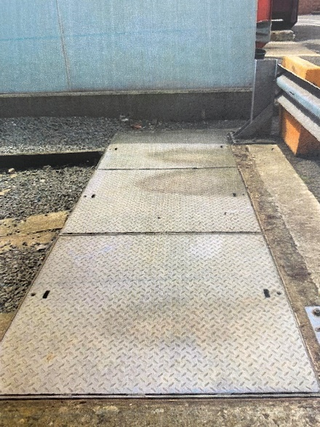
Learning from Previous Accidents
Finger injuries and manual handling (P4 & P5)
Overview
Over the course of just two weeks, the Wessex Inner DU suffered three finger injuries of varying severity.
During the first event, a member of staff suffered a hairline fracture to the tip of his right middle finger when a metal lid, weighing approx. 30kg (see image) which was covering some smoking cables that were being investigated, slipped from the T-pattern drain lifting key and onto his hand, which he inadvertently placed under the edge of the lid.
The other two hand/finger injuries occurred during the loading of tools and equipment, after work had been completed. In one, a contract member of staff was struck by a Pandrol clip as he was loading another tool onto a flatbed vehicle and, in the other, a member of staff crushed his gloved finger between a stressing ram and a saddle, whilst sliding the ram along the flatbed to make room for more tools.
Fortunately, the injuries suffered in the other accidents were less severe than the first one, but each incident highlights the need to focus throughout the entirety of our shifts and reminds us yet again that accidents don’t just occur ‘On or near the line’.
What we can learn:
How do we maintain focus throughout our shift? Accidents can and do happen before we get on or after we have left the track, how can we adopt our practices to minimise this?
Consider the need for manual handling in some of the tasks we undertake, can it be removed? If it can’t be removed, what can we do to reduce, isolate or control the manual handling?
Do we have sufficient resources to carry out the manual handling safely? Or in some cases, are we importing more risk by having too many people trying to load kit on to vans, trolleys at the same time?
Do our staff have access to gloves adequate for the task and are these worn when clear of the track? Whilst wearing of gloves may not prevent incidents, they may reduce the severity of the injury.
Discuss the learning points

Slide 6
Learning from Previous Incidents
Unsafe Working between Gomshall and Reigate (P2)
Overview
On 28/05/2021 at approx. 1635hrs, a Team Leader (TL) who was acting as the COSS/PiC authorised 2 members of staff to cross the open Up Redhill line (RSJ) at Deer Leap Bridge to gain an access to the line blockage (LB) that was in place on the Down Redhill line, after establishing with the Guildford Signaller that there were no trains running.
After completing the work within the LB the COSS crossed the open Up line with the rest of the team (3 staff) to gain access to their vehicle whilst observing there were no trains before crossing the line.
The investigation established the following:
The COSS did not contact the Signaller to make a line side LB request for the Up line due to time constraints. He felt under pressure to get the work done as quickly as possible.
The COSS was under the impression that by contacting the Signaller to check there were no trains running, he had a protection in place. There was no planned LB for the Up line.
The planned LB on the Down line was too long and if the distance had been shortened at the planning stage, it would had given the team more time to perform the maintenance.
The team were 10 hours into their 12-hour shift.
What can we learn:
The importance of collaboration between the Responsible Manager, PiC and Planner to confirm that the planned LBs contain the appropriate access points, correct signals and that all lines are taken into consideration to facilitate movements to and from the site of work. Consider the size of the line blockage that is required to complete the work.
Impact of fatigue on our performance and decision making.
Challenging any unsafe conditions or acts and applying the Work Safe Procedure.
Discuss the learning points

Slide 7
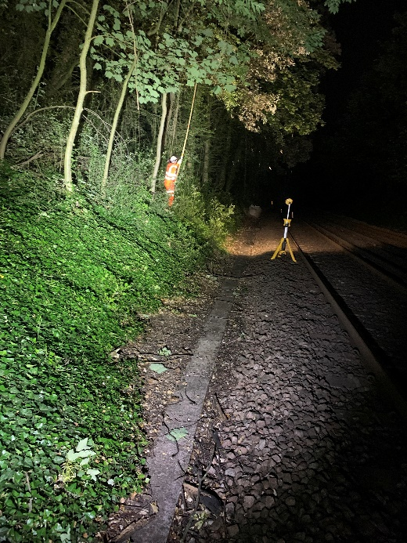
Learning from Previous Incidents
Equipment in contact with a live conductor rail (P3)
Overview
On 25/06/2021 at approx. 0125hrs a 4-men team were undertaking essential vegetation clearance in the Down Portsmouth Cess (SDP2) at approx. 85m70ch between Fareham and Porchester, using a line blockage protection. One member of the team was using an insulated pole saw kit to cut and clear high level vegetation and branches overhanging the track whilst being positioned on the embankment.
Whilst cutting a high branch the saw snagged and in an attempt to free it, the individual lost his footing and slipped, letting go off the pole, which fell across both Up and Down lines. As the pole hit the running rails the metal head came into contact with the live conductor rail on the Up line, causing flash burns to the running rail and superficial damage to the conductor rail.
The investigation established the following:
The pole saws are known to fall due to their length and exclusion zones are set up. However in this case no adequate mitigation measures were implemented to remove the risk of striking the live conductor rail.
The team worked in the same way teams have traditionally worked in the past.
The ground on the embankment was slightly sodden as a result of rainy conditions.
What can we learn:
Importance of thorough scoping visit to identify if an isolation is required to mitigate the risk of equipment coming into contact with a live conductor rail. Please refer to NR/L3/MTC/RCS0216/GA20.
Awareness of underfoot conditions on site and taking adverse weather into consideration.
Discuss the learning points

Slide 8
Learning from Previous Incidents
Possession limit boards and detonator protection placed on open lines at Linford Street Jn (P4)
Overview
On 20/07/2021 at approx. 0137hrs, after the possession Item 21 between Waterloo and Queenstown Road/Nine Elms Jn was granted, the Person in Charge of the Possession (PICOP) was informed that an empty coaching stock 5P88 had struck a possession limit board (PLB) on the Up Chatham line (VIR) just before Linford Street Jn and that there was a PLB in place adjacent on the Down Chatham line.
The investigation established the following:
The Possession Support Staff (PSS) had placed the PLB’s and detonator protection on the Chatham lines outside of the possession limits instead of the planned Up/Down Waterloo Curves (AHG), resulting in the 5P88 striking one of the PLBs.
The PSS was unaware he had stepped into the open lines and further confirmed that it was his first time at this location.
The PSS was supplied with the correct paperwork but failed to verify and accept/reject his Safe Work Pack (SWP) in advance as per the 019 Standard.
The PSS received appropriate briefing prior to carrying out the task and did not ask any further questions to seek clarification.
The Safety Bulletin can be found here
What can we learn:
Ensuring suitability and individual understanding of Possession Pack/SWP and compliance with Standard 019.
Checking the relevant PSS have fully understood the briefings and the appropriate processes are followed to prevent a reoccurrence.
Confirming all PLB and detonator protection are correctly placed and completely removed and counted at the end of the task.
The contract labour supplier implementing an internal assurance mechanism for managing sub-contractors and implementing an assurance regime to review the quality of PICOP briefings to PSS and PSS understanding of the briefings.
Discuss the learning points

Slide 9
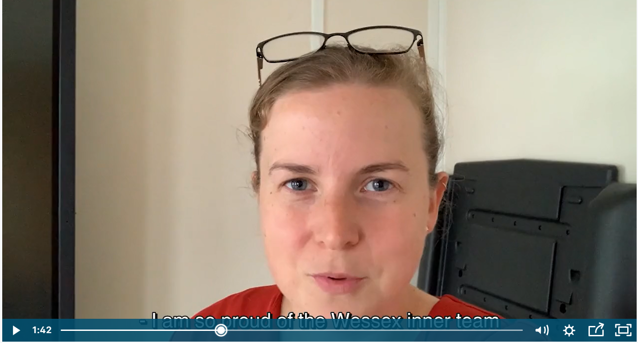
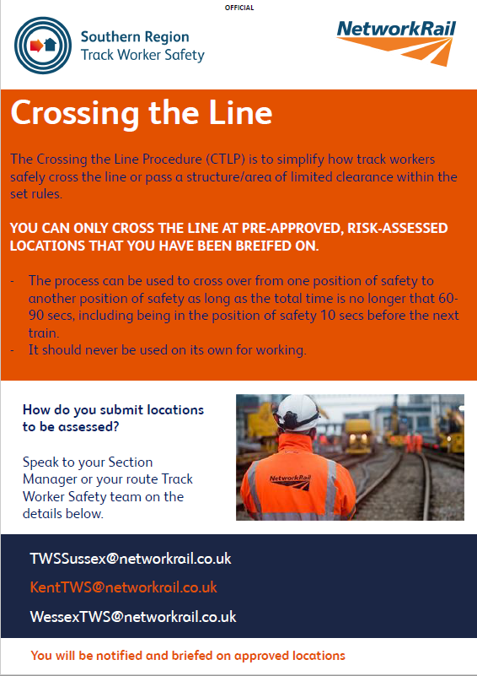

Track Worker Safety update
Round-up
We are saying thank you
Have you seen managers from across the region sharing their thanks in a new video? Visit here to watch and there is no need to sign in.
Crossing the Line Procedure (CTLP) update
On 6 September 2021 the first Crossing the Line location in Wessex goes live at Pirbright Sub Station. The location has been risk assessed and staff briefed.
Details of the location can be found here
Thank you for sending your suggested locations for Crossing the Line Procedure. We’re now risk assessing them and including int the process the relevant section manager, local operations manager, local TU H&S reps (both signalling and track), Operational Risk Advisor (ORA) and Workforce H&S Advisor.
Before a CTLP site can go live, Ops and Maintenance need to brief their staff.
Maintenance will also need to provide a list of authorised users to the TWS team.
If you would like to be briefed to use the process, please contact Martyn Shaftoe - martyn.shaftoe@networkrail.co.uk
Contact the Wessex TWS team on WessexTWS@networkrail.co.uk

Slide 10

Workforce Safety
WorkSafe Procedure NR/L2/OHS/00112 - reminder
The WorkSafe Procedure was introduced in 2009 to empower colleagues to raise safety concerns without fear of recrimination.
The national standard was recently revised and empowers employees to raise their concerns without the need to feel under pressure to return to work until such times that the cause of the concern has been addressed.
The Procedure applies to all Network Rail staff and all staff supplied through the Supply Chain Operations, whether frontline or office based.
If you are applying the WorkSafe Procedure
You need to inform Route Control/Supply Chain Organisation Control (SCO) 24/7 and explain why the activity/task has been suspended.
Route Control
Will create a log reference with the caller and contact the responsible manager (RM) or on call manager (out of hours) and complete section A of the capture form NR/L2/OHS/00112/F01.
Responsible Manager
Will contact the Responsible Person on site to determine if there is a sufficient risk assessment, the system of work is safe and if the activity can be restarted.
If agreement is reached by adding additional controls or amending the safe system of work, the RM will propose a return to work.
If the RM agrees the activity is unsafe or it is not possible to reach an agreement, the work will cease and work site will be left safe.
The RM will inform the Route Control/SCO 24/7 of the outcome.
Route Control
Will send a copy of the completed capture form NR/L2/OHS/00112/F01 to the reporter and the RM.
The WorkSafe Procedure can be found here

Slide 11

Workforce Safety
COVID-19 Update
From Monday 16 August 2021 (in England), adults who are fully vaccinated (both doses, plus 14 days from the last dose), are exempt from the requirement to self-isolate if they are a contact of a positive case. Instead, we are advised to take a PCR test as soon as possible. There is no requirement to self-isolate whilst waiting for the results of the PCR test.
If you are contacted by the Test and Trace contact service and told you are legally required to self-isolate due to a close contact, you must continue to do so.
If you are not fully vaccinated (and this includes any colleagues who are medically prevented from being vaccinated), you will need to self-isolate following a contact with someone who is positive.
Even after being vaccinated, we need to remain cautious to protect people around us, particularly those who may have clinical vulnerabilities, by meeting in well ventilated areas, wearing a face covering and washing our hands regularly.
Wearing a face covering in enclosed spaces is a best practice and is recognised by other employers who are committed to protecting their staff.
COVID-19 Update

Slide 12
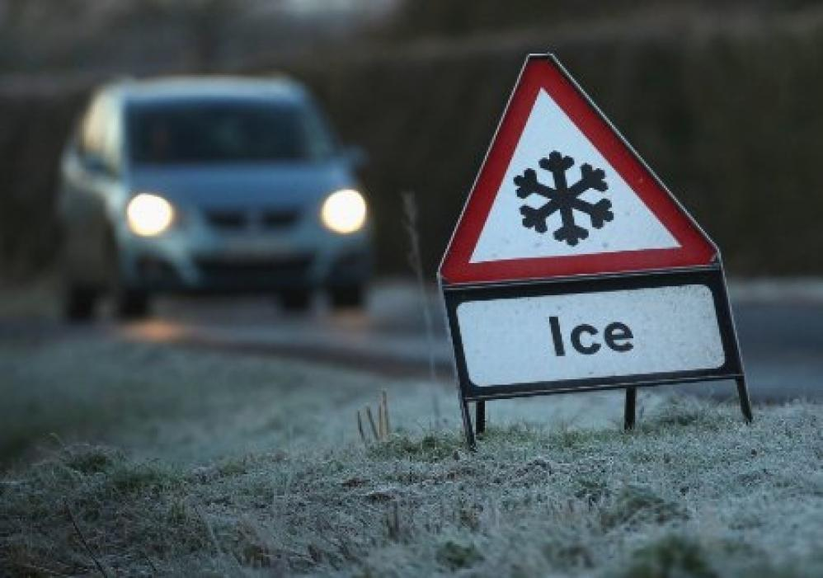
Workforce Safety
Winter Preparedness
Winter will soon be upon us, are you and your teams prepared for the inevitable adverse weather?
Do your teams have access to sufficient wet weather PPE?
Are your vehicles winter ready?
Are your depots winter ready?
Winter safety advice often tells us things that we know already and apply in our day-to-day life.
For example, we all know that pavements and roads will very likely be slippery when the weather is cold and wet and we know to take extra care.
But, even though we all know this and it is common sense, more accidents still occur during the winter period as many of us will forget the risks we take when we are in a hurry!
We need to keep each other safe by looking out for each other and highlighting dangers to make sure we all go home safe every single day.
ACTION
Are you winter ready?

Slide 13
Environment
RACI Updates for Environment Standards
The following environmental standards have been updated and have revised RACIs.
NR/L2/ENV/120 Waste Management
NR/L2/ENV/121: Managing the environmental & social impacts of noise & vibration
If your job role is listed on the right, please review the applicable change summary linked below or review the standard itself via the standards page.
Change Summary for NR/L2/ENV/120 Waste Management
Change Summary for NR/L2/ENV/121: Managing the environmental & social impacts of noise & vibration
Initial awareness briefings have taken place for some roles however, further will be available towards the end of the year. If guidance is needed prior to this please contact the Wessex Route Environment Specialist - Rebecca.Jones@networkrail.co.uk
NR/L2/ENV/120 Waste Management Maintenance & Operations Job Roles | NR/L2/ENV/121: Managing the environmental & social impacts of noise & vibration Maintenance Roles
Area Services Manager (Kent and Sussex) | Community Relations Executive
Environment Specialist | Community Relations Manager
Head of Legal (Southern) | Environment Specialist
Head of Route QHSE | Finance Director
Infrastructure Director | Head of Legal (Southern)
IMDM | Head of Route QHSE
Infrastructure Maintenance Engineer | Head of Stakeholder Engagement
Infrastructure Maintenance Services Manager | Infrastructure Director
Logistics Coordinator | Infrastructure Maintenance Engineer
Maintenance Protection Coordinator | IMDM
Regional environmental manager | Infrastructure Liability and Contracts Manager
Route Crime Team | Legal Counsel (Southern)
Section Manager | Maintenance Protection Coordinator
Senior Procurement Manager (Regions) | Section Manager
Stores Coordinator | Senior Procurement Manager (Regions)
Technical Authority Environment Management Systems Manager | WHSEA
WHSEA
Head of Operations Delivery
Operations Manager (Local and Mobile)
ACTION
The applicable RACIs can also be found directly using this Link.
Notes:
Learning points
Why is it important to know the difference between emergency works, urgent reactive/non-emergency unplanned works, and planned works?
How could you play a part in ensuring that your project has appropriate permits, licensing and consent process when necessary?

Slide 14

Health and Wellbeing
September – Connecting with Others
“Heroes didn’t leap tall buildings or stop bullets with an outstretched hand; they didn’t wear boots and capes. They bled, and they bruised, and their superpowers were as simple as listening, or loving. Heroes were ordinary people who knew that even if their own lives were impossibly knotted, they could untangle someone else’s. And maybe that one act could lead someone to rescue you right back.” –
Jodi Picoult
What: Virtual Lunch and Learn
When: Friday 10 September 2021 from 12:30 to 13:30
Topic: Learn to Listen (Samaritans)
Samaritans Listening Guide can be found here
Notes:
Jodi Picoult in an American writer.

Slide 15
Health and Wellbeing
Mental Health Training
Courses:​ | Date:​ | Time:​ | Training:​ | Link to booking page:​
Back on Track​* | 24 Sept 2021​ | 10:00– 13:00​ | Online​ | https://www.eventbrite.co.uk/e/155946479117​ ​
Managing Suicidal Contacts ​ | 08 Oct 2021​ | 10:00– 13:00​ | Online​ | https://www.eventbrite.co.uk/e/155980725549​ ​
Back on Track​* ​ | 22 Oct 2021​ | 10:00– 13:00​ | Online​ | https://www.eventbrite.co.uk/e/156066311539​ ​
Managing Suicidal Contacts ​ ​ | 05 Nov 2021​ | 10:00– 13:00​ | Online​ | https://www.eventbrite.co.uk/e/156066634505​ ​
*Back on Track course is aimed at all employees who may be exposed to traumatic events on the railway or employees who could emotionally support others following a traumatic event on the railway.
Mental Health Training

Slide 16

Everyone Week needs you!
Help your peers by sharing your wellbeing story
Your story is important
Your story could help others with similar experiences
Your story could help break the stigma around mental illness
Telling your story could be a form of self-therapy
Your story could inform your peers
ACTION
To find out more, please contact us.

Slide 17
Resource Library
Safety Bulletins, Alerts, Advice and Shared Learning
Safety-Advice-NRA21-11-Safe-use-of-ballast-brushes.pdf
Safety-Advice-NRA21-12-Capacitor-failure-at-Waverley-signalling-centre.pdf
Shared-Learning-NRL21-02-Learning-from-others-A-serious-train-accident-near-miss.pdf
Resource Library

Slide 18

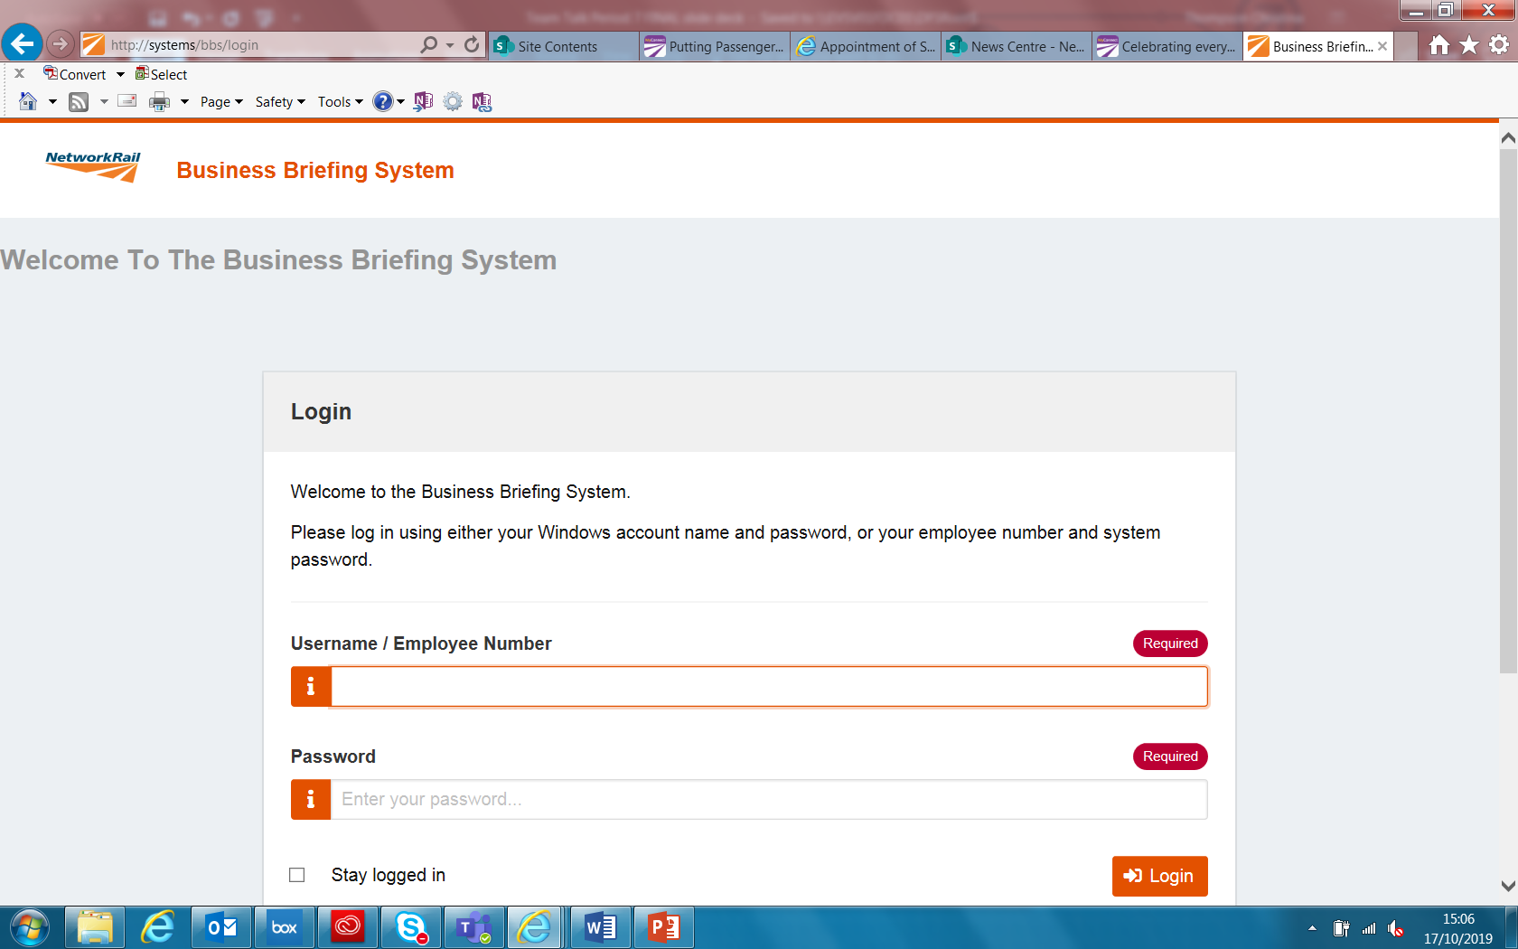
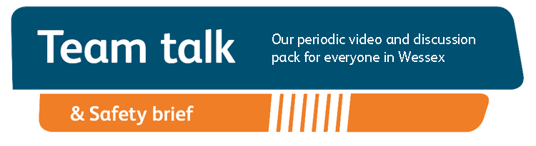
Remember to record that you received your Safety Cascade and have watched Team Talk
Click here for a guide on how to use the new Business Briefing System to do this.
Alternatively you can record you received the Briefing via the dedicated person in your Business Unit.
7

