Slide 1


Safety Cascade
Wessex: Period 7
Our periodic video and discussion pack for Wessex

Slide 2


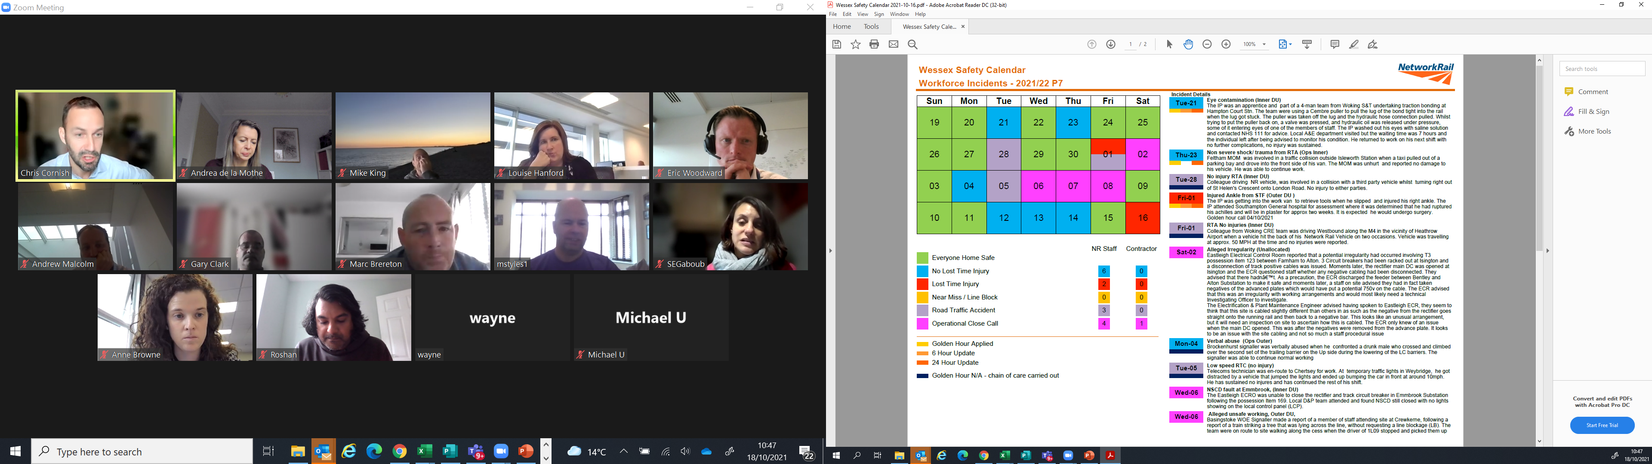
Wessex Safety
Period 7 overview
Fatality Weighted Injuries (FWI) 0.29 MAA against target of 0.059 for the route
Days without a Lost Time Injury (LTI)
Business Unit | Outer DU | Inner DU | Area Services | Operations | Planning
Number of Days | 20 | 35 | 295 | 5 | 218
* date valid as of 21/10/2021
Lost Time Accidents
01/10/2021 (Outer DU) a member of staff ruptured his right Achilles’ tendon whilst entering the back of the van to retrieve tools at Marchwood.
16/10/2021 (Operations) a member of staff operating No.2pts (Blackwater Ground frame) felt a sharp shooting pain down his arm.
Operational Close Calls
08/10/2021 (Inner DU) a Protection Controller (PC) strayed outside of his LB limits into another team’s LB at Woking. He later gave up his LB without informing a COSS of another team that was signed into his LB.
We have seen an increase in ankle injuries as a result of underfoot obstructions and/or uneven ground. Some of them occurred during the daylight hours.
What can you do to keep yourself safe and free from harm?
Always pay attention to your underfoot conditions and if you need to make a phone call or refer to your paperwork, stop and remain stationery until you conclude what you are doing.
At night time ensure you have sufficient site lighting but also access lighting.
If the ground is obstructed by heavy vegetation and you can’t see if it is level or if there are any obstructions, stop and seek an alternative route.
Notes:
FWI measure explained
Network Rail defines a work place injury as any injury sustained by staff, both direct employees and contractor/suppliers, while undertaking activities connected with Network Rail’s business.
All reported injuries are to be entered into SMIS, the companies corporate Safety Management Intelligence System.
Fatality weighted injury rate (FWIR) is a KPI that uses the following calculation:
The number of fatalities, plus the (number of specified injuries / 10) plus the (number of 3+ lost day injuries / 200) plus the (number of all other injuries / 1000) divided by the hours worked, multiplied by 1,000,000, over the last 13 periods
RIDDOR reporting shall be based on the requirements of the RIDDOR 2013 regulations and the ORR guidance http://orr.gov.uk/__data/assets/pdf_file/0010/2332/riddor-guidance.pdf.

Slide 3
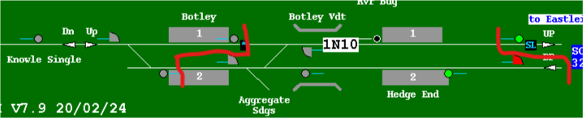
Learning from previous incidents
LB irregularity at Botley
Overview
On 02/09/2021 at approx. 1118hrs, Eastleigh panel 2 signaller called the incorrect Controller of Site Safety (COSS) when requiring a Line Blockage(LB) to be given up at Botley. Subsequent communications checks confirmed the signaller called the COSS for Fareham LB in error. The error wasn’t realised, resulting in a train being routed through the LB between Botley station and Eastleigh South Jn that had not been given up yet. The work group at Botley had completed their work and were in a position of safety when the train went past the worksite .
The investigation established the following;
Upon planning to contact the Botley COSS, the signaller dialled the Fareham COSS and failed to clearly confirm that he was speaking to the correct COSS. He used the name of the Botley COSS, the authority number and the LB limits, whilst speaking to the Fareham COSS. The signaller went on to fill out the Fareham LB form and agreed hand back time.
The Fareham COSS failed to engage in active listening and offered limited challenge when the signaller quoted the incorrect information.
The signaller focused on the clearing of the LB to run trains resulting in not hearing key details indicating he may be speaking to the incorrect COSS. During the exchange several opportunities were missed to detect this error.
The protecting limits were published incorrectly, in spite of the correct signals being planned in the Safe Work Pack.
What can we learn:
ALWAYS double check an authority number.
Be aware of confirmation bias – listening but only hearing the items that fit with your understanding of the matter.
Applicable to signallers and COSSs; The importance of Take 5 – if something doesn’t seem right STOP and ASK more questions, if you’re not happy STOP and invoke the Work Safe Procedure.
The importance of cross-checking the correct information is entered on the Safe Work Pack and any GZAC applications.
Notes:
Discuss the learning points

Slide 4


Workforce Safety
Wessex Route Golden Hour – 1 Hour Reminder
Following some recent incidents within the Wessex Route, the Golden Hour, that critical time to prevent further incident or injury, collect initial evidence, interview the involved parties, take photographs of the site (amongst other duties), has been lost.
It is absolutely vital that this early stage process is followed, as the investigation that will follow, to determine the causes and the important lessons to be learnt, may be heavily reliant on what is found in this initial stage.
Workforce accident or near miss reported to Wessex ICC,
On site Person in Charge (PiC) identified and any immediate action undertaken,
Responsible Manager (RM) appointed by Wessex ICC; liaises with PiC,
A For Cause D&A screening must be arranged through the Wessex ICC for anyone who has contributed to an accident/incident, either through their own action or omission,
RM should consider if the individuals involved in the accident/incident should be stood down pending the initial findings or completion of the investigation,
RM will gather initial facts and secure all evidence from witnesses,
Photographs of all injuries and site/plant involved will be taken,
Wessex ICC issues Level 1A to the existing distribution list.

Slide 5

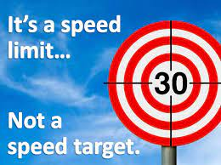
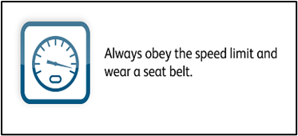
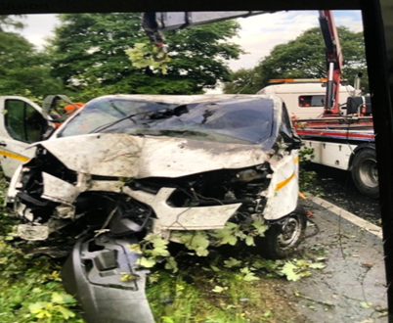
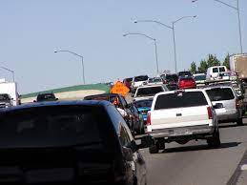
Workforce Safety
Speeding
Wessex Speeding Offences from 01/04/2021 to date – 13 in total
Inner DU x 6 events, 50mph speed limit exceeded by 12mph on the on the M3 junction 3-4 at Camberley
Outer DU x 7 events, 50mph speed limit exceeded by 14mph on the M27, junction 4 & 5 at Eastleigh
Operations x 1 event
Take 5 and drive accordingly for the conditions that you are confronted with e.g.; Rain, fog, ice etc.
Don’t let others dictate how you are going to drive. Don’t keep up with the traffic flow, if this forces you to speed.
Obeying the speed limit is one of Network Rail’s Life Saving Rules, and it is also the law!
Speed limits are exactly that, THE ABSOLUTE LIMIT and they should not be exceeded. They are there for a reason, so please stick to them!

Slide 6
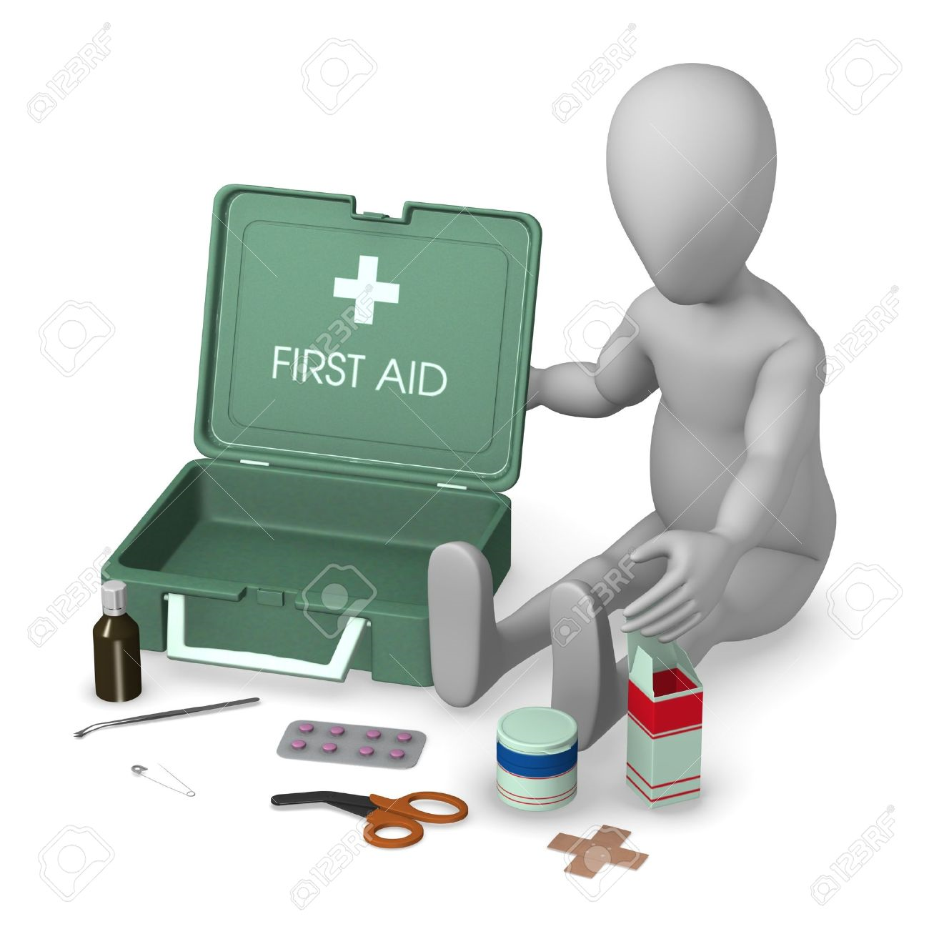
Workforce Safety
First Aid Kits
We all know that First Aid (FA) can save lives so it is important that it is available in the workplace. The Health and Safety (First Aid) Regulations requires employers to provide their staff with access to suitable and sufficient FA equipment and facilities.
Recent site visits, audits and accident investigations have highlighted the fact the First Aid kits are not always available on site.
The First Aid at Work Standard (NR/L2/OHS/00110) mandates that;
The Person in Charge should confirm whether:
there is sufficient first aid cover for the work activities to be undertaken;
the first aid kit is readily available on scene and appropriately stocked for the work activity;
prior to starting any works all workers in the group are aware of the first aid arrangements; and
first aiders can be easily identified in the event of an emergency.
As the Person in Charge, you must appoint a Nominated First Aider and task them with ensuring the kit is with your team at all times!
The First Aid Kit (Standard 10 People) is available on I-procurement/Lyreco UK Ltd (product code 1.539.133), as is the First Aid Kit for Burns (product code 5.048.656) and Ice Packs (product code 5.048.725)
The standard mandates the minimum contents of a First Aid kit but also contains a list of additional requirements that will be determined based on the work activity and associated risk, for example – welding activity, burns kits should be provided.
A useful guide/notice for your notice boards can be found here
PLEASE, ALWAYS TAKE THE FIRST AID KIT WITH YOU TO SITE, YOU NEVER KNOW WHEN YOU MAY NEED IT!
First Aid Kits can only be used when you have them with you!
Notes:
FWI measure explained
Network Rail defines a work place injury as any injury sustained by staff, both direct employees and contractor/suppliers, while undertaking activities connected with Network Rail’s business.
All reported injuries are to be entered into SMIS, the companies corporate Safety Management Intelligence System.
Fatality weighted injury rate (FWIR) is a KPI that uses the following calculation:
The number of fatalities, plus the (number of specified injuries / 10) plus the (number of 3+ lost day injuries / 200) plus the (number of all other injuries / 1000) divided by the hours worked, multiplied by 1,000,000, over the last 13 periods
RIDDOR reporting shall be based on the requirements of the RIDDOR 2013 regulations and the ORR guidance http://orr.gov.uk/__data/assets/pdf_file/0010/2332/riddor-guidance.pdf.

Slide 7
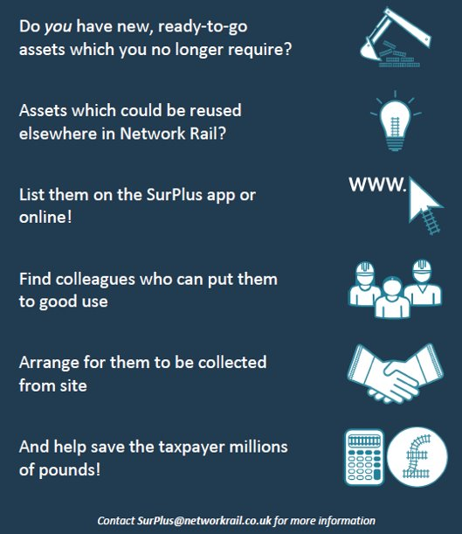

Environment
SurPlus
Surplus (Sur+) is an 'internal eBay' for Network Rail to move assets from one site to another, saving costs and materials. ​
Surplus can be found in the following places and accessed using your NR login:
Network Rail App store.
MyConnect
https://surplus-web-app-prod.22c8.nwr-prod.openshiftapps.com ​
​Action: Log in to Surplus and list any unused equipment so that other Southern teams can potentially make use of them.​
Action: Before buying new equipment or tools, first check if it is available on the SurPlus app.
Have you checked SurPlus for any equipment you need?

Slide 8
Period Safety Communications
Bulletins, Alerts, Advice and Shared Learning
Publication | Date | Title
Environment Bulletin | 20/09/21 | Restrictions on products containing the active ingredient triclopyr.
Safety Advice | 30/09/21 | Dangerous occurrence: fall from scaffolding resulting in significant risk of drowning.
Notes:
Discuss the learning and immediate actions needed to be undertaken by your team. Click on the image above to access national bulletins on Safety Central.

