Slide 1

HAVS Awareness Brief
What is HAVS
Signs and Symptoms
How to reduce your risks
Health Surveillance

Slide 2
QUICK QUIZ:
Vibration exposure is monitored using points. Which two factors are used to calculate points?
The vibration emission of ALL plant is exactly the same? True or False.
A tool with a vibration emission of 3m/s² would be considered to have a vibration emission that is: (circle the correct answer)
Low Risk Medium Risk High Risk
List the symptoms associated with HAVS?
What, if anything, can I do to reduce my HAVS risk?
Notes:
Answer:
1: Trigger time and Vibration emission of the tool
2: False
3. Medium Risk
3: Exposure Action Value (EAV): 100 points
Exposure Limit Value (400 points)
4. Tingling & or Numbness of fingers and thumb, Loss of strength, Whitening of fingers, pain
5.

Slide 3
What is HAVS?
HAVS is preventable, but once diagnosed, irreversible
HAVS affects the blood vessels, nerves, muscles and joints of your hand, wrists and arm
It’s caused by repeated use of hand held vibrating tools
Some people may be affected sooner than others

Slide 4
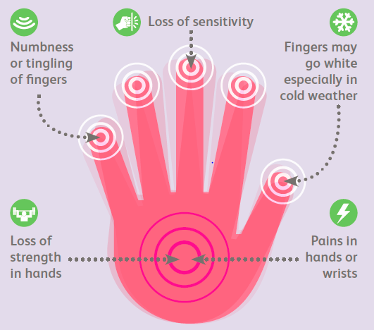
Signs & Symptoms of HAVS

Slide 5
How to reduce your risk of HAVS?
When possible, use lower vibration tools
Always use the right tool for the job
Check that the tool is well maintained and service is in date.
When using the tool, avoid gripping or forcing the tool or workpiece more than you have to
Rotate task using vibrating tools.
Cut down or quit smoking, due to its effect on your blood circulation
Depending on the weather, dress warmly, especially keeping hands warm and dry.

Slide 6
Health Surveillance
 | Health Surveillance
Drivers: | Legislation Health and Safety at Work Act (1974) Control of Vibrations at Work Act (2005) Control of Noise at Work Act (2005) Control of Substances Hazardous to Health (COSHH)
Why? | Health Surveillance is a means to monitor whether controls to manage a hazard (e.g. noise) is working and to identify potential harm caused to the employees early.
Who need to attend? | Employees exposed to one or more of the 5x Occupational Hazards (HAVS, Noise, Respiratory, Skin and night work) whilst undertaking their normal work tasks.
Review frequency: | Legislations requires employees complete a Health Surveillance screening questionnaire annually.
What is assessed? | Initial Screening questionnaires for HAVS, Noise, Respiratory, Skin and Night Worker
When are appointments? | Night (22:00 to 01:00) appointments Day (06:30 to 17:00) appointments Early evening (17:00 to 22:00) appointments
How? | Telephone Assessment (up to 1hour)
Clinician: | OH Technician
Outcome: | Fit Onward referral for one or more of the Occupational conditions screened.
Spotting the signs as early as possible, limits the damage.
Your LM is given advice on how best to support you at work.

Slide 7
Print off the below and give to employees:
https://safety.networkrail.co.uk/wp-content/uploads/2015/07/HAV-A-guide-for-employees-HSE.pdf

